Slide 1
AAC: Augmentative and Alternative Communication
Brooke Lang and Bryn Bowles

Slide 2
Some AAC Programs
Proloquo2go
Proloquo4Text AAC
TouchChat
TD Snap
Speech Assistant
Clarocom

Slide 3
TD Snap
TD Snap is a flexible software offering a choice of AAC solutions to help people with communication disabilities
Wide variety of page sets to explore, including Scanning and Aphasia
Compatible with select Tobii Dynavox devices, but also can purchase as a standalone app for iPad and Windows devices.
**SLP can program remotely with their own software – free with tobii dynavox account**
Cost → Subscription based (*new May 2024) - $9.99/month

Slide 4
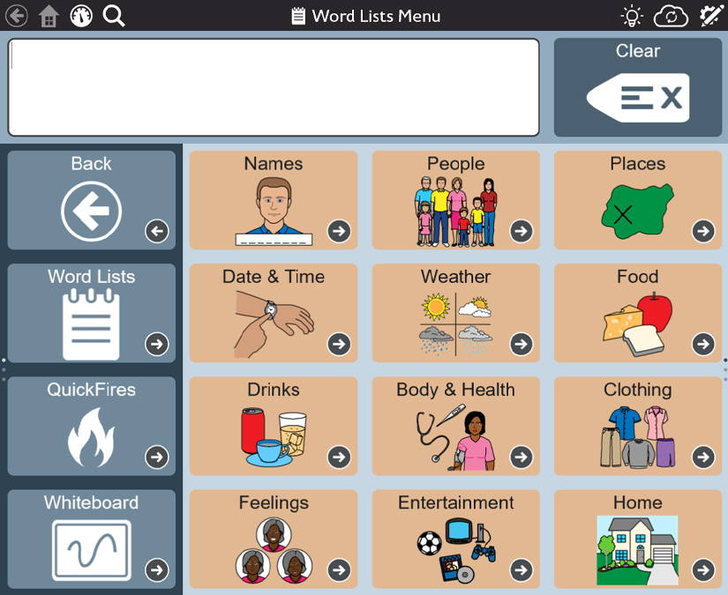
TD Snap

Slide 5
SpeechAssistant
Link for USER MANUAL:
https://www.a-soft.nl/SpeechAssistantAAC-iOS-UserManual.pdf
Notes:
https://www.a-soft.nl/SpeechAssistantAAC-iOS-UserManual.pdf

Slide 6
SpeechAssistant
Speech Assistant AAC is a text-to-speech app designed for people who are speech impaired, for example due to Aphasia, MND/ALS, Autism, Stroke, Cerebral Palsy or other speech problems.
With the app you can create categories and phrases, which are placed on buttons. With these buttons you can create messages that can be shown or spoken (text-to-speech). It is also possible to type any text using the keyboard.
Iphone iOS/ Android: $23.99

Slide 7
SpeechAssistant
Easy to use and completely customizable to your needs and preferences
Categories and subcategories to organize your phrases.
History option for quick access to previously typed phrases.
Option to select photos from your Photo Library or Symbols on the buttons.
Option for voice recordings or select one of the iOS text-to-speech voices.
Support for Apple's Personal Voice.
Full screen button to show your message with a large font.
Key features
Notes:
Key features
Easy to use and completely customizable to your needs and preferences.
Categories and subcategories to organize your phrases.
History option for quick access to previously typed phrases.
Option to select photos from your Photo Library or Symbols on the buttons.
Option for voice recordings or select one of the iOS text-to-speech voices.
Integration with ElevenLabs for using a highly realistic Al Professional Voice Clone.
Support for Apple's Personal Voice.
Full screen button to show your message with a large font.
Autocomplete feature that shows phrase suggestions in a drop-down list.
Tabs for multiple conversations (optional setting).
Designed for iPhone/iPad and both support portrait and landscape layout.
Support for the Apple watch.
Backup to iCloud, Mail or AirDrop.
Phone calls
The app can also be used while making Phone and FaceTime calls.
So you don't need a second device anymore for the speech output.

Slide 8
SpeechAssistant
The app can also be used while making Phone and FaceTime calls.
So you don't need a second device anymore for the speech output.
Phone Calls
Notes:
Key features
Easy to use and completely customizable to your needs and preferences.
Categories and subcategories to organize your phrases.
History option for quick access to previously typed phrases.
Option to select photos from your Photo Library or Symbols on the buttons.
Option for voice recordings or select one of the iOS text-to-speech voices.
Integration with ElevenLabs for using a highly realistic Al Professional Voice Clone.
Support for Apple's Personal Voice.
Full screen button to show your message with a large font.
Autocomplete feature that shows phrase suggestions in a drop-down list.
Tabs for multiple conversations (optional setting).
Designed for iPhone/iPad and both support portrait and landscape layout.
Support for the Apple watch.
Backup to iCloud, Mail or AirDrop.
Phone calls
The app can also be used while making Phone and FaceTime calls.
So you don't need a second device anymore for the speech output.

Slide 9
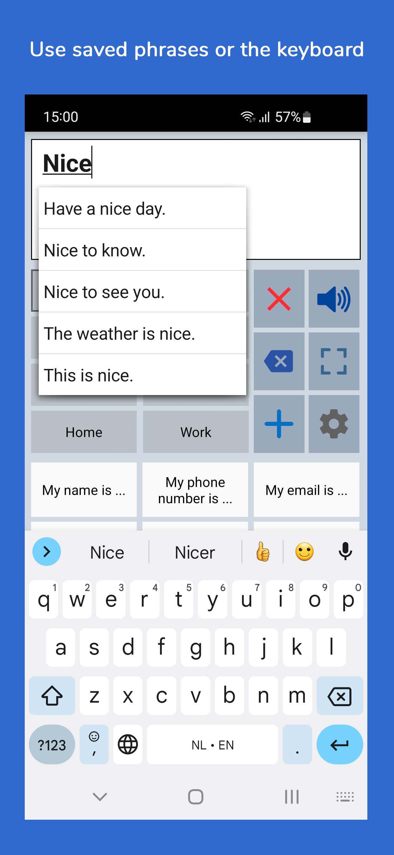
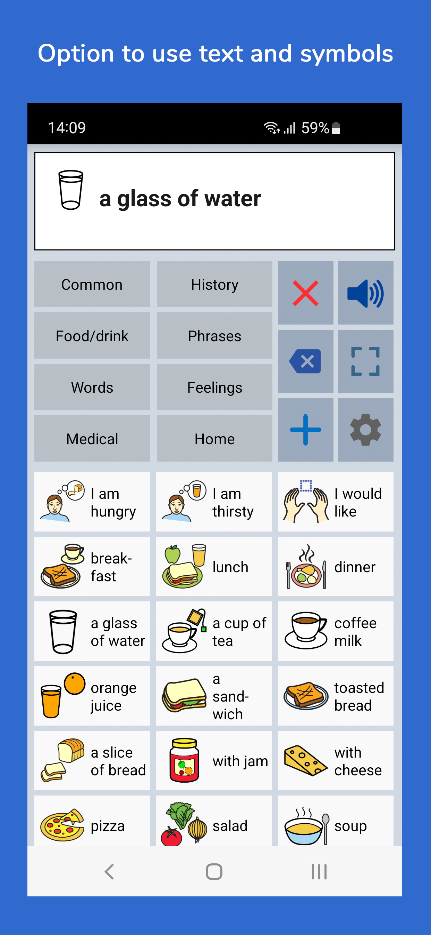
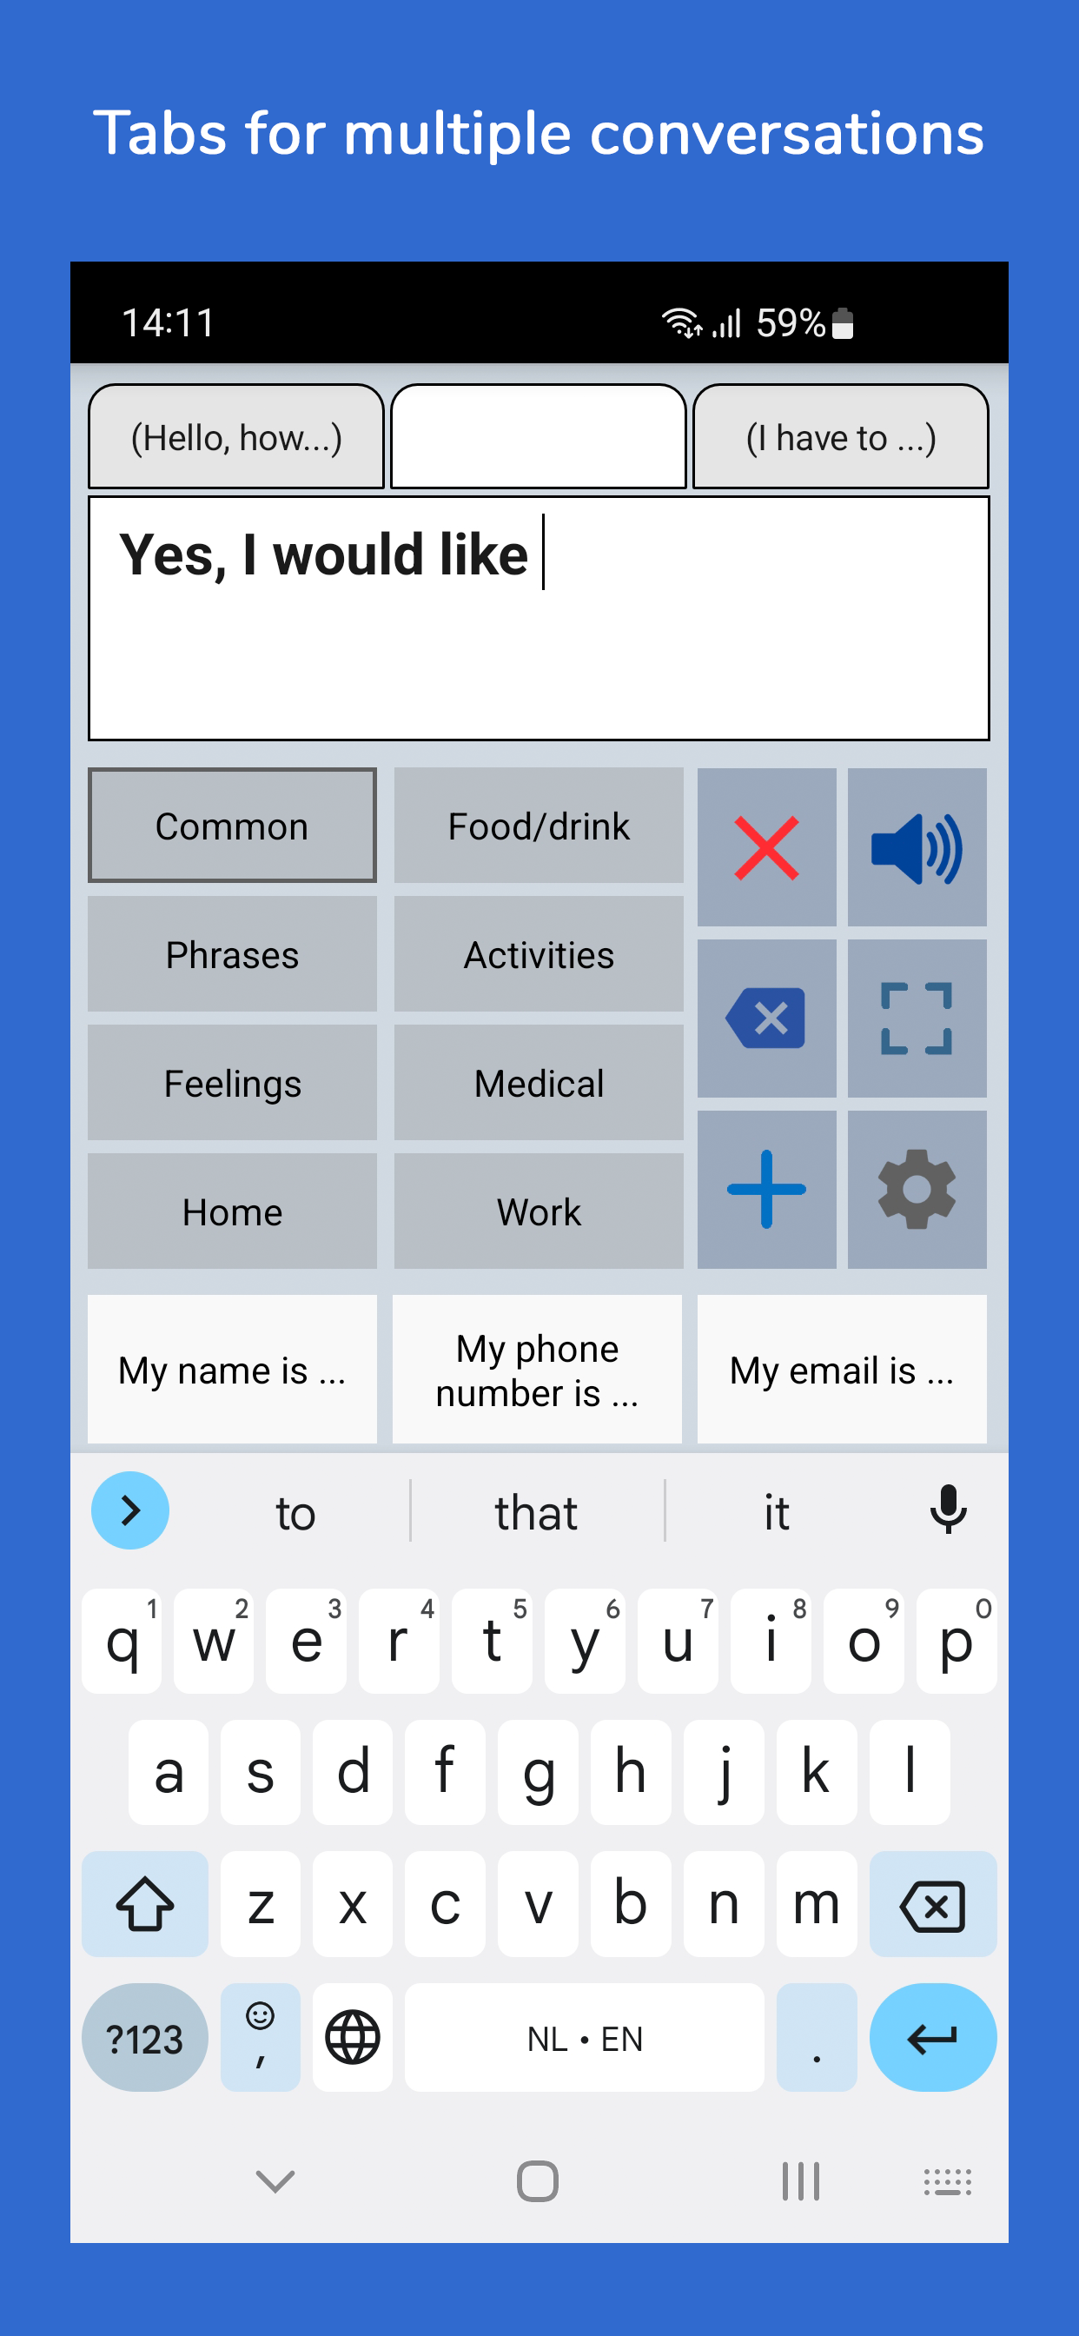
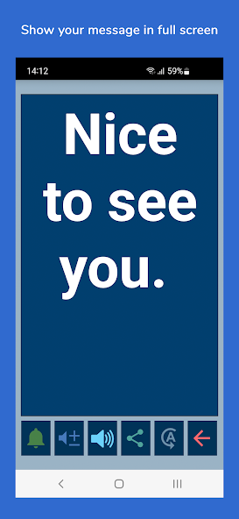

Slide 10
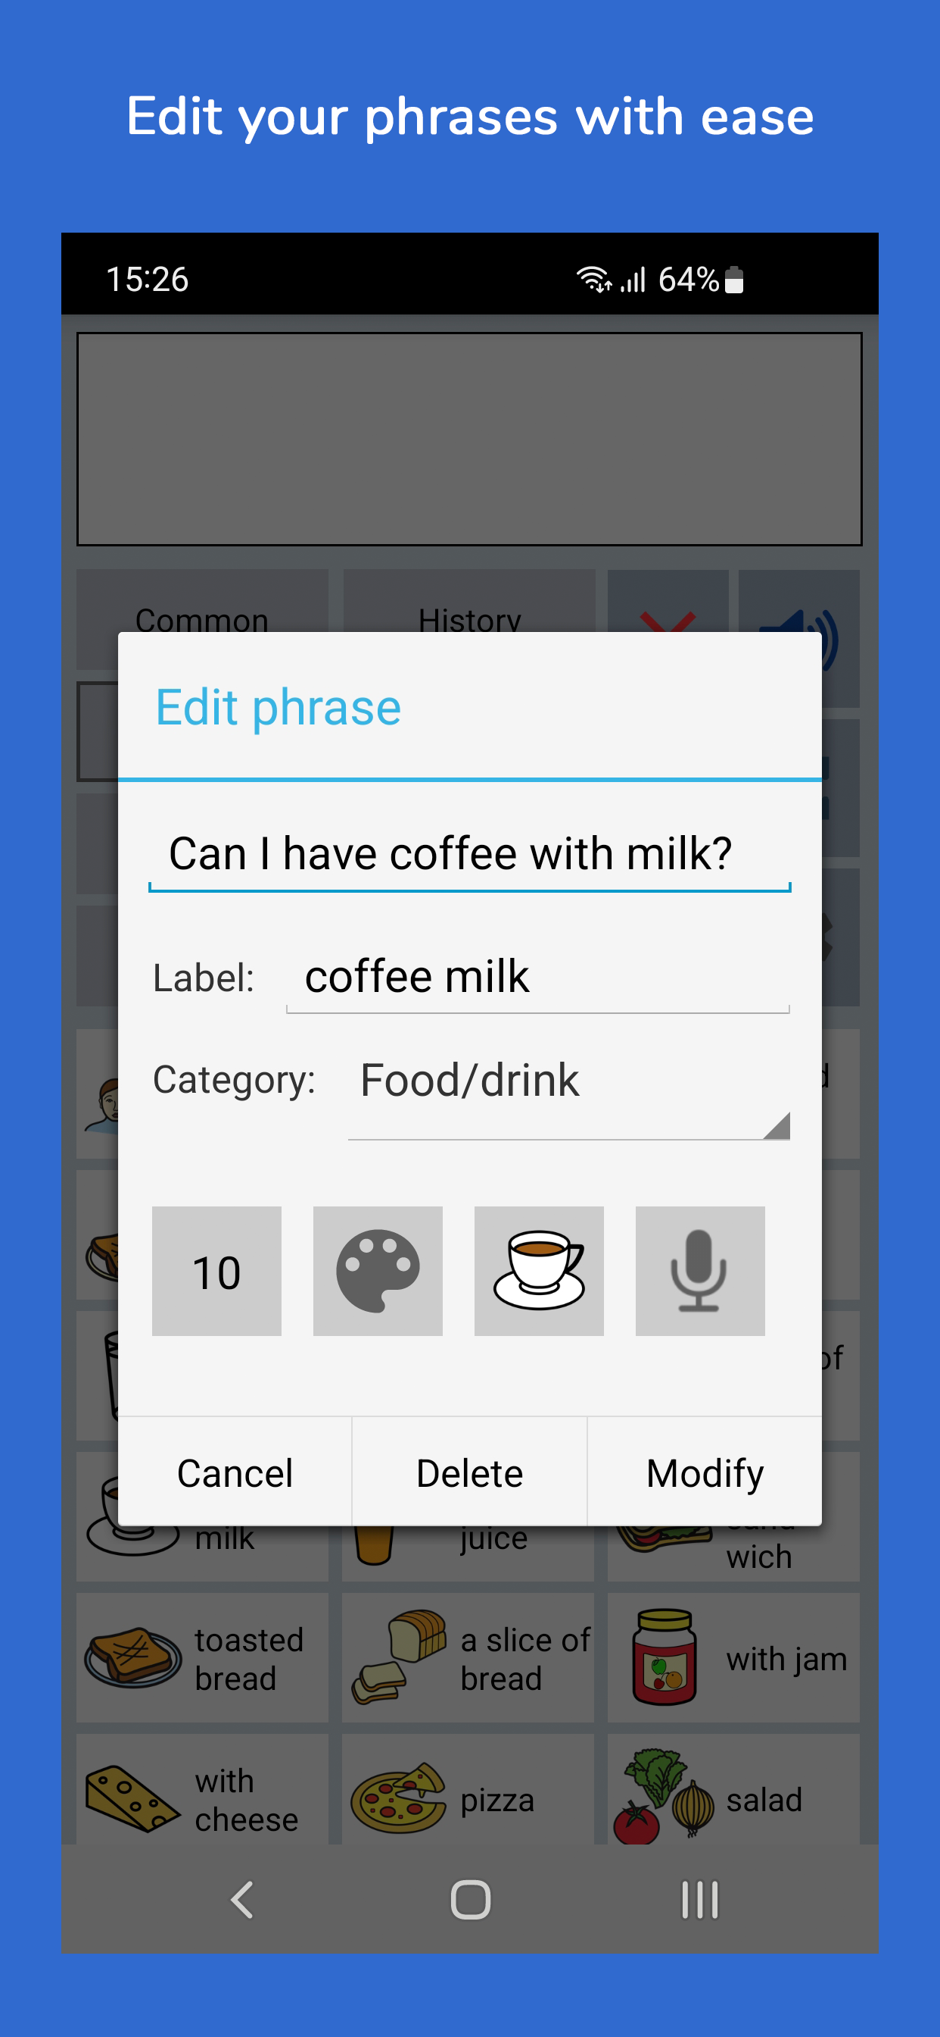
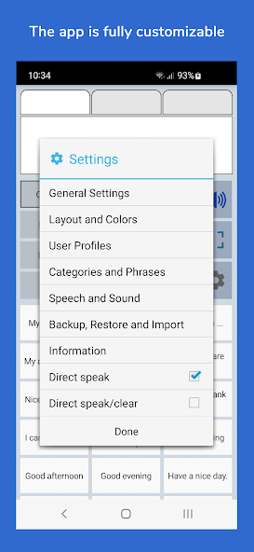

Slide 12
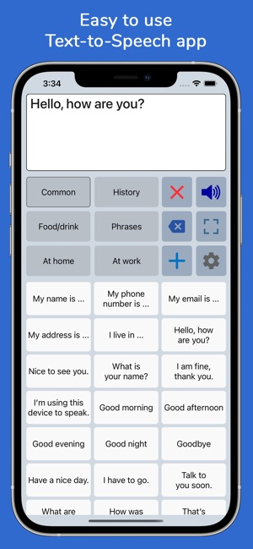
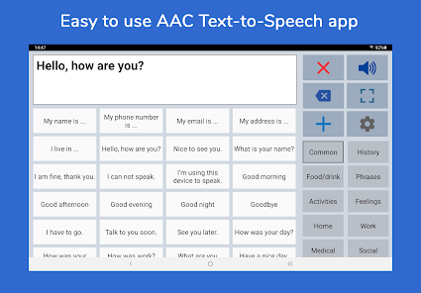

Slide 13
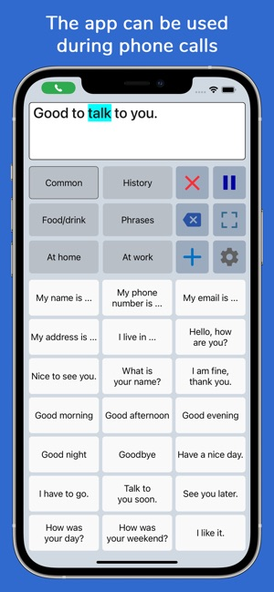
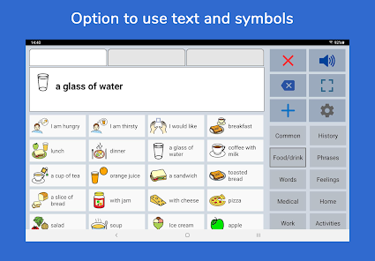

Slide 14
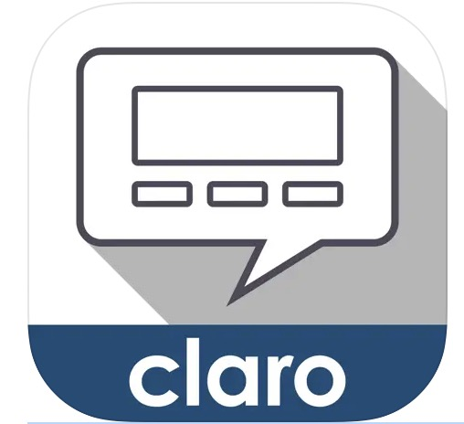
ClaroCom
The app offers a range of features including writing capabilities, word prediction, and phrase prediction.
Users can type messages, have them spoken aloud, and utilize word and phrase prediction to enhance communication speed and accuracy.
ClaroCom also allows for customization of voices, fonts, colors, and more, ensuring adaptability to individual user preferences.
For Iphone or ipad, FREE!

Slide 15
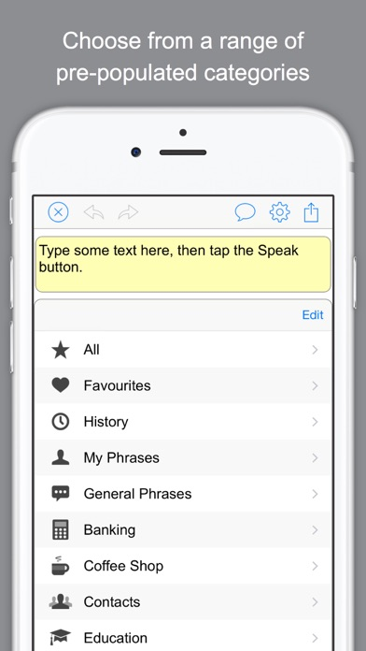
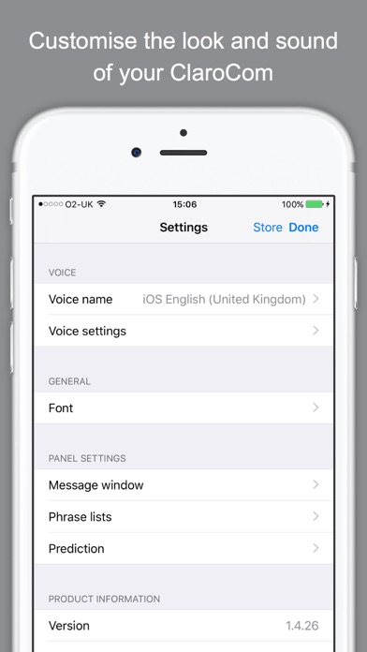
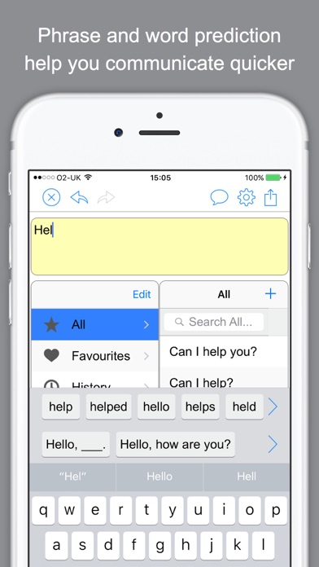
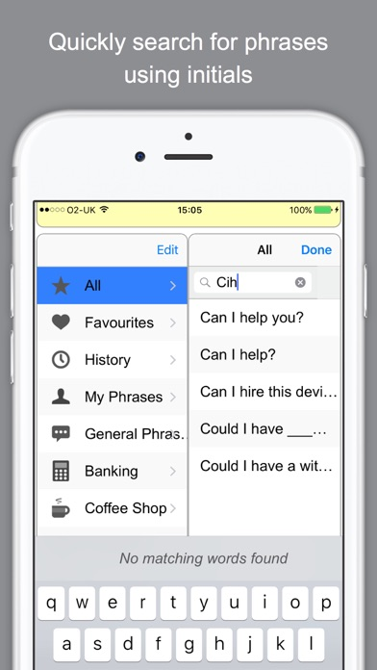
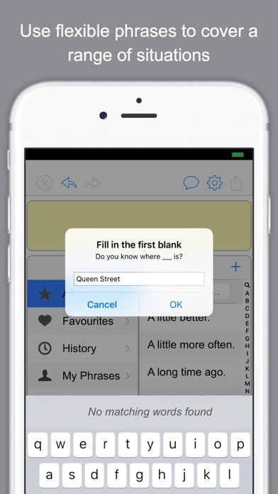

Slide 16
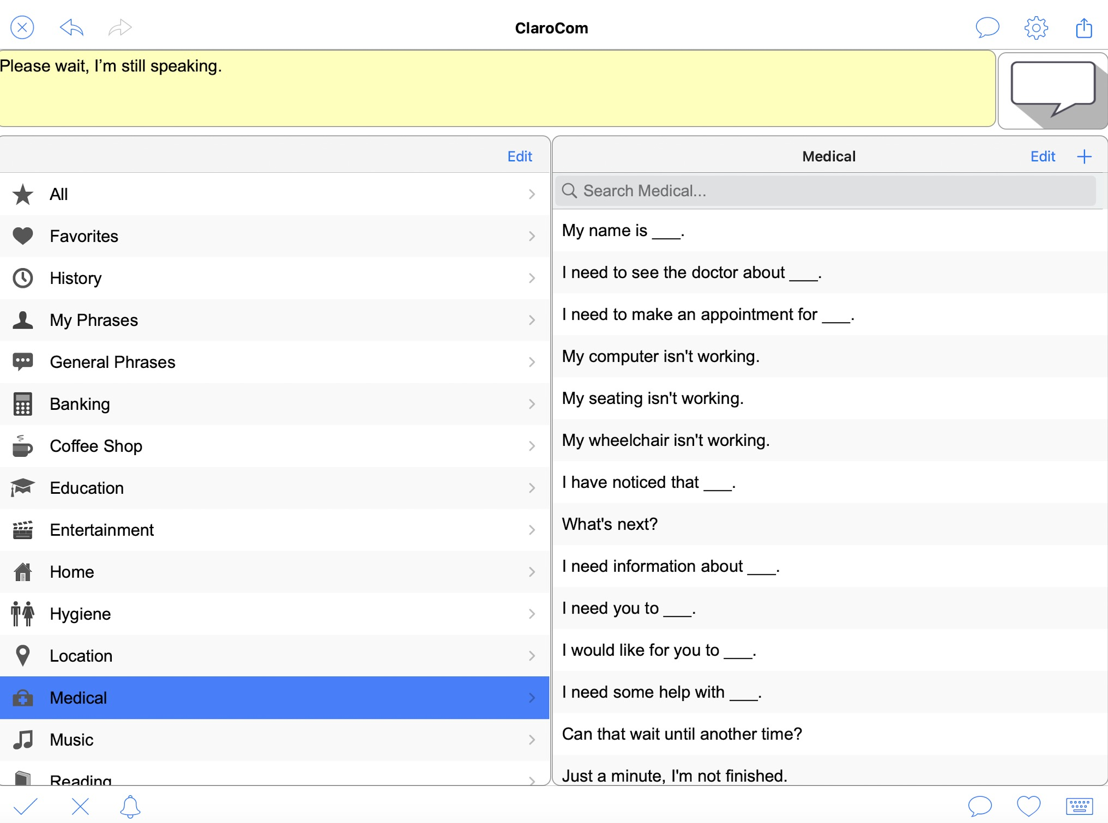

Slide 17
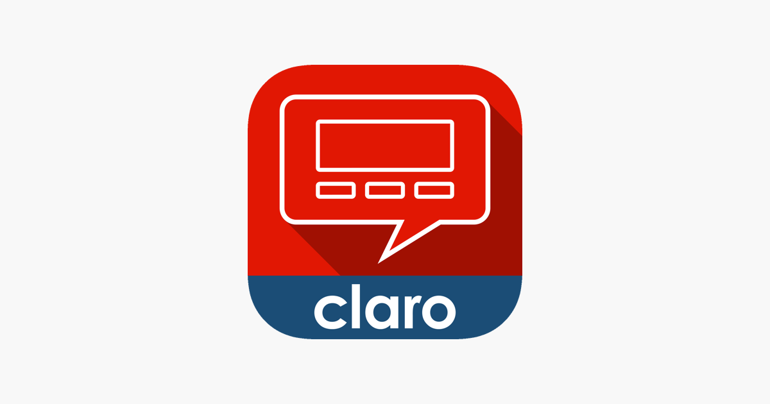
ClaroCom vs ClaroCom Pro
ClaroCom
ClaroCom Pro
FREE
ClaroCom provides basic communication capabilities.
Individuals who require basic communication needs with a simple interface and a standard vocabulary.
$16.99
ClaroCom Pro offers significantly more features including a larger vocabulary, custom categories, social media integration, and the flip display function,
for greater personalization with options to add custom phrases, adjust voice settings more extensively, and change display features like color and font size.
Users who need advanced communication features, extensive customization options, and the ability to integrate with social media platform

Slide 18
QUESTIONS?
See you next time – Tuesday, April 8th @4:00pm EST.

