Slide 1
Technology and Supports for Aphasia:
App updates and Chat GPT fun!
Brooke Lang, M.A., CCC-SLP and Bryn Bowles
Integrative Reconnective Aphasia Therapy

Slide 2
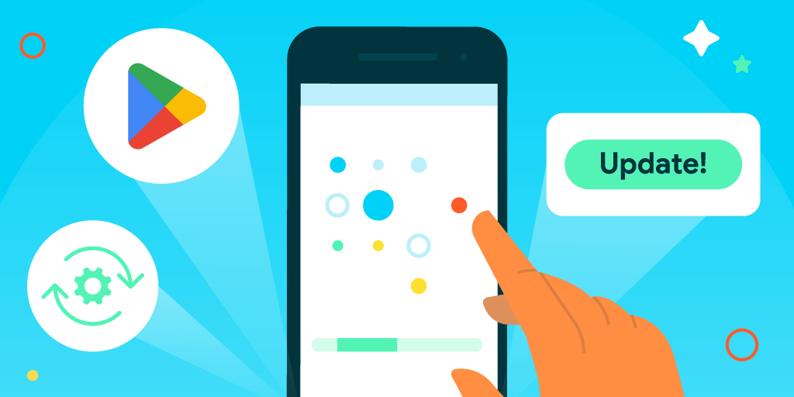
Updates to Apps
Changes and updates to previously discussed apps or programs!

Slide 3
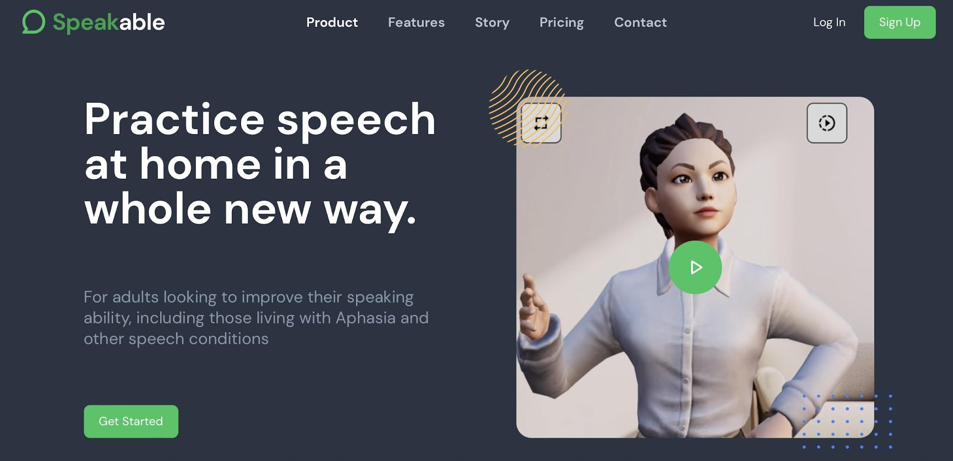
Speakable

Slide 4
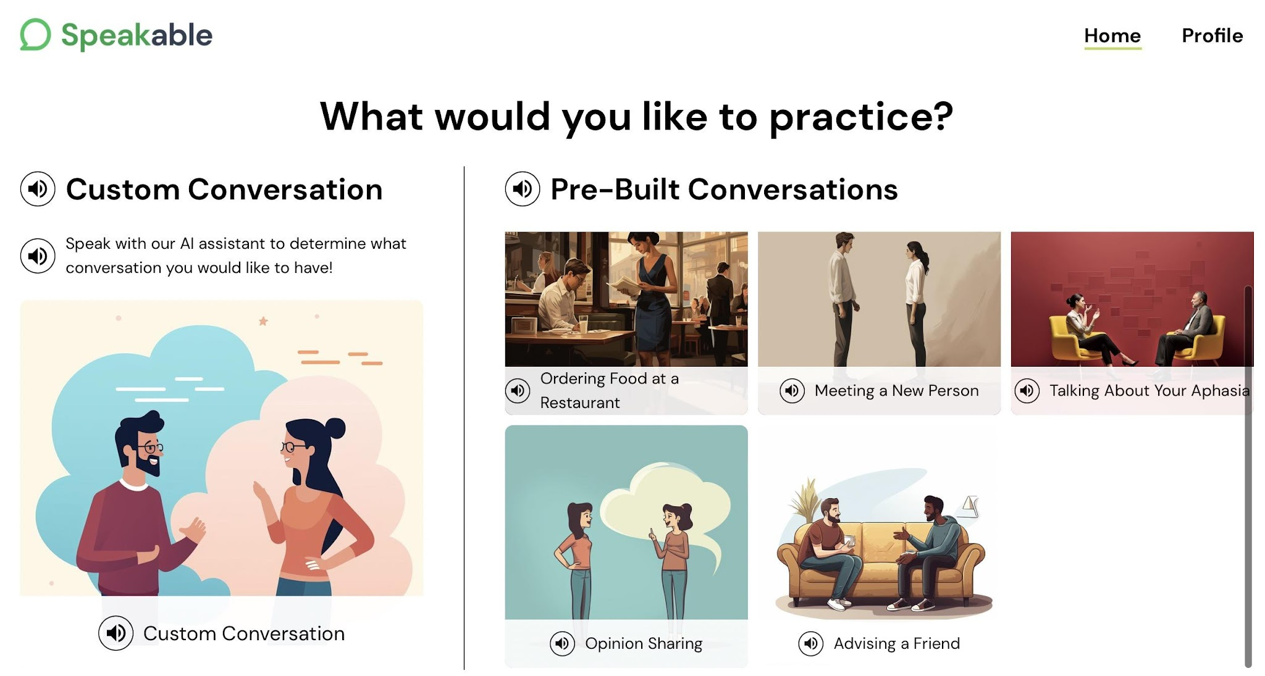
Speakable
Added more pre-built conversation options (i.e. hardware store, library visit, recipe sharing, auto mechanic visit, etc.)
We have also modified the avatars so that hard-to-understand avatars (heavy accents, idioms, slang, etc) are not presented to clients using lower difficulty level settings.
Implemented new "difficulty level" settings to modify the way the avatars speak. There are now user settings for:
  The complexity of the avatar's speech
  The length of avatar responses
  The frequency with which the avatar asks questions (to choose between leading the conversation vs being led)

Slide 5
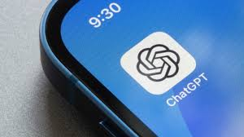
Chat GPT
ChatGPT on iPhone is AMAZING with iOS 18.2! (Apple Intelligence)
ChatGPT is a versatile AI tool that can answer questions, create content, translate, and analyze text.
FREE, with limited use, but full unlimited use $20/month
  Bryn suggests creating an account so it keeps track of previous searches
Notes:
https://youtu.be/au15o-sozTw?si=sb6n0DPR8zugapvg
https://youtu.be/au15o-sozTw?si=sb6n0DPR8zugapvg

Slide 6
How to Set up ChatGPT
ChatGPT is an AI chatbot that's integrated with Apple's Siri and Writing Tools on iPhones. You can use ChatGPT to ask questions, get answers, and create content.
How to set up ChatGPT
  Open Settings
  Tap Apple Intelligence & Siri
  Tap ChatGPT
  Tap Set Up
  Tap Enable ChatGPT to use without an account, or Use ChatGPT with an Account to use with an existing account

Slide 7
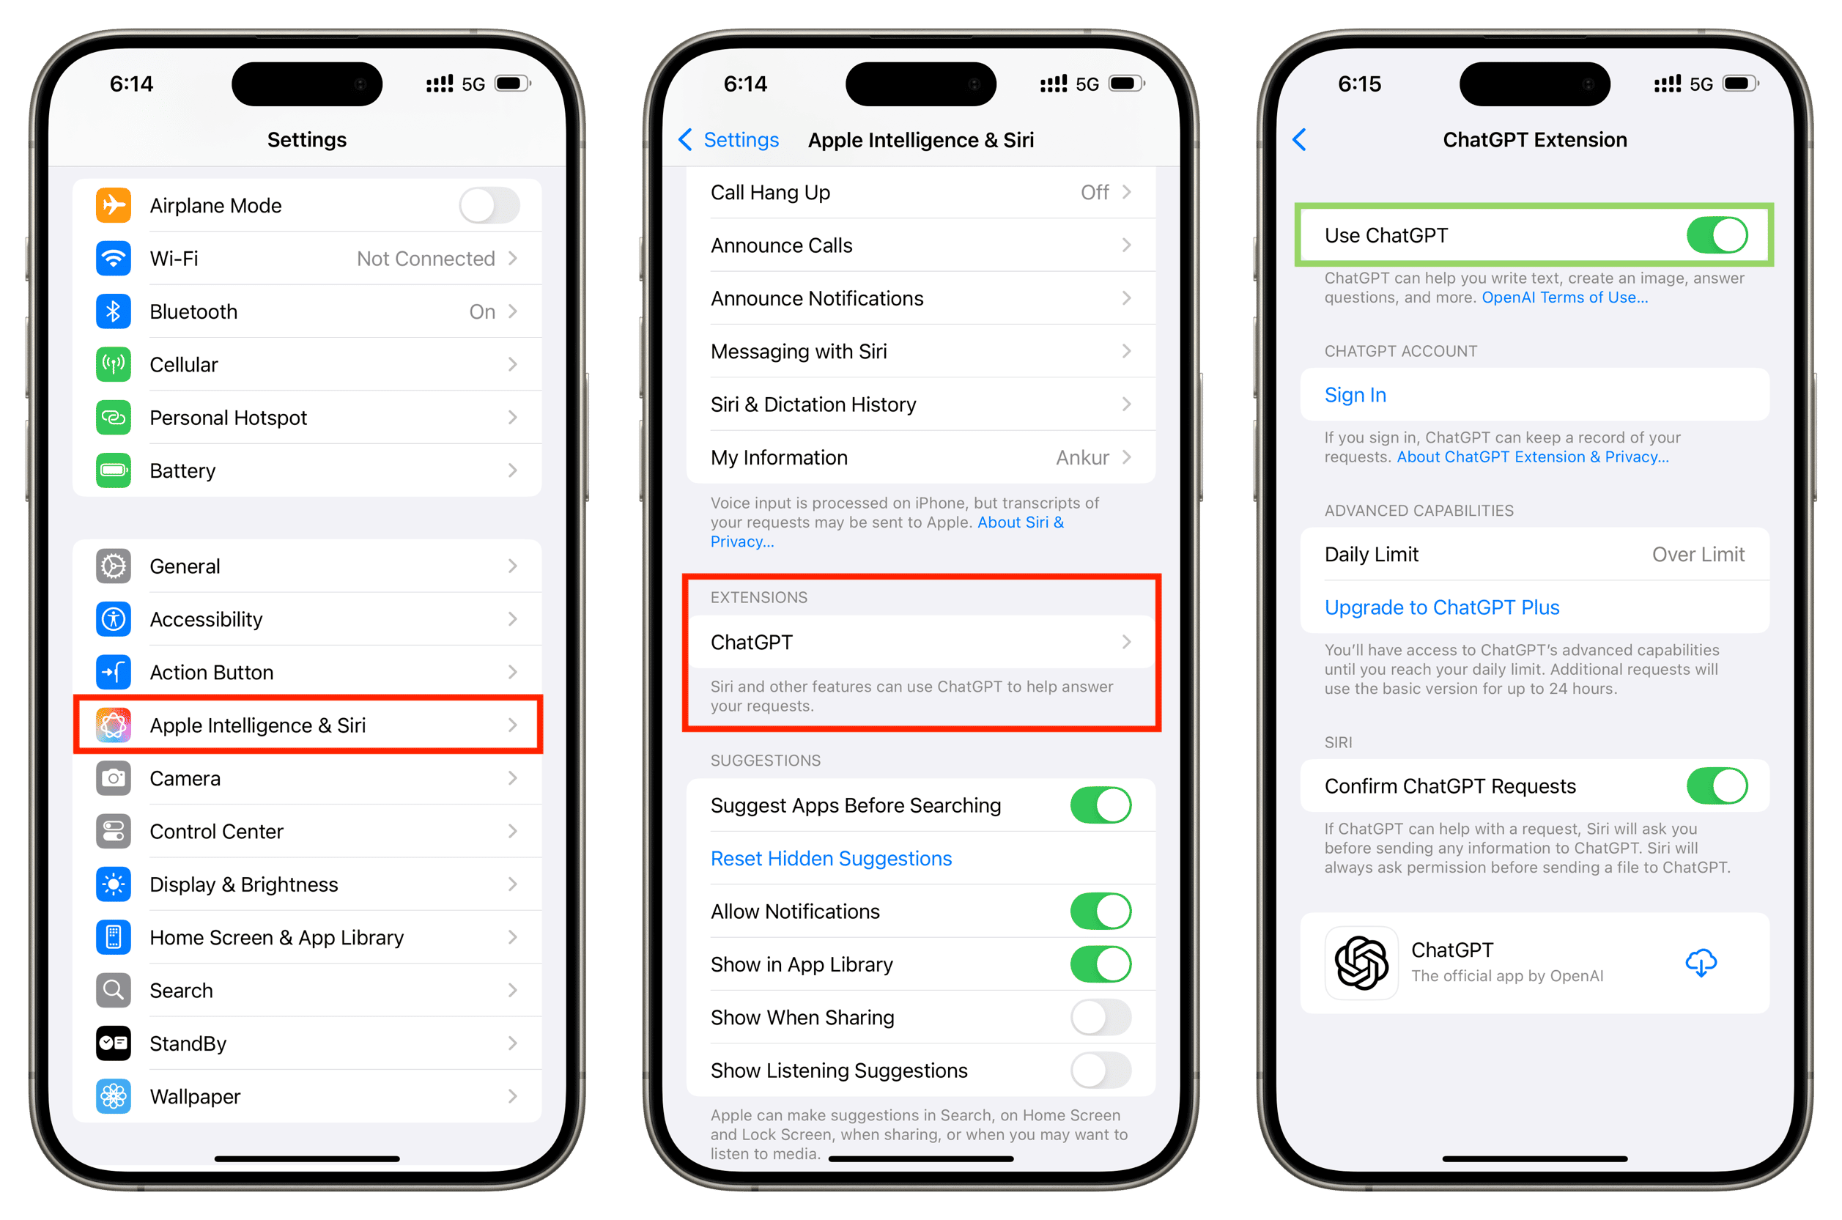

Slide 8


ChatGPT APP – if not on phone

Slide 9
10 daily uses for ChatGPT
1. Brainstorm ideas for meals or movies with given preferences.
2. Plan complex events like holidays, parties, or trips.
3. Create workout routines or training plans.
4. Identify plants, animals, or items from descriptions or photos.
5. Enhance or translate your writing.
6. Draft difficult emails or texts.
7. Solve crossword clues (after trying first).
8. Summarize lengthy texts.
9. Assist with homework and learning.
10. Simplify complex topics for better understanding.

Slide 10
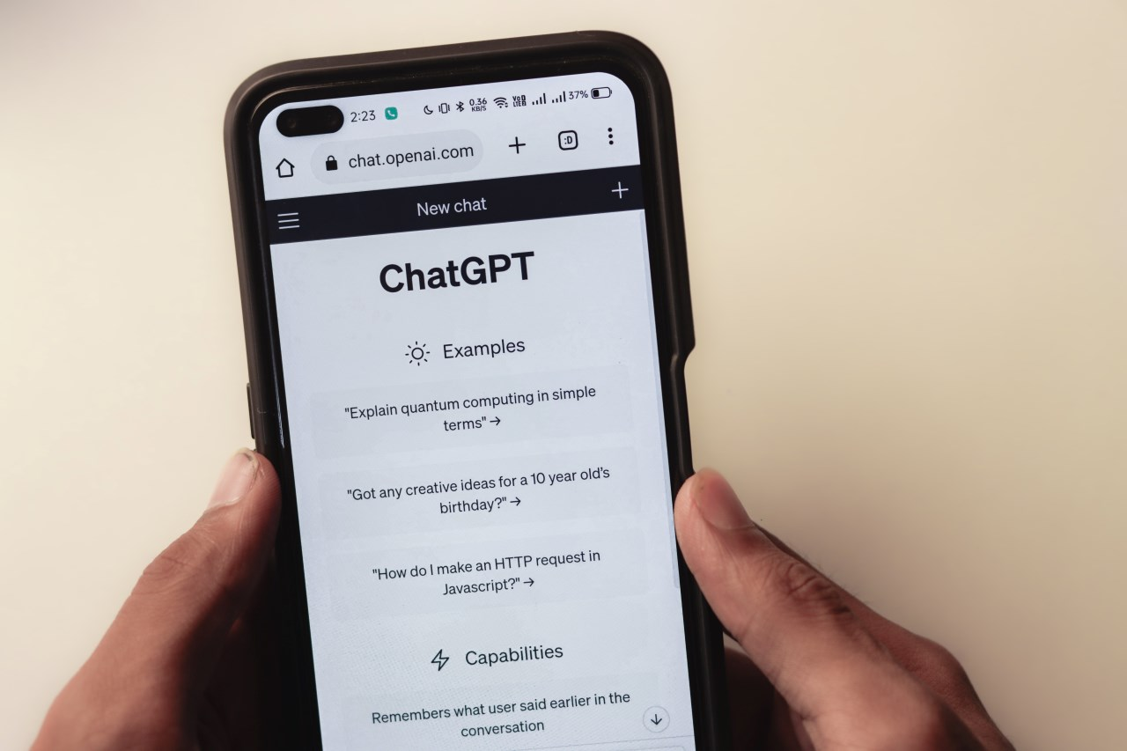
What Bryn uses ChatGPT for
Creating emails: Bryn takes a picture of email, and asks ChatGPT how to respond.
Word finding: Bryn takes a picture of something in her environment and asks ChatGPT what it is.
What to make for dinner: I have chicken, tomato sauce, and mozzarella cheese, what can I make?
Uses “Aphasia Help” – category in ChatGPT specific to Aphasia
Talking to professionals in community:
  Telling mechanic brakes are not working
  Talking to doctor about symptoms
  Talking to bank teller about depositing money
  **If unable to SAY or WRITE info into ChatGPT, you can take a picture of content and send it**

Slide 11

QUESTIONS?
See you next time – Tuesday, May 13th @4:00pm EST.

