Slide 1
Technology and Supports for Aphasia: Apps, phone features, transportation assistance, artificial intelligence (AI), and MORE!
Brooke Lang, M.A., CCC-SLP (Owner of Integrative Reconnective Aphasia Therapy)
Bryn Bowles (Aphasia survivor)

Slide 2
Quick Announcement
Alie Chandler, Board Certified Neurologic Music Therapist, has an ONLINE program Sing for Speech - music based speech practice; now subscription based
E-Guide for Home Practice | Ossia Music Therapy, LLC

Slide 3
Using ESL Apps for Aphasia Therapy (ESL = English as Second Language)
Rosetta Stone’s
Duolingo
IXL Language Arts

Slide 4
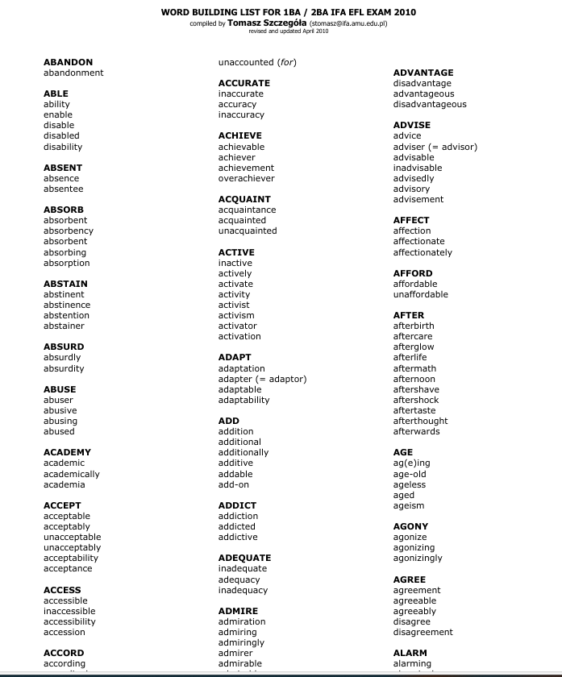
Word Formation List

Slide 5
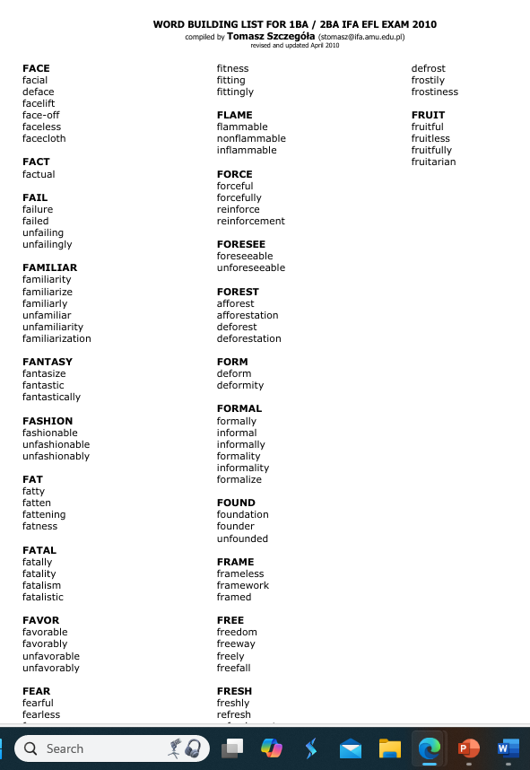
Word Formation List
https://igcsesite.wordpress.com/wp-content/uploads/2015/12/word-formation-list-efl-exam-2009-10.pdf

Slide 6
Word Formation List
How to use words from list:
Practice SAYING different word forms
Identify # of syllables and stressed syllable
For example:
Par-TI-ci-pate (4 syllables)
Par-ti-ci-PA-tion (5 syllables)
Par-TI-ci-pa-tor-y (6 syllables)
Use each form in a SENTENCE (or make into a MC task)
She hopes to participate in the race.
Her participation in class was rewarded.
They took a participatory approach in the classroom.

Slide 8
IXL Language Arts
Educational platform - interactive exercises to help students improve their skills in reading, writing, grammar, and vocabulary. I
Offers personalized learning experiences through adaptive practice, progress tracking, and feedback
The platform caters to students from kindergarten through 12th grade, covering a wide array of topics within the realm of language arts.
Cost $$: FREE
Notes:
1. **Reading:**
- Reading Comprehension: Exercises to help understand and interpret texts.
- Literary Analysis: Analyzing themes, characters, and literary devices in various genres.
- Informational Texts: Understanding and analyzing non-fiction texts.
2. **Writing:**
- Grammar & Mechanics: Lessons on sentence structure, punctuation, and usage.
- Writing Strategies: Techniques for prewriting, drafting, revising, and editing.
- Types of Writing: Practice with different forms of writing such as narratives, essays, and persuasive texts.
3. **Vocabulary:**
- Word Meaning: Exercises to understand and use a wide range of words.
- Context Clues: Using context to determine the meaning of unfamiliar words.
- Word Relationships: Understanding synonyms, antonyms, homophones, and more.
4. **Grammar:**
- Parts of Speech: Lessons on nouns, verbs, adjectives, adverbs, etc.
- Sentence Structure: Understanding simple, compound, and complex sentences.
- Usage: Correct use of language in writing and speaking.
Each exercise adapts to the student's learning pace, offering easier or more difficult questions based on their performance. This personalized approach aims to fill knowledge gaps and accelerate learning.
The platform also provides:
- **Real-time Feedback:** Immediate feedback on answers to help students learn from their mistakes.
- **Progress Tracking:** Detailed reports that help students and educators track improvement over time.
- **Interactive Content:** Engaging and varied content to keep learners motivated.
Is there a particular feature or topic you would like more information on?
IXL Language Arts is designed to cater to students from kindergarten through 12th grade, covering a wide array of topics within the realm of language arts. Here's a more detailed breakdown of what it offers:
1. **Reading:**
- Reading Comprehension: Exercises to help understand and interpret texts.
- Literary Analysis: Analyzing themes, characters, and literary devices in various genres.
- Informational Texts: Understanding and analyzing non-fiction texts.
2. **Writing:**
- Grammar & Mechanics: Lessons on sentence structure, punctuation, and usage.
- Writing Strategies: Techniques for prewriting, drafting, revising, and editing.
- Types of Writing: Practice with different forms of writing such as narratives, essays, and persuasive texts.
3. **Vocabulary:**
- Word Meaning: Exercises to understand and use a wide range of words.
- Context Clues: Using context to determine the meaning of unfamiliar words.
- Word Relationships: Understanding synonyms, antonyms, homophones, and more.
4. **Grammar:**
- Parts of Speech: Lessons on nouns, verbs, adjectives, adverbs, etc.
- Sentence Structure: Understanding simple, compound, and complex sentences.
- Usage: Correct use of language in writing and speaking.
Each exercise adapts to the student's learning pace, offering easier or more difficult questions based on their performance. This personalized approach aims to fill knowledge gaps and accelerate learning.
The platform also provides:
- **Real-time Feedback:** Immediate feedback on answers to help students learn from their mistakes.
- **Progress Tracking:** Detailed reports that help students and educators track improvement over time.
- **Interactive Content:** Engaging and varied content to keep learners motivated.
Is there a particular feature or topic you would like more information on?
IXL Language Arts can be helpful for individuals with aphasia, but it may require some adjustments and additional support to be most effective. Here are some considerations for using IXL Language Arts with individuals who have aphasia:
1. **Customizable Learning Pace:**
IXL's adaptive learning technology can adjust the difficulty level of exercises based on the user's performance. This can be beneficial in providing practice at a level appropriate for someone with aphasia.
2. **Practice in Key Areas:**
- **Reading Comprehension:** Exercises can help improve understanding of written text, which is often challenging for individuals with aphasia.
- **Grammar & Vocabulary:** Regular practice with grammar and vocabulary can aid in language recovery.
3. **Immediate Feedback:**
The platform provides instant feedback, which can help users understand their mistakes and learn the correct usage. This immediate correction can be beneficial in language therapy.
4. **Progress Tracking:**
Detailed progress reports can help therapists and caregivers monitor improvements and identify areas that need more focus.
5. **Supportive Environment:**
Given that aphasia can vary greatly in its severity, working with a speech-language pathologist (SLP) who can provide tailored guidance and support while using the platform can be very beneficial.
6. **Visual and Interactive Content:**
The engaging and interactive nature of IXL can help maintain the interest of the user, which is particularly important in therapeutic settings.

Slide 9
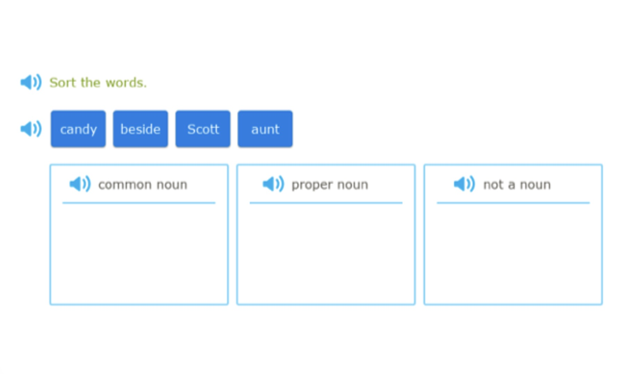
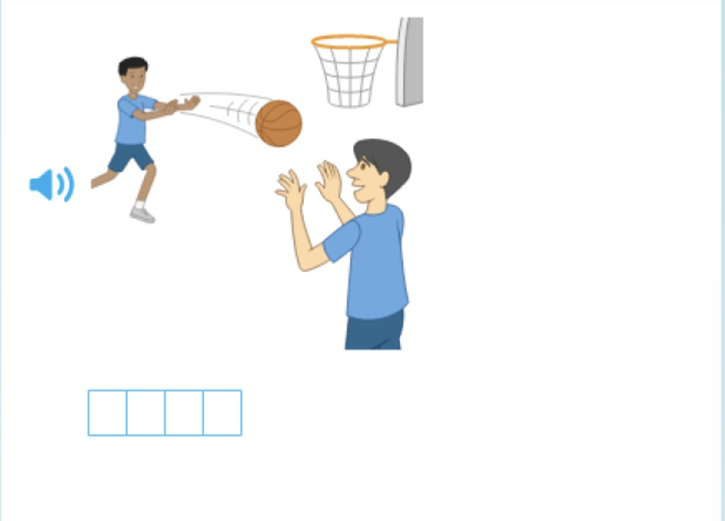
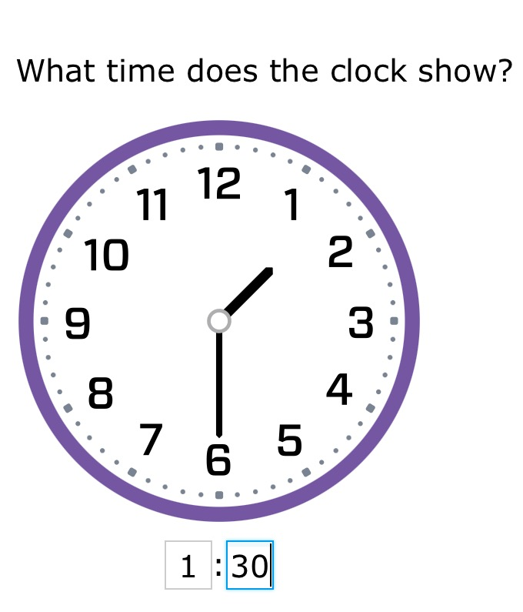
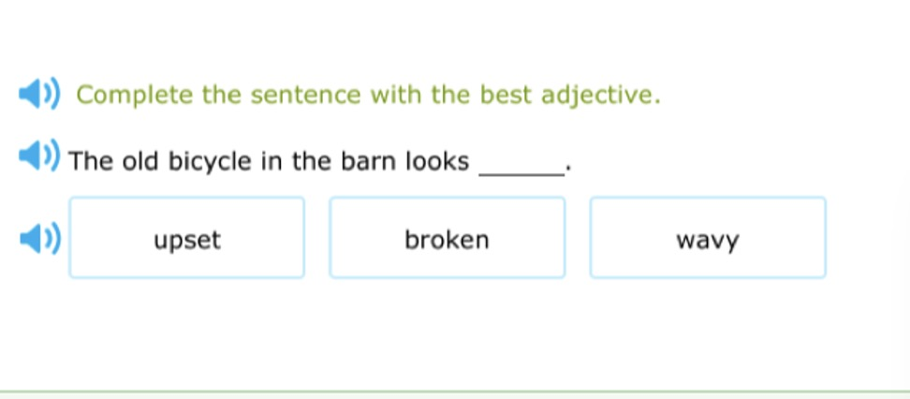
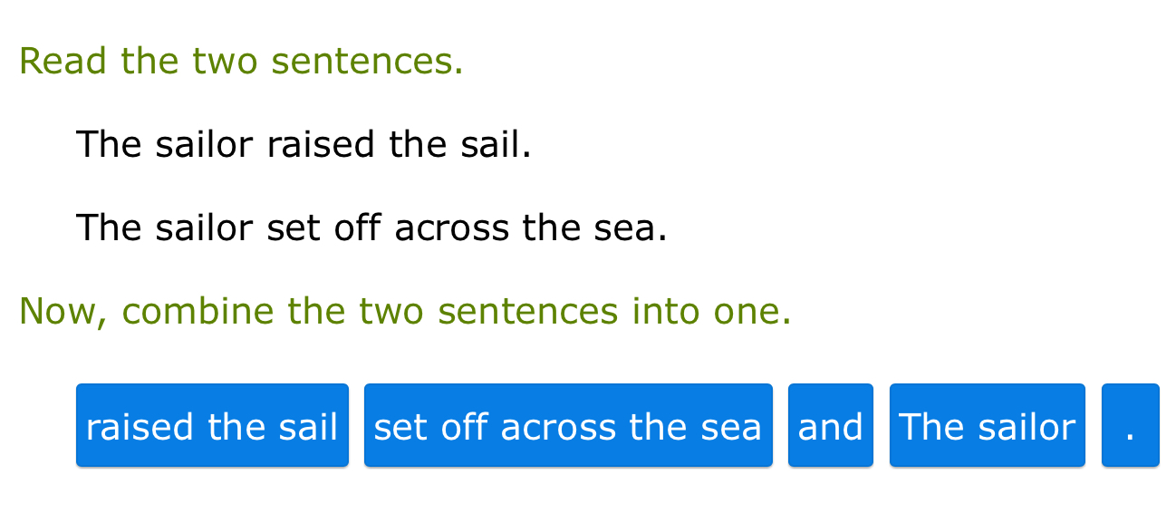
IXL Language Arts

Slide 10
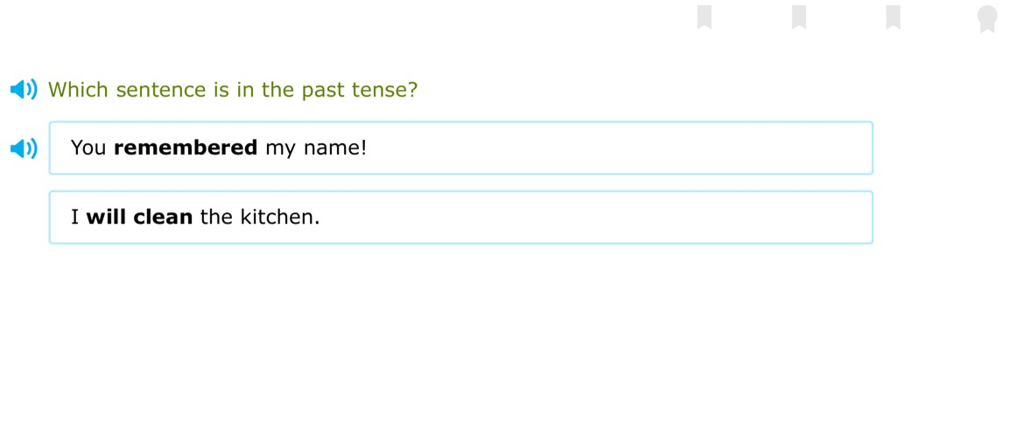
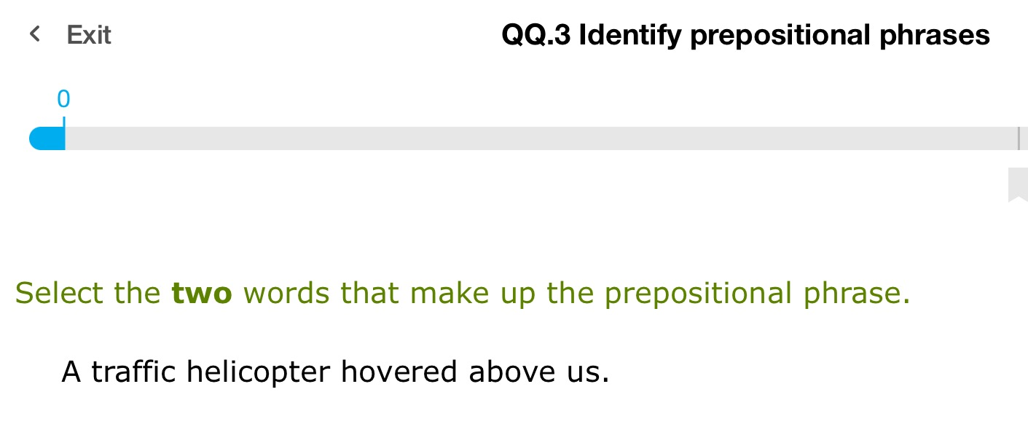
IXL Language Arts

Slide 11
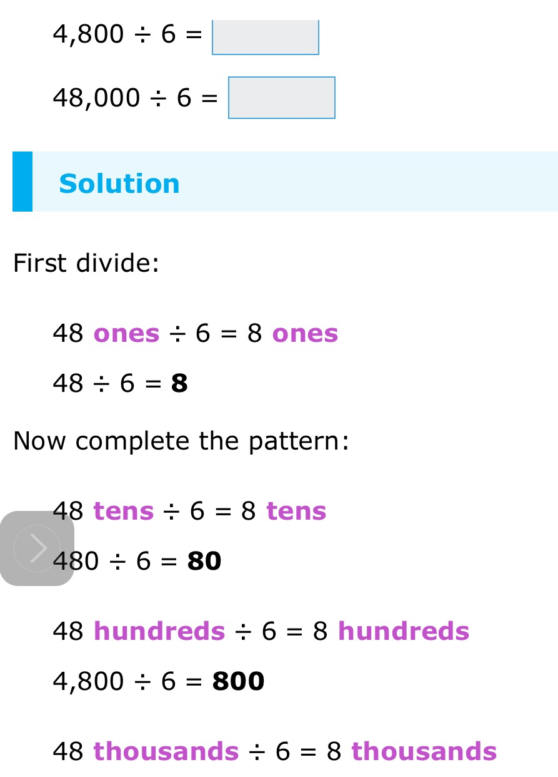
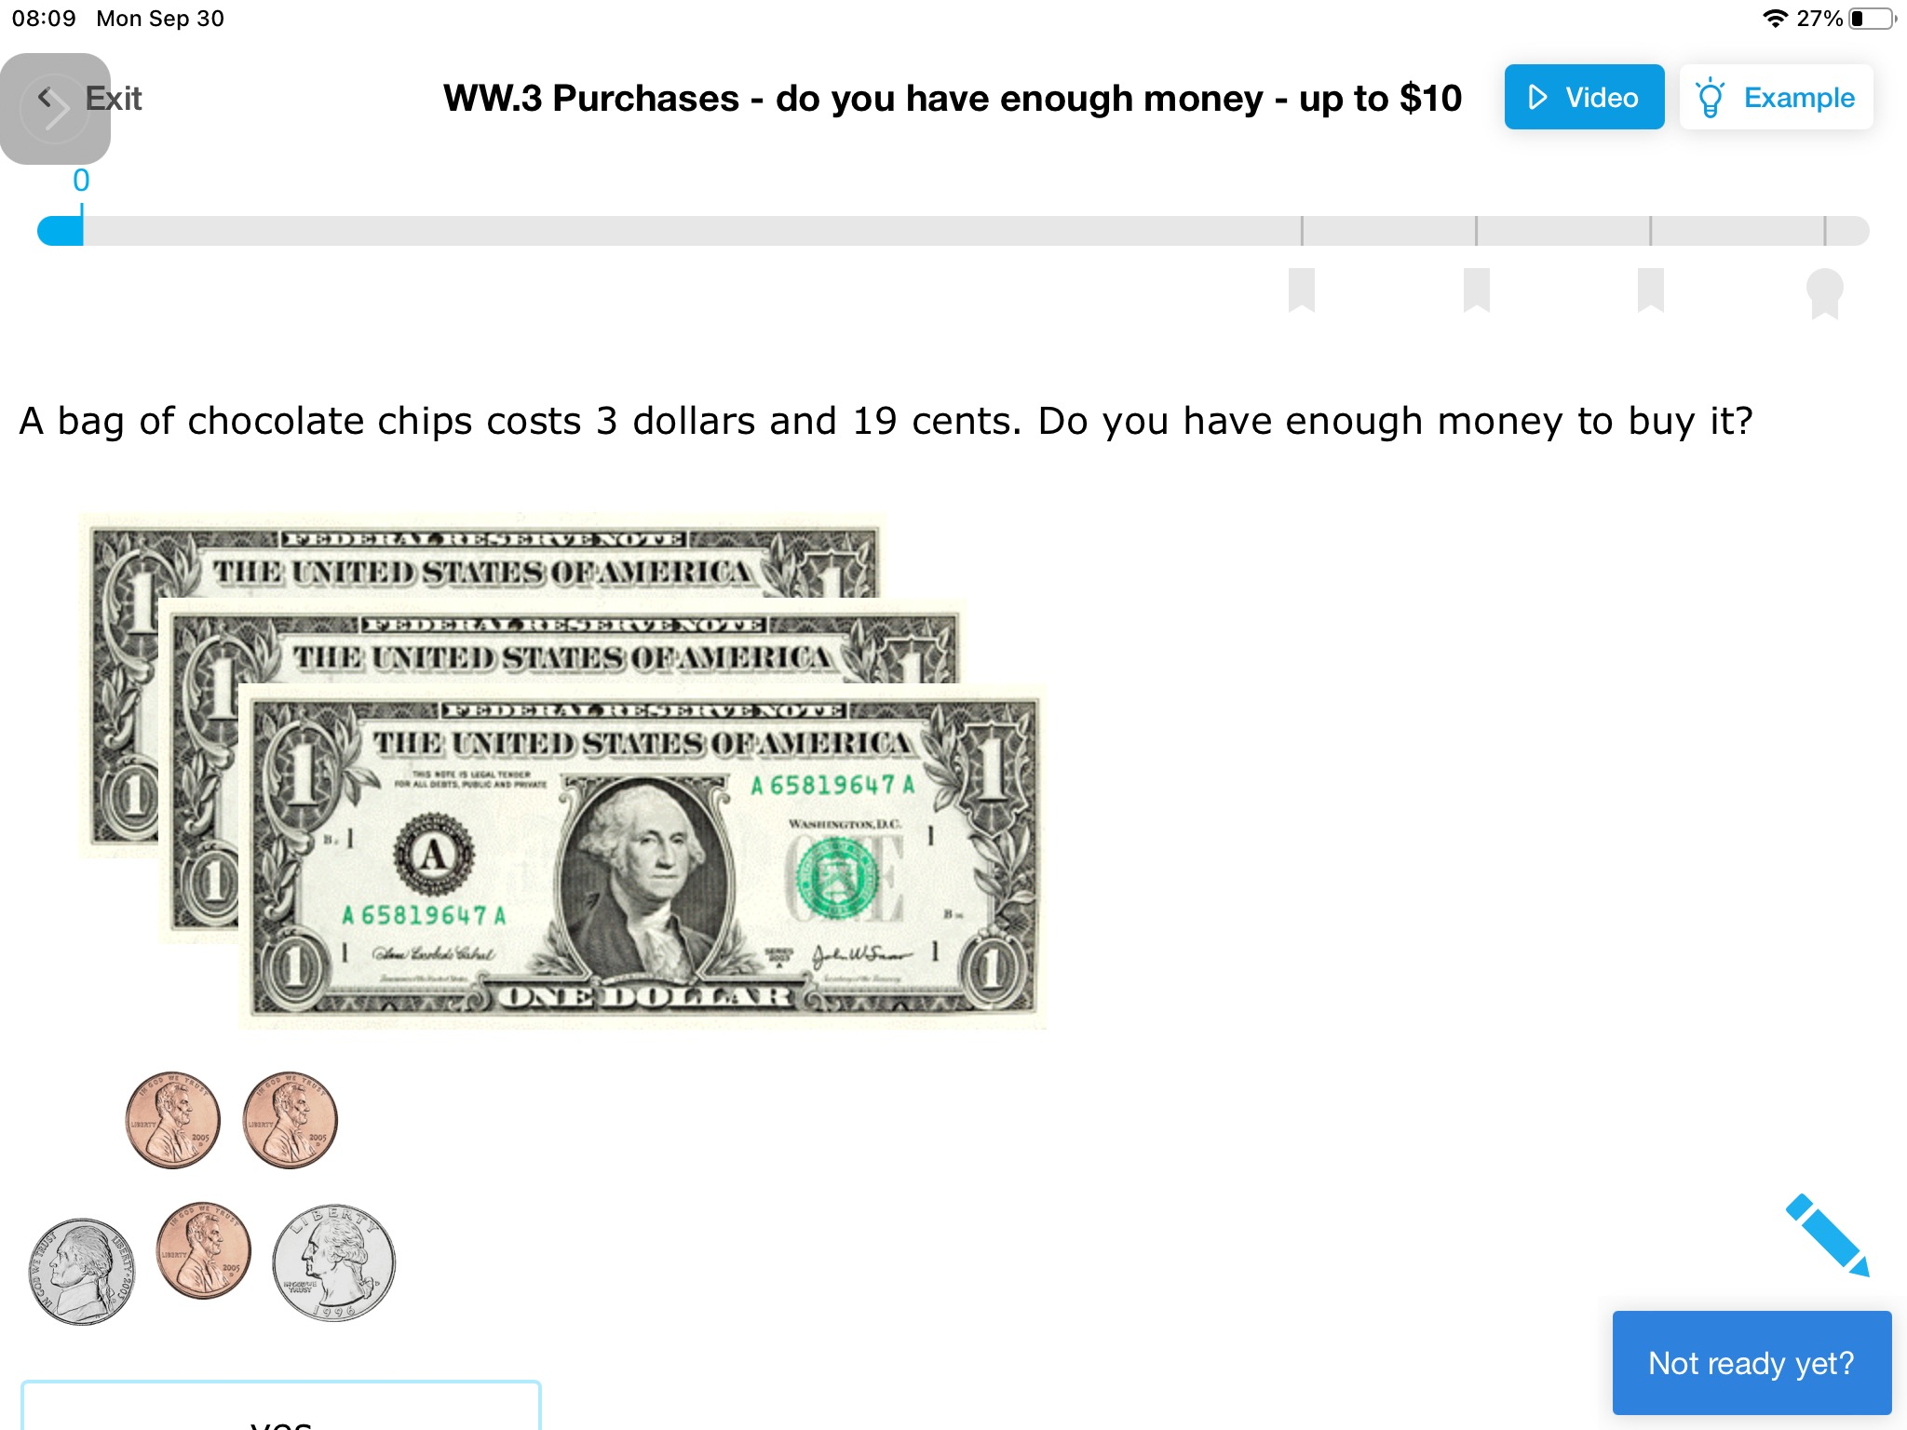
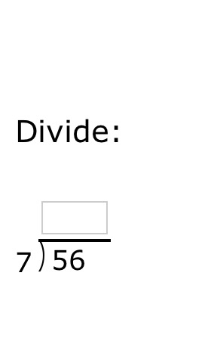
IXL Language Arts

Slide 12
Bryn’s Thoughts
THE GOOD:
I love it! And if you don’t have the right answer, they will show you WHY it’s right or wrong.
LOTS of activities!
THE NOT SO GOOD:
Offers A LOT of tasks and activities – hard to know what they are (overwhelming setup)
Categorized by grade level – not sure where to start (requires a lot of exploring)
Has audio option for reading aloud, but reads entire paragraph (wish it would read single line at a time)

Slide 13
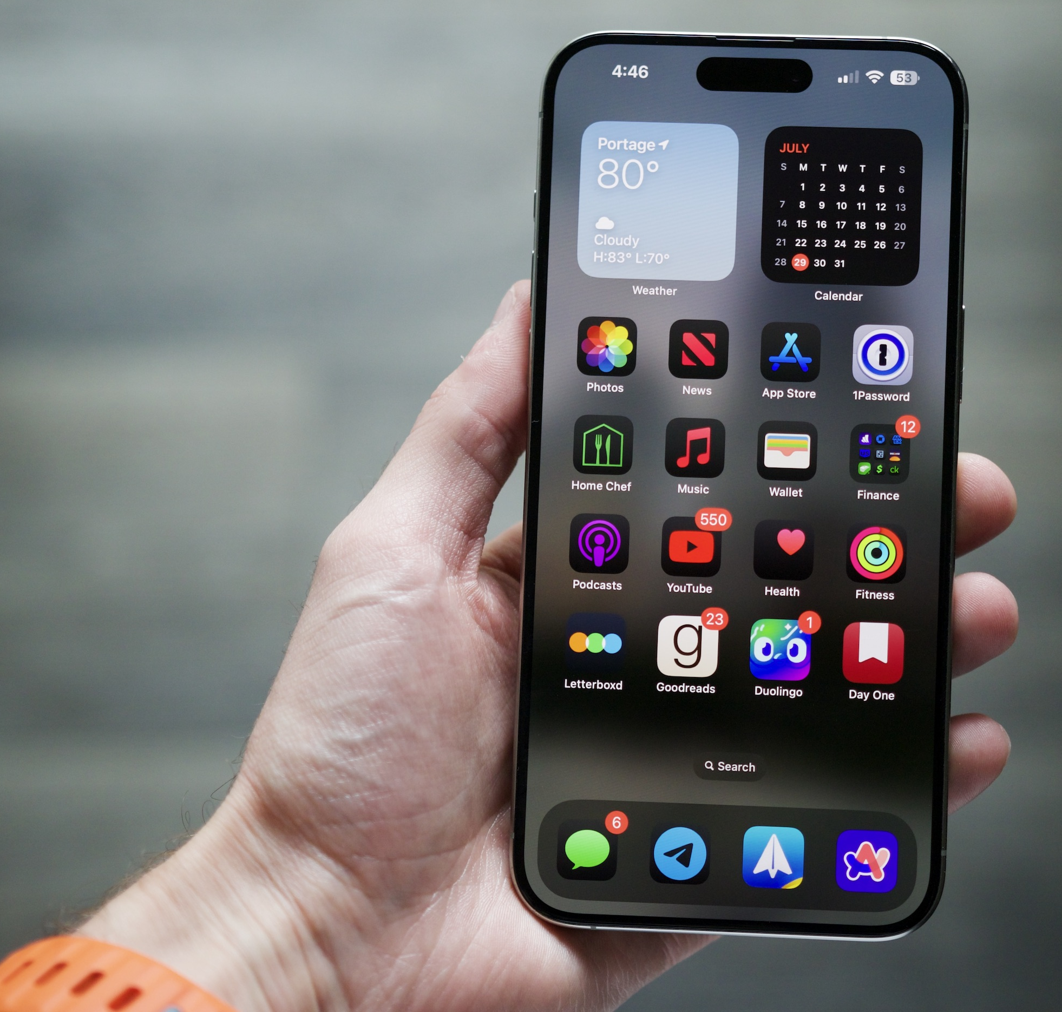
Update on IPHONE Features – iOS 18
Exciting new features!!
Magnifier feature
Record and transcribe live calls
Control Center redesigned
Live Captions (Bryn’s dream has become a reality!!)
Bold, underline, italicize text in messages
Compose message to SEND LATER
Turn on Siri to listen for ATYPICAL SPEECH

Slide 14
Magnifier feature: ZOOM
The Magnifier tool - handy accessibility feature designed to help users see better by turning the iPhone into a digital magnifying glass.
Here are some of the key features and functions it provides:
Zoom In and Out: The Magnifier allows you to zoom in and out to get a closer look at text, objects, or images by using the pinch-to-zoom gesture or a slider.
Filters: The Magnifier provides various filters to enhance visibility, such as grayscale, inverted colors, and color filters. These can be especially useful for people with color blindness or other visual impairments.
Accessibility Shortcuts: You can quickly access the Magnifier by setting it up as an accessibility shortcut, allowing you to triple-click the side button or home button to enable the feature.
Notes:
Zoom magnifies the entire screen:
Double-tap three fingers to zoom
Drag three fingers to move around the screen
Double-tap three fingers and drag to change zoom
The Magnifier tool on an iPhone is a handy accessibility feature designed to help users see better by turning the iPhone into a digital magnifying glass. Here are some of the key features and functions it provides:
1. **Zoom In and Out**: The Magnifier allows you to zoom in and out to get a closer look at text, objects, or images by using the pinch-to-zoom gesture or a slider.
2. **Adjust Brightness and Contrast**: You can enhance the visibility of the item you're viewing by adjusting the brightness and contrast settings to suit your needs.
3. **Filters**: The Magnifier provides various filters to enhance visibility, such as grayscale, inverted colors, and color filters. These can be especially useful for people with color blindness or other visual impairments.
4. **Freeze Frame**: Capture and hold a still image of what you're viewing, allowing you to take a closer look without needing to hold the iPhone steady.
5. **Flashlight**: If you need more light, you can use the flashlight feature directly from the Magnifier to illuminate your target.
6. **Save Images**: On newer iOS versions, you can save the captured images for later use.
7. **Multiple Windows**: If you are using the latest iOS versions, the Magnifier can open multiple frames so you can compare different sections or angles.
8. **Accessibility Shortcuts**: You can quickly access the Magnifier by setting it up as an accessibility shortcut, allowing you to triple-click the side button or home button to enable the feature.
These features make the Magnifier a versatile and indispensable tool for anyone needing a closer look at something detailed or small.

Slide 15
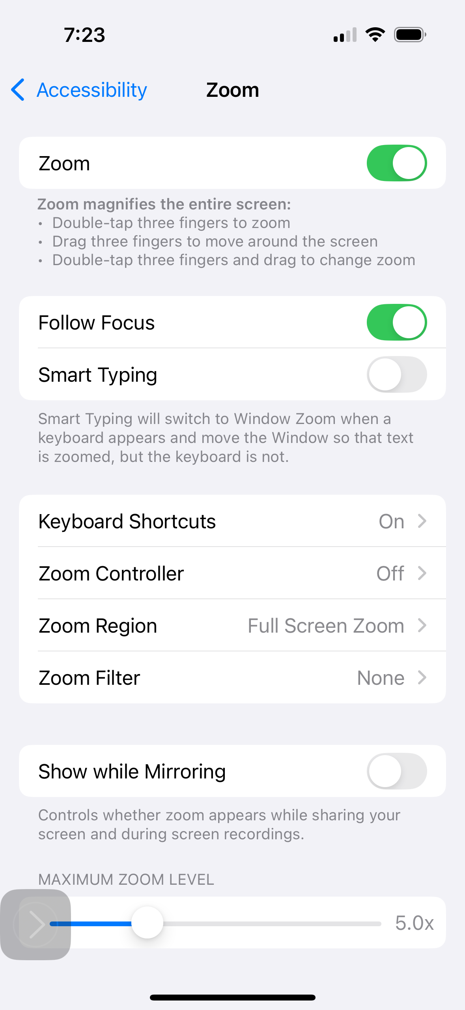
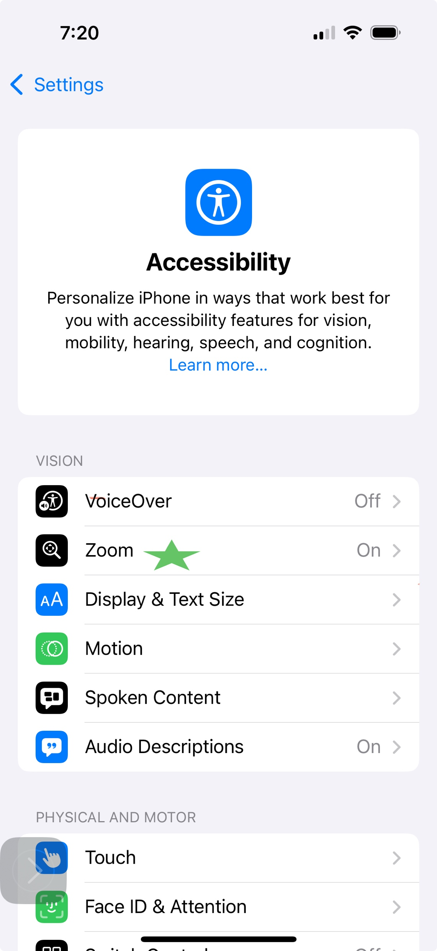
Zoom magnifies the entire screen:
-Double-tap three fingers to zoom
-Drag three fingers to move around the screen
- Double-tap three fingers and drag to change zoom

Slide 16
Record and transcribe live calls
To record and transcribe a call on an iPhone, you can use the built-in features in the Phone app and Notes app:
Record the call While on a call, tap the Record button in the top left corner of the screen. Siri will alert everyone on the call that it's being recorded.
Save the recording The recording is automatically saved to a Call Recordings folder in the Notes app.
View the transcript Open the Notes app, select a note in the Call Recordings folder, and tap Transcript. The transcript will identify the speaker of each statement.
Edit the transcript You can search the transcript, add the text to the note, or copy the text to other documents.
Notes:
https://www.youtube.com/watch?v=dV_m8oiMH3s
https://youtu.be/iSqi1AGycHE?si=bPQOBHl4xxb_UnZa

Slide 17
Record and transcribe live calls
Notes:
https://www.youtube.com/watch?v=dV_m8oiMH3s
https://youtu.be/iSqi1AGycHE?si=bPQOBHl4xxb_UnZa

