Slide 1

Naa’s Lunch and Learn
"From Awareness to Action: How Every Person Can Advocate for Aphasia"
Wednesday, 6/24/2026
12 pm EDT

Slide 2
But first…
Some Announcements

Slide 3
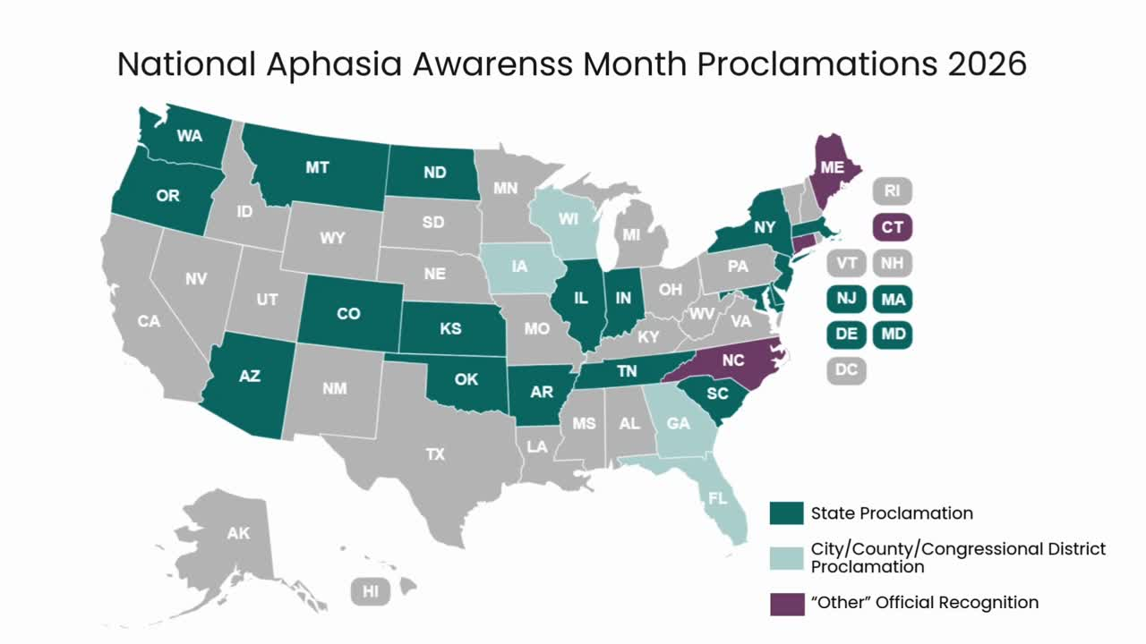
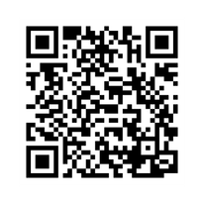

June is Aphasia Awareness Month
  United For Aphasia Awareness
    NAA Ambassadors and aphasia advocates have been working on getting Aphasia Awareness Month proclamations in all 50 states.
    Follow along as we fill the map!
    Let the NAA know if you’d like to help in your state or community.
Notes:
At this month's "After the Expert", we will have a discussion about today's webinar. And you will be given the opportunity to design and share your own mask.

Slide 4
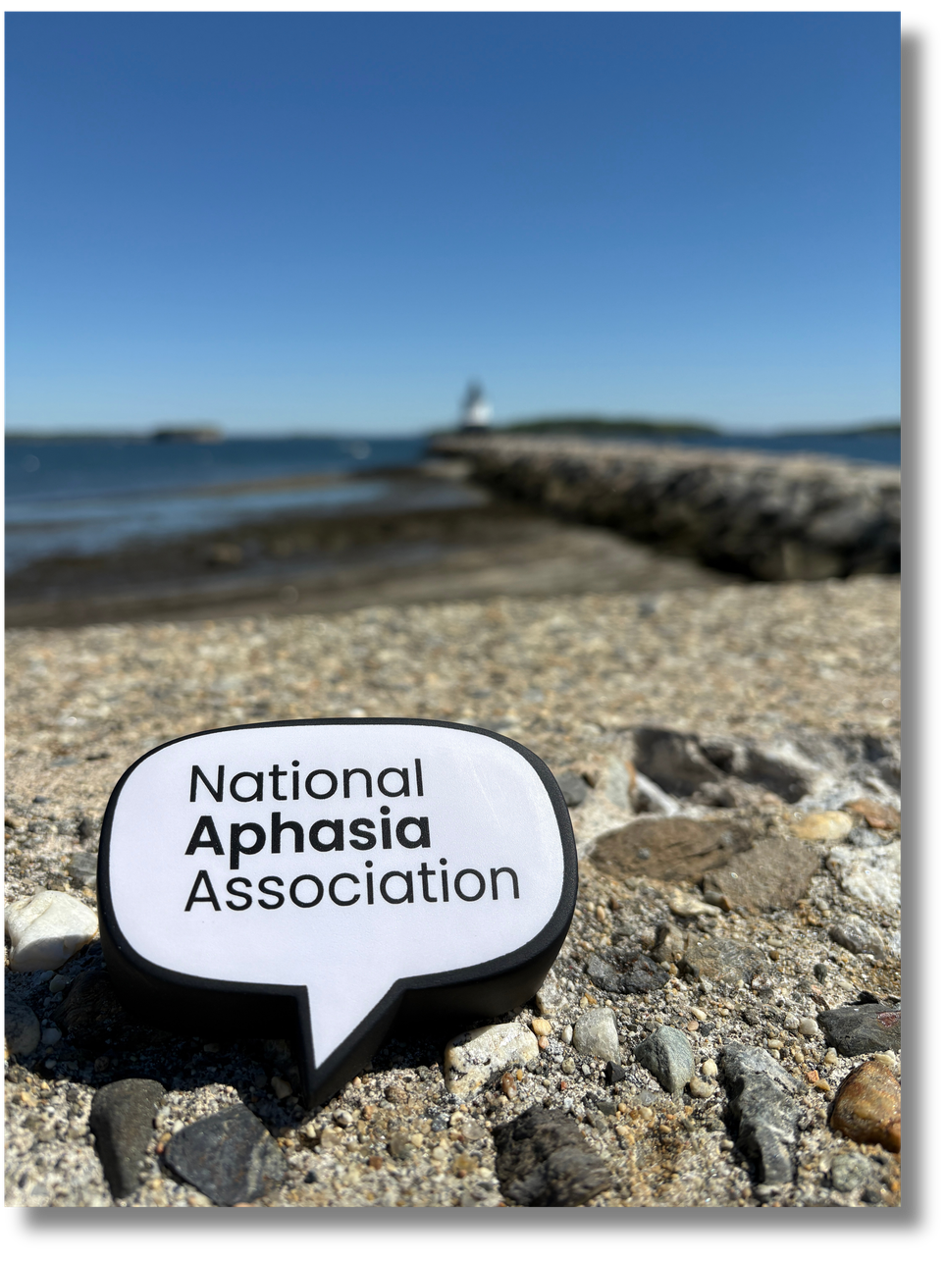

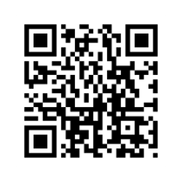

June is Aphasia Awareness Month
  The NAA Speech Bubble Tour
    Follow the NAA on social media
    Every morning we post a mystery photo with three clues.
    Comment your guess of where the NAA Speech Bubble is each day.
    The location will be revealed each afternoon at 5pm ET (4pm CT, 3pm MT, 2pm PT)
Notes:
At this month's "After the Expert", we will have a discussion about today's webinar. And you will be given the opportunity to design and share your own mask.

Slide 5
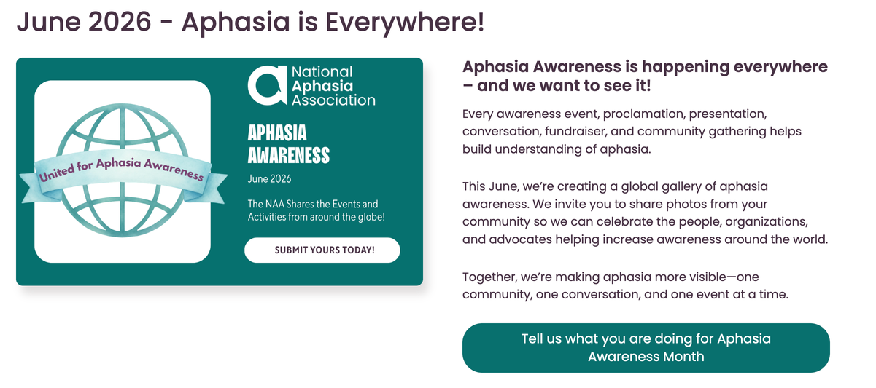
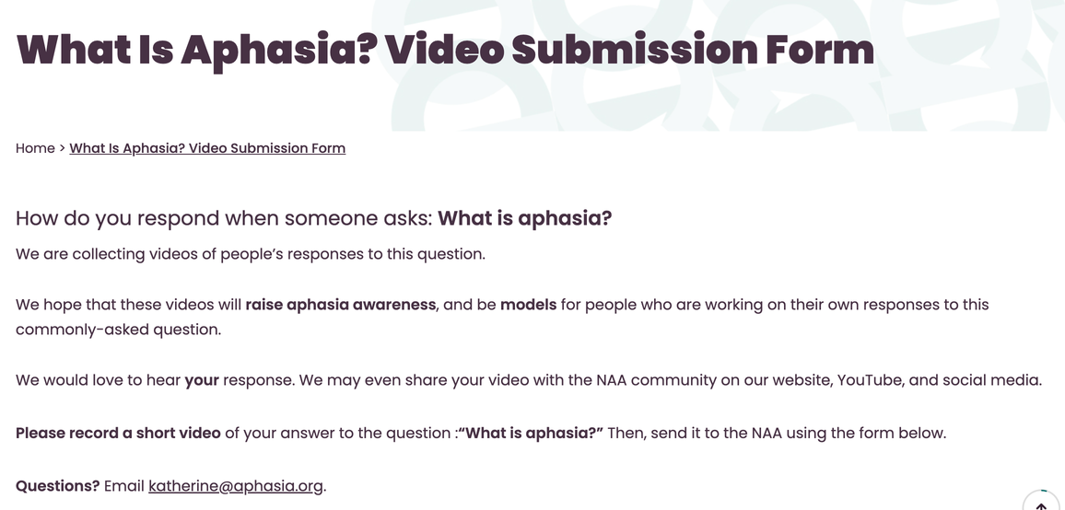
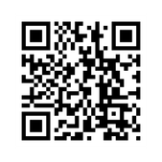
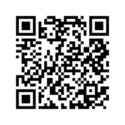
June is Aphasia Awareness Month
Let us know what YOU are doing
for Aphasia Awareness Month!
Submit the form on our website
Share YOUR response to the question
“What is aphasia?”
Submit the form on our website

Slide 6
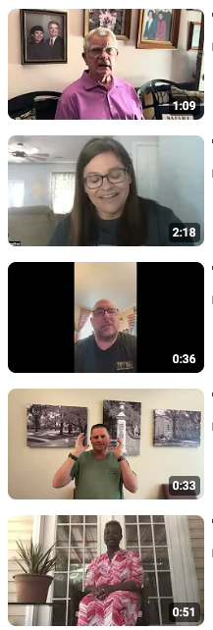
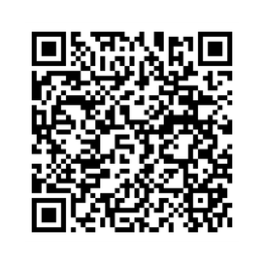
Check out the
“What is Aphasia?” YouTube Playlist

Slide 7
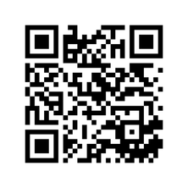
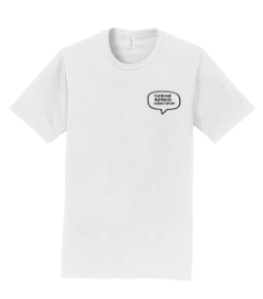
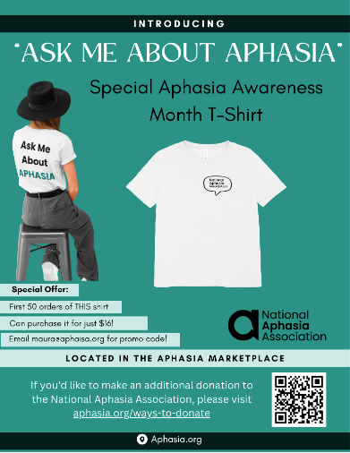
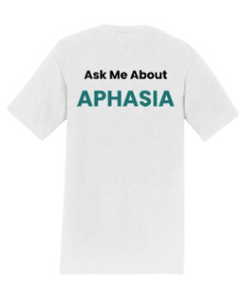
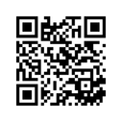
Start the Conversation about Aphasia

Slide 8
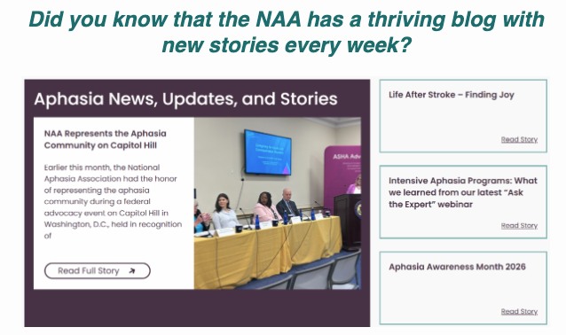
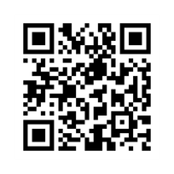
Check out the NAA blog
aphasia.org/blog

Slide 9
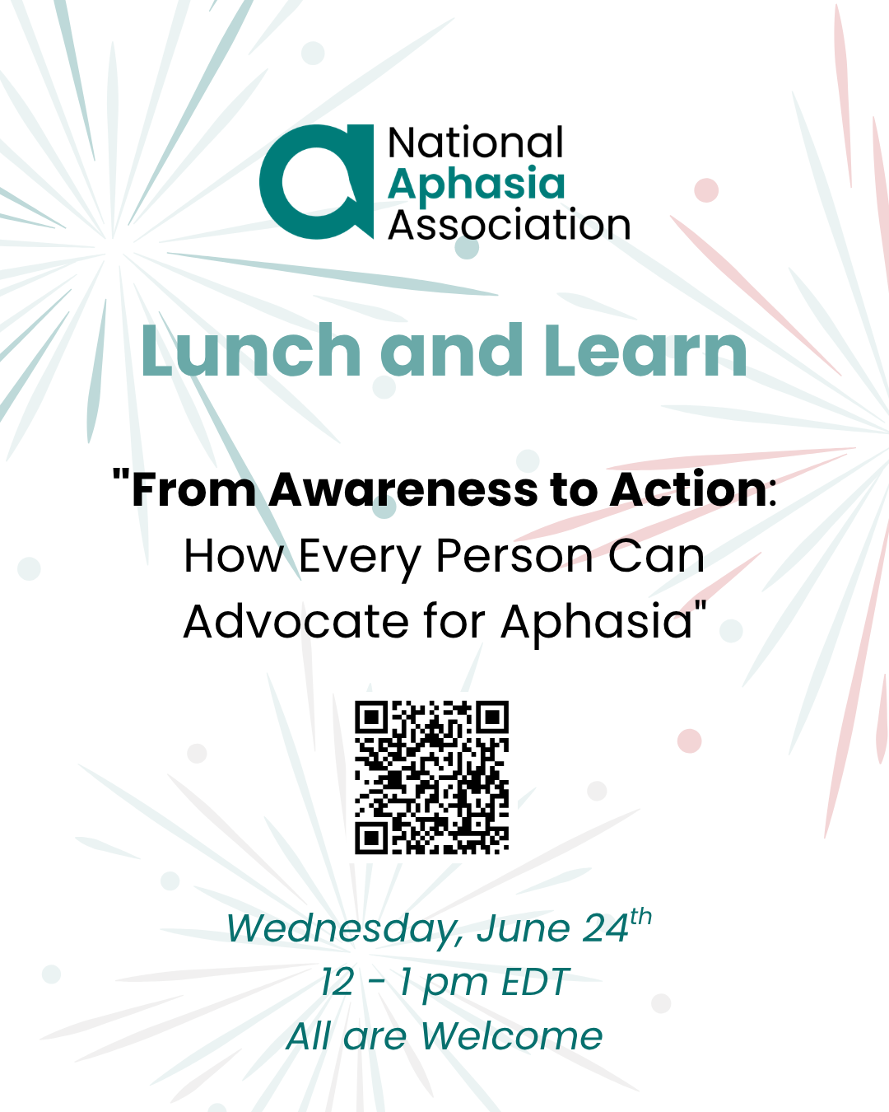
Today’s topic

Slide 10
AWARENESS
ADVOCACY
Awareness is the act of informing people to help them understand an issue.
Goal: To educate, spark interest, and change public attitudes.
Advocacy is the action taken to support that cause or influence decision-makers to create change.
Goal: To influence policies, laws, or behaviors of key decision-makers.
ACTION!

Slide 11


Often, people think advocacy means:
Giving a Speech
Meeting with Law-Makers
Being on TV or in the paper
Leading a Campaign

Slide 12
Advocacy is taking action to improve understanding, support, and opportunities for people with aphasia.

Slide 13


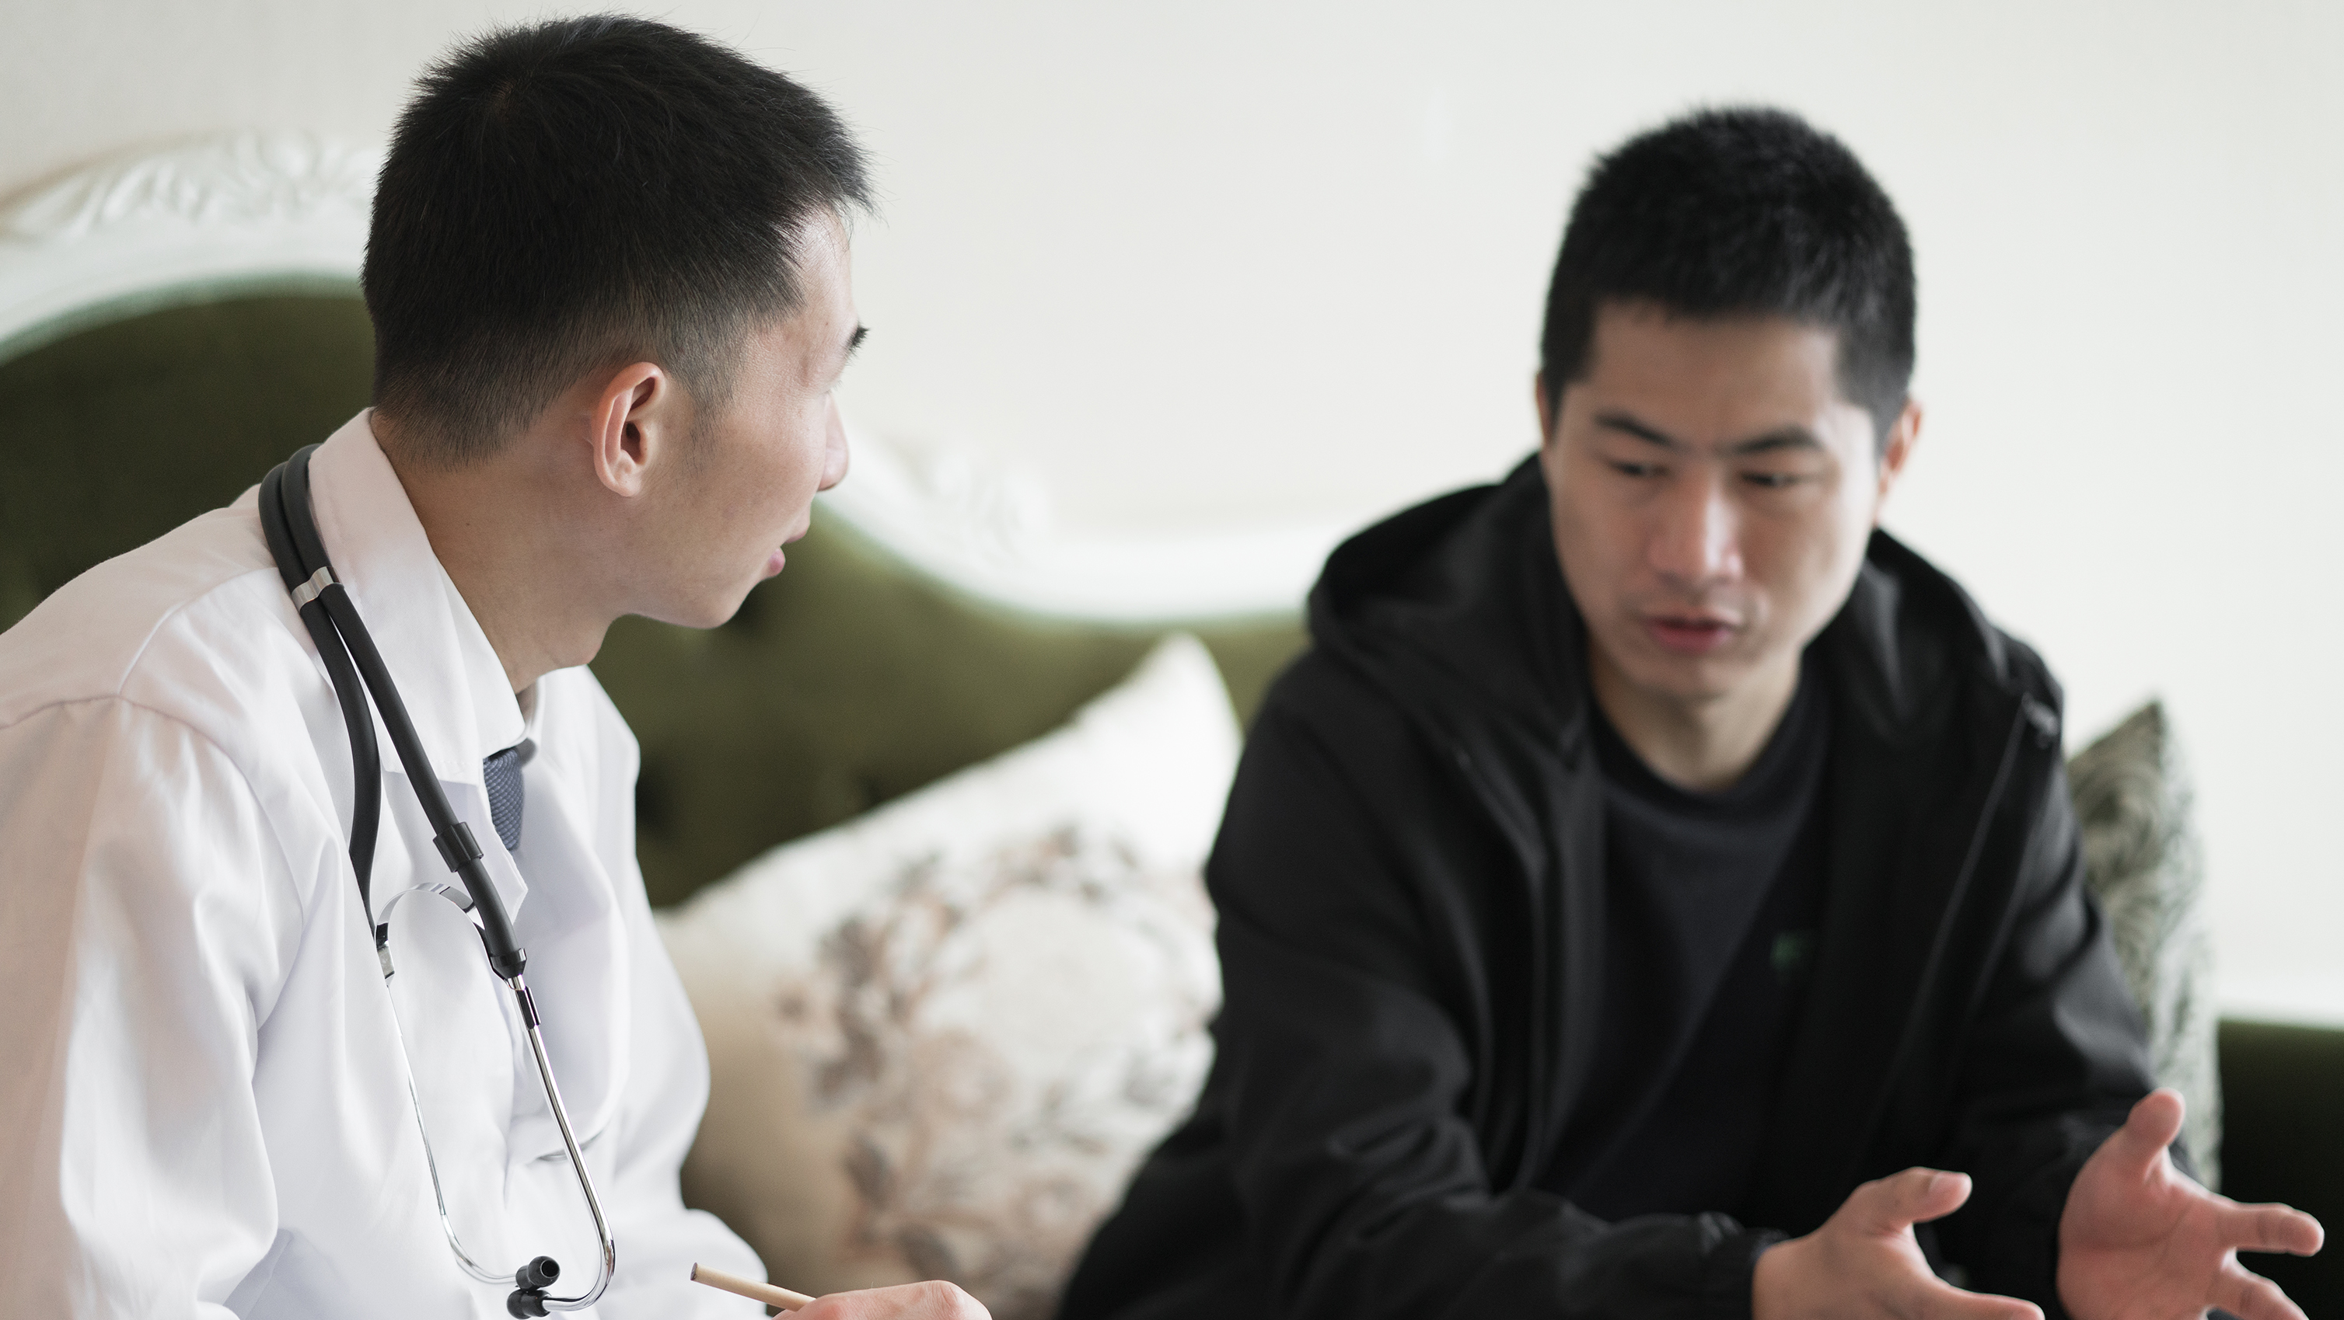
Advocacy is taking action to improve understanding, support, and opportunities for people with aphasia.

Slide 14
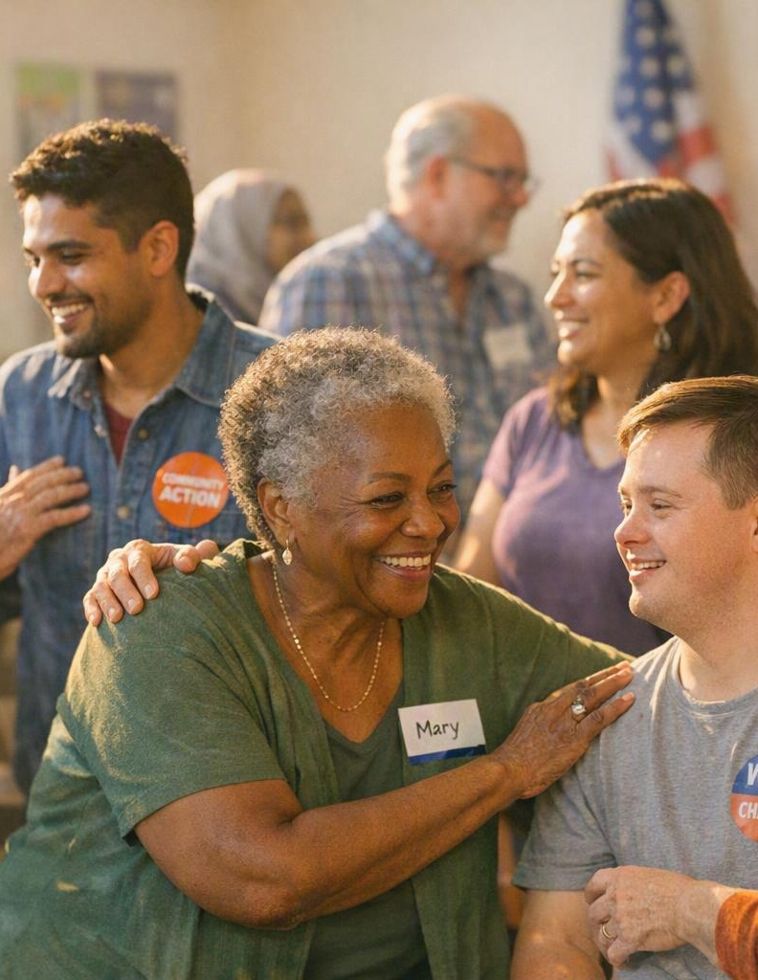
Have you ever?
✅ Explained aphasia to someone?
✅ Shared your story?
✅ Corrected a misconception?
✅ Brought a communication card to a doctor?
✅ Helped someone communicate?
✅ Shared an NAA post?

Slide 15

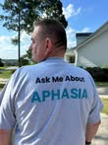

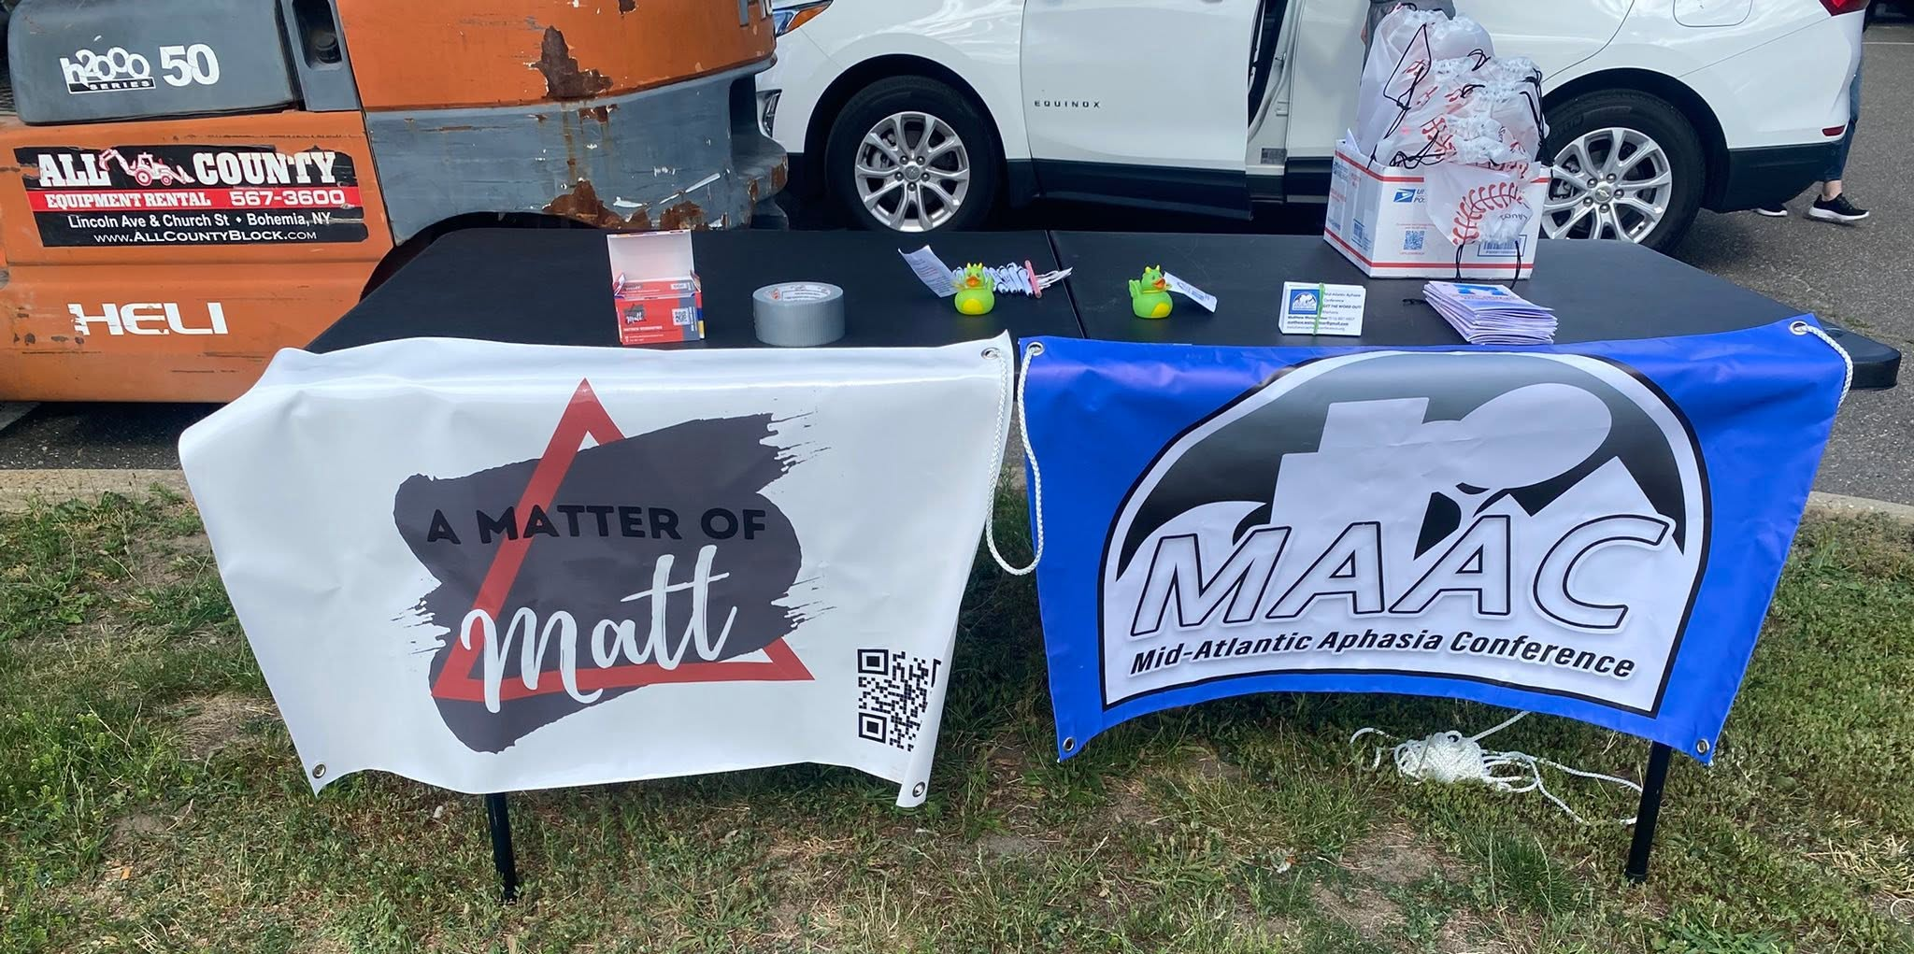
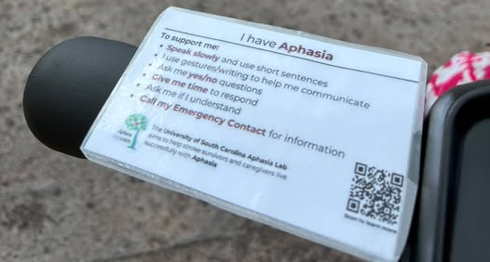
Small Actions = Big Impact
Examples:
Wear an aphasia shirt
Share a social media post
Invite a friend to learn about aphasia
Submit a proclamation request
Participate in NAA activities
Write a letter
Support another person with aphasia

Slide 16
Let’s talk about it!

