Slide 1
Technology and Supports for Aphasia
Brooke Lang, M.A., CCC-SLP and Bryn Lander

Slide 2

Communication Challenge
EXAMPLE:
I enjoy fixing things around the house. I find it difficult to read an instruction manual and follow the directions.

Slide 3


FEATURED
App/Resource/Accessibility Feature
Natural Reader
OR
Speechify (text to speech program)
ChatGPT – simplify steps; see a picture

Slide 4
Natural Reader and Speechify
NATURAL READER
Text‑to‑speech (TTS) app → converts written content—PDFs, webpages, ebooks, scanned documents—into spoken audio using AI voices
Plus ($20.90/month) and Pro($25.90) plans available
SPEECHIFY
Text‑to‑speech (TTS) app → converts written content—PDFs, webpages, ebooks, scanned documents—into spoken audio using AI voices
FREE, or Premium ($29/month)

Slide 5
Bryn Demo
Using Natural Reader to help understand an instruction manual

Slide 6

FEATURED
App/Resource/Accessibility Feature
Chat GPT- Bryn uses it every day for texting back and emailing
App – AI powered chatbot available on iOS, Android, desktop
FREE (limited usage, basic features); $20/month faster responses, expanded messaging and uploads)
Designed to provide answers, generates content, assists with learning, creates images, etc.

Slide 7
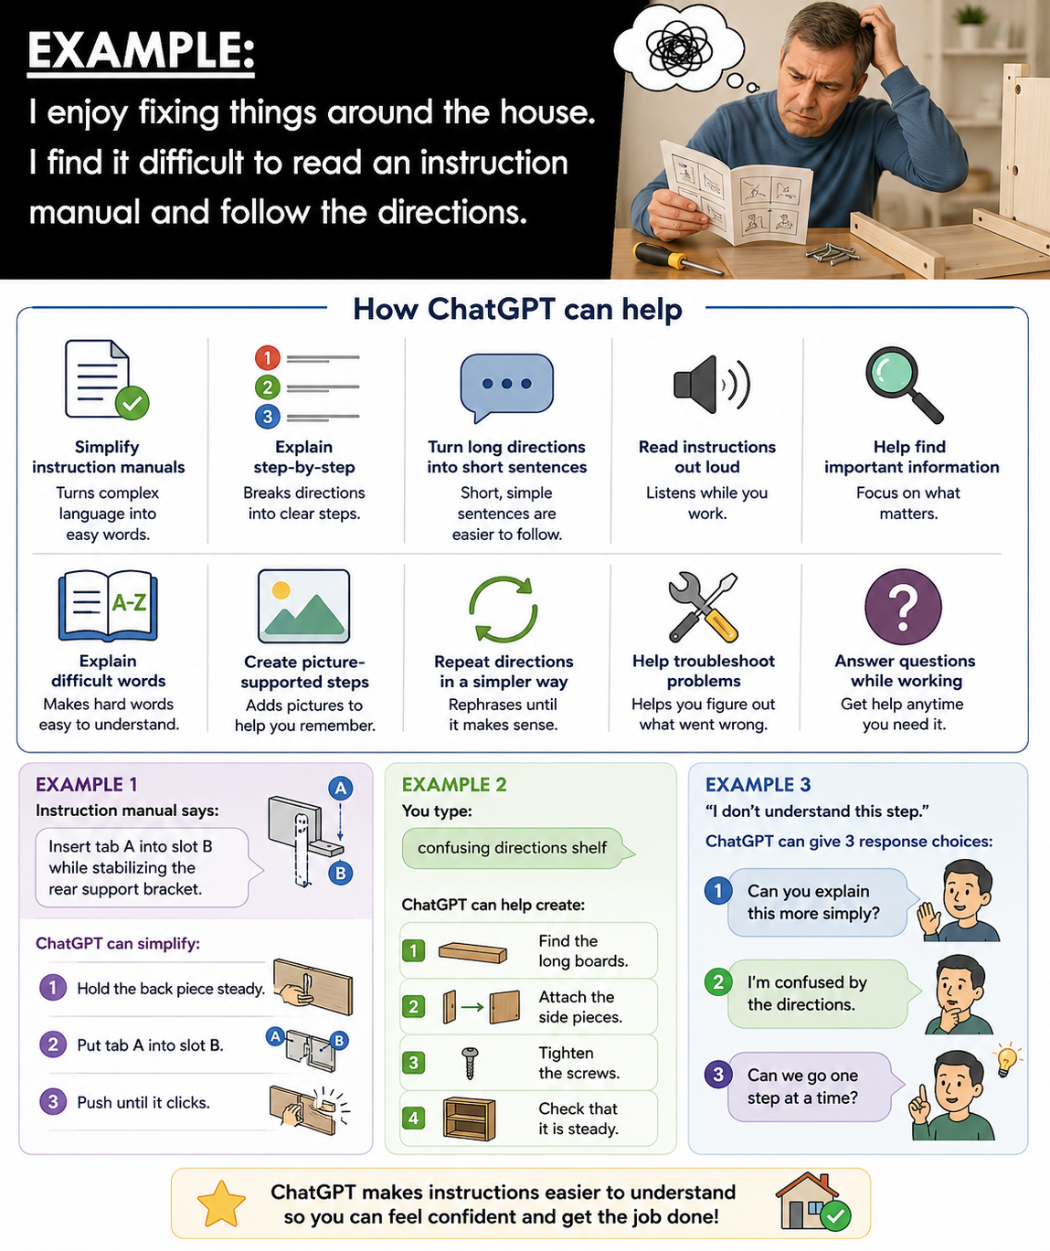

Slide 8
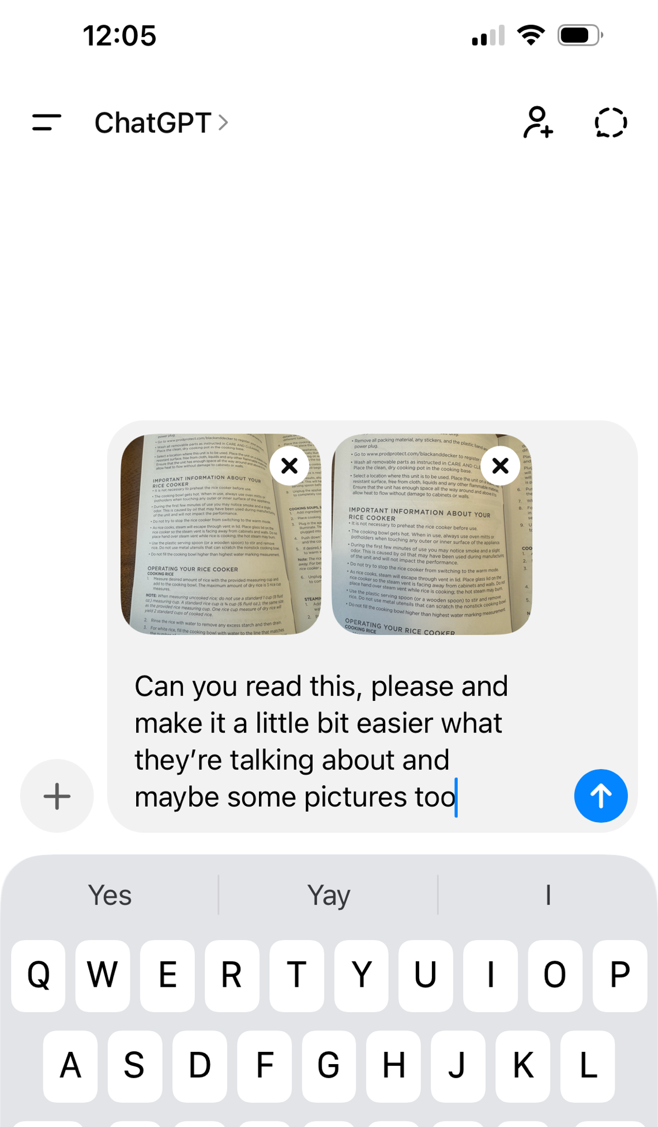
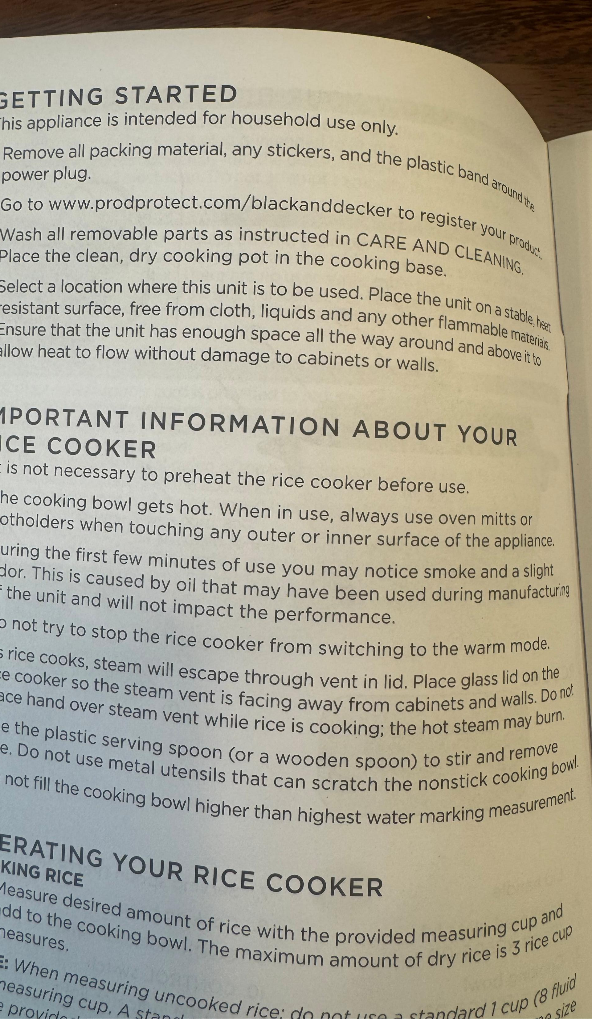

Slide 9
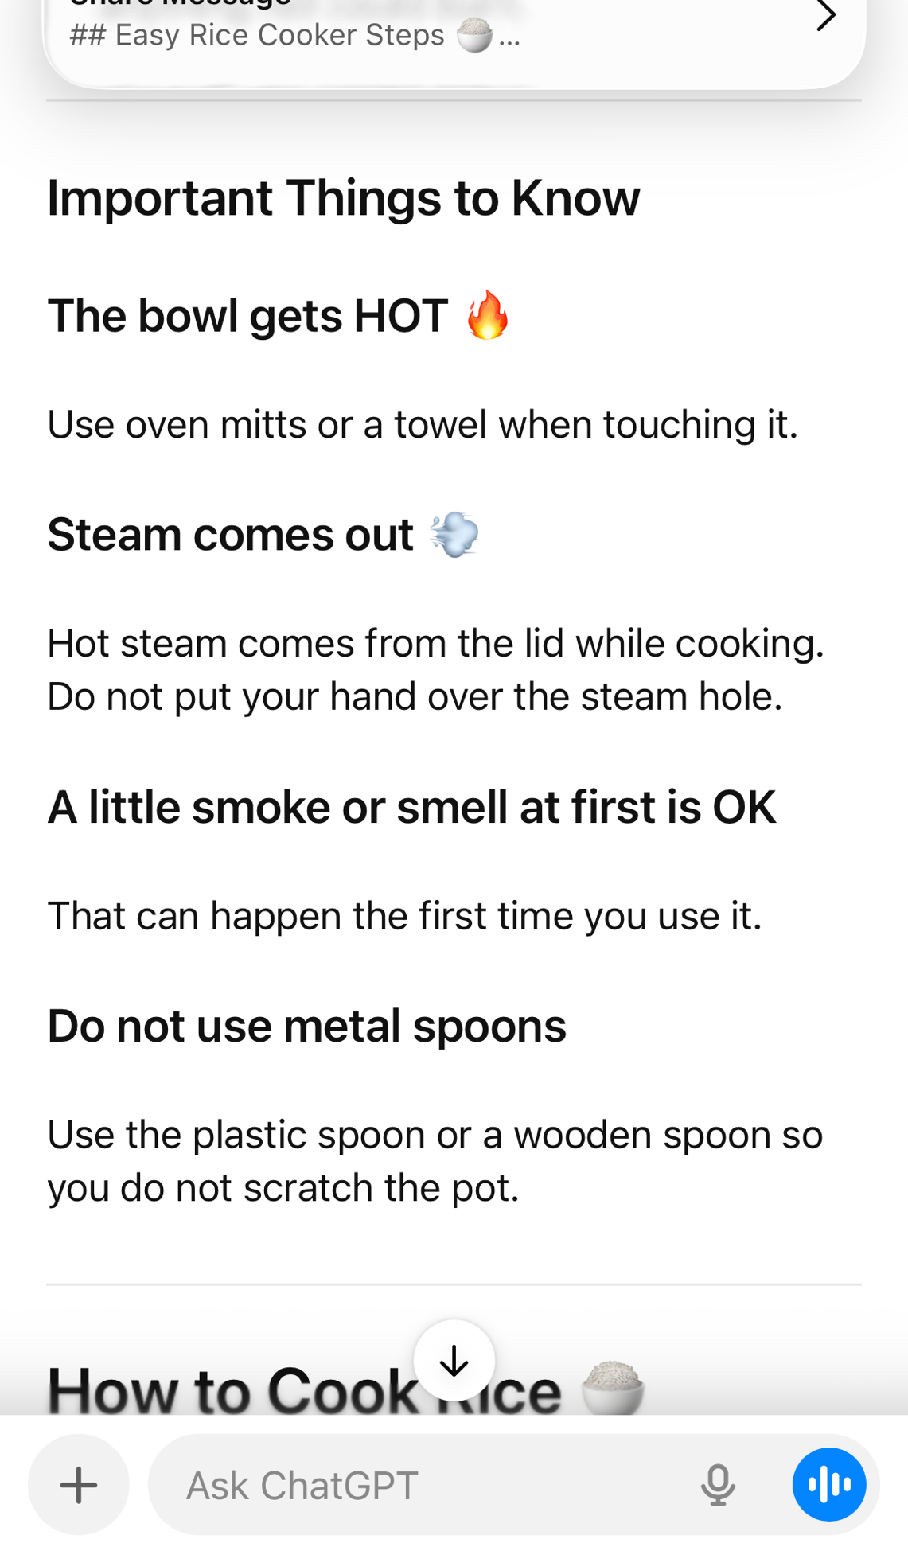
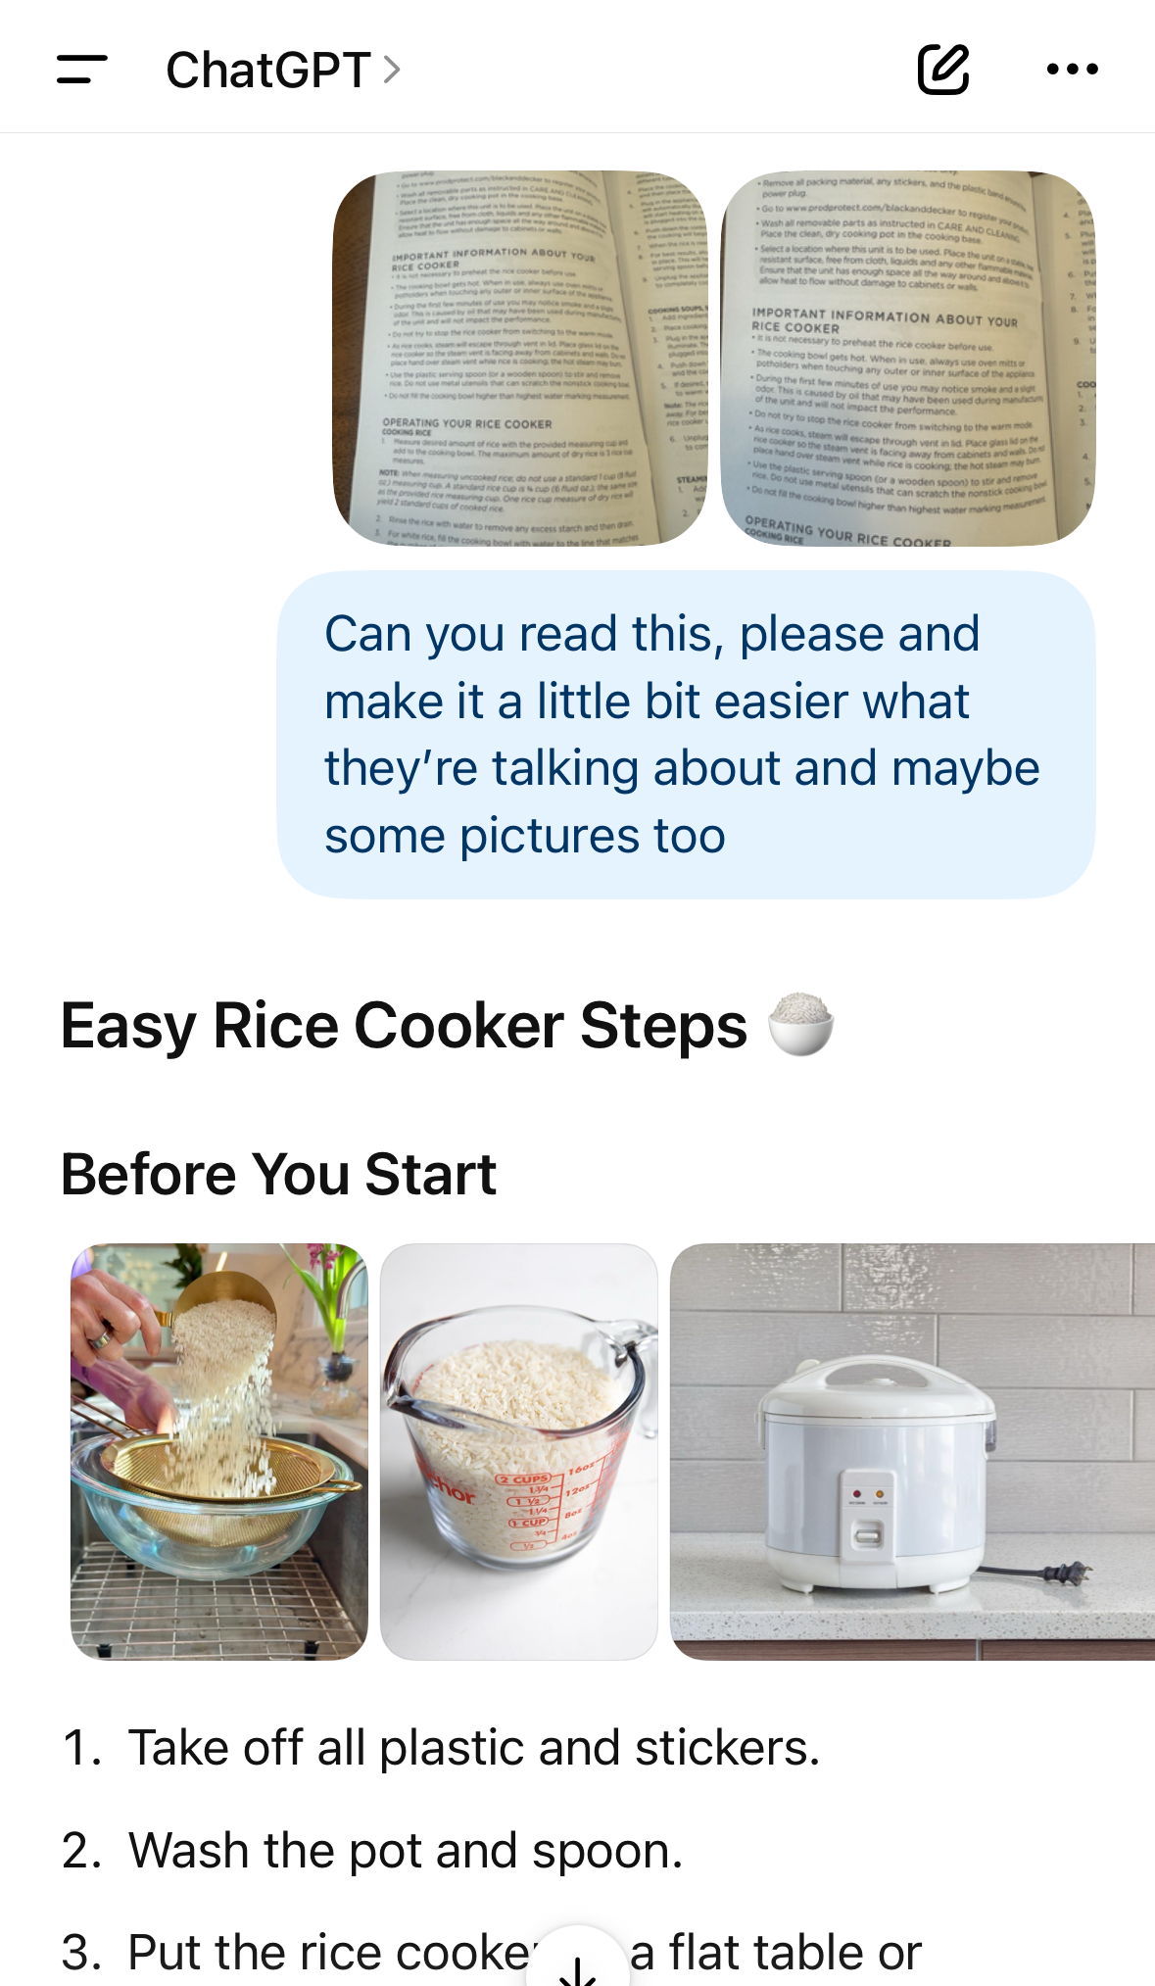

Slide 10
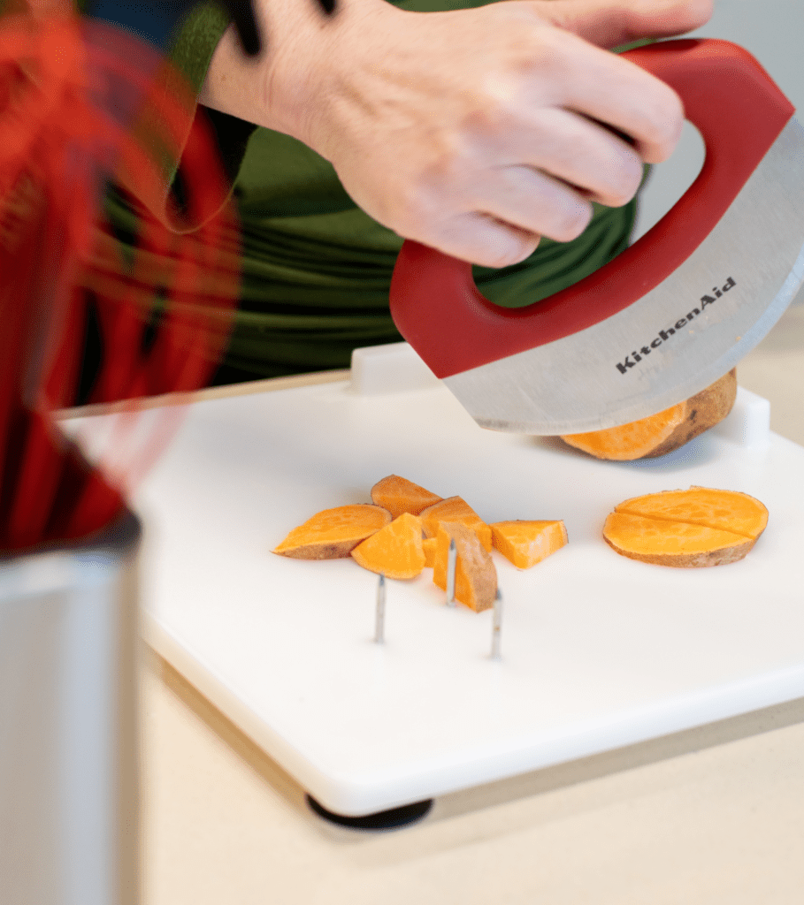
Communication Challenge
I have right sided hemiplegia and have a difficult time cooking, which I used to love to do.

Slide 11
My Favorite Adaptive Kitchen Tools
My Favorite Adaptive Kitchen Tools
Slow Cooker (Crock-Pot) – I can add the ingredients, press one button, and let it cook.
Kitchen Mama Electric Can Opener – Opens cans with one button. No twisting or gripping.
Manual Vegetable Chopper – I use this all the time. It quickly chops onions, peppers, carrots, and other vegetables with much less effort.
Ninja Food Chopper – Great for chopping larger amounts of vegetables, cheese, nuts, and herbs.
Digital Kitchen Scale – Much easier than using measuring cups with one hand. I can place a bowl on the scale, zero it out (tare), and add each ingredient by weight.
One-Handed Cutting Board – Holds food in place so I can cut more safely with one hand.

Slide 12
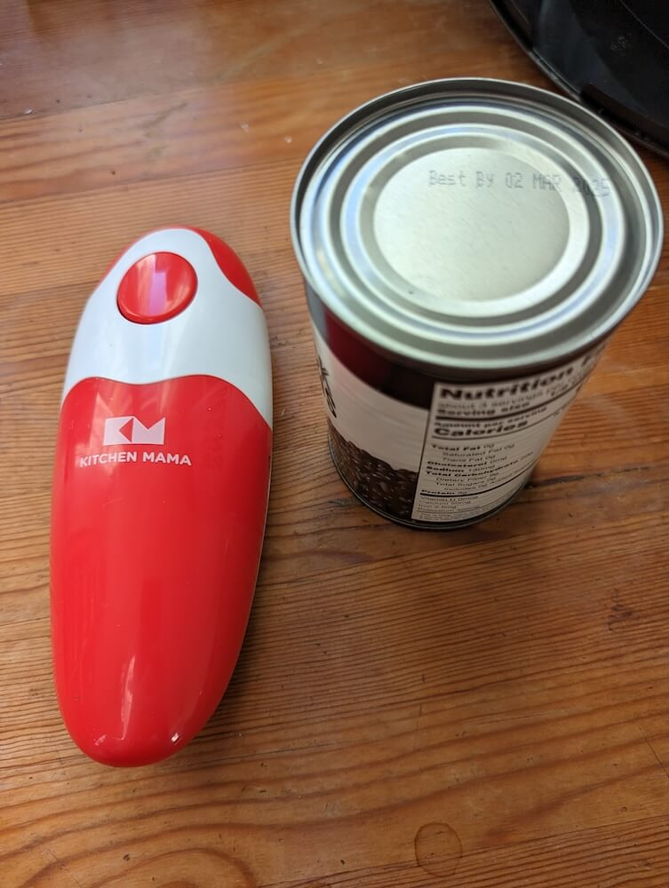
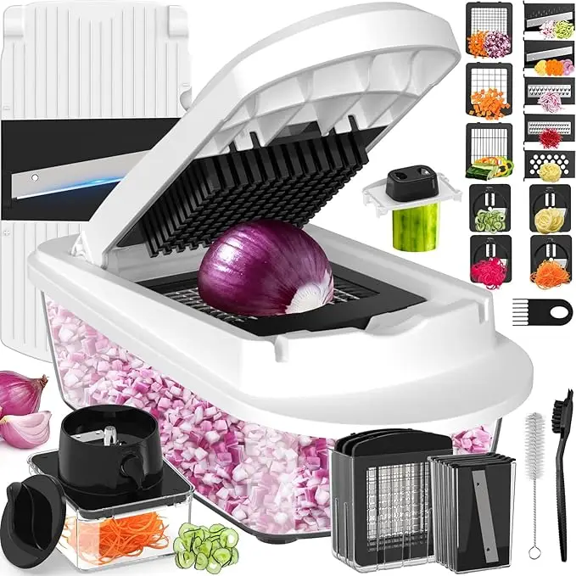
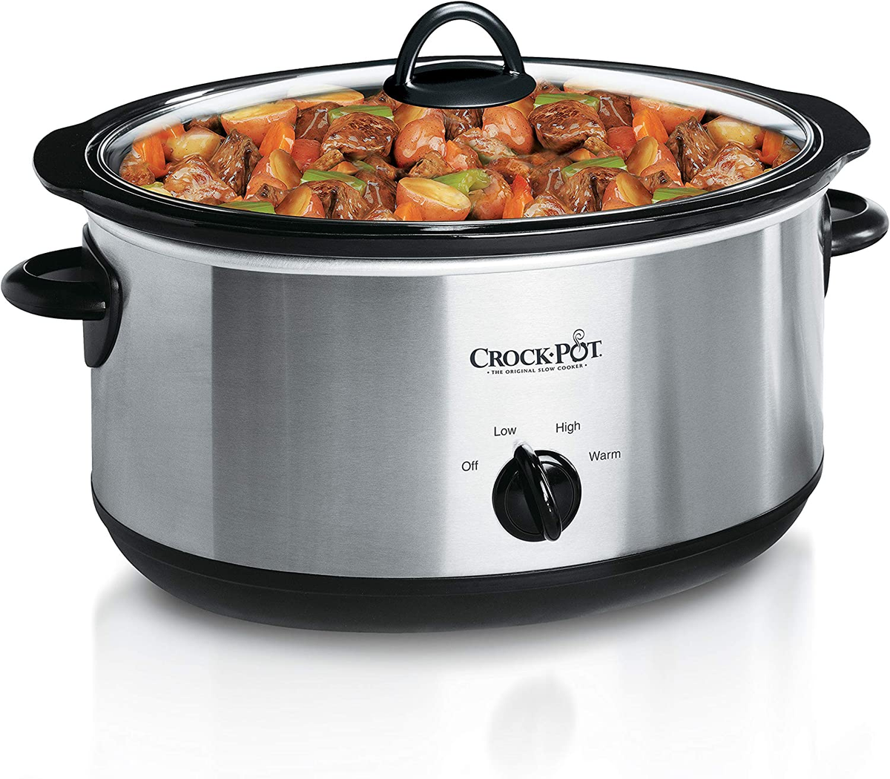
Slow Cooker
Manual Vegetable Chopper
Kitchen Mama Electric Can Opener

Slide 13
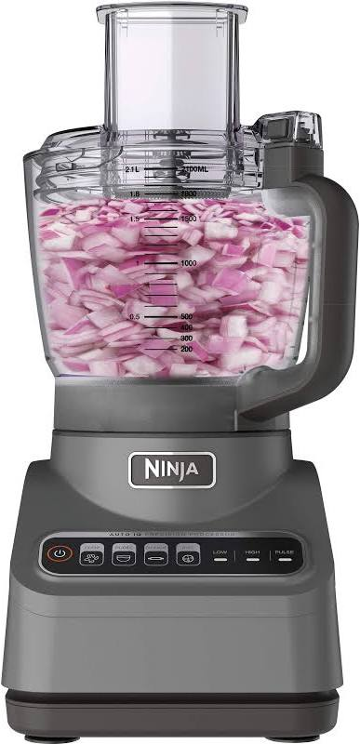
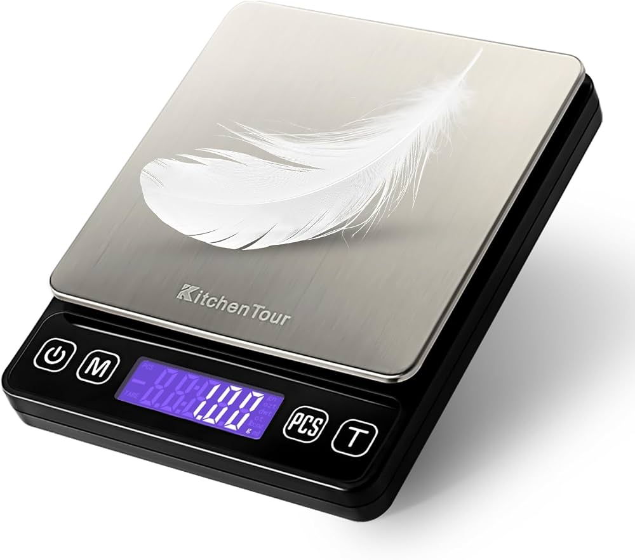
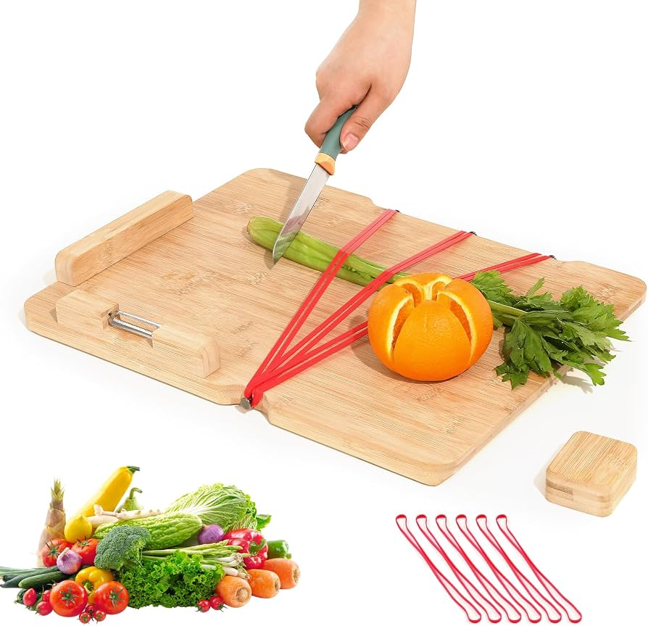
Digital Kitchen Scale
One-Handed Cutting Board
Ninja Food Chopper

Slide 14

Communication Challenge
Reading recipes can be difficult, especially while cooking with one hand.

Slide 15
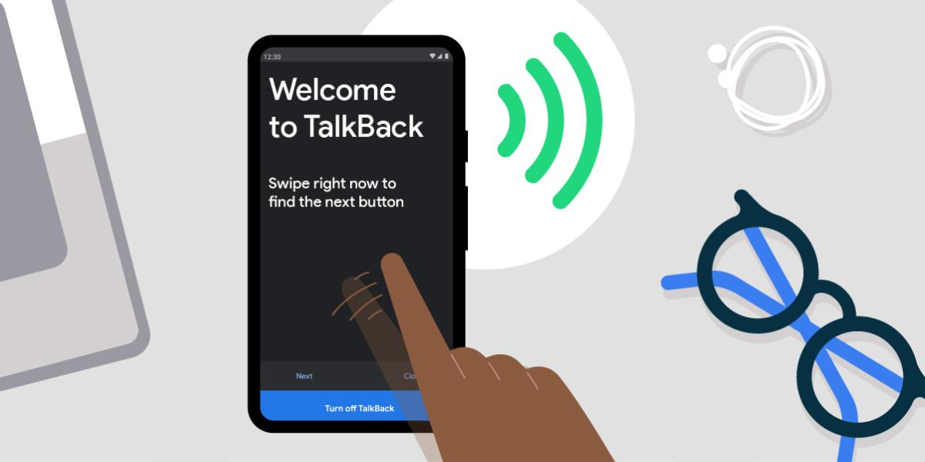
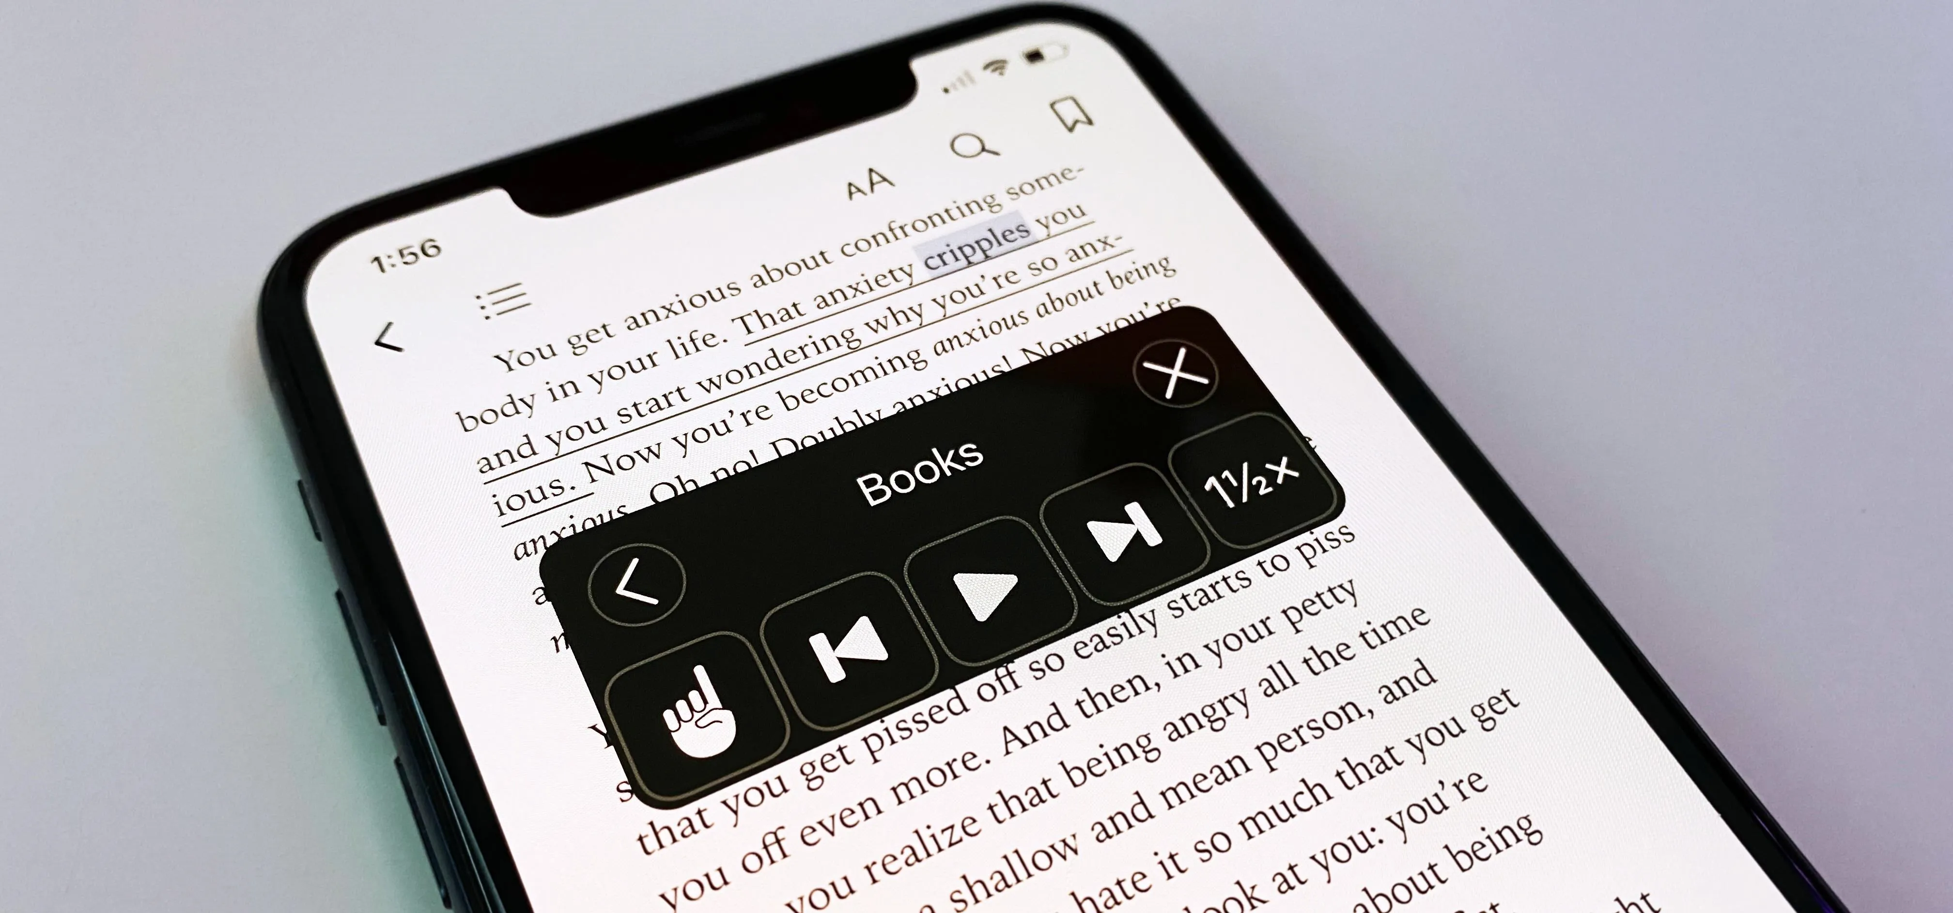

FEATURED
App/Resource/Accessibility Feature
Android Accessibility Feature
Iphone Accessibility Feature

Slide 16
Technology for “Reading” Recipes
iPhone
Speak Screen – Reads the entire recipe out loud.
Speak Selection – Reads only the text you highlight.
Live Speech (if needed for communication while cooking).
ChatGPT (iPhone & Android)
Simplifies recipes into easy, step-by-step directions.
Answers cooking questions while I'm cooking.
Can read recipes one step at a time.
Android
Select to Speak – Tap to have text read aloud.
Reading Mode – Makes recipes easier to read and can read them aloud.
TalkBack – Reads everything on the screen for people who need full screen-reader support.

Slide 17
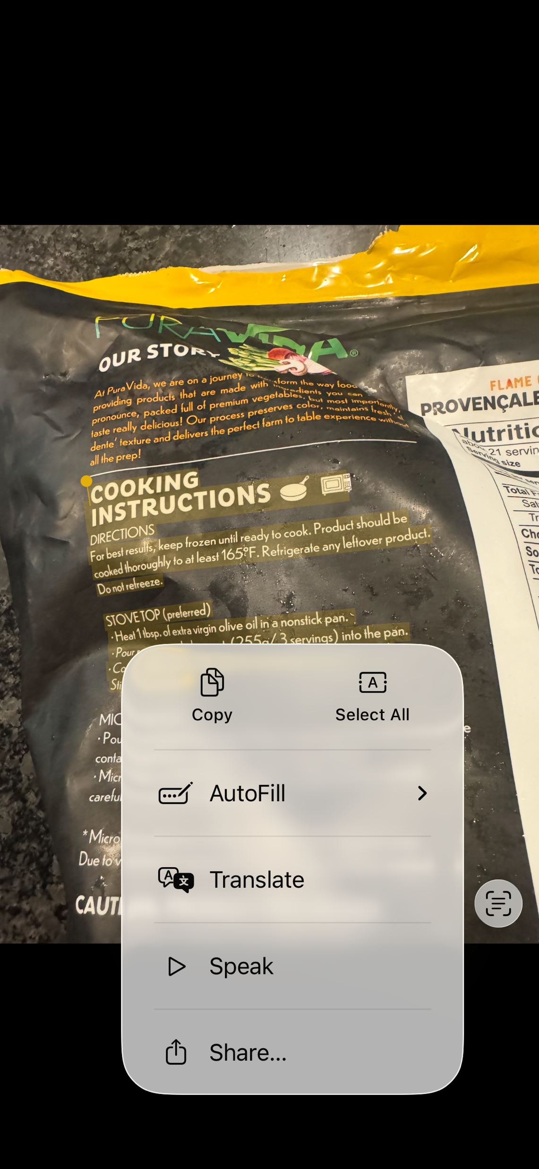
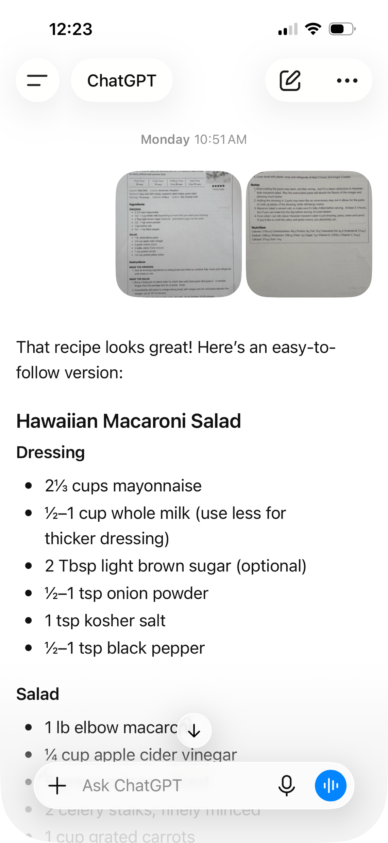
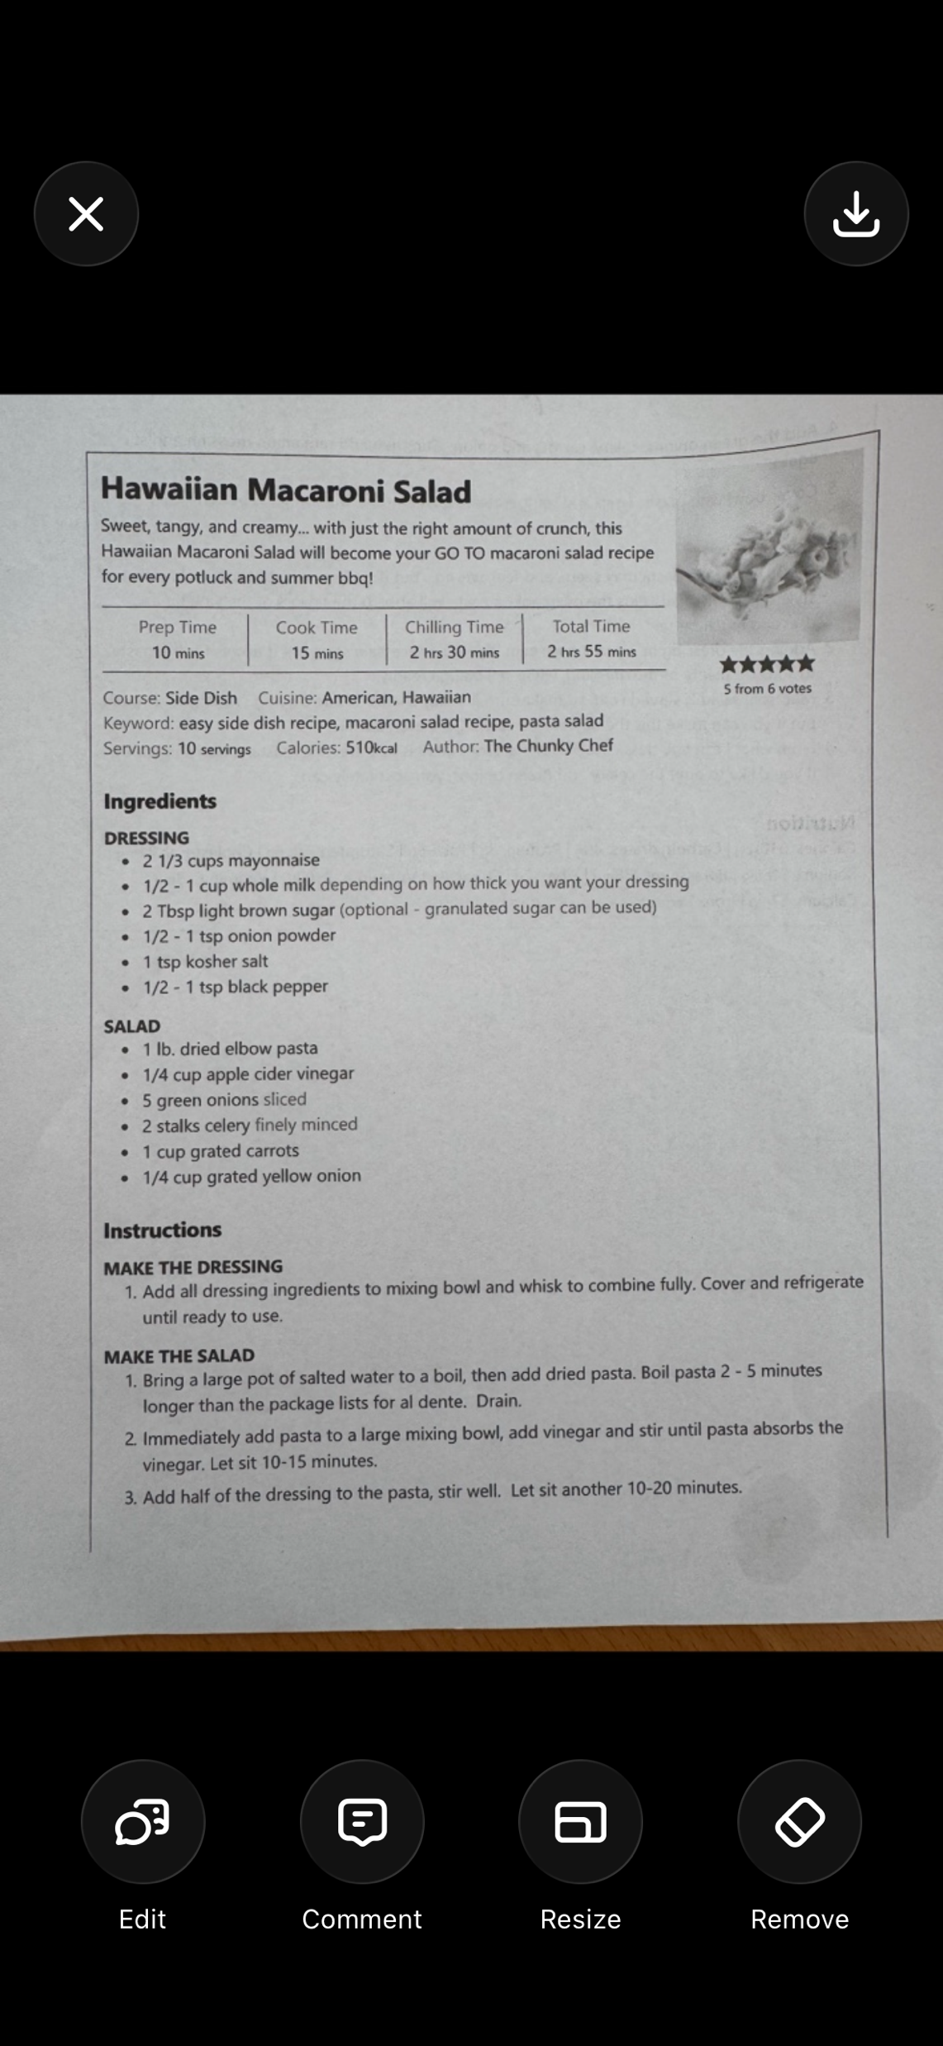

Slide 18
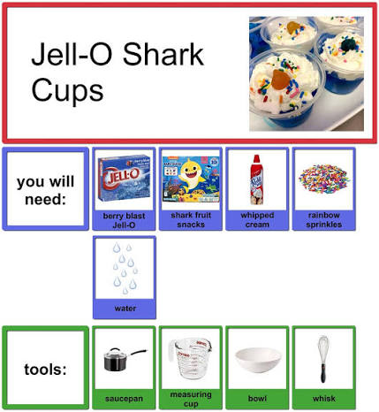
Accessible Chef
Accessible Chef – Accessible Cooking for Budding Chefs
Collection of FREE visual recipes and other resources to help teach cooking skills to individuals with disabilities
Resources also available
Recipe Creator and Image Bank

Slide 19
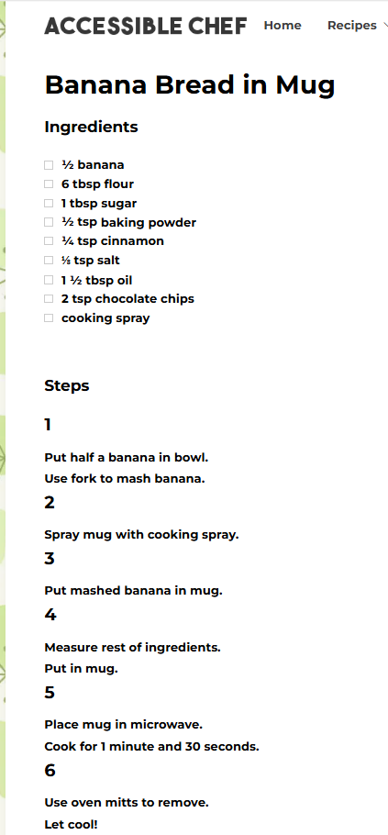
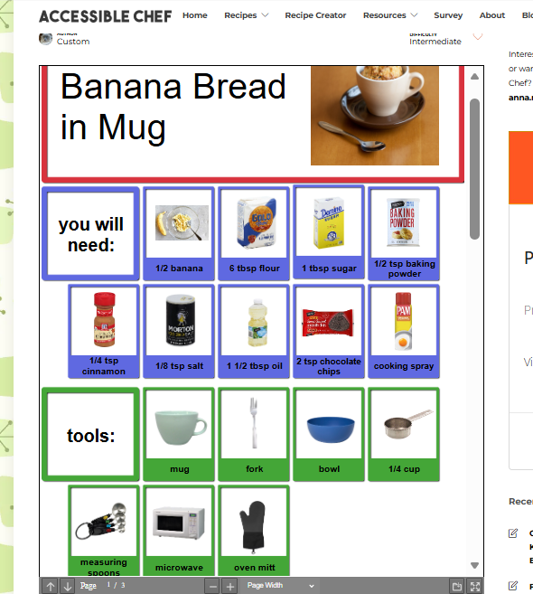
Accessible Chef (continued)

Slide 20
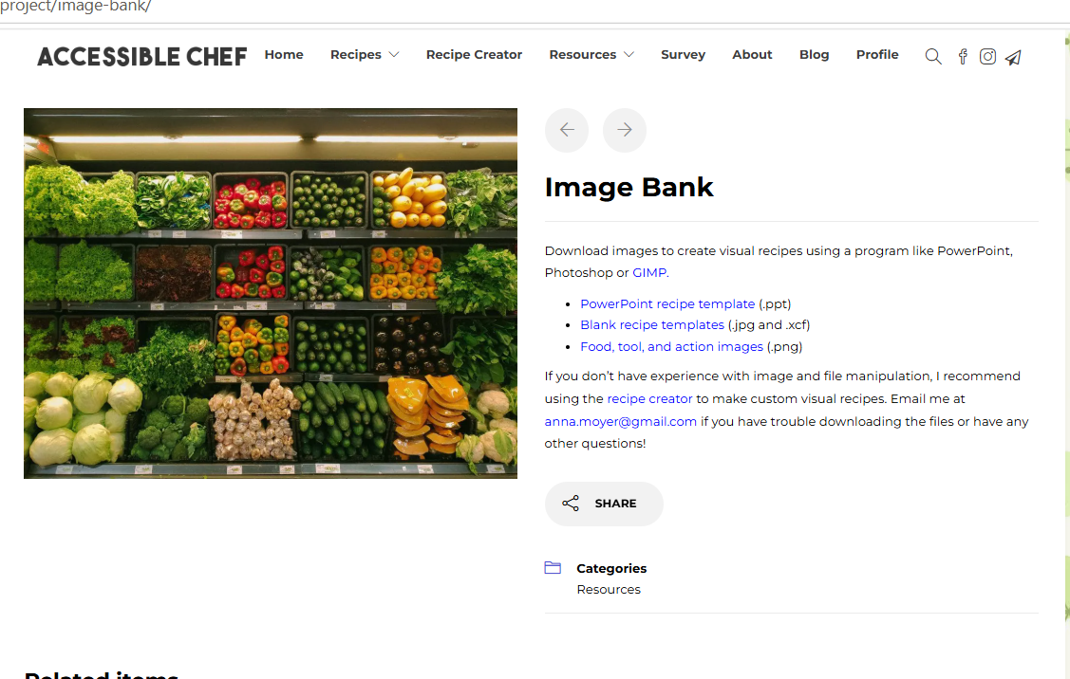
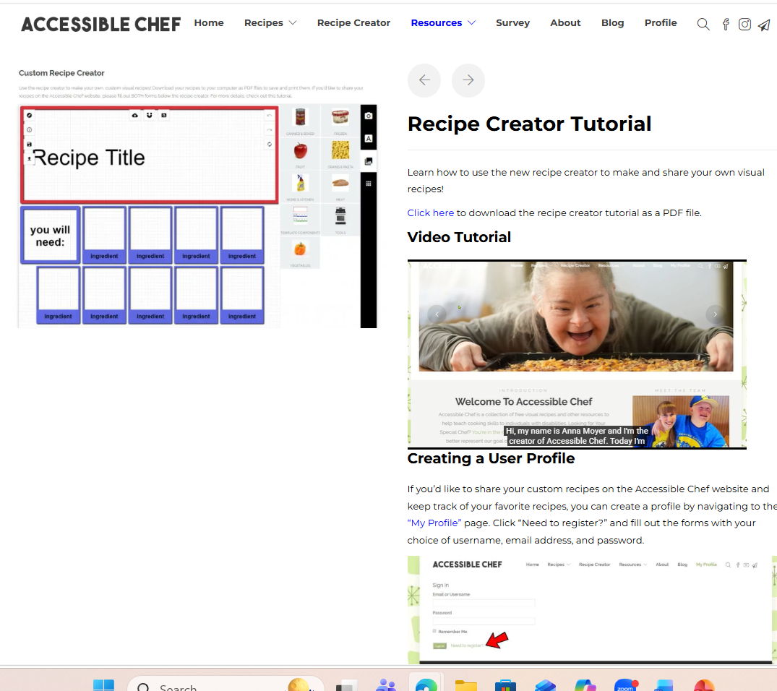
Accessible Chef (continued)

Slide 21

NEXT TIME:
WEDNESDAY, September 2nd at 4:00pm EST
What else do you want to learn?

