Slide 1
Technology and Supports for Aphasia
Brooke Lang, M.A., CCC-SLP and Bryn Lander

Slide 2

Communication Challenge
EXAMPLE:
I used to enjoy writing in my diary or journal, but now it is difficult for me to write because of my Aphasia.

Slide 3

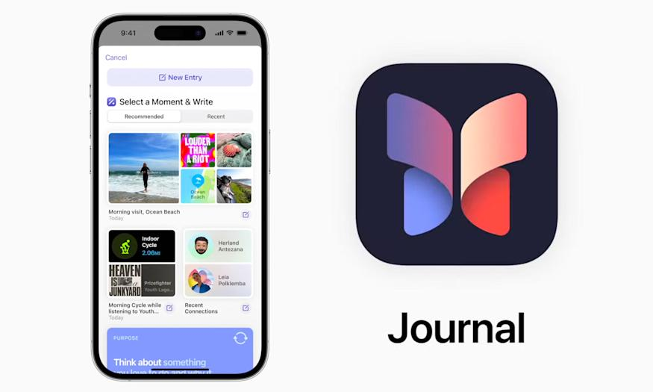
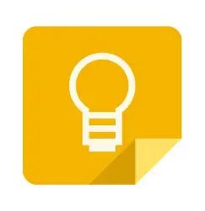
FEATURED
App/Resource/Accessibility Feature
Journal (App)
Google Keep (App)
Day One Journal App

Slide 4
FEATURED
App/Resource/Accessibility Feature
Day One | Apple Journal | Google Keep
📖 Journaling & memories | 📖 Simple journaling | 🧠 Notes & remembering
📸 Photos | 📸 Photos | 📸 Photos
🎤 Audio/voice | 🎤 Audio/Dictation | 🎤 Voice notes
✍️ Longer journal entries | ✍️ Journal entries | ✍️ Short notes
⭐ More journal features | 🍎 Simple & built into Apple devices | ✅ Lists & reminders
💲 Free + optional paid features | 💲 Free | 💲 Free

Slide 5
Day One Journal App
Day One Journal App | Your Journal For Life
Speech to text available
Can add photos, videos, audio recordings, and drawings
Voice Recorder – do it monthly, also a way you can see improvements
Compatible with all devices
FREE plan vs. Premium (unlimited) $24.99-$34.99 depending on device

Slide 6
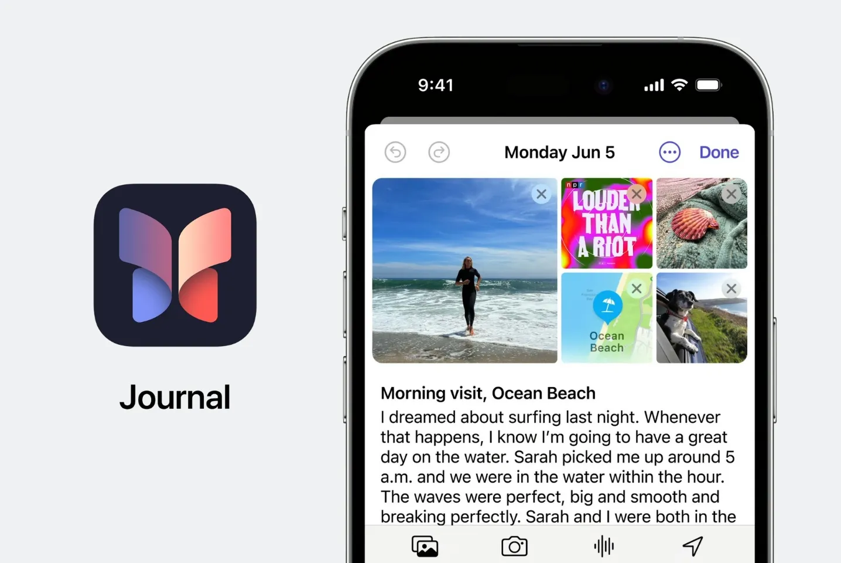
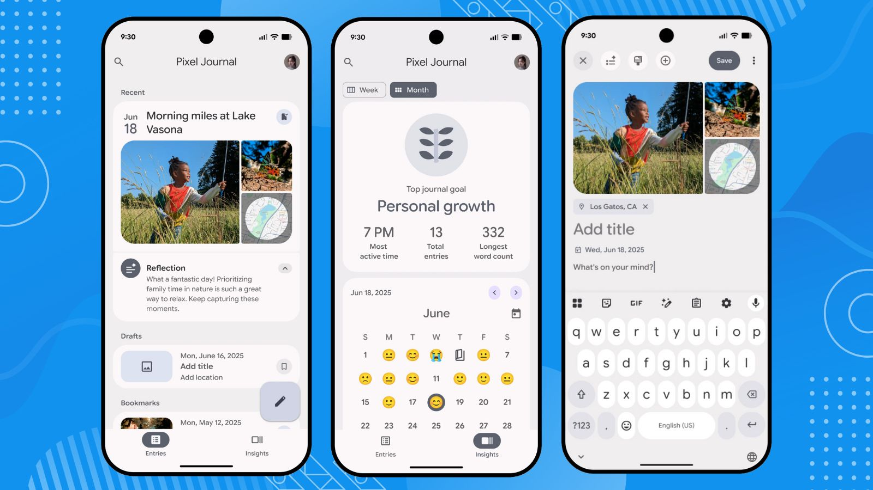
Journal — Apple iPhone App
Apple app for keeping a personal journal
Type as much or as little as you want
Use Dictation if writing is difficult
Add photos and videos instead of relying only on words
Add audio recordings to an entry
Can include places you've visited
Gives you suggestions/prompts for things you might want to remember or write about
Journal can be locked for privacy
FREE on supported Apple devices
Notes:
I don't personally use apple journal app very much, but I wanted to show it because it's another option. If writing is difficult because of aphasia, you don't necessarily have to write a big paragraph. You could use a picture, dictate a few words, or make an audio recording.

Slide 7
Journal — Apple iPhone App
BRYN DEMO

Slide 8
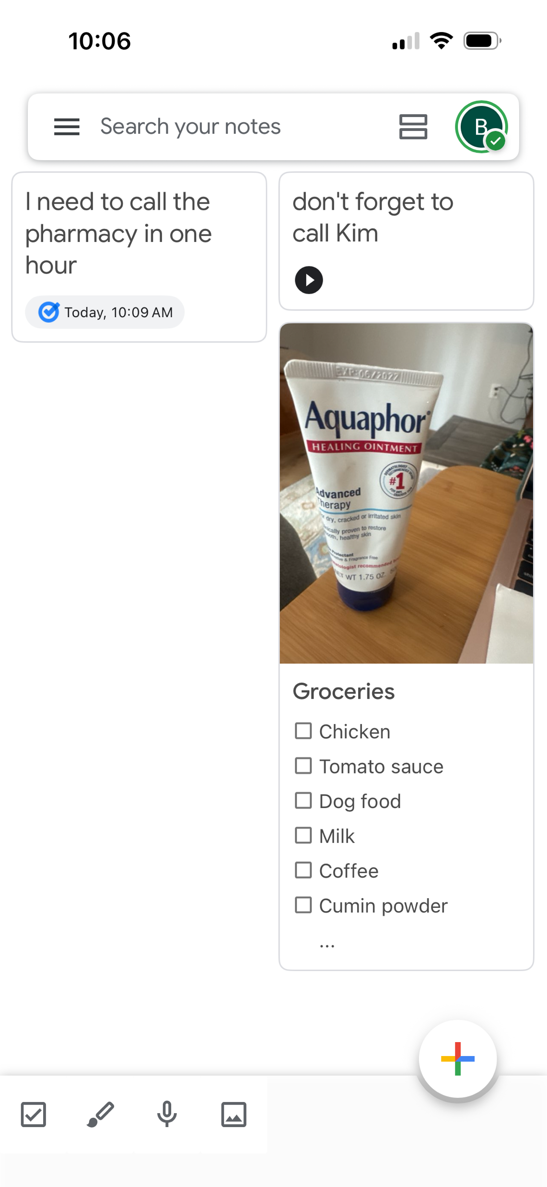
Google Keep
Quick notes, lists, and reminders
Use pictures instead of words
Take a picture of something I need at the store if I can't think of the word
Use my voice instead of typing
Make checklists and check things off
Can also be used as a simple journal
FREE with a Google account
Available on iPhone, Android, and computer

Slide 9
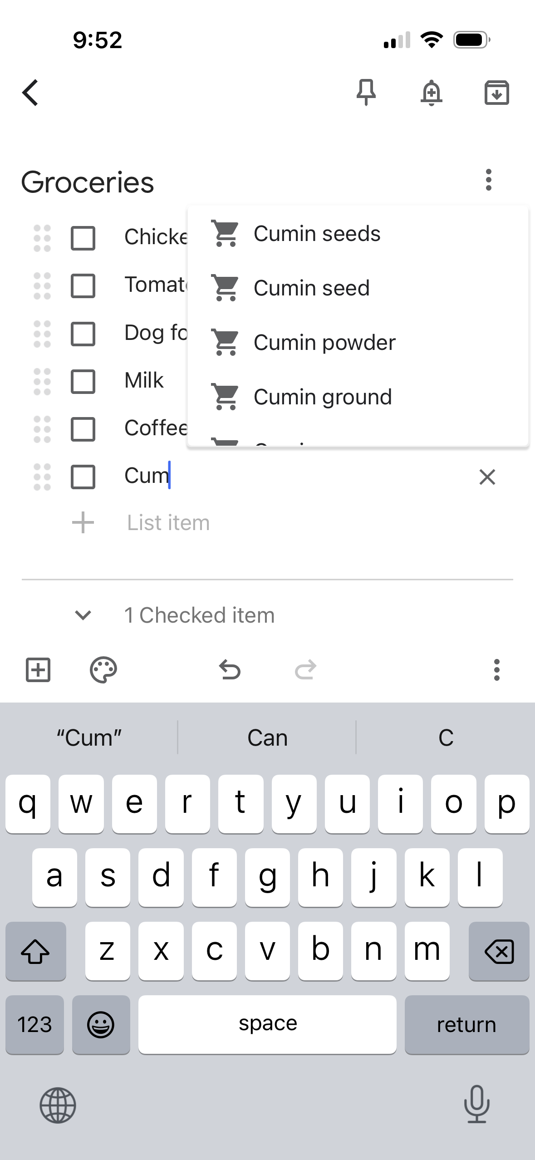
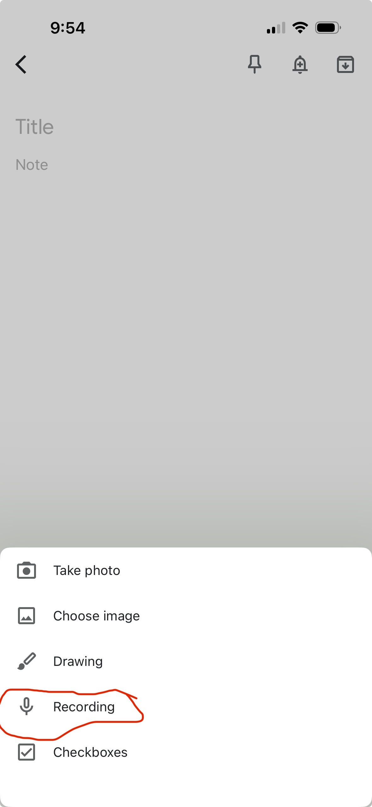
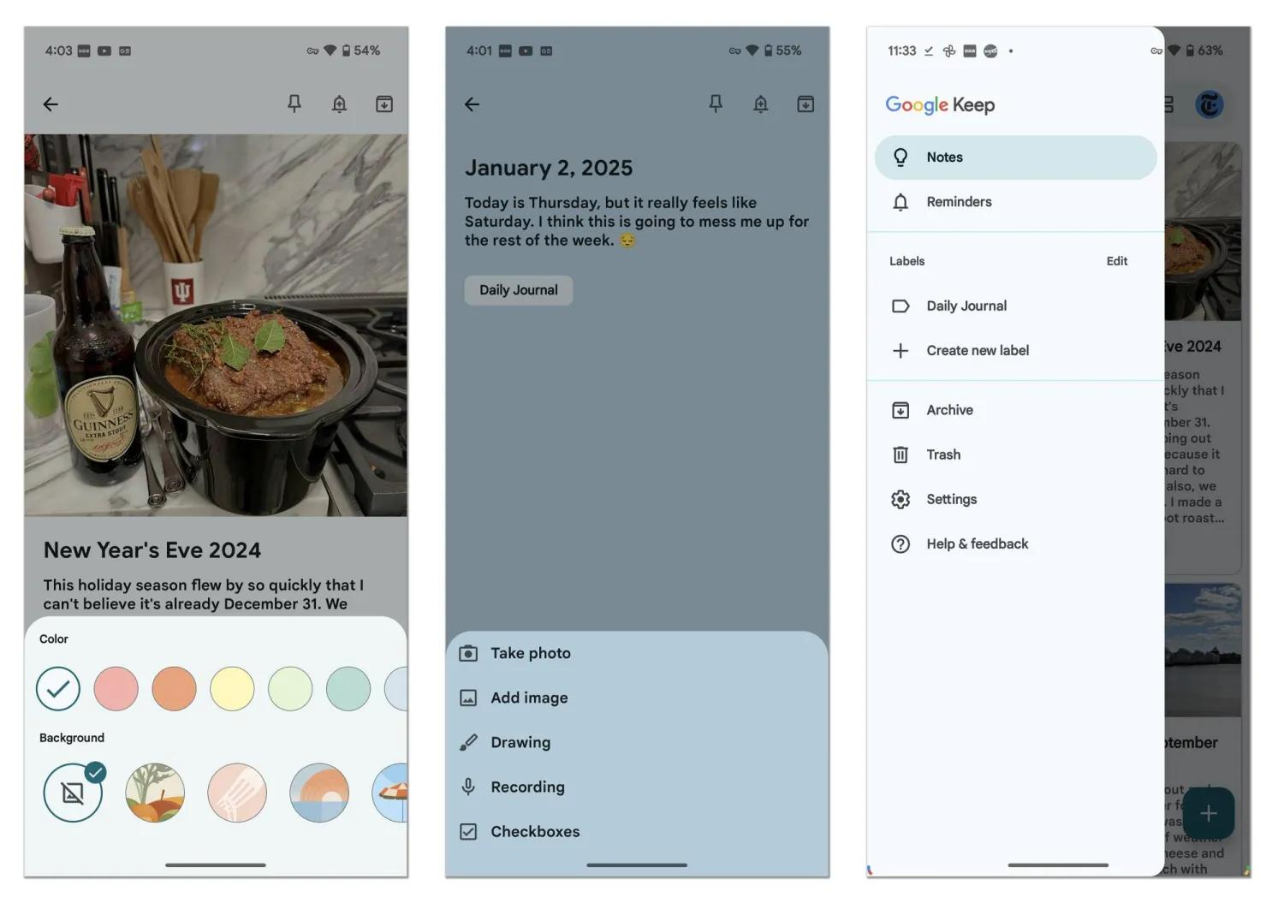
Notes:
For me, Google Keep is really helpful when I can't remember something or can't think of the word. For example, if I need something from the store but don't know what it's called, I can just take a picture and save it. Then I don't have to find the word or type it.
You could also use Google Keep as a simple journal. You can add pictures, notes, lists, or use your voice. It's free, so you can try it and see if it works for you.

Slide 10
Google Keep
Bryn Demo

Slide 11
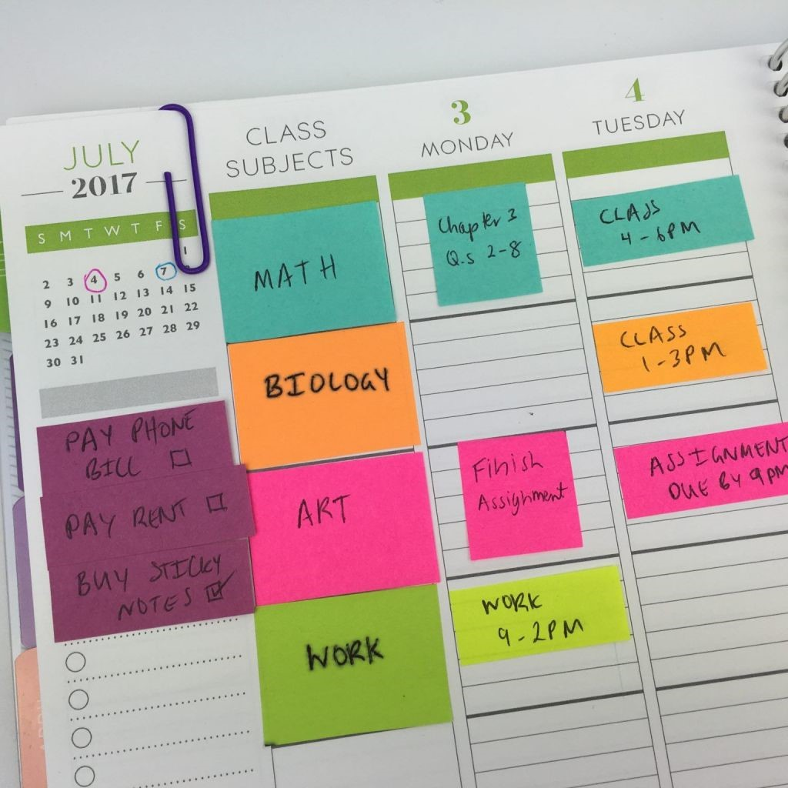
Communication Challenge
I used to be so organized and now I have trouble keeping track of appointments and tasks that I need to get done.

Slide 12
FEATURED
App/Resource/Accessibility Feature
Apps that help me remember and stay organized
📅 Calendar — Appointments & events
Doctor appointments, meetings, birthdays, therapy, etc.
You can also set an alert so your phone reminds you.
⏰ Reminders — Things I need to DO
“Take my medicine.”
“Call the doctor.”
“Put the laundry in the dryer.”
You can even use your voice instead of typing.
📝 Google Keep — Notes, lists & pictures
Grocery lists, things you don't want to forget, pictures of something you need to buy, or quick voice notes.
📔 Journal / Day One — Remembering your DAY
Pictures, memories, what you did that day, places you went, and things you want to remember later.

Slide 13
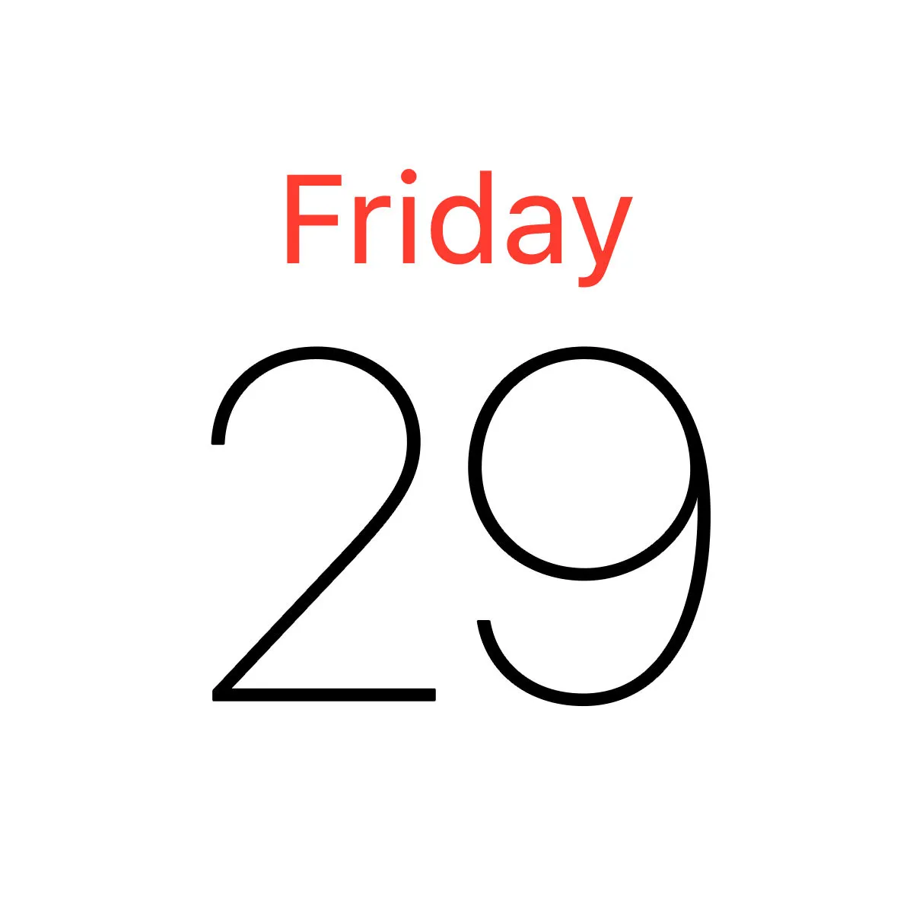
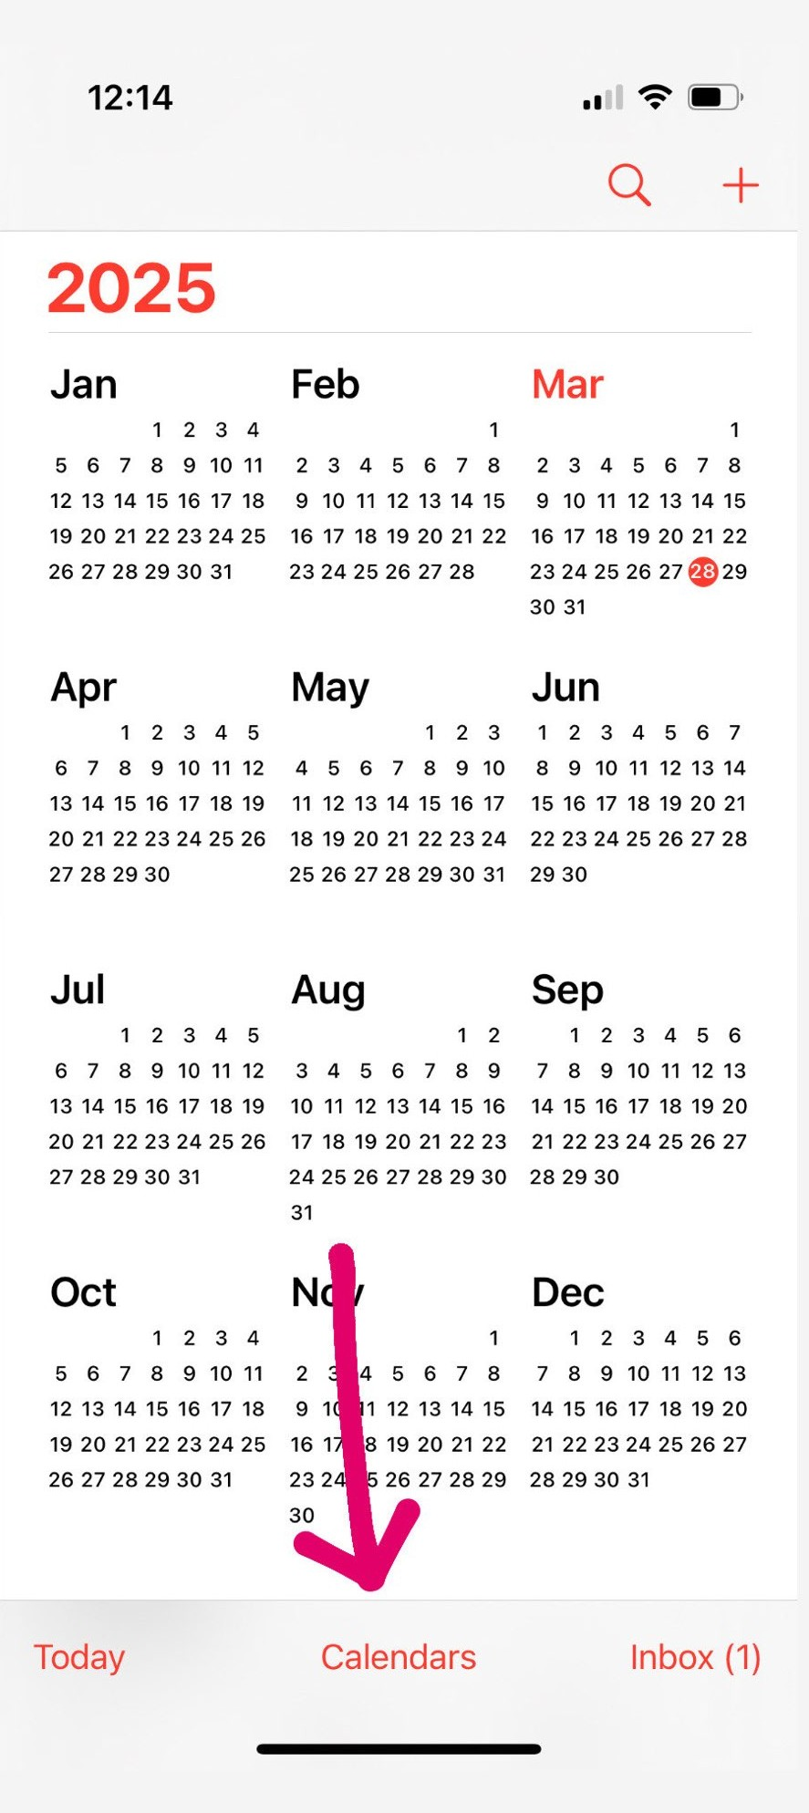
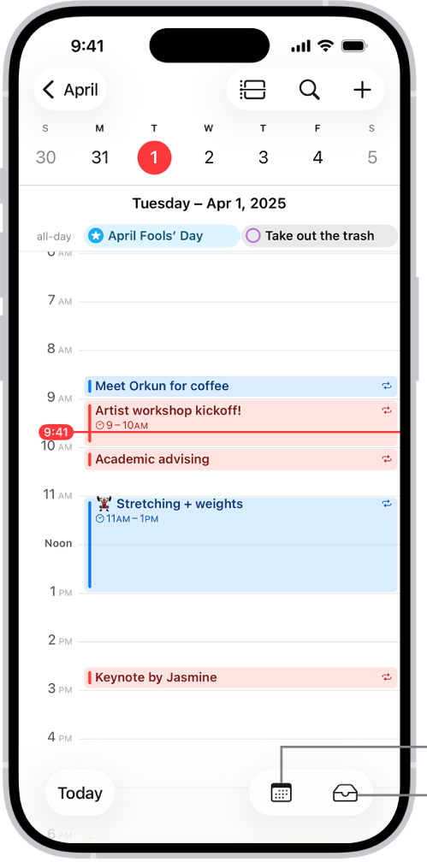
Calendar
Doctor appointments, meetings, birthdays, therapy, etc.
You can also set an alert so your phone reminds you.
Can also use your email calendar such as google calendar

Slide 14
Calendar
BRYN DEMO

Slide 15
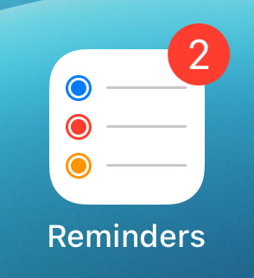
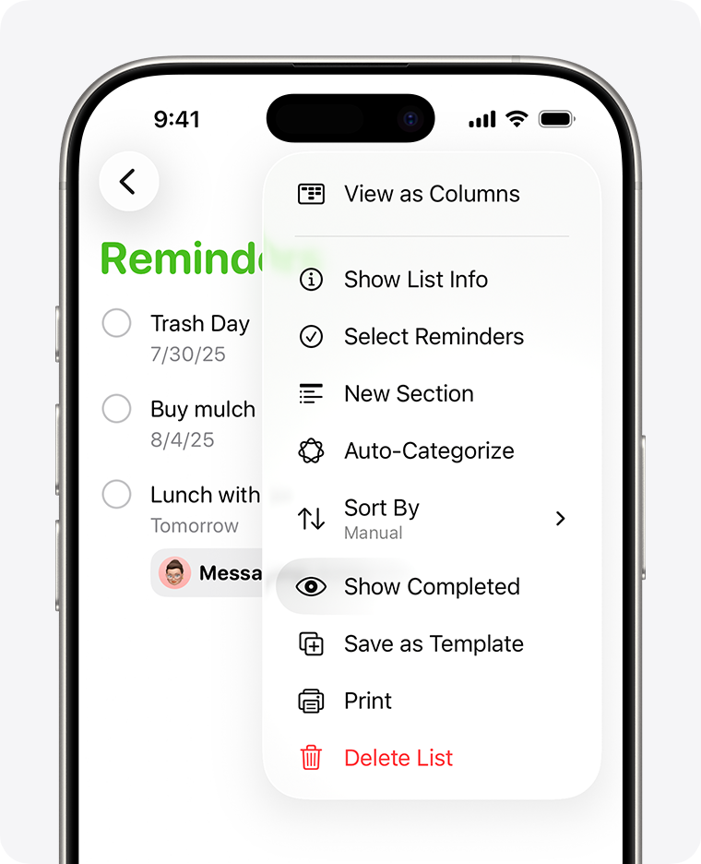
⏰ Reminders — Things I need to DO
“Take my medicine.”
“Call the doctor.”
“Put the laundry in the dryer.”
You can even use your voice /dictation instead of typing

Slide 16

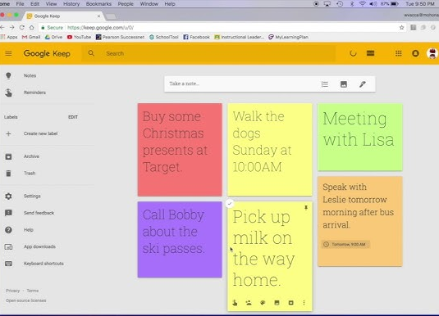
📝 Google Keep — Notes, lists & pictures
Grocery lists, things you don't want to forget, pictures of something you need to buy, or quick voice notes.

Slide 17
Google Keep
BRYN DEMO

Slide 18
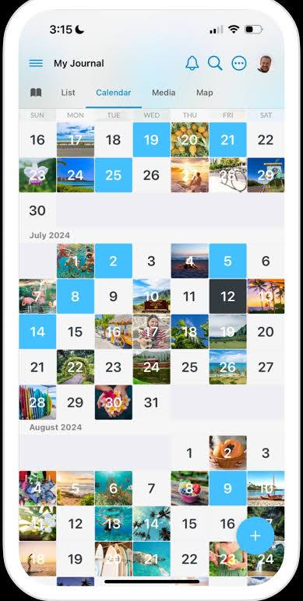
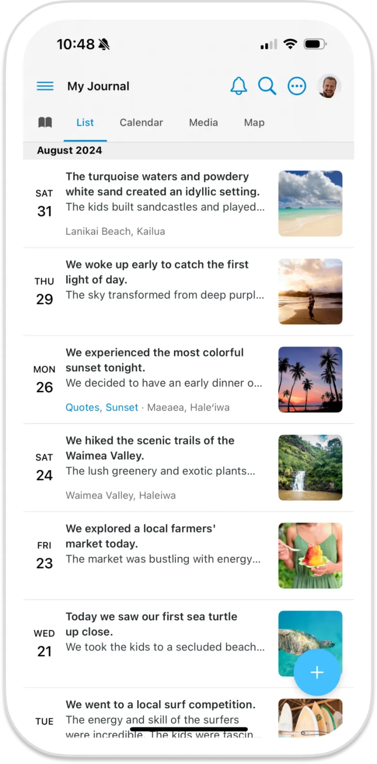
📔 Journal / Day One — Remembering your DAY
Pictures, memories, what you did that day, places you went, and things you want to remember later.

Slide 19


Communication Challenge
I used to love to read, and now I find it exhausting and frustrating. How can I still enjoy reading newspapers and books with Aphasia?

Slide 20

Text to Speech (TTS): Speechify
Rated #1 AI text to speech app
Works with mjultiple text formats (articles, web pages, pdf files, etc.)
High quality, natural sounding voices – may assist with comprehension
Variety of customizable features
Created for people who struggle with dyslexia
Limited version (free) ; Premium ($139/year)

Slide 21
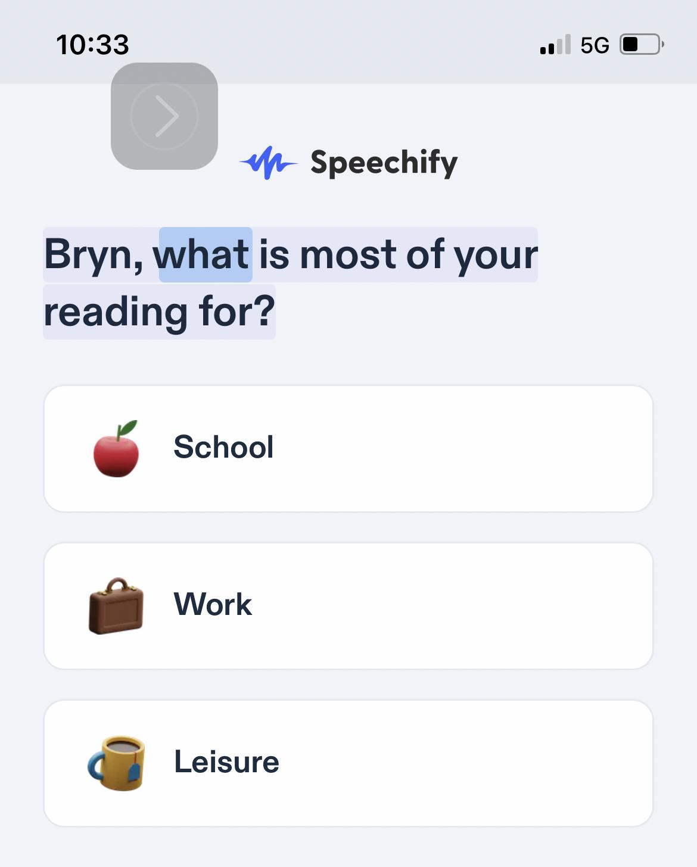
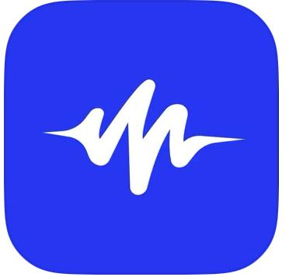
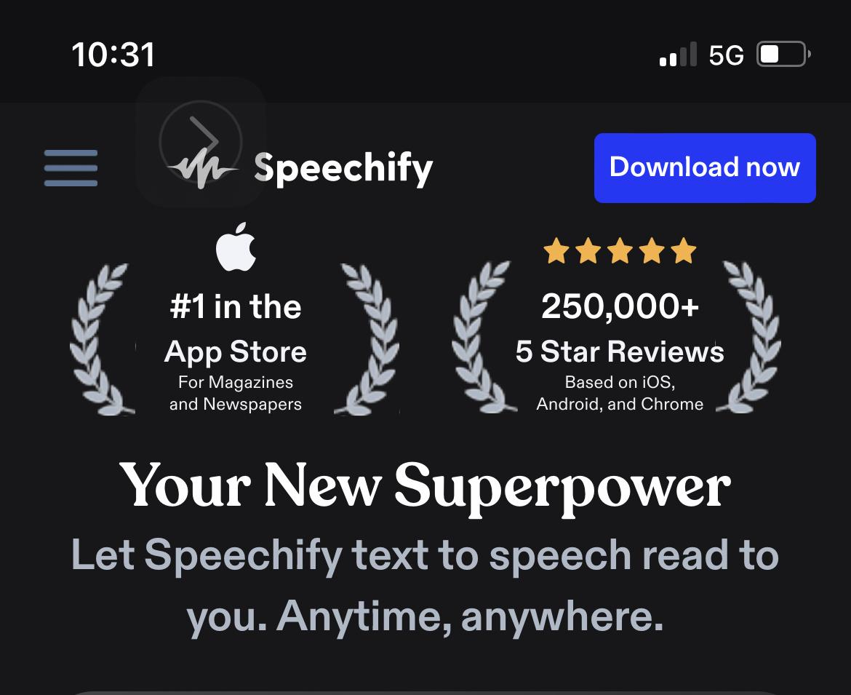
Speechify
This is a really good app for fun reading or for work, too!

Slide 22
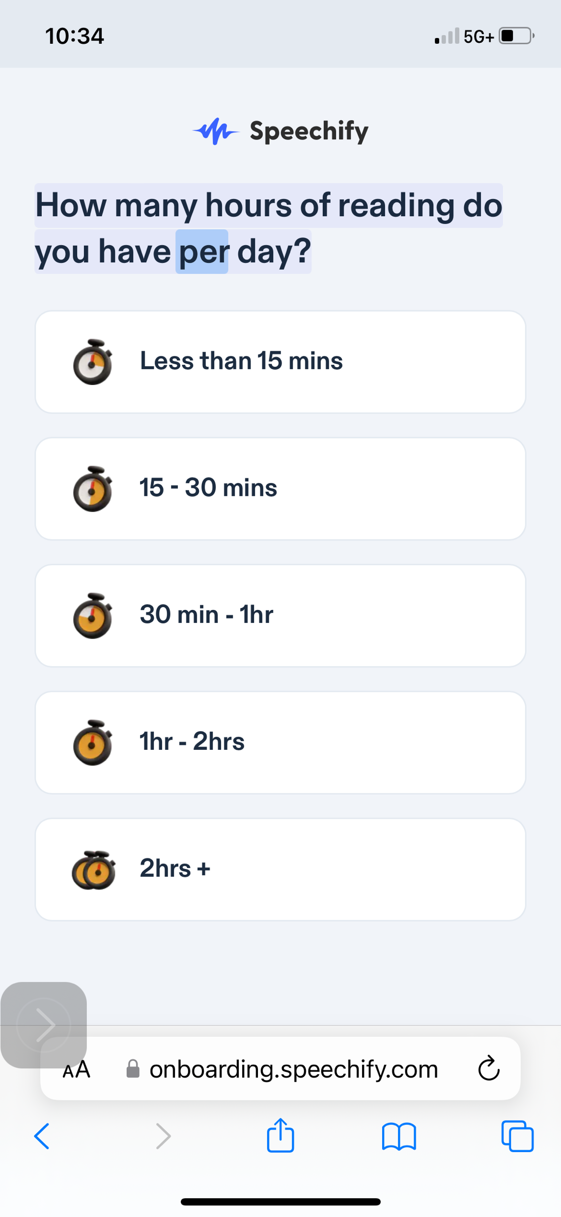
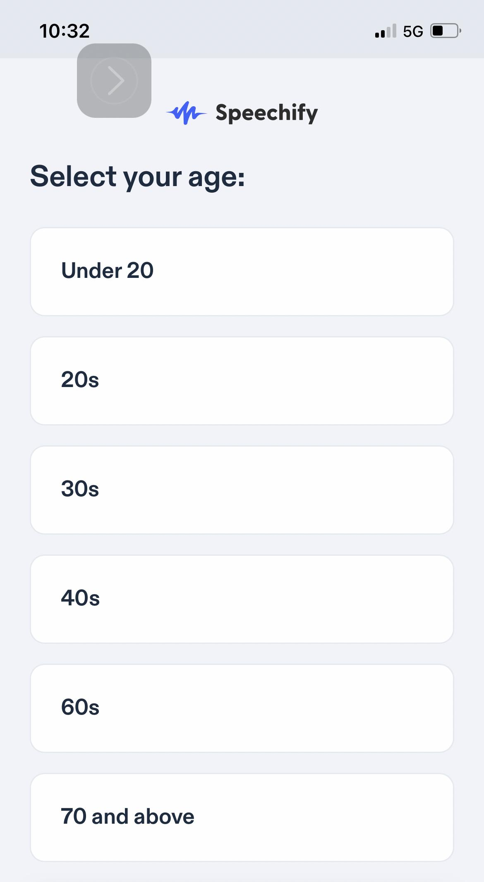
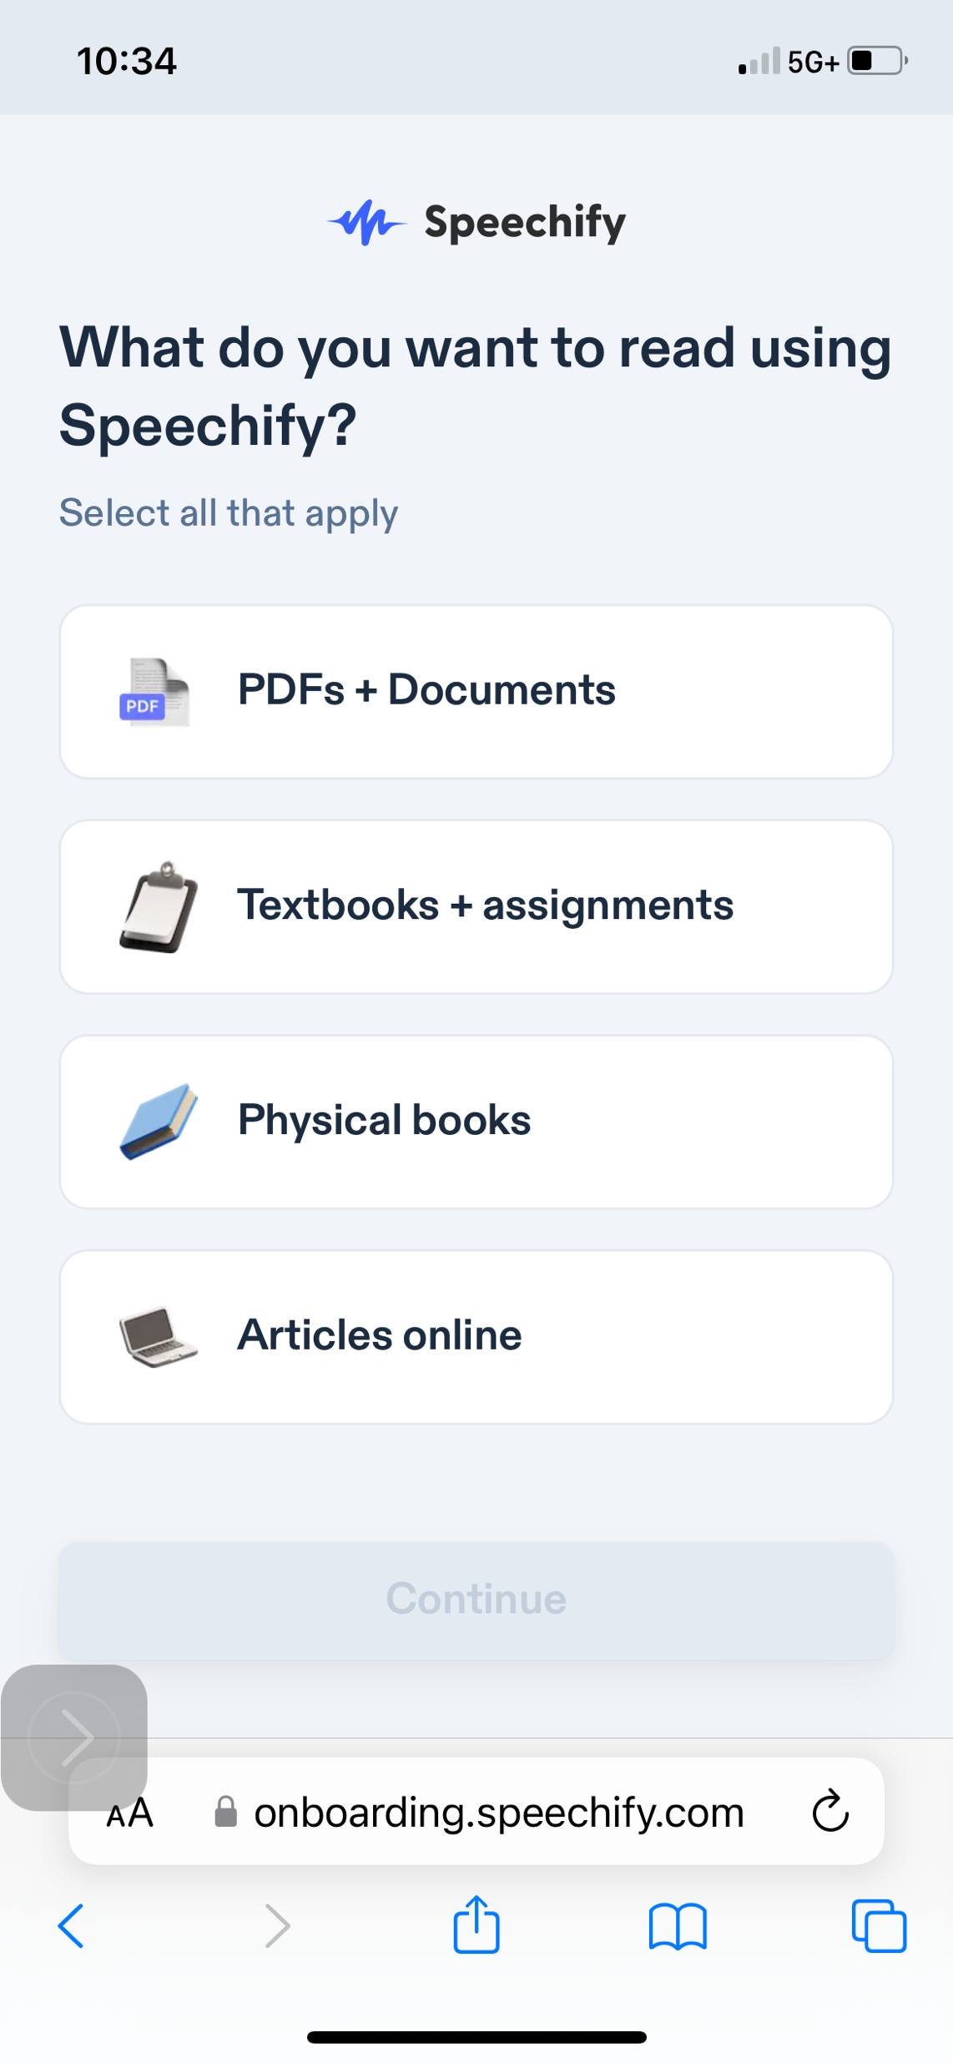
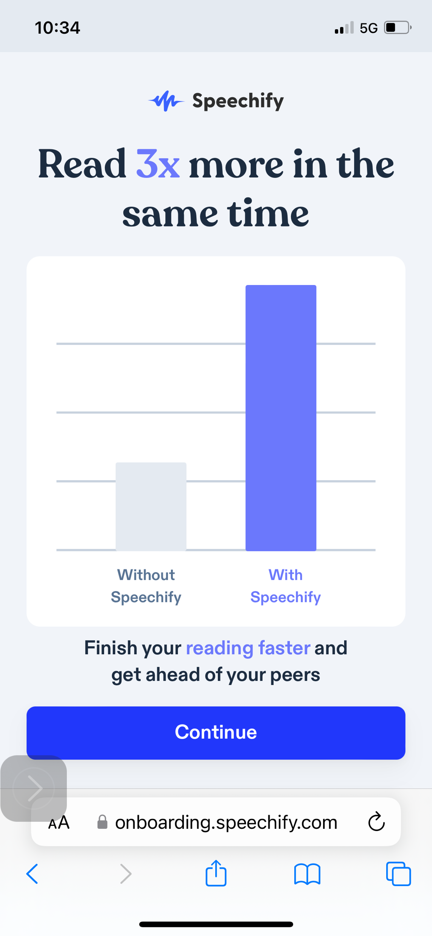

Slide 23

Iphone/Ipad/Computer: Spoken Content
Go to Settings > Accessibility > Spoken Content.
Turn on any of the following:
  Speak Selection: Select what you want spoken.
  Speak Screen: Have iPhone read everything onscreen.
  Speech Controller: Quickly access Speak Screen and Speak on Touch when Speak Screen is on.
  Highlight Content: Move a cursor over words or sentences as you listen.
  Typing Feedback: Have iPhone speak each character, entire words, autocorrections, autocapitalizations, and typing predictions.
(To hear typing predictions, you also need to go to Settings > General > Keyboard, then turn on Predictive.)
Notes:
https://support.apple.com/guide/iphone/hear-whats-on-the-screen-or-typed-iph96b214f0/ios

Slide 24
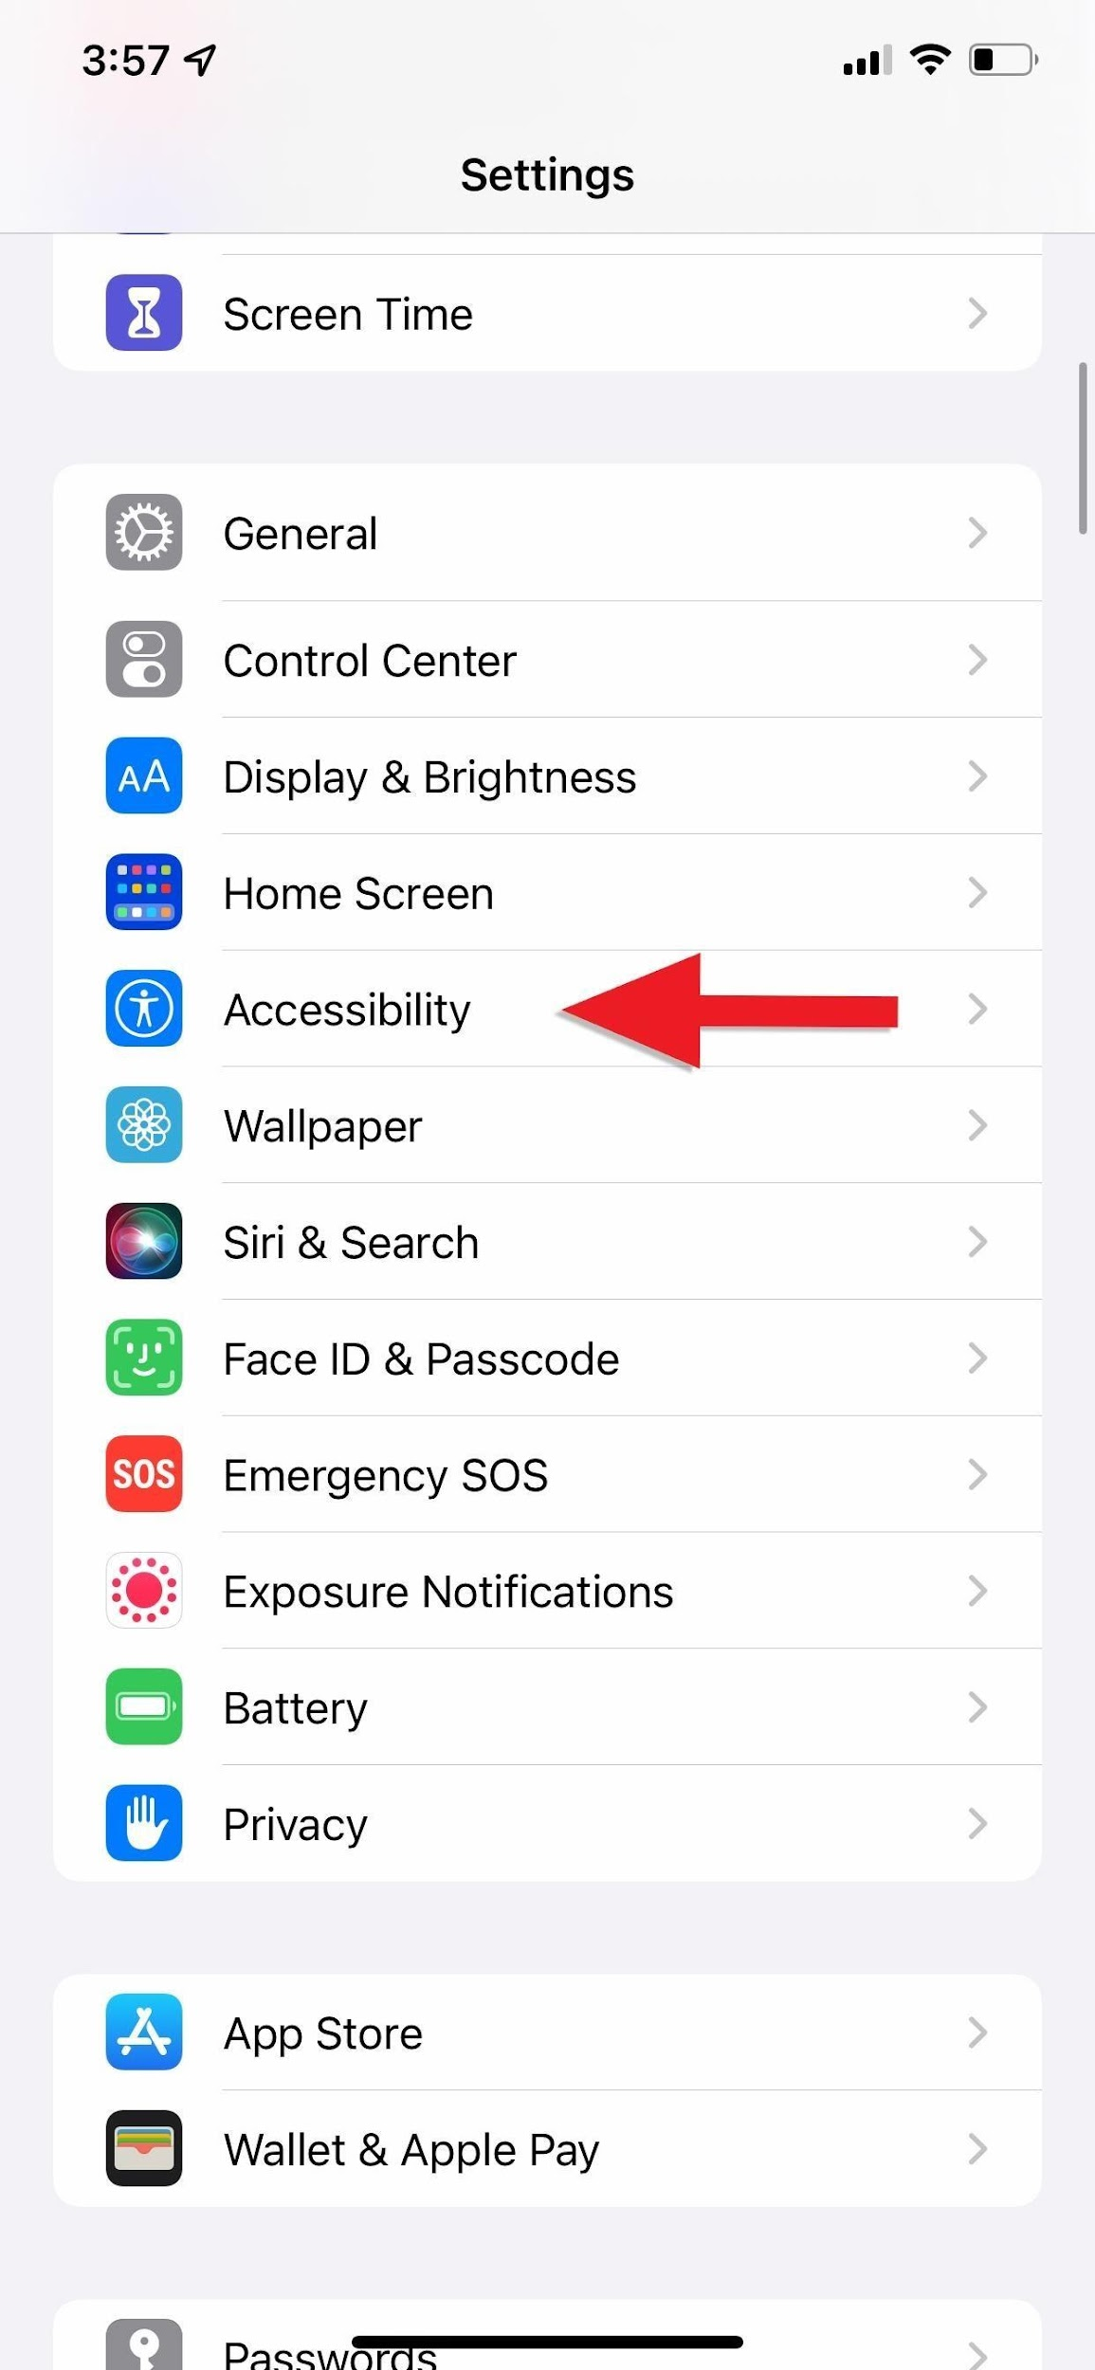
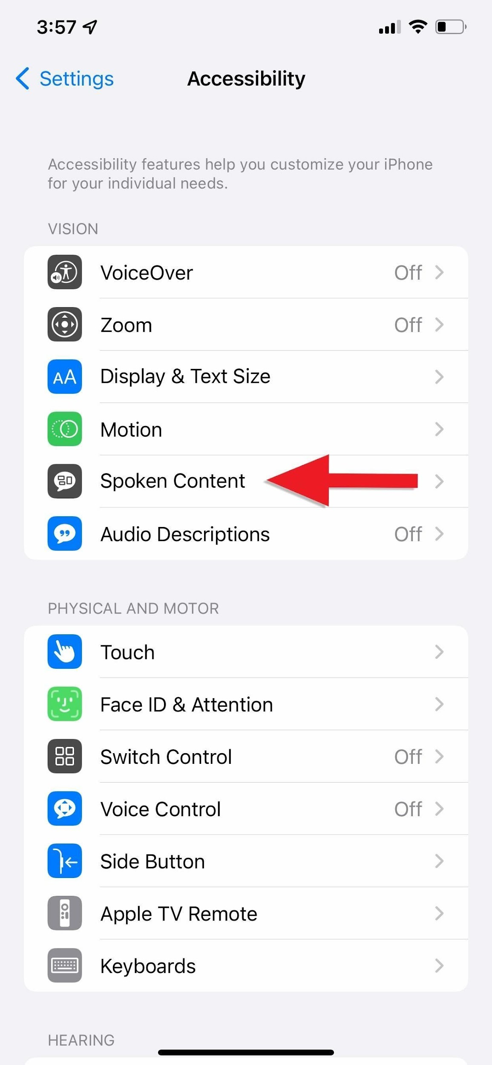
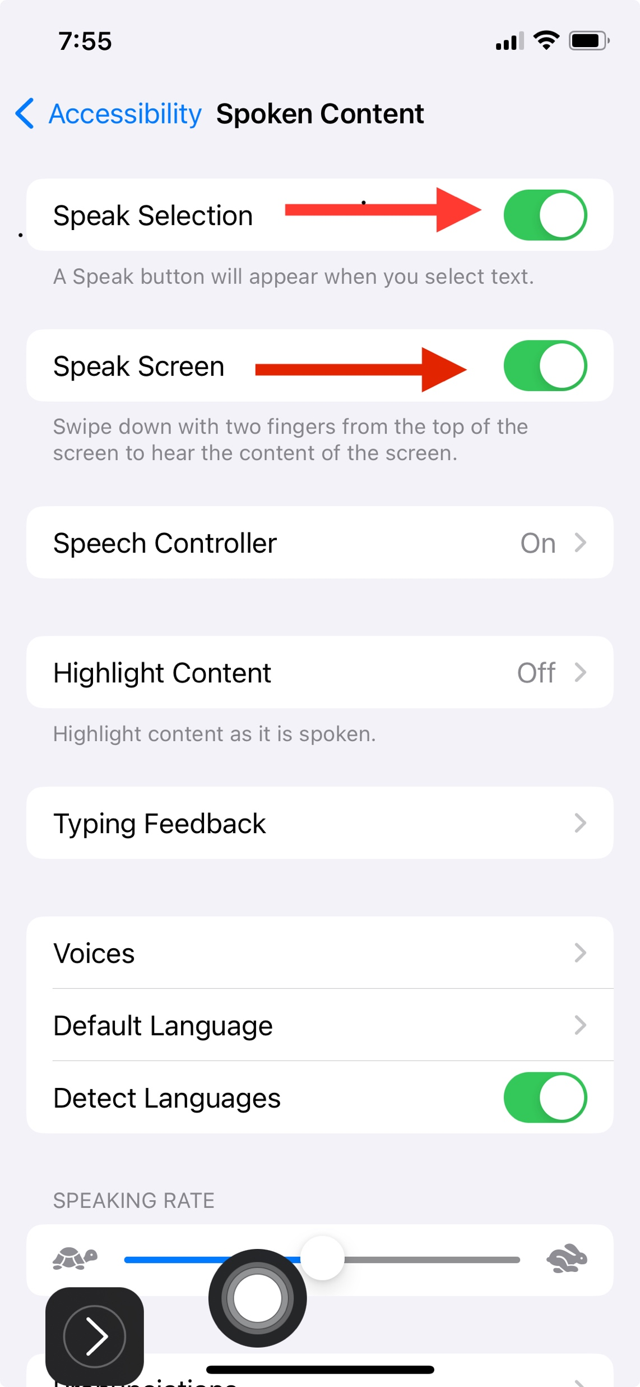

Slide 25
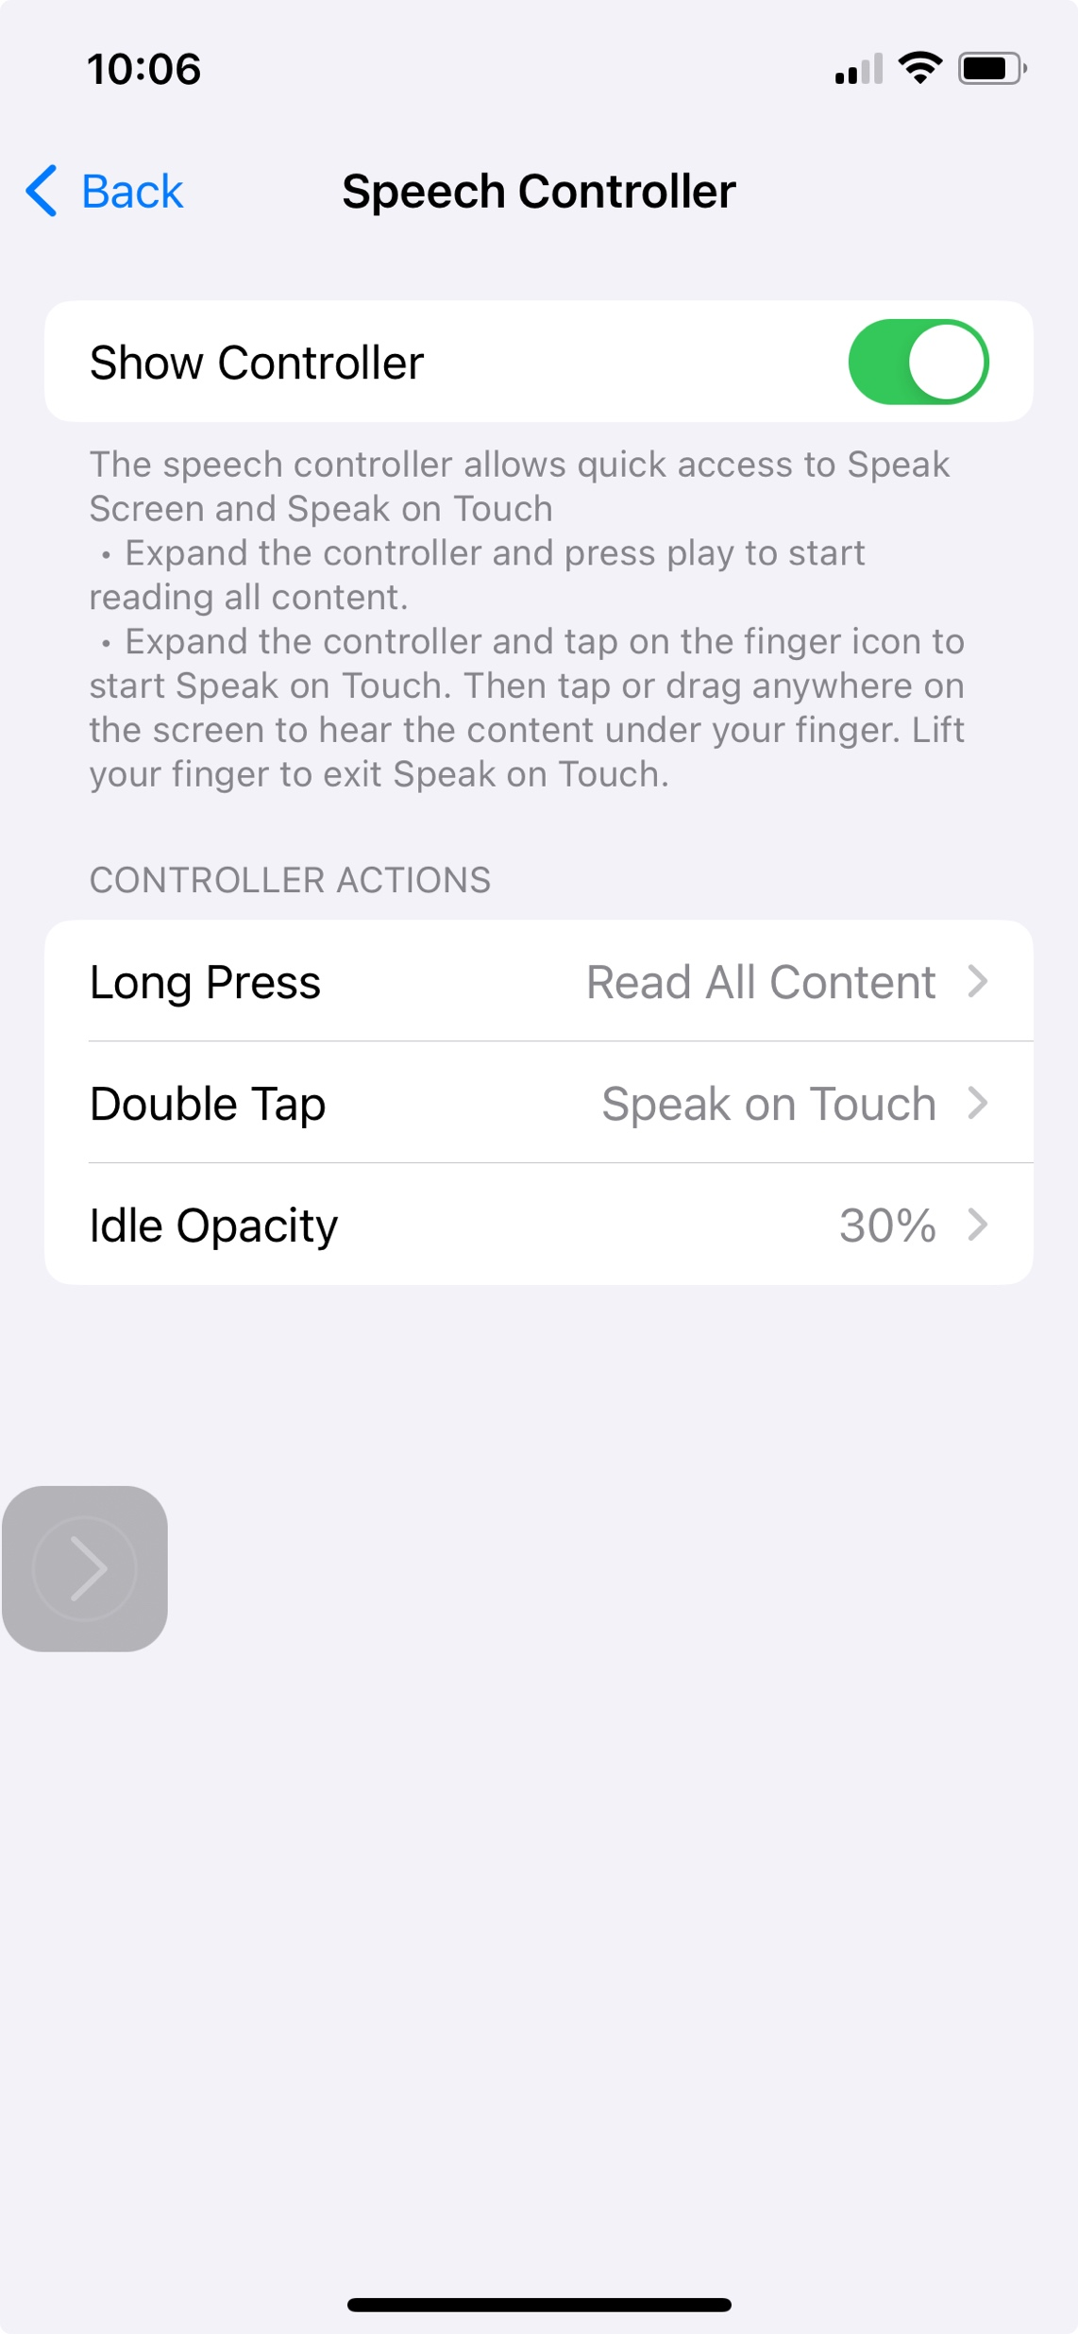
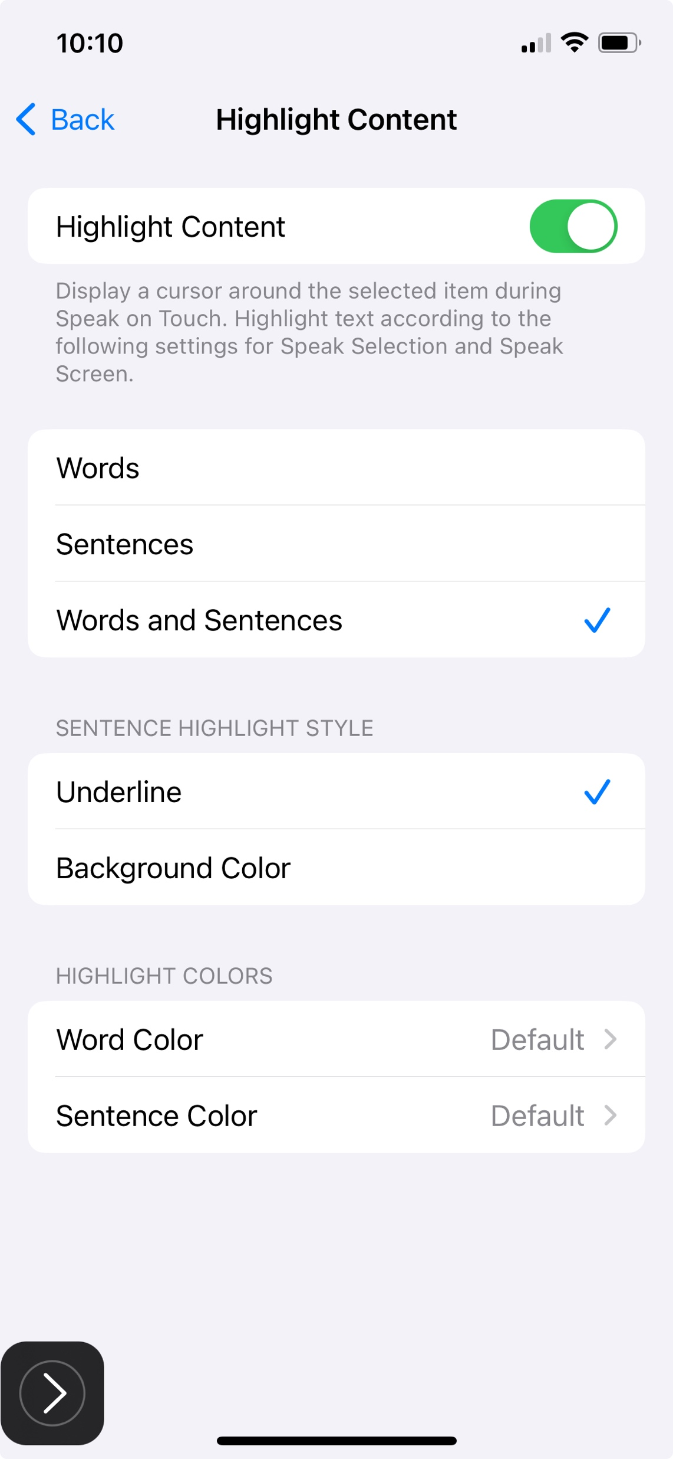

Slide 26
How to Use Google Text-to-Speech on Android
What to Know
On an Android phone, tap Settings (the Gear icon) and then tap Accessibility > Select to Speak.
Tap the Select to Speak toggle switch to turn on the feature. Select OK to confirm permissions.
Open any app, and then tap Select to Speak > Play to hear the phone read the text aloud. Tap Stop to end playback.
Notes:
https://www.lifewire.com/use-google-text-to-speech-on-android-4767200

Slide 27
Other Text-to-Speech (TTS) Apps
Amazon Polly
Notevibes
NaturalReader
What do you use?

Slide 28
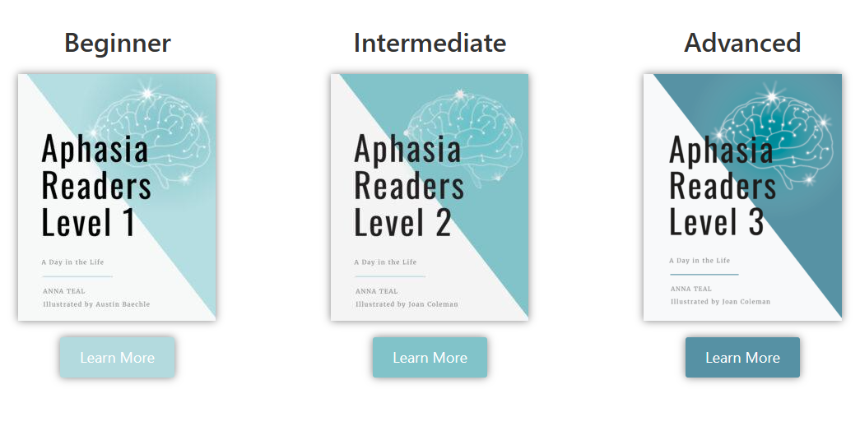
Aphasia Readers
Created by a young stroke survivor and his wife – wanted more than children’s books
  Home - Aphasia Readers
Books designed as a supplementary recovery tool
Practice reading and reading aloud to improve speech.
Each book contains multiple sessions designed to relate to a person at various stages of their recovery journey.
  Beginner, Intermediate, Advanced
A portion of proceeds goes back into supporting aphasia awareness

Slide 29
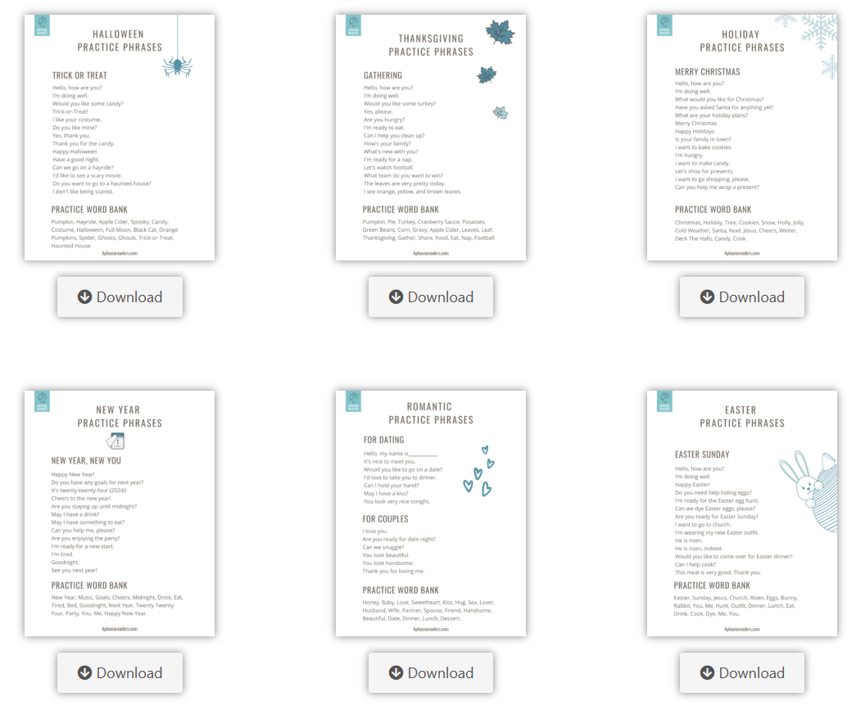
Functional Fridge Phrases
Goal: to reduce the loneliness and lack of confidence those with aphasia experience in extreme social situations
List of functional phrases to practice when she knew husband would be in these types of situations (i.e. holidays)
Improved confidence and interactions

Slide 30
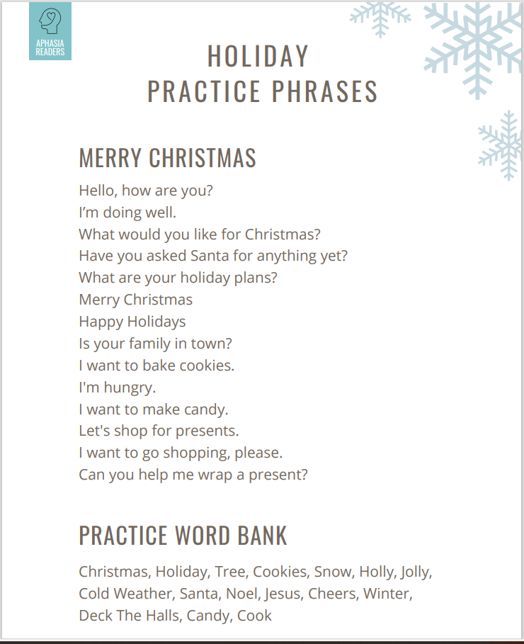

Slide 31
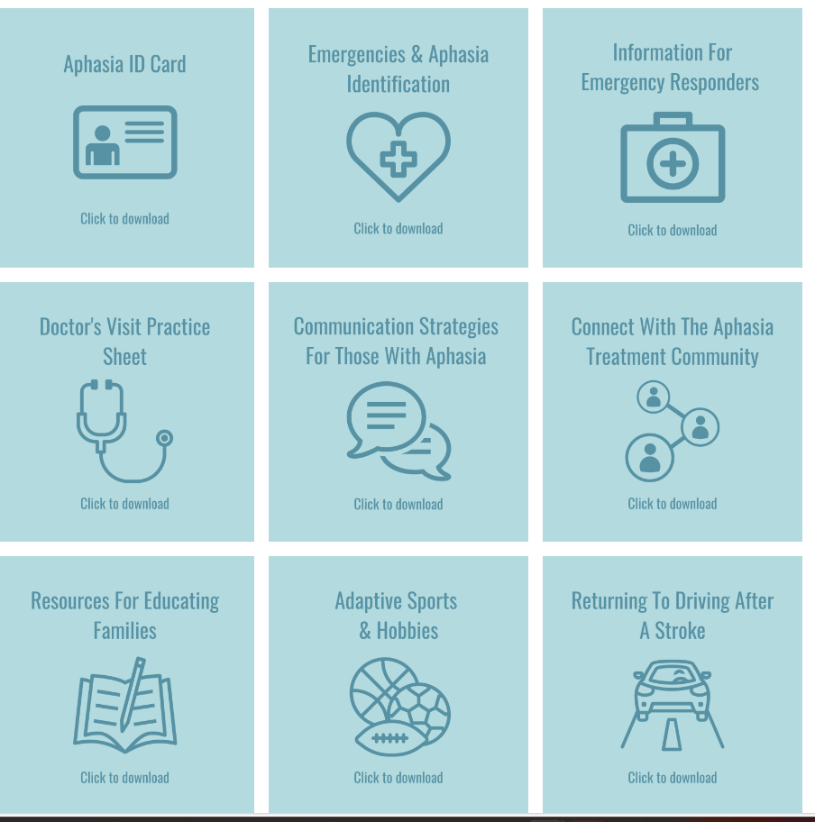
Aphasia Toolbox
Aphasia Resource Toolbox (aphasiareaders.com)
Great list of resources and materials

Slide 32
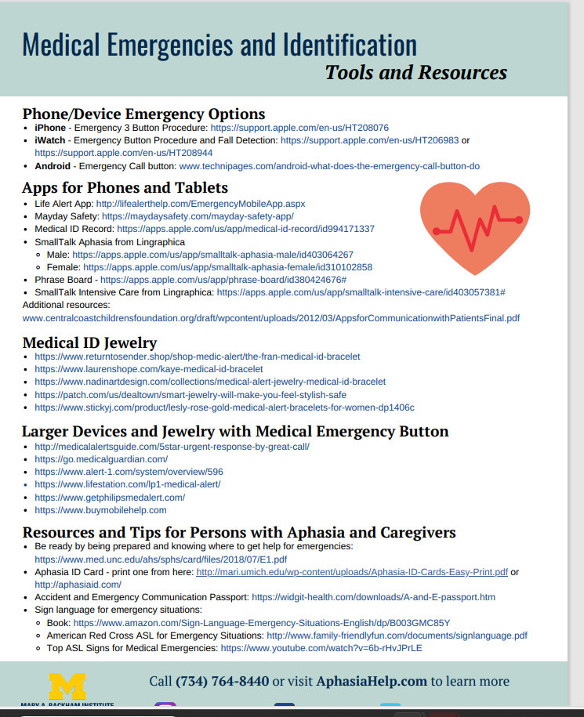

Slide 33
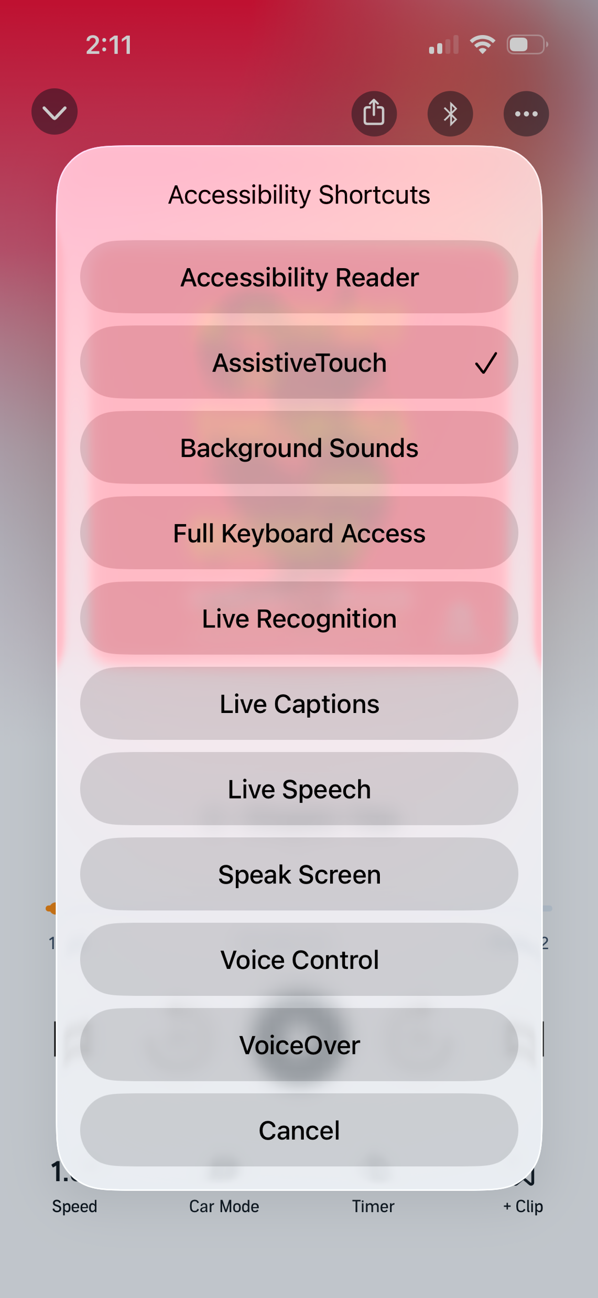

FEATURED
App/Resource/Accessibility Feature
Audio + Visual (Audible (or another audiobook app) + Live Captions

Slide 34
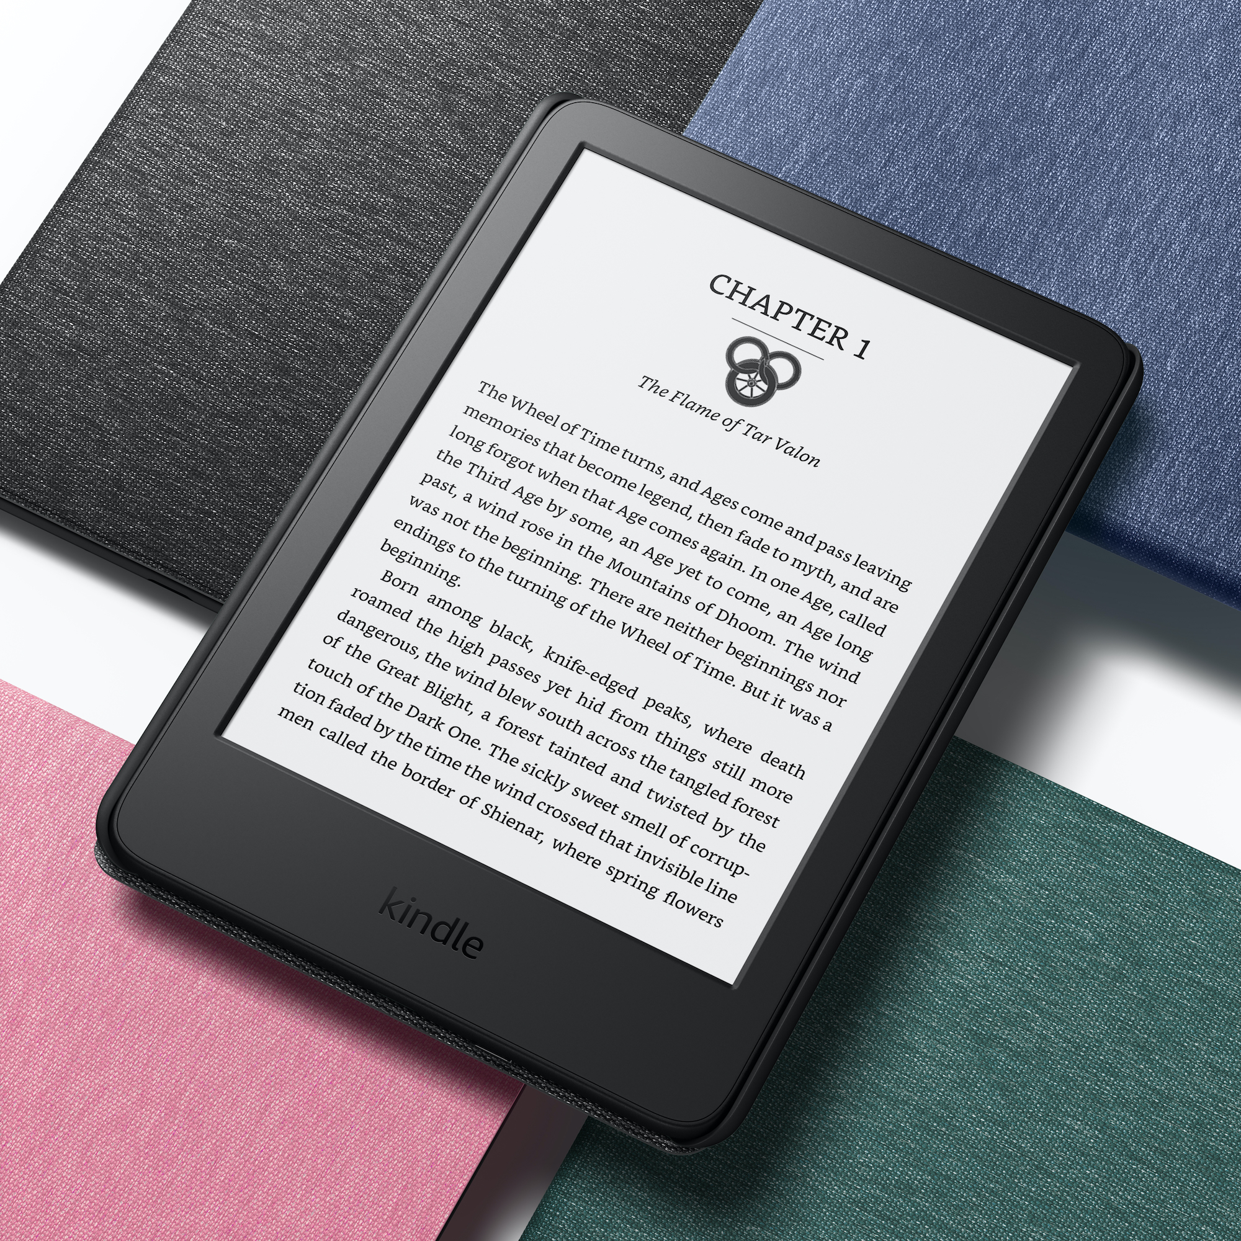
Audible + Kindle Read & Listen
Cost: About $15/month for an Audible Premium Plus membership (free trial available). Kindle eBooks are purchased separately or borrowed if available.
Features
Listen and read at the same time.
Words are highlighted as they are read aloud.
Syncs your place between reading and listening.
You can change the reading speed.

Slide 35
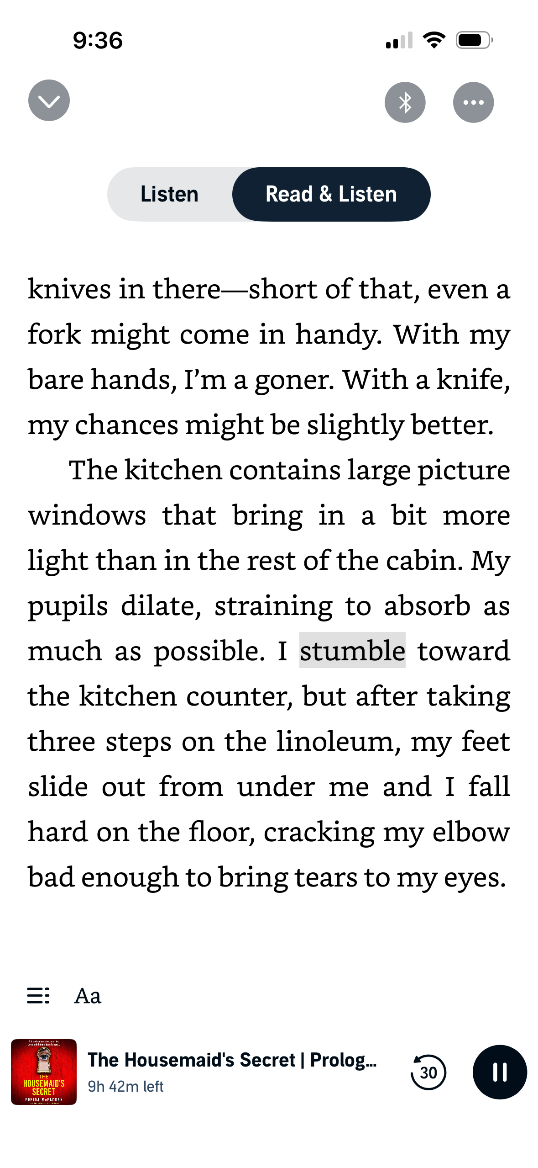
Audible + Kindle Read & Listen
What You Need
The Kindle app (free)
The Audible app
The same book in both Kindle and Audible
How It Works
Open the Kindle app.
Open a book that you also own on Audible.
Tap Play at the bottom of the screen (if available).
The audiobook starts playing.
The words are highlighted as they are read aloud.

Slide 36
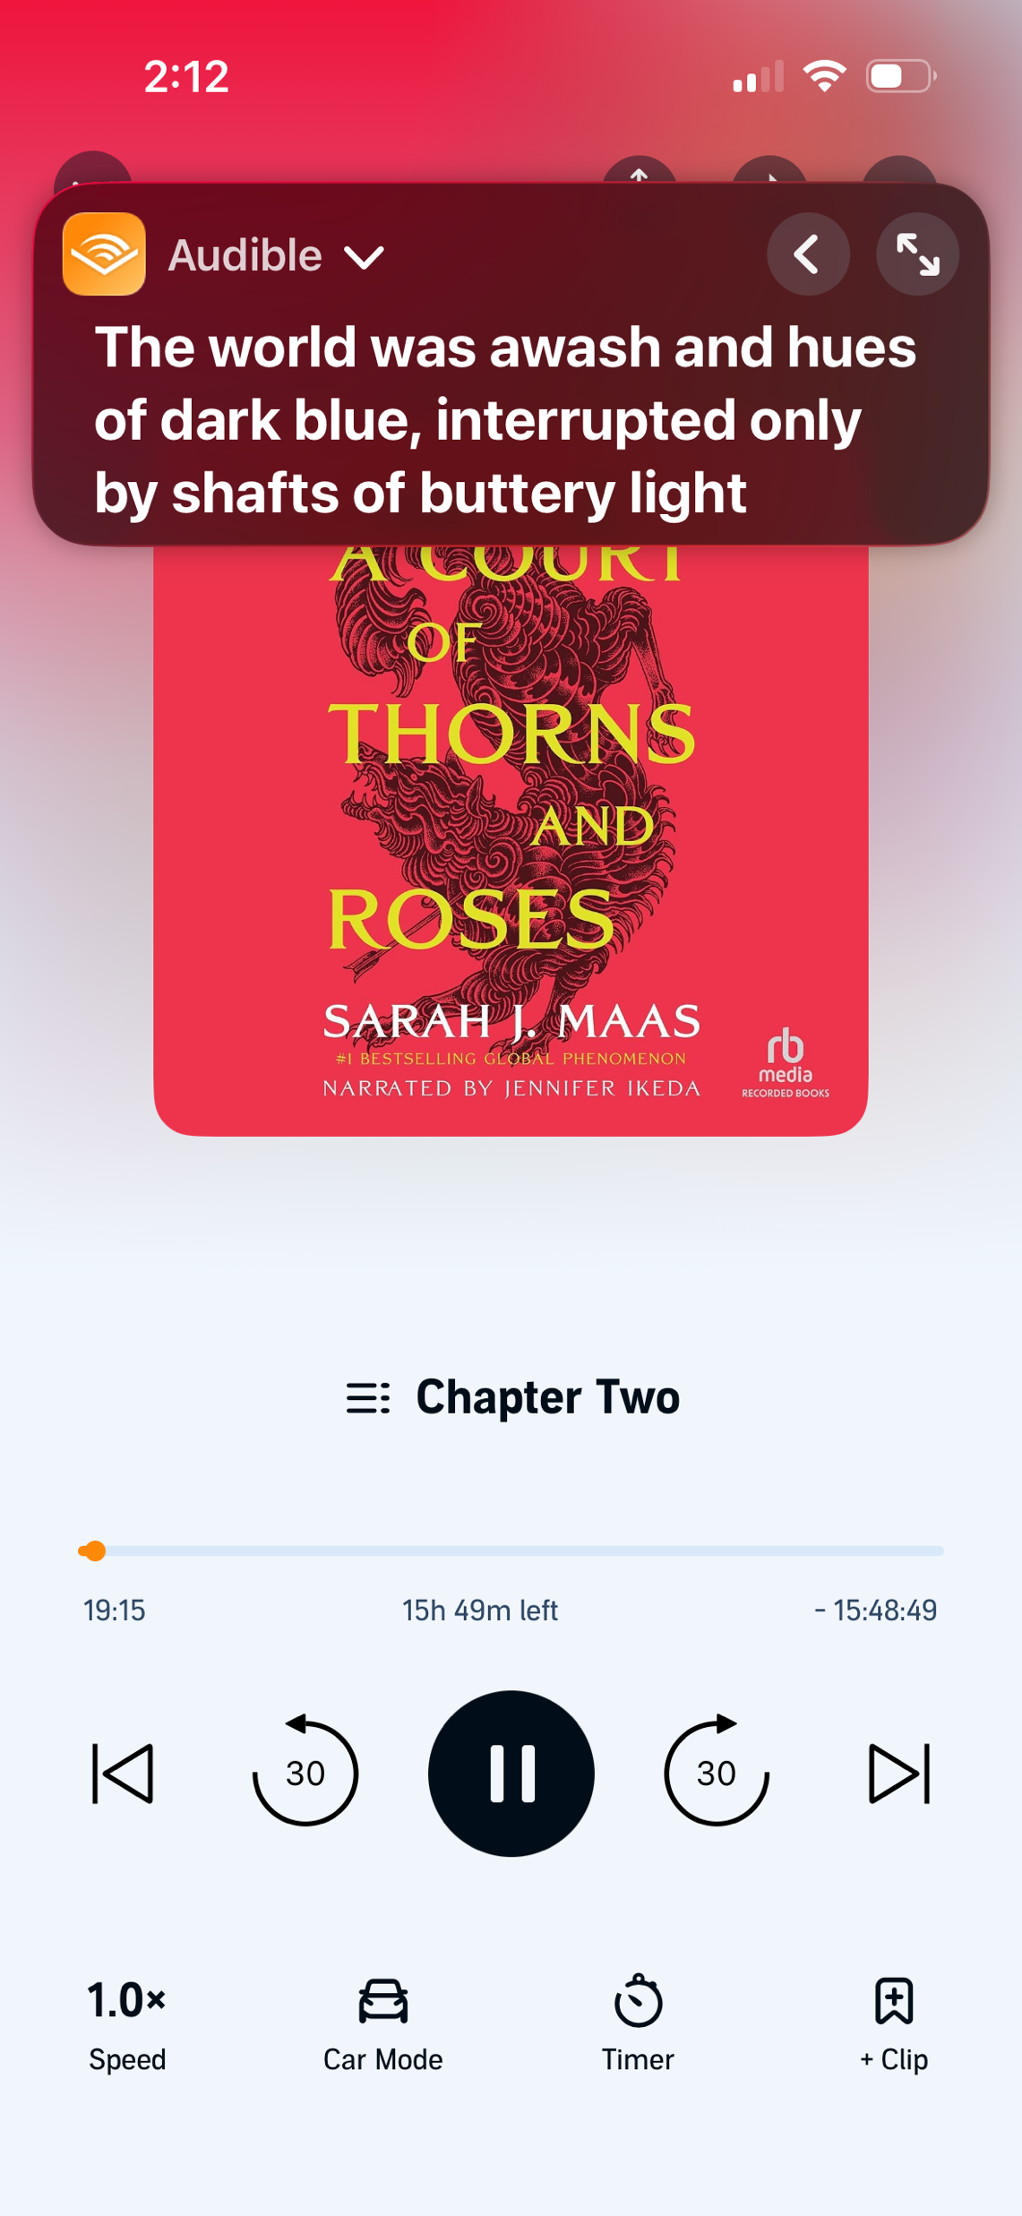
If You Don't Want to Buy Both...
This is what I do!
Open the Audible app.
Start the audiobook.
Turn on Live Captions on your iPhone.
Read the captions while you listen.
This is a less expensive option because you only need the audiobook.

Slide 37
Notes:
I really like this a lot because it actually will read every word so it’s good for reading out loud and listening at the same time but I can’t get a little bit expensive not always but sometimes so I just like to do live captions instead.
Open Audible.
Start playing the book.
Look above the book cover for a toggle that says "Whispersync for Voice" or "Read & Listen."
If you see it, tap it. The text should appear, and the words will highlight as they're spoken.

Slide 38

Libby
Cost: FREE! All you need is a library card.
Features
Borrow eBooks and audiobooks.
Read or listen on your phone or tablet.
Adjust text size.
Place holds on popular books.
Return books automatically—no late fees.
Notes:
https://help.libbyapp.com/en-us/6144.htm?utm_source=chatgpt.com

Slide 39
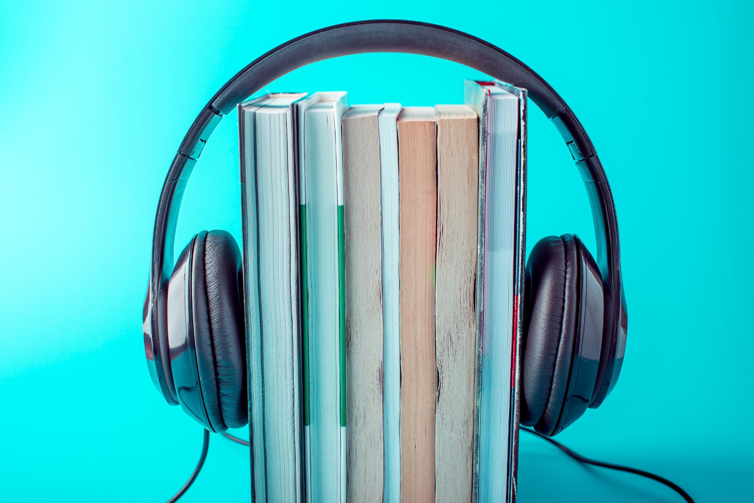
Audio books
Audible.com (Amazon)-Love it but I wish I had subtitles and audio at the same time
  Try for FREE
  $14.95/month
  LISTEN to books and podcasts
  Create your own library

Slide 40

FREE Audio books: LIBRARY
Borrow Audiobooks for FREE (virtual library card)
Libby – you can borrow ebooks and audiobooks; borrow through website, download from iOS, Android, Windows, or Kindle Fre and listen from any device
Libby - Welcome (libbyapp.com)

Slide 41
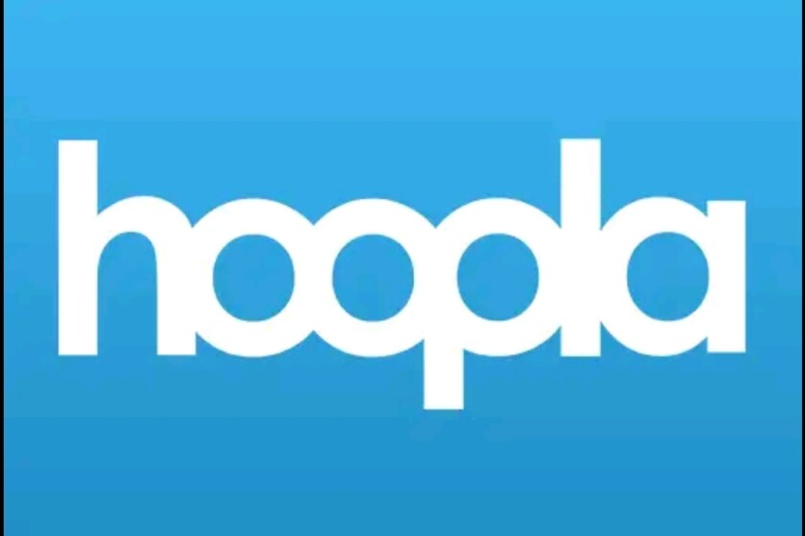
FREE Audio books: LIBRARY
Borrow Audiobooks for FREE (virtual library card)
Hoopla - borrow ebooks, movies, TV shows, comics, audiobooks, and music
  Supports iOS, Android and Chroms OS, Amazon tablets
  Borrow and download content
hoopla | streaming audiobooks, music, video & ebooks (hoopladigital.com)

Slide 42

FREE Audio books: LIBRARY
Borrow Audiobooks for FREE (virtual library card)
SimplyE – borrow audiobooks from supported libraries
iOS or Android app and choose a library (enter library’s user ID or barcode)
SimplyE | The New York Public Library (nypl.org)

Slide 43

NEXT TIME:
WEDNESDAY, October 7th at 4:00pm EST
What else do you want to learn?

