Slide 1
NAA Technology and Supports for Aphasia
Brooke Lang, M.A., CCC-SLP and Bryn Lander

Slide 2
New Format
Learn a phone accessibility feature, app, resource, etc.
See how it works
Practice a real-life situation
Examples: • phone calls • doctor appointments • ordering food • talking with family

Slide 3

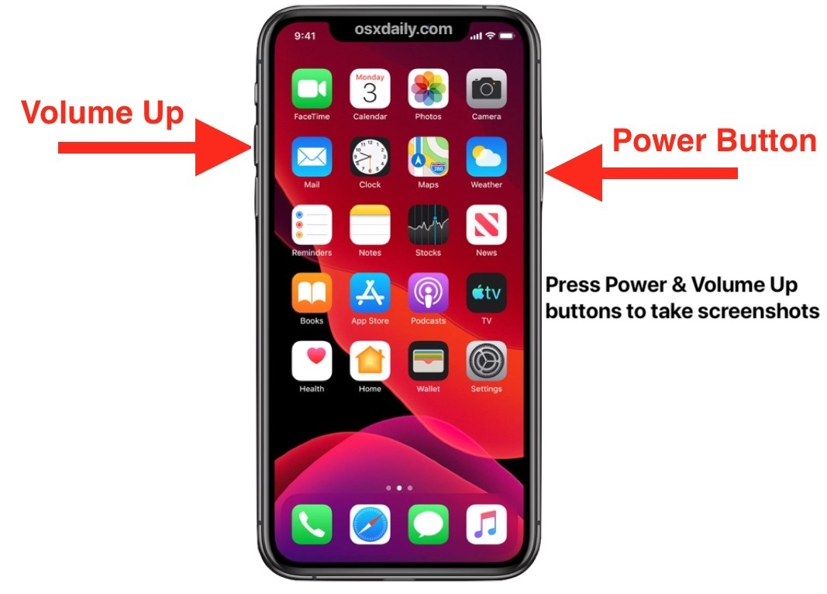
FEATURED App/Resource/Accessibility Feature
Notes app
Using screenshots for support

Slide 4
FEATURED App/Resource/Accessibility Feature

Slide 5
Communication Challenge or Breakdown Example 1
Ordering at a Restaurant
Sometimes it is hard to:
• say your order • understand the choices • respond quickly
Technology can help to PREPARE and help IN THE MOMENT.

Slide 6

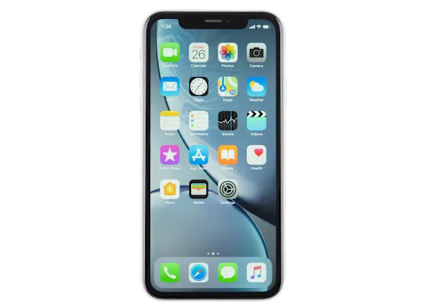
Ordering at a Restaurant
Phone Strategies That Help
Easier reading
Less pressure
Easier speaking

Slide 7
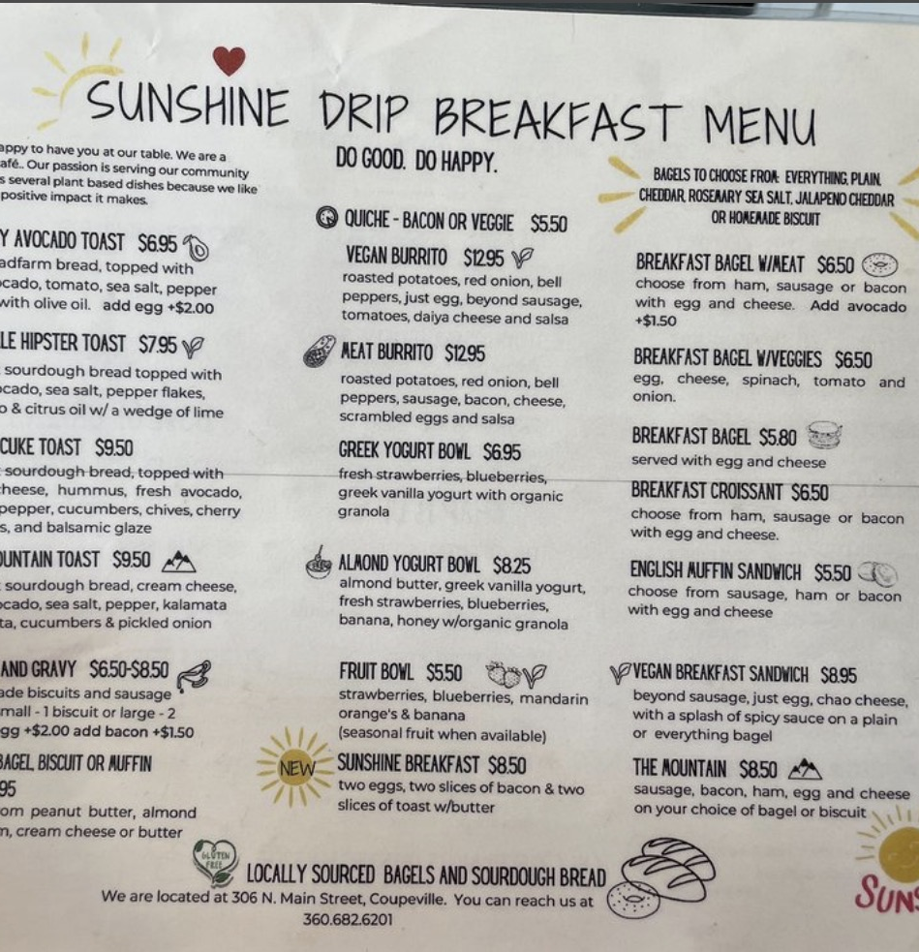
WHY THIS IS HARD
Why ordering can be hard
Menus can be long
Small print is hard to read
People talk fast
It feels rushed
It can be hard to say what you want
My phone helps me get ready.

Slide 8
BIG IDEA: What helps me most
Ways to prepare BEFORE I order:
Look at the menu early
Save my order
Screenshot the item
Show my phone if needed

Slide 9
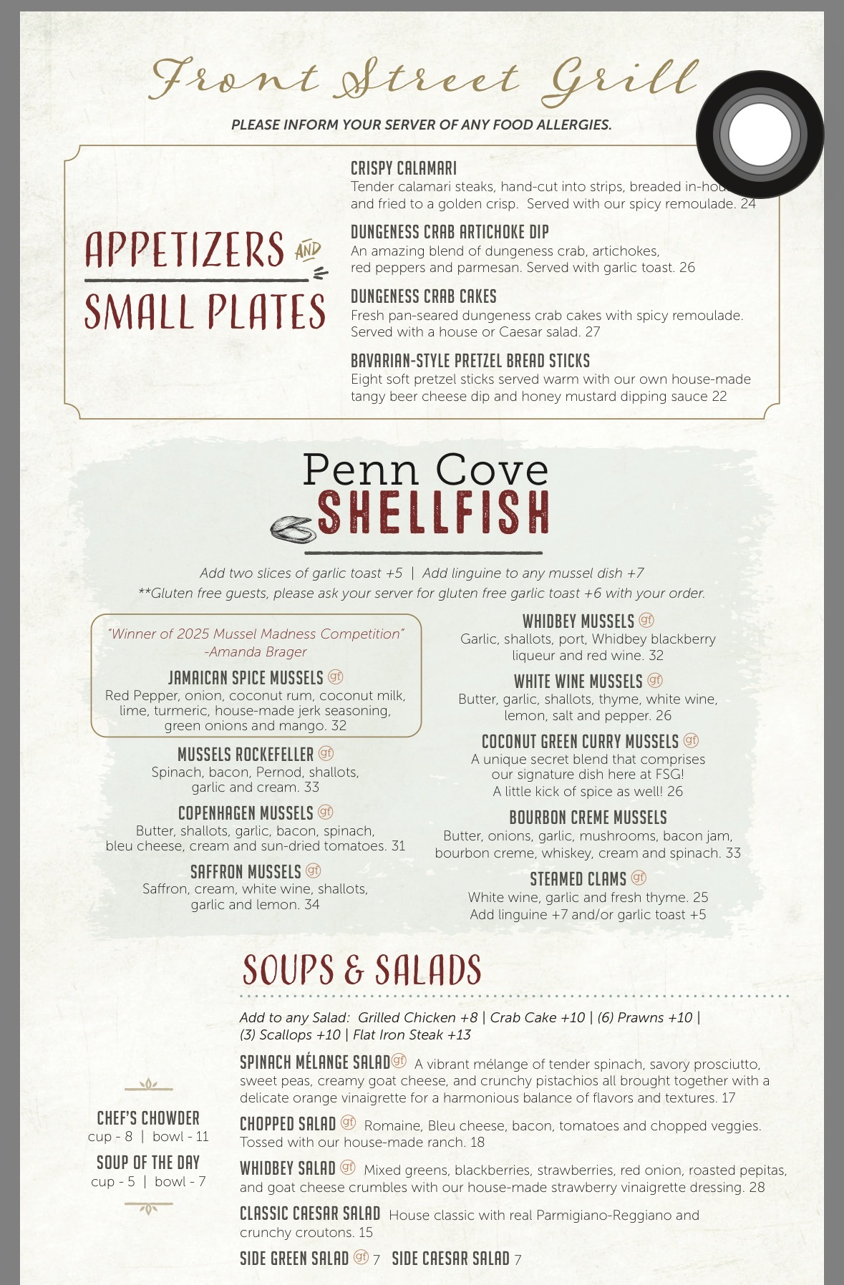
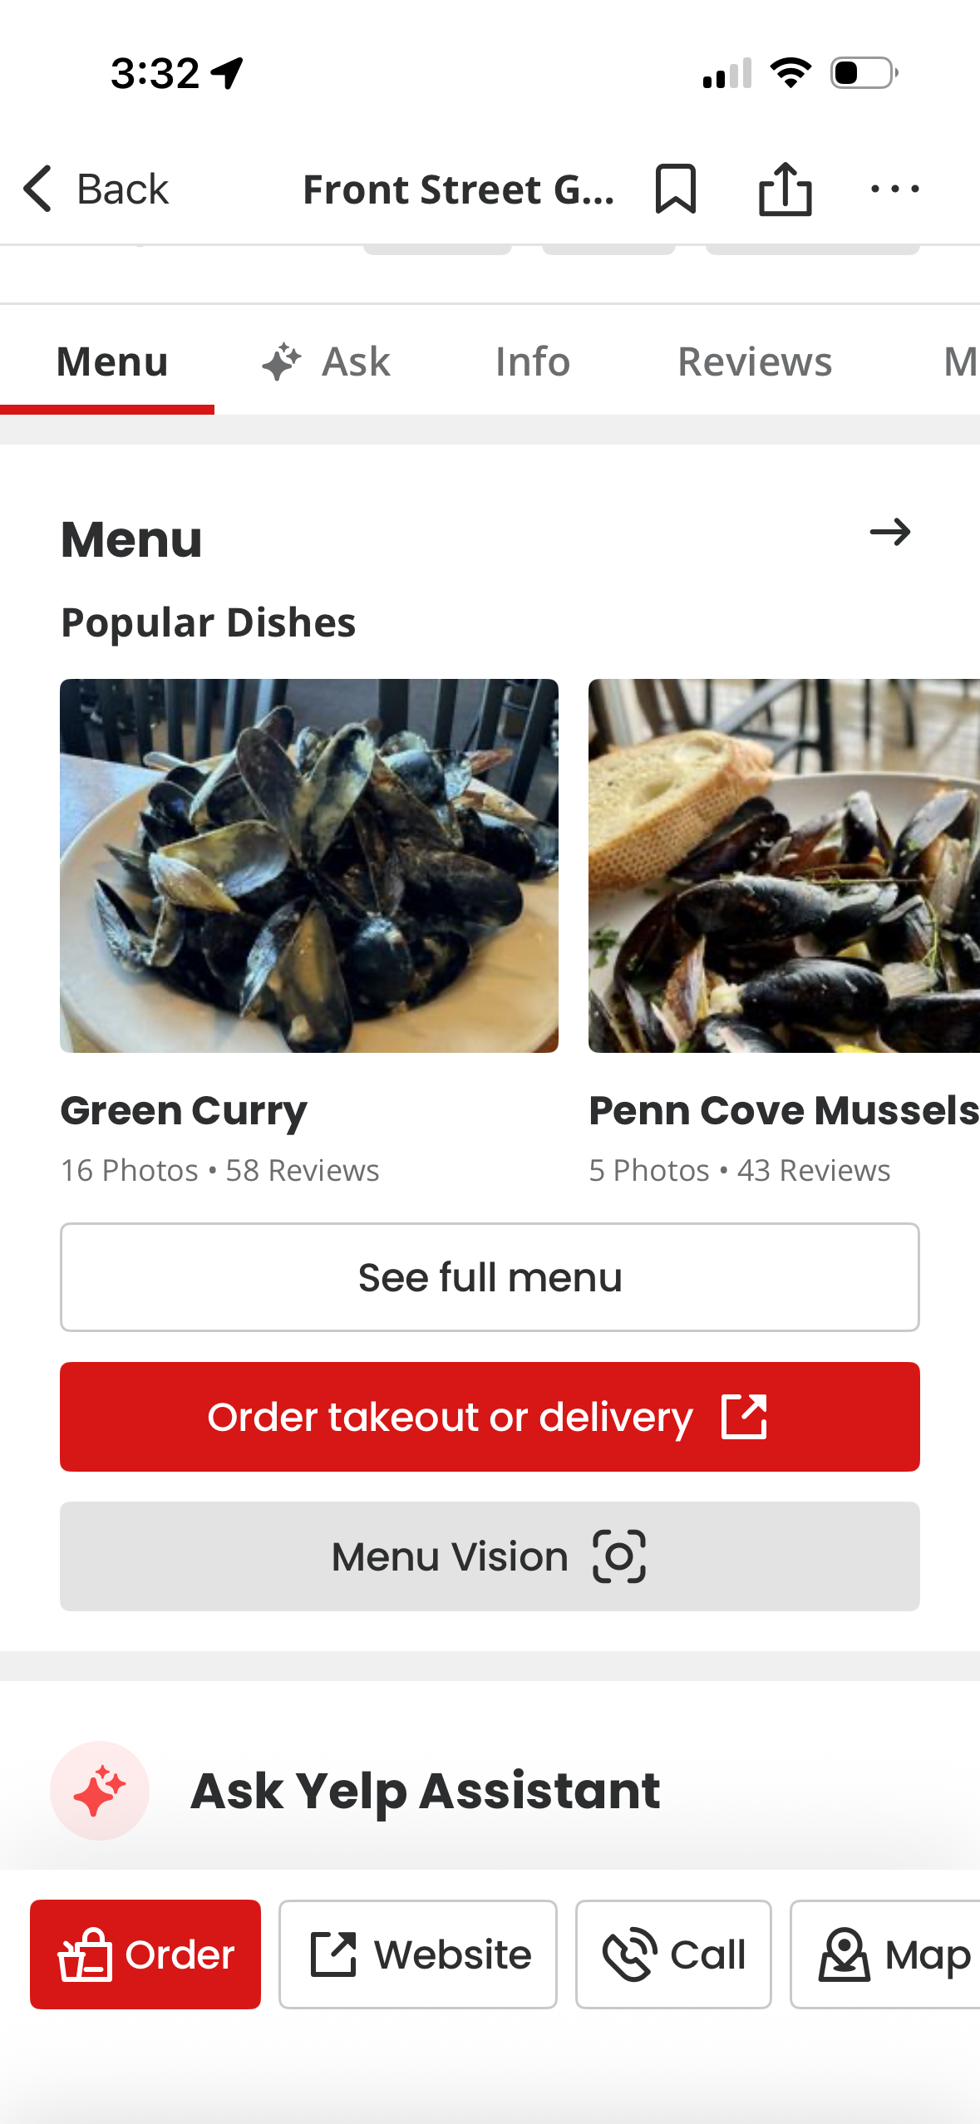
STRATEGY 1: Look at the menu before you go
Strategy 1:
Use Yelp, Google, or website
Look at menu early
Pick 1–2 choices
Less pressure later.

Slide 10
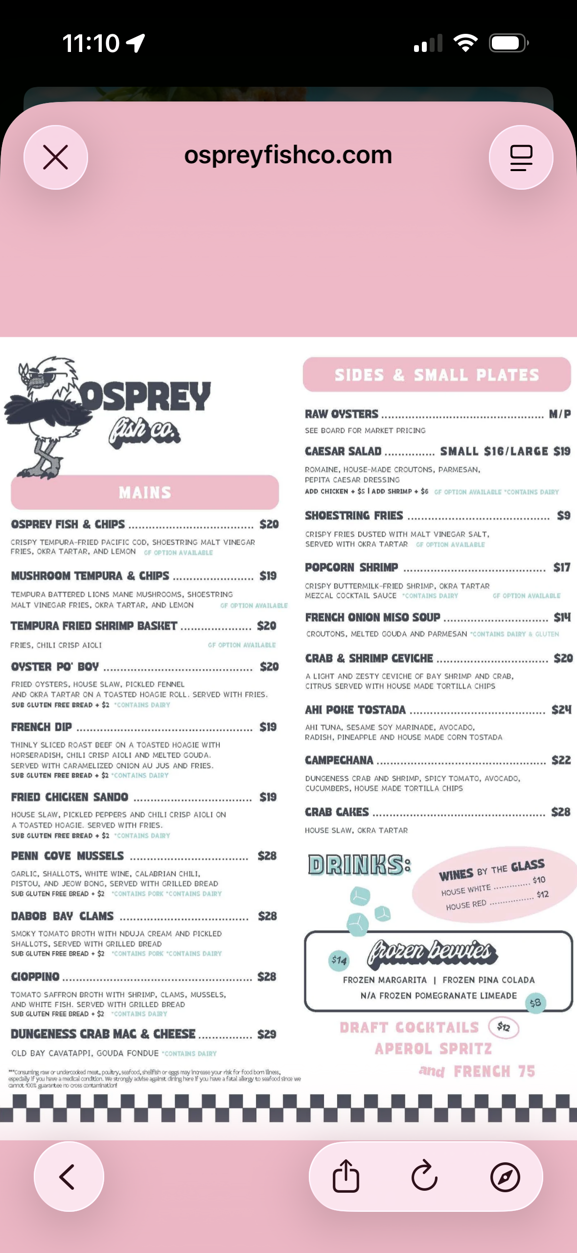
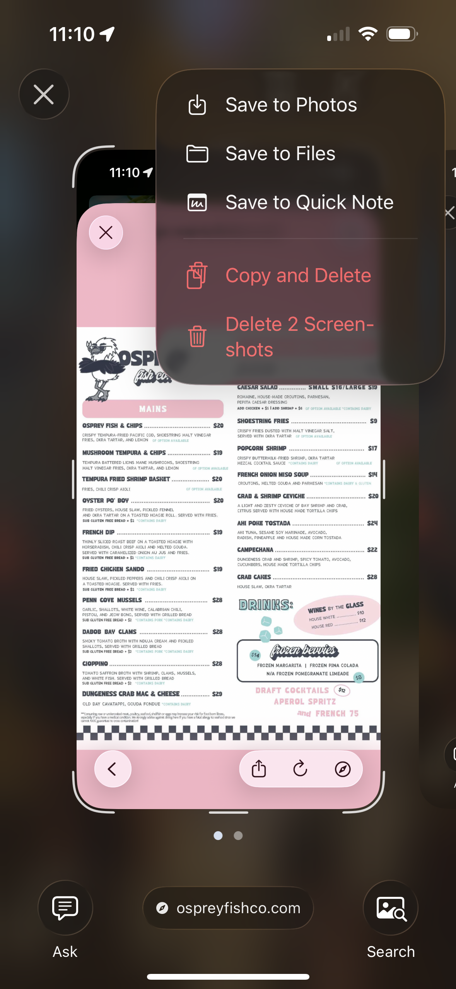
STRATEGY 2: Screenshot the menu
Find your item
Take a screenshot
Save it on your phone
Now you can find it fast.

Slide 11
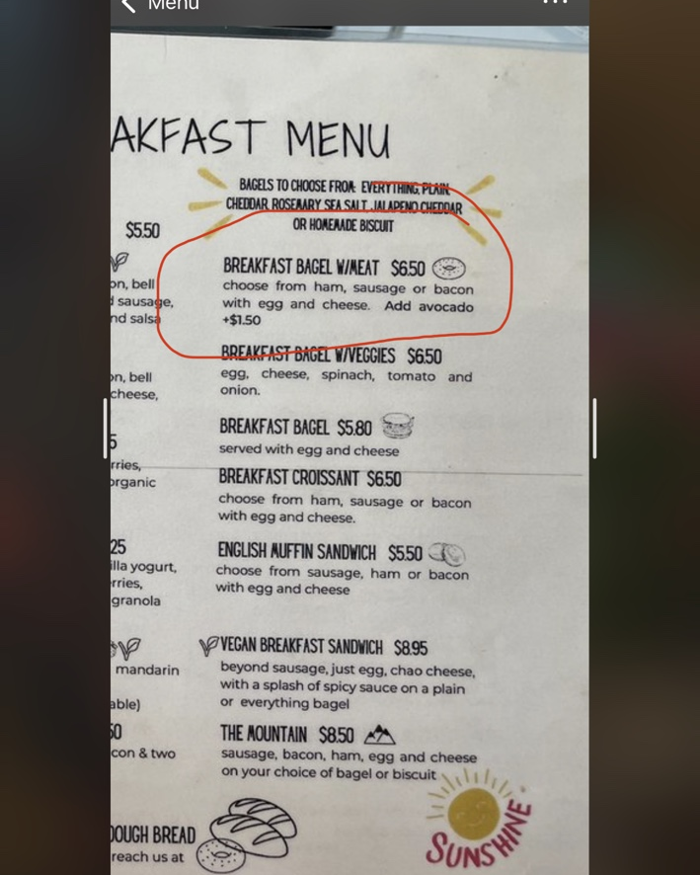
Strategy 3: Mark the picture
Circle your food
Underline it
Add short notes
Examples: no onion, add avocado, bacon
A picture can be easier than re-reading the whole menu.

Slide 12

Strategy 4: Copy and paste the menu
Press and hold on the text
Tap Copy
Paste into Notes
You do not have to type everything

Slide 13
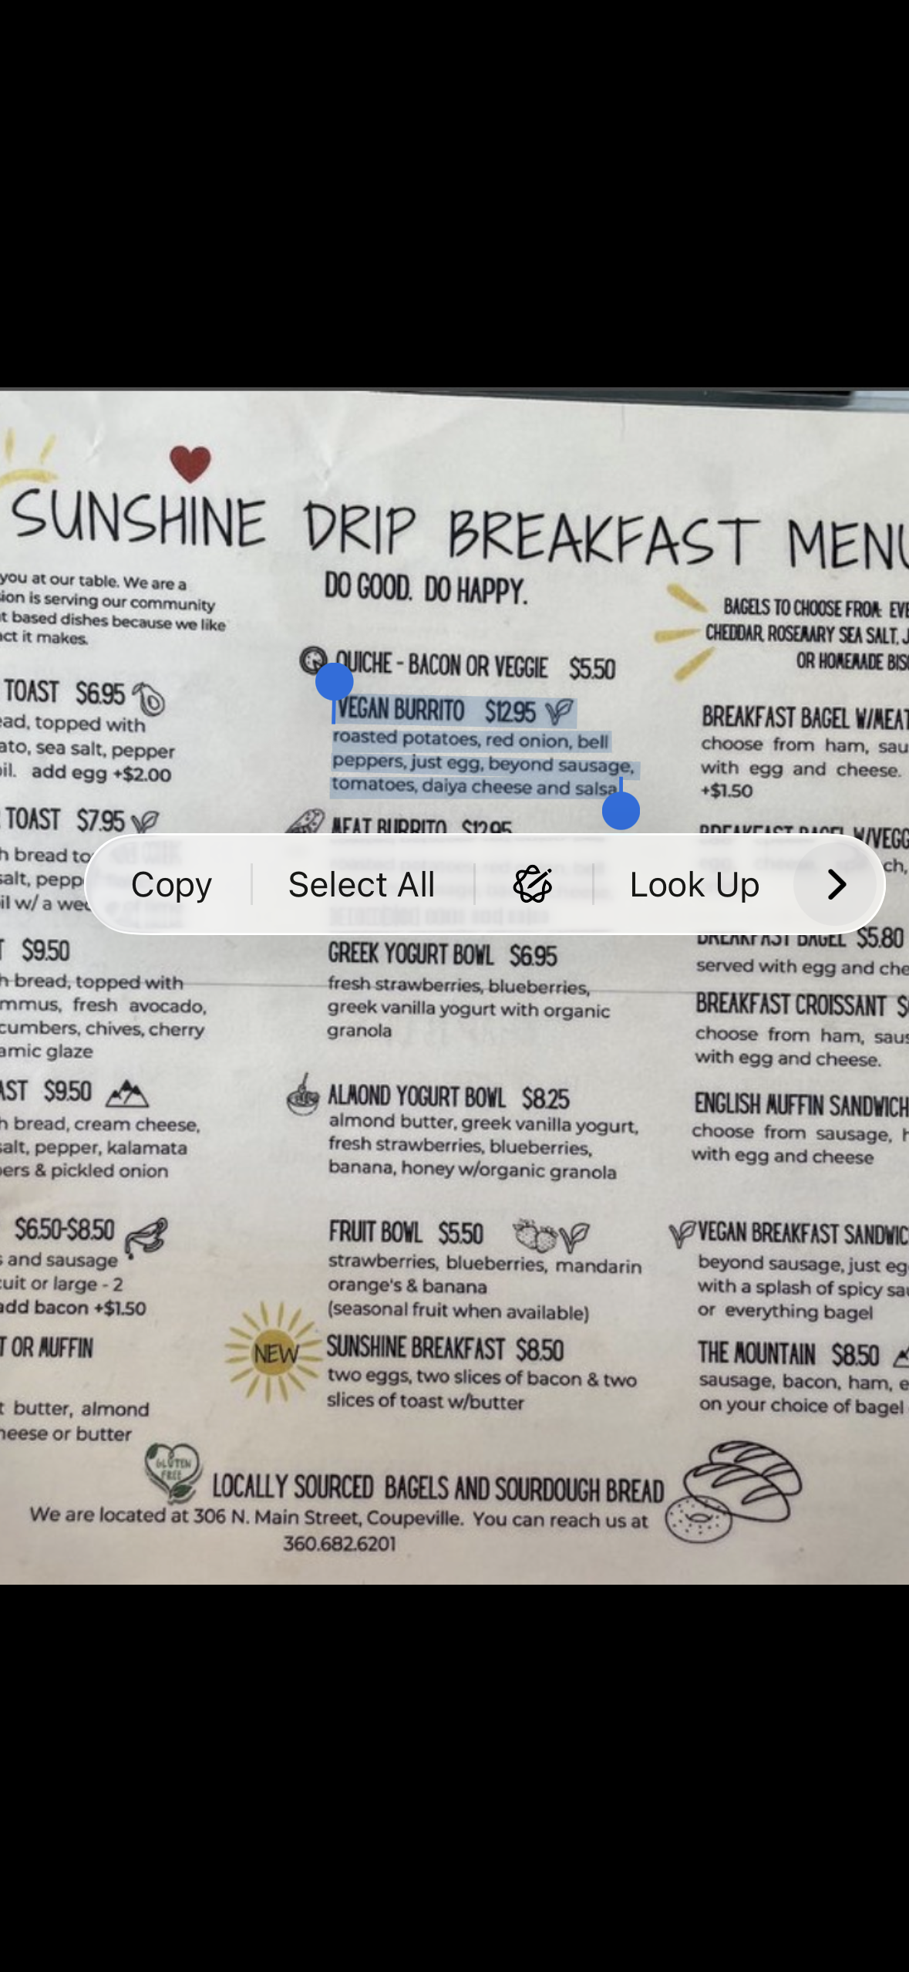
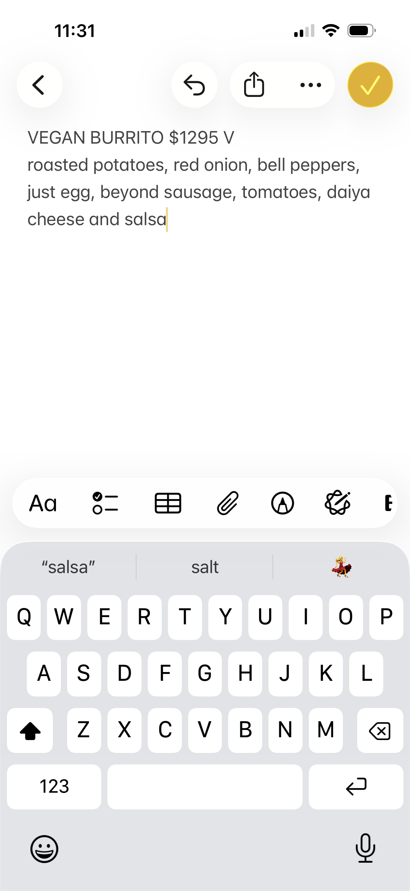

Slide 14
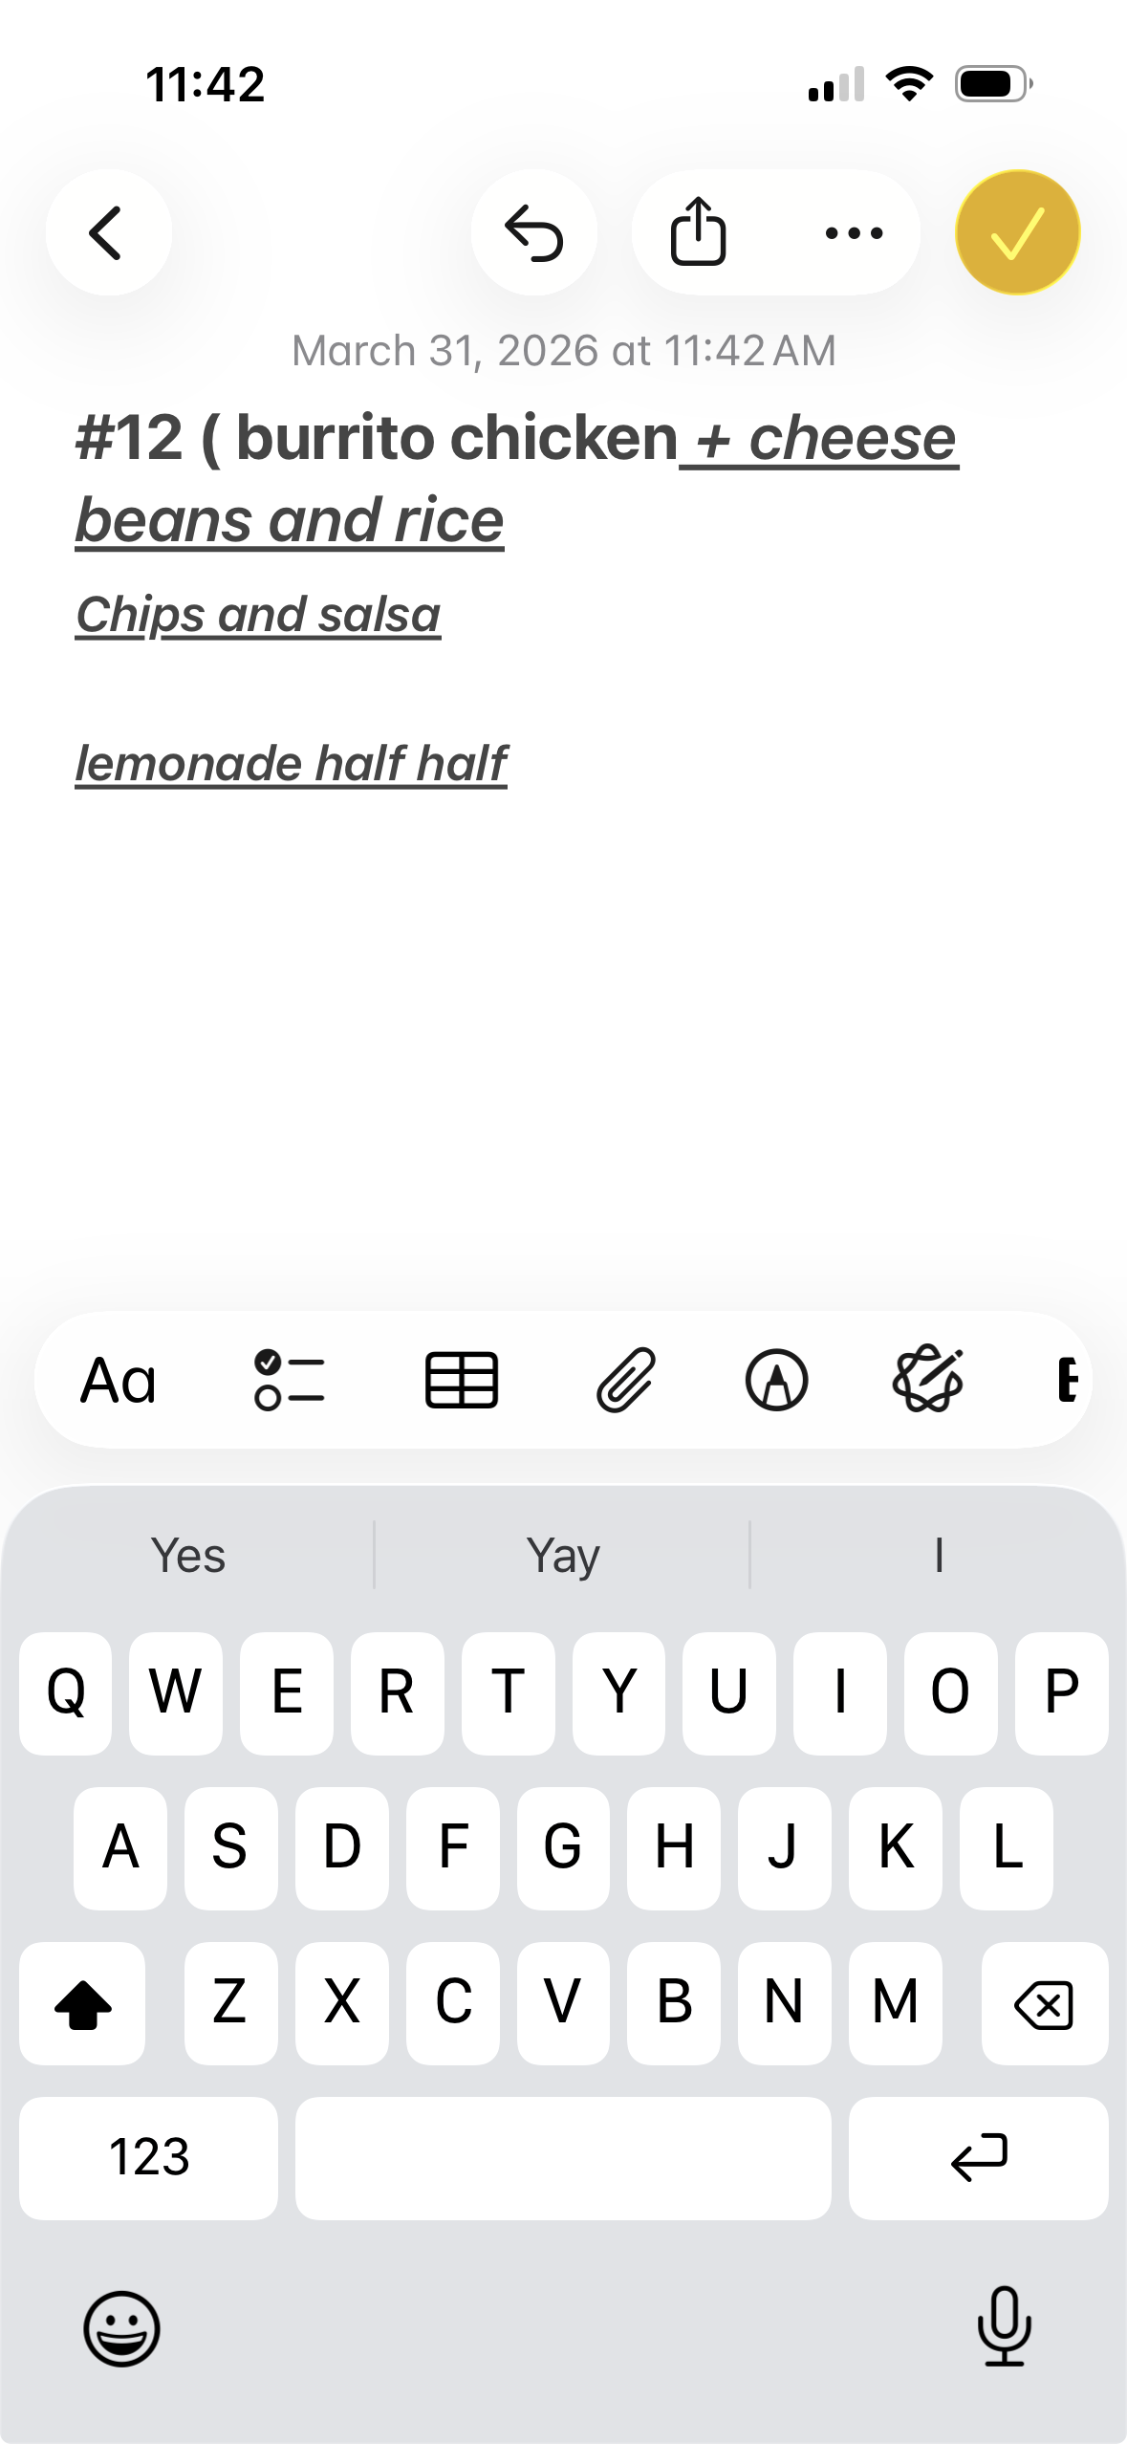
Strategy 5: Save your usual order
If you go there often, save your order in Notes
Use it again next time
Update it anytime
This helps when I go to the same place again.

Slide 15
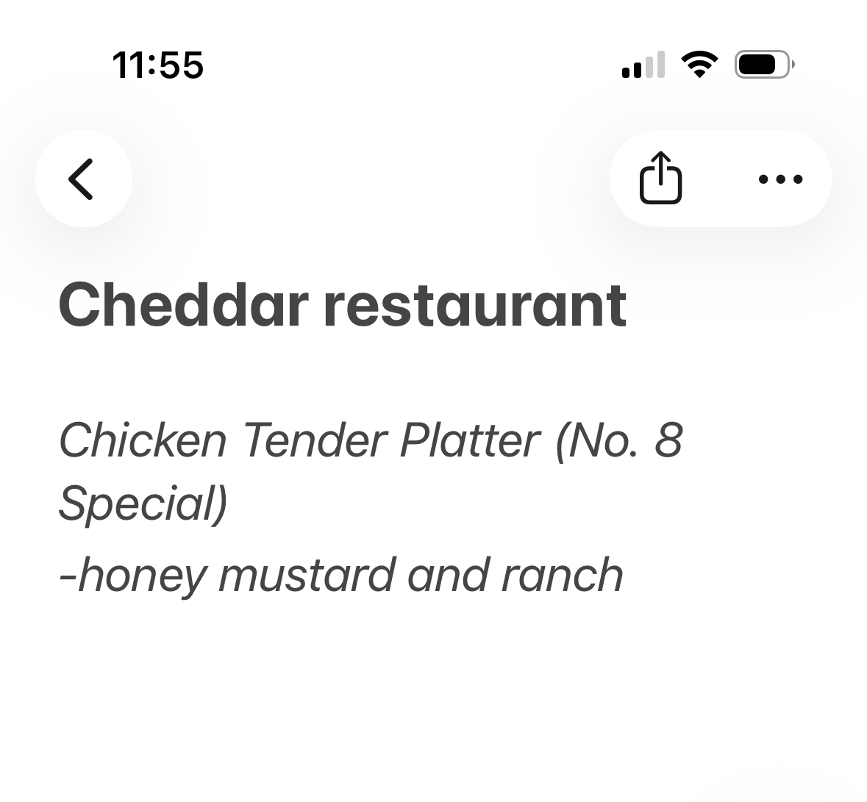
You can show your phone
You do not have to say everything
Point to your order
Show your Notes
Show your screenshot
Showing my phone is a communication strategy.

Slide 16
PERSONAL INFORMATION SECTION

Slide 17
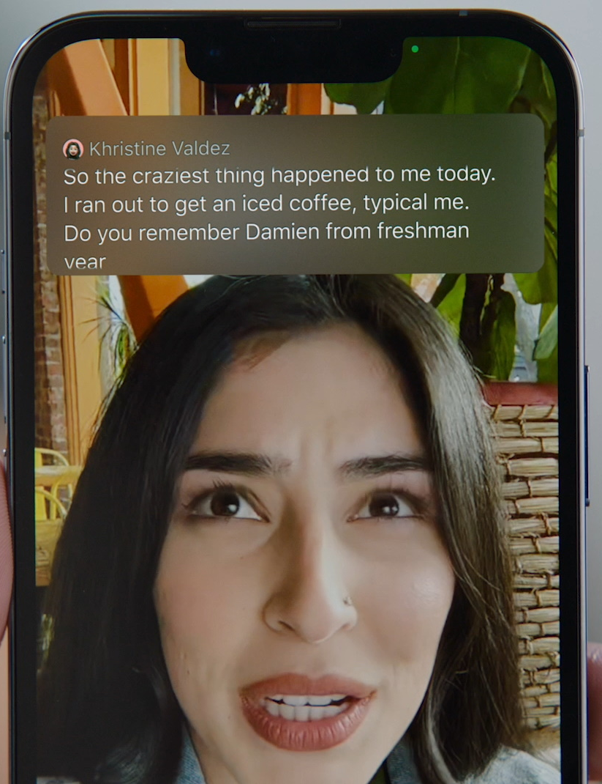
FEATURED App/Resource/Accessibility Feature
Phone Accessibility Features
Live Captions
Live Speech

Slide 18
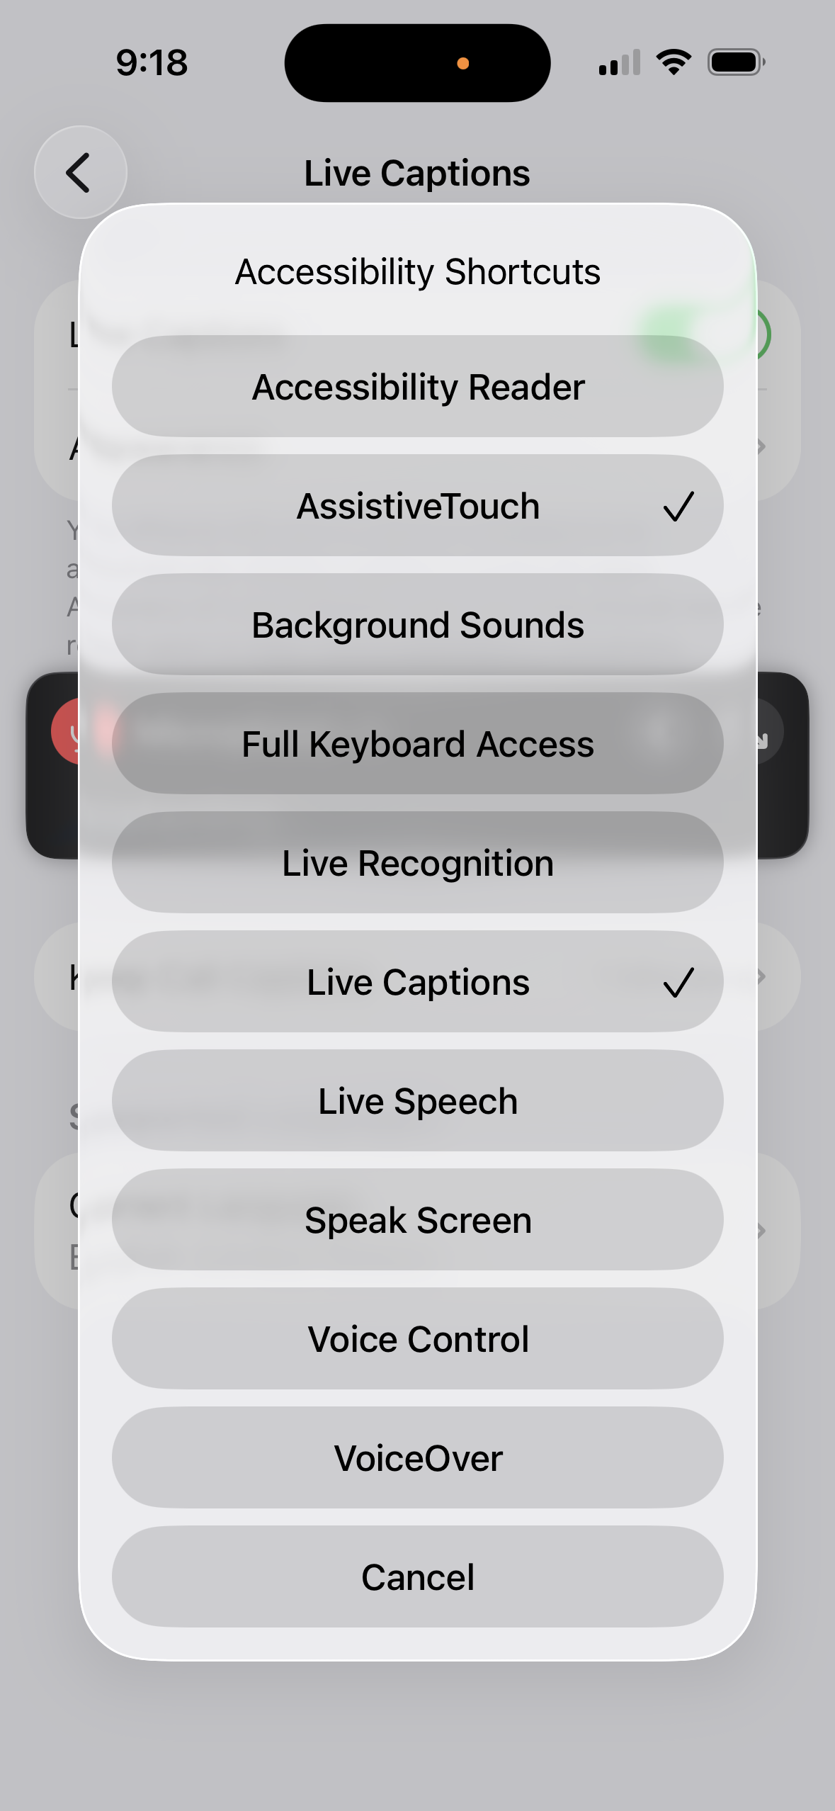
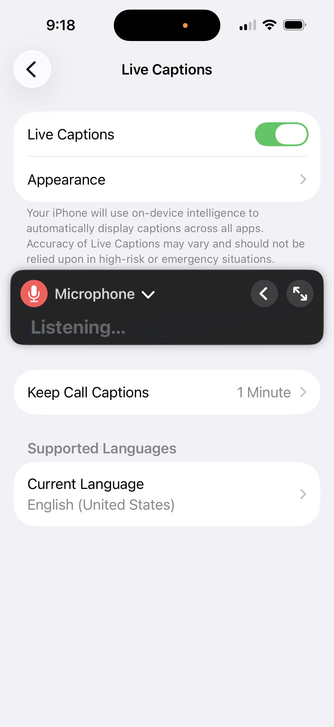
iPhone (Live Captions)
Turn ON:
Settings → Accessibility → Live Captions (Beta) → Turn ON

Slide 19
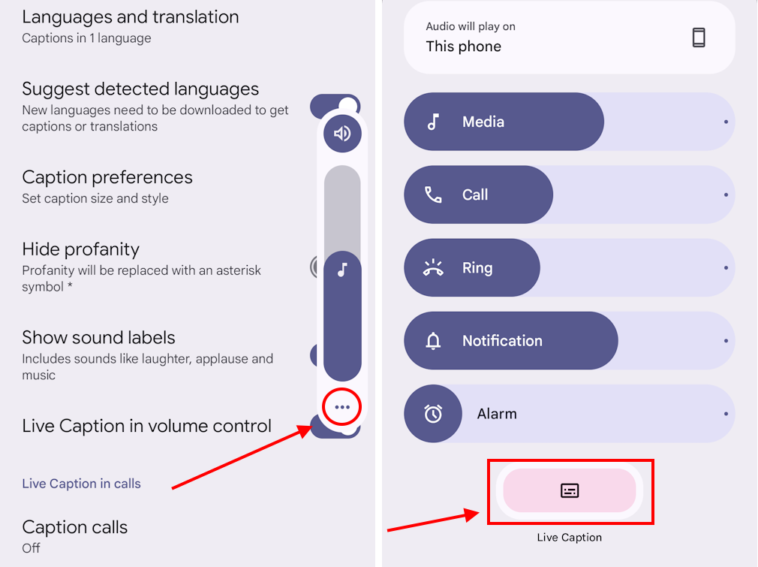
Android (Live Captions)
Press Volume button
Tap Live Caption icon
Captions appear automatically
OR:
Settings → Accessibility → Live Caption

Slide 20
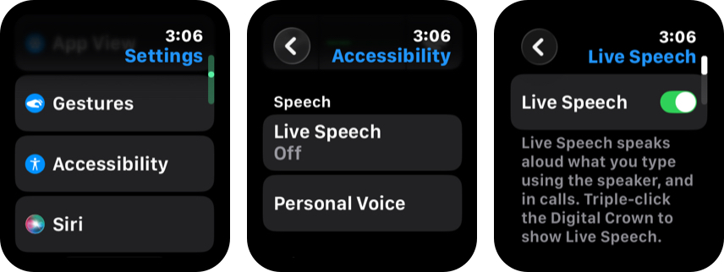
Live Speech (IPHONE)

Slide 21

Personal Information Challenge
When It’s Hard to Give Personal Information
Examples:
name
birthday
address
phone number
medications
Notes:
Sometimes people ask for a lot of important information quickly, and that can feel stressful.

Slide 22
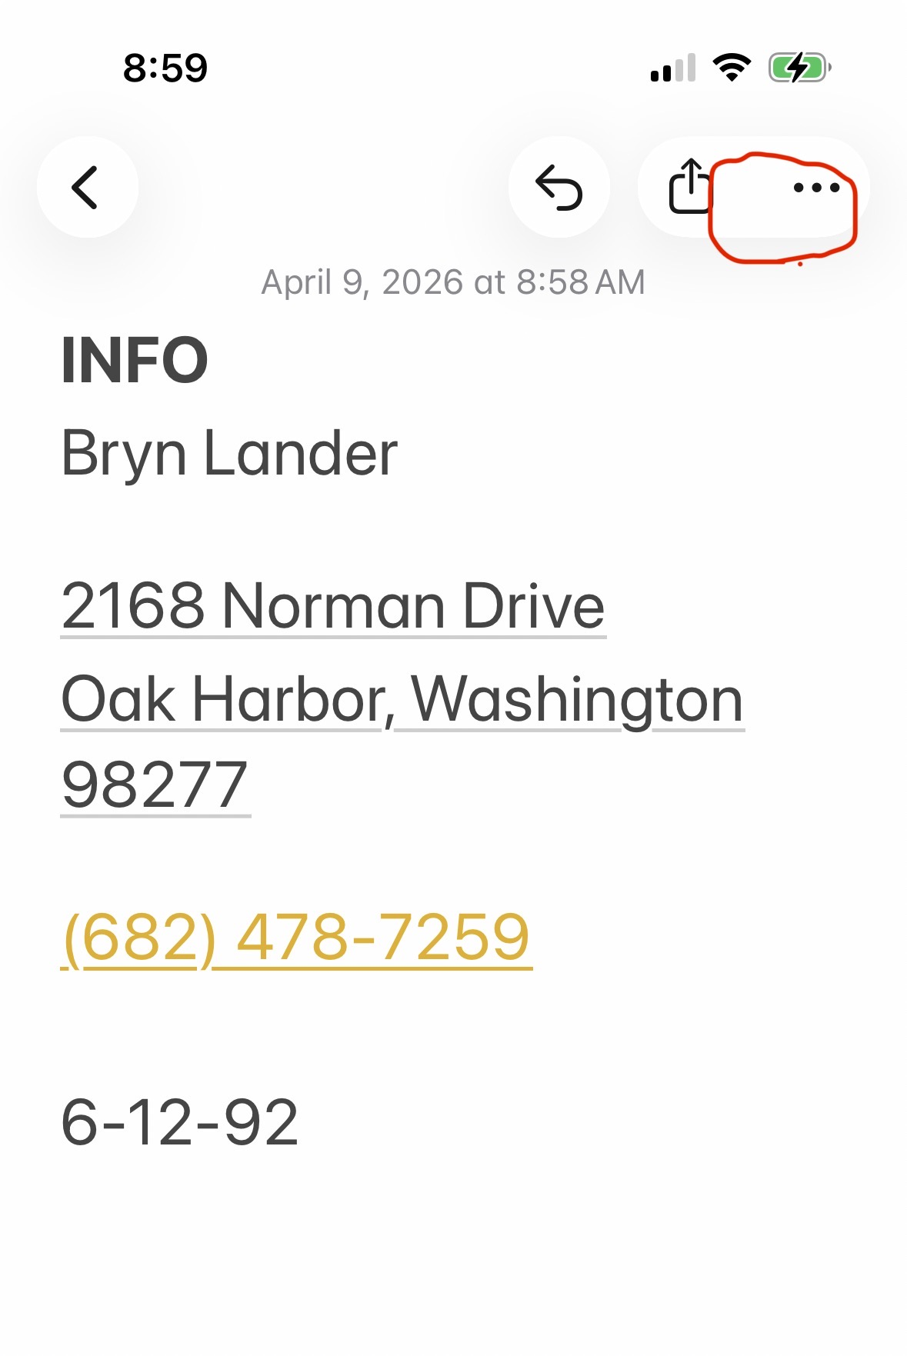
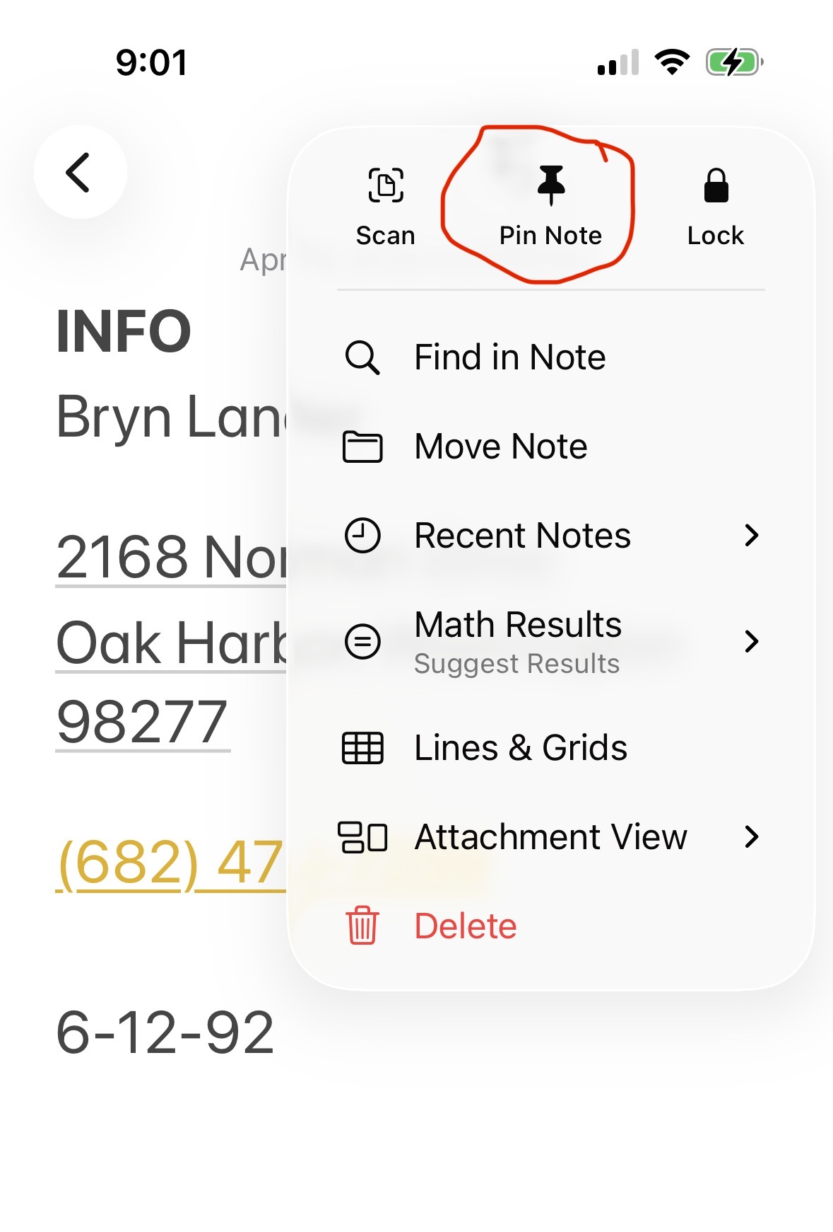
Personal Info Tool 1
What Helps: Notes App
save important information
show it if talking is hard
pin it so it is easy to find
lock it for privacy if needed
Notes:
I like this because if I need it quickly, I don’t want to be scrolling around trying to find it. You can pin it at the top, and if you want, you can lock it too.

Slide 23
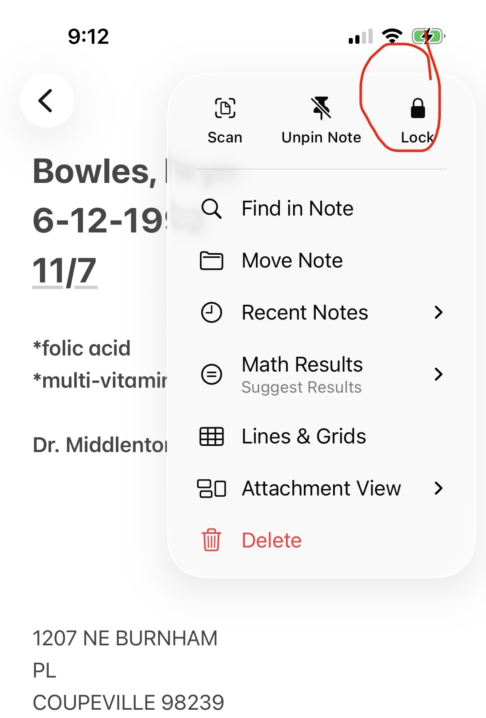
Personal Info Tool 2
How to Make Notes Easier to Use
pin the note at the top
lock it if you want privacy
keep it short and clear
use it for medical or personal info

Slide 24
Personal Info Tool 3
What Helps: Live Captions
read what someone says
helpful if they talk too fast
good for:
doctor visits
pharmacy questions
phone calls

Slide 25
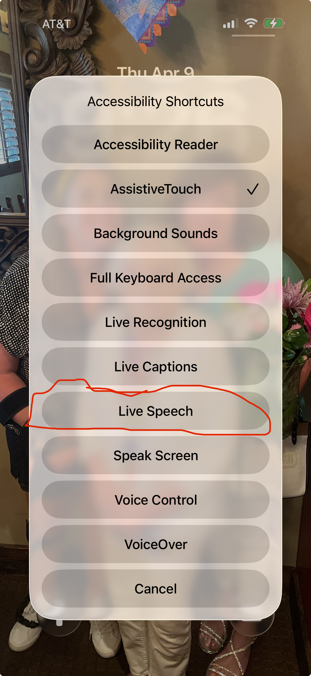
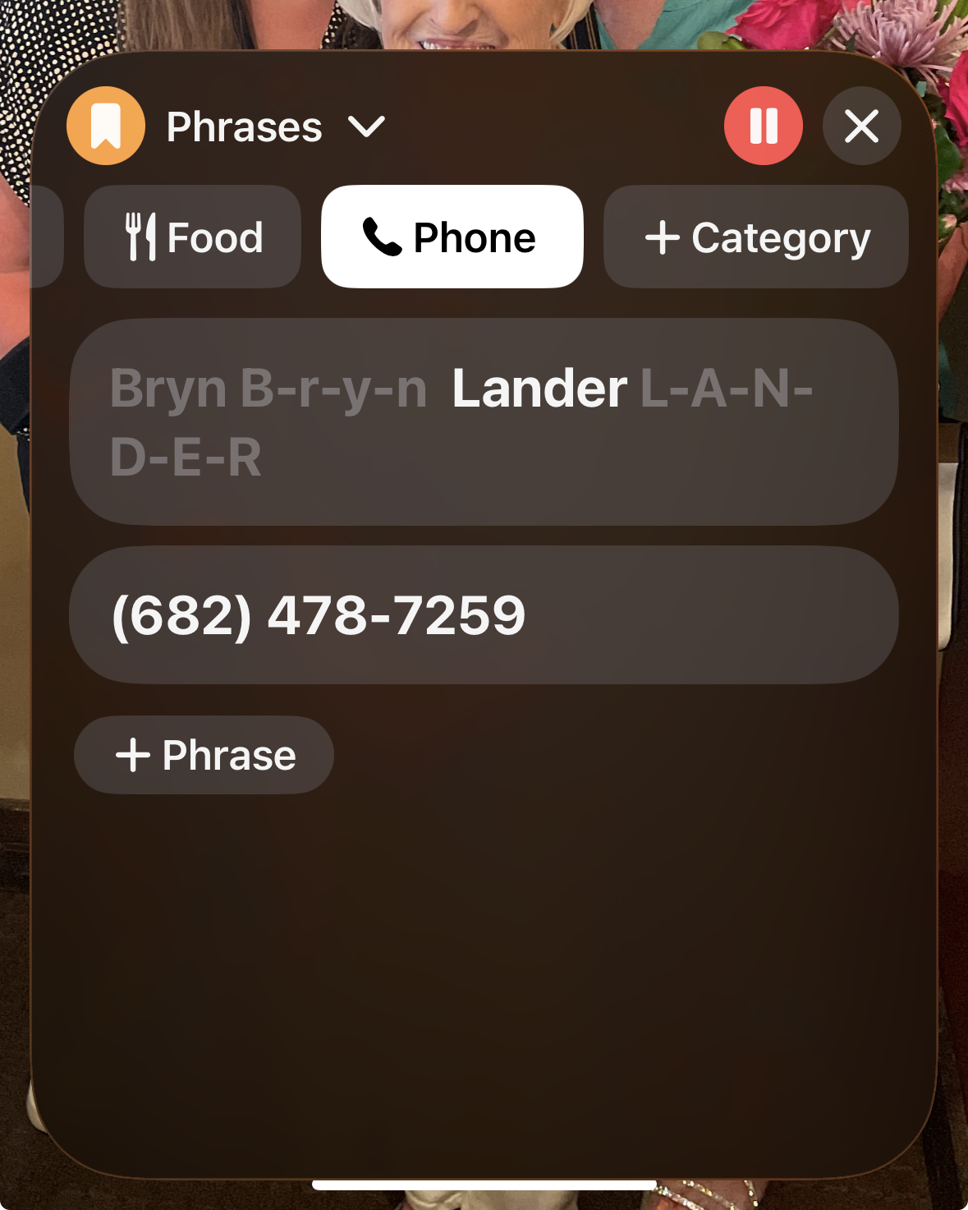
Personal Info Tool 4
What Helps: Live Speech
type what you want to say
your phone can say it out loud
helpful for:
check-in desks
phone calls
noisy places

Slide 26

NEXT TIME:
WEDNESDAY, MAY 6th at 4:00pm EST
What else do you want to learn?

