Slide 1
Technology and Supports for Aphasia
Brooke Lang, M.A., CCC-SLP and Bryn Lander

Slide 2

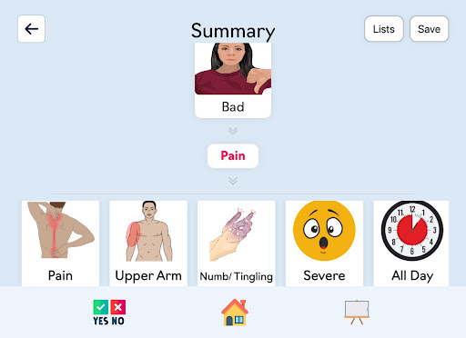
Med Concerns App
A tool to help you share medical symptoms and concerns; created by SLP and Physician
Cost: $49.99 (designed for ipad; working on web-based app)
Uses supported conversation tolls to help people with Aphasia communicate symptoms
  Pick from pictures and icons
  Confirm each answer
  See summary at the end

Slide 3
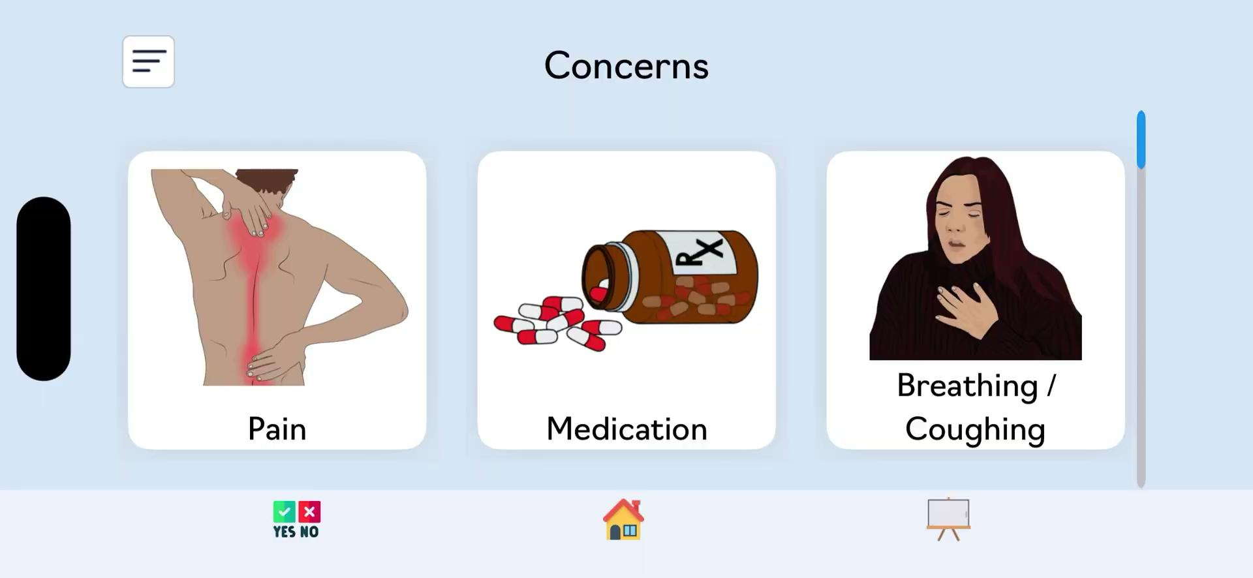
What can you share?

Slide 4

How does it work?
1
2
3
4
Tap your
concern
Answer
follow-up
questions
Confirm
each
answer
View your summary to double-check
Example: Medication → Hard to Swallow → Too Big
To say: "I'm having trouble swallowing my medication because it is too big."

Slide 5
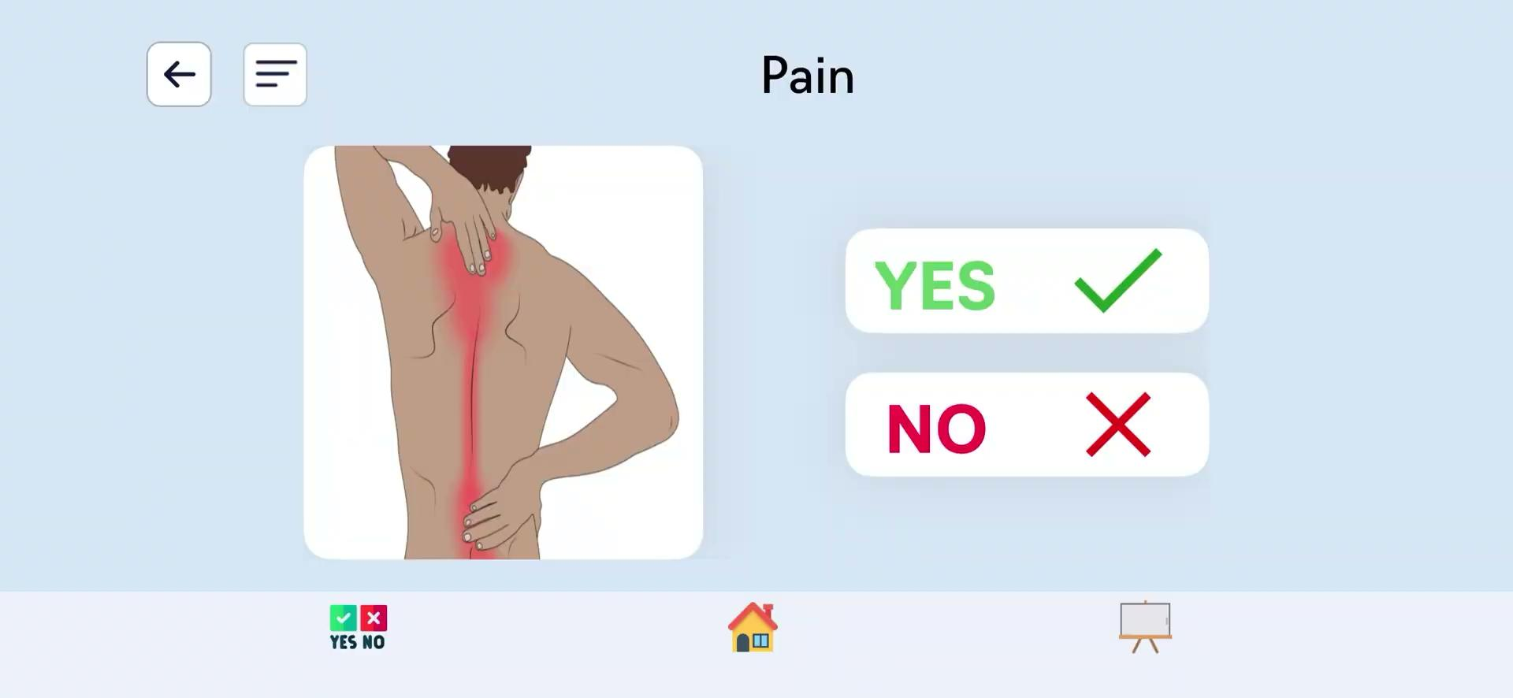
How does it work?
Notes:
From the literature and from our own conversations with people who have aphasia and care partners, we know that 1:1 visits with providers are some of the most stressful experiences for people with aphasia. And yet, this is when the stakes are highest for clearly communicating concerns or symptoms. You can use the app before an encounter with healthcare staff to avoid the stress or time pressure of the encounter or you can use it during if that feels comfortable.

Slide 6

You Can Customize the App
Settings let you change things to work better for you.
Icons per screen:
Show 1 to 6 icons at a time. Fewer = bigger tap targets.
Hide icons:
Remove icons you don't need to keep it simple.
Language:
Switch between English and Spanish.
Body image & voice:
Choose male or female for the body diagram and audio.
Notes:
https://youtu.be/HN_qrcin7HU

Slide 7
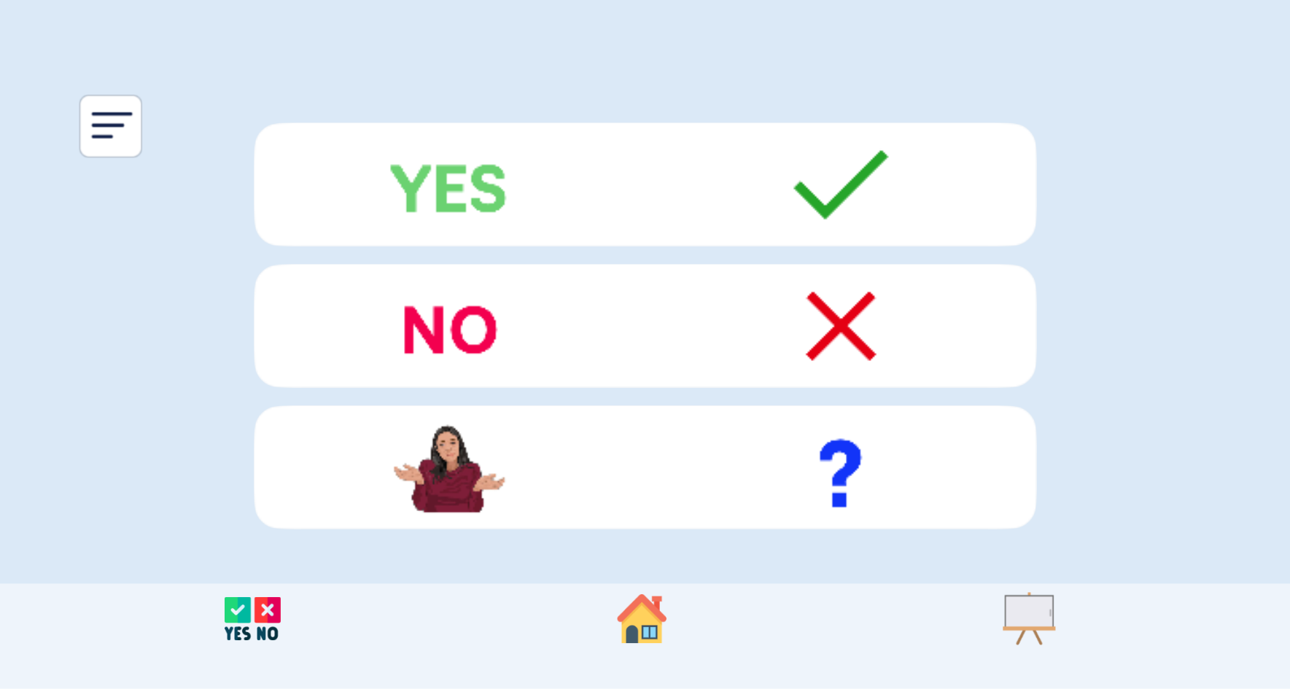
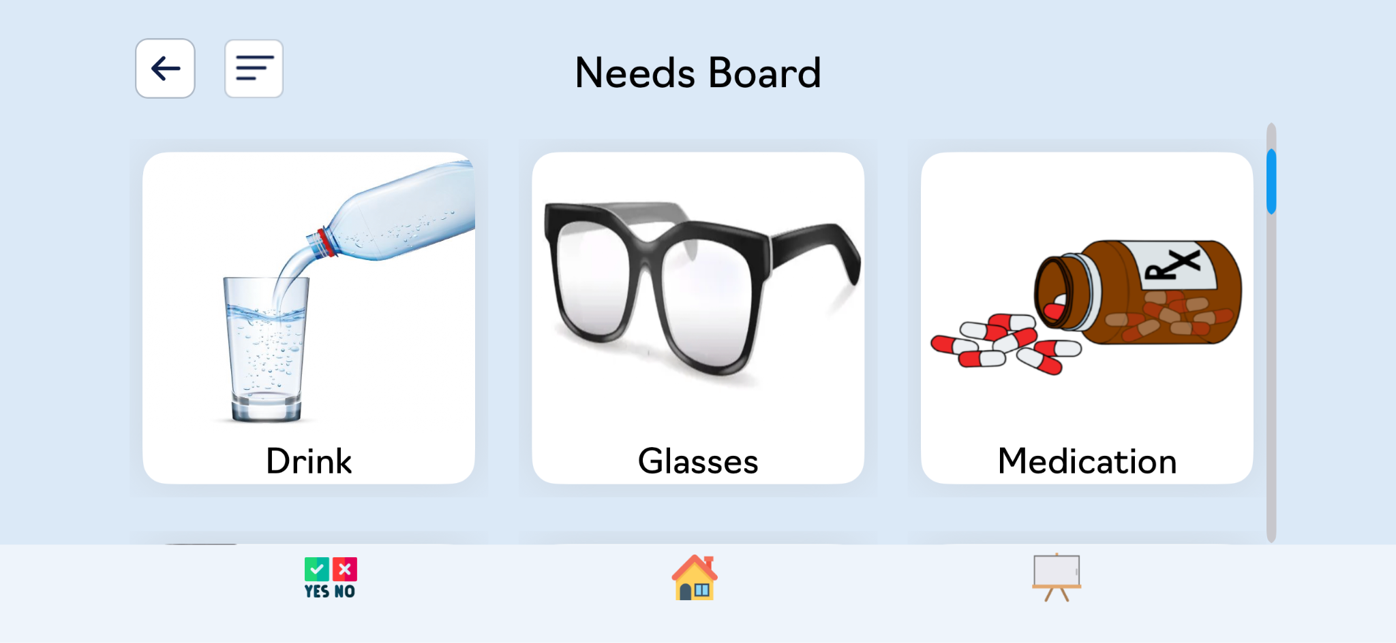
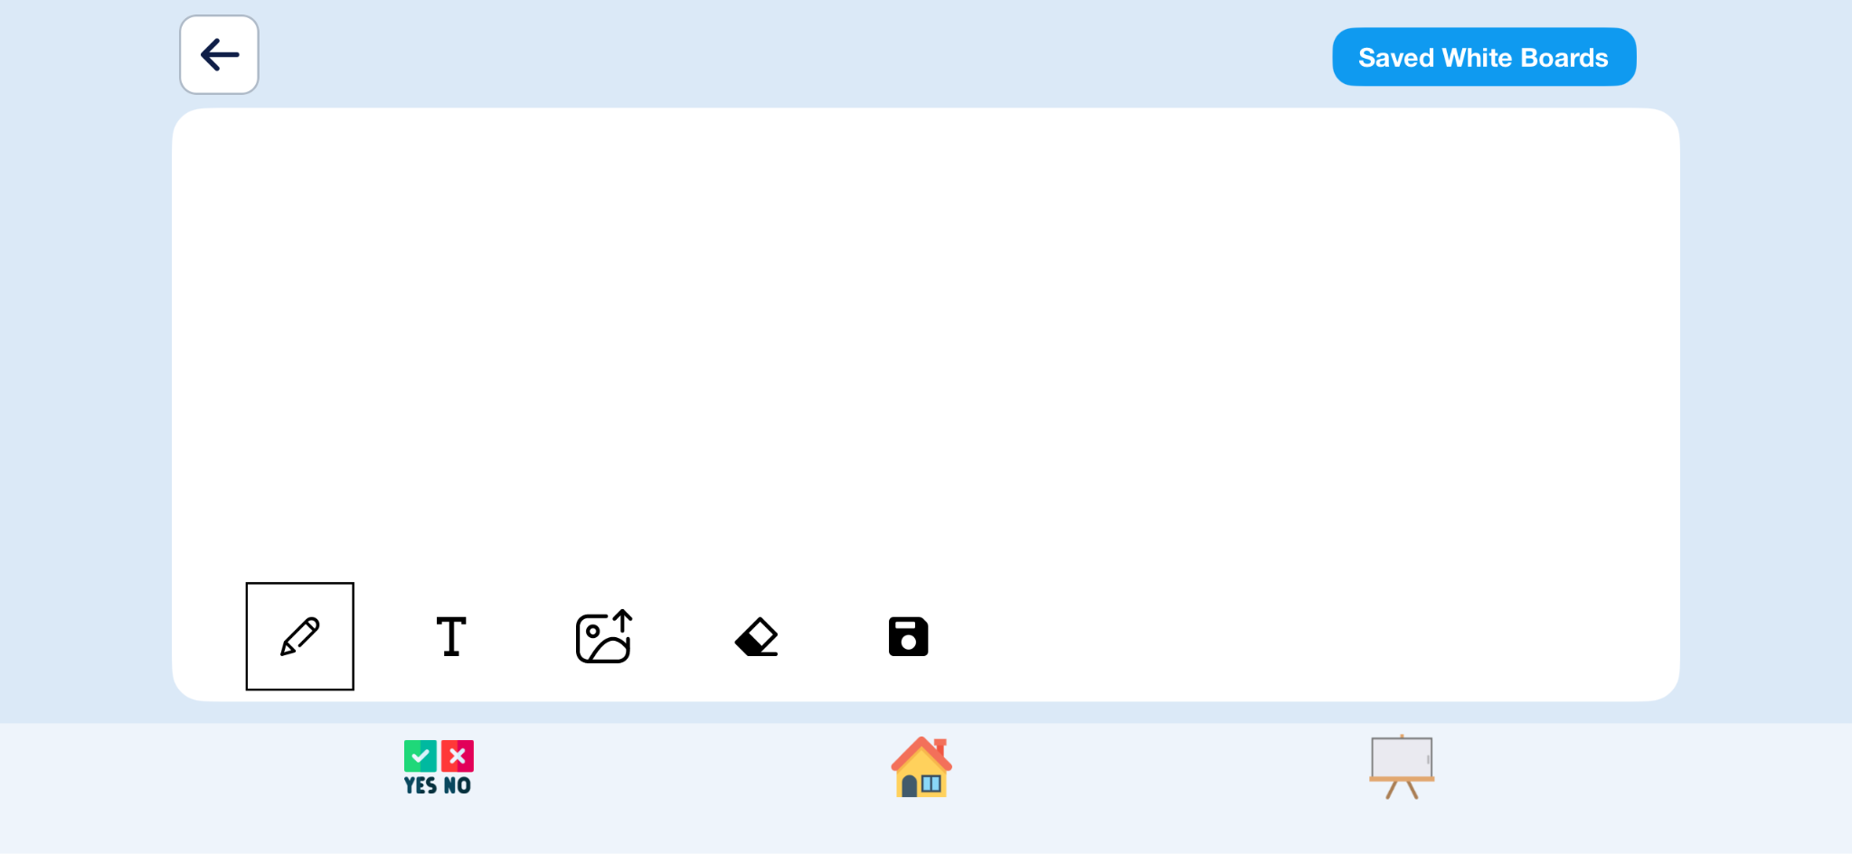


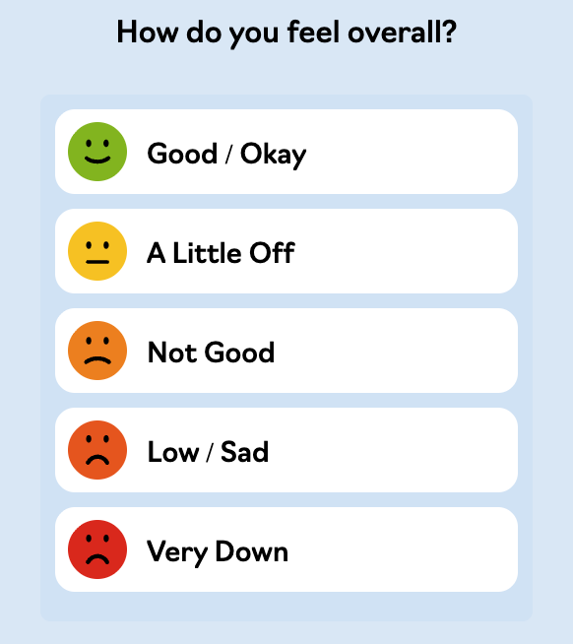
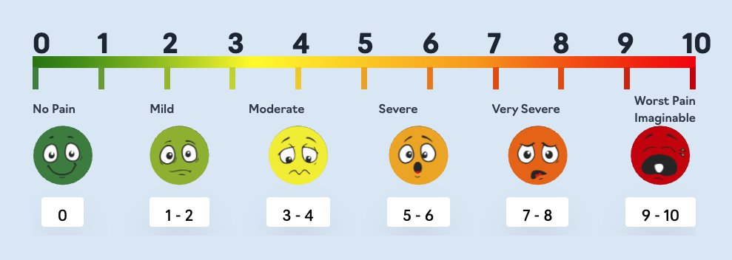
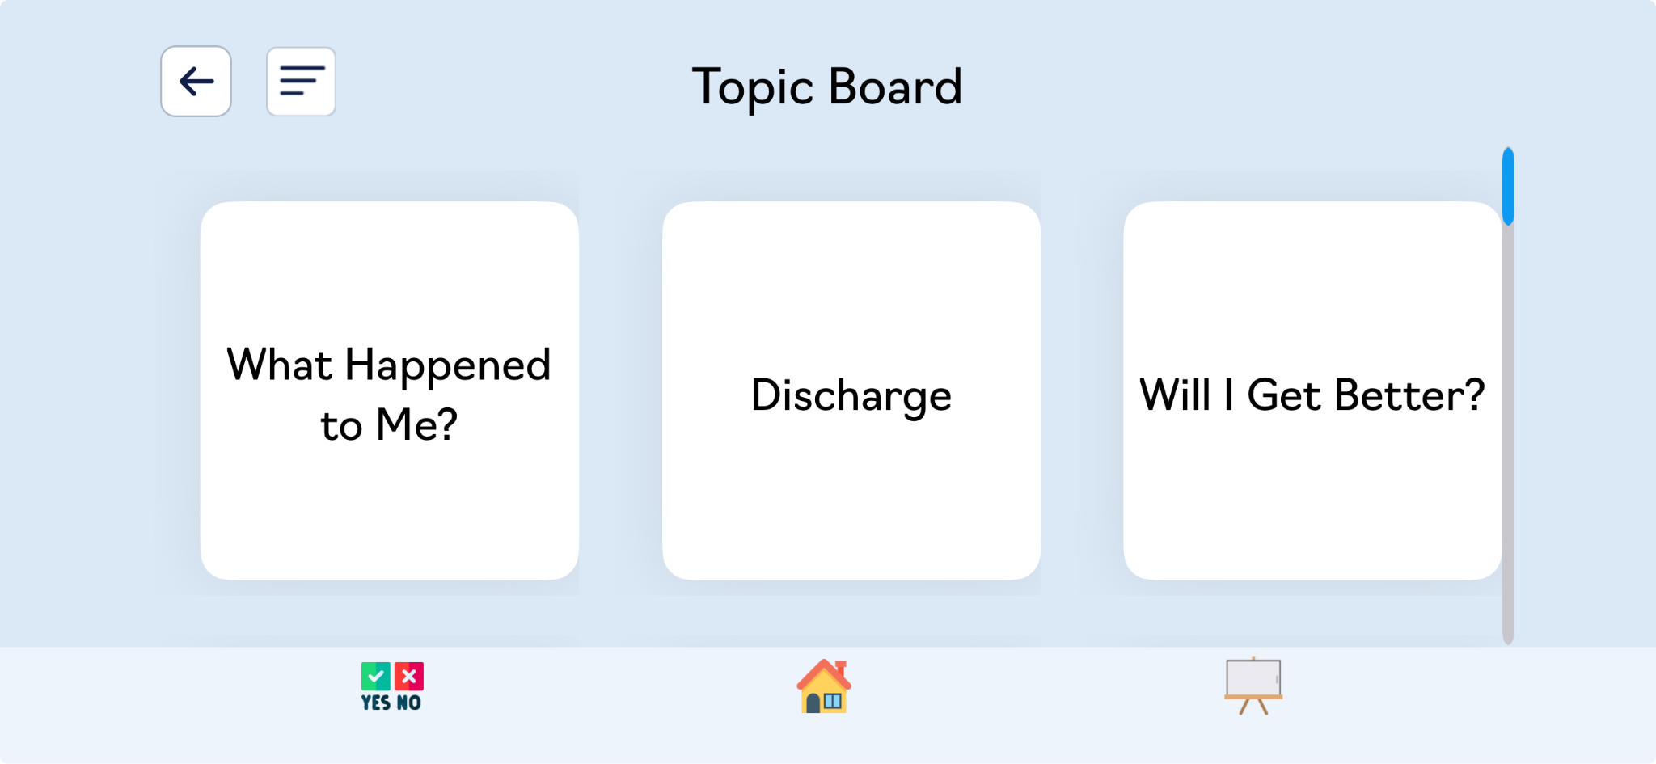
Some of the Extra Tools
Yes / No Board
Whiteboard
Needs Board
Quick yes, no,
or I don't know.
Write, draw, or
add pictures.
Ask for water, blanket,
bathroom,
and more.
Pain Scale
Mood Scale
Topic Board
Rate your pain
quickly.
Share how you
are feeling.
Bring up topics, including therapy, family, communication.
Notes:
https://www.youtube.com/playlist?list=PLnUvWRXs1X-0FZjgCNWX7WBaGBbPNbZqk
Whiteboards and summary screens can be saved or screenshotted to use again. If there is something you want to be sure to communicate during a medical visit, consider using the whiteboard to write or otherwise document what you want to share, and pull up the saved Whiteboard or the screenshot for healthcare staff to ensure the information is communicated clearly during your visit.
The mental health section of MedConcerns has been expanded to include the Mood Scale and a depression and anxiety screener.

Slide 8

Med Concerns App
For questions or support with the Med Concerns App:
Reach out to Hilary Sample: hilary@medconcerns.com

Slide 9
New Format
Learn a phone accessibility feature, app, resource, etc.
See how it works
Practice a real-life situation

Slide 10
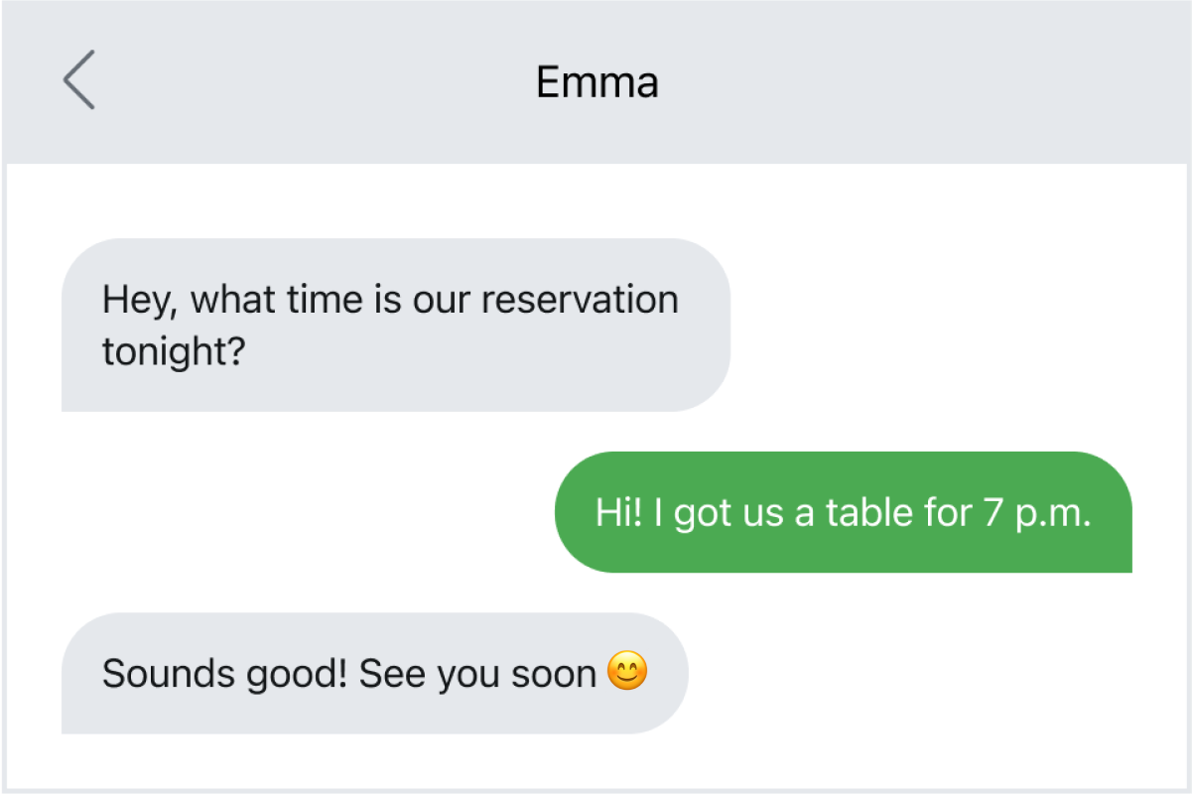
Communication Challenge
EXAMPLE:
I receive text messages from friends and family, and it’s hard for me to respond, but I want to stay connected to them.

Slide 11
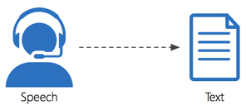

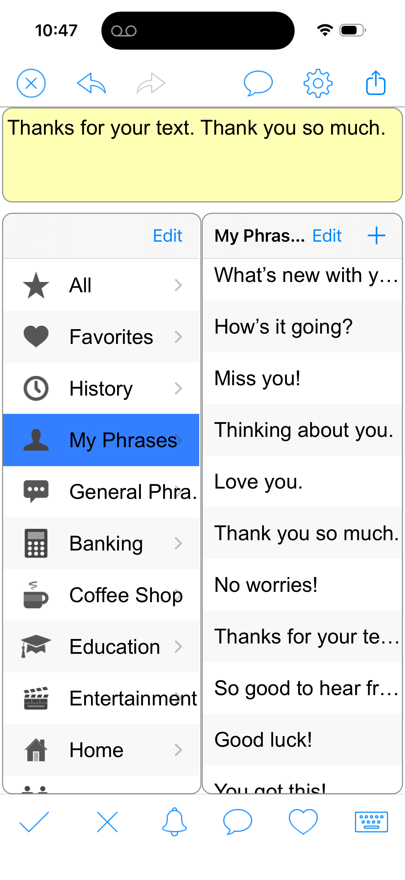
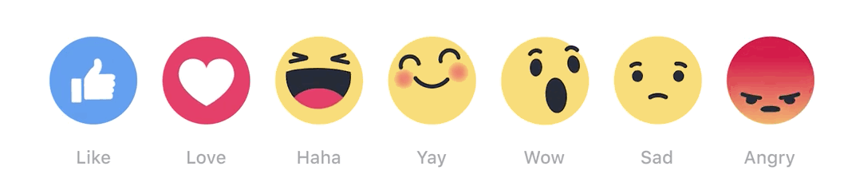
FEATURED
App/Resource/Accessibility Feature
Speech to text
Screenshots into AI (copy / paste)
Emojis + “React” buttons
Common phrases / responses programmed ahead of time
  Word Board Keyboard add-on + Clarocom App (copy / paste)

Slide 12
FEATURED
App/Resource/Accessibility Feature
Speech-to-text
Available on any device
If SPEAKING is better than WRITING/TYPING

Slide 13
FEATURED
App/Resource/Accessibility Feature
Chat GPT- Bryn uses it every day for texting back and emailing
App – AI powered chatbot available on iOS, Android, desktop
FREE (limited usage, basic features); $20/month faster responses, expanded messaging and uploads)
Designed to provide answers, generates content, assists with learning, creates images, etc.

Slide 14
How ChatGPT can help?
Practice texting conversations before sending them
Simplify long or confusing text messages (this happens to me all the time!)
Help respond to group texts without feeling overwhelmed
Suggest emojis or tone ideas 😊
Read messages out loud using text-to-speech
Help organize thoughts before replying
Help write a short text back
(“Thanks for checking on me. I’m tired today but okay.”)
Give 3 response choices to pick from
Make messages sound more natural or friendly
Turn a few words into a complete sentence
Help with spelling and word finding
Create saved “quick replies” for common situations

Slide 15
Example 1: Turns a few words into sentences
You type:
“hard answer tired”
ChatGPT response choices:
Choice 1:
“Sorry it took me a while to answer.”
Choice 2:
“Sorry I’m slow to reply lately. I’ve been tired.”
Choice 3:
“Sorry it took me a while to answer. I’ve been really tired lately.”

Slide 16
Example 2: Gives 3 responses to pick from
Friend texts:
“How are you doing?” 😊
Choice 1:
“I’m okay. Thanks for checking on me.”
Choice 2:
“I’m tired today, but doing alright.”
Choice 3:
“Busy lately, but happy to hear from you 😊”

Slide 17
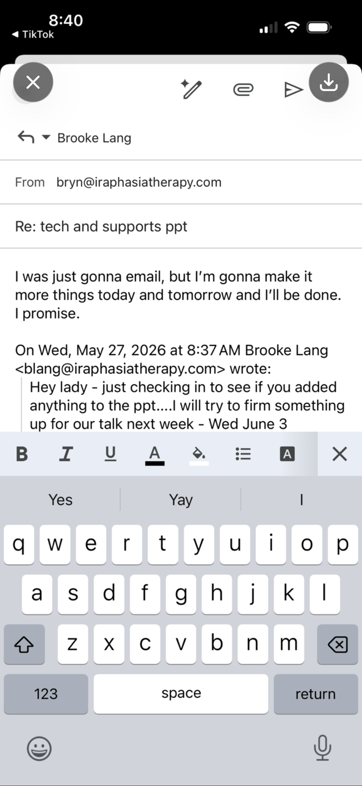
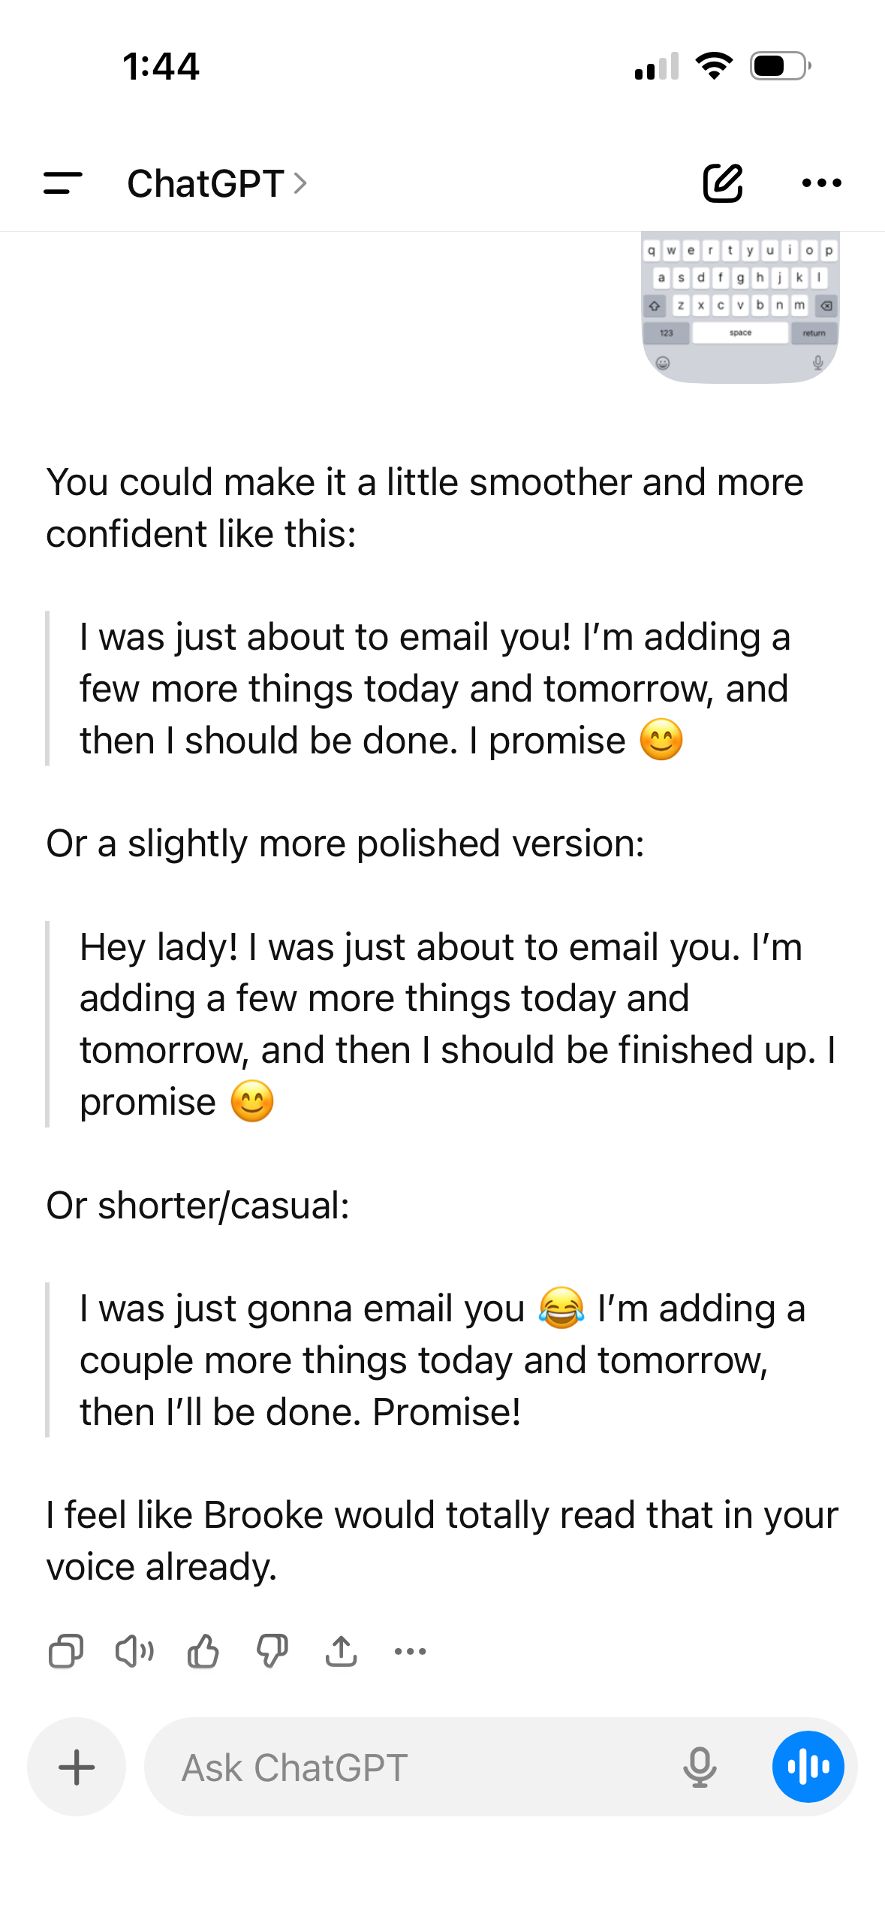
EXAMPLE 3: Helping with email response

Slide 18
Bryn Demo
Using ChatGPT to simplify LONG or CONFUSING text messages/emails

Slide 19
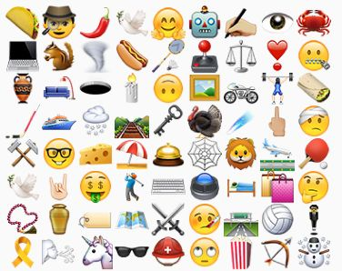
FEATURED
App/Resource/Accessibility Feature
Using Emojis or Reactions as RESPONSES

Slide 20
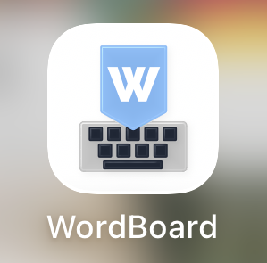

FEATURED
App/Resource/Accessibility Feature
Word Board (keyboard add-on)
Clarocom App

Slide 21
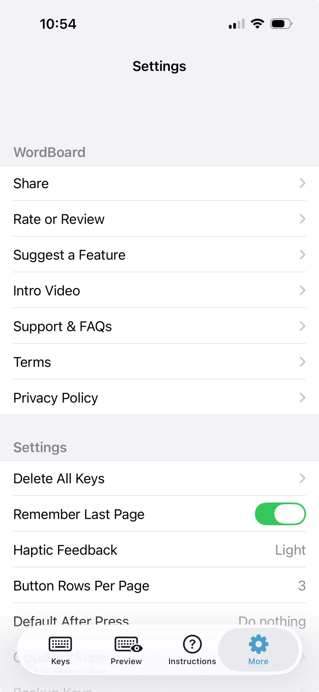
Word Board
App for iphone/ipad (FREE version includes 6 keys, Pro upgrade unlocks unlimited keys and advanced features - $49.99)
WordBoard App for iPhone - Text Snippets, Templates, and Copy Paste
Creates keys for phrases, replies, addresses, and templates you type every day
One tap inserts your saved text in Messages, Mail, WhatsApp, Notes, etc
Group keys into folders by topic

Slide 22
Clarocom
App for Ipad/Iphone (FREE)
Designed for AAC to assist people who have trouble with spoken language
Offers text-to-speech, word prediction, and customizable phrase features

Slide 23
Bryn Demo
Using Word Board Keyboard and Clarocom for Text Message Responses

