Slide 1
AAC: Augmentative and Alternative Communication

Slide 2
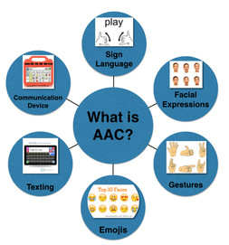
What is AAC?
Strategies, techniques, or devices intended to supplement or replace insufficient or ineffective communication skills
Augmentative – add to someone’s speech
Alternative – instead of speech
Comprehensive collection of communication strategies that provide external support for people who cannot understand or generate messages on their own (Garret & Lasker, 2005)

Slide 3




What is AAC?
Unaided (do not require external tool, require some degree of motor control)
  Body language
  Facial expressions
  Finger spelling
  Gestures
  Manual signs
  Vocalizations
  verbalizations

Slide 4
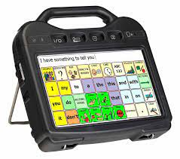
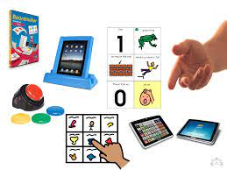
What is AAC?
Aided (require some form of external tool)
Nonelectronic (“low tech”)
  Communication boards/books
  Objects, pictures, photographs
  Visual schedules
  Writing
Electronic forms “high tech”
  Computer/tablet/smartphone
    Communication apps, such as AAC software
    Text-to-speech features
    Texting
    Drawing/writing using a tablet
  SGD’s

Slide 5

AAC and Aphasia
A system, not a device
Needs to be multifaceted and part of a communication system
Benefit from strategies that provide redundancy through multiple modalities

Slide 6
Revisiting Role of AAC in Aphasia Rehab
AAC should be introduced earlier and more broadly in post-stroke journey
AAC should focus beyond basic wants/needs to increase life participation and connection
Combining AAC with traditional interventions can address needs today while also working on enhancing language abilities for future
Use AAC to increase ability while focusing on participation
Dietz, Wallace & Weissling 2020

Slide 7
Some AAC Programs
Proloquo2go
Proloquo4Text AAC
TouchChat
TD Snap
Speech Assistant
Clarocom

Slide 8

Proloquo2go:
Tap symbols. Type words. Speak.
Customizable Vocabulary: offers a diverse vocabulary set that can be adjusted to suit the user's specific needs and language proficiency.
  Users can add, remove, or modify vocabulary items to make communication more personalized and effective.
Voice Output: The app includes high-quality, natural-sounding text-to-speech voices, enabling users to have their typed or selected messages spoken aloud.
Intuitive Interface: Proloquo2Go provides an intuitive and user-friendly interface - designed to be easy to navigate, reducing the frustration that can accompany complex communication tasks.
Symbol and Text-based Communication: It supports both symbol-based and text-based communication, allowing users to express themselves using symbols, photos, or text, depending on their preferences and abilities.
Usability Across Devices: Proloquo2Go can be used on various devices, such as iPads or iPhones, providing flexibility and mobility for users who need to communicate on the go.
COST → $249.99
Notes:
Proloquo2Go is an augmentative and alternative communication (AAC) app designed to support individuals who have difficulty speaking, including those with aphasia. Here are some key features and benefits of Proloquo2Go for people with aphasia:
1. **Customizable Vocabulary**: The app offers a diverse vocabulary set that can be adjusted to suit the user's specific needs and language proficiency. Users can add, remove, or modify vocabulary items to make communication more personalized and effective.
2. **Intuitive Interface**: Proloquo2Go provides an intuitive and user-friendly interface, which makes it accessible for individuals with varying levels of technological skills. The app is designed to be easy to navigate, reducing the frustration that can accompany complex communication tasks.
3. **Symbol and Text-based Communication**: It supports both symbol-based and text-based communication, allowing users to express themselves using symbols, photos, or text, depending on their preferences and abilities.
4. **Voice Output**: The app includes high-quality, natural-sounding text-to-speech voices, enabling users to have their typed or selected messages spoken aloud. This feature is particularly valuable for individuals with severe speech difficulties.
5. **Language Support**: Proloquo2Go offers support for multiple languages, making it versatile for users who speak different languages or are multilingual.
6. **Self-Expression**: The app can help individuals with aphasia express their thoughts, needs, and emotions more easily, promoting social interaction and participation in daily activities.
7. **Usability Across Devices**: Proloquo2Go can be used on various devices, such as iPads or iPhones, providing flexibility and mobility for users who need to communicate on the go.
8. **Educational Resources and Support**: The developers provide resources and support to help users and their caregivers make the most out of the app.
Overall, Proloquo2Go can be a powerful tool for individuals with aphasia, offering them a means to communicate with greater independence and confidence.

Slide 9
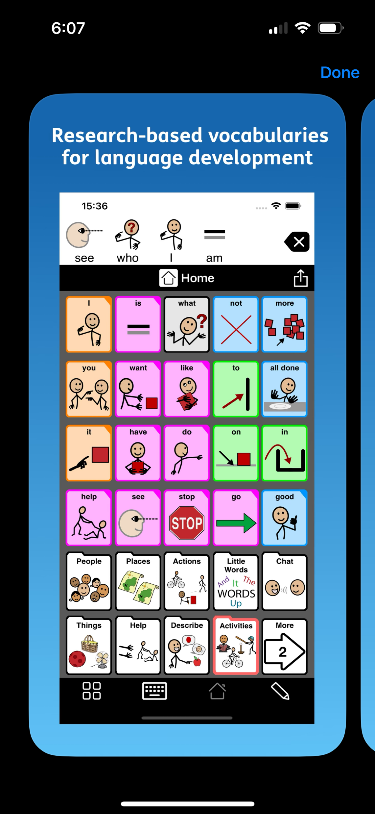
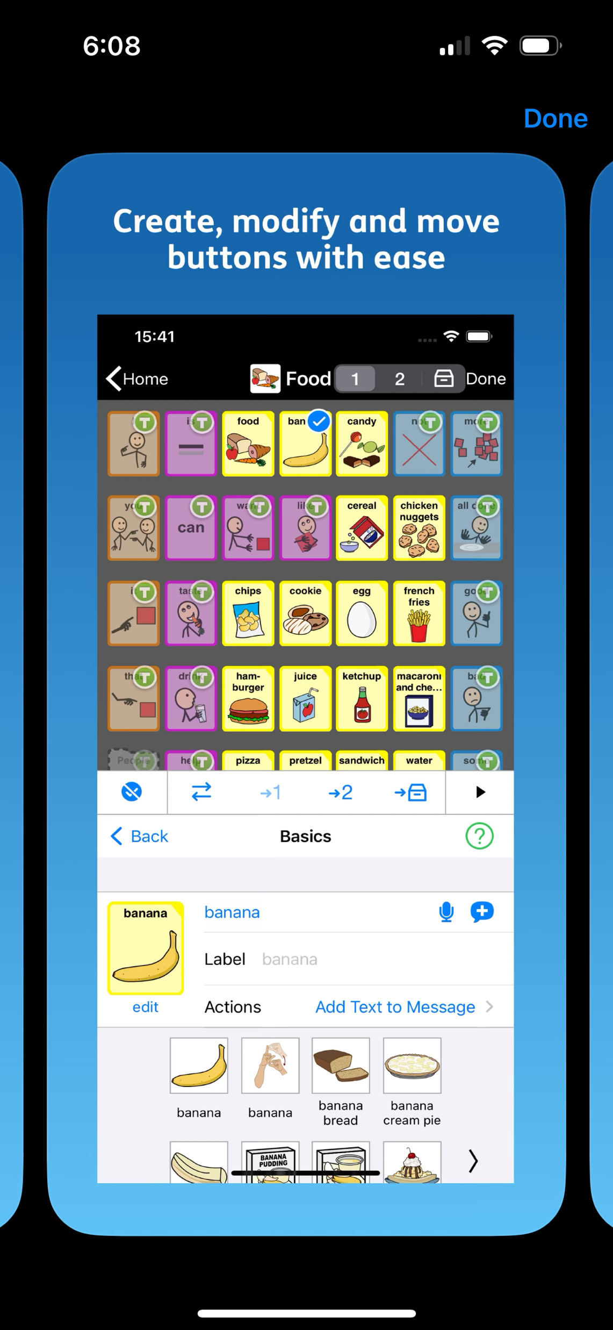
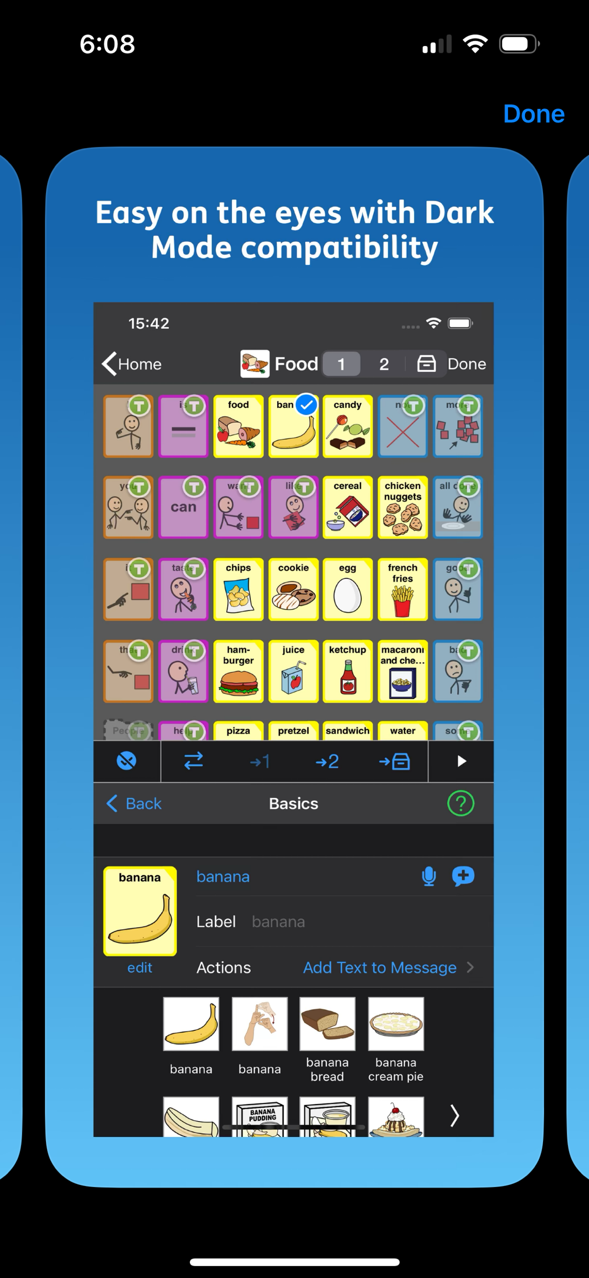
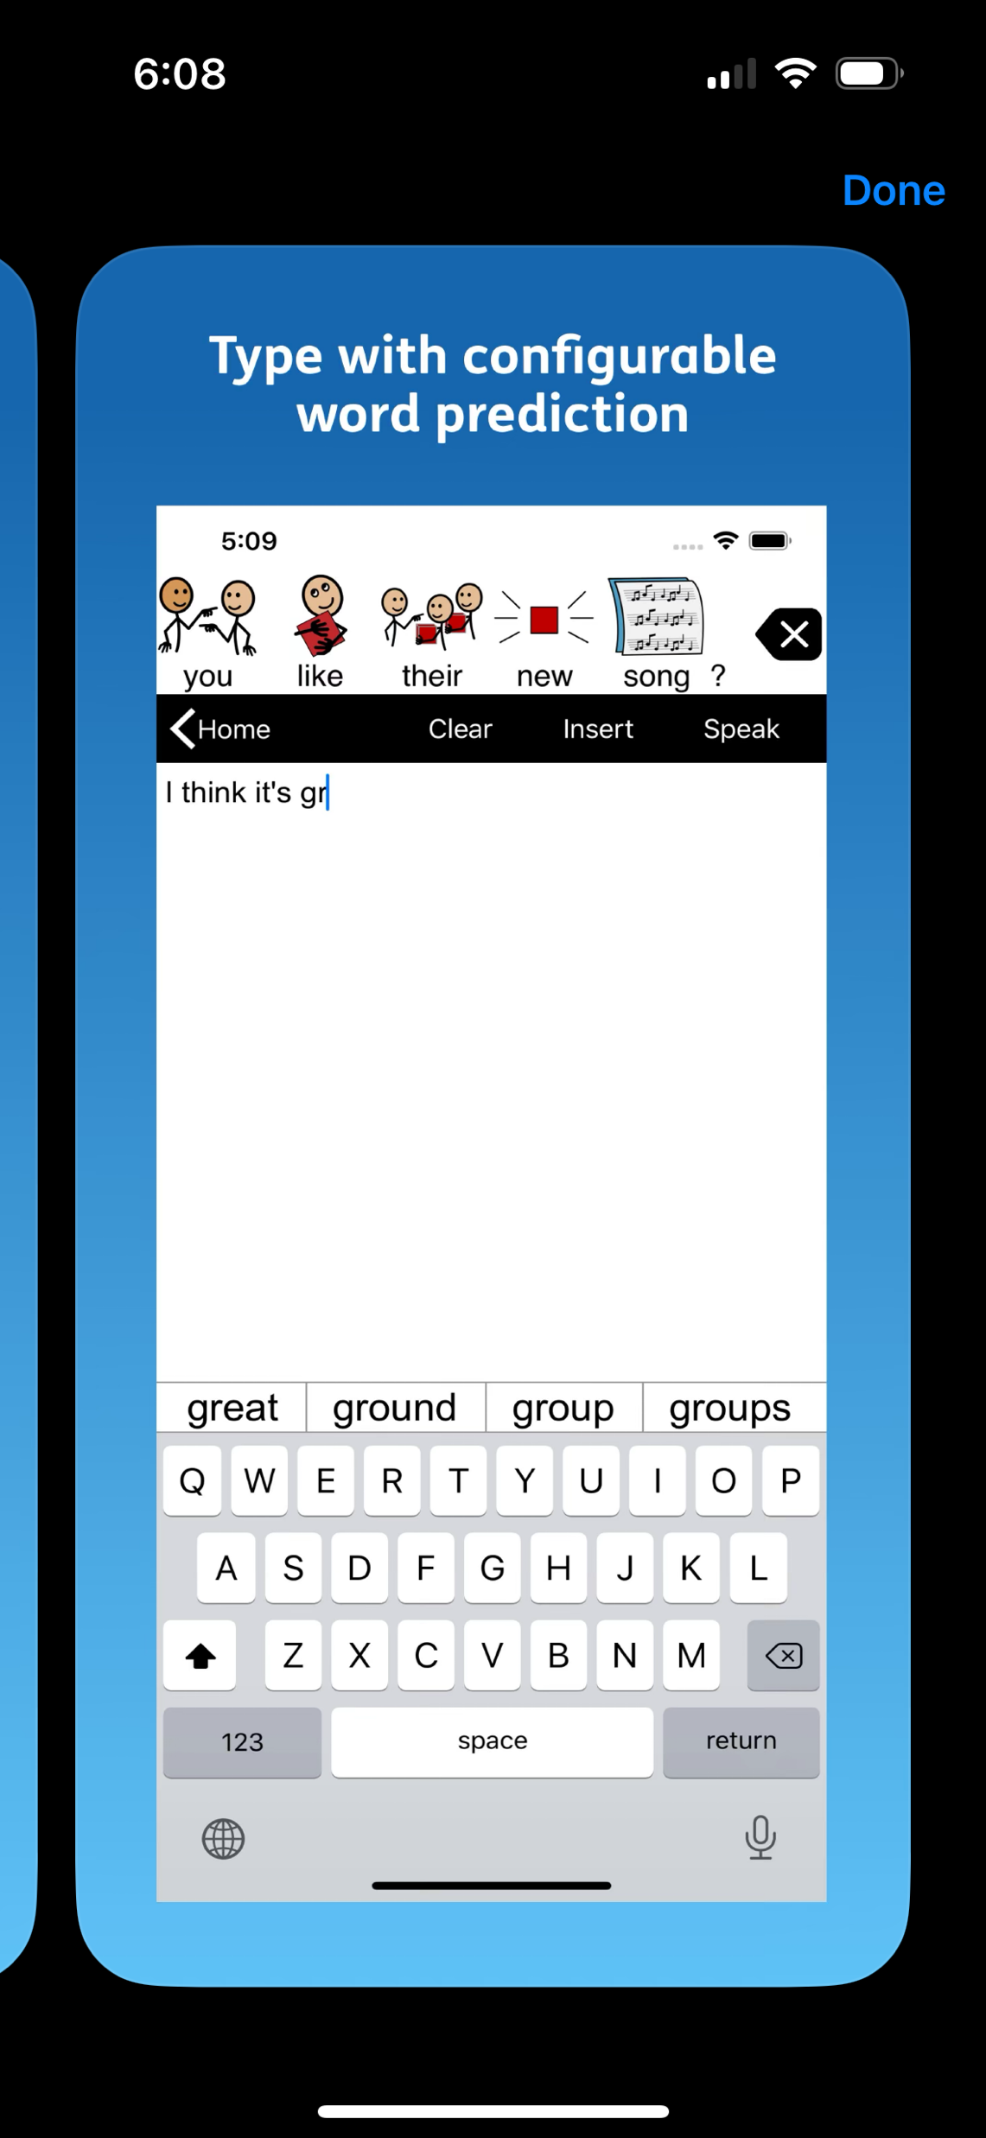

Slide 10
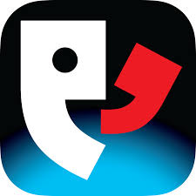
Proloquo4Text AAC
Text-to-speech communication
Text-to-Speech: This is especially helpful for those who can type but struggle with verbal communication.
Word Prediction: Word and sentence prediction, which speeds up communication by suggesting words and phrases based on the user's typing habits.
Quick Talk
Customizable Speech: Users can select from a variety of voices and adjust the speech rate, volume, and pitch, tailoring it to their preferences or needs.
Multilingual Support
Sharing Options: Proloquo4Text allows users to share their messages via text, email, or social media directly from the app, providing diverse communication channels.
Accessibility Features: offering features like large buttons, adjustable text size, and compatibility with accessibility settings on the device.
COST → $119.99
Notes:
Here’s how Proloquo4Text can be beneficial for people with aphasia:
1. **Text-to-Speech**: Users can type their messages, and the app converts the text into speech. This is especially helpful for those who can type but struggle with verbal communication.
2. **Word Prediction**: The app offers word and sentence prediction, which speeds up communication by suggesting words and phrases based on the user's typing habits.
3. **Quick Talk**: Users can save frequently used phrases and organize them for easy access. This is beneficial for commonly used expressions or responses.
4. **Customizable Speech**: Users can select from a variety of voices and adjust the speech rate, volume, and pitch, tailoring it to their preferences or needs.
5. **Multilingual Support**: The app supports multiple languages, allowing users who are multilingual or prefer to communicate in a language other than English to use the app effectively.
6. **Sharing Options**: Proloquo4Text allows users to share their messages via text, email, or social media directly from the app, providing diverse communication channels.
7. **Accessibility Features**: The app is designed with accessibility in mind, offering features like large buttons, adjustable text size, and compatibility with accessibility settings on the device.
By leveraging these features, individuals with aphasia can express themselves more independently and engage in conversations with those around them, thereby improving their quality of life and social interactions.

Slide 11
Proloquo4Text AAC
Text-to-speech communication
https://youtu.be/1TaUEIJgBU0?si=Eln-RME39z6E-vE8

Slide 12

TouchChat
TouchChat is a full-featured communication solution for individuals who have difficulty using their voice/speaking.
Available in French, Spanish, Mandarin and English
Universal app supporting iPhone®, iPod®, and iPad®.
Words, phrases and messages are spoken with a built-in voice synthesizer or by playing recorded message
Gives an individual the ability to navigate through page sets and speak messages. Page sets are linked pages, each of which is divided into a number of buttons. The buttons are programmed to have specific actions, such as speaking a message, navigating to a different page, changing the volume or clearing the display.
Cost → $299.99
Overivew of TouchChat HD with Wordpower

Slide 13
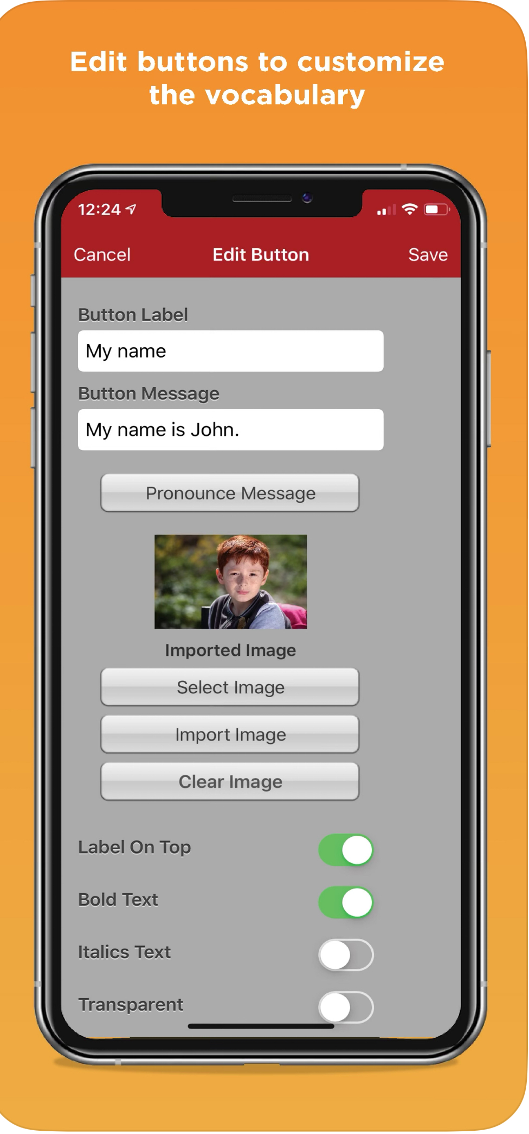
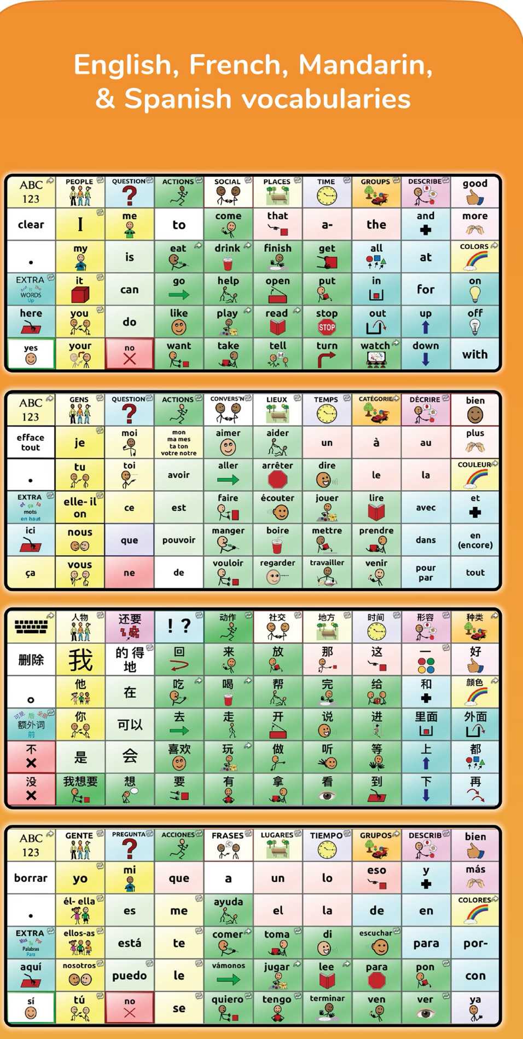
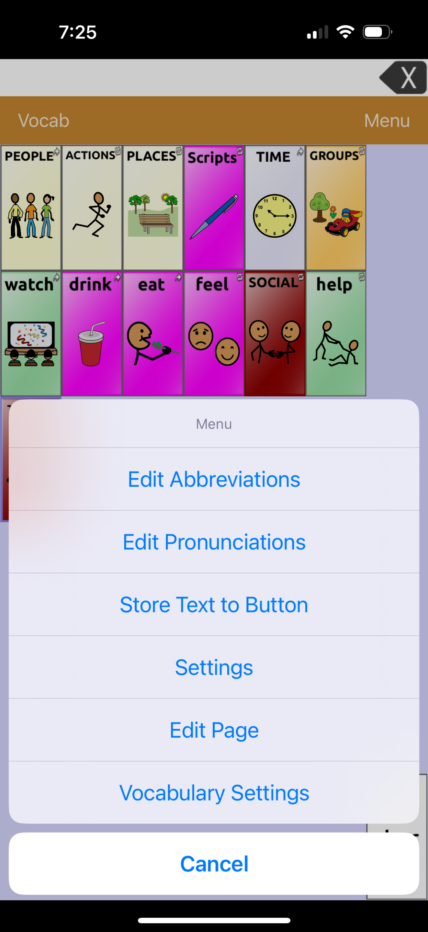

Slide 14

QUESTIONS?
See you next time – Tuesday, March 11th @4:00pm EST.

