Slide 1
Technology and Supports for Aphasia
Brooke Lang, M.A., CCC-SLP and Bryn Lander

Slide 2
GOOD NEWS! Resources available!
Here is where you can find our powerpoints and other resources:
https://aphasia.org/all-about-naa-events/

Slide 3
A new AI app – made just for YOU!
Stephen Albright – stroke survivor
Created AphasiaGPT – AI tool designed to assist individuals with aphasia in rebuilding their communication skills.
Offers AI powered conversations, exercises, and real-world scenario and practice

Slide 4
What is AphasiaGPT?
AphasiaGPT is an app designed to support communication for people with aphasia and other language challenges.
It helps with:
Word finding
Vocabulary practice
Listening and speaking
Everyday communication
You can use it:
on a computer
on a phone (availability may depend on the device)
Notes:
Android support is in progress

Slide 5
Word Finder
Word Finder
This tool helps when a word feels “stuck.”
It can:
explain the meaning of a word in simple language
give examples in short or longer sentences
find similar words or opposite words
read answers out loud so you can listen and read together
Helpful for word finding, reading, and understanding new words.

Slide 6
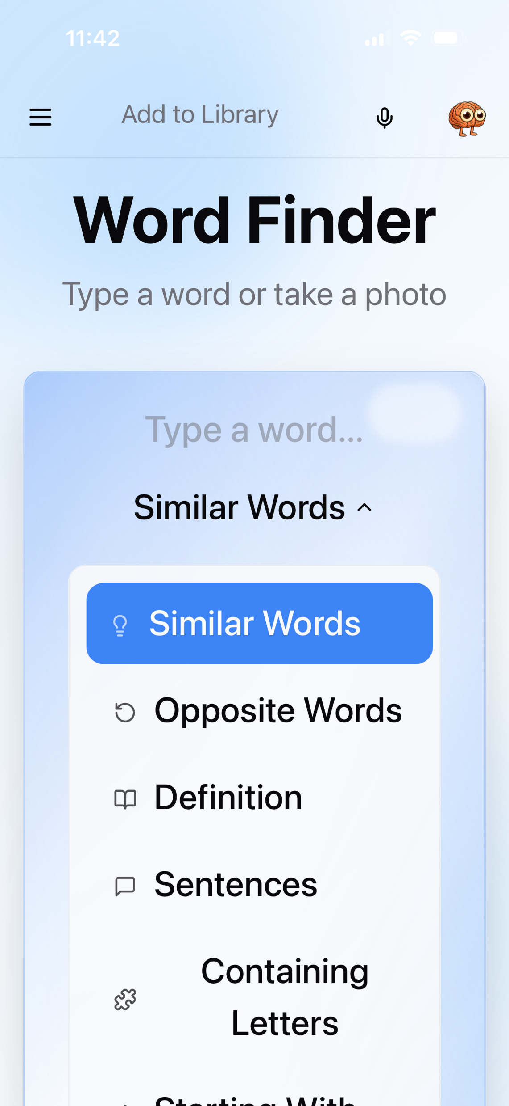
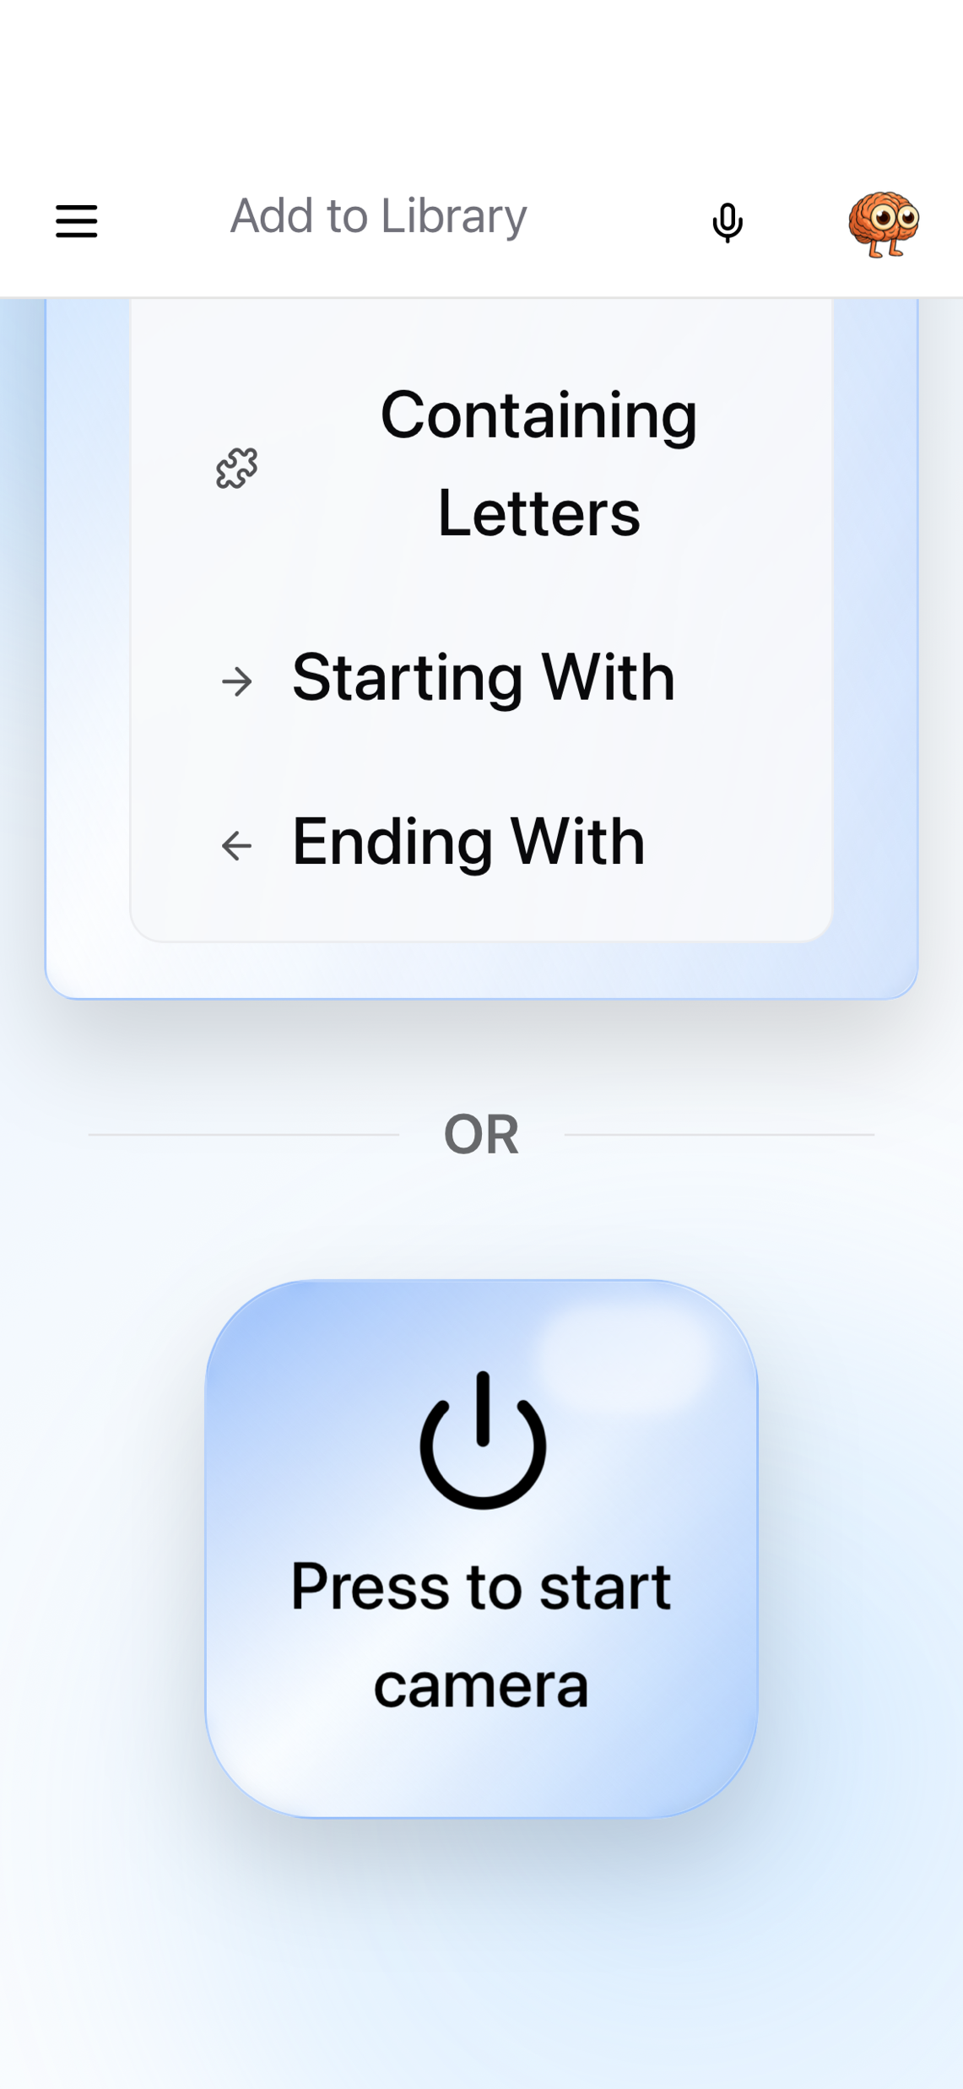

Slide 7
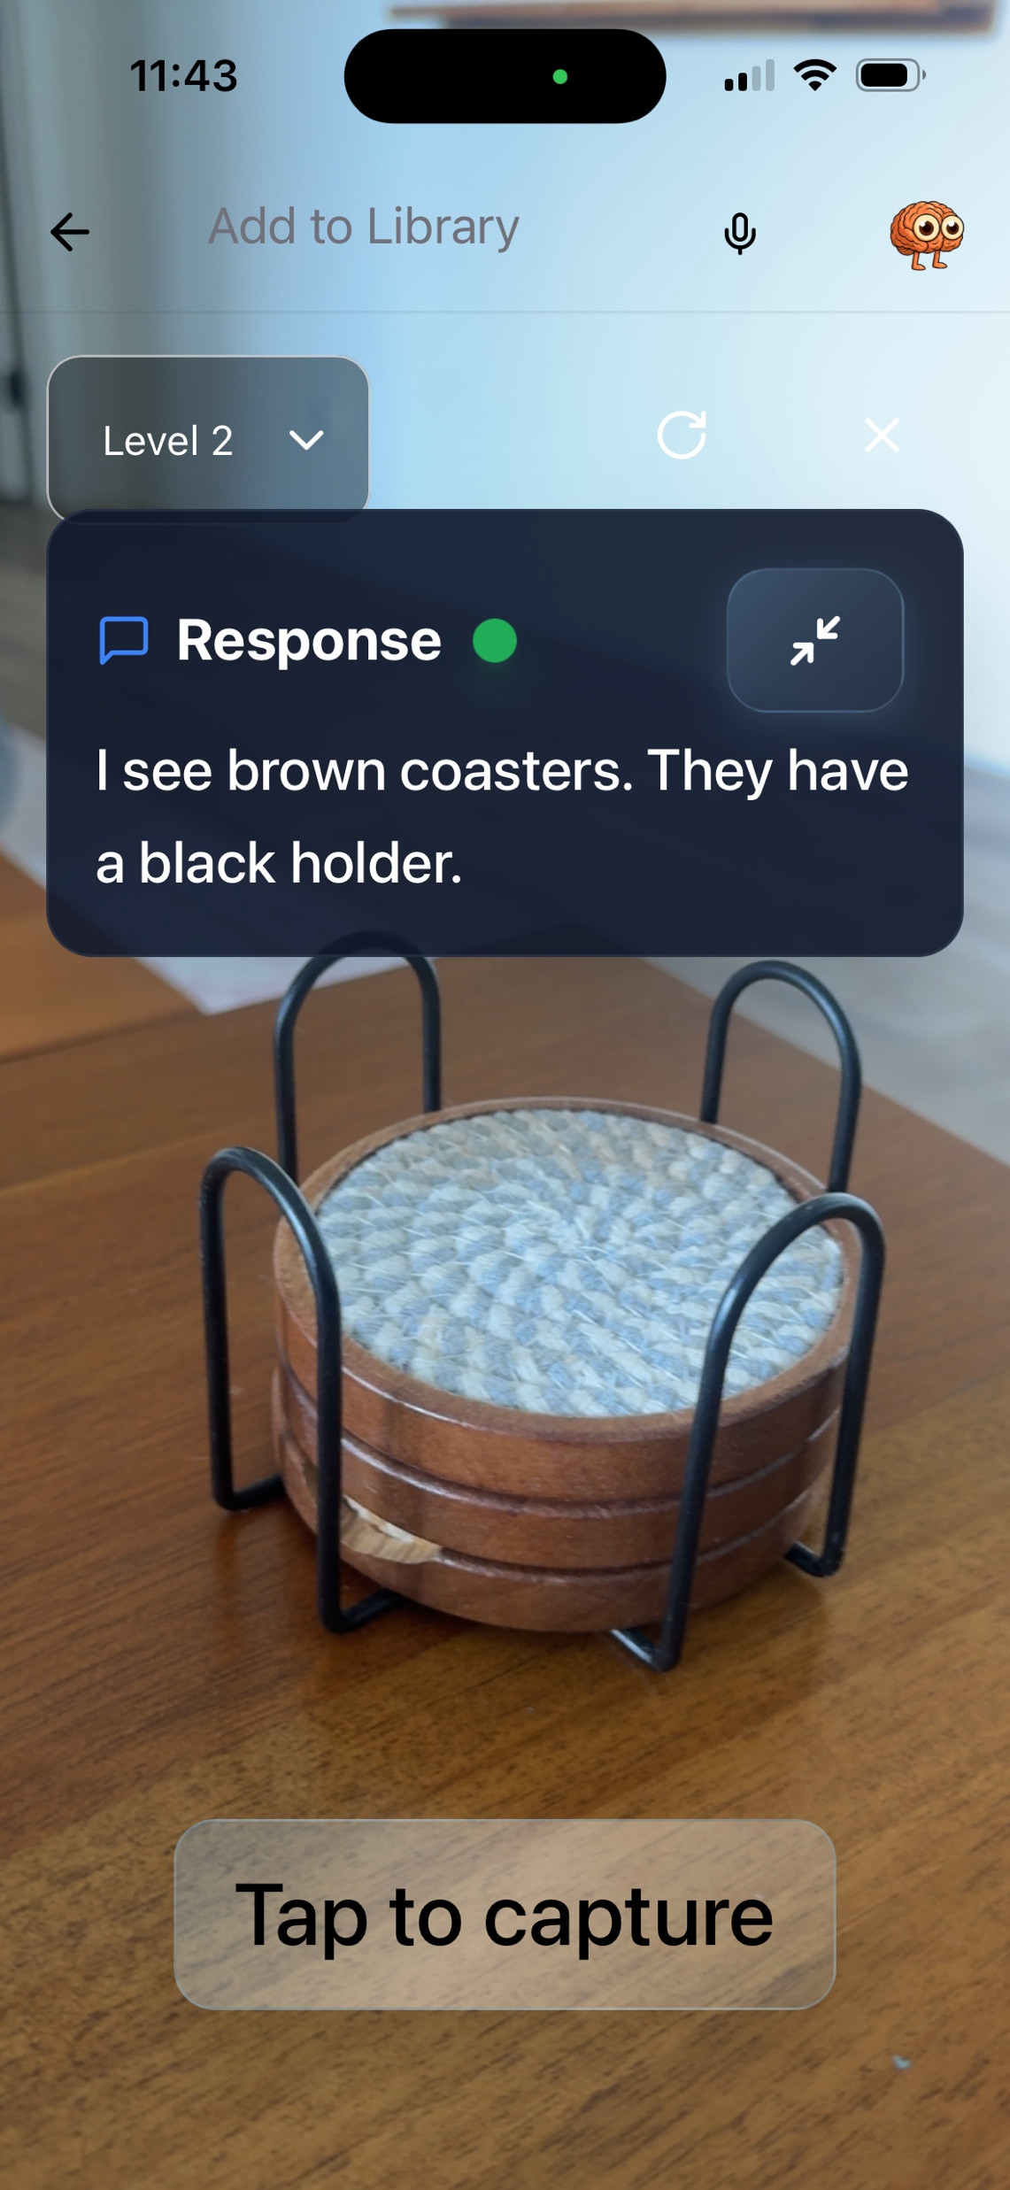
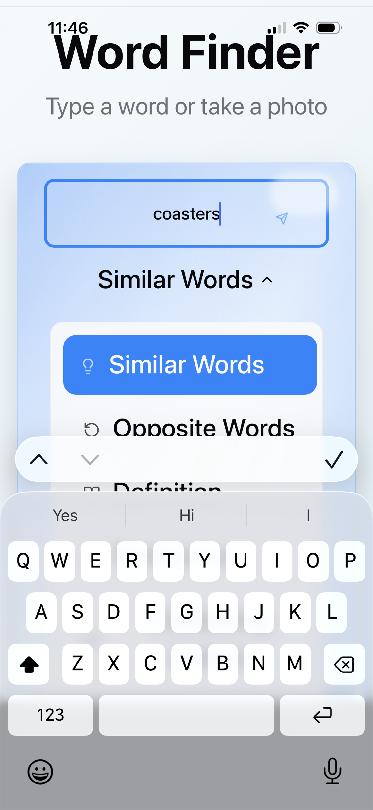
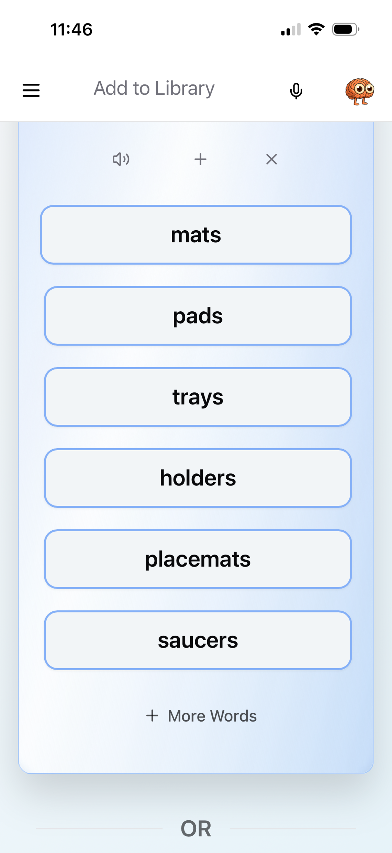

Slide 8
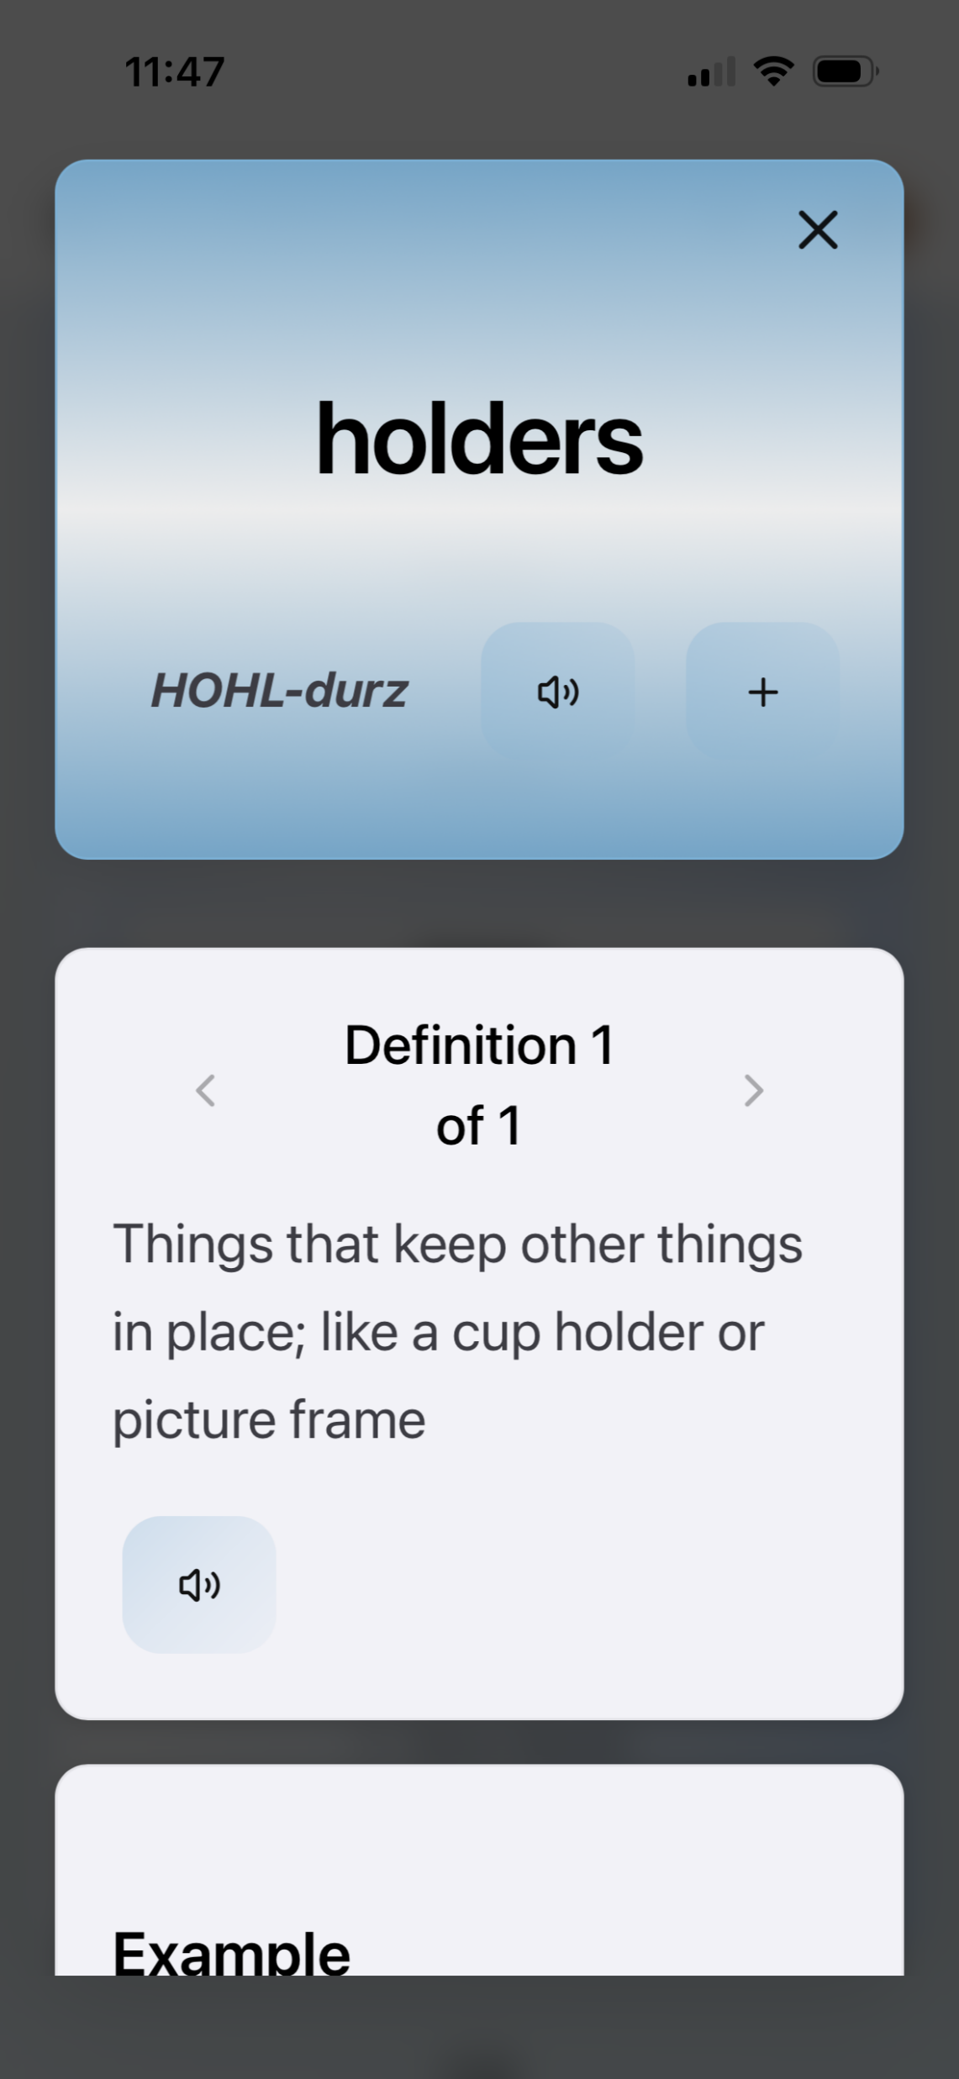
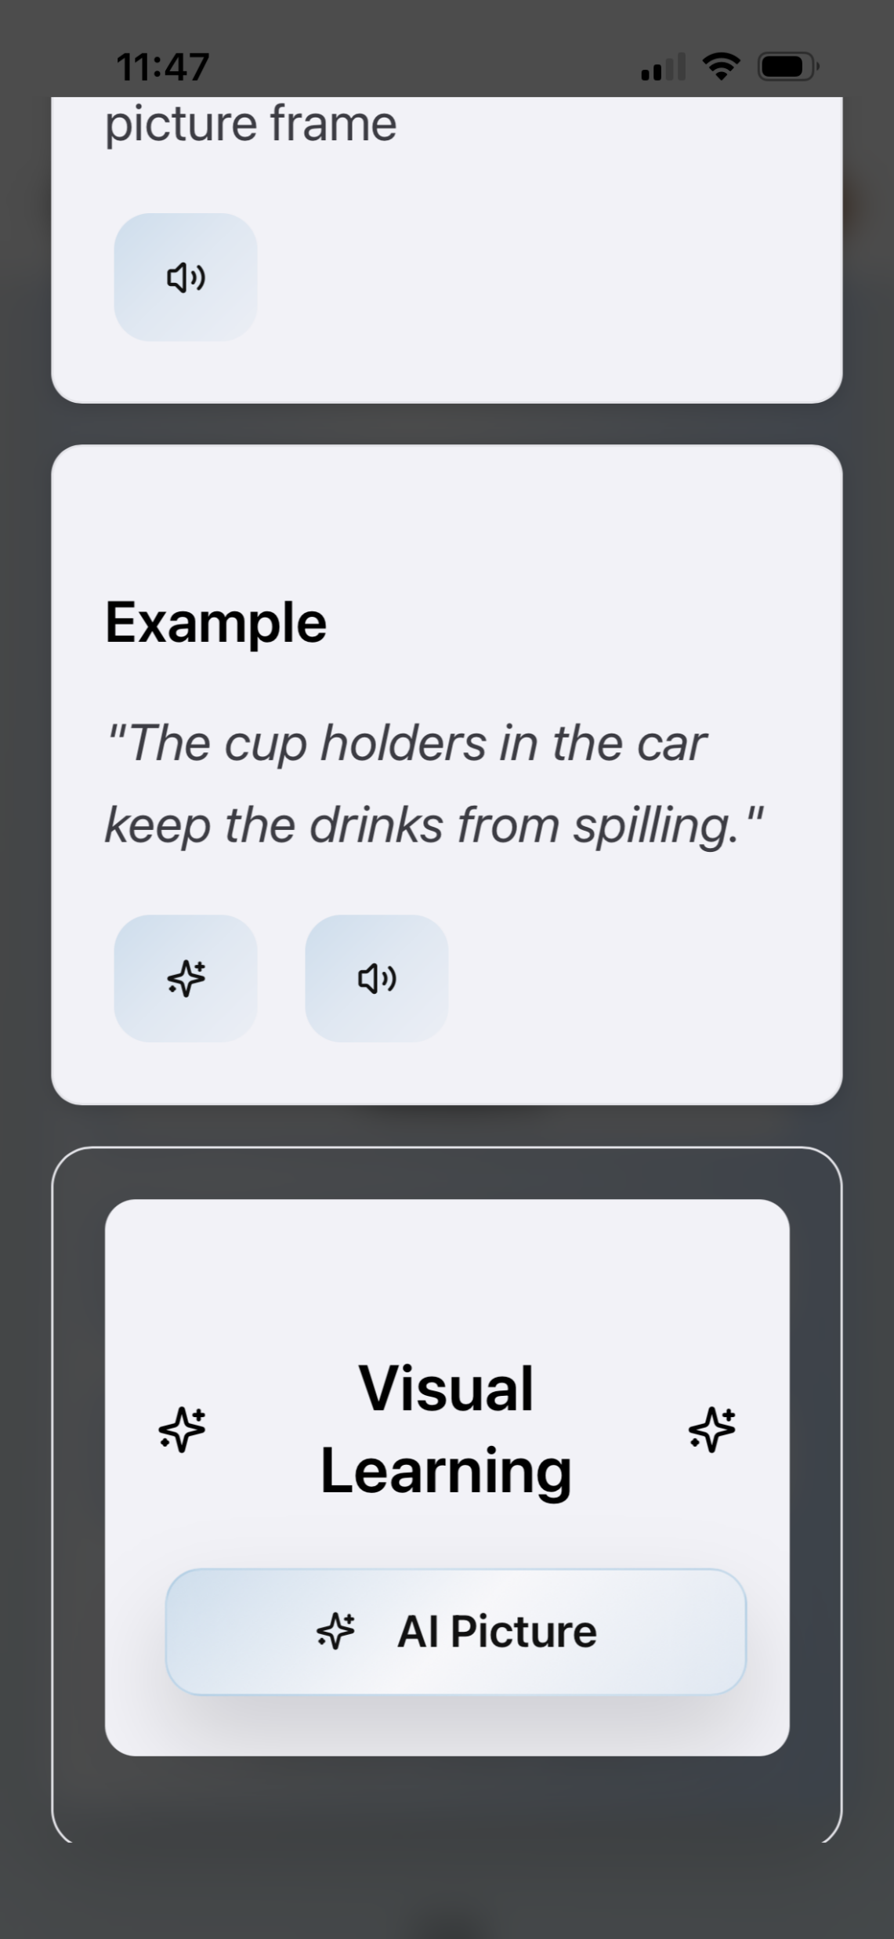
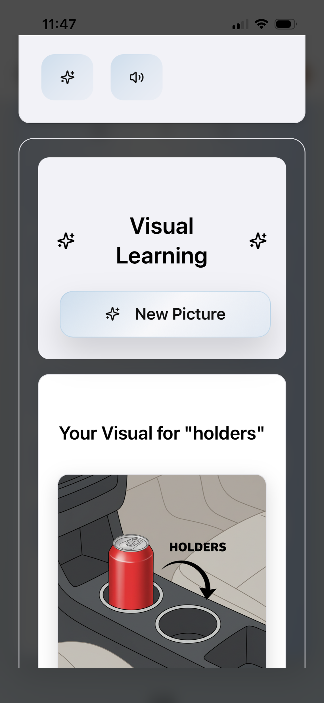

Slide 9
Vocabulary Builder
Vocabulary Builder
This feature helps you save and practice important words.
You can:
create your own personal word lists
tap a word to hear it spoken slowly
see visual examples to help memory
track your progress over time
Helpful for therapy practice and everyday words you use a lot.

Slide 10
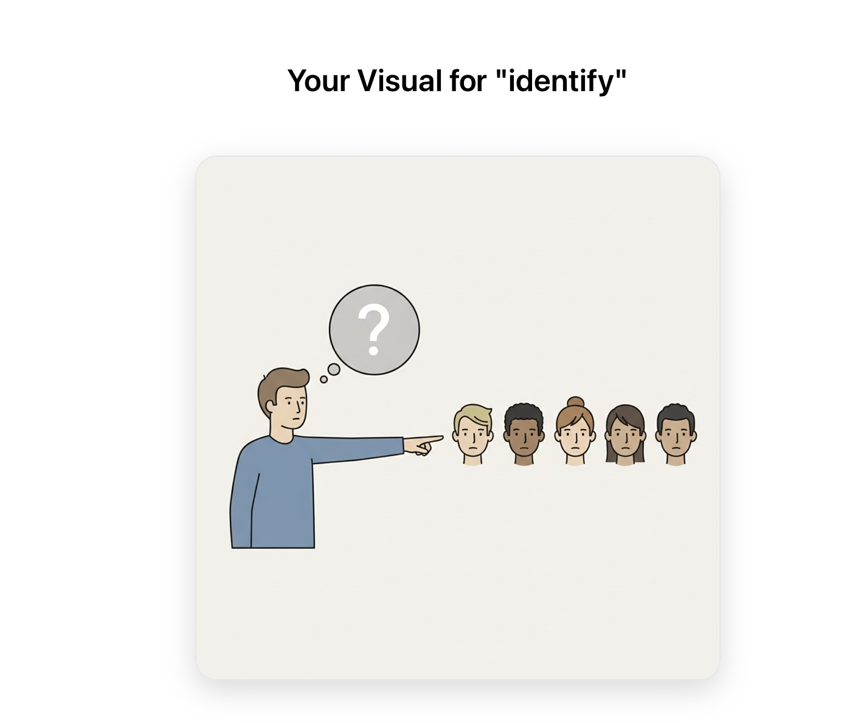
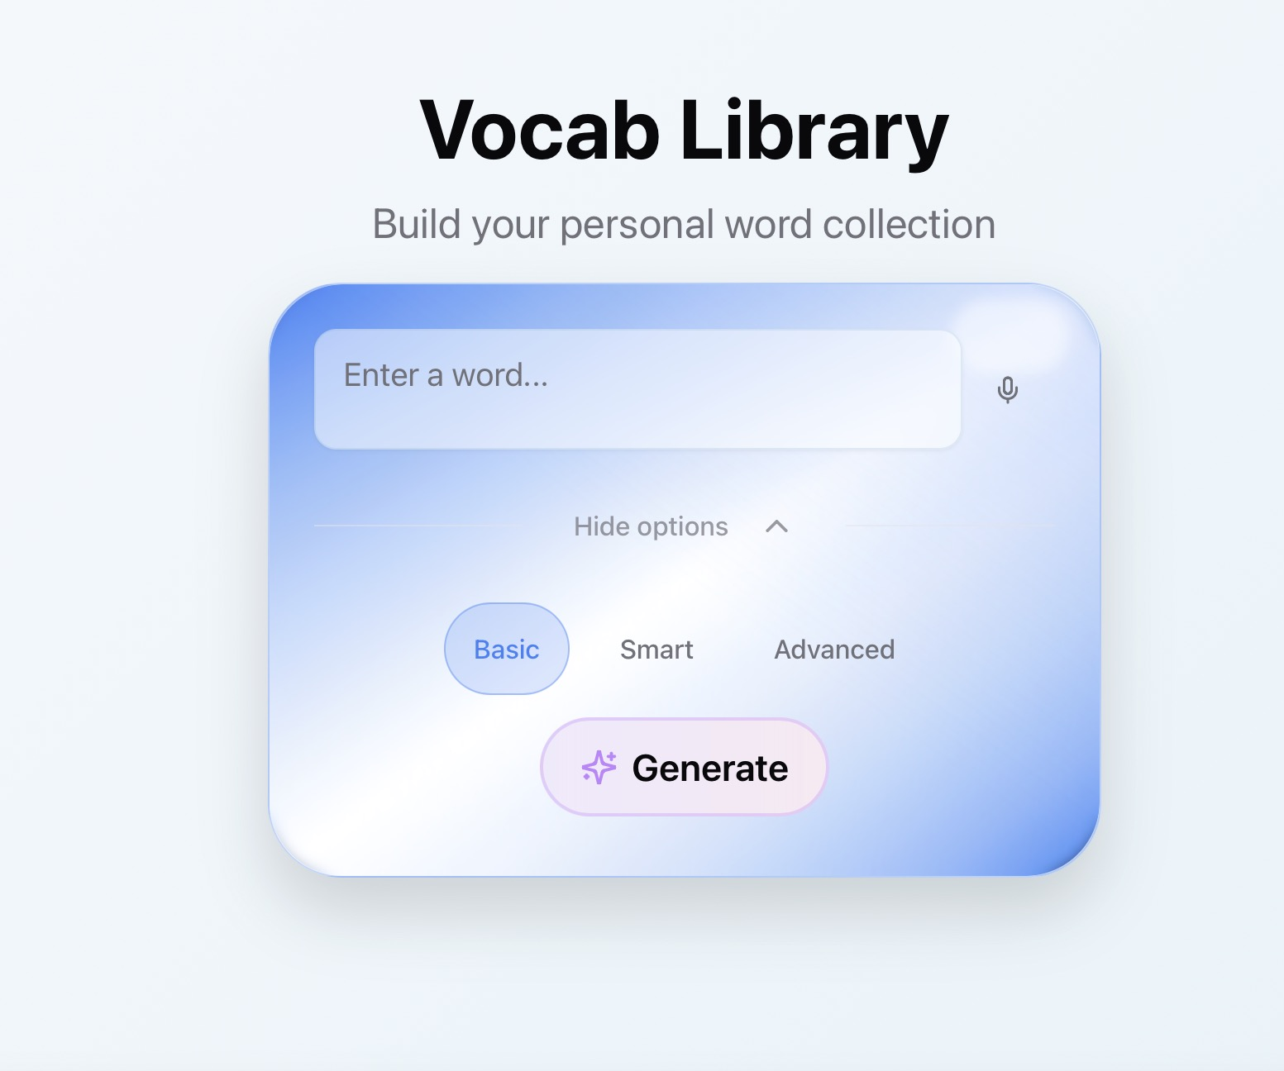
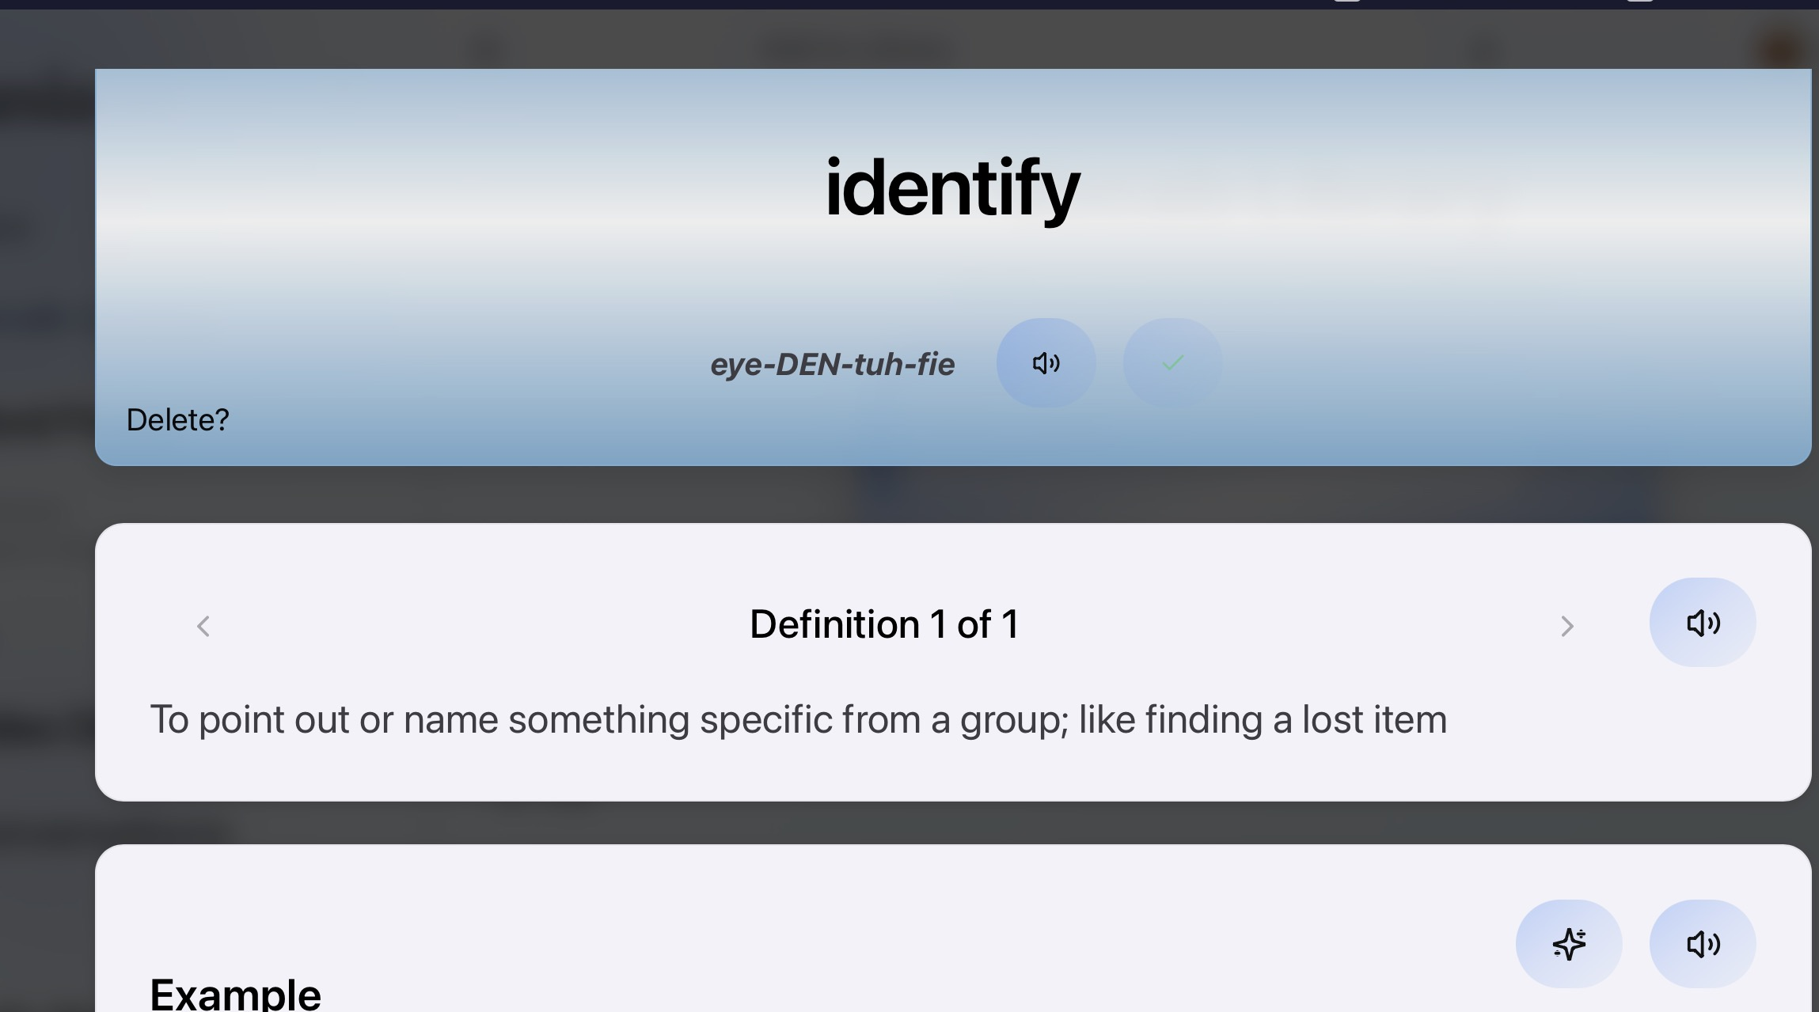

Slide 11
Personalized News
Personalized News
This tool helps you stay informed without feeling overwhelmed.
It lets you:
choose topics you care about (health, sports, tech, etc.)
choose how long the summary is
listen instead of reading
focus on the main ideas
Helpful if long articles or complex words feel tiring.

Slide 12
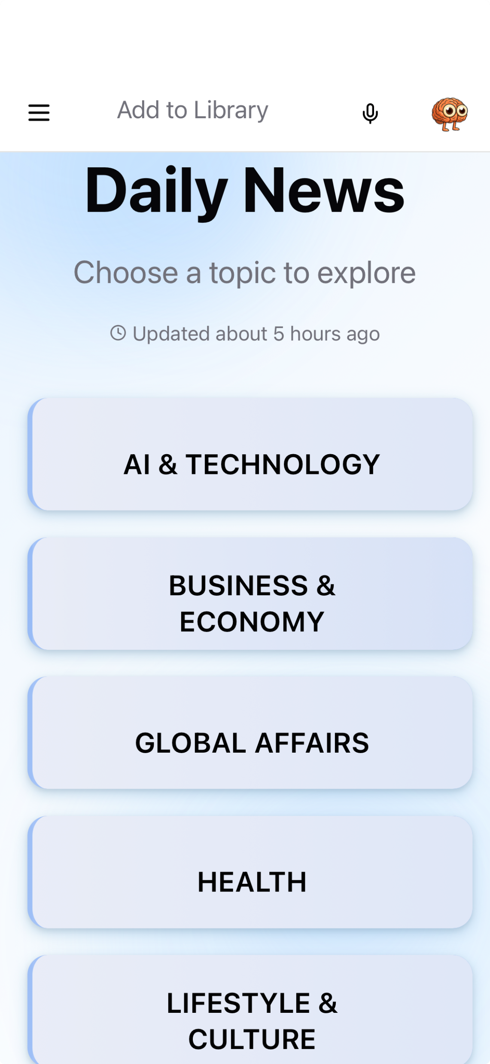
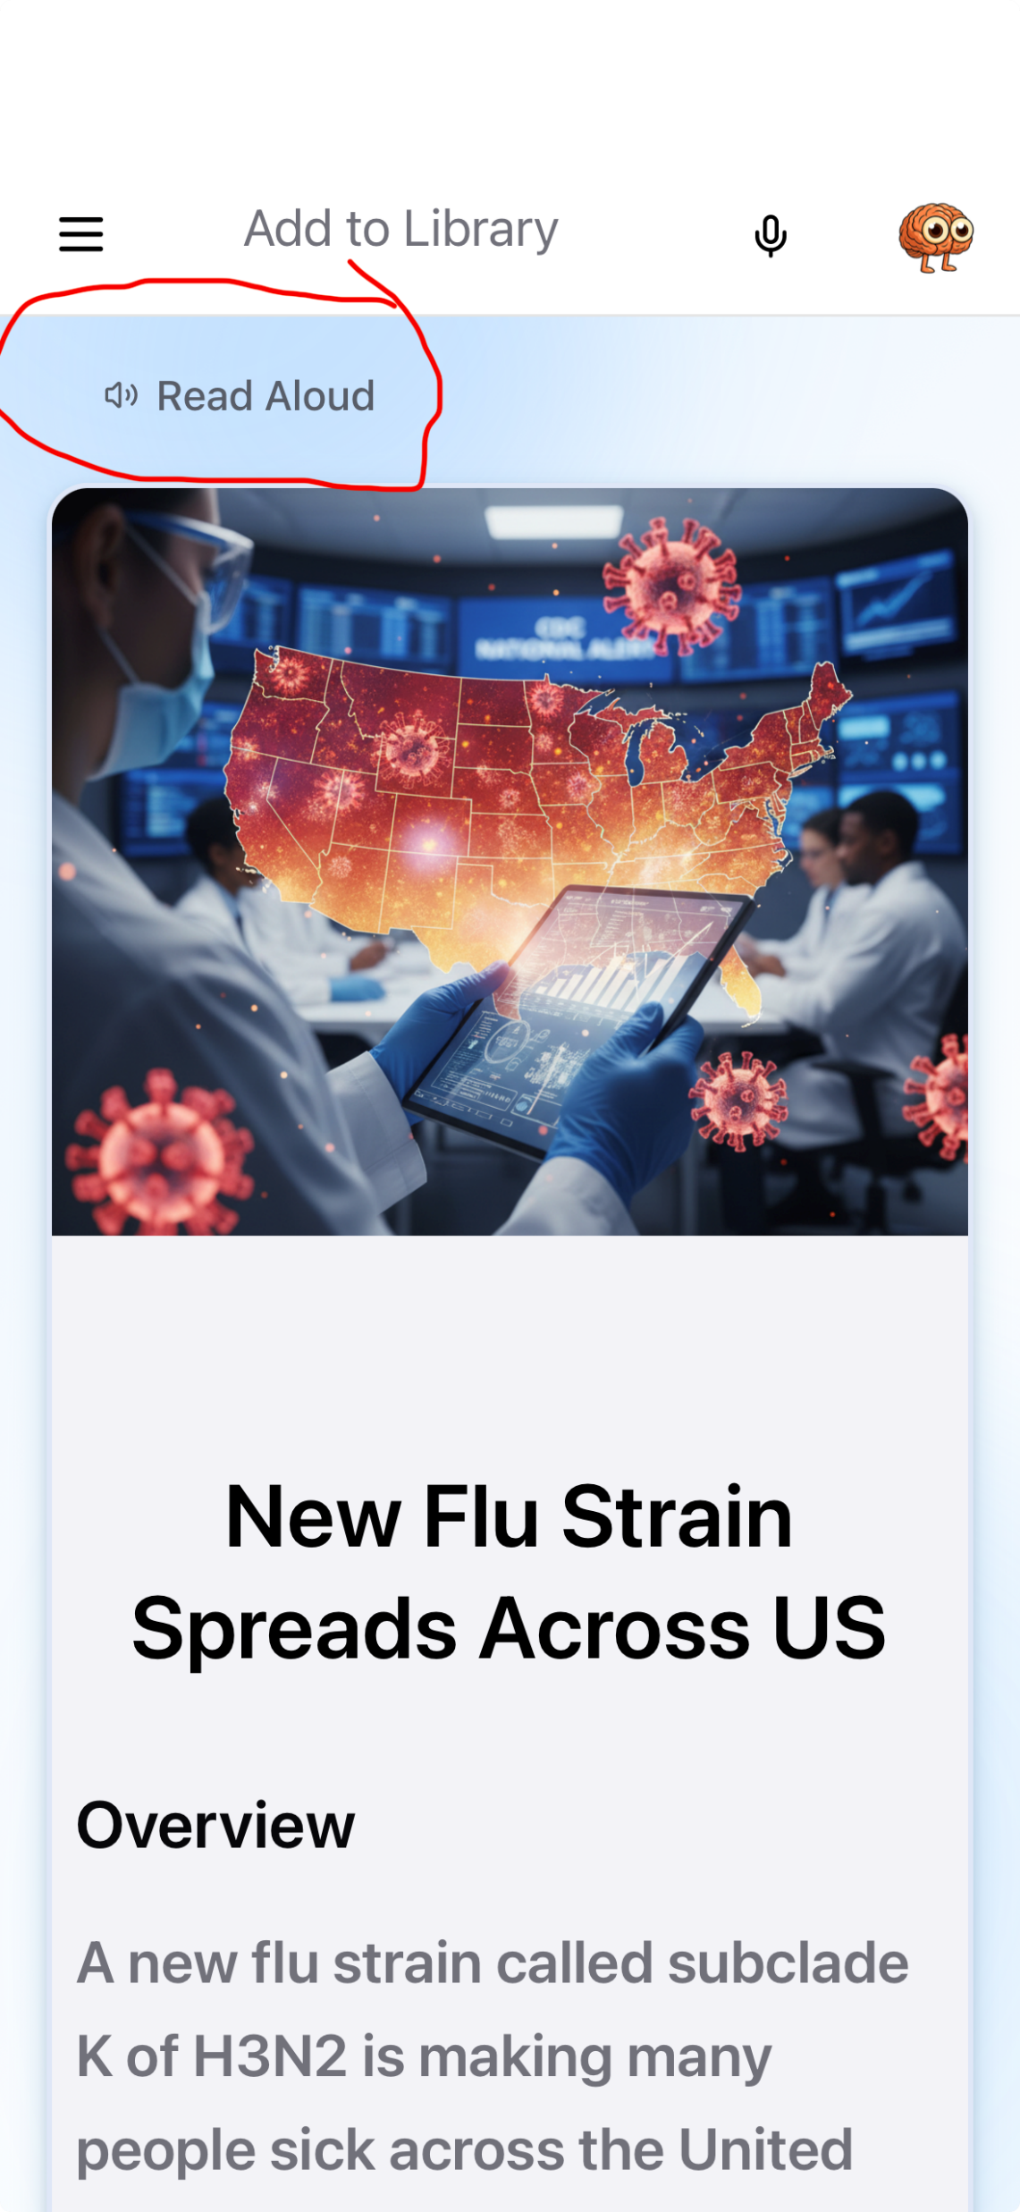
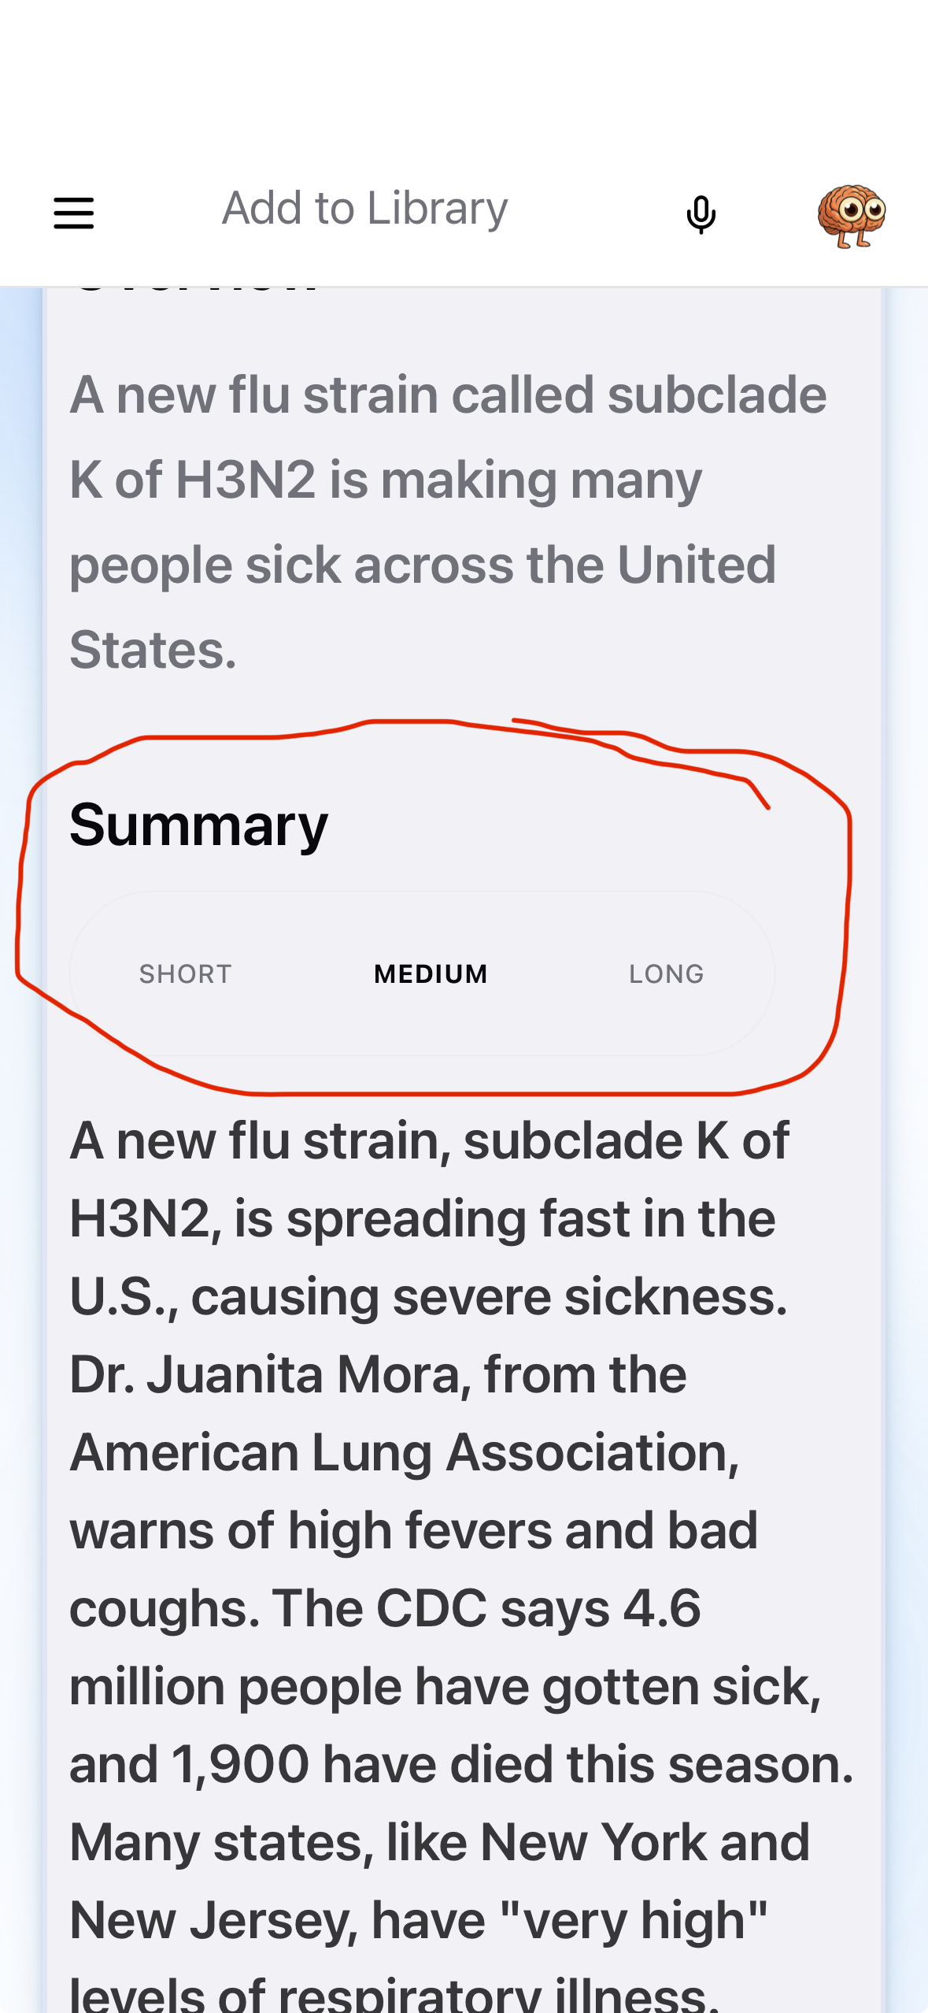

Slide 13
Recorder
Recorder
This tool records speech and turns it into text.
It can:
transcribe conversations or meetings
add punctuation automatically
create summaries and key points
save or export notes
Helpful for meetings, appointments, or speech therapy sessions.

Slide 14
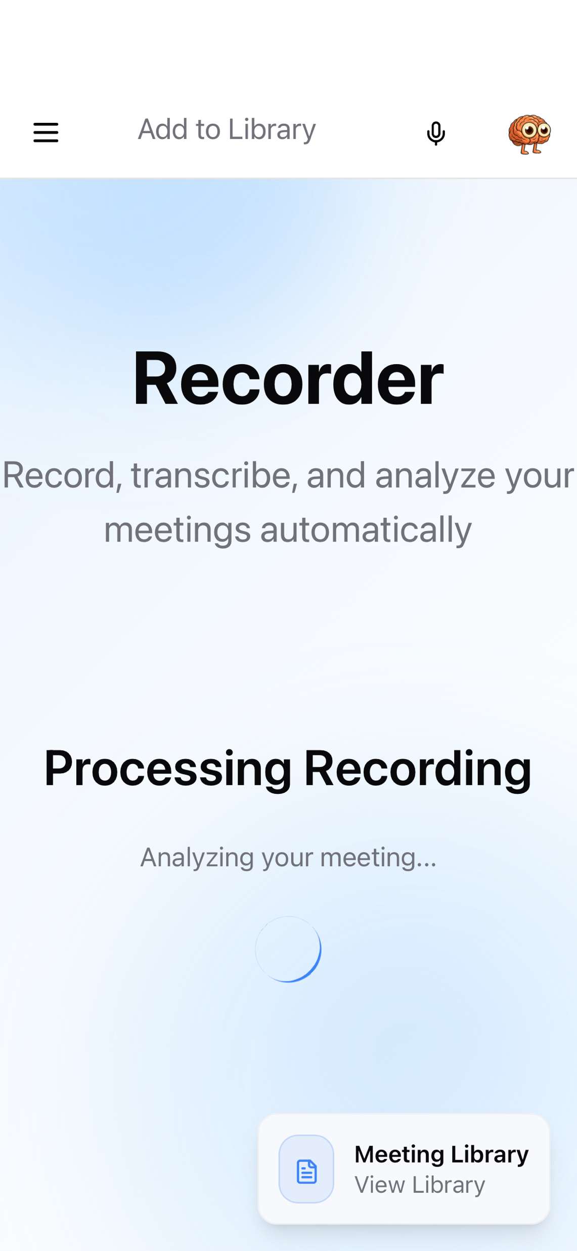
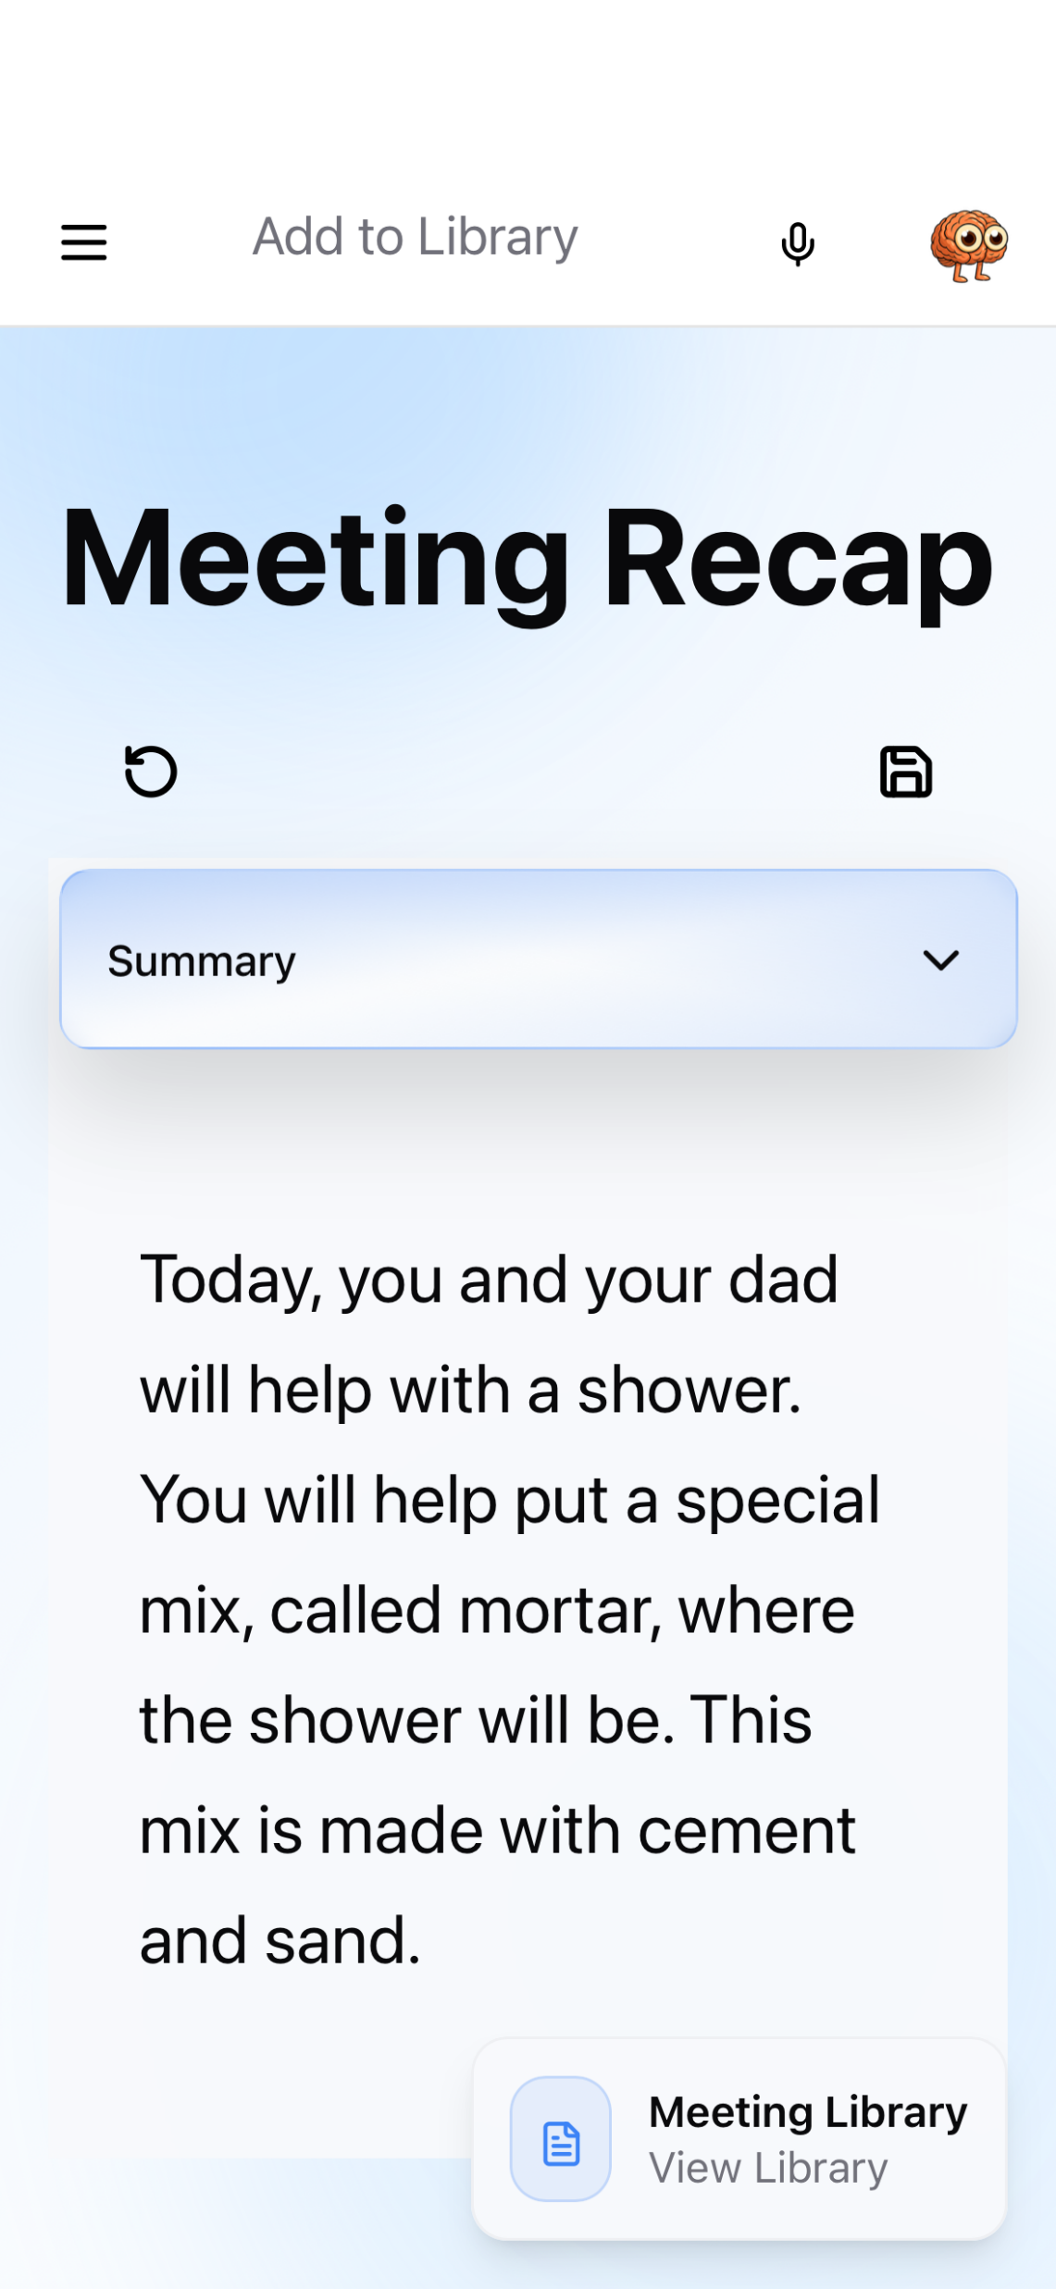

Slide 15
Simulation
Conversation Practice (Simulation)
This feature lets you practice real-life situations.
You can:
practice talking in places like a café, doctor’s office, or airport
speak naturally with an AI character
see a transcript of the conversation
practice at your own pace
Helpful for confidence and real-world communication.

Slide 16



Slide 17
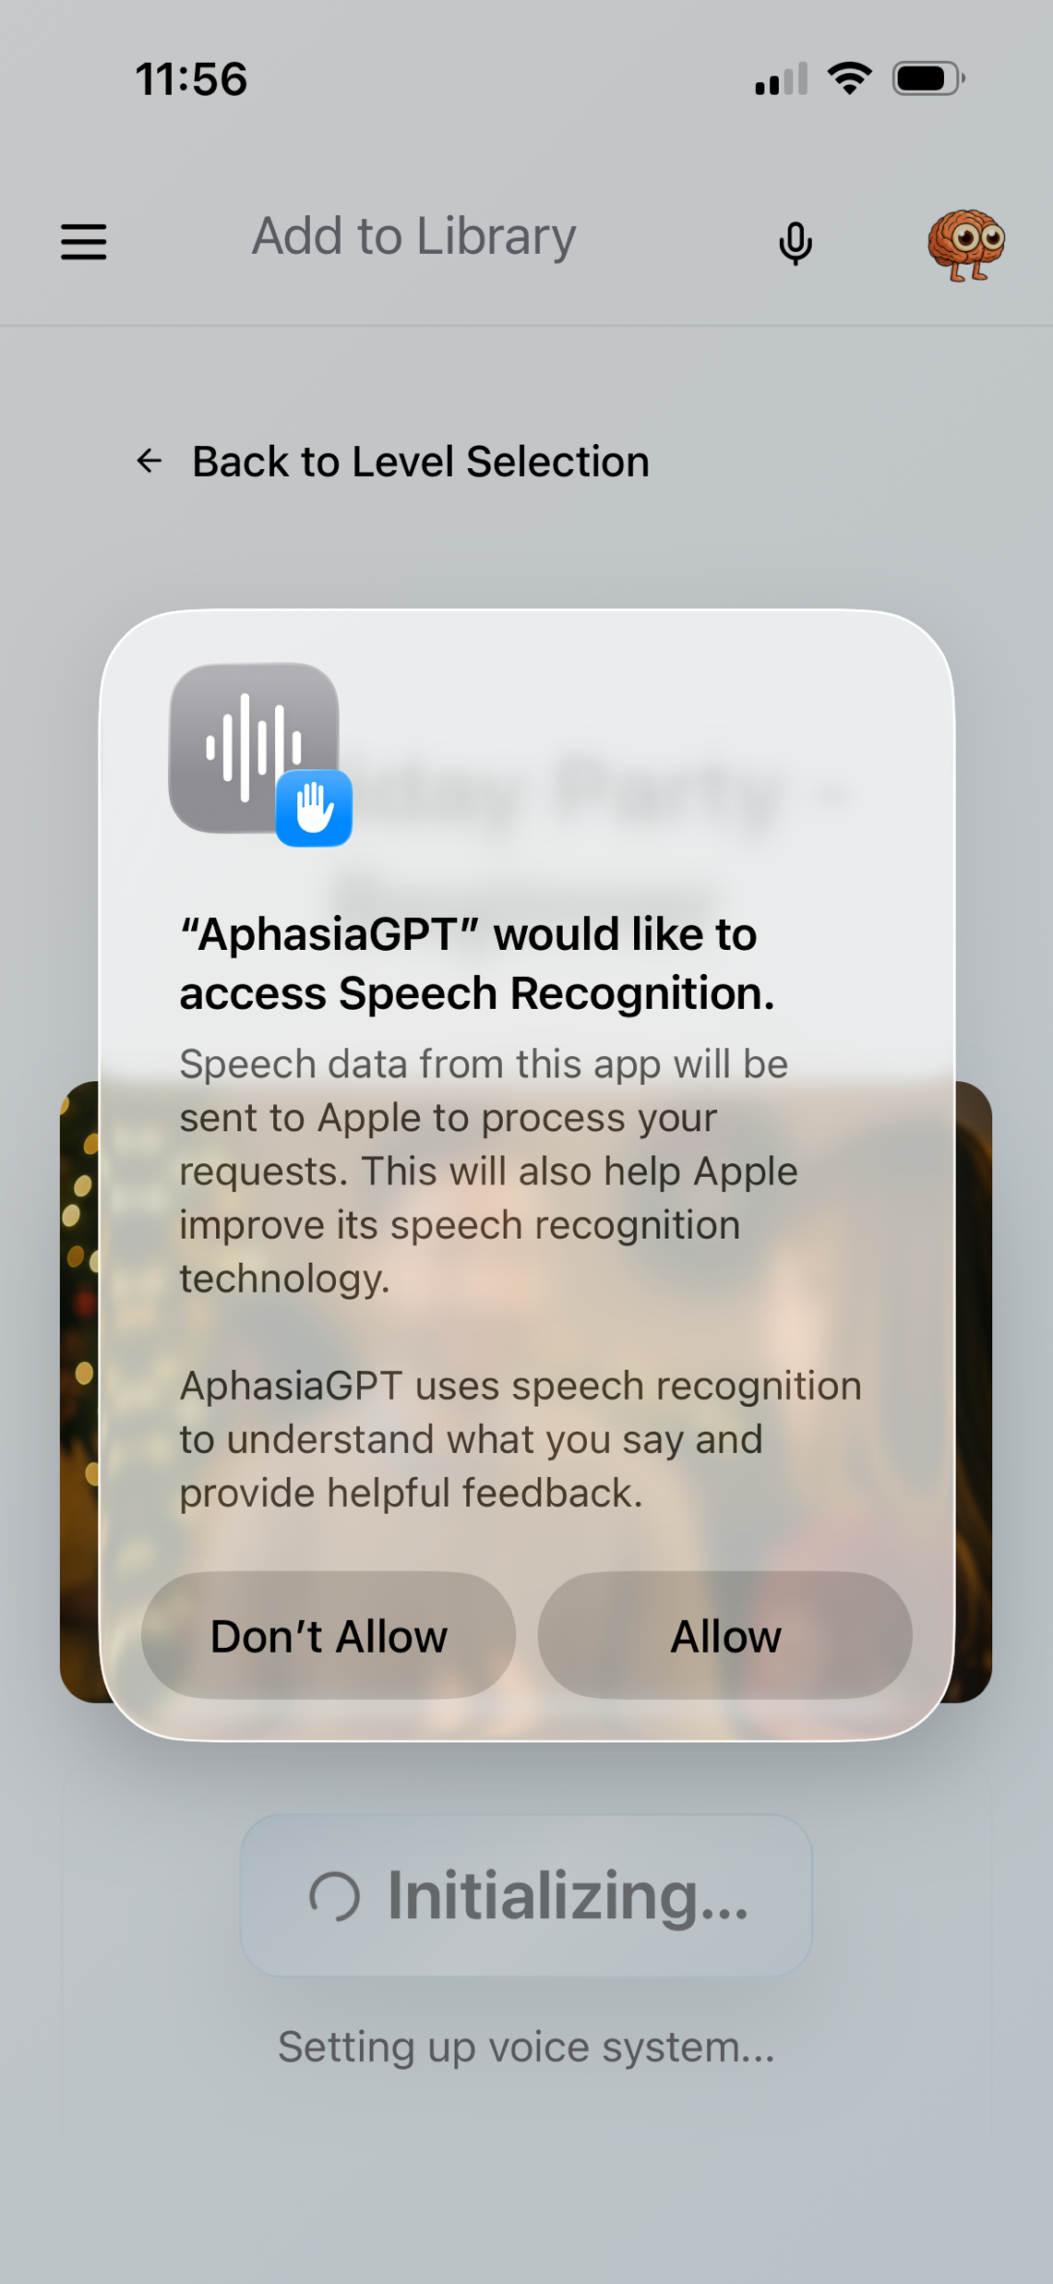
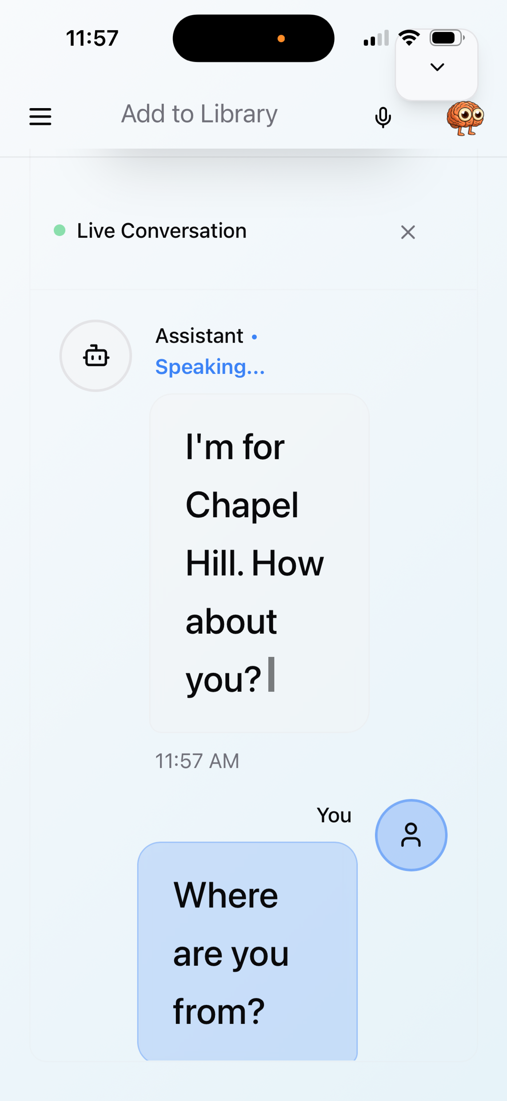

Slide 18
Coach
Coach
This tool focuses on expression and describing.
It helps you:
watch short videos
describe what you see
practice speaking or writing
receive gentle feedback
Helpful for storytelling, descriptions, and expressive language.

Slide 19
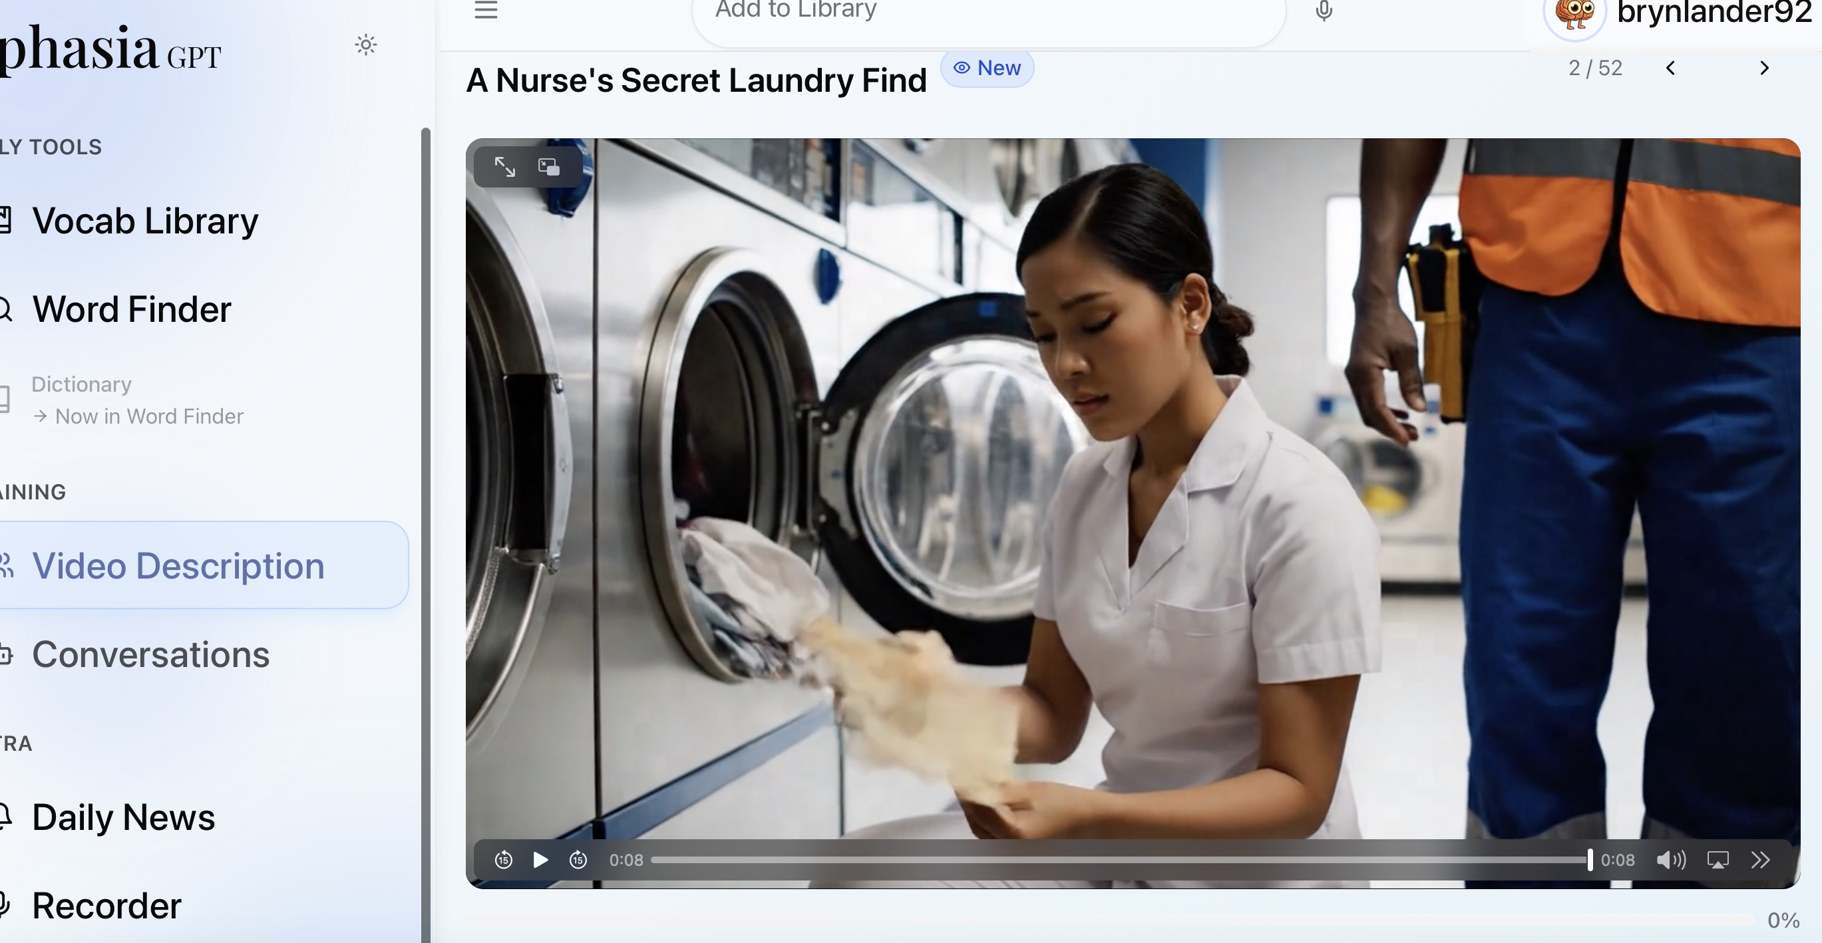
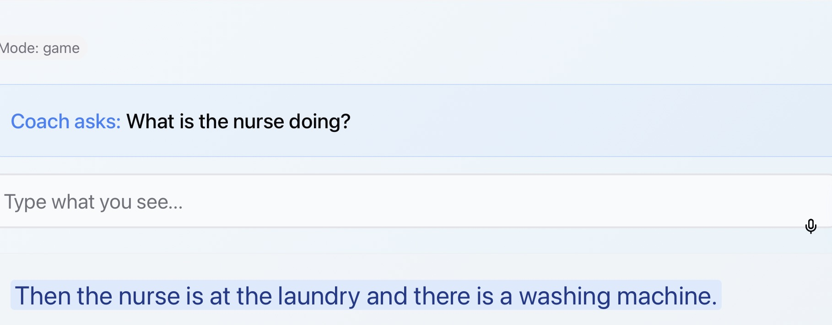

Slide 20
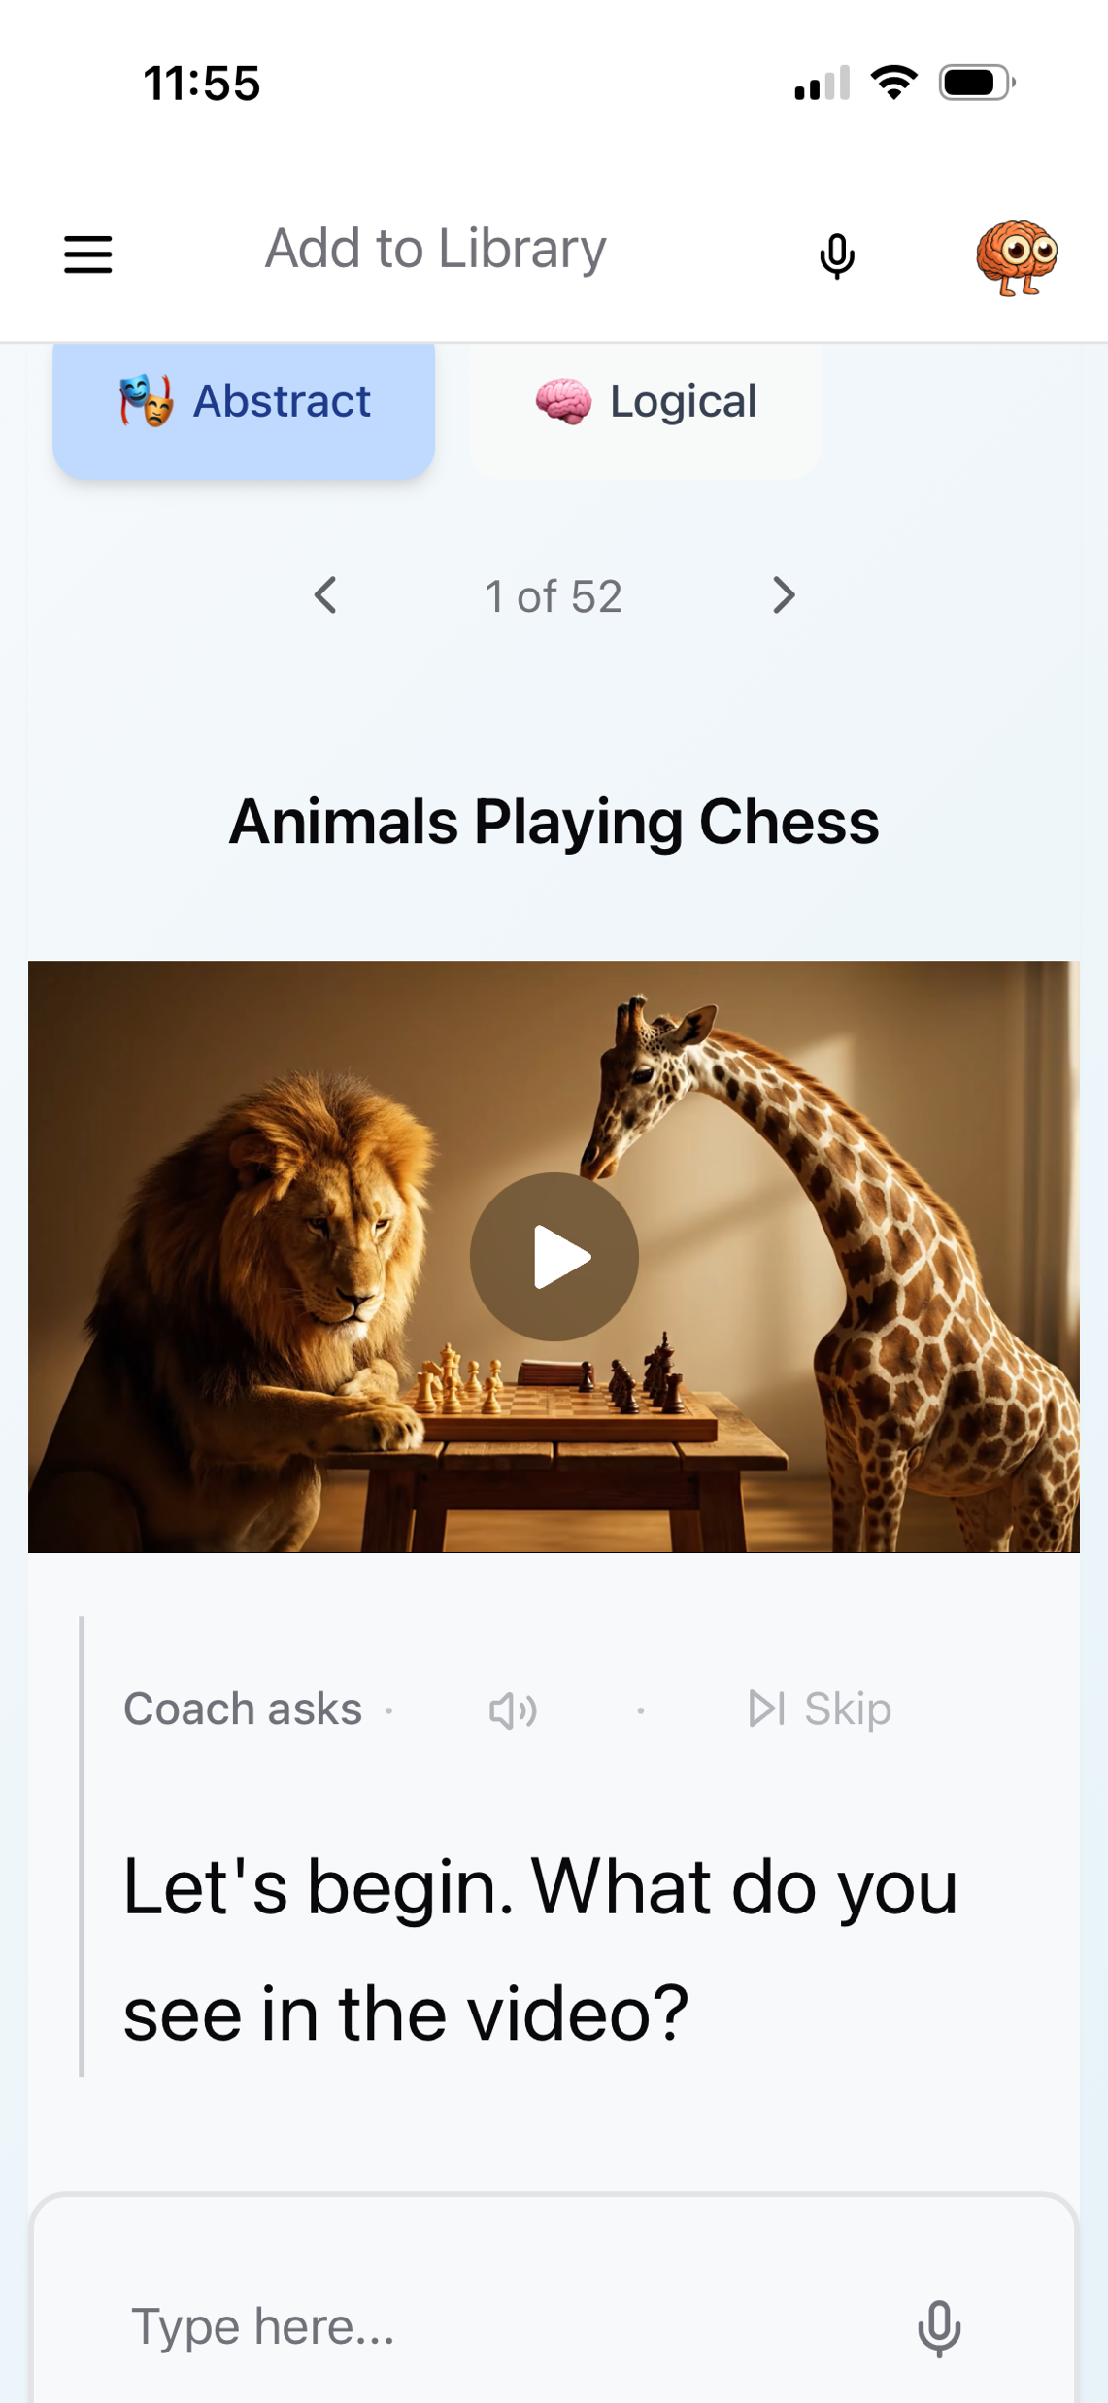

Slide 21

NEXT MEETING
See you next time!
Next Group: Wednesday, Mar 4th @4:00pm EST

