Slide 1
Technology and Supports for Aphasia:
Apps, phone features, transportation assistance, artificial intelligence (AI), and MORE!
Brooke Lang, M.A., CCC-SLP (Owner of Integrative Reconnective Aphasia Therapy)
Bryn Bowles (Aphasia survivor)
Notes:
https://www.accessibility.com/blog/ios-v.-android-mobility-accessibility-features-listed

Slide 2
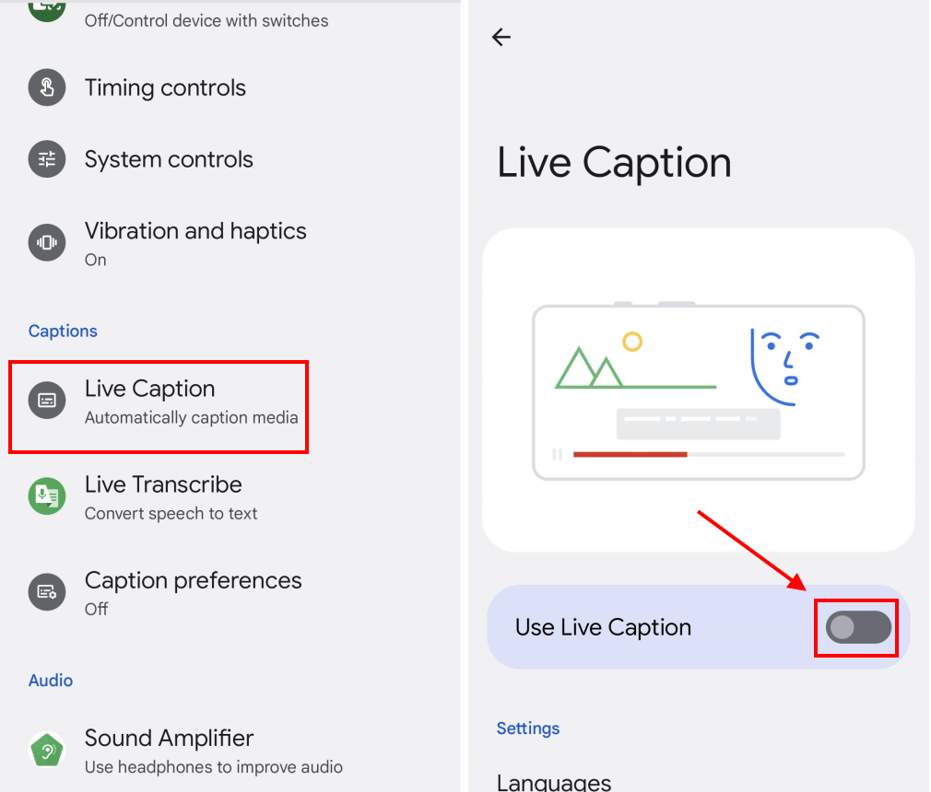
Live Captions: Android
Notes:
https://youtu.be/Tgd_FOfCoSA?si=HpBAOf913Bry-LYG
https://youtu.be/UNyOI5L5Ktk?si=n5gz0mHPZ_PKJeEs

Slide 3
Live Captions: Android
How to turn on
*Go to Settings, then Accessibility, then Live Caption, and turn on Use live captions
How to customize
*Go to Settings, then Accessibility, then Live Caption, and then tap Appearance
How to turn on and off
*Open the device's volume controls
How to change settings
*Go to Settings, then Accessibility, then Live Caption, and then you can:
*Hide or show profanity
*Hide or show sound labels, such as laughter and applause
*Hide or show the Live Caption icon in volume control
*Turn call captioning on or off

Slide 4
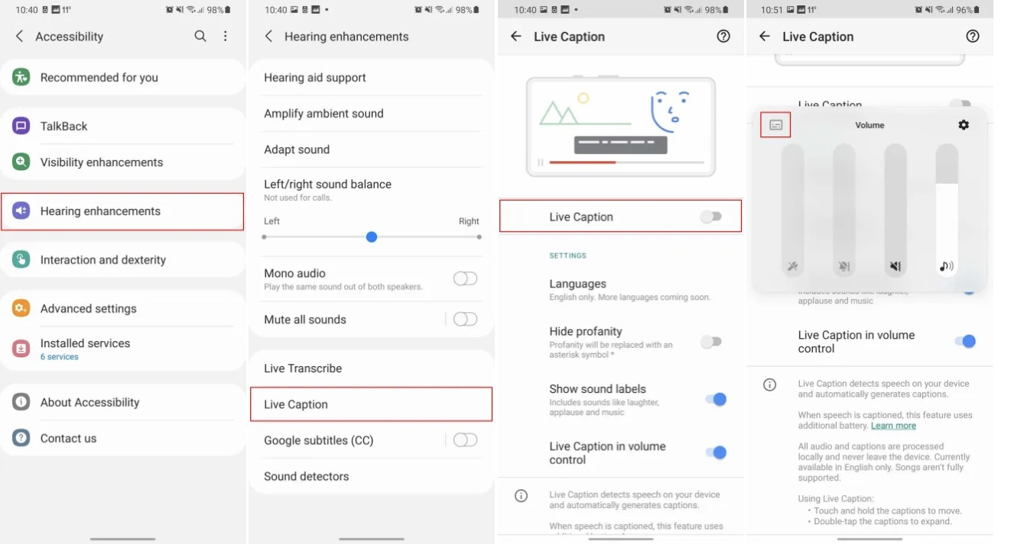

Slide 5
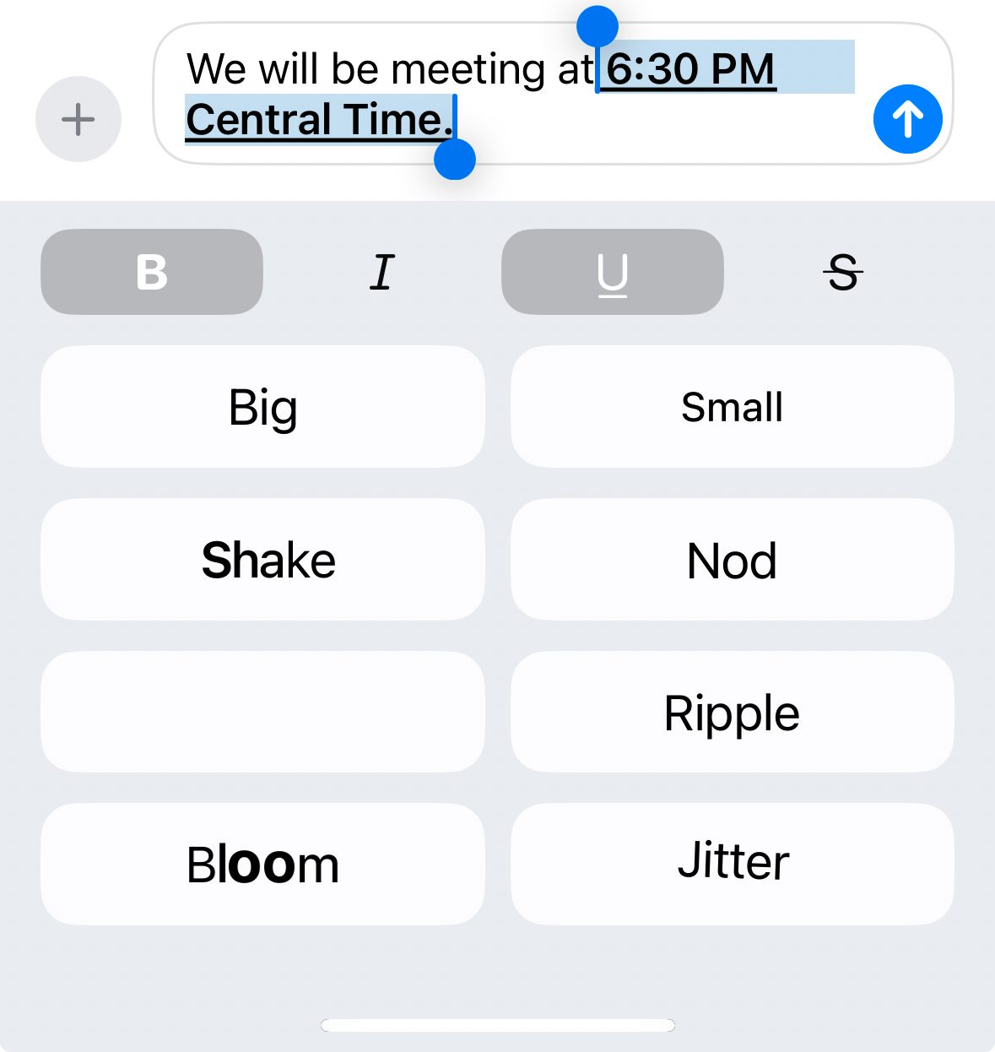
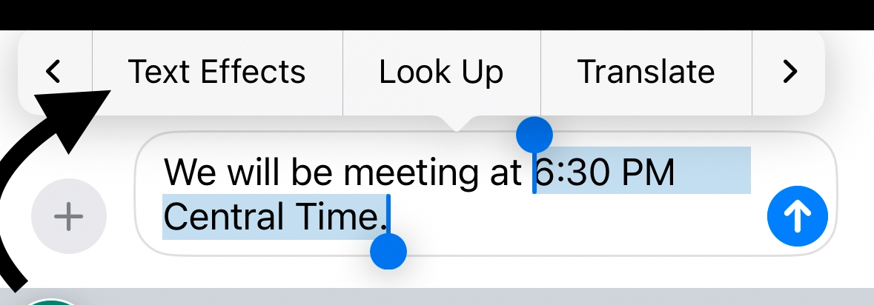
Bold, underline, italicize text in messages
  **NOTE: If you are texting someone who DOES NOT have iOS update, their messages will NOT display the bold, underline, italicize

Slide 6
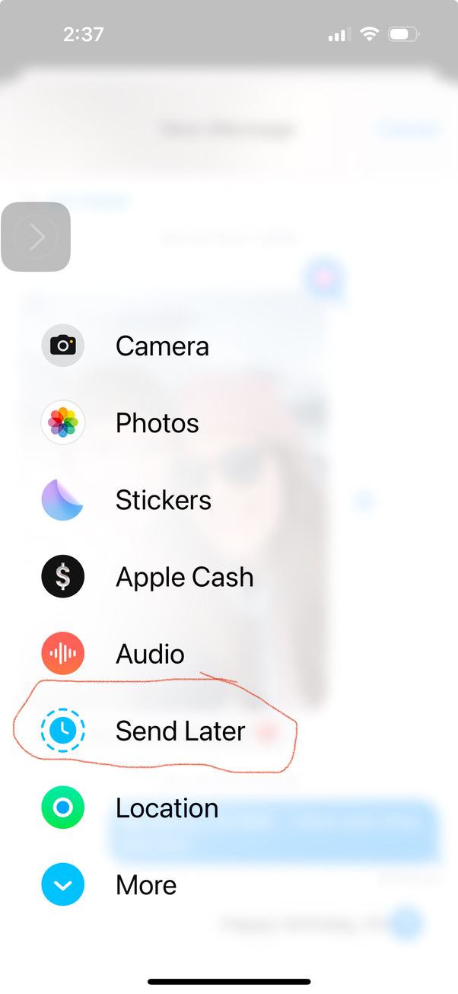
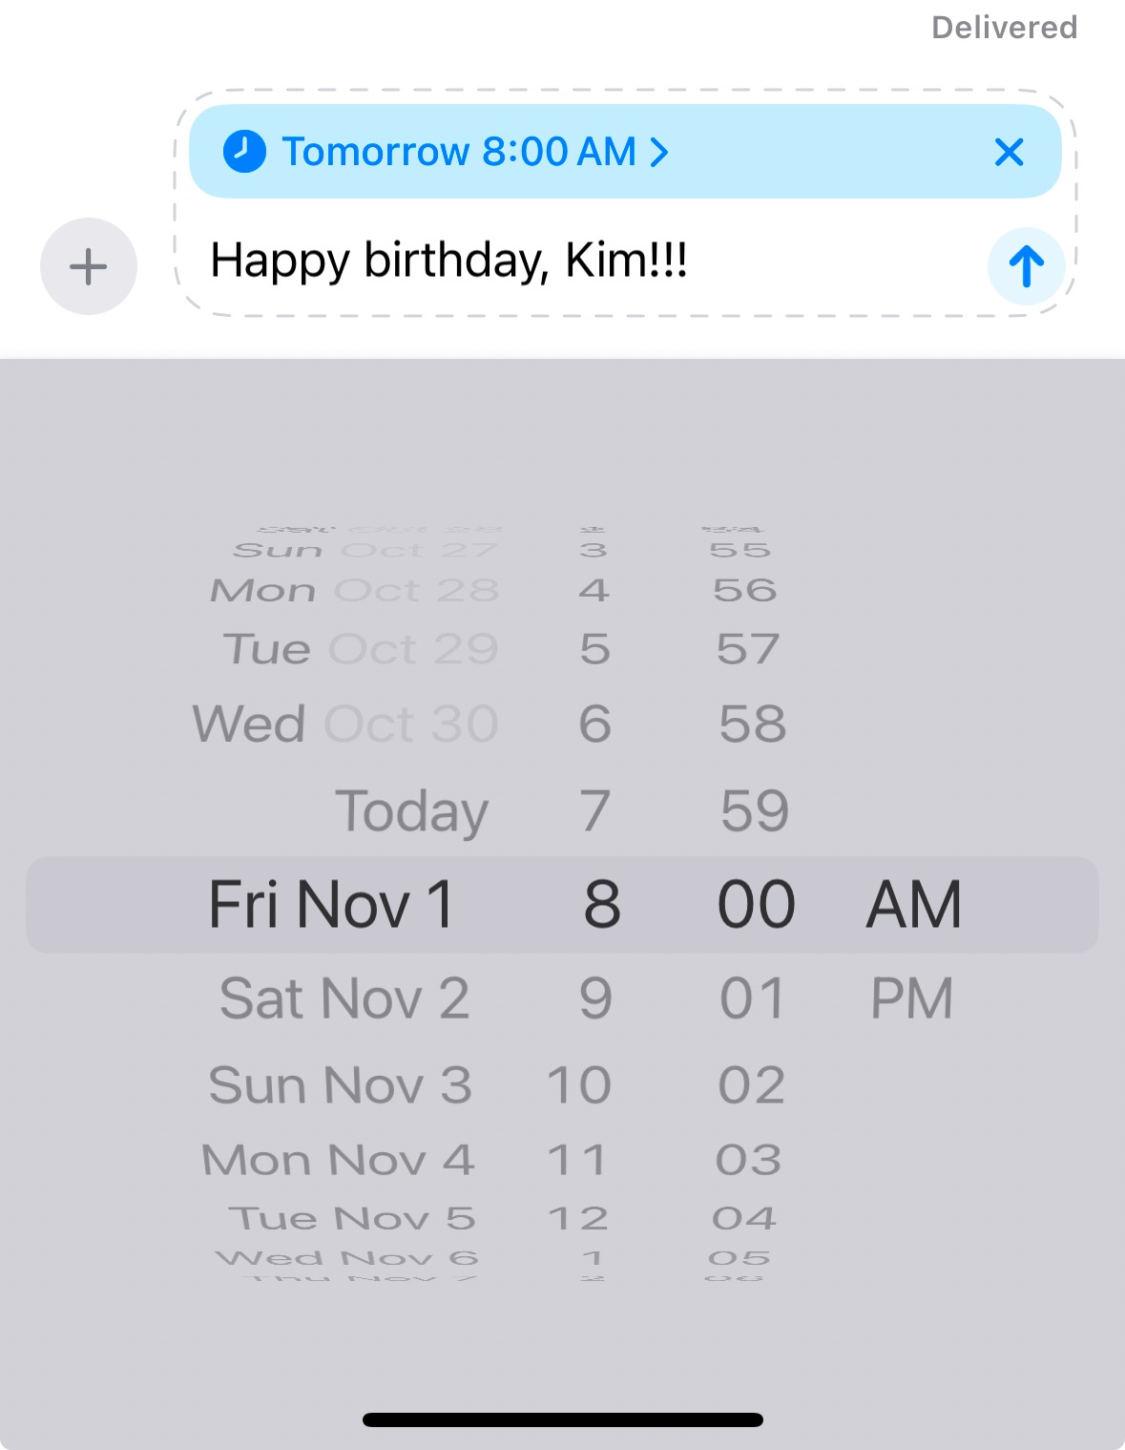
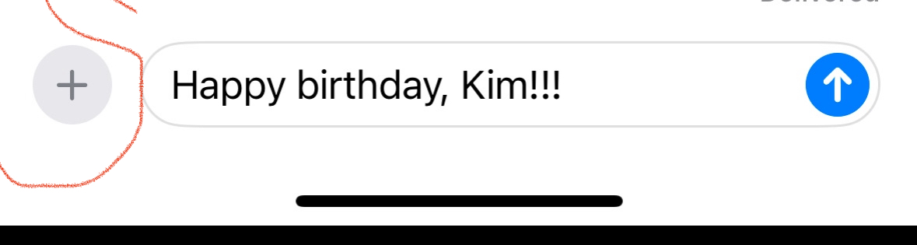


Can compose a message to SEND LATER

Slide 7
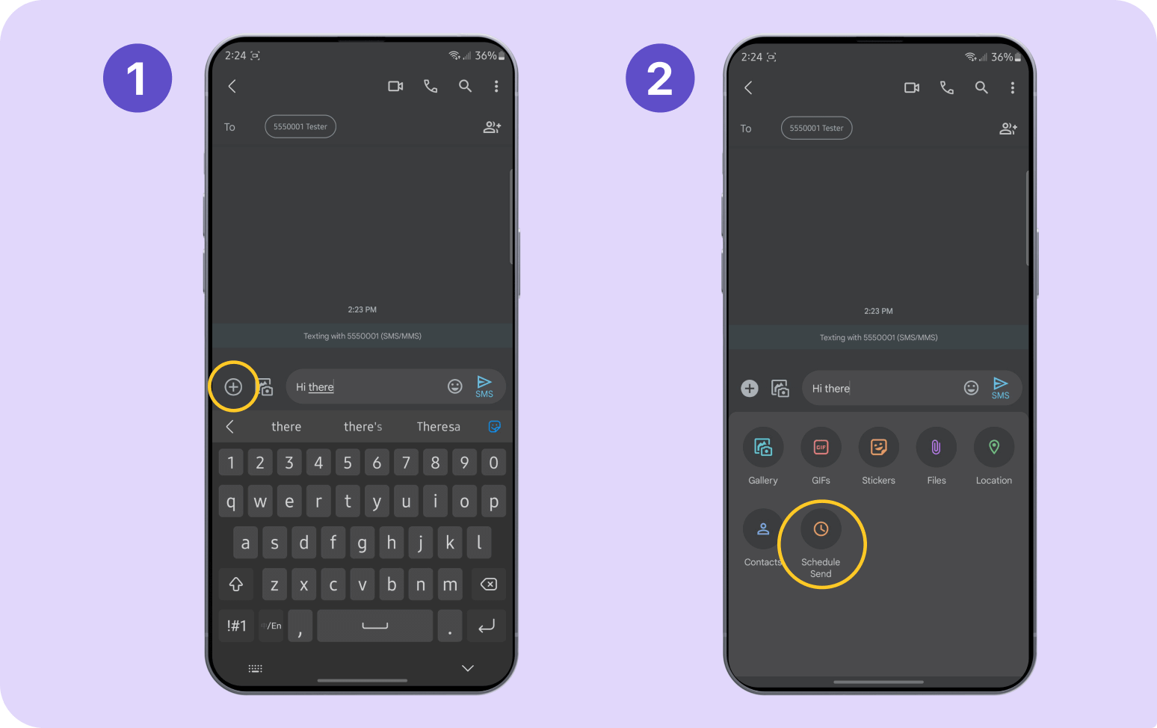
To SCHEDULE a text with
Google Messages (ANDROID):
Start a new conversation or navigate to an existing conversation.
Type out your message.
Tap the ‘+’ icon to bring up the “schedule send” menu.
**Alternatively, you can press and hold the “send” button to bring up the “schedule send” menu (but be careful not to accidentally send the text before you’re ready).

Slide 8
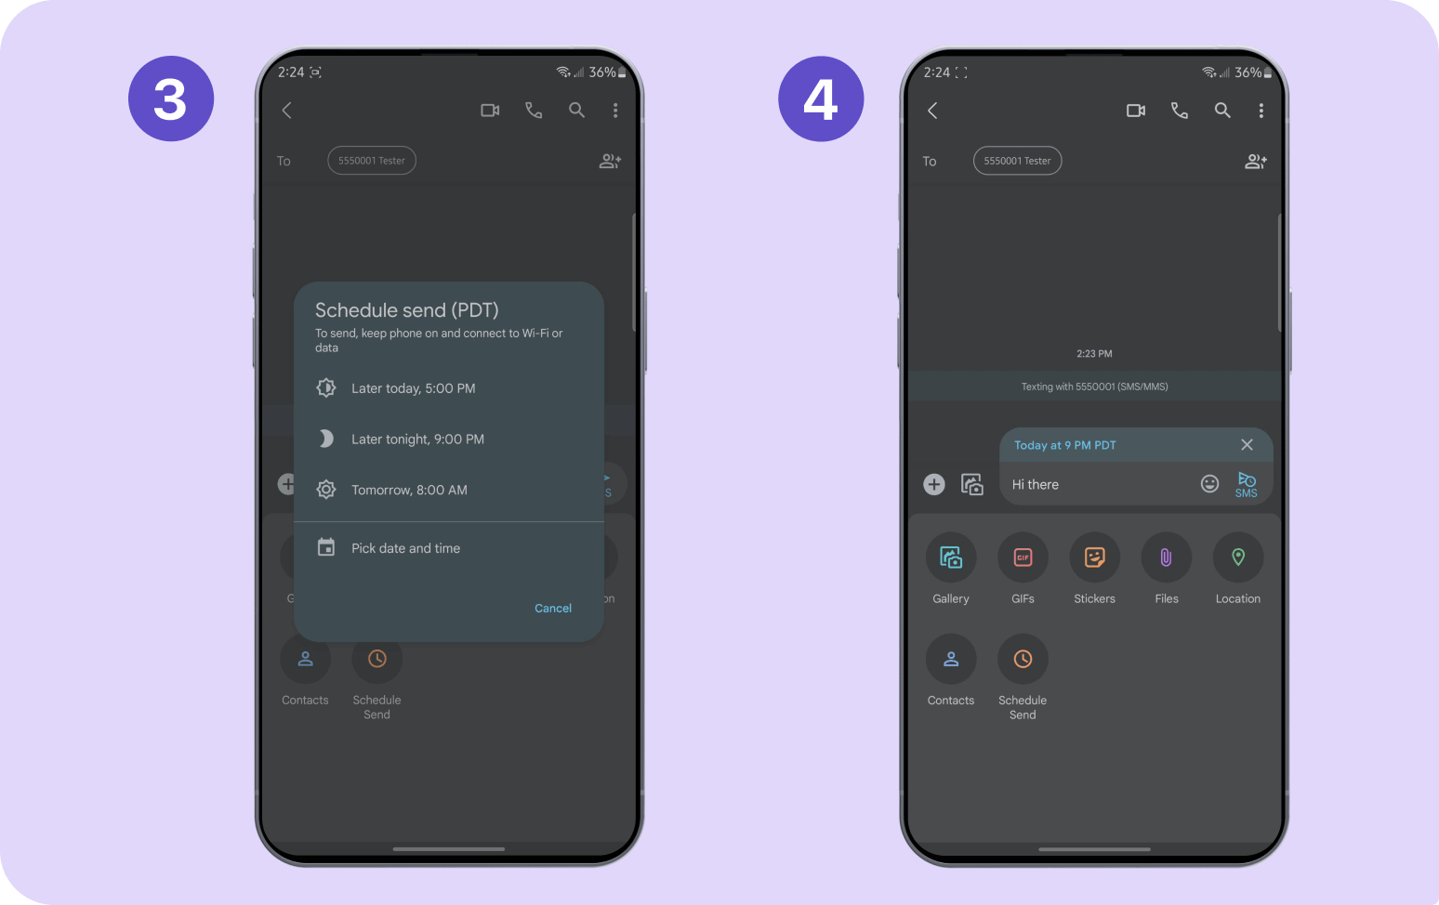
To SCHEDULE a text with
Google Messages (ANDROID):
Choose a preset delivery time or choose your own by tapping “pick date and time” and entering the timing information.
Double-check your text, look for the banner stating the scheduled time, and then press the paper plane icon with a clock next to your message to schedule the text.

Slide 9
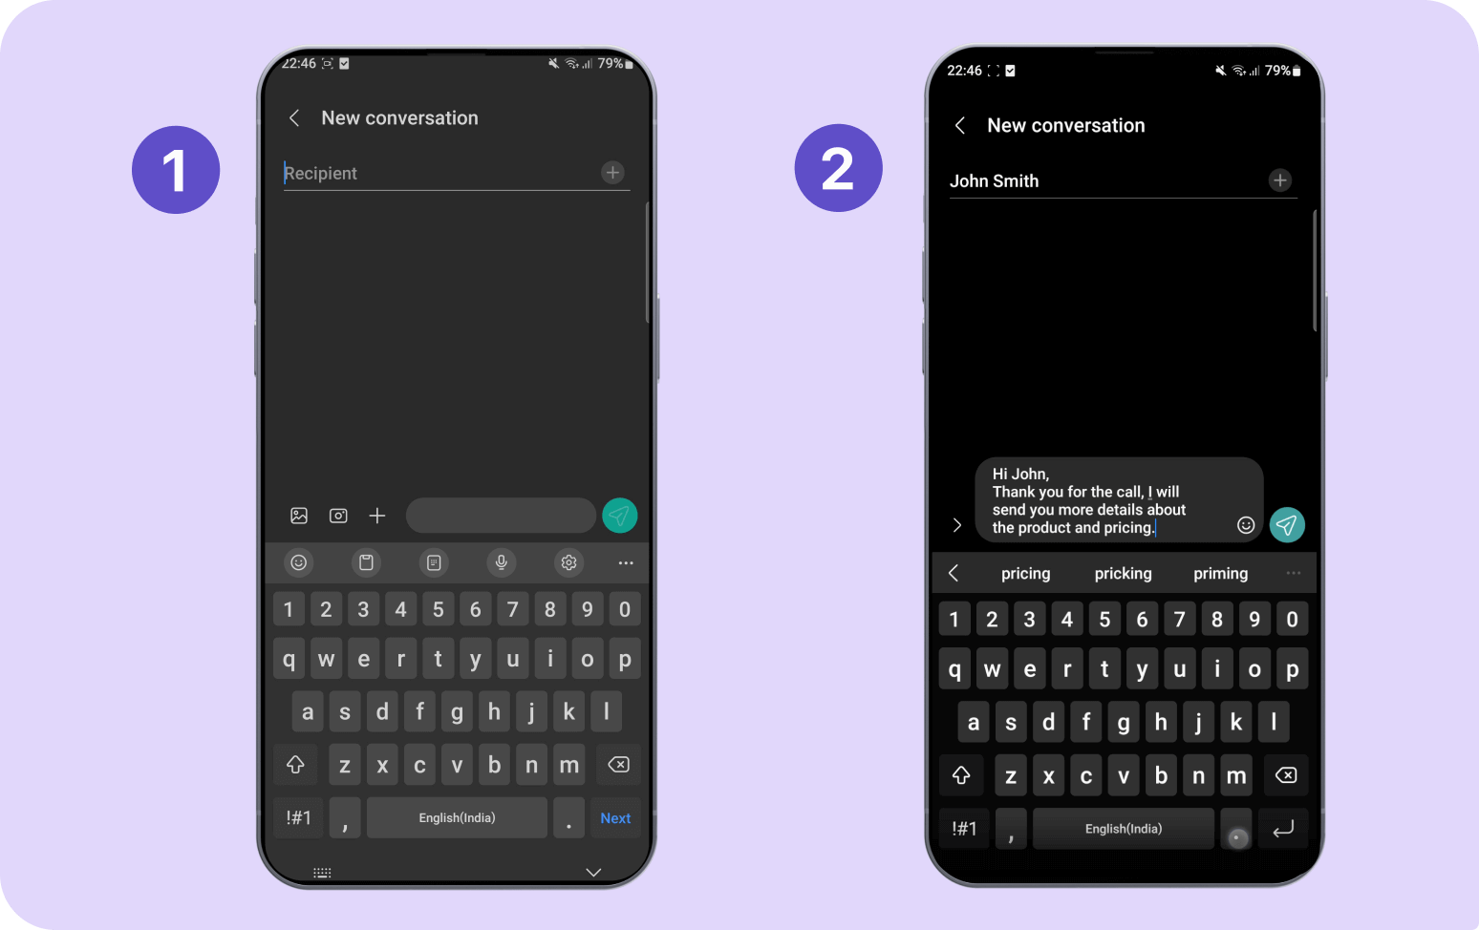
How to send scheduled texts using
Samsung Messages
Create a new conversation or choose an existing one.
Type your message.

Slide 10
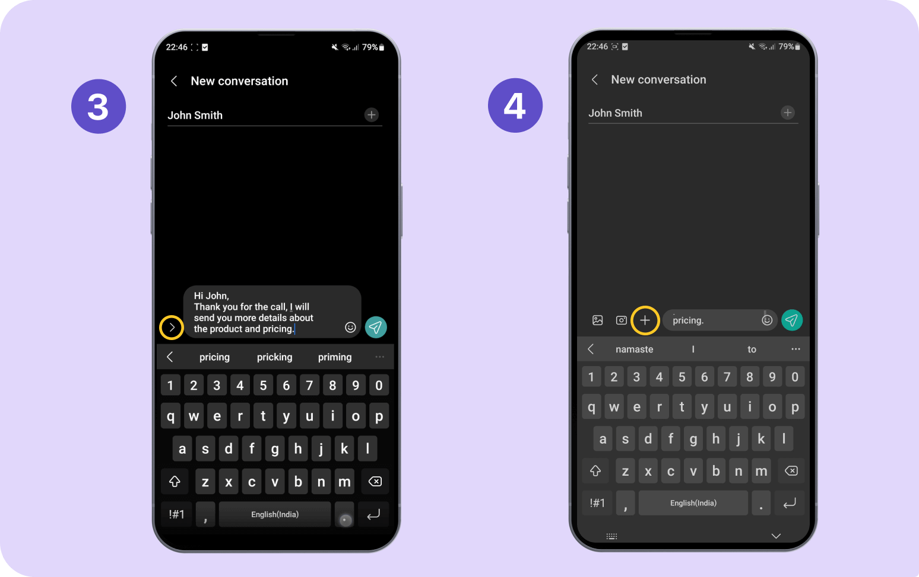
How to send scheduled texts using
Samsung Messages
Tap the chevron icon (>) on the left side of your message.
Tap the ‘+’ icon to bring up the text menu options.

Slide 11
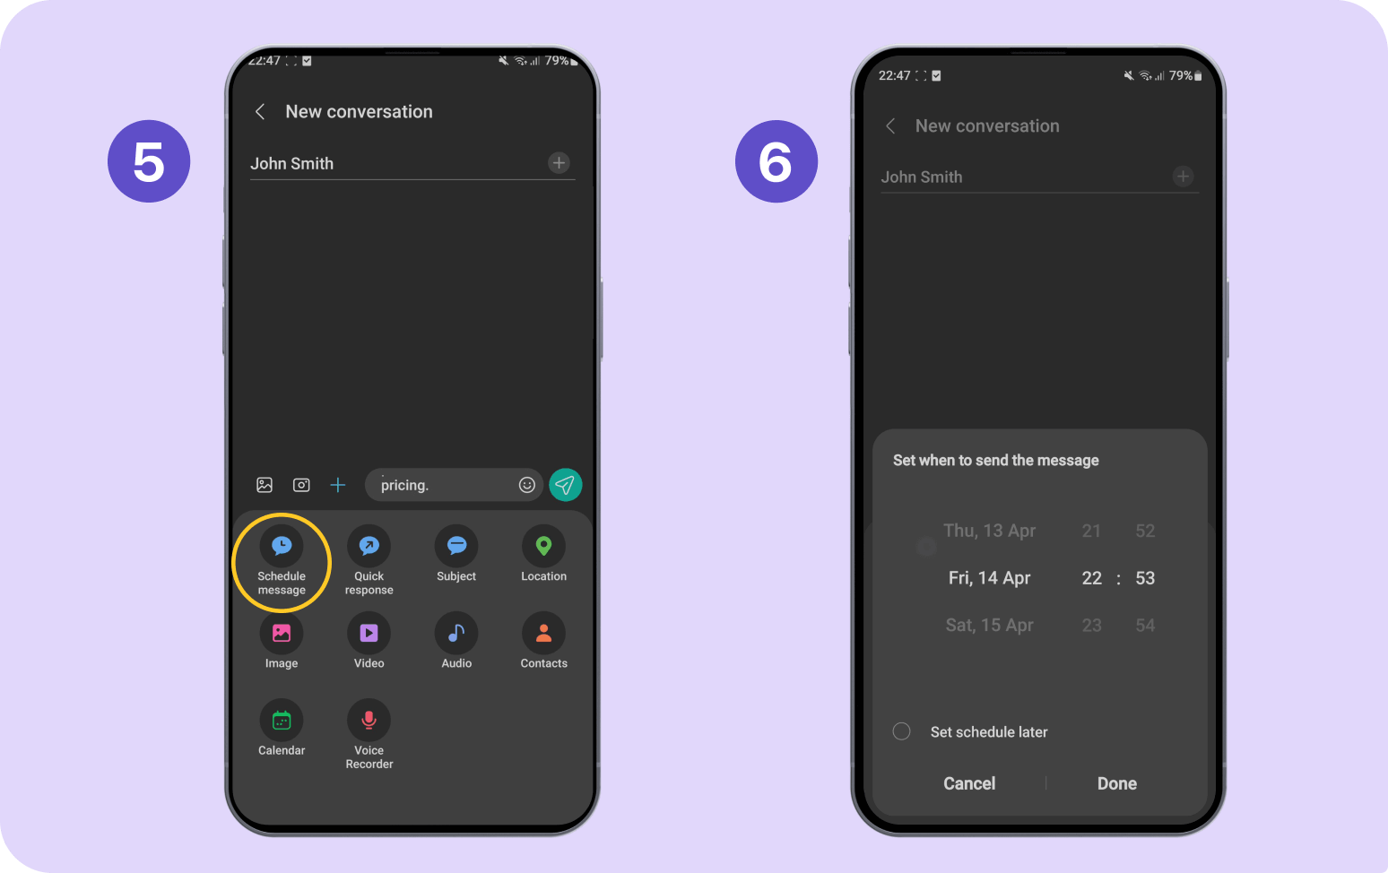
How to send scheduled texts using
Samsung Messages
Select “schedule message” to access the date and time options.
Set your date and time within the provided range or choose “set schedule later” for more options, then press “done.”

Slide 12
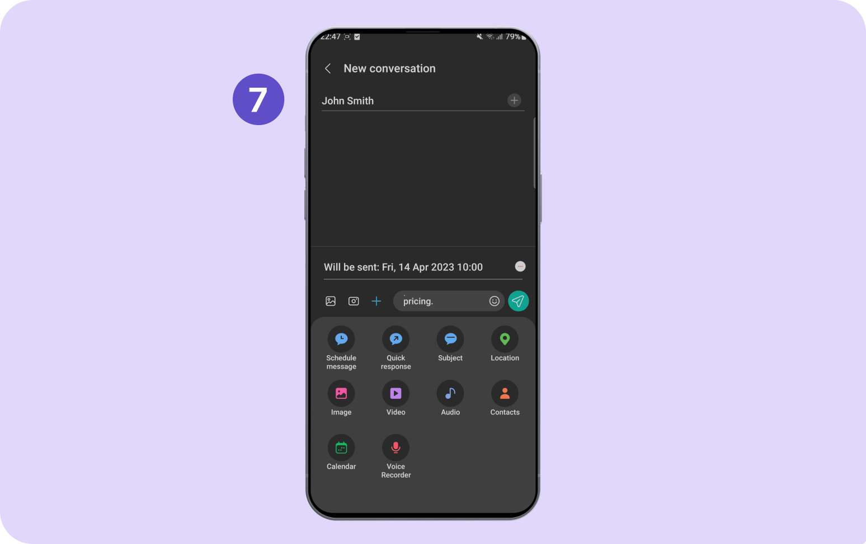
How to send scheduled texts using
Samsung Messages
Review your message and ensure the time shown above your text is correct, then press the paper plane icon to the right of your message to schedule your text.

Slide 13

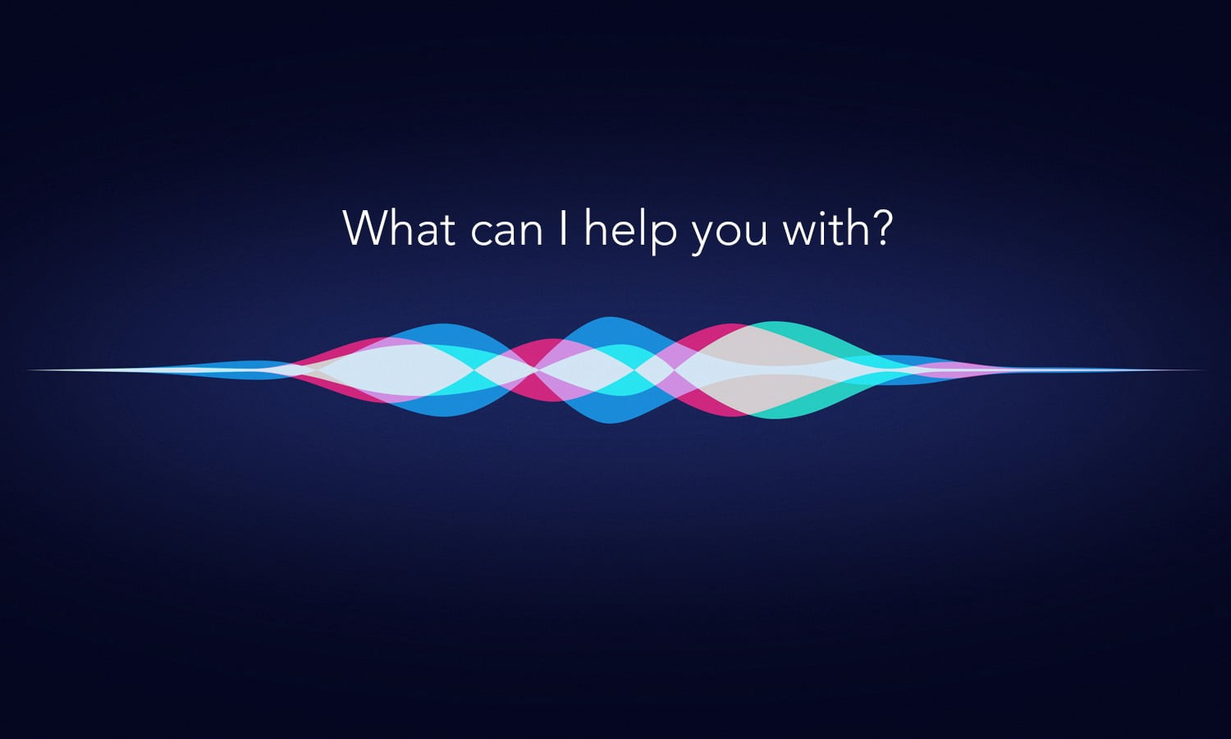
Turn on Siri to listen for atypical speech
Siri can recognize a wider range of speech patterns
You can have Siri listen for atypical speech.
This may be helpful if you have an acquired or progressive condition that affects speech, such as cerebral palsy, amyotrophic lateral sclerosis (ALS), or stroke.
Go to Settings ® > Accessibility > Siri, then turn on Listen for Atypical Speech

Slide 14
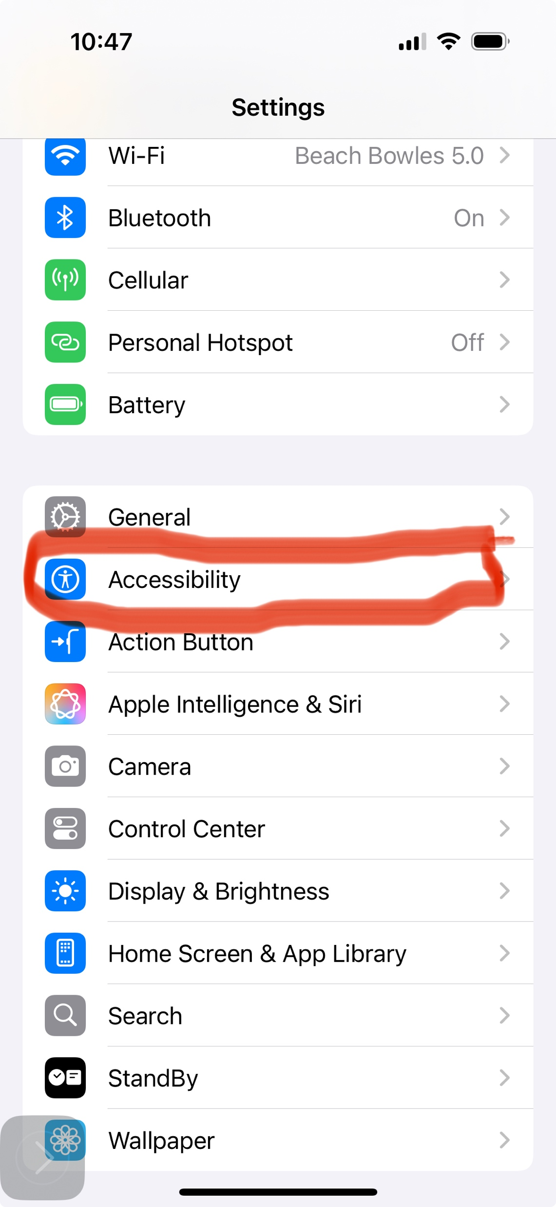
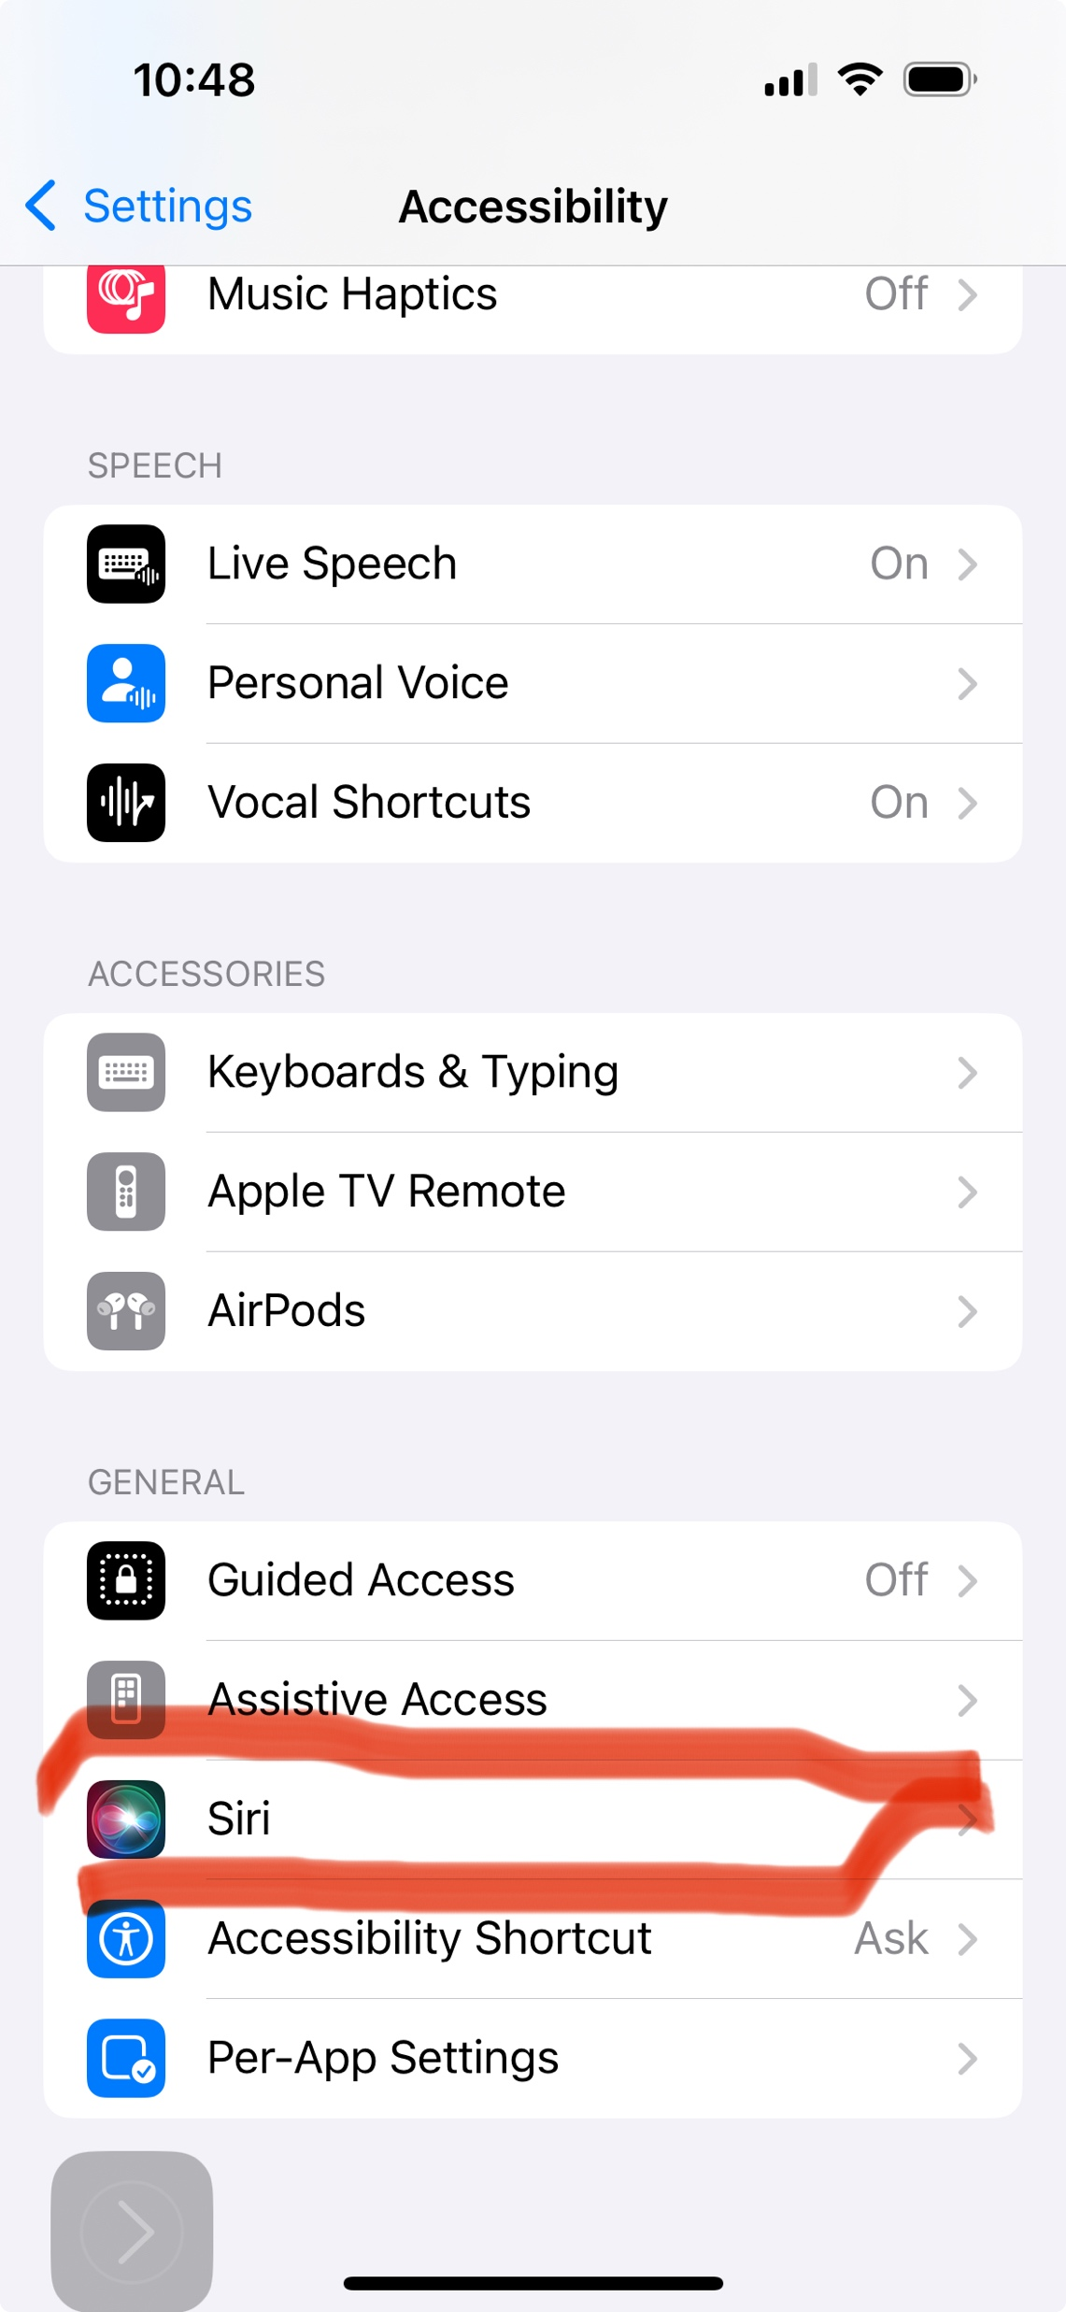
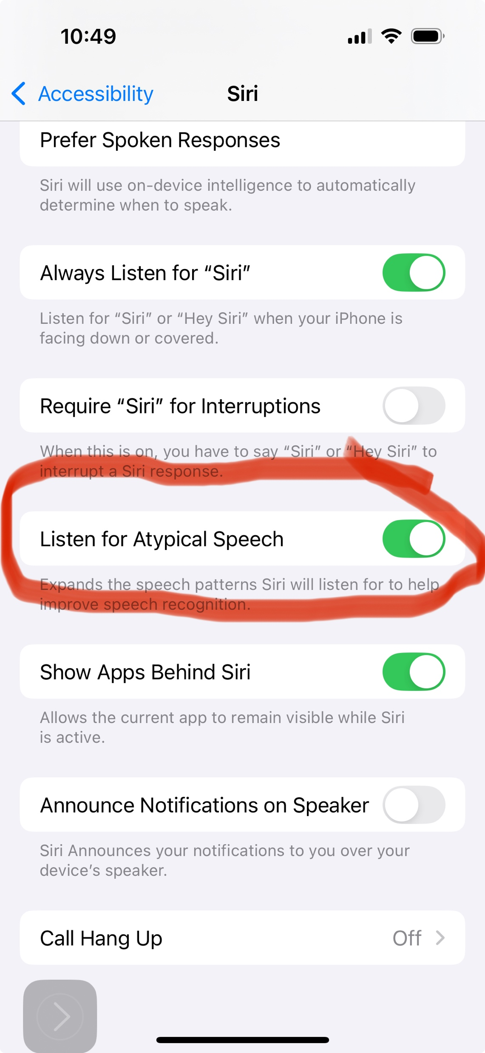


Slide 15
Voice Control Commands
Set voice commands to a WORD or SOUND
Have had some trouble with this feature working consistently

Slide 16
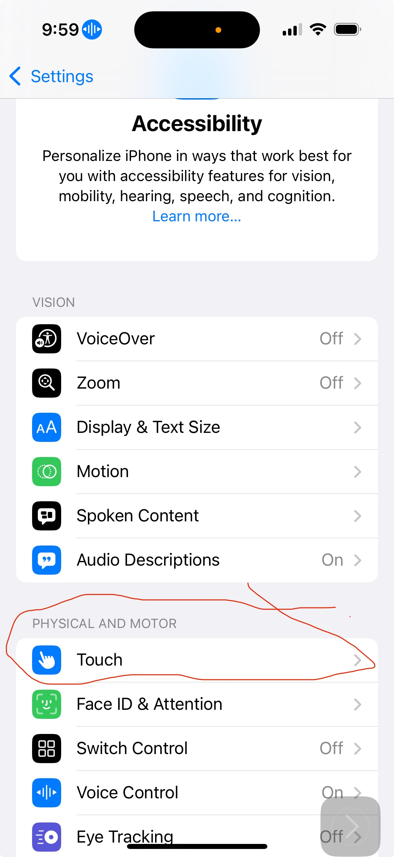
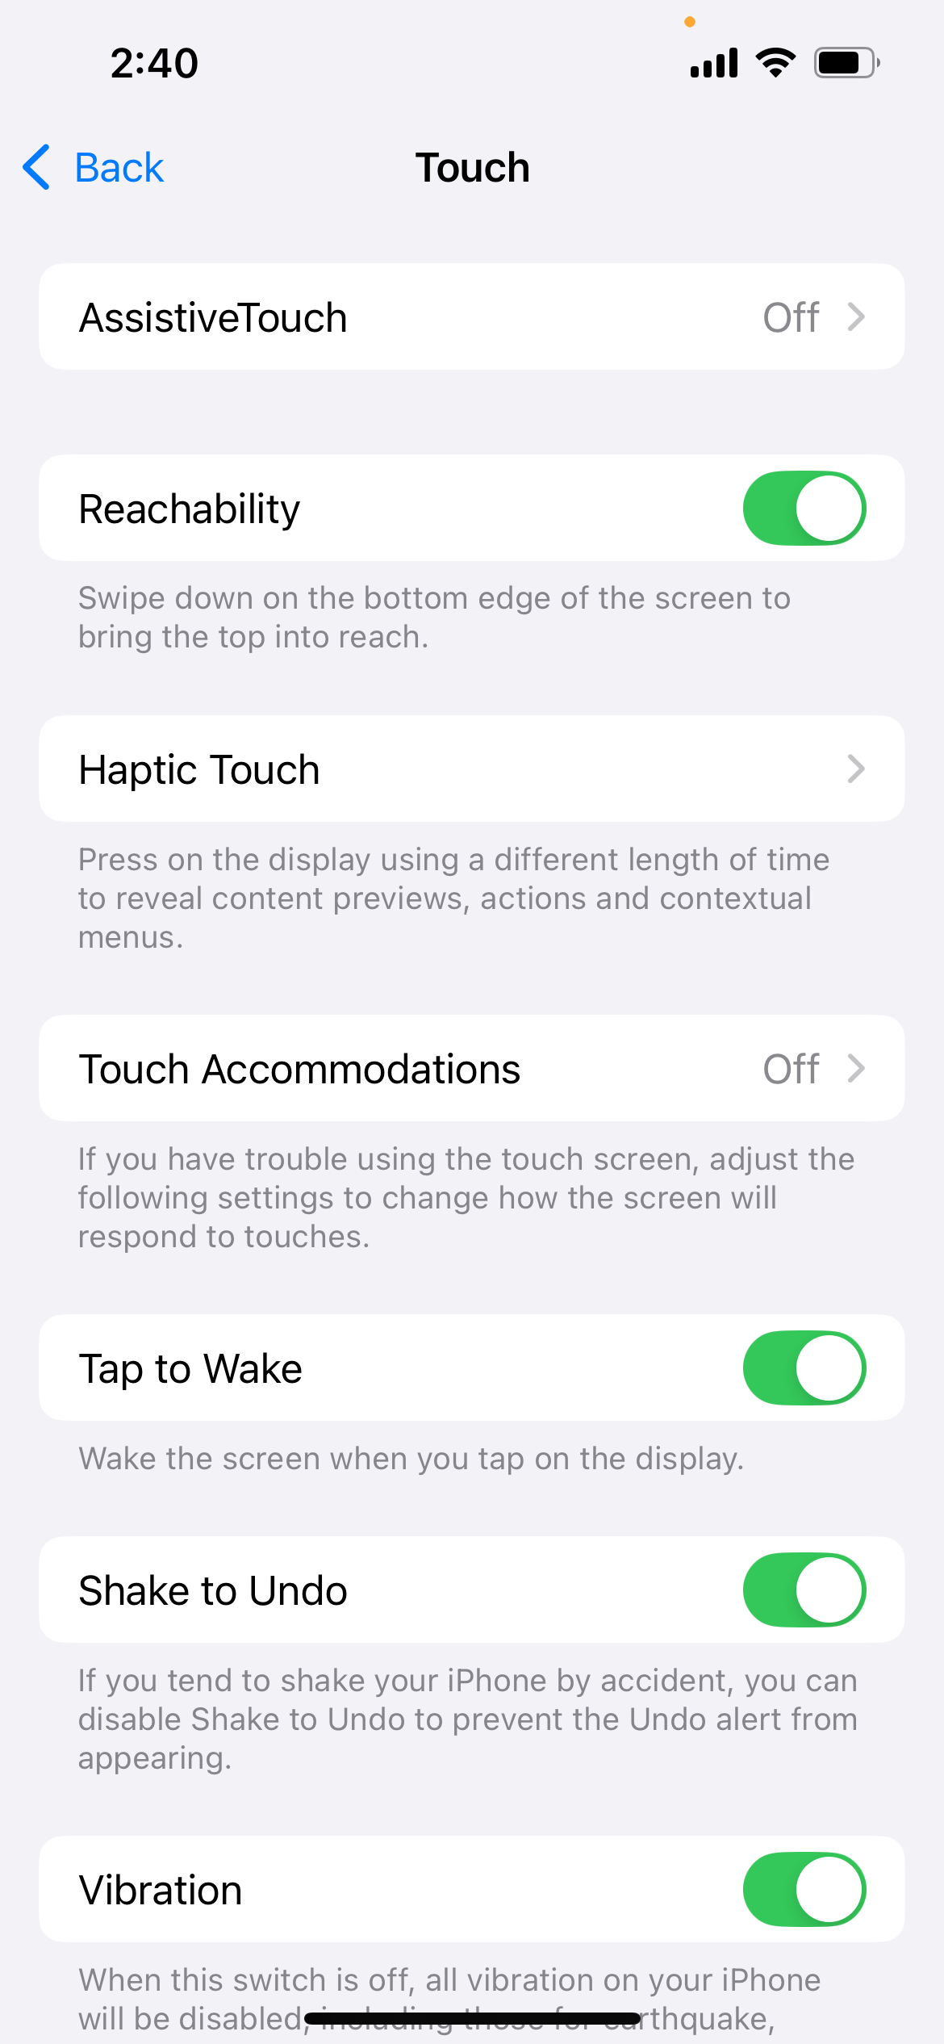
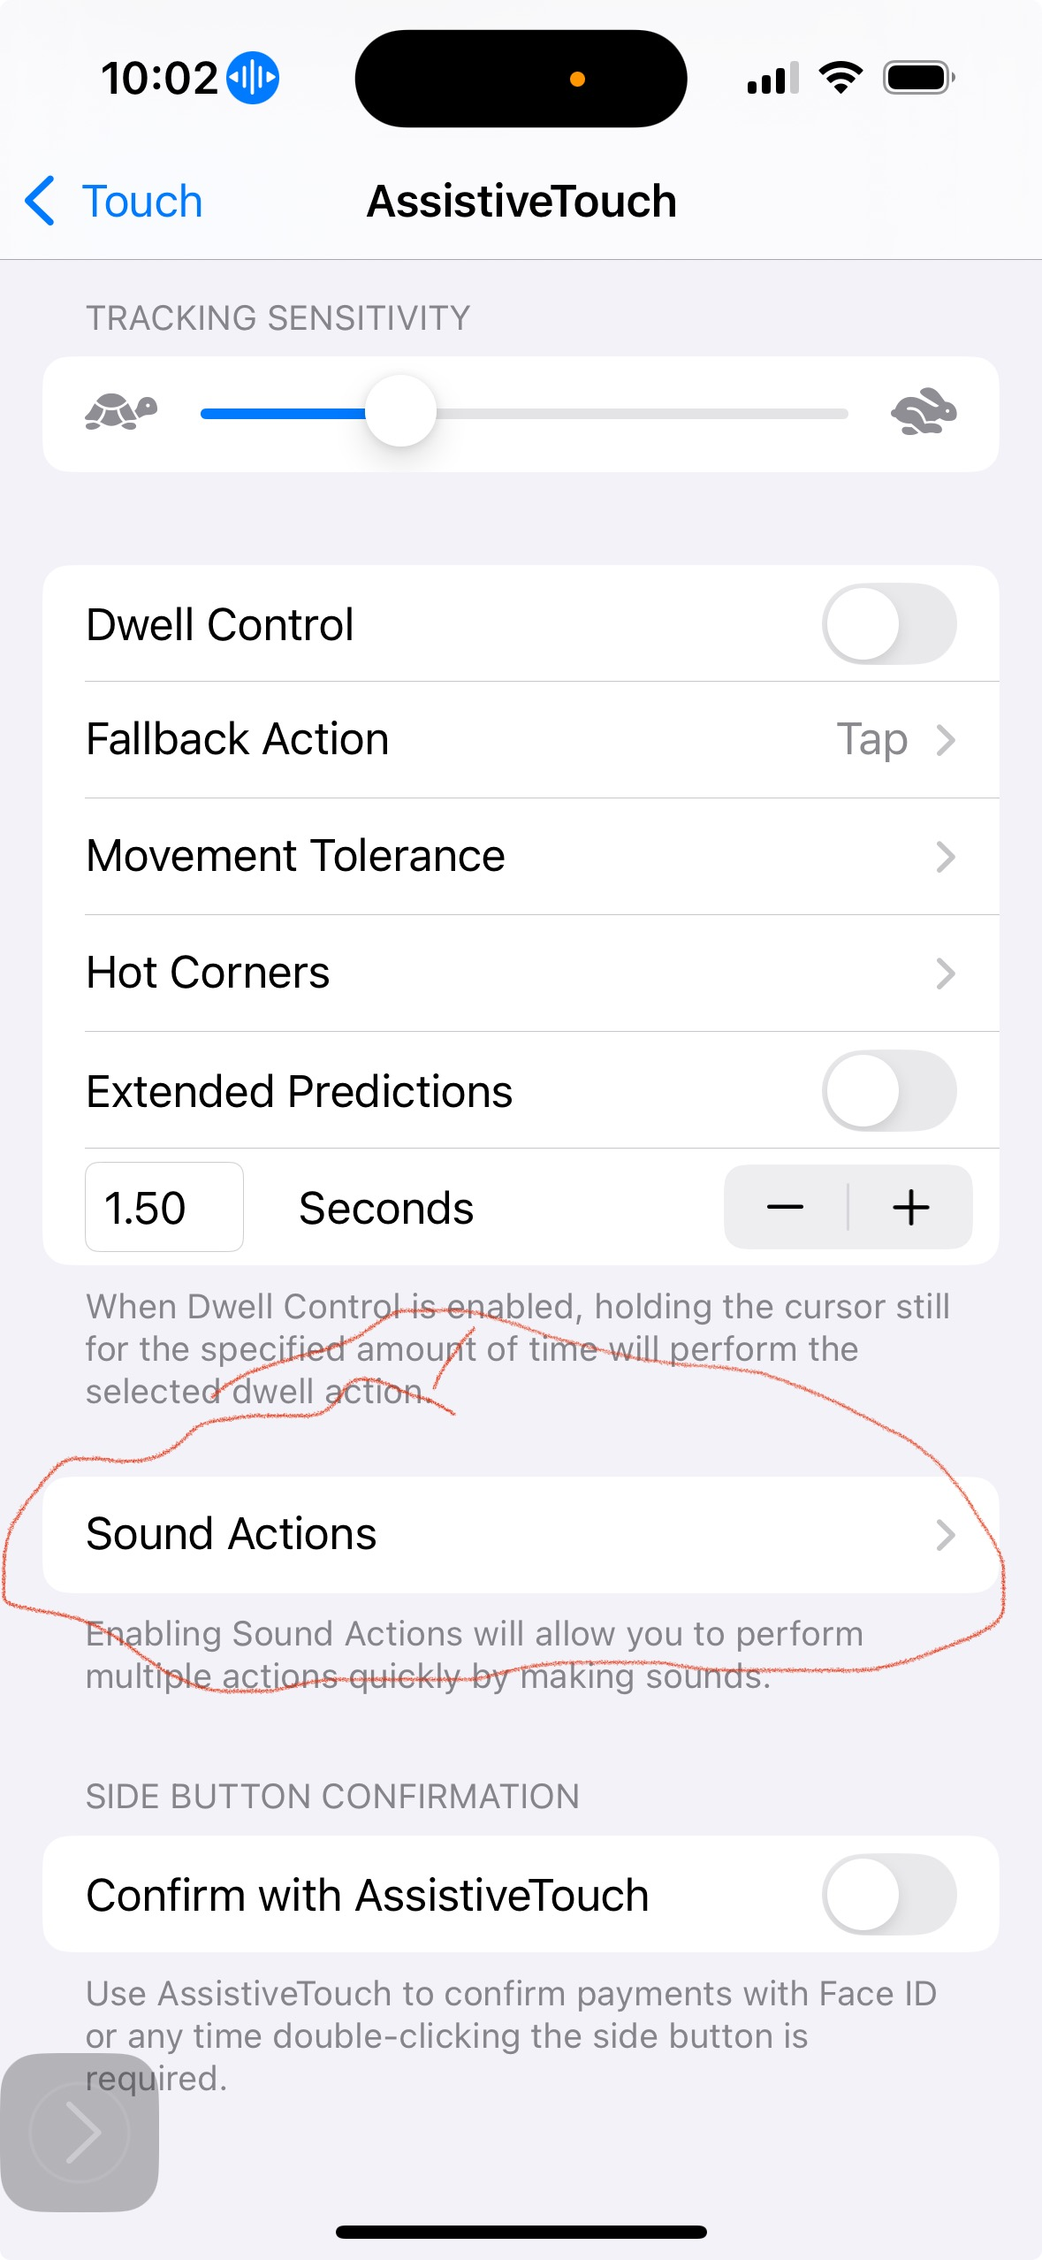
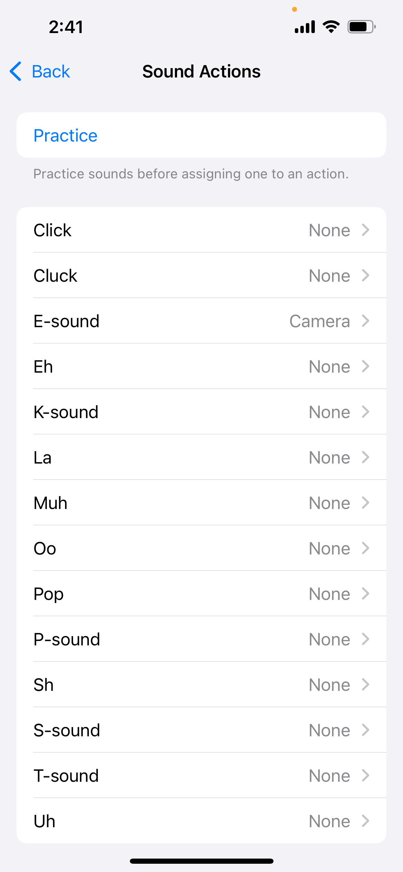



Voice Control Commands

Slide 17
Use Vocal Shortcuts on iPhone
With Vocal Shortcuts, you can teach iPhone to perform an action when you speak a word or another sound of your choosing.
Vocal Shortcuts can be useful if you have moderate to severe atypical speech but can reliably vocalize certain utterances. Audio is processed on device.
Vocal Shortcuts – teaches iPhone to recognize a custom phrase to quickly perform an action (“picture” for camera; or “subtitles” for it to show subtitles when at restaurant and waitress is talking)

Slide 18
Set up Vocal Shortcuts
Go to Settings > Accessibility > Vocal Shortcuts.
Tap Set Up, then tap Continue.
Choose an action for iPhone to perform when you say the shortcut. If you want the action to be a request to Siri, tap Siri Request, then enter the request.
Enter the phrase you’ll say when you want iPhone to perform the action, then follow the onscreen instructions to repeat the phrase out loud so that iPhone can recognize it.

Slide 19
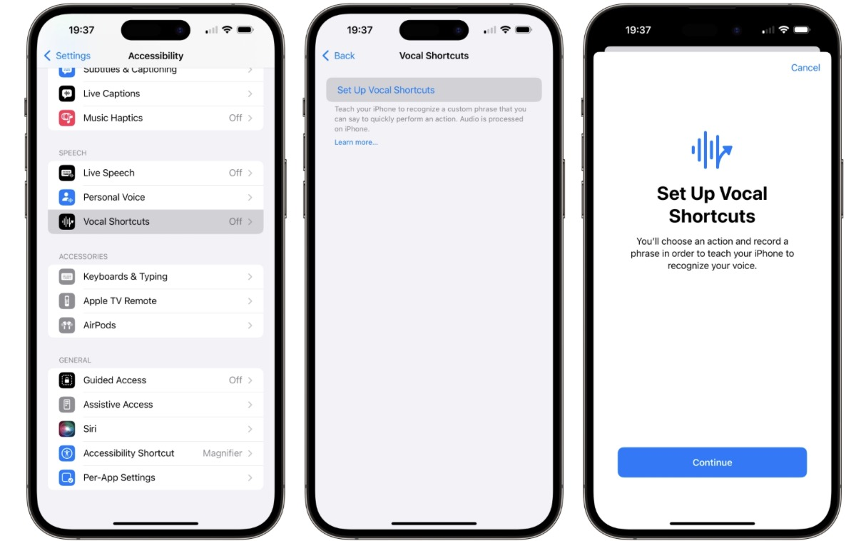

Slide 20
Less Distracting Web Browsing
To make web browsing less distracting on an iPhone, you can use Safari's Distraction Control feature to hide items on a webpage:
Open the Safari app
Tap the Page Menu button in the Smart Search field
Tap Hide Distracting Items
Select the items you want to hide
Tap anywhere within the item to hide it
Tap Done in the Smart Search field

Slide 21
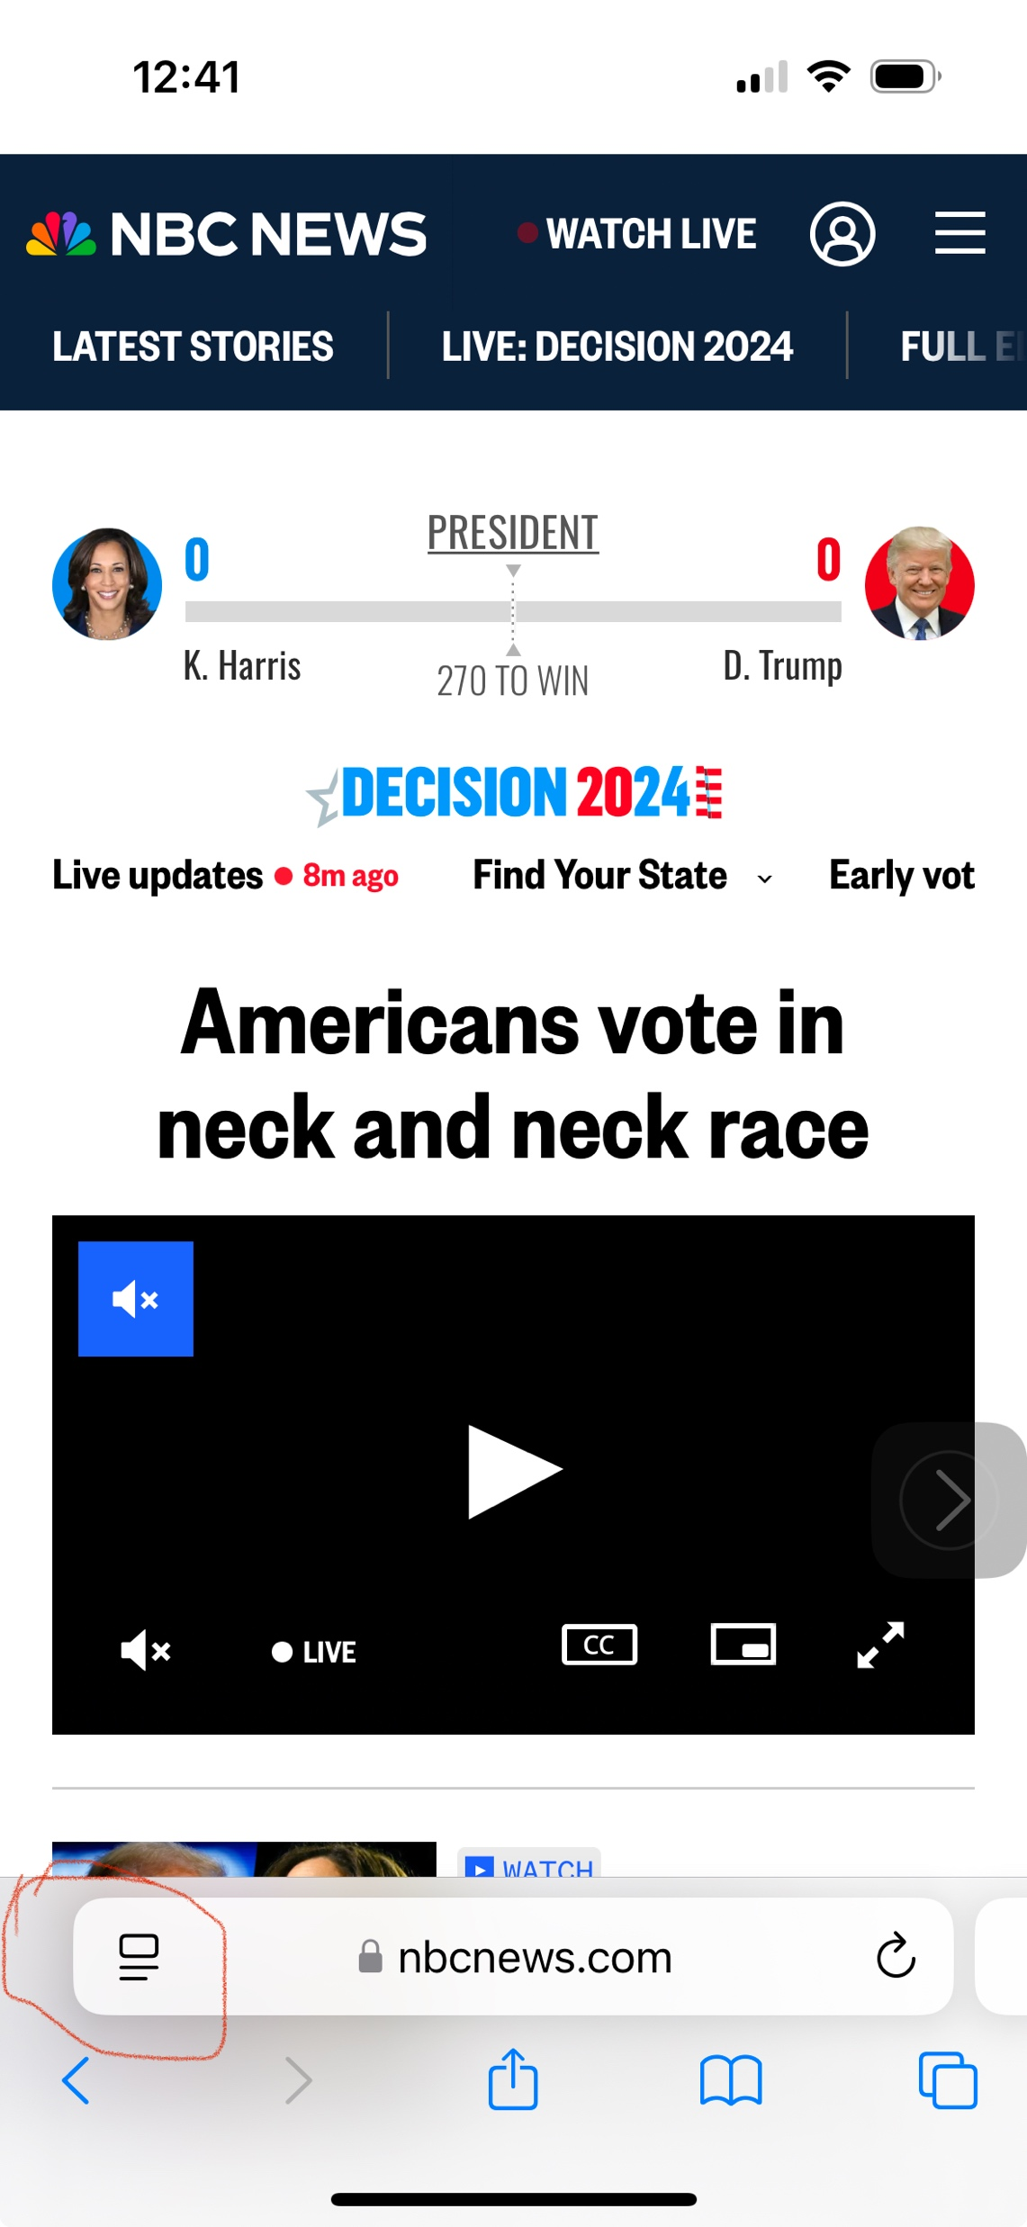
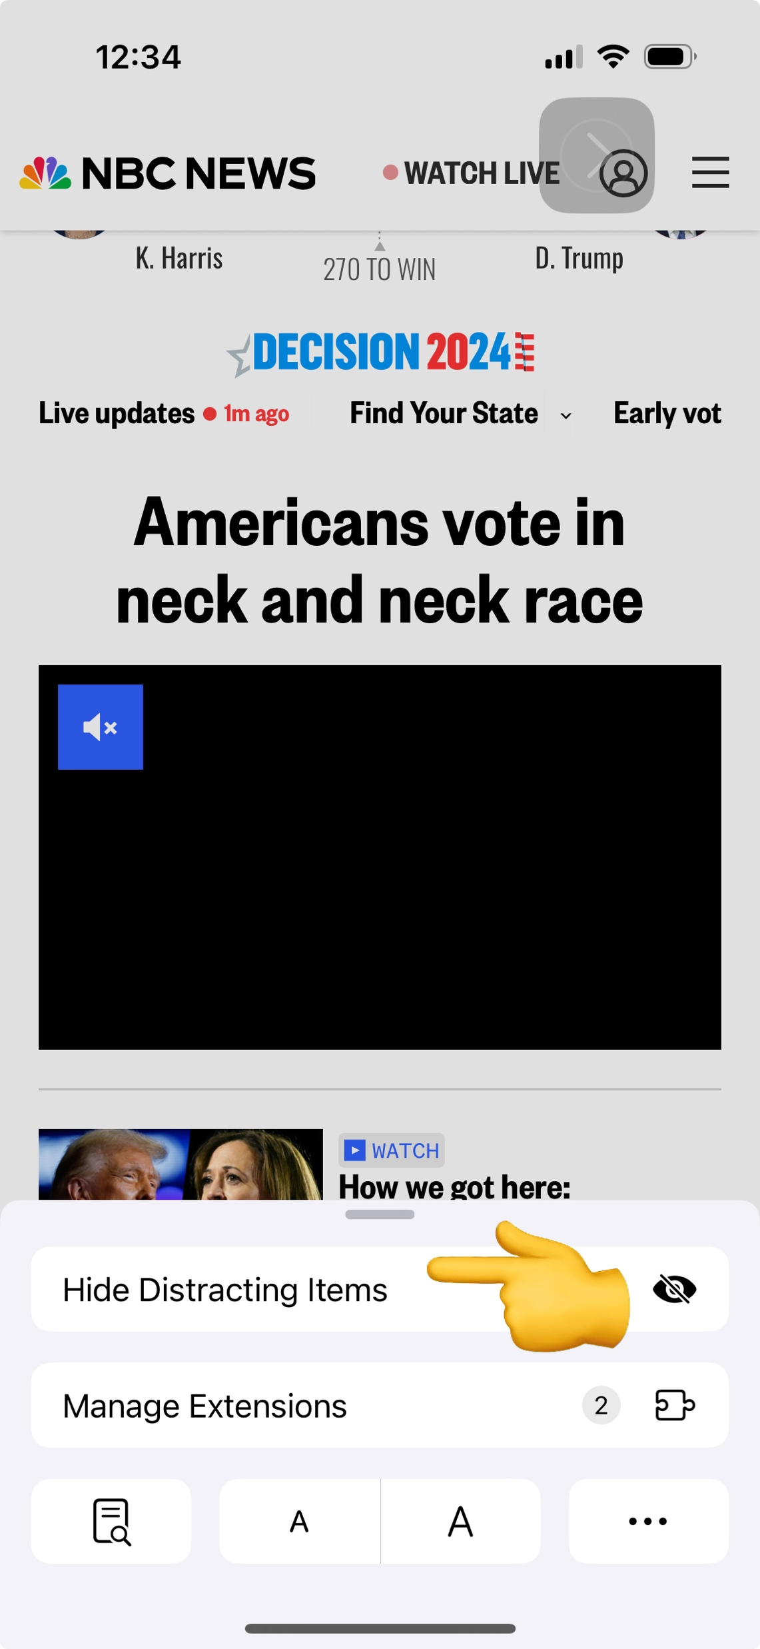
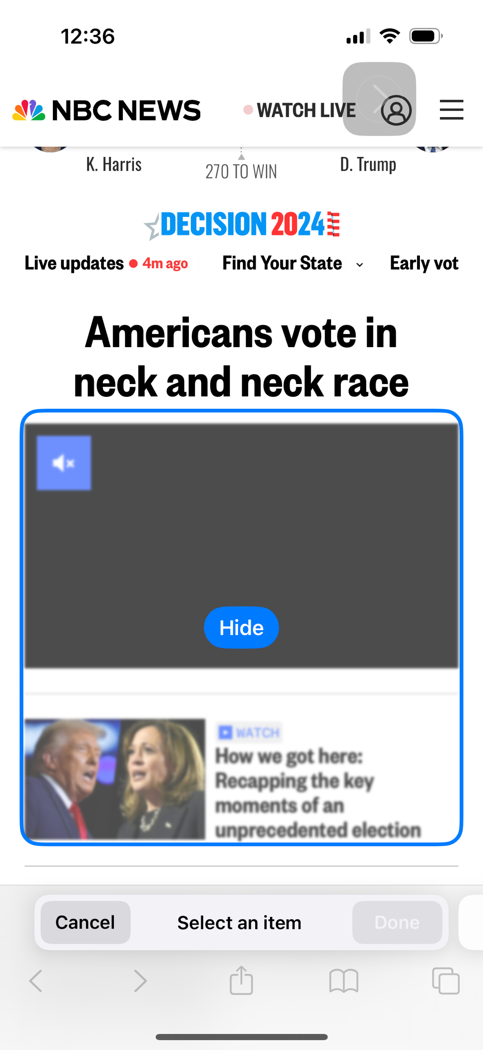
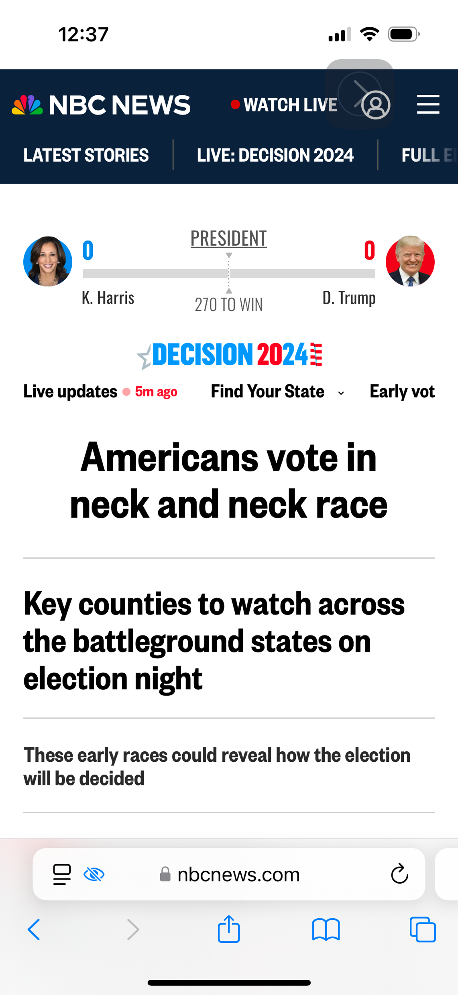



Slide 22
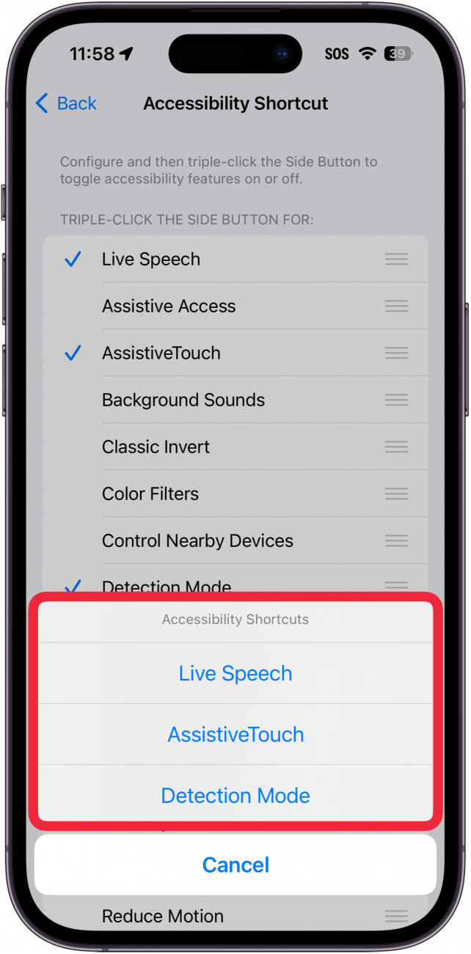
Accessibility Shortcut for iPhone/ iPad
To set up Accessibility Shortcut: Go to Settings > Accessibility > Accessibility Shortcut, then select the features that you use the most.
Notes:
Use the side or top button
If your device doesn't have a Home button, it has either a side or top button.
To set up Accessibility Shortcut: Go to Settings > Accessibility > Accessibility Shortcut, then select the features that you use the most.
To use Accessibility Shortcut: Triple-click the side or top button.
To slow down the double-click or triple-click speed for the side or top button: Go to Settings > Accessibility > Side [or Top] Button, then change the setting.
Use the Home button
To set up Accessibility Shortcut: Go to Settings > Accessibility > Accessibility Shortcut, then select the features that you use the most.
To use Accessibility Shortcut: Triple-click the Home button.
To slow down the double-click or triple-click speed for the Home button: Go to Settings > Accessibility > Home Button, then change the setting.
Use Control Center
To customize Control Center: Go to Settings > Control Center then tap the Add button
next to accessibility features such as Accessibility Shortcuts, Magnifier, Hearing Aids, and Guided Access.
To activate an accessibility feature from Control Center: Open Control Center, then tap the accessibility feature.

Slide 23
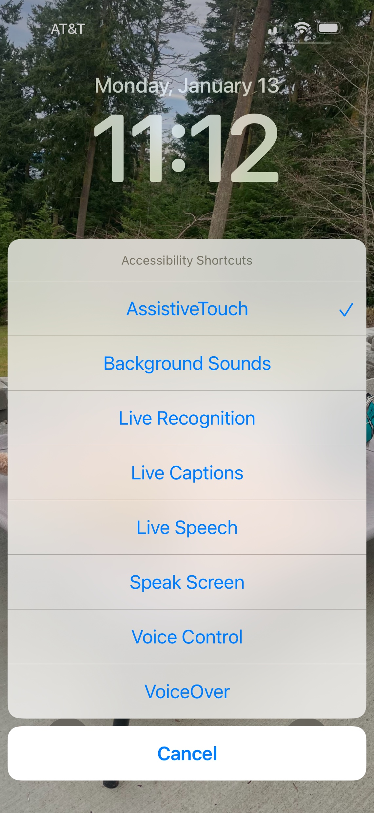
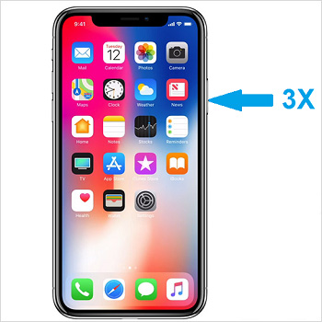
Accessibility Shortcut for iPhone/ iPad
To use Accessibility Shortcut: Triple-click the side
Notes:
Use the side or top button
If your device doesn't have a Home button, it has either a side or top button.
To set up Accessibility Shortcut: Go to Settings > Accessibility > Accessibility Shortcut, then select the features that you use the most.
To use Accessibility Shortcut: Triple-click the side or top button.
To slow down the double-click or triple-click speed for the side or top button: Go to Settings > Accessibility > Side [or Top] Button, then change the setting.
Use the Home button
To set up Accessibility Shortcut: Go to Settings > Accessibility > Accessibility Shortcut, then select the features that you use the most.
To use Accessibility Shortcut: Triple-click the Home button.
To slow down the double-click or triple-click speed for the Home button: Go to Settings > Accessibility > Home Button, then change the setting.
Use Control Center
To customize Control Center: Go to Settings > Control Center then tap the Add button
next to accessibility features such as Accessibility Shortcuts, Magnifier, Hearing Aids, and Guided Access.
To activate an accessibility feature from Control Center: Open Control Center, then tap the accessibility feature.

Slide 24

QUESTIONS?
See you next time – Tuesday, February 11th @4:00pm EST.

