Slide 1
Technology and Supports for Aphasia
Brooke Lang, M.A., CCC-SLP and Bryn Lander

Slide 2
Today’s Topic
How to combine AI (Artificial Intelligence) and the best Aphasia apps to create more practice
How to make tasks easier or harder
Add more examples to your practice
Switch modalities (writing task can become a reading task)
AND…..
NEW APP – AphasiaGPT

Slide 3
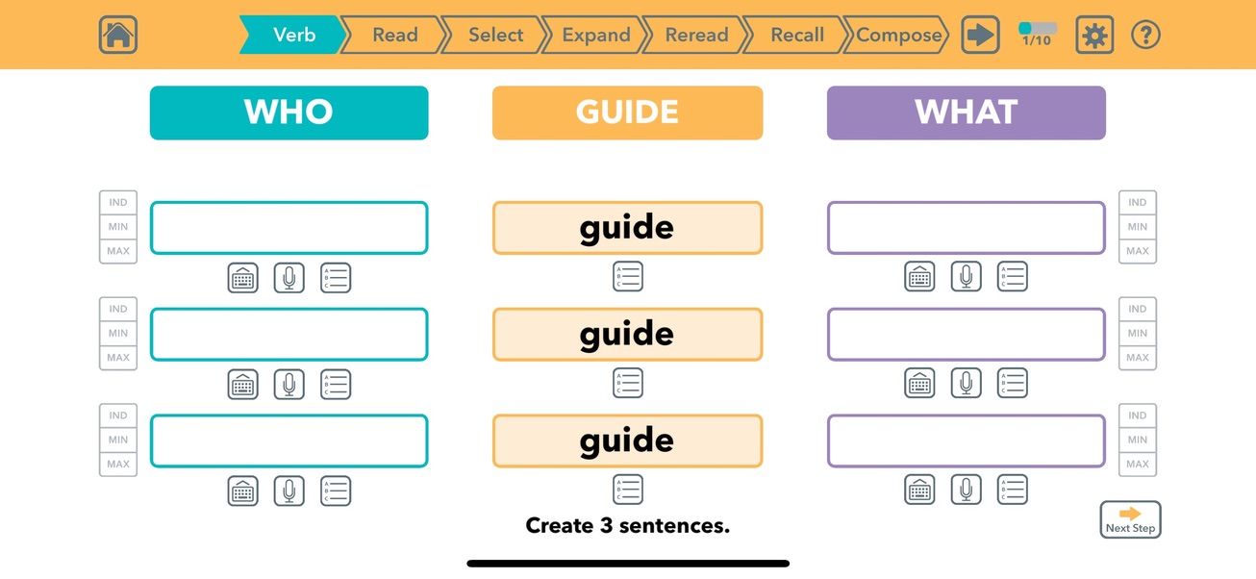

EXPAND THE “WHO – VERB – WHAT” SENTENCE BUILDER
**Put picture in as AI prompt**

Slide 4
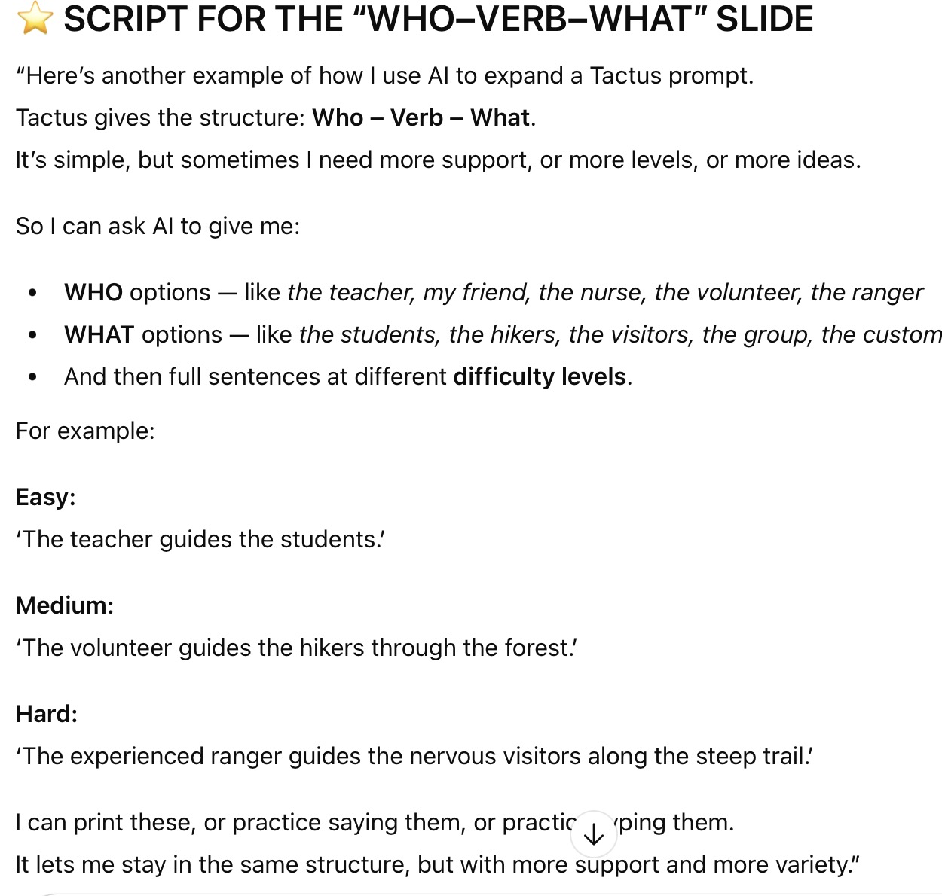
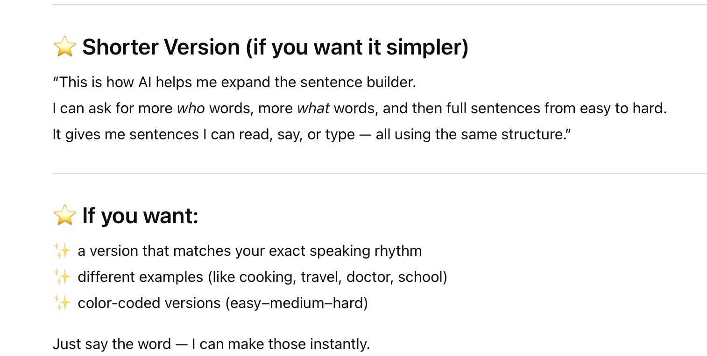

Slide 5
EXPAND THE “WHO – VERB – WHAT” SENTENCE BUILDER
Full models (levels):
Easy: “The teacher guides the students.”
Medium: “The volunteer guides the hikers through the forest.”
Hard: “The experienced ranger guides the nervous visitors along the steep trail.”
You can print these or practice saying them.
AI can generate:
People (WHO)
The teacher
My friend
The nurse
The volunteer
The ranger
WHAT objects
the students
the hikers
the visitors
the group
the customers

Slide 6
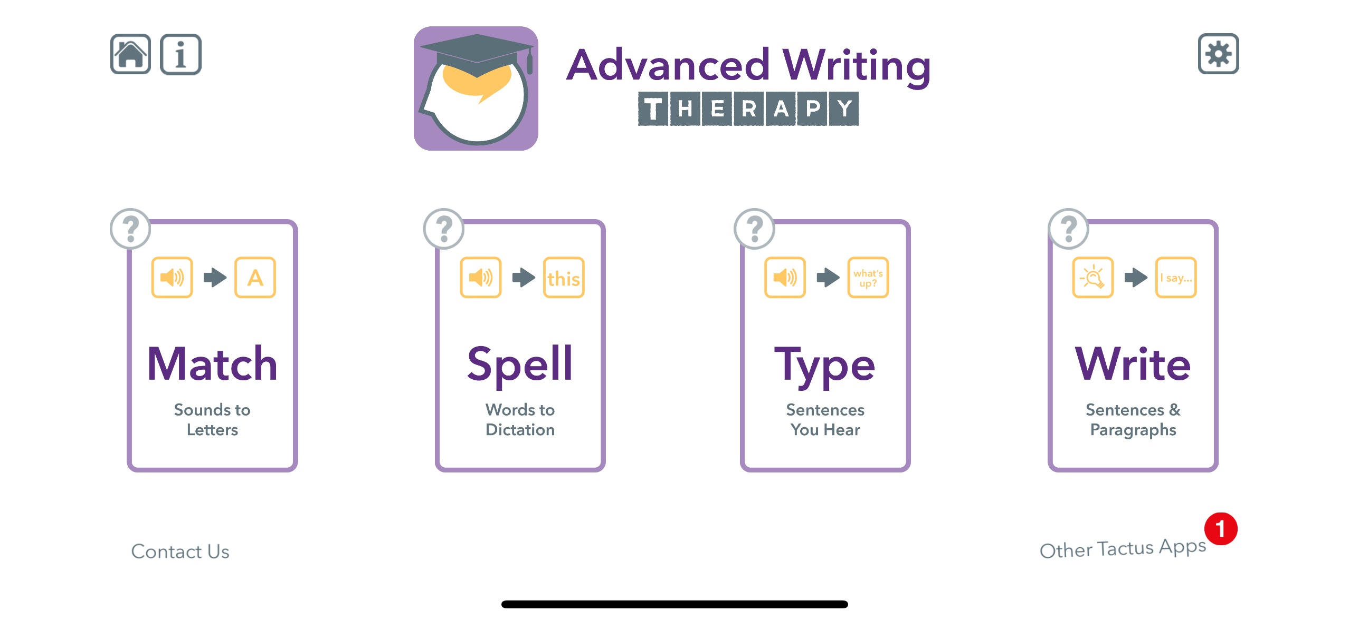
Create Extra Practice for the Advanced Writing App
CREATE EXTRA PRACTICE FOR THE ADVANCED WRITING APP: (MATCH · SPELL · TYPE · WRITE)
Using AI, you can instantly make more practice, more levels, and custom examples.

Slide 7
MATCH – Sounds to Letters
Examples:
pro (1 syllable)
pro-tect (2 syllables)
pro-gress (2 syllables)
pro-fess-ion (3 syllables)
pro-por-tion-al (4 syllables)
Use AI to create:
Word lists by syllable count
Beginning sound lists (pr-, st-, bl-)
Ending sound lists (-tion, -ing)
Minimal pairs for apraxia
Easy → Medium → Hard levels
**only downfall, the speech output is TOO FAST sometimes; Bryn copies/pastes into word document and uses text-to-speech

Slide 8
SPELL – Words to Dictation
Use AI to create:
10 easy spelling words
10 medium spelling words
10 hard spelling words
Slow, broken-down versions
Sentences using each word
Examples: Word: practice
Slow: prac… tiss
Sentence: “I need to practice today.”
Word: protein
Slow: pro… teen
Sentence: “She added protein to her smoothie.”

Slide 9
TYPE – Sentences You Hear
Easy Sentences:
“The dog ran.”
“I like coffee.”
Medium Sentences:
“The teacher guides the class.”
“The woman fixed the broken lamp.”
Hard Sentences:
“The photographer adjusted the professional lighting before the session.”
Use AI to create:
Short, medium, and long sentences
Sentences with a specific sound
Sentences that match the Tactus level
Past tense, questions, commands
Word-finding sentences

Slide 10
A new AI app – made just for YOU!
Stephen Albright – stroke survivor
Created AphasiaGPT – AI tool designed to assist individuals with aphasia in rebuilding their communication skills.
Offers AI powered conversations, exercises, and real-world scenario and practice

Slide 11
What is AphasiaGPT?
AphasiaGPT is an app designed to support communication for people with aphasia and other language challenges.
It helps with:
Word finding
Vocabulary practice
Listening and speaking
Everyday communication
You can use it:
on a computer
on a phone (availability may depend on the device)
Notes:
Android support is in progress

Slide 12
Word Finder
Word Finder
This tool helps when a word feels “stuck.”
It can:
explain the meaning of a word in simple language
give examples in short or longer sentences
find similar words or opposite words
read answers out loud so you can listen and read together
Helpful for word finding, reading, and understanding new words.

Slide 13
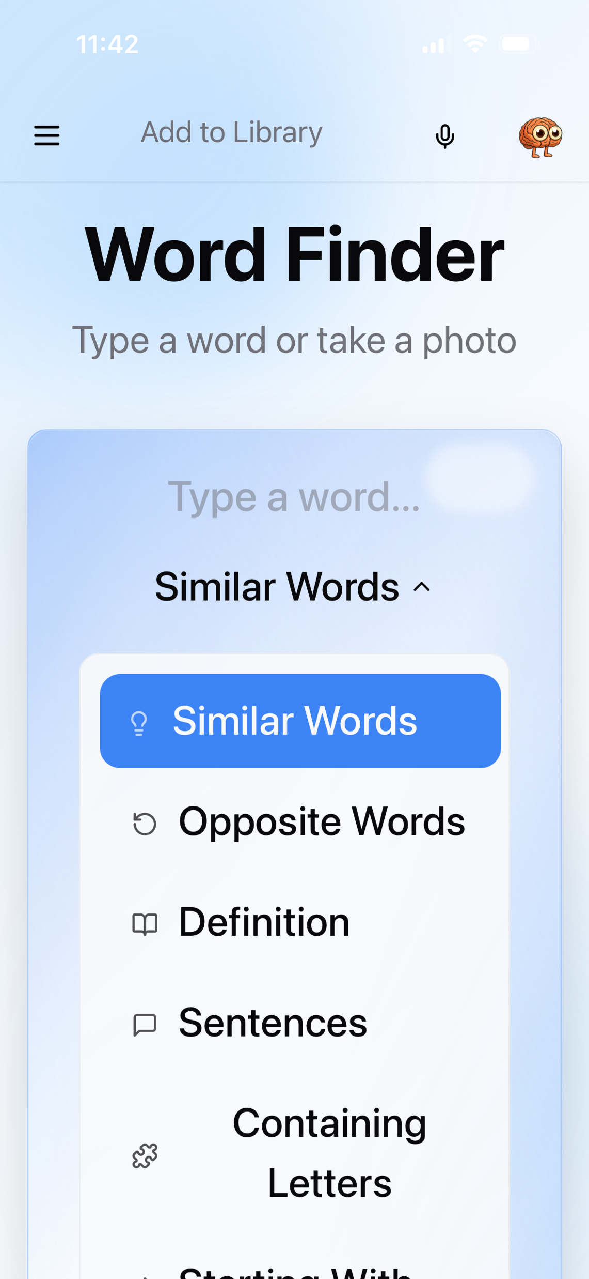
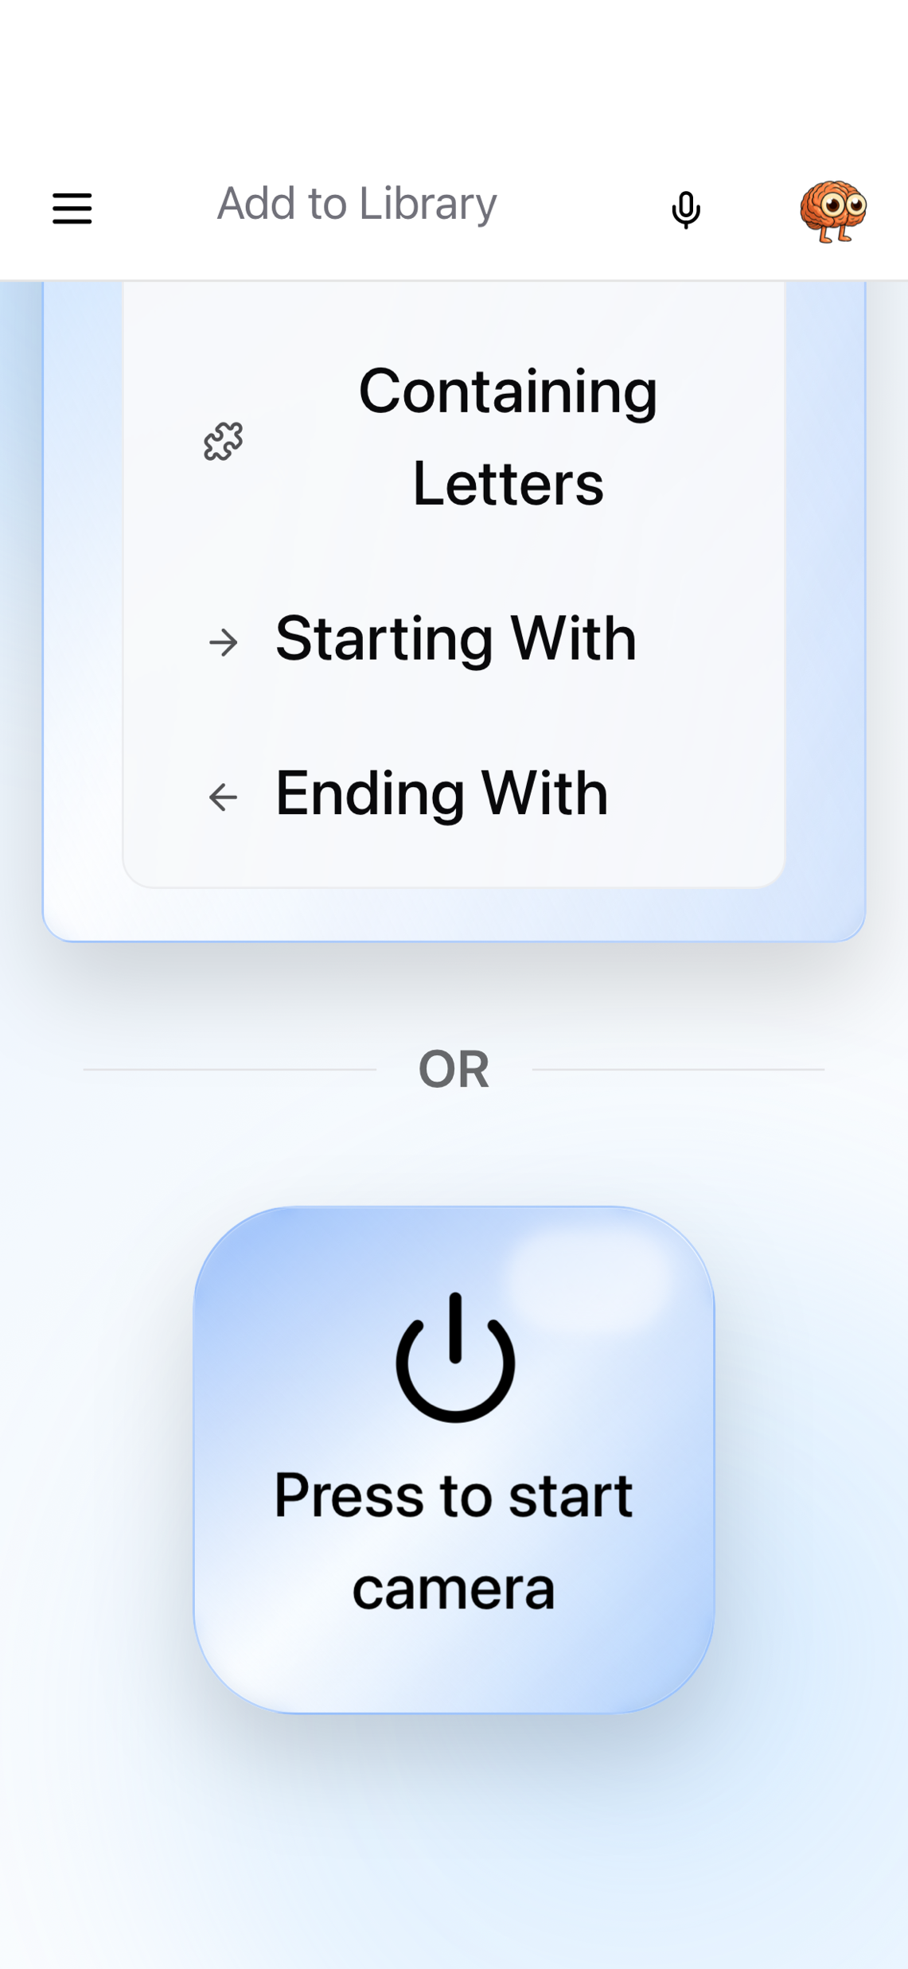

Slide 14
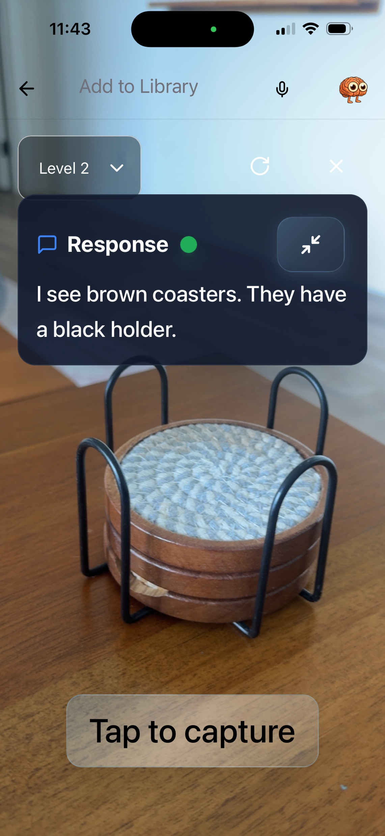
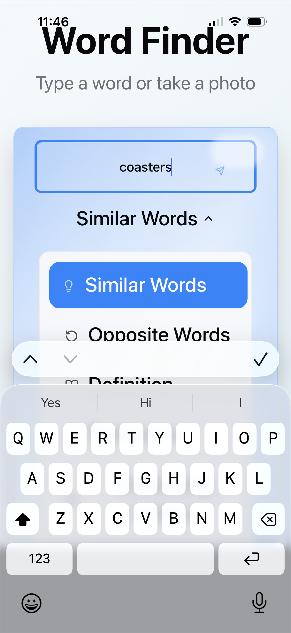
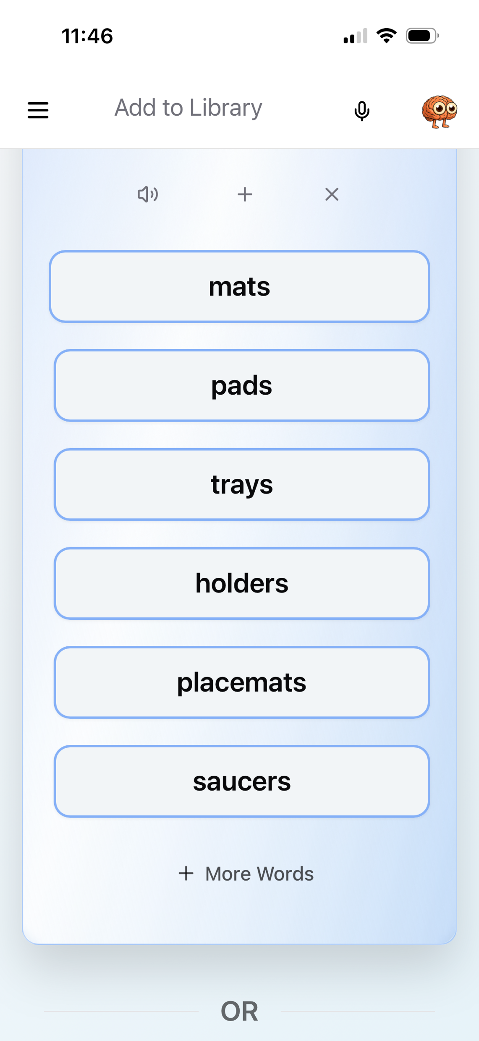

Slide 15
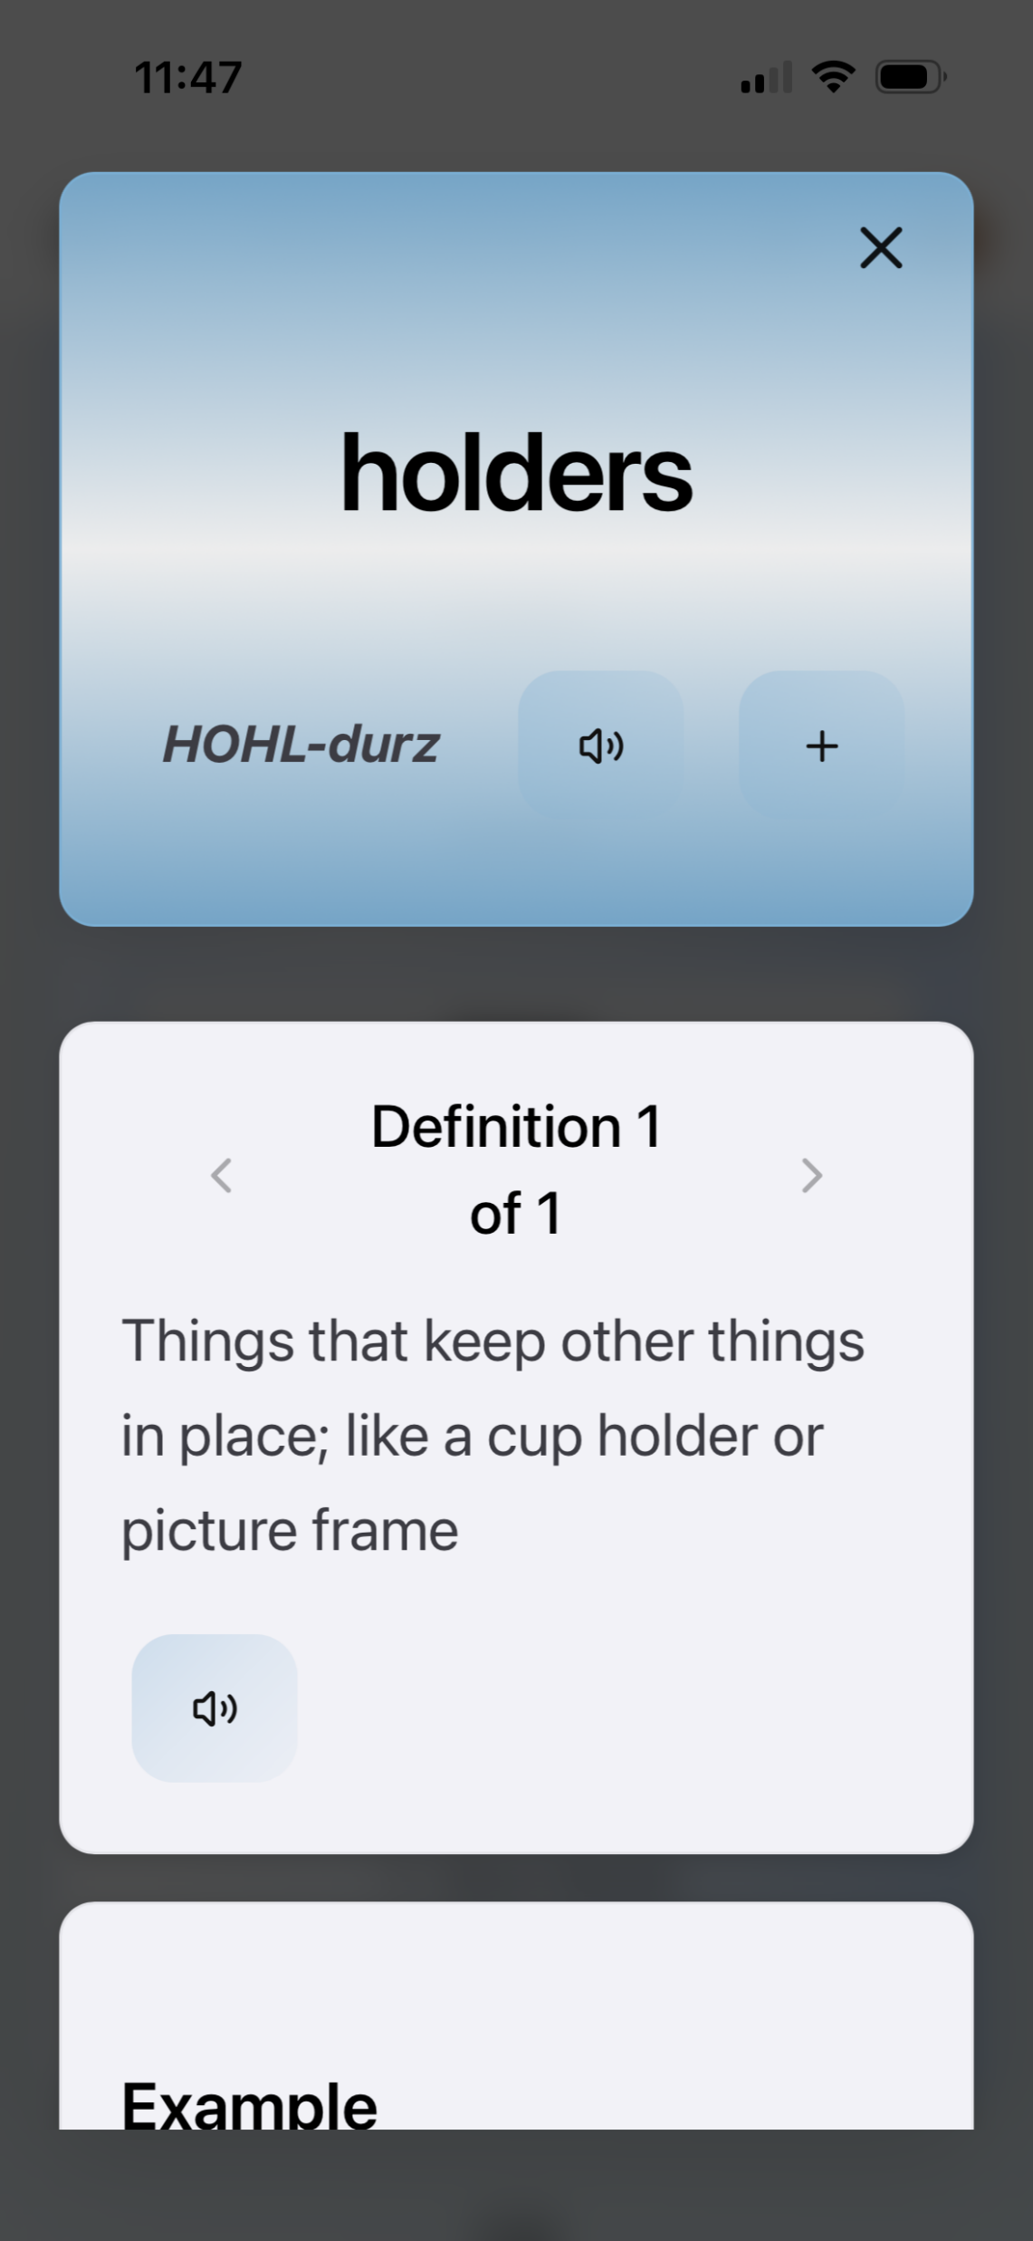
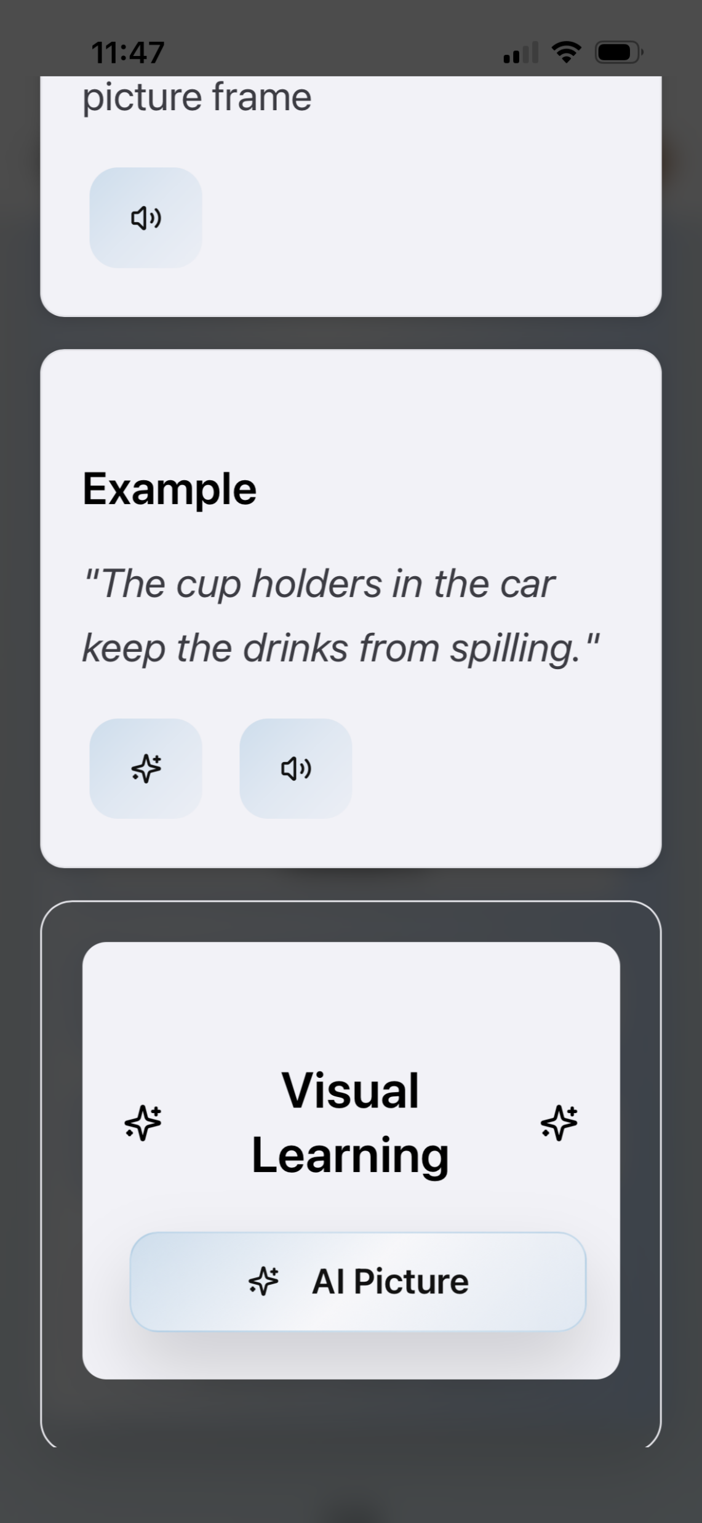
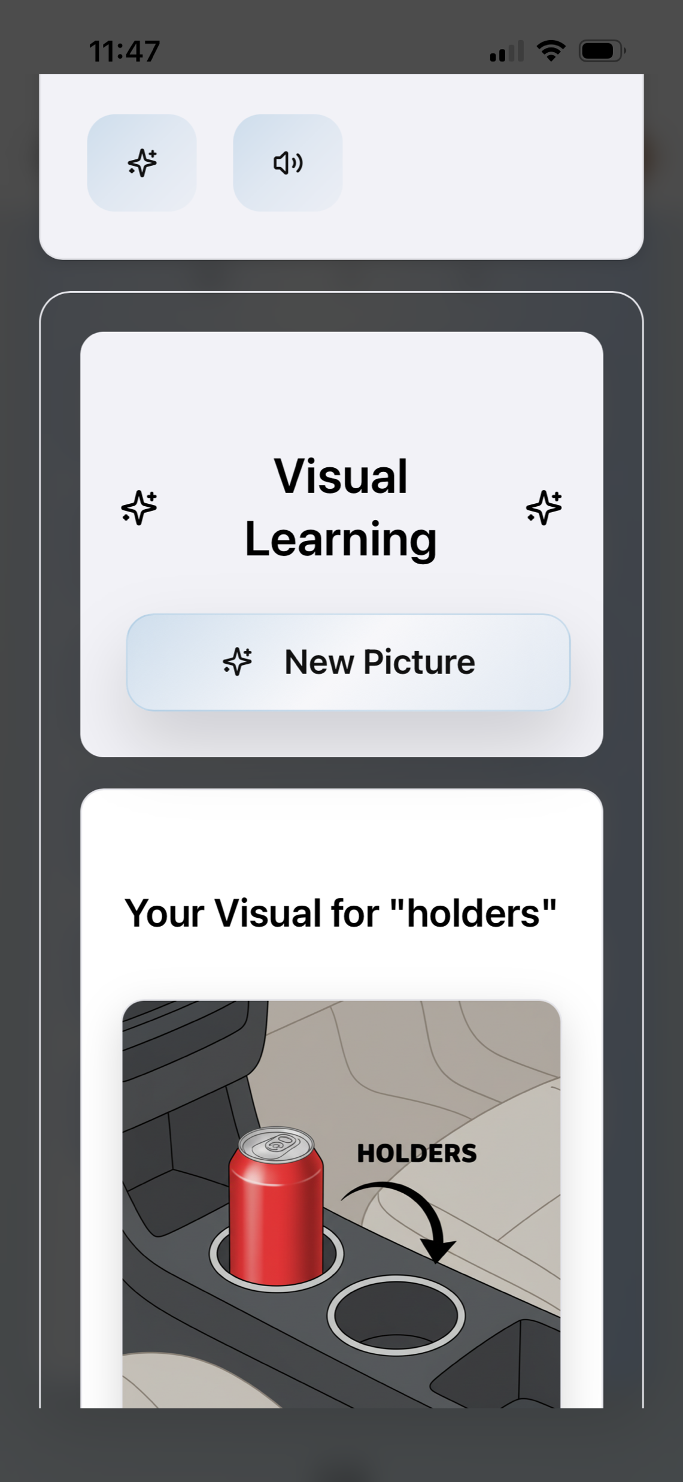

Slide 16
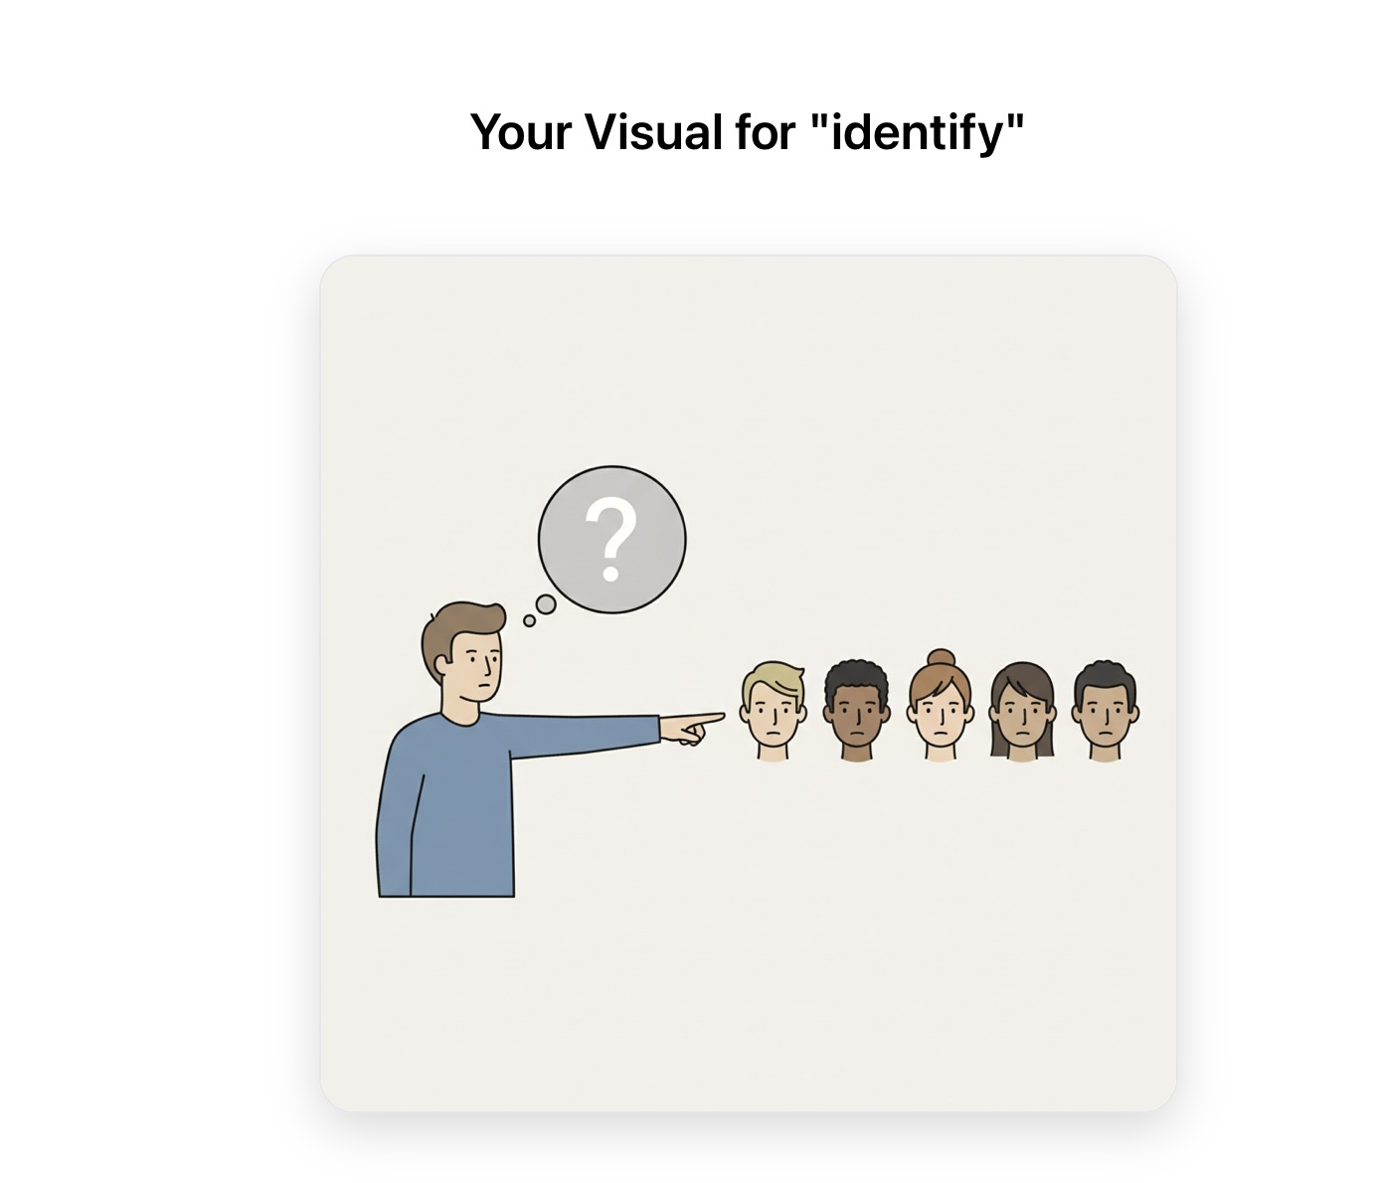
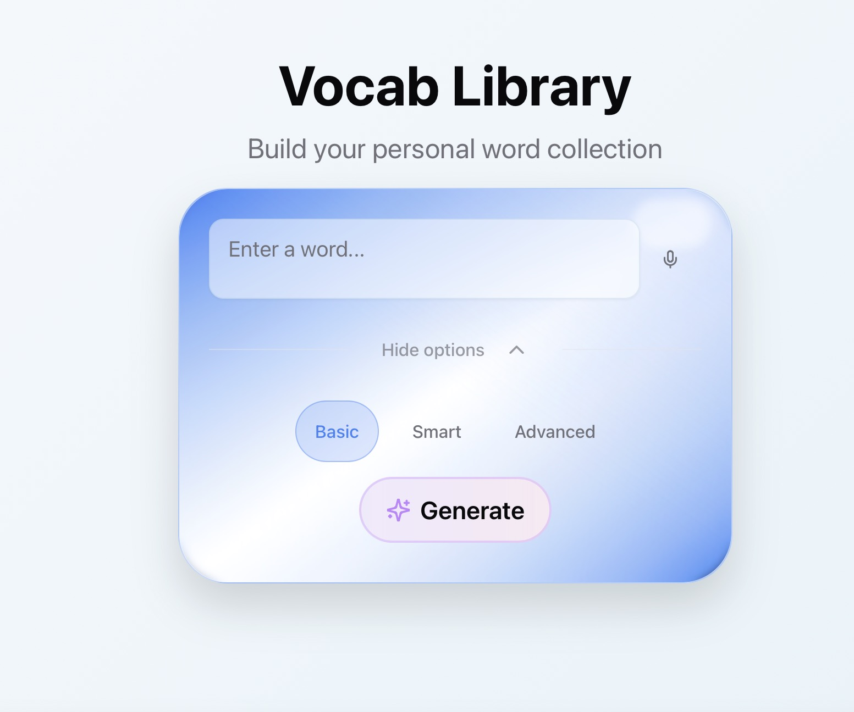
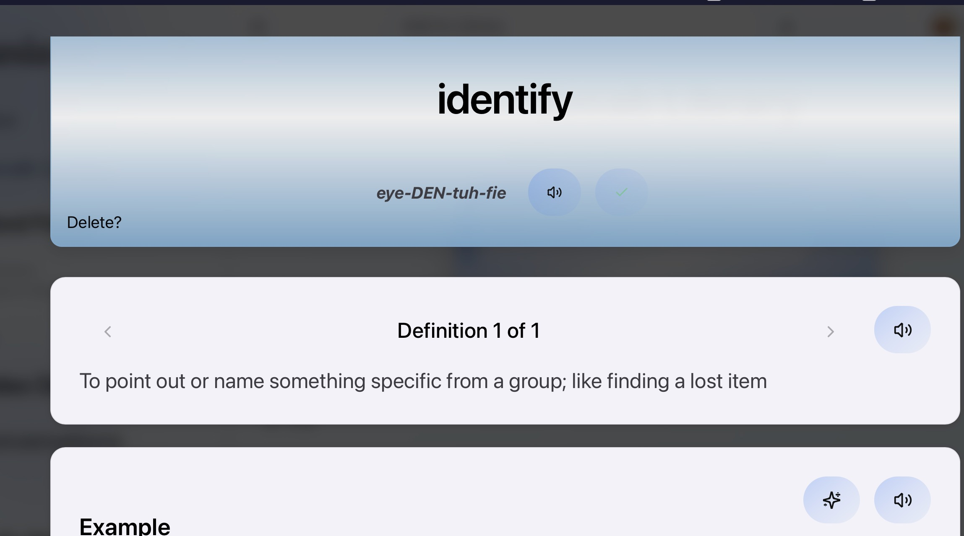

Slide 17

NEXT MEETING
See you next time!
Next Group: Wednesday, February 4th @4:00pm EST

