Slide 1
Technology and Supports for Aphasia
Brooke Lang, M.A., CCC-SLP and Bryn Lander

Slide 2
Plan for Today
Share 2 apps targeting Phonics/sound system
Working memory and Aphasia – What is it?
How you can work on Working Memory (activities and apps)

Slide 3
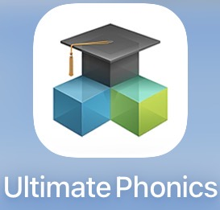
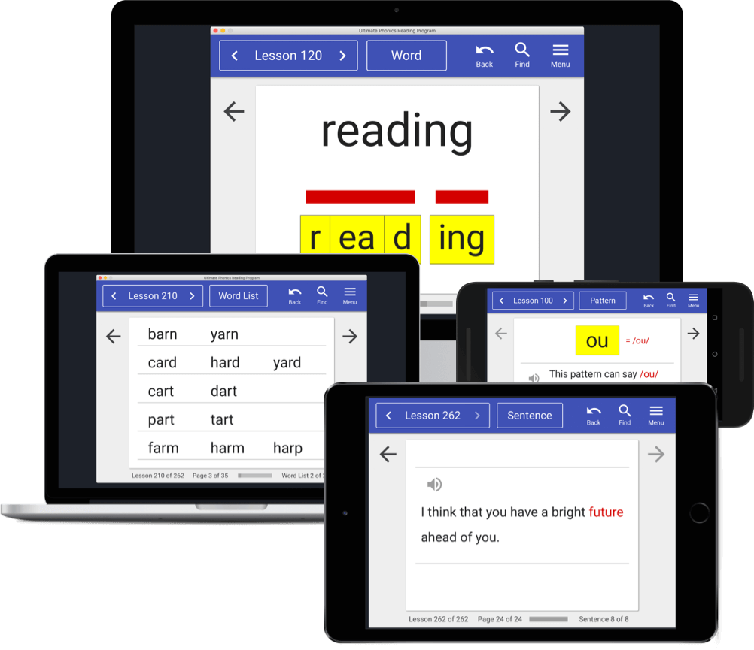
Ultimate Phonics
WHAT IS IT?
COMPREHENSIVE phonics learning program
Teaches ALL phonics patterns and sounds of English (beginning to advanced levels)
COST?
Free access to FIRST LEVEL
Can buy FULL VERSION for $29.99
Ultimate Phonics is free to use. You can also buy the full version for $29.99.

Slide 4
Ultimate Phonics
What it does:
Helps sound out letters and words
Best for:
Reading
Spelling
Apraxia support
Why it helps:
Breaks words into smaller parts
Slows reading down in a helpful way
Offers a “Find” feature to locate lessons by phonogram quickly.

Slide 5
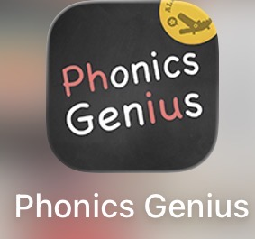
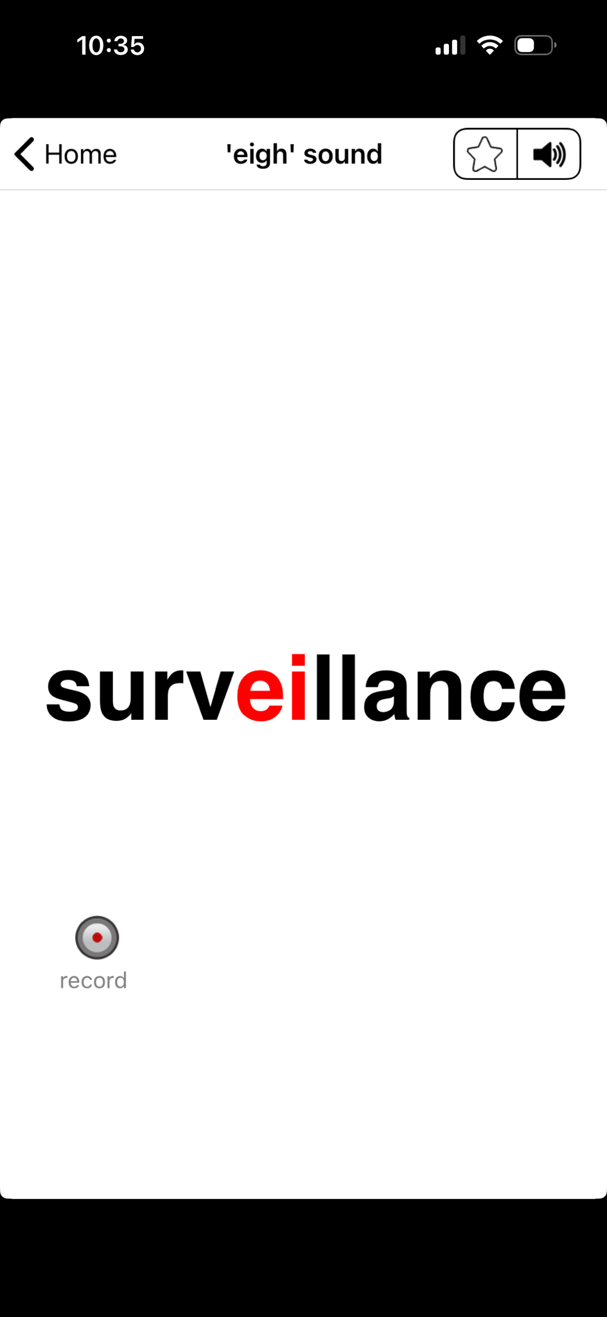
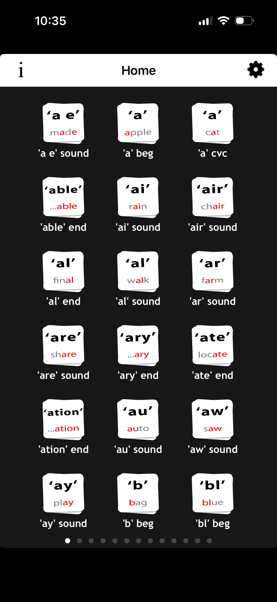
Phonics Genius
What it does:
Reading and spelling practice through a
flash-card style program (audio playback)
Best for:
Word recognition
Sound-to-letter practice
Why it helps:
Visual support
Repetition without pressure

Slide 6
Phonics Genius
Interactive and customizable:
Includes game mode quizzes and other play modes
Customizable sets; able to create/record your own cards
Prices:
- Standard Price: $0.99 in the Apple App Store.
- Content: you get the full library of over 6,000 words grouped by phonetics without additional subscriptions.

Slide 7
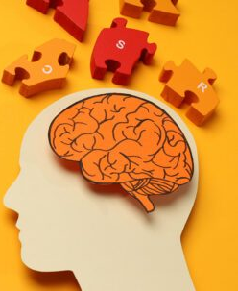
Working Memory and Aphasia
What is Working memory?
Your brain’s ability to hang onto something in your head, and manipulate it
Why is it important for communication and Aphasia recovery?
Word finding difficulties interrupting flow of communication
Crucial for language processing

Slide 8

Working Memory and Aphasia
Examples
Keeping a word in mind long enough to get say it
Holding onto beginning of a sentence while planning for end
Following what a conversational partner is saying and following multiple steps
Hanging onto a choice long enough to get the preferred one out (i.e. Do you want tea or coffee?)

Slide 9
Working Memory Tasks (working with SLP or Care Partner)
Pick a sentence (Start with 3 words in length)
Present it auditorily, asking person with Aphasia to hold in their head
i.e. Children play outside.
Ask them to do the following:
Give the words in ALPHABETICAL ORDER (children – outside – play)
Give the words LONGEST to SHORTEST in length (children - outside –– play)
Give the words reversed (outside – play – children)
Give the words in REVERSED ALPHABETICAL ORDER (play – outside – children)
Give the words SHORTEST to LONGEST in length (play – outside – children)

Slide 10
Working Memory Tasks (working with SLP or Care Partner)
You can make it more challenging by:
Using sentences longer in length (more than 3)
Using words in sentences that are closer in length or closer alphabetically
You can make it easier by:
Doing the opposite of above

Slide 11
Working Memory Tasks (working with SLP or Care Partner)
Word or sentence manipulation
Idea: manipulate a word by taking it out and replacing it with a new one

Slide 12
Working Memory Tasks (working with SLP or Care Partner)
Word manipulation (use compound words)
Rainfall (change rain to snow)
Snowfall (change fall to man)
Snowman (change snow to door)
Doorman
Sentence manipulation
We play ball. (change ball to games)
We play games. (change play to win)
We win games. (change we to they)
They win games.

Slide 13
Brain/Cognitive Apps vs Aphasia Apps
Examples: Lumosity, Peak, Elevate, NeuroNation, Brain HQ
What do these apps do?
Address executive function skills (attention, problem solving, memory – different types, etc, mental flexibility)
Help with mental stamina and focus
Offer fun and motivating games
What are they not? X Not designed for word-finding recovery X Not speech-specific

Slide 14
Brain & Working Memory Games
Not aphasia-specific, but useful for exercise and mental stamina:
Lumosity: classic brain games that target memory, attention, and flexibility.
Peak & Elevate: short bursts of cognitive games with memory, language, and focus drills.
NeuroNation: personalized cognitive training that includes memory tasks.

Slide 15

NEXT MEETING
See you next time!
Next Group: Wednesday, April 1st @4:00pm EST

