Slide 1
Technology and Supports for Aphasia
Brooke Lang, M.A., CCC-SLP and Bryn Lander (aneurysm survivor)

Slide 2
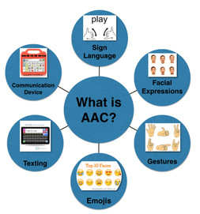
What is AAC?
Strategies, techniques, or devices intended to supplement or replace insufficient or ineffective communication skills
Augmentative – add to someone’s speech
Alternative – instead of speech
Comprehensive collection of communication strategies that provide external support for people who cannot understand or generate messages on their own (Garret & Lasker, 2005)

Slide 3


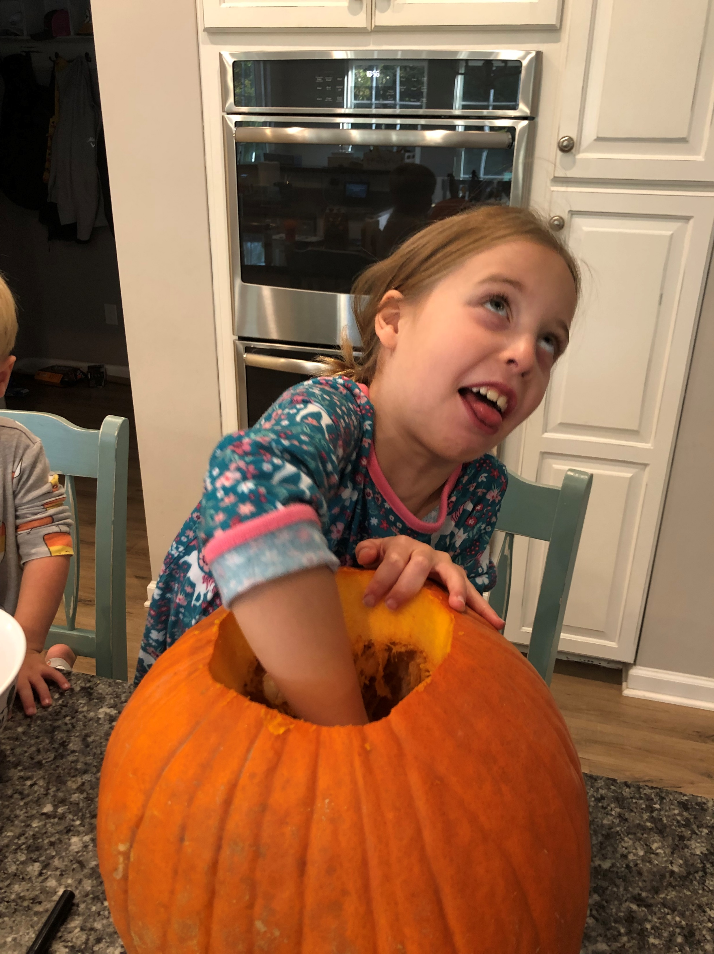
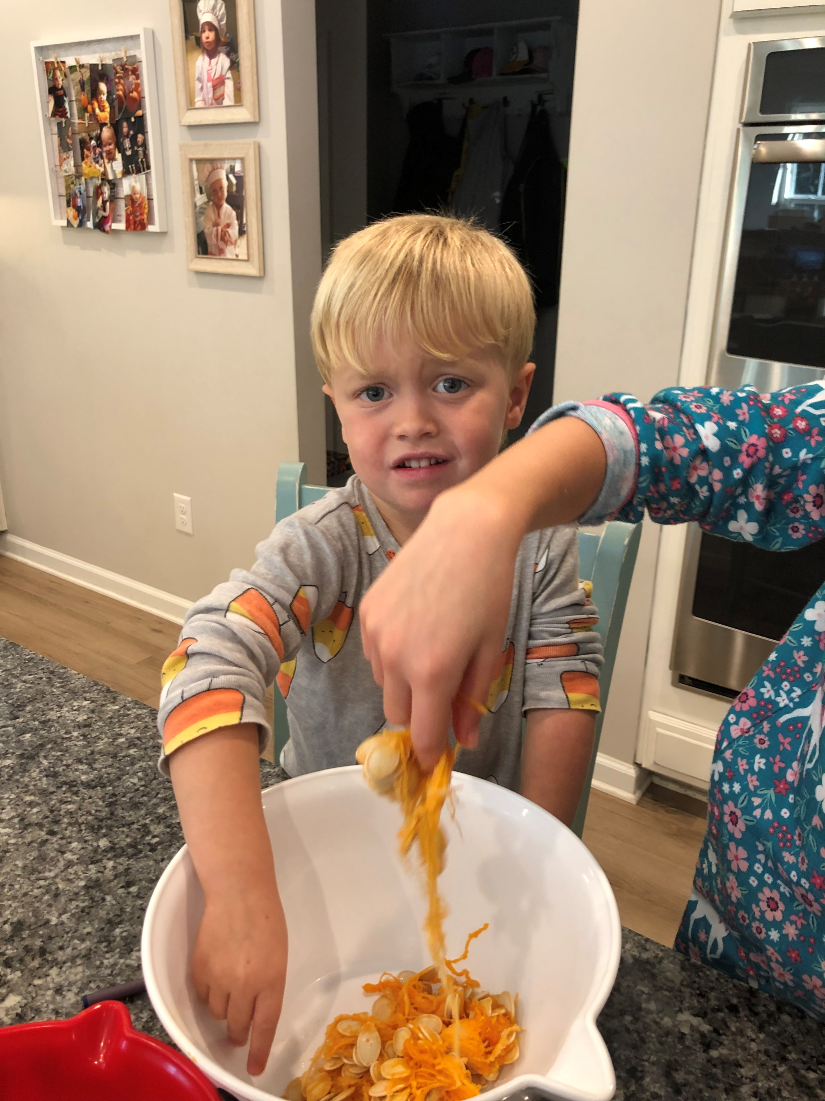
What is AAC?
Unaided (do not require external tool, require some degree of motor control)
Body language
Facial expressions
Finger spelling
Gestures
Manual signs
Vocalizations/Verbalizations

Slide 4
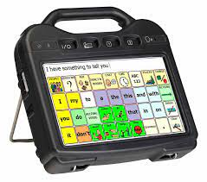
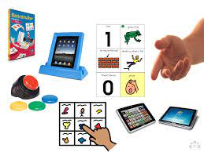
What is AAC?
Aided (require some form of external tool)
Nonelectronic (“low tech”)
Communication boards/books
Objects, pictures, photographs
Visual schedules
Writing
Electronic forms “high tech”
Computer/tablet/smartphone
Communication apps, such as AAC software
Text-to-speech features
Texting
Drawing/writing using a tablet
Speech Generating Devices (SGDs)

Slide 5

AAC and Aphasia
A system, not a device
Needs to be multifaceted and part of a communication system
Benefit from strategies that provide redundancy through multiple modalities

Slide 6
Revisiting Role of AAC in Aphasia Rehab
AAC should be introduced earlier and more broadly in post-stroke journey
AAC should focus beyond basic wants/needs to increase life participation and connection
Combining AAC with traditional interventions can address needs today while also working on enhancing language abilities for future
Use AAC to increase ability while focusing on participation
Dietz, Wallace & Weissling 2020

Slide 7
Common Questions About AAC/Aphasia
Does insurance cover AAC, or are there other coverage options?
Why can AAC be difficult for people with Aphasia?
Will using AAC make my loved one with Aphasia talk less or become lazy with communication?

Slide 8

Insurance and AAC
Insurance can cover AAC devices
Depends on:
Insurance plan
Medical necessity
Proper documentation
Some states offer additional funding through disability waivers, which can supplement Medicaid or private insurance coverage
There are several grants available that support AAC needs – keep an eye on resources listing these grants, as they are updated frequently and new opportunities arise
State Vocational Rehab offices can assist you in obtaining funding for your AAC device

Slide 9
AAC Challenges in Aphasia
Why can AAC be difficult for people with Aphasia?
Takes time and patience to find the RIGHT option (Aphasia is different for everyone)
Visual challenges may be present (neglect, field cuts, visual processing, etc.)
May not know what the symbol or picture represents
Semantic deficits make categorization challenging (i.e. selecting a picture of a CUP to correspond with “thirst” may be difficult)
Cognitive deficits may make it hard – attention/memory/executive functioning
Hard to follow instructions, remember sequences, and navigate a complex AAC system
Training and generalization limitations – instruction often limited to controlled settings, so skills may not transfer to everyday environments, leaving PWA unable to use AAC in real-world situations
For AAC to be a success, need to have personalized and context appropriate tools, ongoing training, and strong communication partner support.

Slide 10

AAC = less talking?
FALSE!! → research and clinical practice show AAC can support, enhance, and even improve natural speech recovery in PWA.
AAC is not a REPLACEMENT for speech
More of a supplement or designed to help compensate for communication challenges
Use both AAC and speech together
AAC can actually improve speech outcomes
When introduced early and consistently, it can enhance speech production; helps people express themselves more clearly, which supports language recovery
AAC supports independence and participation
Reduces frustration and social isolation, allowing PWA to engage in activities, socialize, and ask questions without relying only on verbal output
AAC DOES NOT keep someone from recovering their natural speech
AAC should be part of a dual-purpose communication system that includes speech
In Summary → AAC expands communication options and can lead to better overall communication and QOL

Slide 11

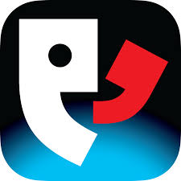

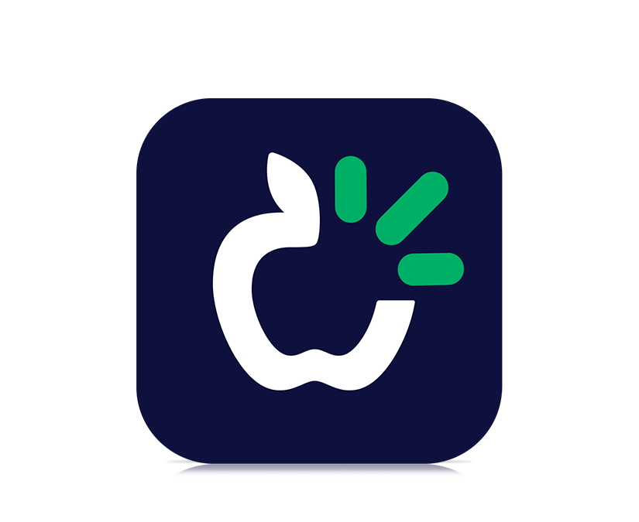
Some AAC Programs
Proloquo2go
Proloquo4Text AAC
TouchChat
TD Snap
Speech Assistant
Nova Chat (Android)
Clarocom

Slide 12
Proloquo2go: Tap symbols. Type words. Speak.
Customizable Vocabulary: offers a diverse vocabulary set that can be adjusted to suit the user's specific needs and language proficiency.
Users can add, remove, or modify vocabulary items to make communication more personalized and effective.
Voice Output: The app includes high-quality, natural-sounding text-to-speech voices, enabling users to have their typed or selected messages spoken aloud.
Intuitive Interface: Proloquo2Go provides an intuitive and user-friendly interface - designed to be easy to navigate, reducing the frustration that can accompany complex communication tasks.
Symbol and Text-based Communication: It supports both symbol-based and text-based communication, allowing users to express themselves using symbols, photos, or text, depending on their preferences and abilities.
Usability Across Devices: Proloquo2Go can be used on various devices, such as iPads or iPhones, providing flexibility and mobility for users who need to communicate on the go.
COST → $249.99
Notes:
Proloquo2Go is an augmentative and alternative communication (AAC) app designed to support individuals who have difficulty speaking, including those with aphasia. Here are some key features and benefits of Proloquo2Go for people with aphasia:
1. **Customizable Vocabulary**: The app offers a diverse vocabulary set that can be adjusted to suit the user's specific needs and language proficiency. Users can add, remove, or modify vocabulary items to make communication more personalized and effective.
2. **Intuitive Interface**: Proloquo2Go provides an intuitive and user-friendly interface, which makes it accessible for individuals with varying levels of technological skills. The app is designed to be easy to navigate, reducing the frustration that can accompany complex communication tasks.
3. **Symbol and Text-based Communication**: It supports both symbol-based and text-based communication, allowing users to express themselves using symbols, photos, or text, depending on their preferences and abilities.
4. **Voice Output**: The app includes high-quality, natural-sounding text-to-speech voices, enabling users to have their typed or selected messages spoken aloud. This feature is particularly valuable for individuals with severe speech difficulties.
5. **Language Support**: Proloquo2Go offers support for multiple languages, making it versatile for users who speak different languages or are multilingual.
6. **Self-Expression**: The app can help individuals with aphasia express their thoughts, needs, and emotions more easily, promoting social interaction and participation in daily activities.
7. **Usability Across Devices**: Proloquo2Go can be used on various devices, such as iPads or iPhones, providing flexibility and mobility for users who need to communicate on the go.
8. **Educational Resources and Support**: The developers provide resources and support to help users and their caregivers make the most out of the app.
Overall, Proloquo2Go can be a powerful tool for individuals with aphasia, offering them a means to communicate with greater independence and confidence.

Slide 13
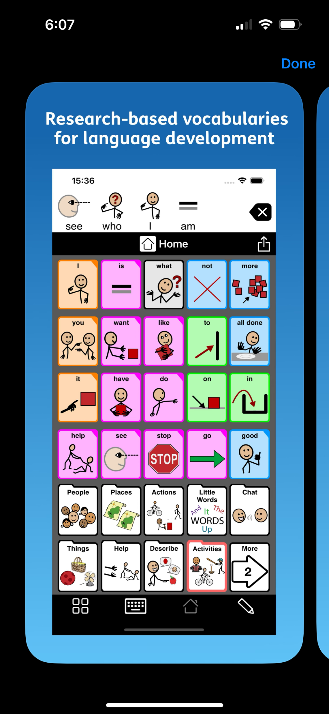
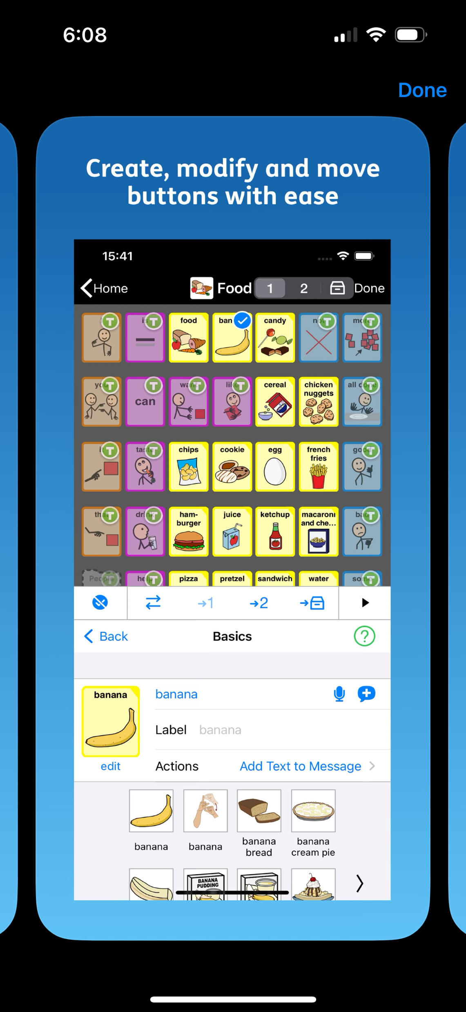
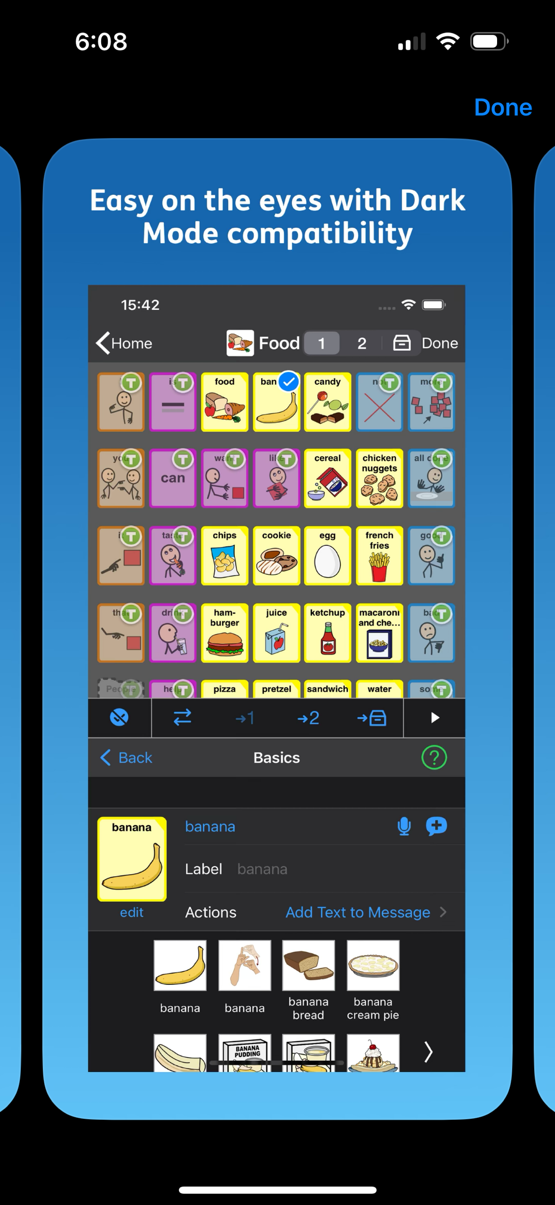
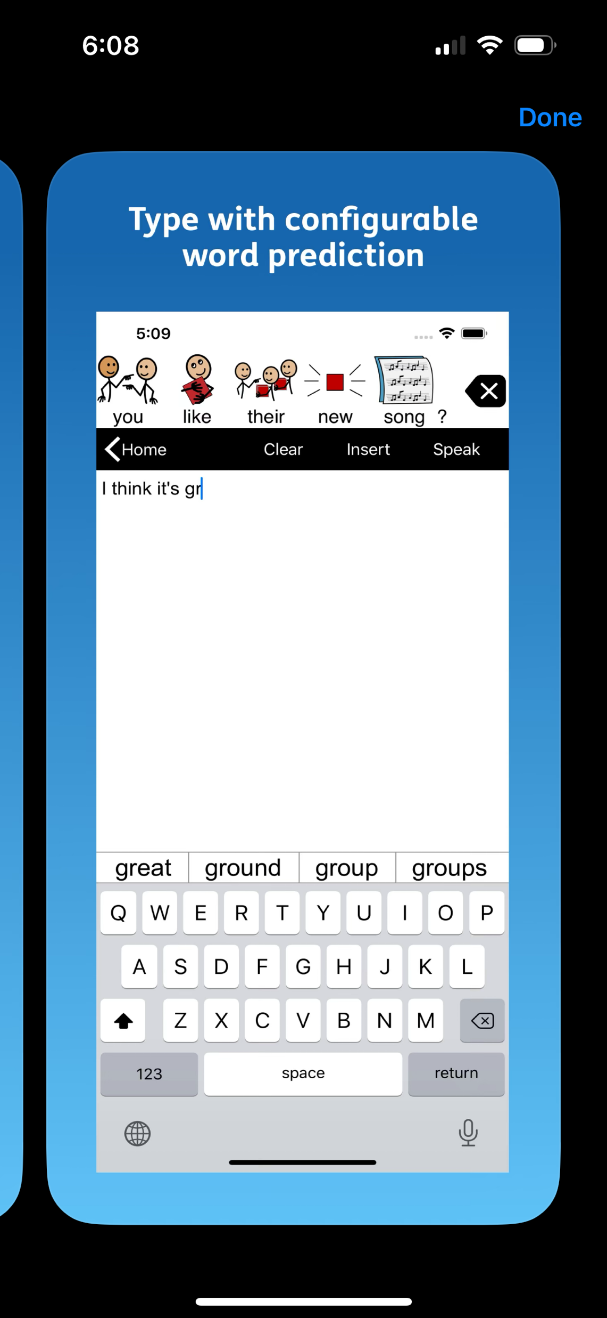

Slide 14
Proloquo4Text AAC Text-to-speech communication
Text-to-Speech: This is especially helpful for those who can type but struggle with verbal communication.
Word Prediction: Word and sentence prediction, which speeds up communication by suggesting words and phrases based on the user's typing habits.
Customizable Speech: Users can select from a variety of voices and adjust the speech rate, volume, and pitch, tailoring it to their preferences or needs.
Multilingual Support
Sharing Options: Proloquo4Text allows users to share their messages via text, email, or social media directly from the app, providing diverse communication channels.
Accessibility Features: offering features like large buttons, adjustable text size, and compatibility with accessibility settings on the device.
COST → $119.99
Notes:
Here’s how Proloquo4Text can be beneficial for people with aphasia:
1. **Text-to-Speech**: Users can type their messages, and the app converts the text into speech. This is especially helpful for those who can type but struggle with verbal communication.
2. **Word Prediction**: The app offers word and sentence prediction, which speeds up communication by suggesting words and phrases based on the user's typing habits.
3. **Quick Talk**: Users can save frequently used phrases and organize them for easy access. This is beneficial for commonly used expressions or responses.
4. **Customizable Speech**: Users can select from a variety of voices and adjust the speech rate, volume, and pitch, tailoring it to their preferences or needs.
5. **Multilingual Support**: The app supports multiple languages, allowing users who are multilingual or prefer to communicate in a language other than English to use the app effectively.
6. **Sharing Options**: Proloquo4Text allows users to share their messages via text, email, or social media directly from the app, providing diverse communication channels.
7. **Accessibility Features**: The app is designed with accessibility in mind, offering features like large buttons, adjustable text size, and compatibility with accessibility settings on the device.
By leveraging these features, individuals with aphasia can express themselves more independently and engage in conversations with those around them, thereby improving their quality of life and social interactions.

Slide 15
Proloquo4Text AAC Text-to-speech communication
https://youtu.be/1TaUEIJgBU0?si=Eln-RME39z6E-vE8

Slide 16
TD Snap
TD Snap is a flexible software offering a choice of AAC solutions to help people with communication disabilities
Customizable: Wide variety of page sets to explore, including Scanning and Aphasia
Compatible with select Tobii Dynavox devices, but also can purchase as a standalone app for iPad and Windows devices.
**SLP (Speech Language Pathologists) can program remotely with their own software – free with tobii dynavox account**
Cost → Subscription based (*new May 2024) - $9.99/month

Slide 17
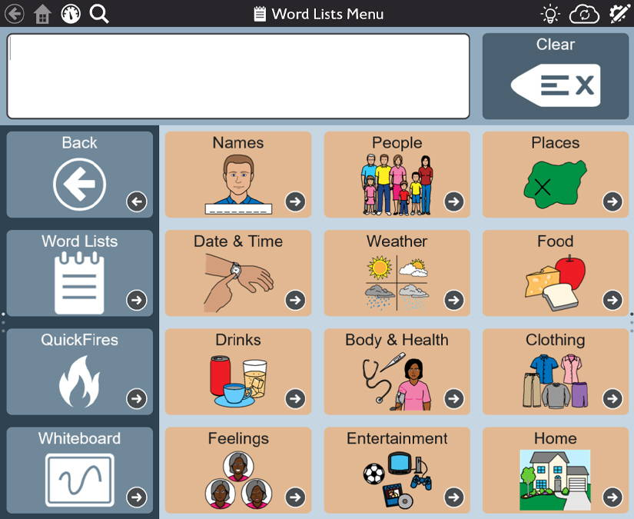
TD Snap

Slide 18
SpeechAssistant
Speech Assistant AAC is a text-to-speech app designed for people who are speech impaired
With the app you can create categories and phrases, which are placed on buttons. With these buttons you can create messages that can be shown or spoken (text-to-speech). It is also possible to type any text using the keyboard.
Iphone iOS/Android: $23.99

Slide 19
SpeechAssistant
Link for USER MANUAL:
https://www.a-soft.nl/SpeechAssistantAAC-iOS-UserManual.pdf
Notes:
https://www.a-soft.nl/SpeechAssistantAAC-iOS-UserManual.pdf

Slide 20
SpeechAssistant
Easy to use and completely customizable to your needs and preferences
Categories and subcategories to organize your phrases.
History option for quick access to previously typed phrases.
Option to select photos from your Photo Library or Symbols on the buttons.
Option for voice recordings or select one of the iOS text-to-speech voices.
Support for Apple's Personal Voice.
Full screen button to show your message with a large font.
Key features
Notes:
Key features
Easy to use and completely customizable to your needs and preferences.
Categories and subcategories to organize your phrases.
History option for quick access to previously typed phrases.
Option to select photos from your Photo Library or Symbols on the buttons.
Option for voice recordings or select one of the iOS text-to-speech voices.
Integration with ElevenLabs for using a highly realistic Al Professional Voice Clone.
Support for Apple's Personal Voice.
Full screen button to show your message with a large font.
Autocomplete feature that shows phrase suggestions in a drop-down list.
Tabs for multiple conversations (optional setting).
Designed for iPhone/iPad and both support portrait and landscape layout.
Support for the Apple watch.
Backup to iCloud, Mail or AirDrop.
Phone calls
The app can also be used while making Phone and FaceTime calls.
So you don't need a second device anymore for the speech output.

Slide 21
SpeechAssistant
The app can also be used while making Phone and FaceTime calls.
So you don't need a second device anymore for the speech output.
Phone Calls
Notes:
Key features
Easy to use and completely customizable to your needs and preferences.
Categories and subcategories to organize your phrases.
History option for quick access to previously typed phrases.
Option to select photos from your Photo Library or Symbols on the buttons.
Option for voice recordings or select one of the iOS text-to-speech voices.
Integration with ElevenLabs for using a highly realistic Al Professional Voice Clone.
Support for Apple's Personal Voice.
Full screen button to show your message with a large font.
Autocomplete feature that shows phrase suggestions in a drop-down list.
Tabs for multiple conversations (optional setting).
Designed for iPhone/iPad and both support portrait and landscape layout.
Support for the Apple watch.
Backup to iCloud, Mail or AirDrop.
Phone calls
The app can also be used while making Phone and FaceTime calls.
So you don't need a second device anymore for the speech output.

Slide 22
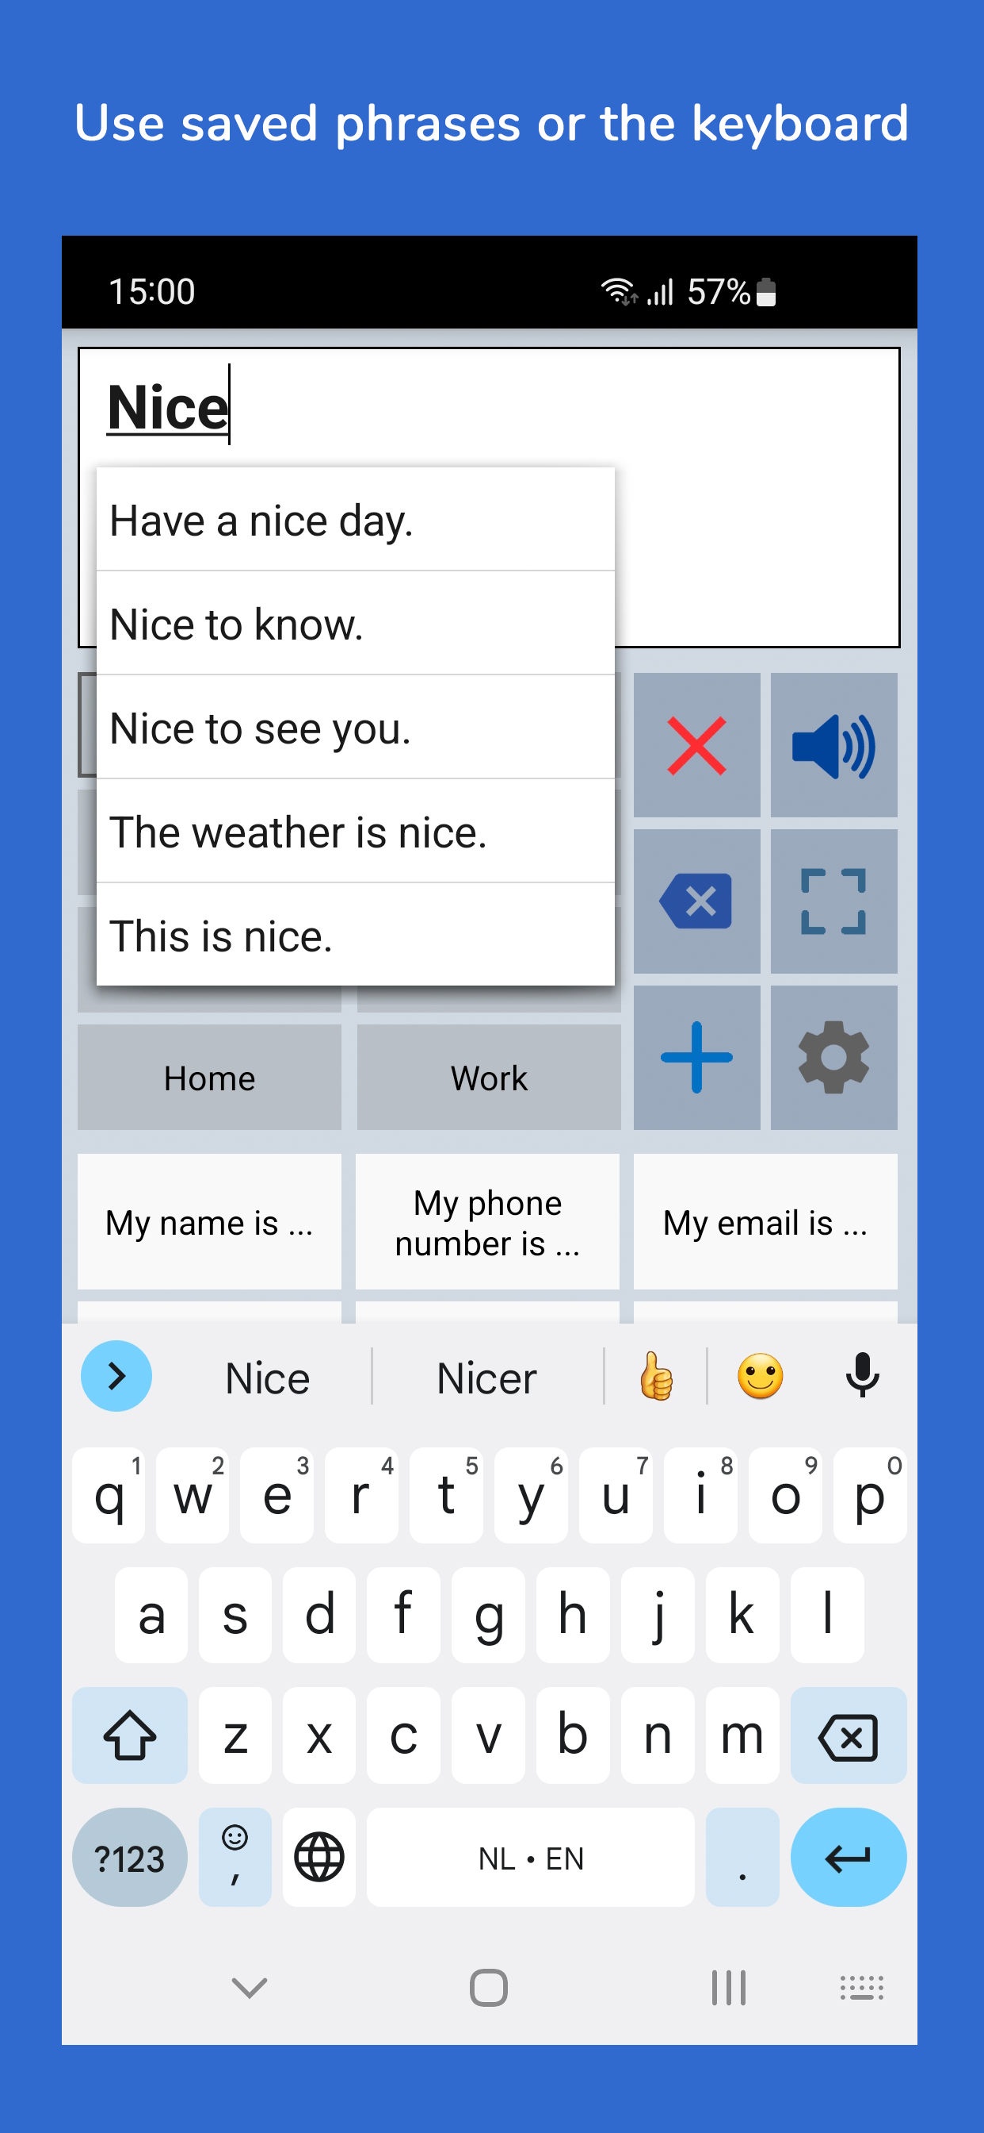
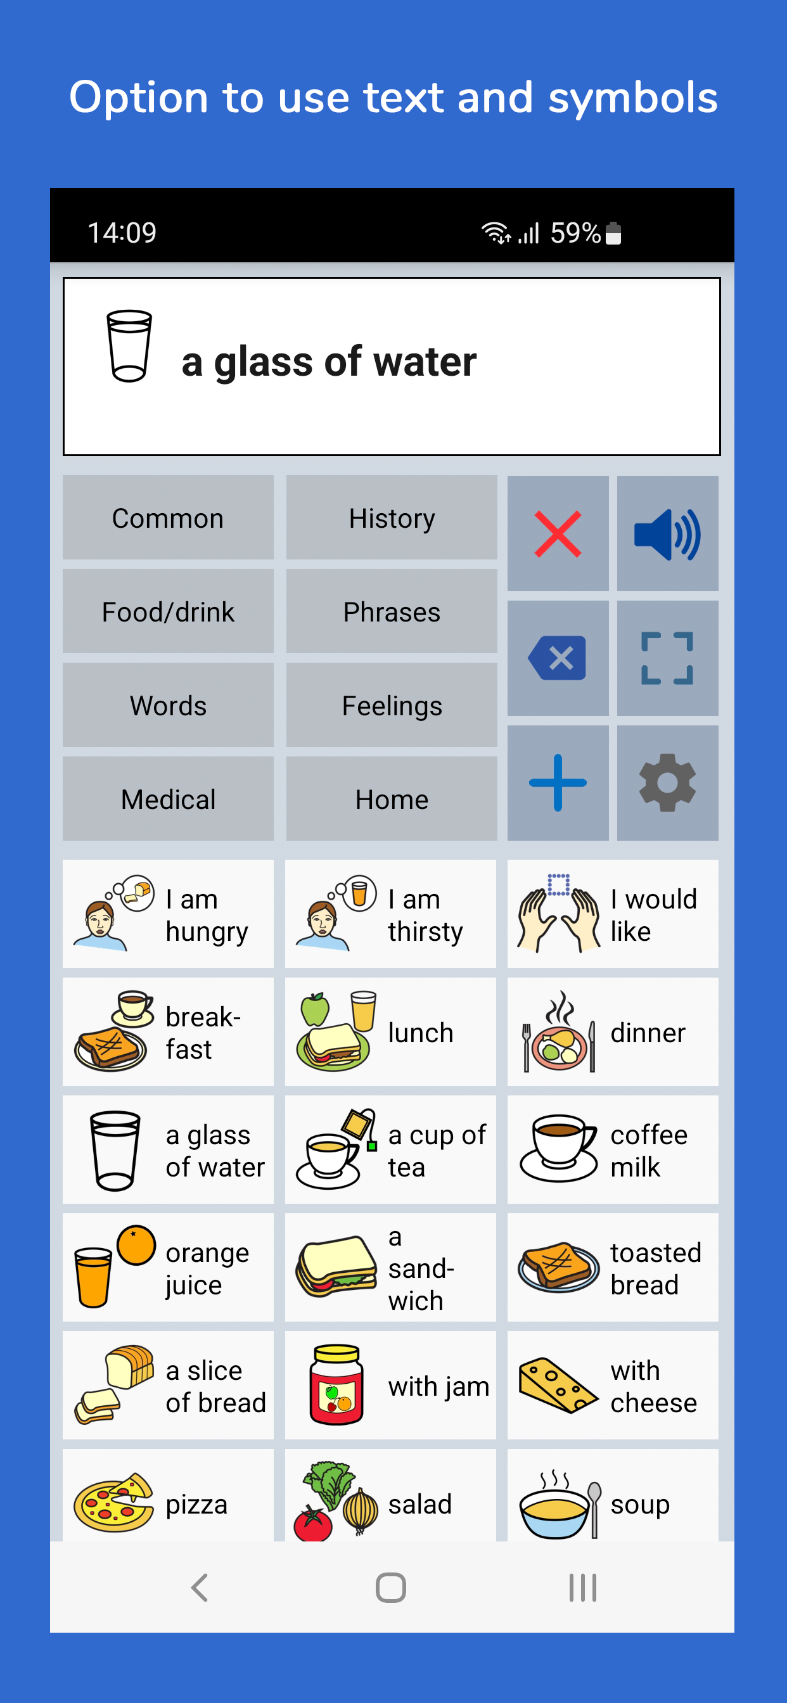
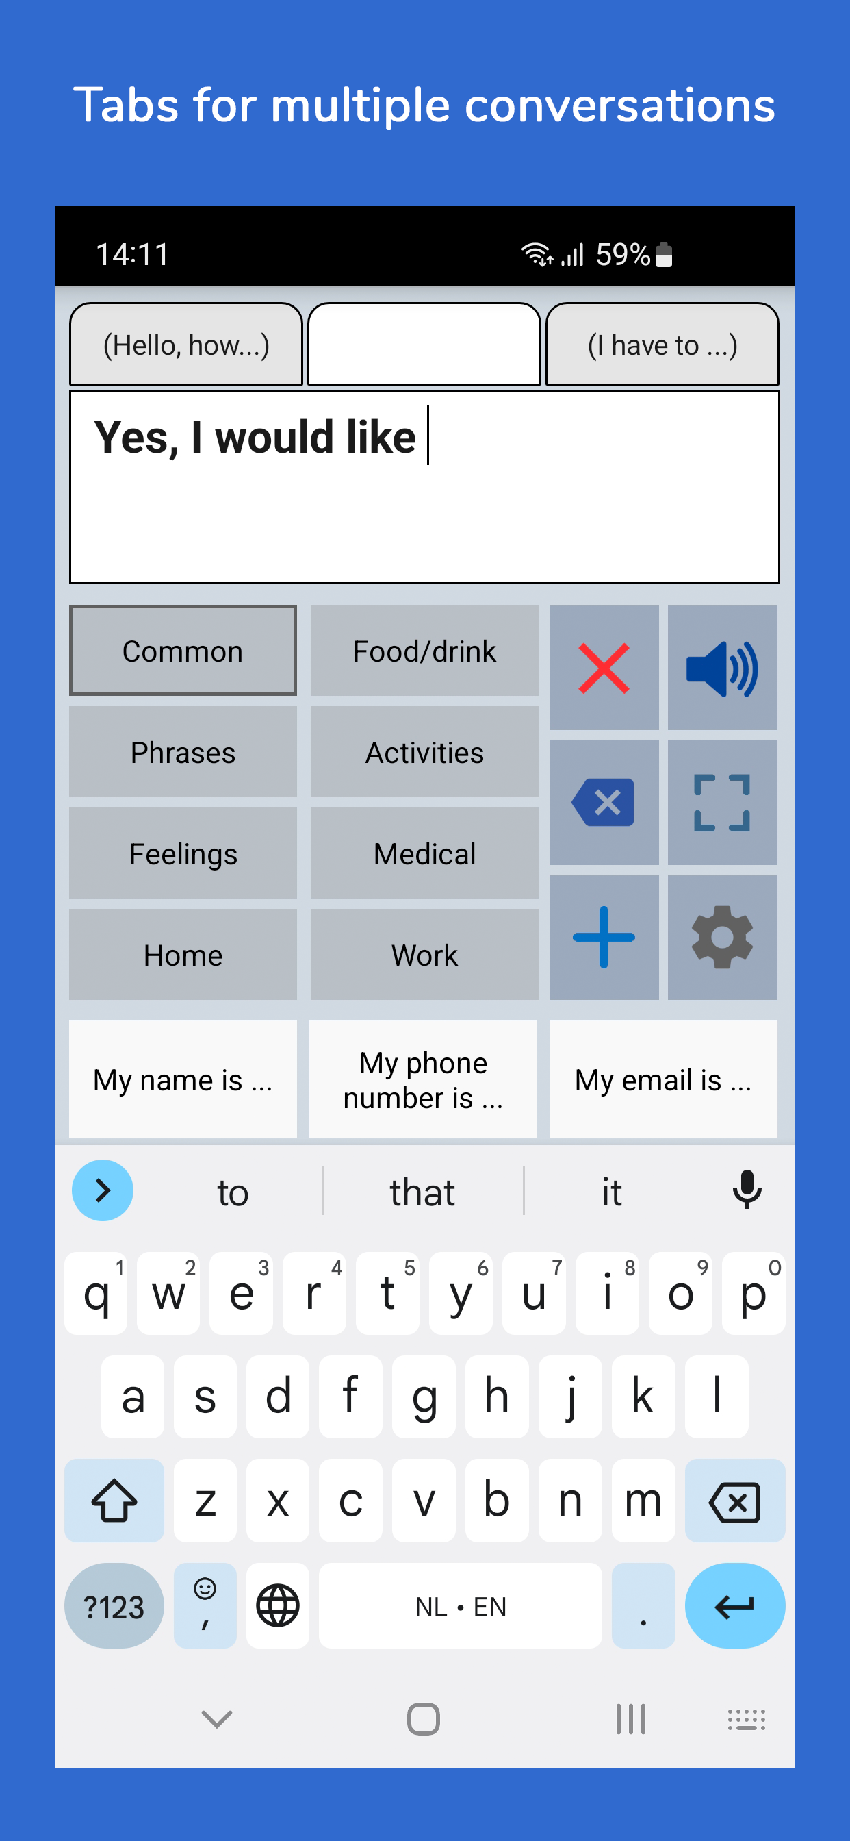
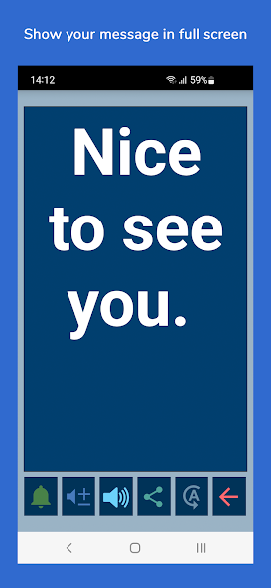

Slide 23
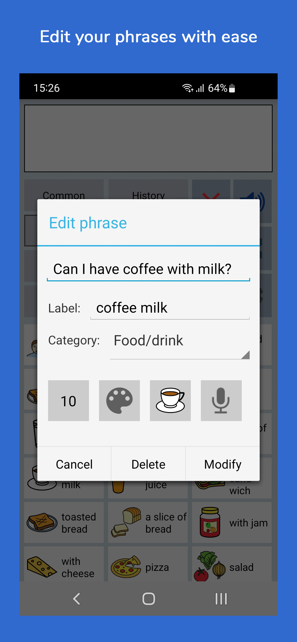
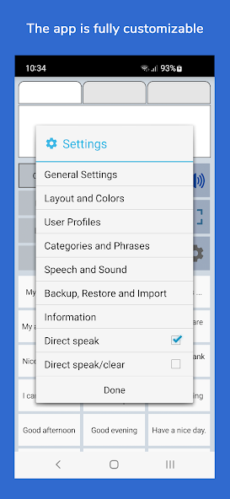

Slide 24
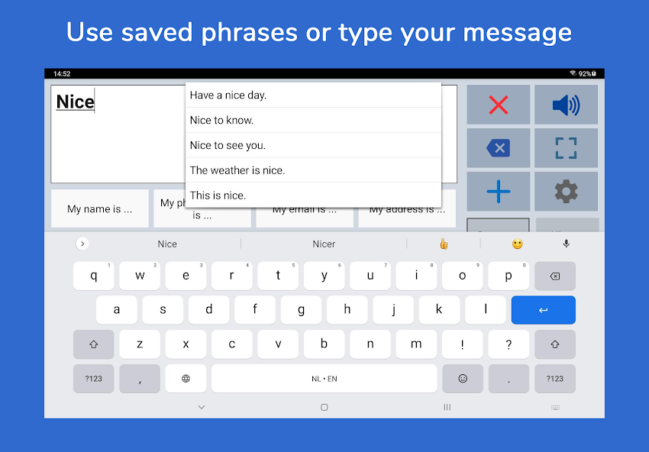

Slide 25
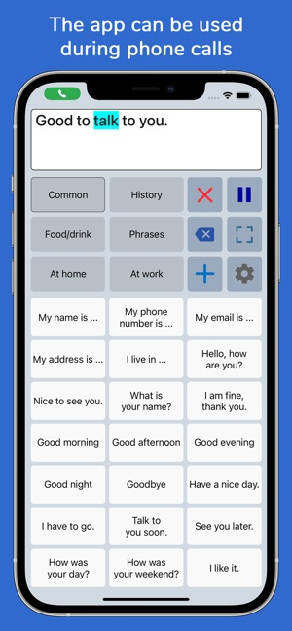
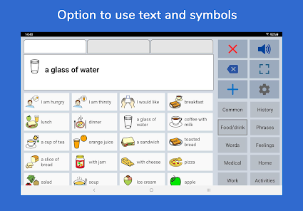

Slide 26
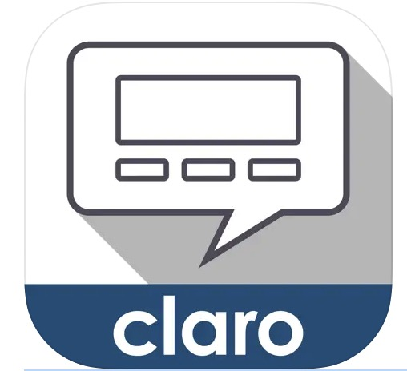
ClaroCom
The app offers a range of features including writing capabilities, word prediction, and phrase prediction.
Users can type messages, have them spoken aloud, and utilize word and phrase prediction to enhance communication speed and accuracy.
ClaroCom also allows for customization of voices, fonts, colors, and more, ensuring adaptability to individual user preferences.
For Iphone or ipad, basic version is FREE!

Slide 27
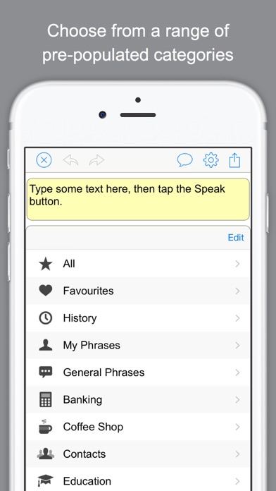
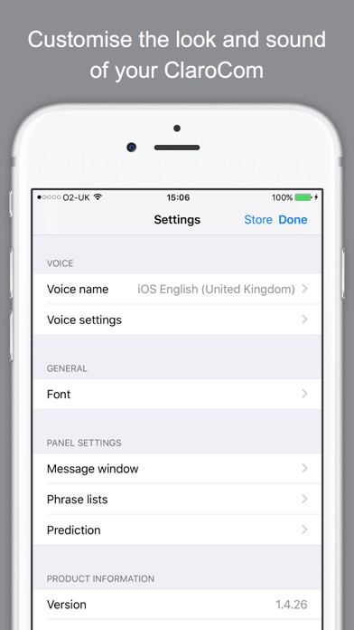
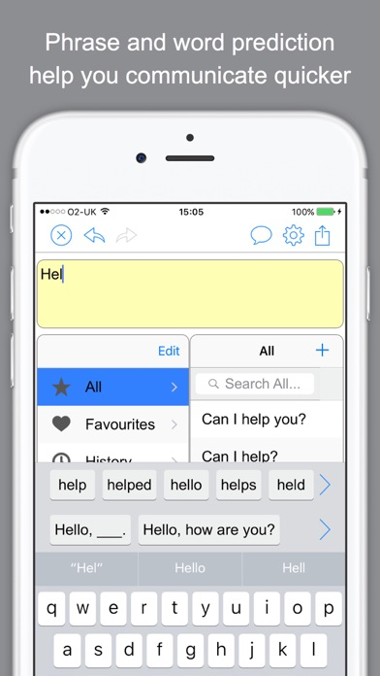
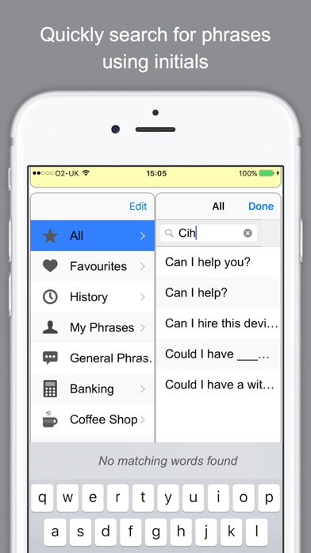
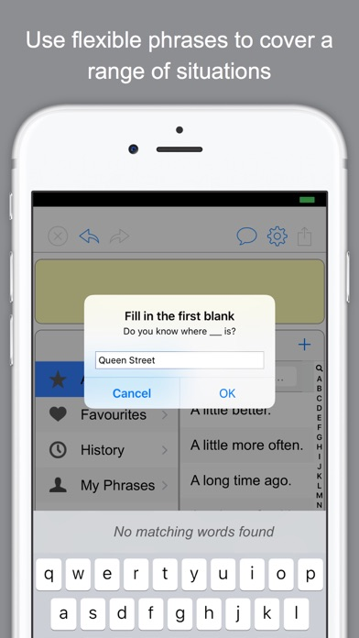

Slide 28
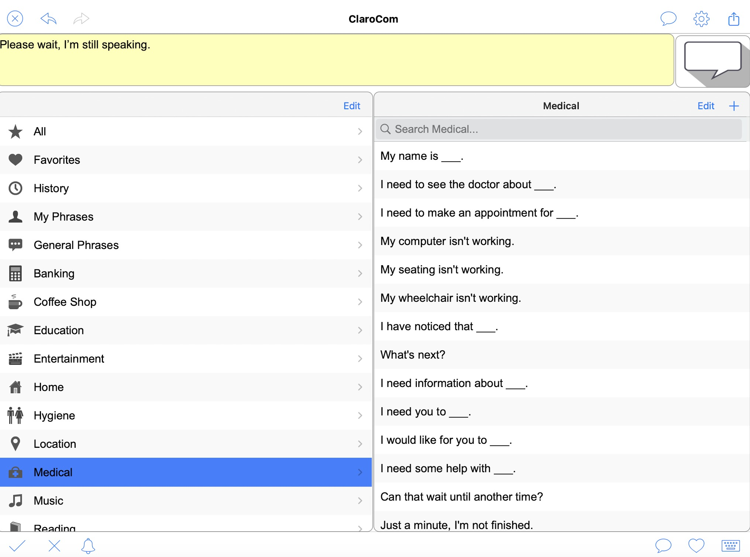

Slide 29
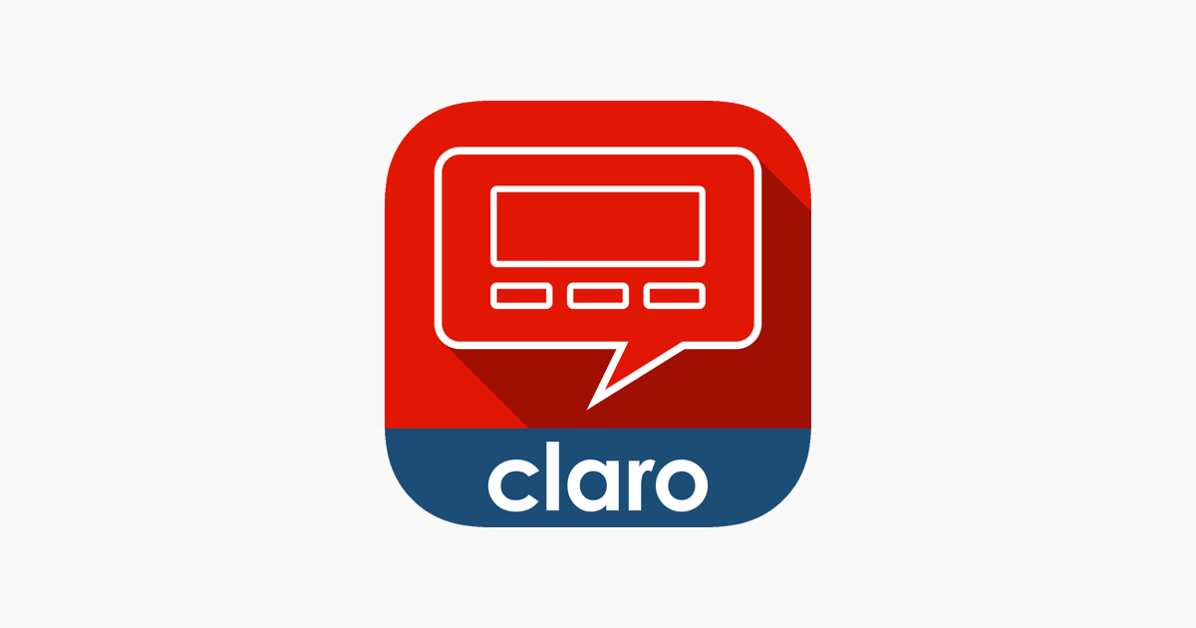
ClaroCom vs ClaroCom Pro
ClaroCom
ClaroCom Pro
FREE
ClaroCom provides basic communication capabilities.
Individuals who require basic communication needs with a simple interface and a standard vocabulary.
$16.99
ClaroCom Pro offers significantly more features including a larger vocabulary, custom categories, social media integration, and the flip display function,
For greater personalization with options to add custom phrases, adjust voice settings more extensively, and change display features like color and font size.
Users who need advanced communication features, extensive customization options, and the ability to integrate with social media platform

Slide 30

TouchChat
TouchChat is a full-featured communication solution for individuals who have difficulty using their voice/speaking.
Available in French, Spanish, Mandarin and English
Universal app supporting iPhone®, iPod®, and iPad®.
Words, phrases and messages are spoken with a built-in voice synthesizer or by playing recorded message
Gives an individual the ability to navigate through page sets and speak messages. Page sets are linked pages, each of which is divided into a number of buttons. The buttons are programmed to have specific actions, such as speaking a message, navigating to a different page, changing the volume or clearing the display.
Cost → $299.99
Overvew of TouchChat HD with Wordpower

Slide 31
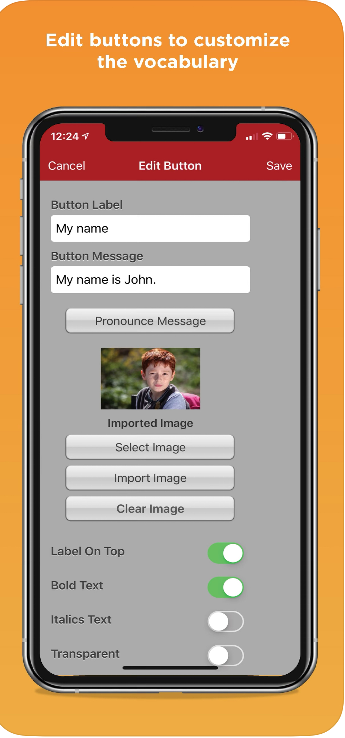
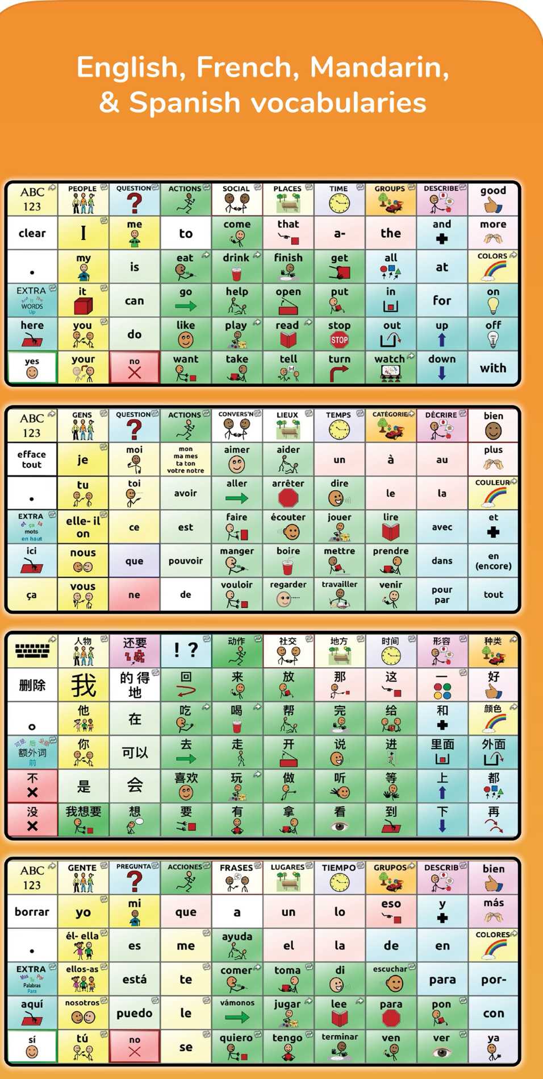
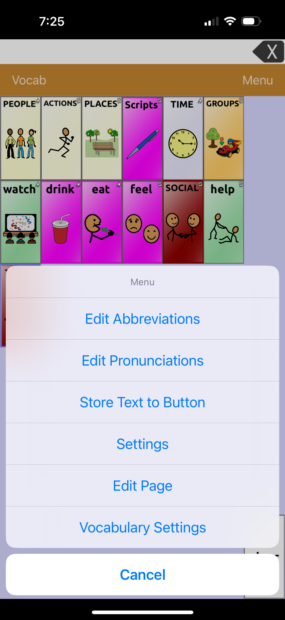

Slide 32

QUESTIONS?
See you next time – Wednesday, June 3rd @4pm EST.

