Slide 1
Technology and Supports for Aphasia
Bryn Bowles and Brooke Lang, M.A., CCC-SLP

Slide 2
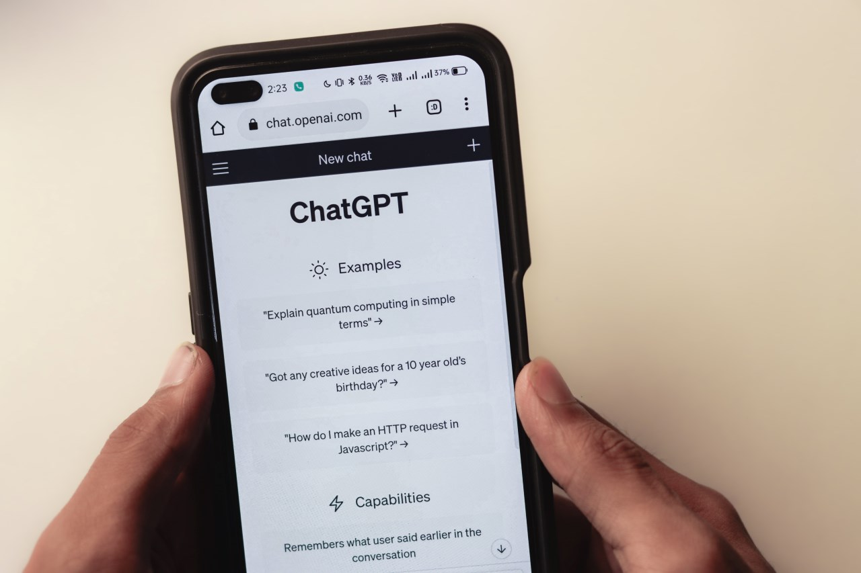
What Bryn uses ChatGPT for
Creating emails: Bryn takes a picture of email, and asks ChatGPT how to respond.
Word finding: Bryn takes a picture of something in her environment and asks ChatGPT what it is.
What to make for dinner: I have chicken, tomato sauce, and mozzarella cheese, what can I make?
Uses “Aphasia Help” – category in ChatGPT specific to Aphasia
Talking to professionals in community:
  Telling mechanic brakes are not working
  Talking to doctor about symptoms
  Talking to bank teller about depositing money
  **If unable to SAY or WRITE info into ChatGPT, you can take a picture of content and send it**

Slide 3
Bryn’s Suggestions
Ask ChatGPT to help you with ONE thing EACH day
  You will learn more about what it can do
  You will feel more comfortable using it
  You will start having fun with all the possibilities
  You will become MORE INDEPENDENT!

Slide 4
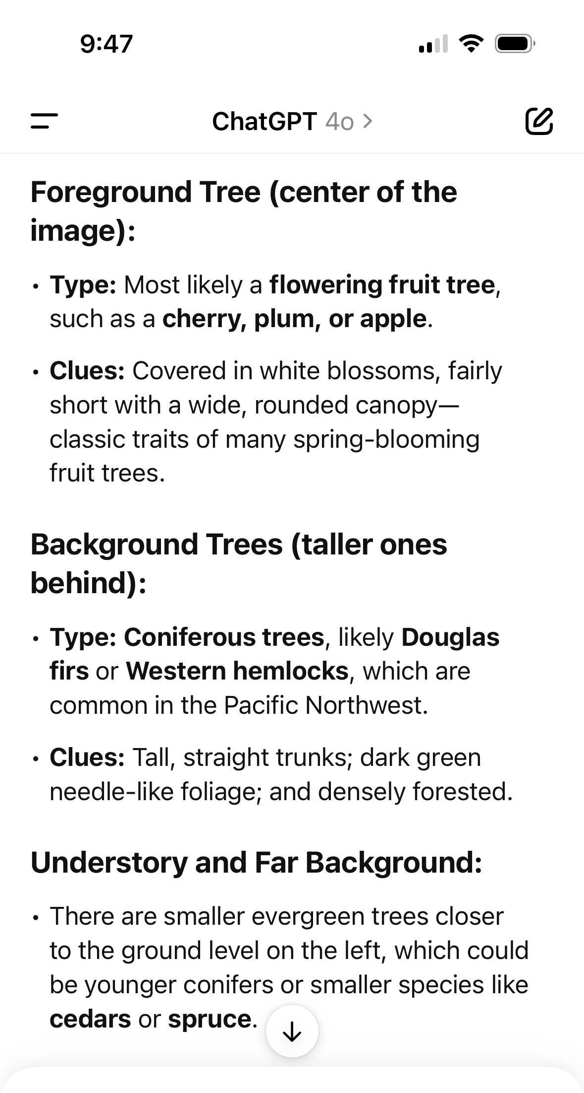
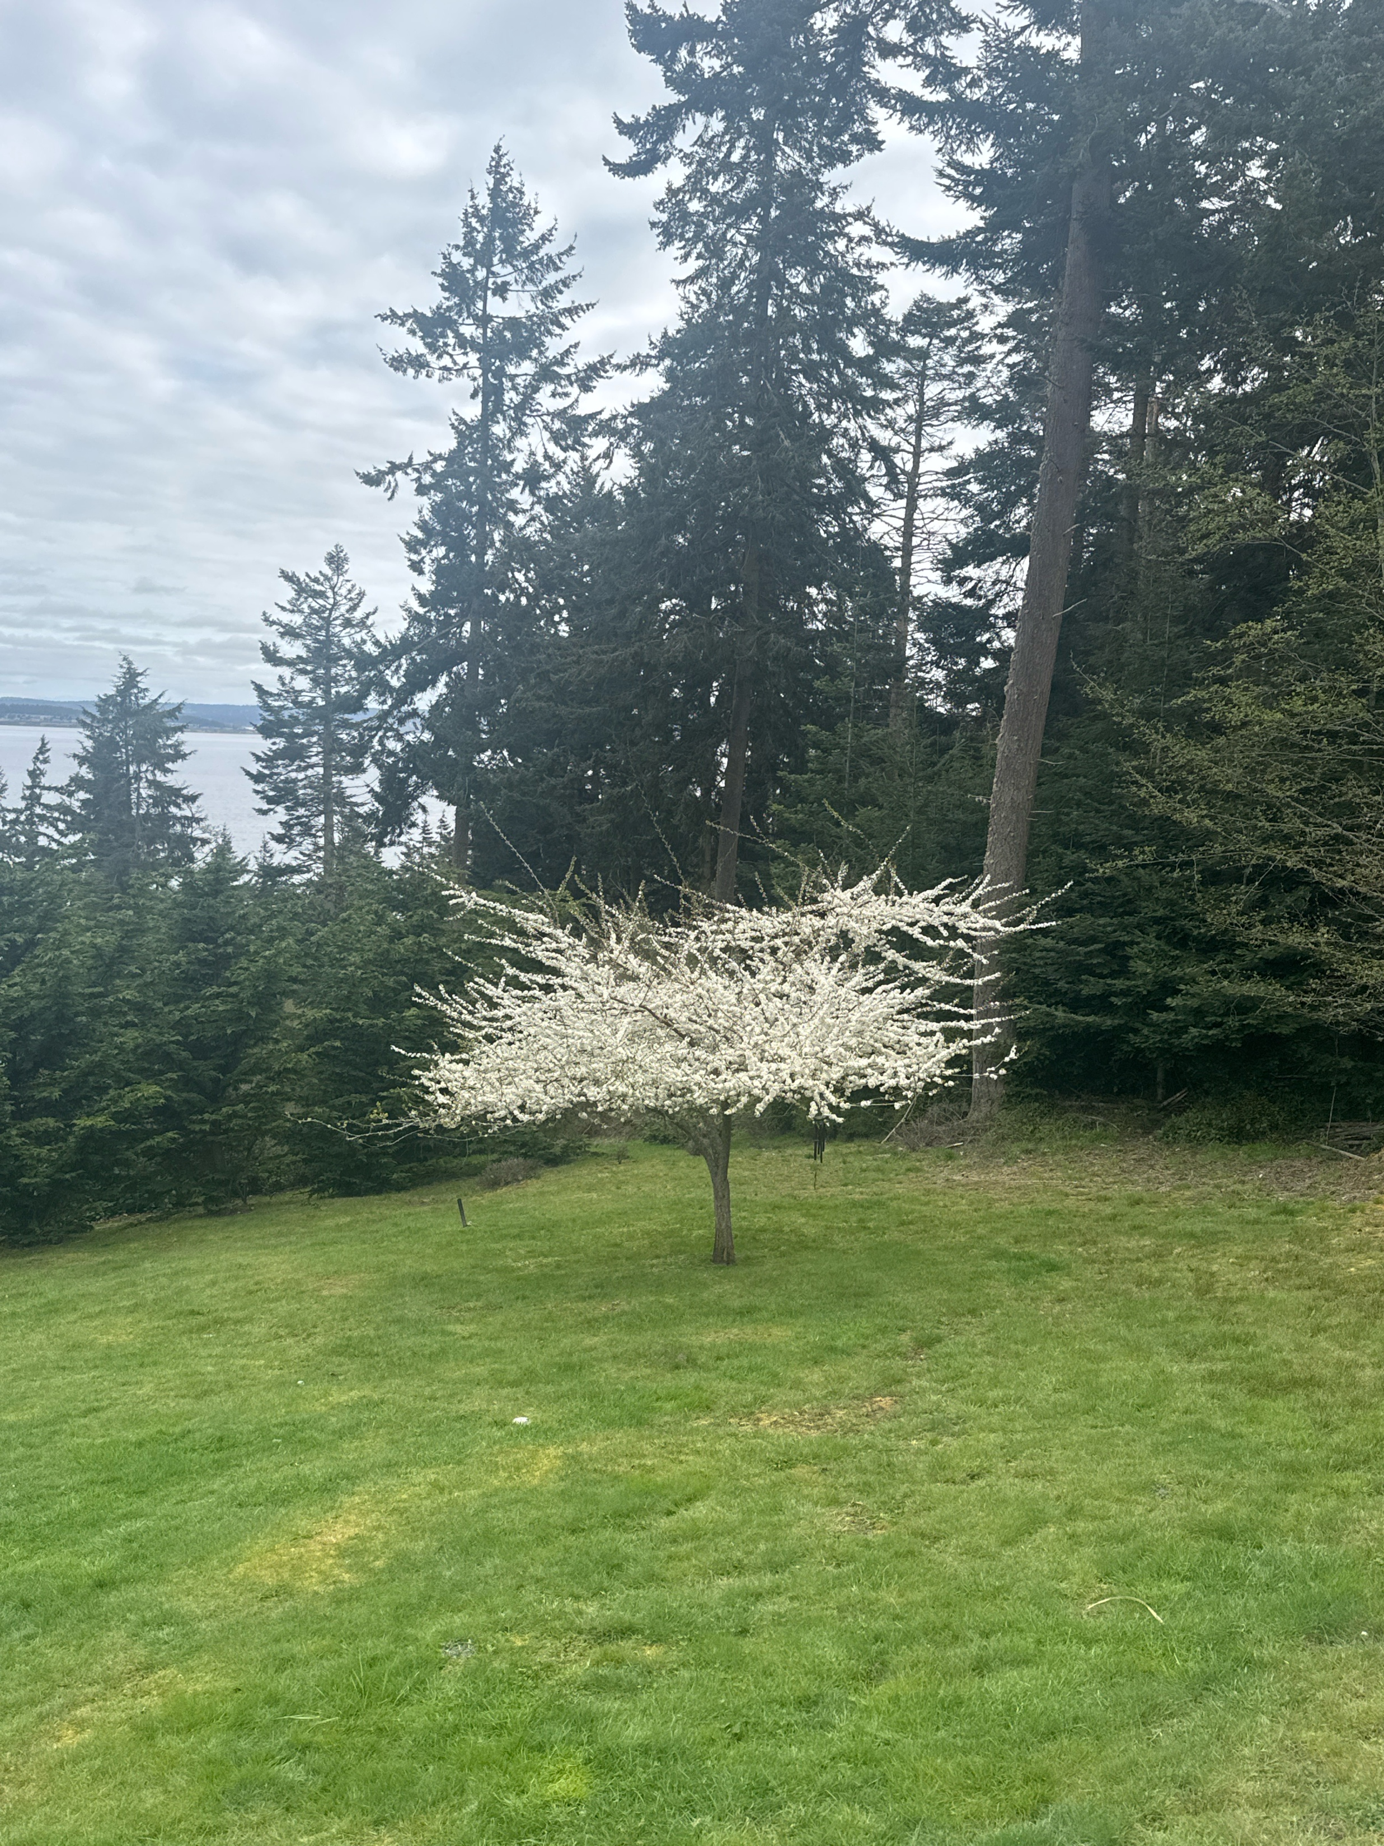
ChatGPT: What a day!
I’ll show you a picture and tell me the types of trees.

Slide 5
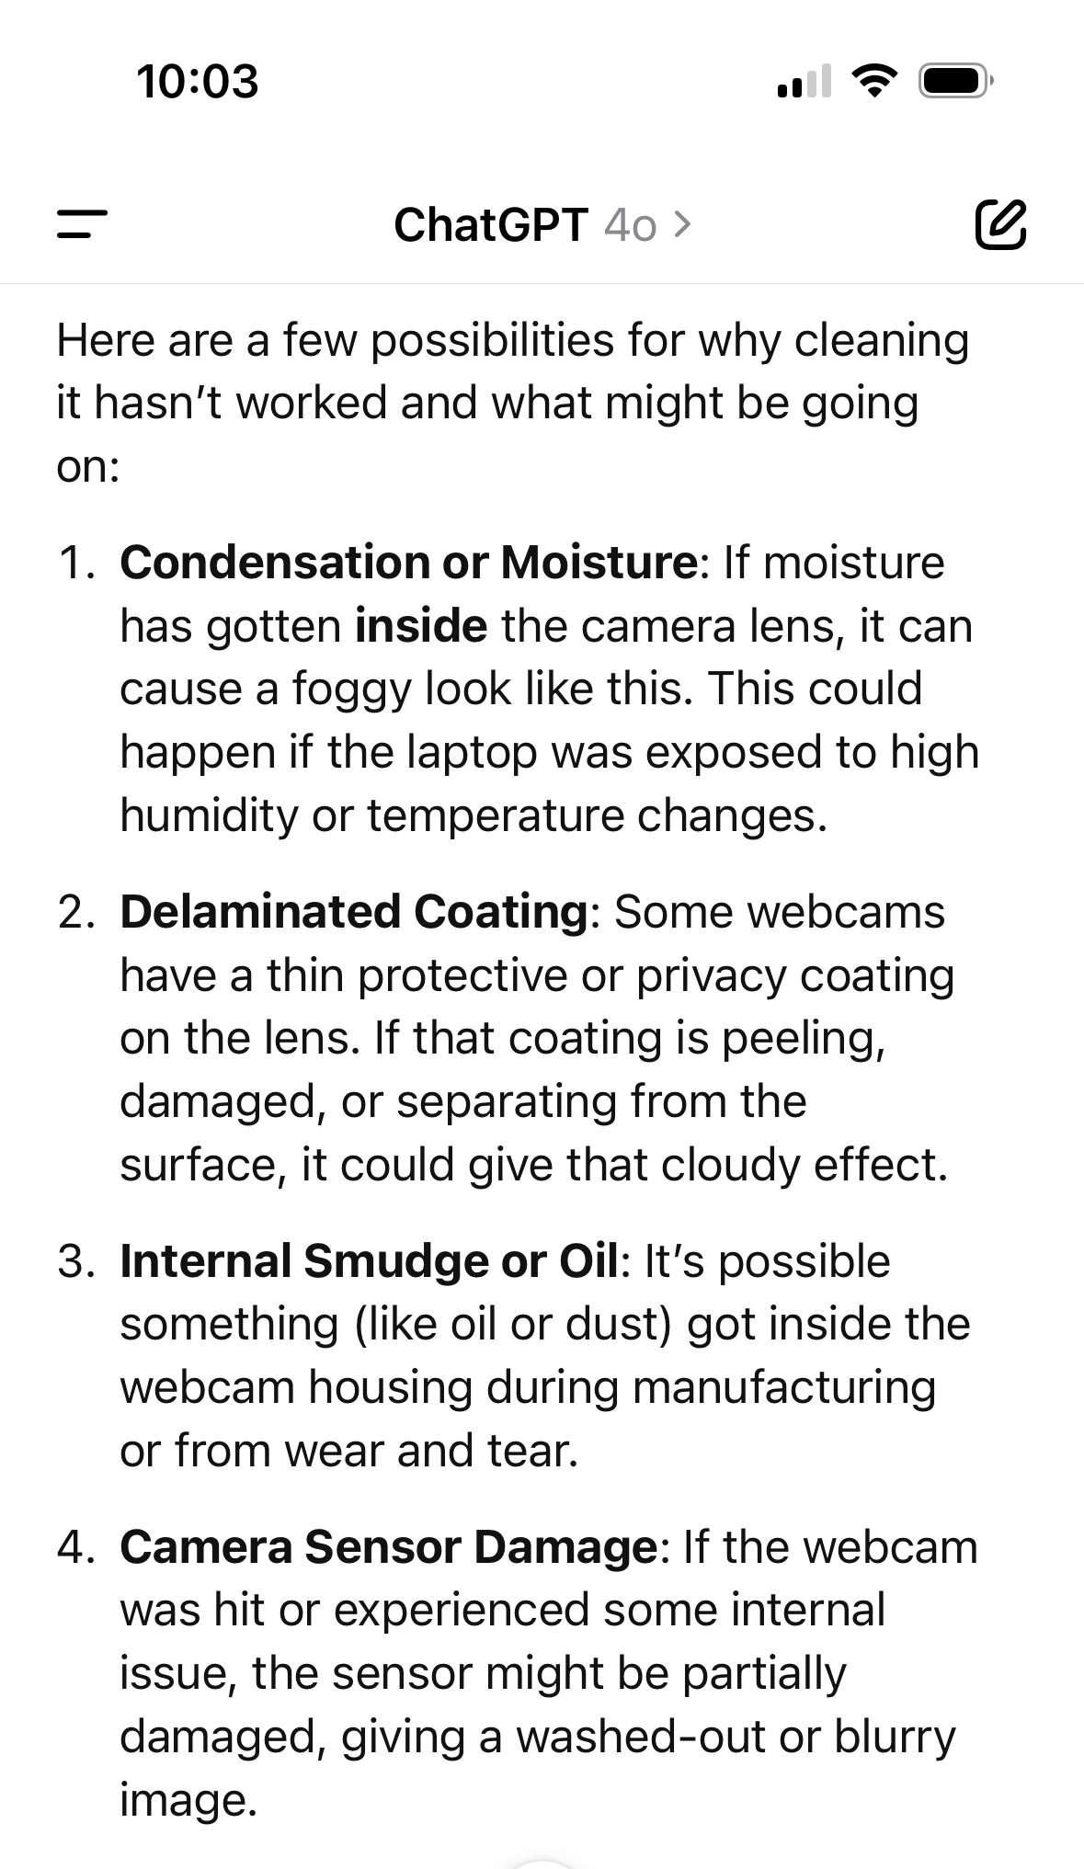
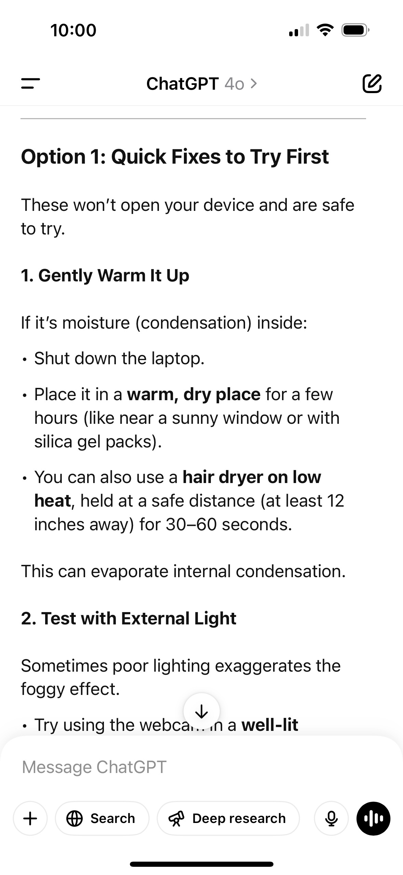
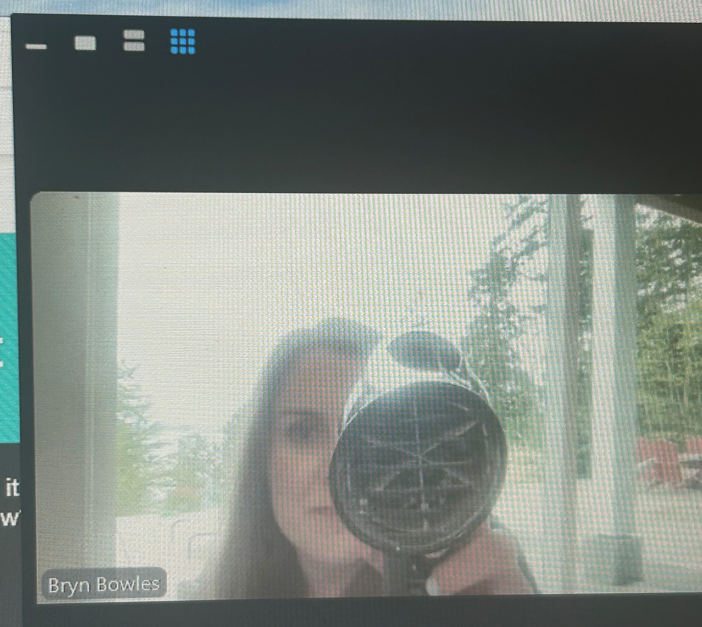
ChatGPT: What a day!
“My computer’s video looks foggy, and I can’t clean it because it’s not working. I don’t know why it’s not working. Why do you know?“

Slide 6
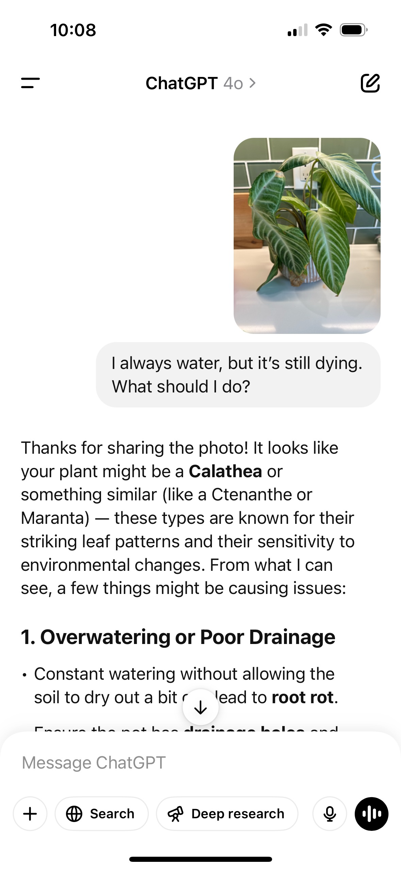
ChatGPT: What a day!

Slide 7
Using ChatGPT to:
BUILD A HOME PRACTICE SCHEDULE
Day | Focus | Sample Activity
Monday | Verbs | Name and act out common verbs
Tuesday | Sentence structure | Rearrange words to make a simple sentence
Wednesday | Word-finding strategies | Use gestures, first-letter cue, drawing
Thursday | Conversation starters | Practice greetings, comments, questions
Friday | Writing short sentences | Copy or fill-in-the-blank sentence writing
Saturday | Story retell (with support) | Watch a video or read a story, then retell
Sunday | Rest/light practice | Family chat, picture naming, or storytelling

Slide 8
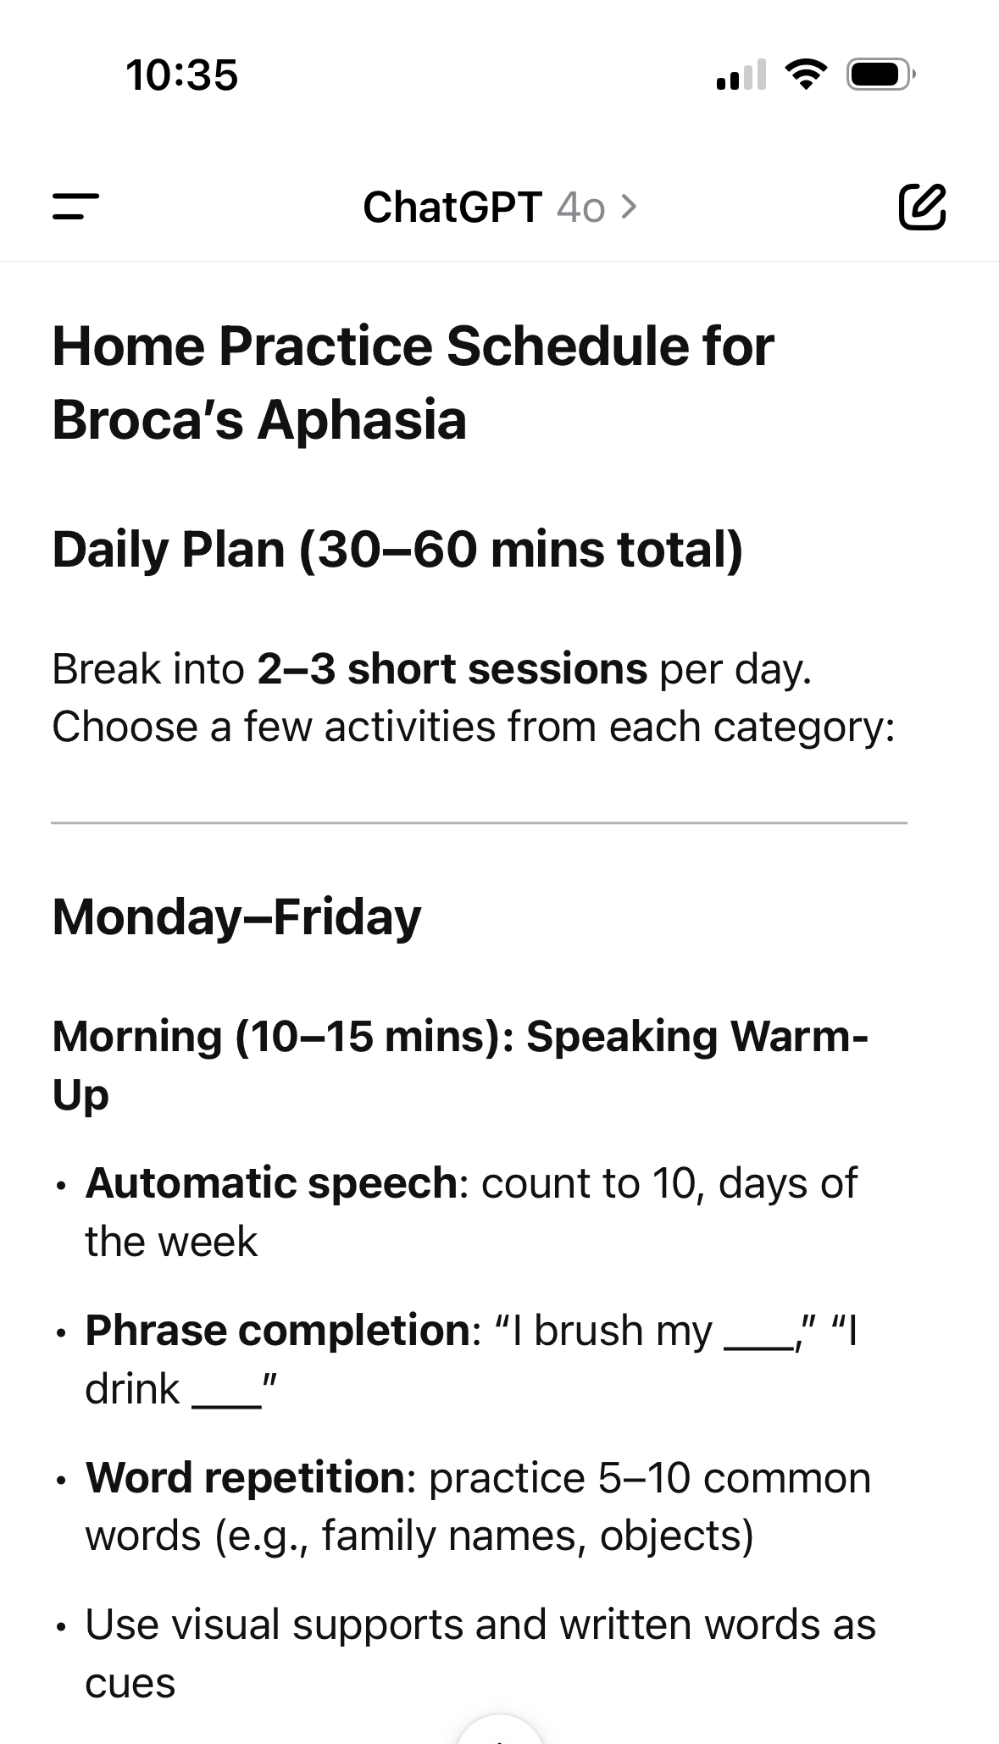
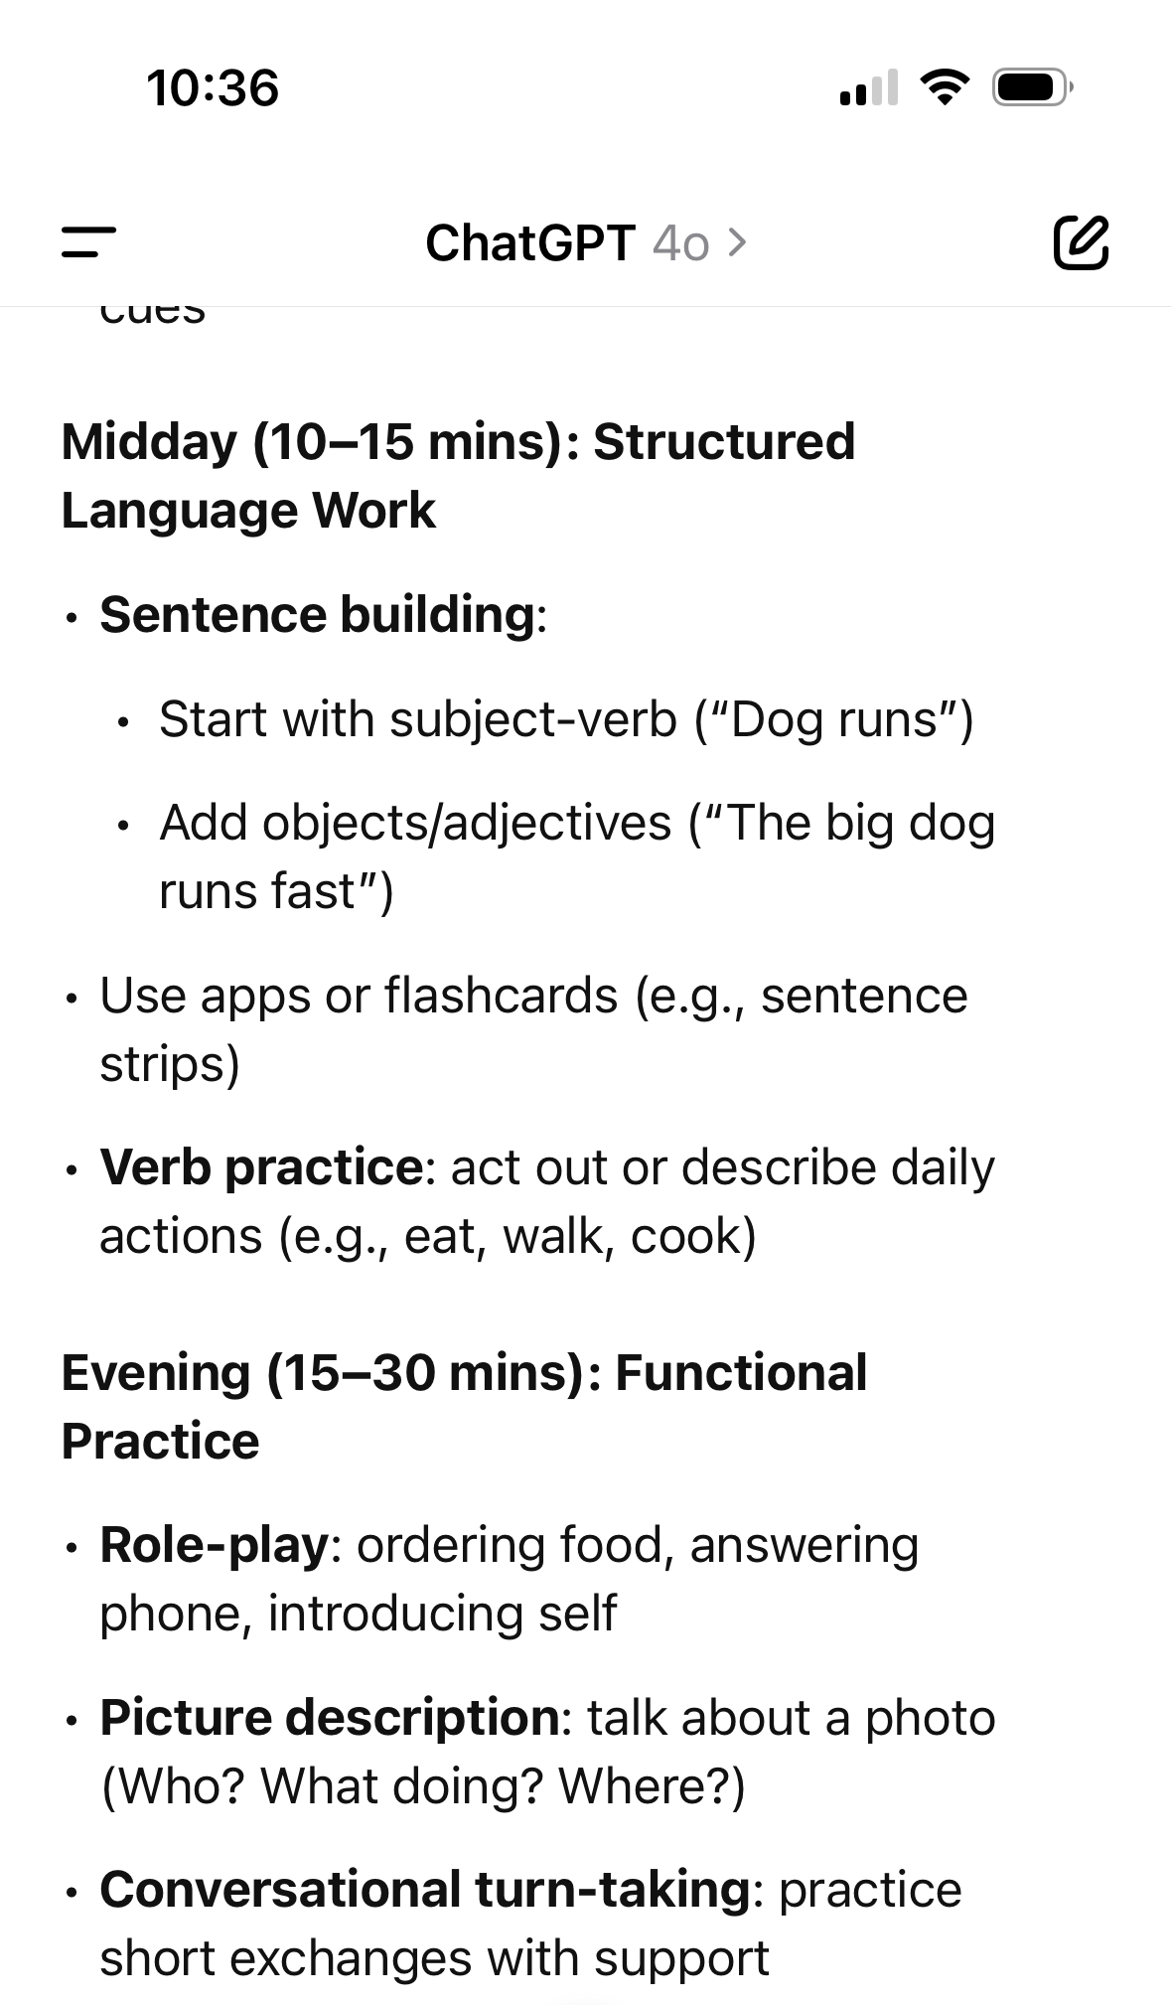
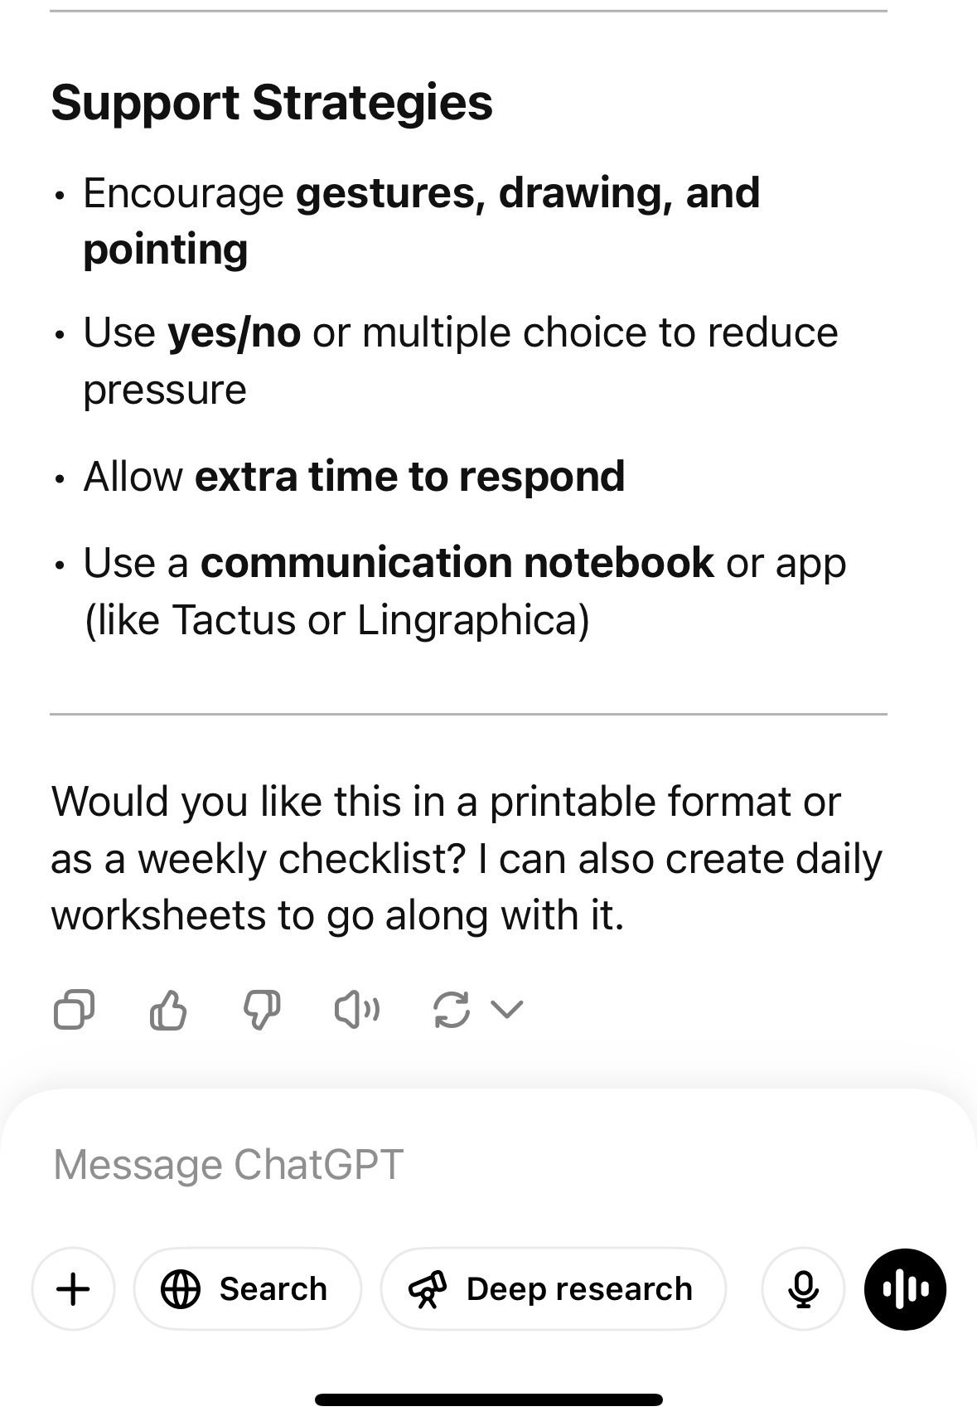

Slide 9
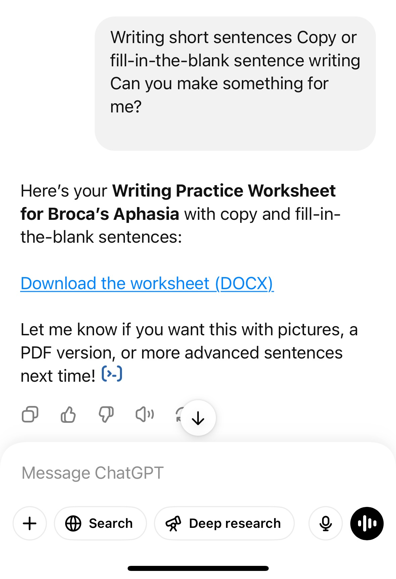
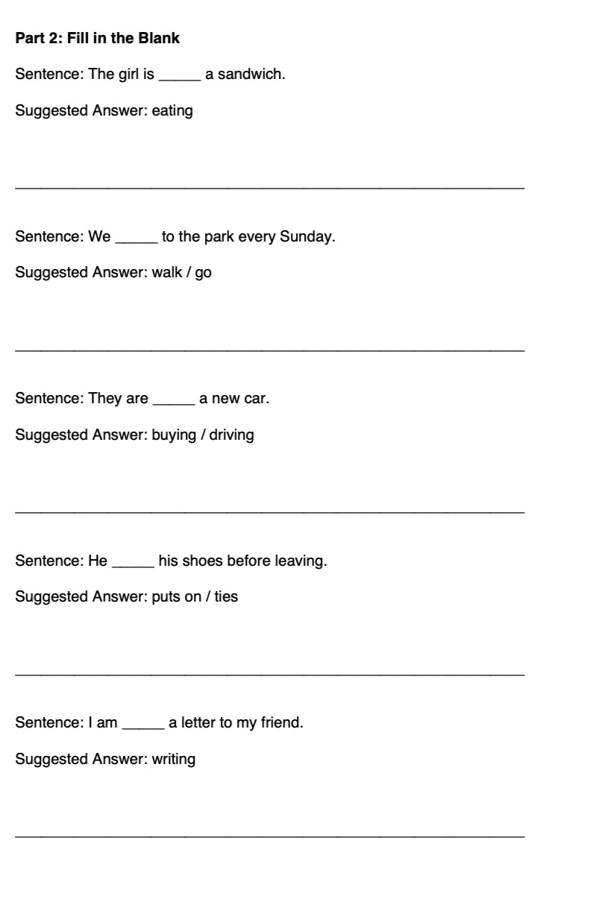

Slide 10
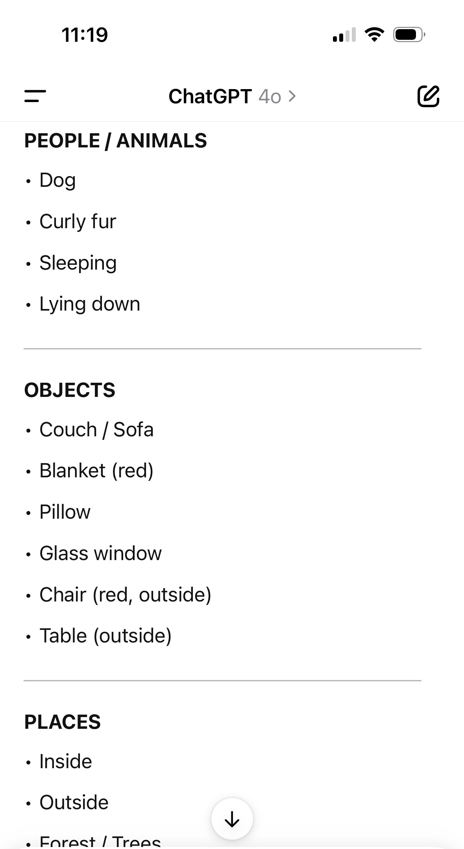
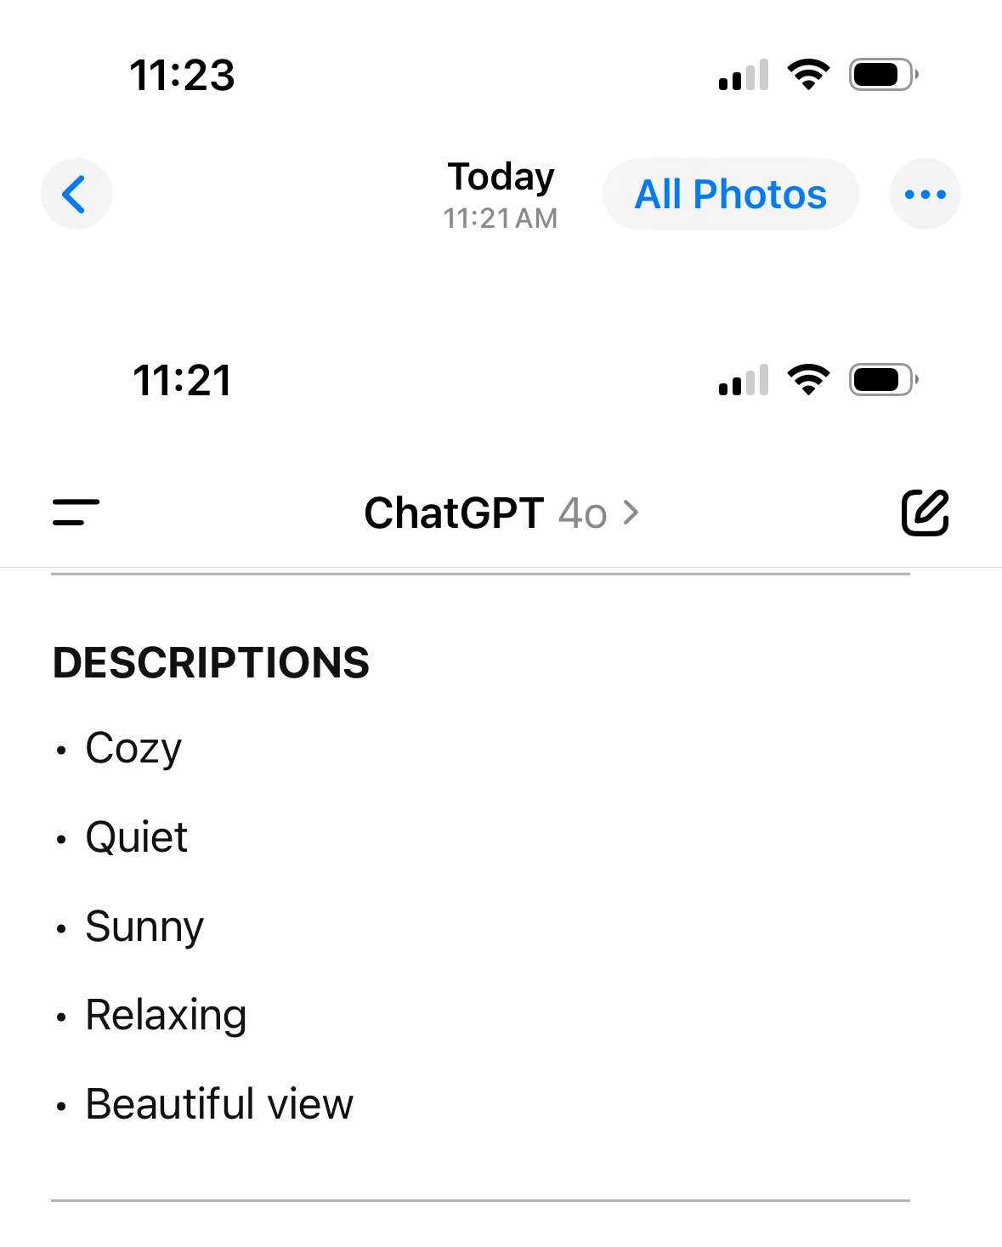
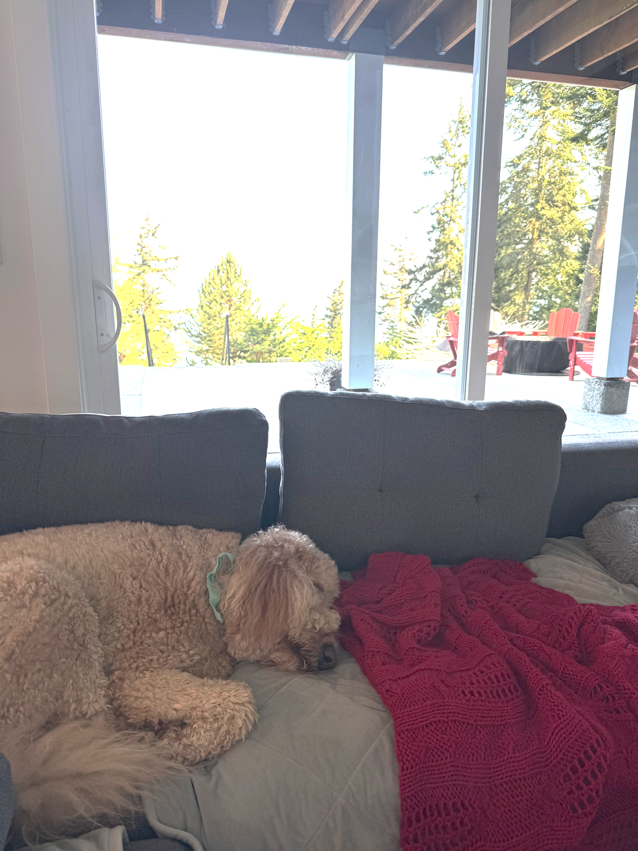
Using ChatGPT:
TO HELP WITH NAMING AND DESCRIBING THINGS IN YOUR ENVIRONMENT

Slide 11
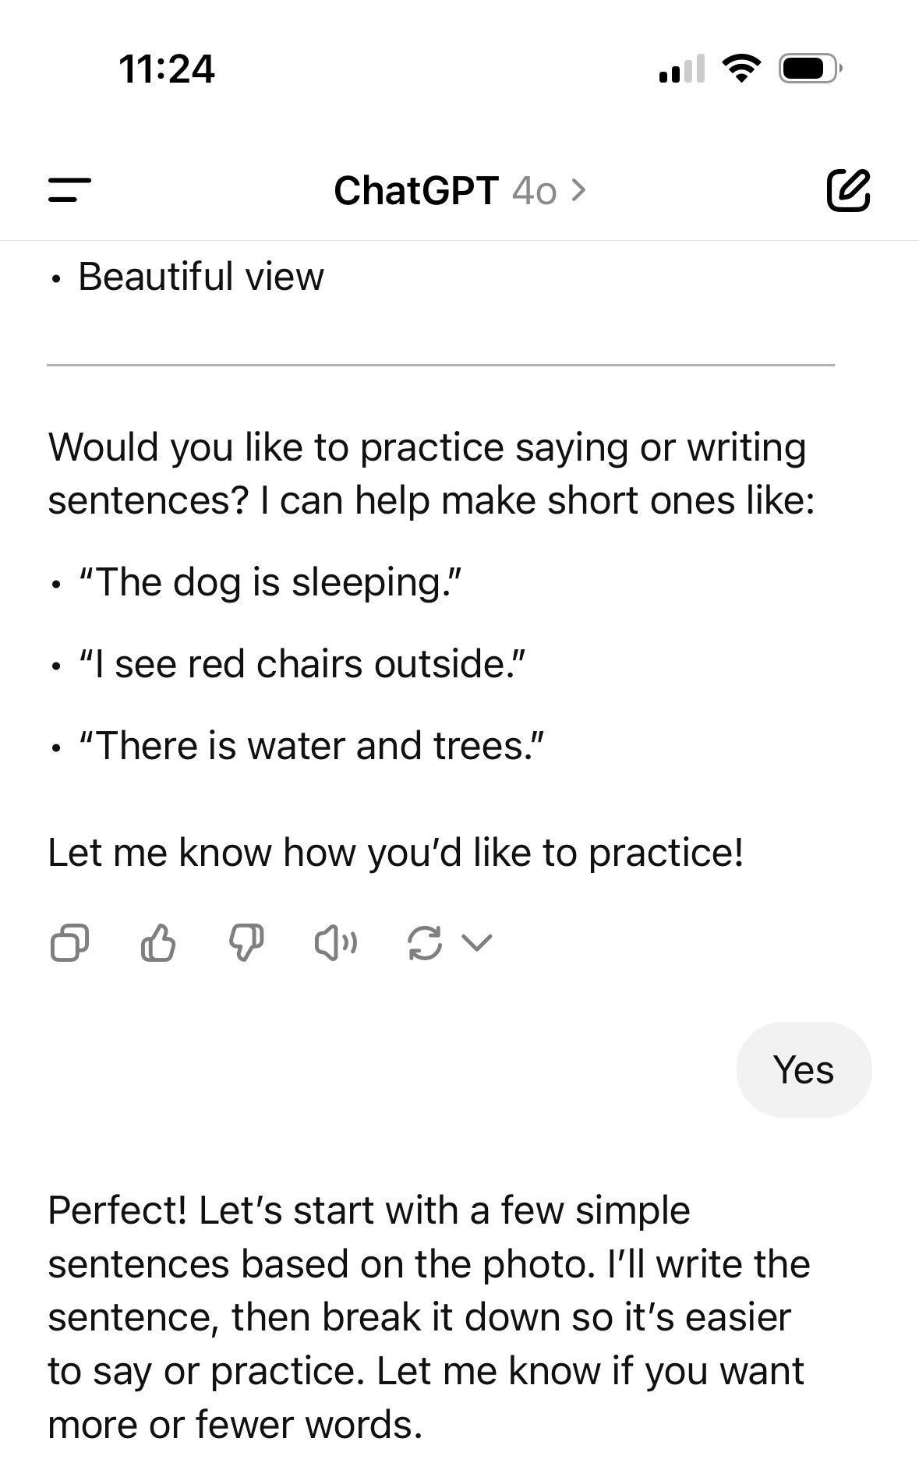
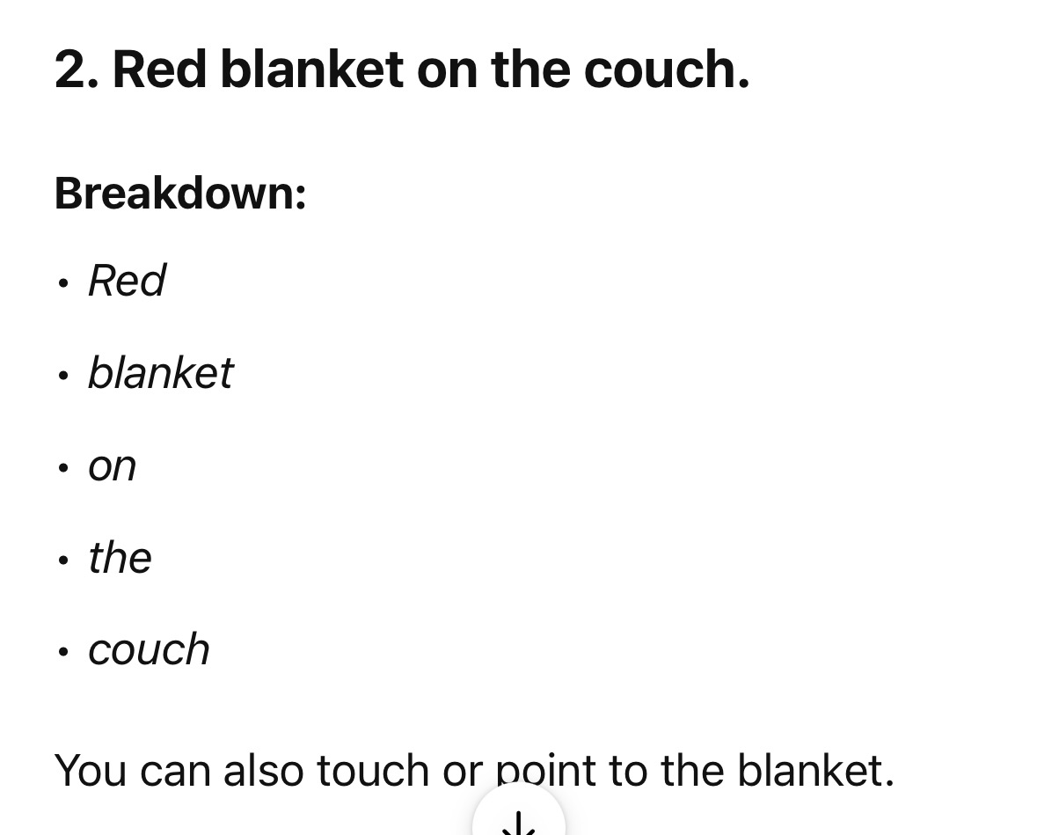

Slide 12
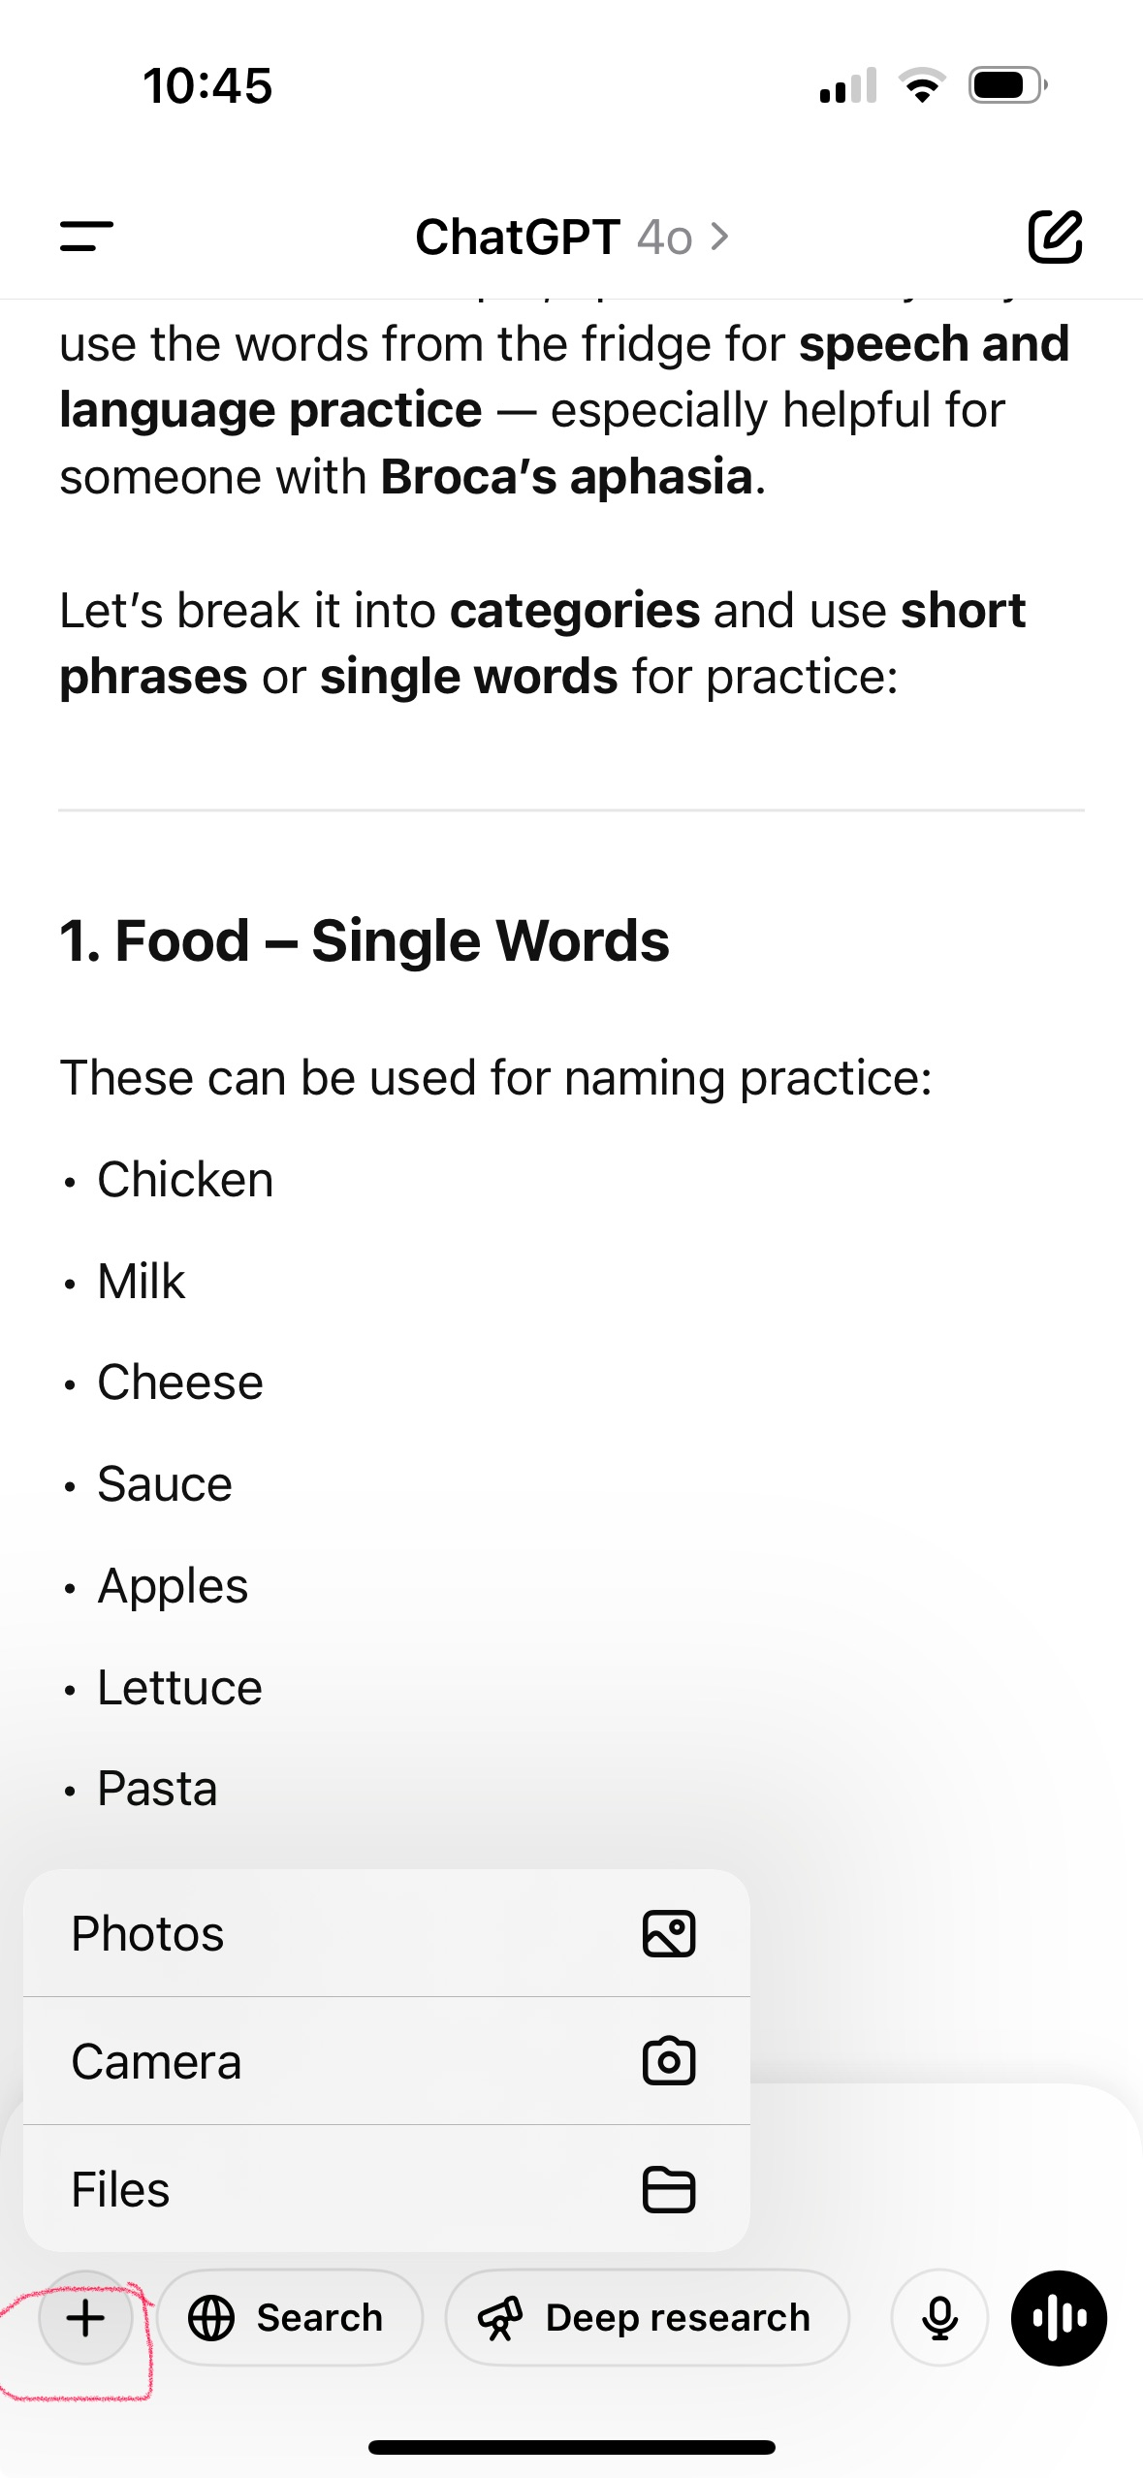


How to SEND CHATGPT a PICTURE:
Click on the + symbol….
Then you can select to choose from
1. Saved pictures
2. Take a picture, or…
4. From file/folder

Slide 13
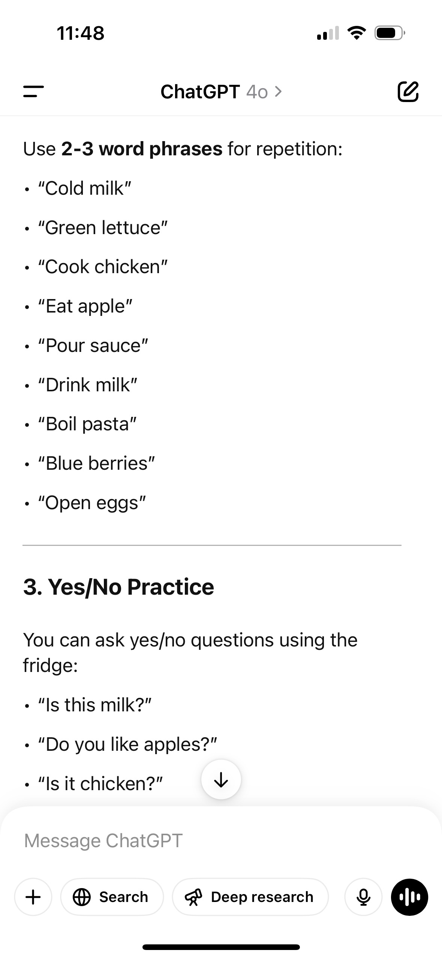
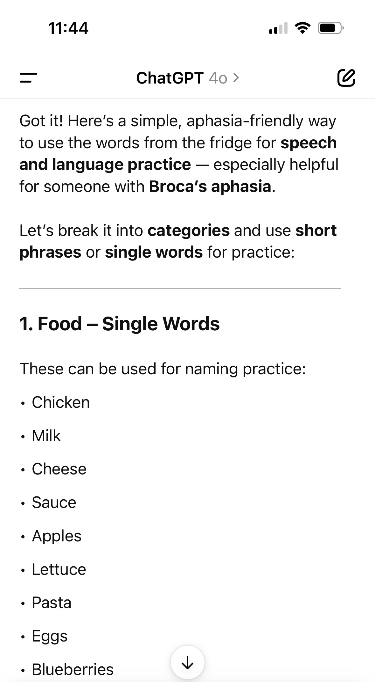
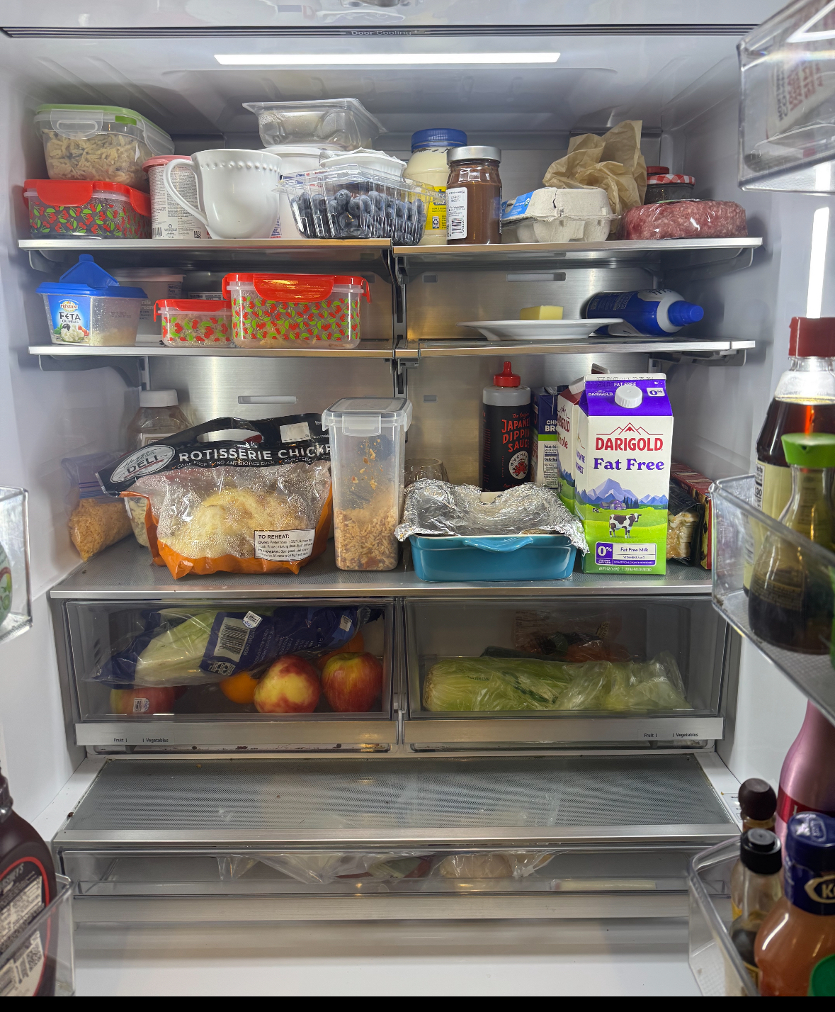
Using ChatGPT:
TO HELP WITH SPEECH/LANGUAGE PRACTICE
“Tell me all the words”

Slide 14
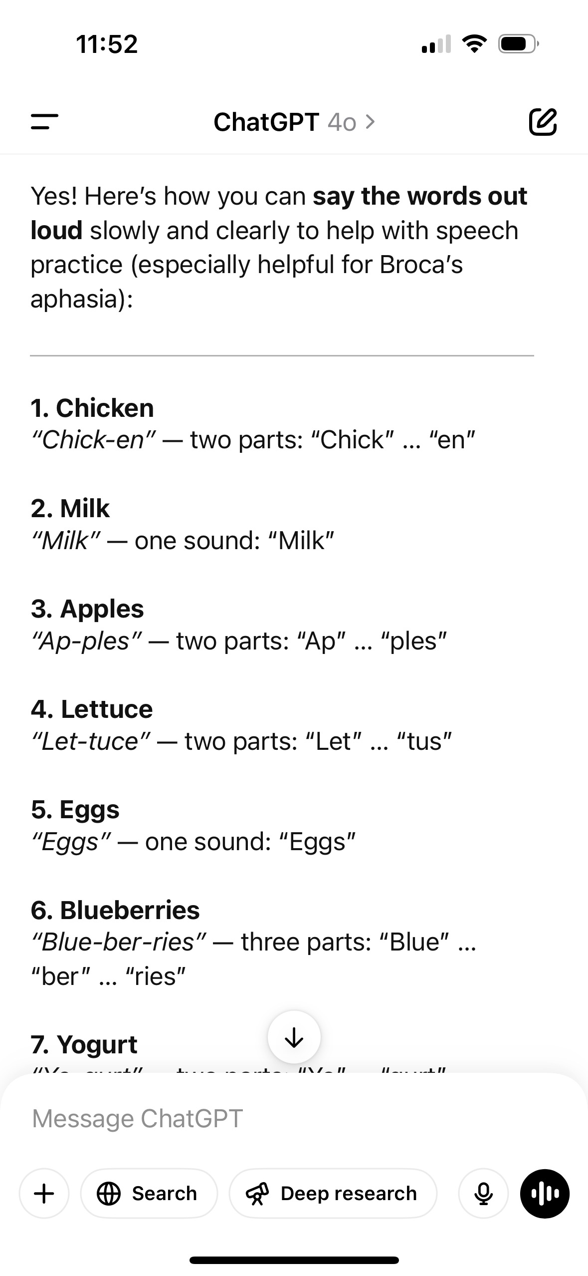
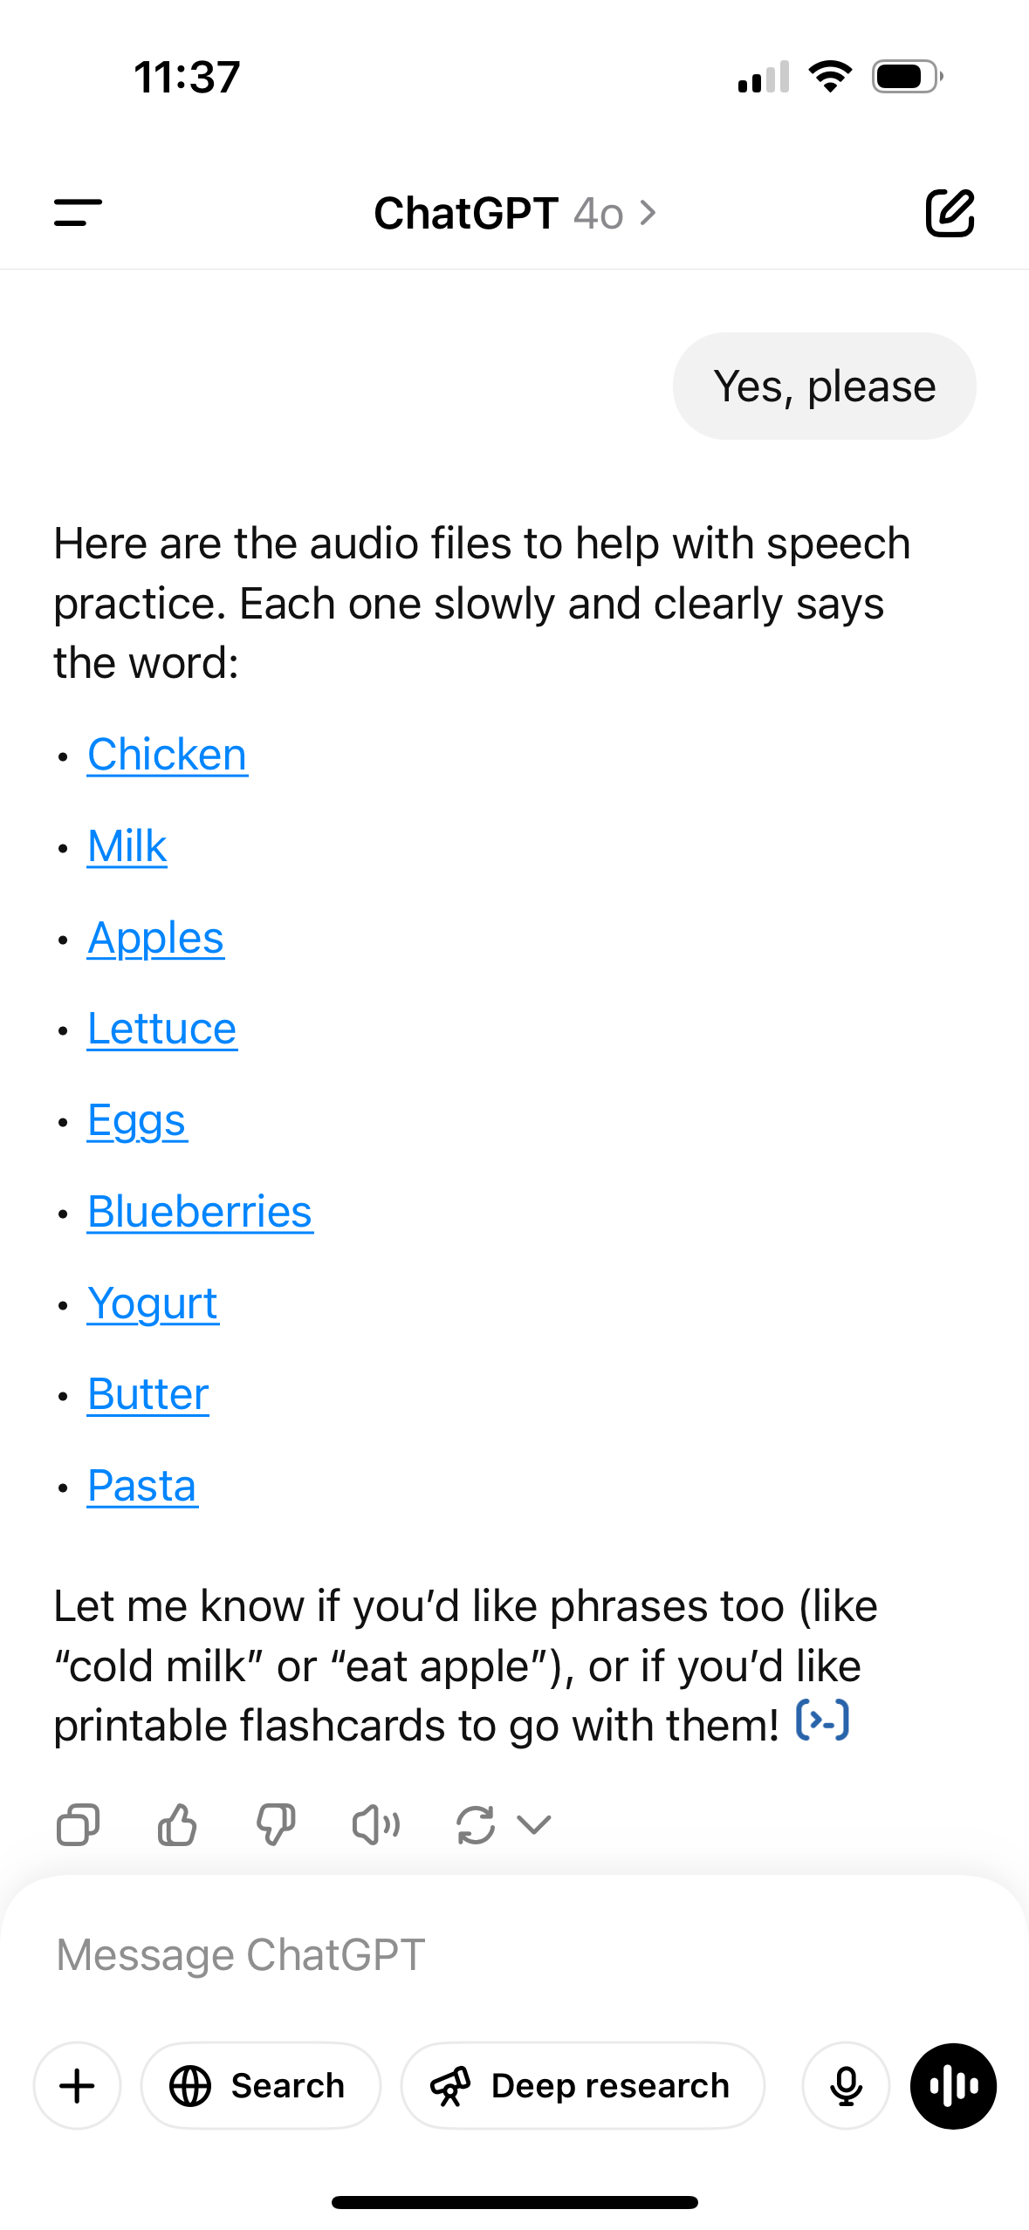
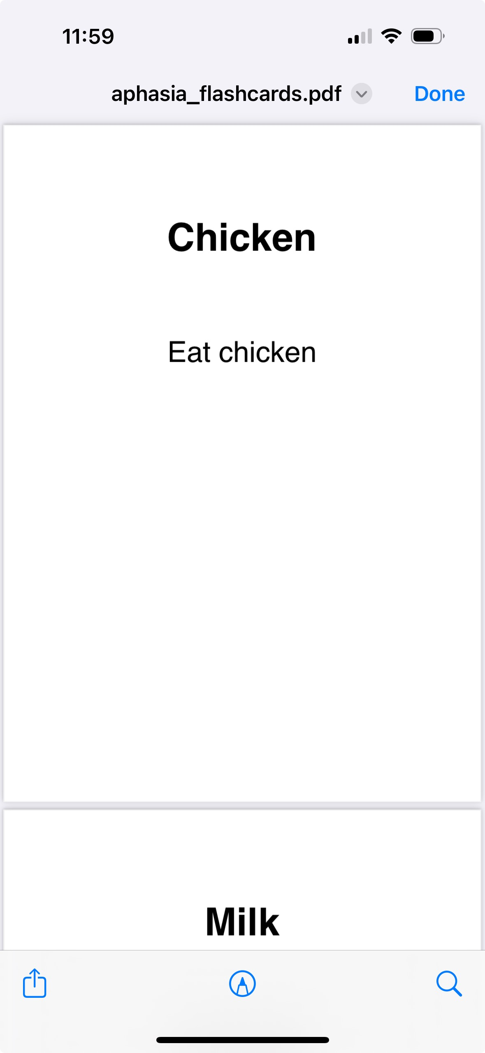

Slide 15
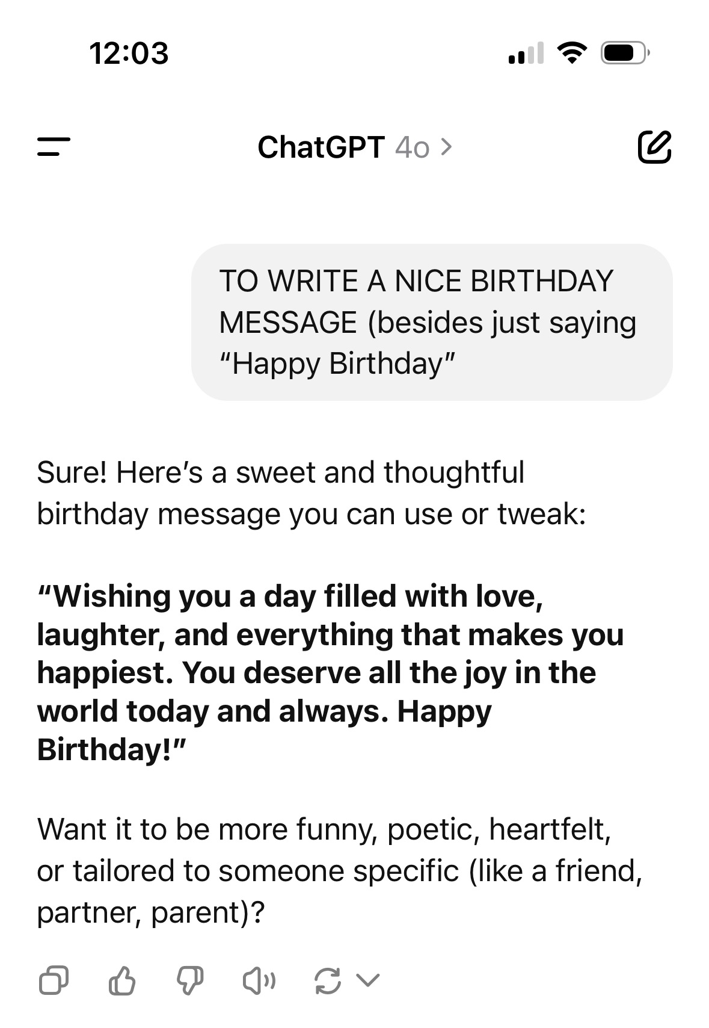
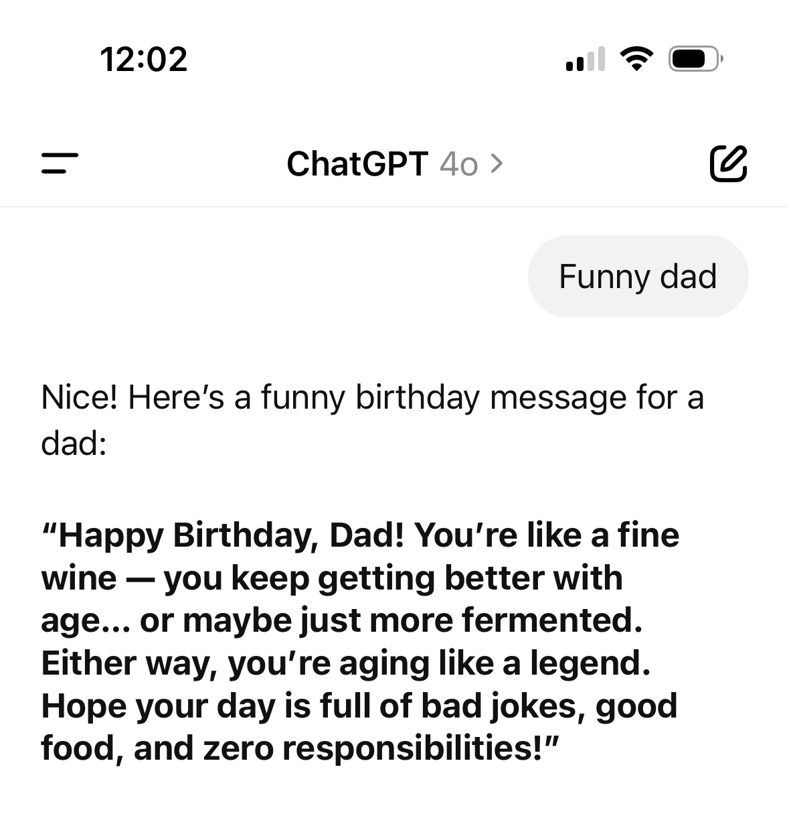
Using ChatGPT:
TO WRITE A NICE BIRTHDAY MESSAGE (besides just saying “Happy Birthday”

Slide 16

QUESTIONS?
See you next time – Tuesday, June 10th @4:00pm EST.

