Slide 1
Technology and Supports for Aphasia
Brooke Lang, M.A., CCC-SLP and Bryn Bowles

Slide 2
Today’s Topic
How to combine AI (Artificial Intelligence) and the best Aphasia apps to create more practice
  How to make tasks easier or harder
  Add more examples to your practice
  Switch modalities (writing task can become a reading task)

Slide 3
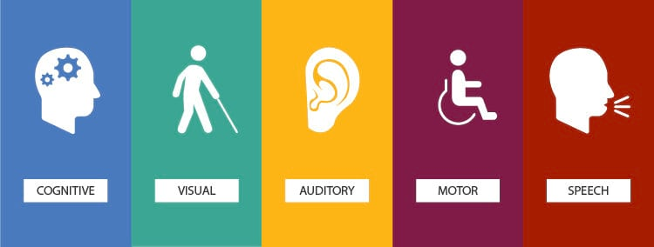
Purpose of Technology and Apps
Provide rehabilitation exercises (language/cognition)
Supplement/facilitate communication
Assist with school/job related tasks

Slide 4

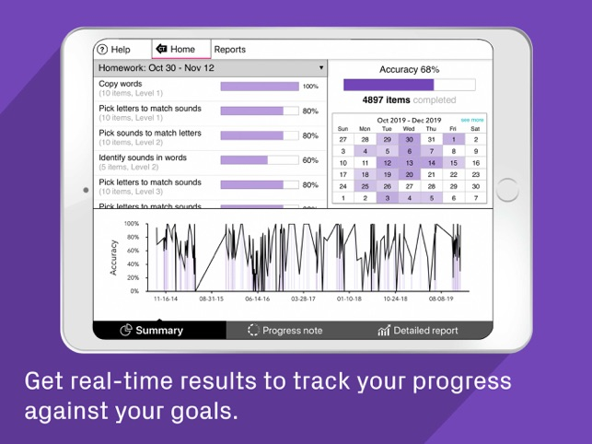
OVERVIEW OF CONSTANT THERAPY
Developed by neuroscientists and clinicians from Boston University
85+ evidence-based interactive therapy activities
$29.99 per month or $299.99 per year (subscription based)
  14-day free trial
Built on smart technology that adjusts your program as you progress
Variety of speech/language, cognitive, visuospatial, memory, and attention tasks

Slide 5
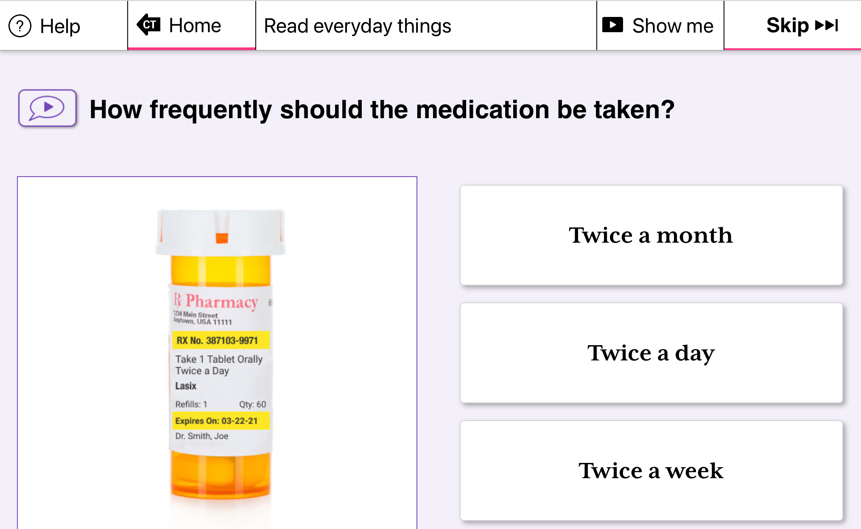
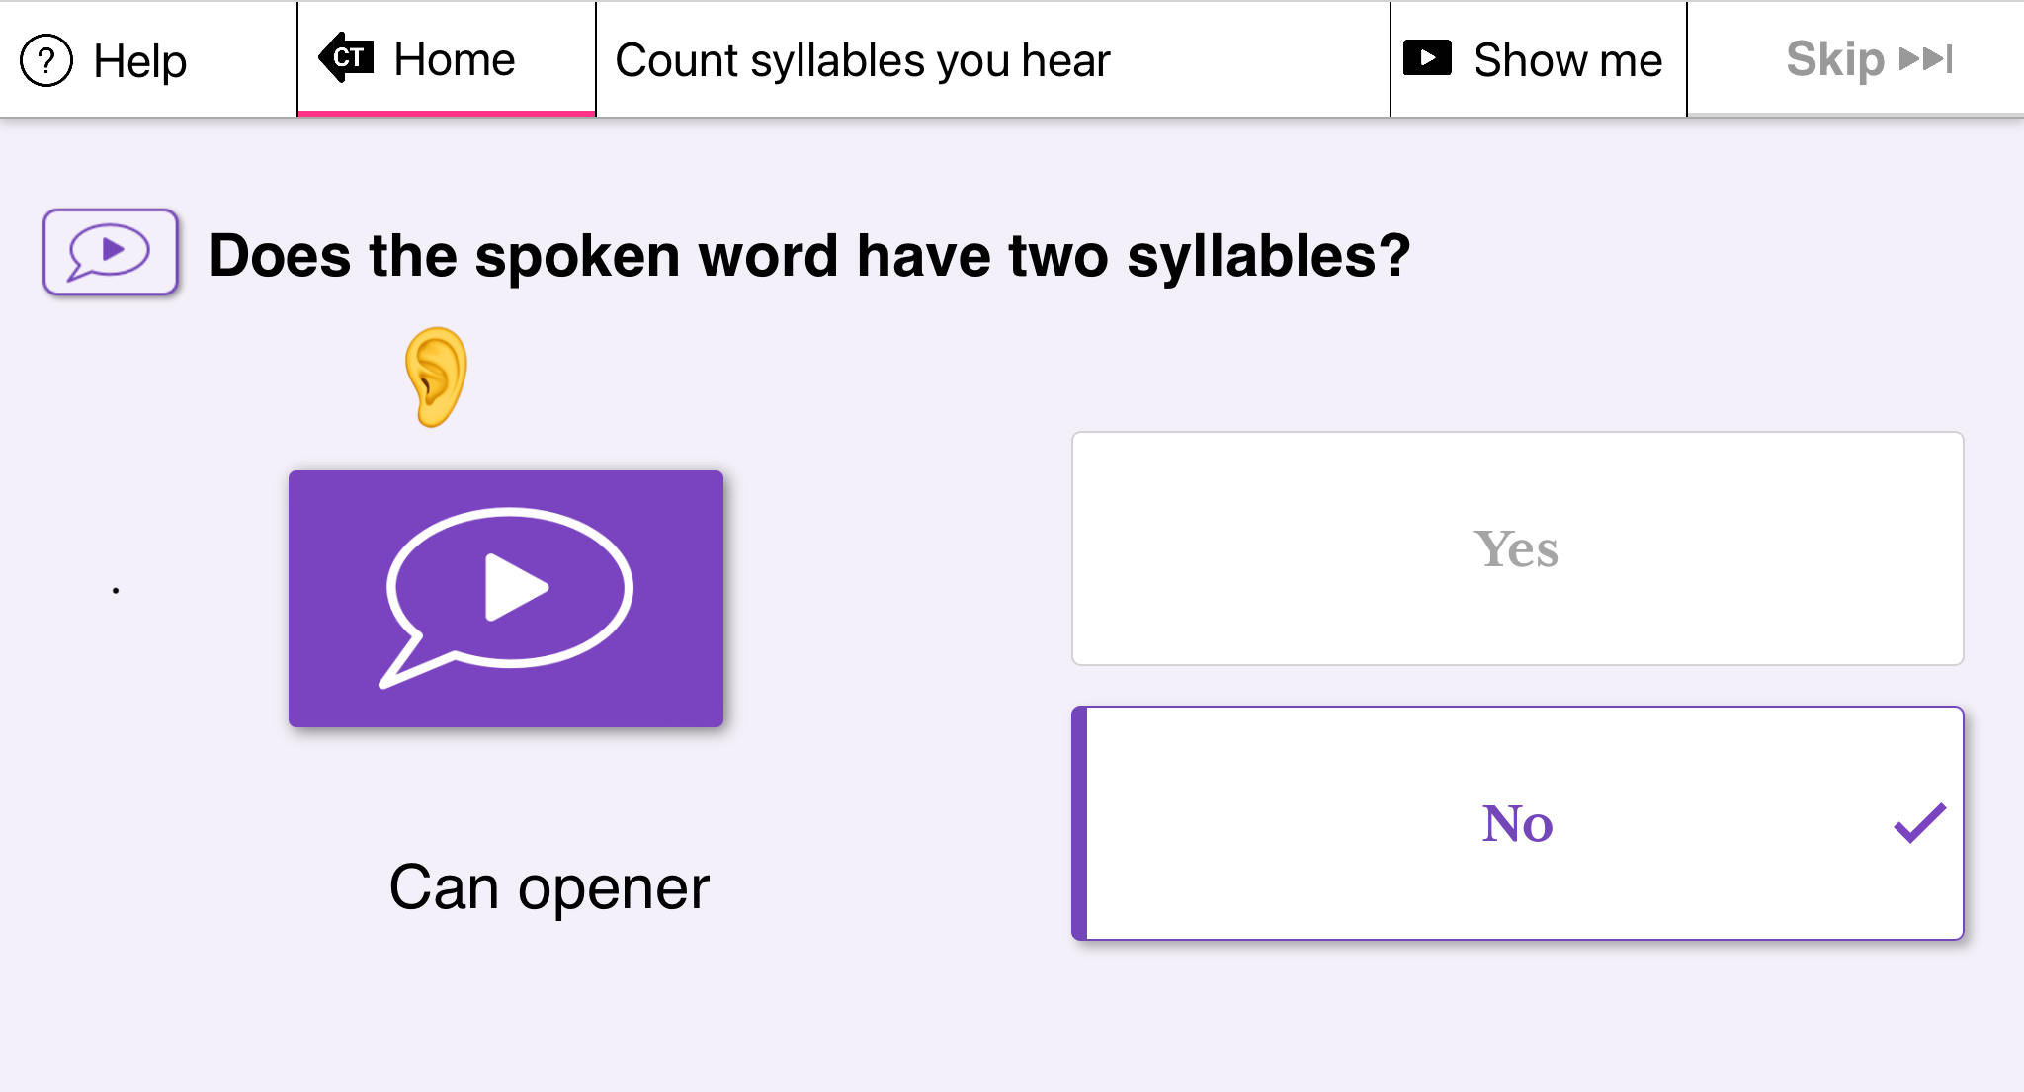
CONSTANT THERAPY
READING COMPREHENSION
SYLLABLE IDENTIFICATION

Slide 6
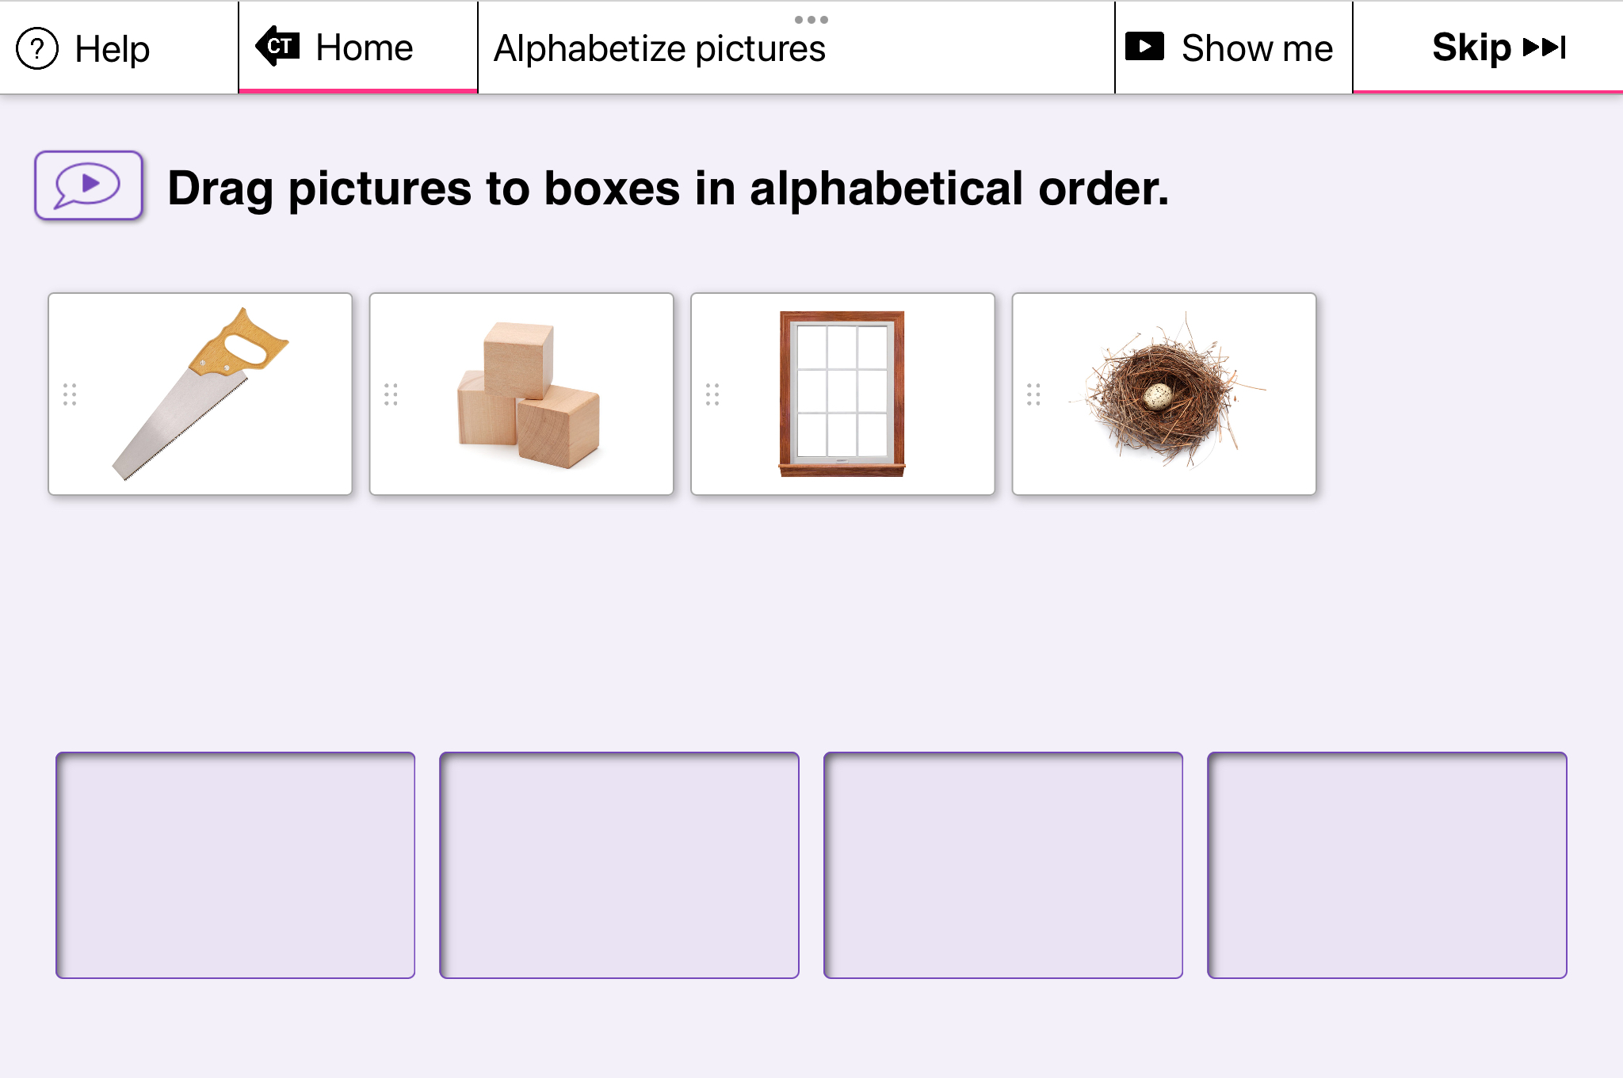
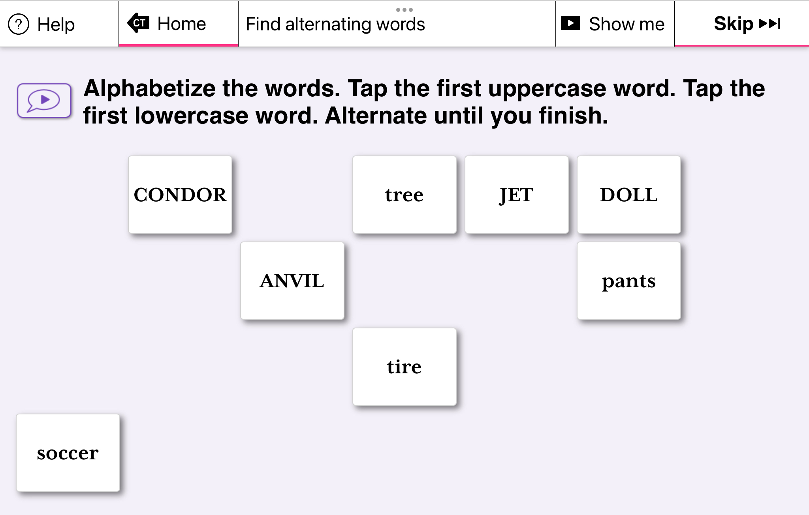
CONSTANT THERAPY
Alphabetize Pictures
Alphabetize and Alternate Case

Slide 7
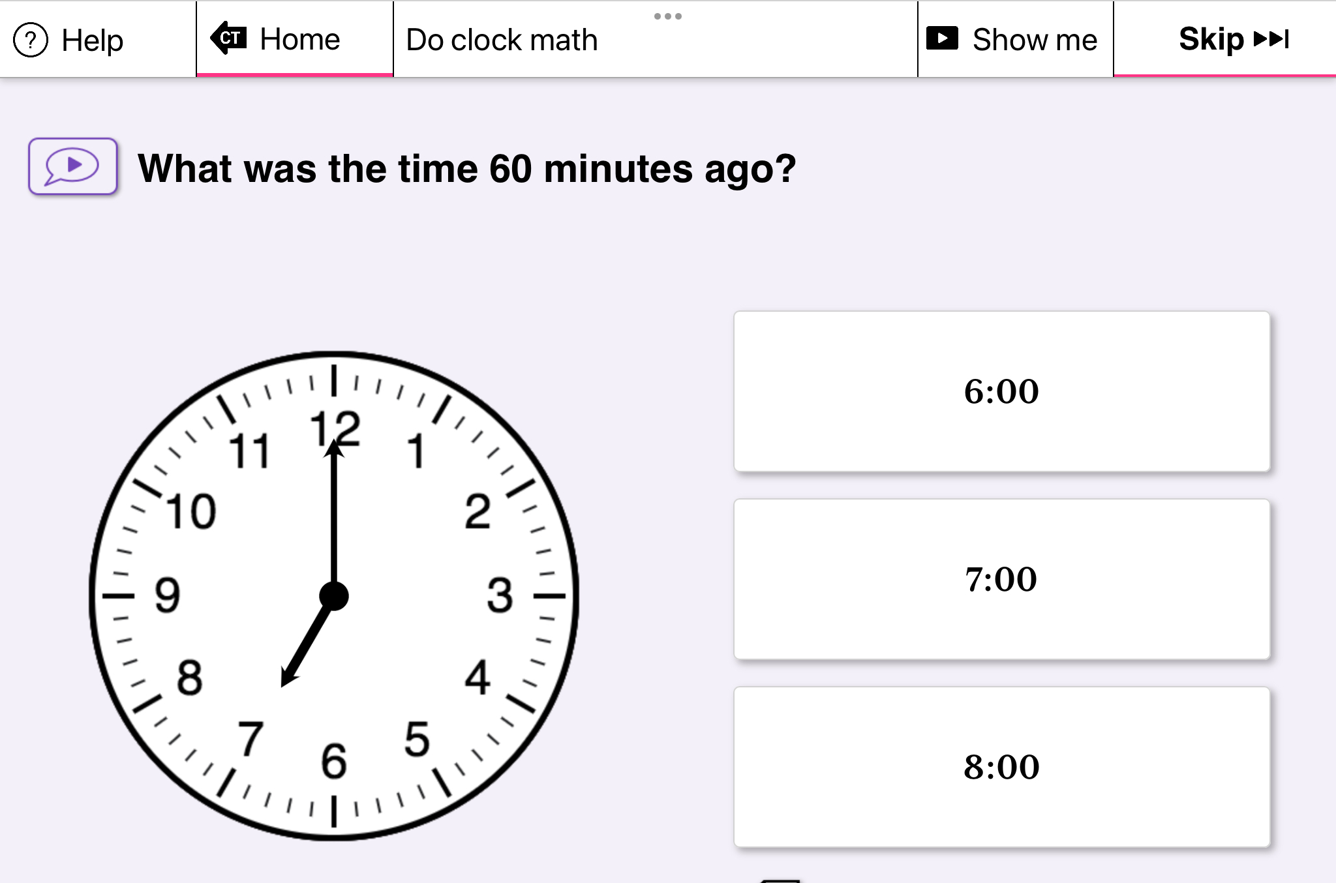
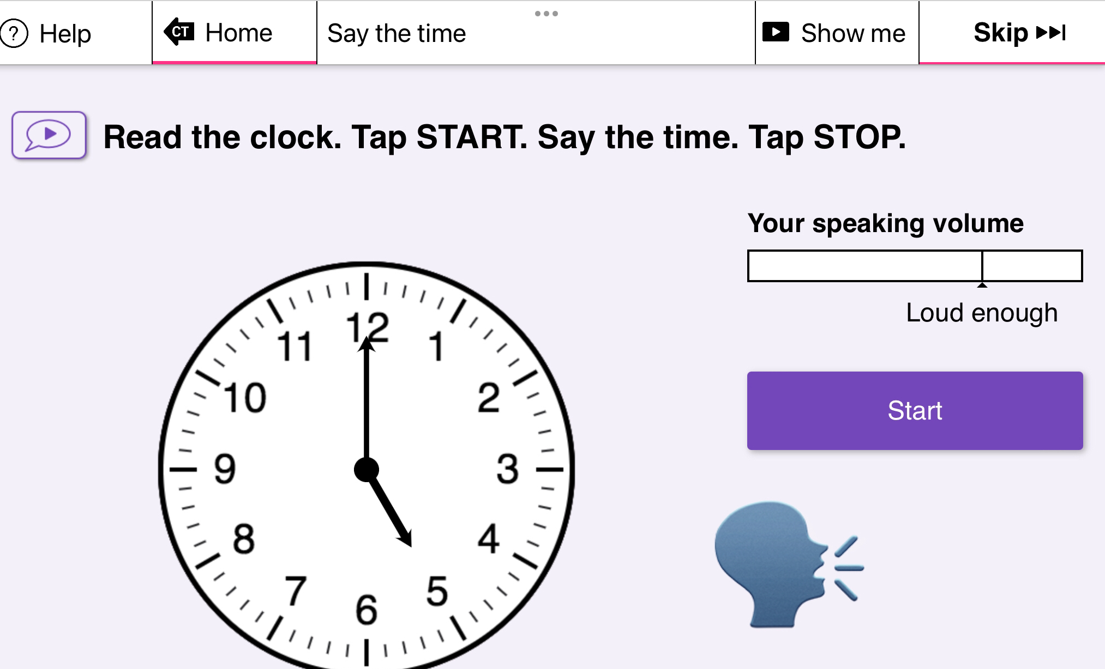
CONSTANT THERAPY
Clock Math
Say the Clock Time

Slide 8
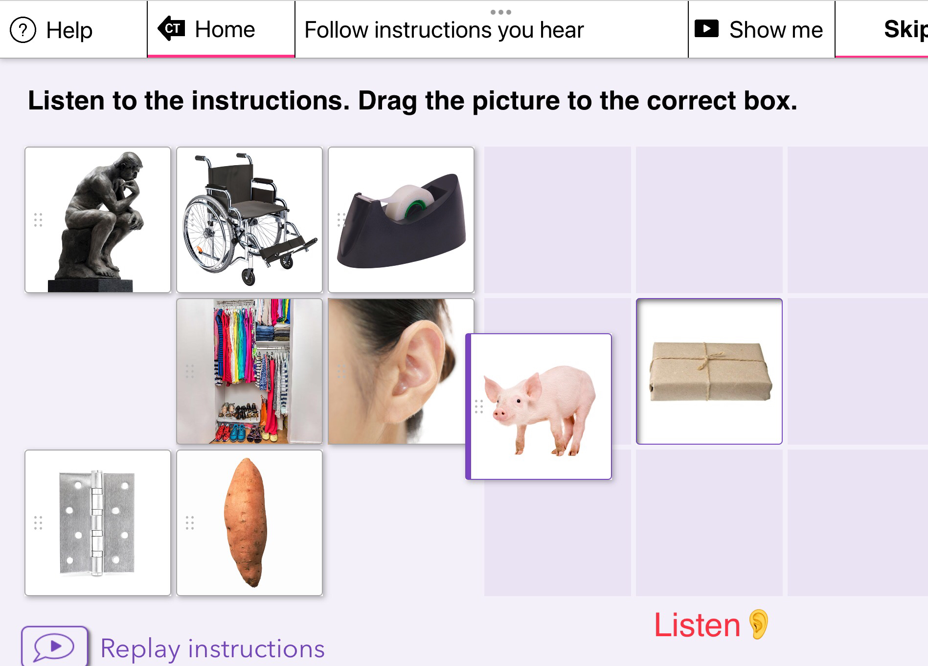
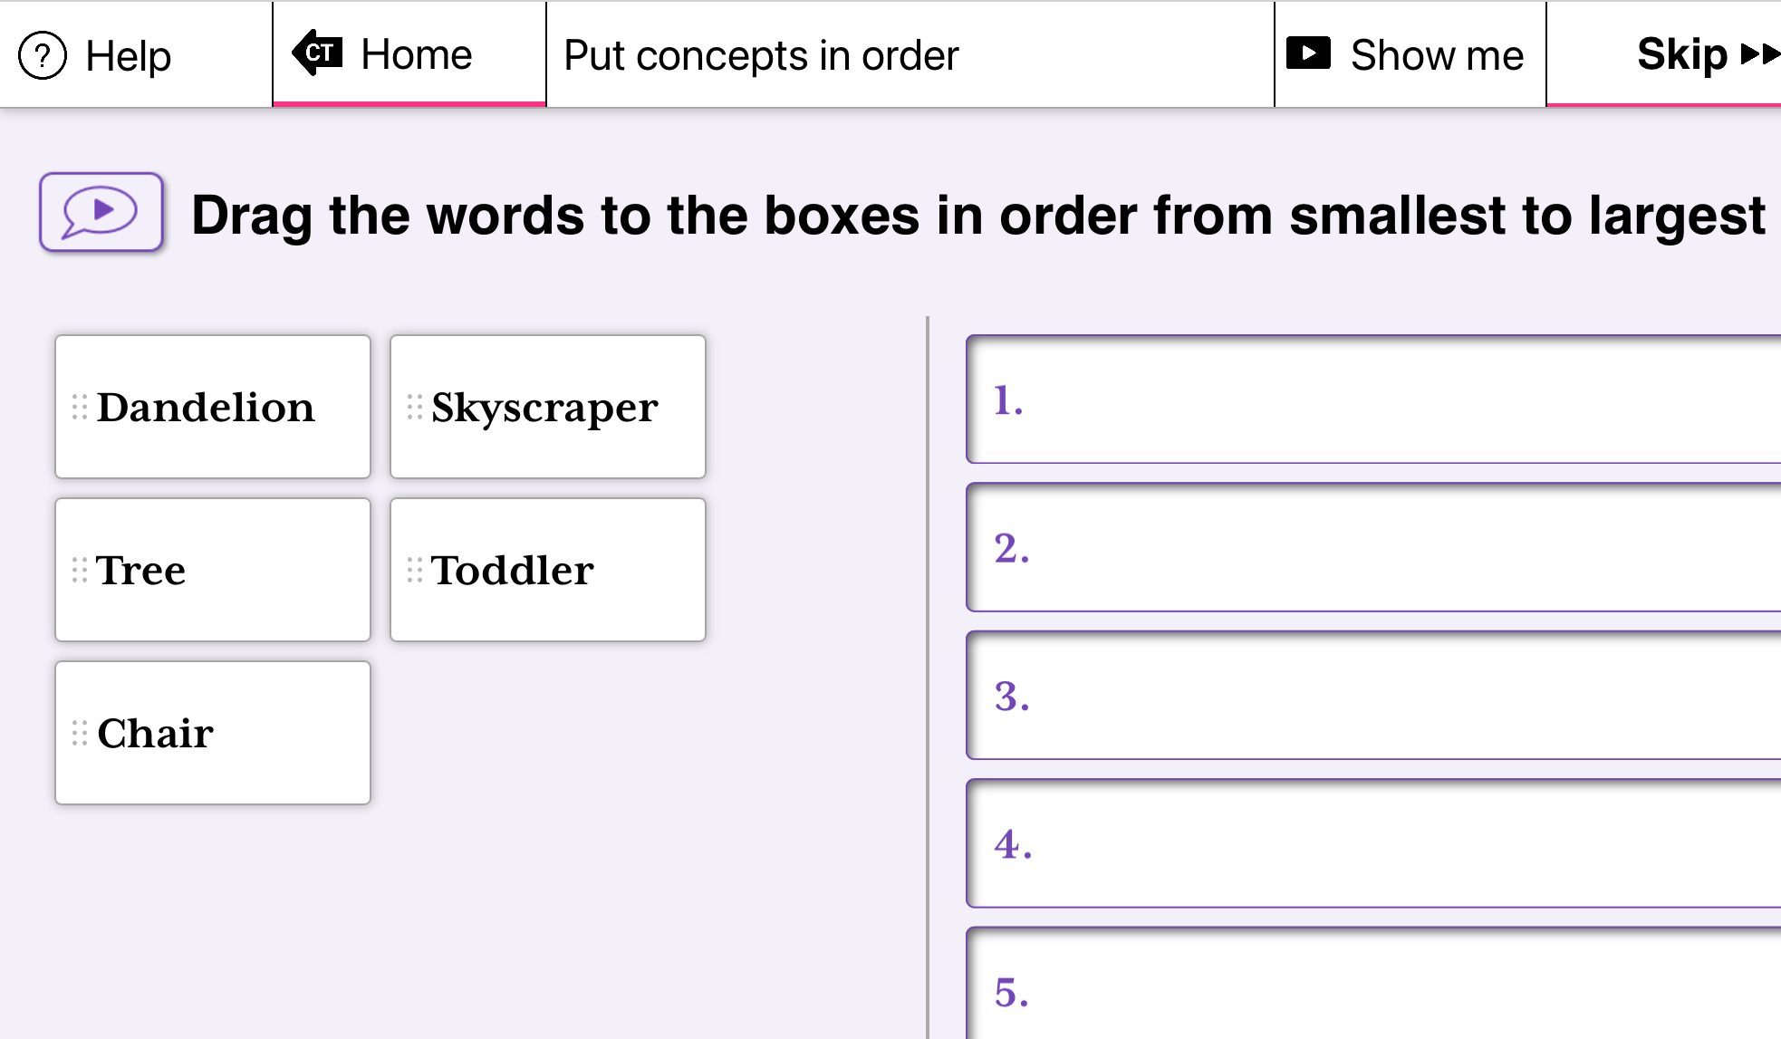
CONSTANT THERAPY
Following Verbal Instructions
Ordering Concepts

Slide 9
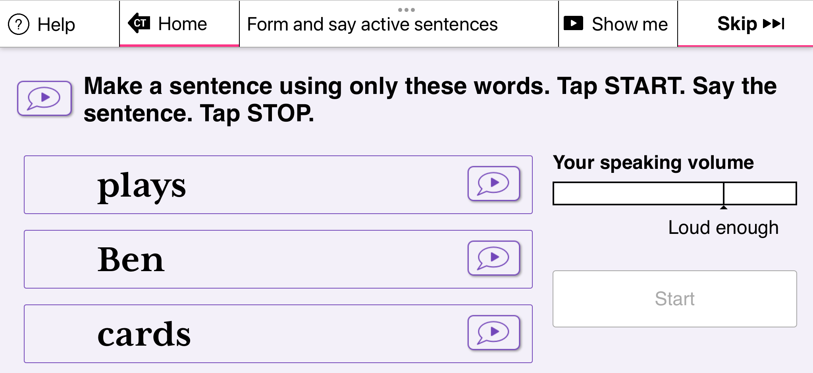
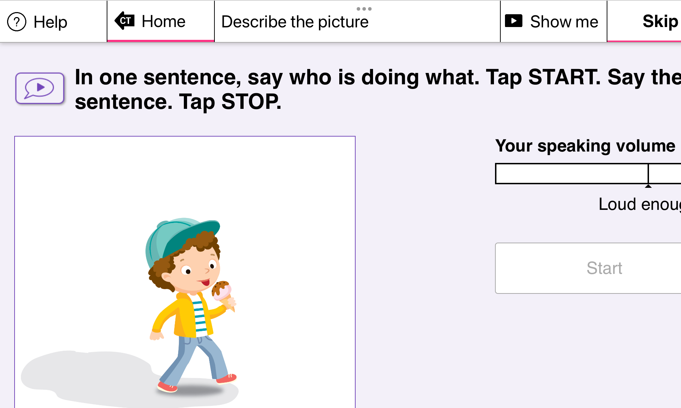
CONSTANT THERAPY
Active Sentences
Describing Pictures

Slide 10
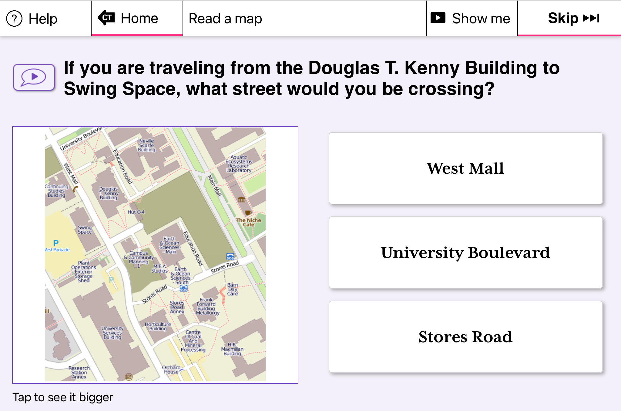
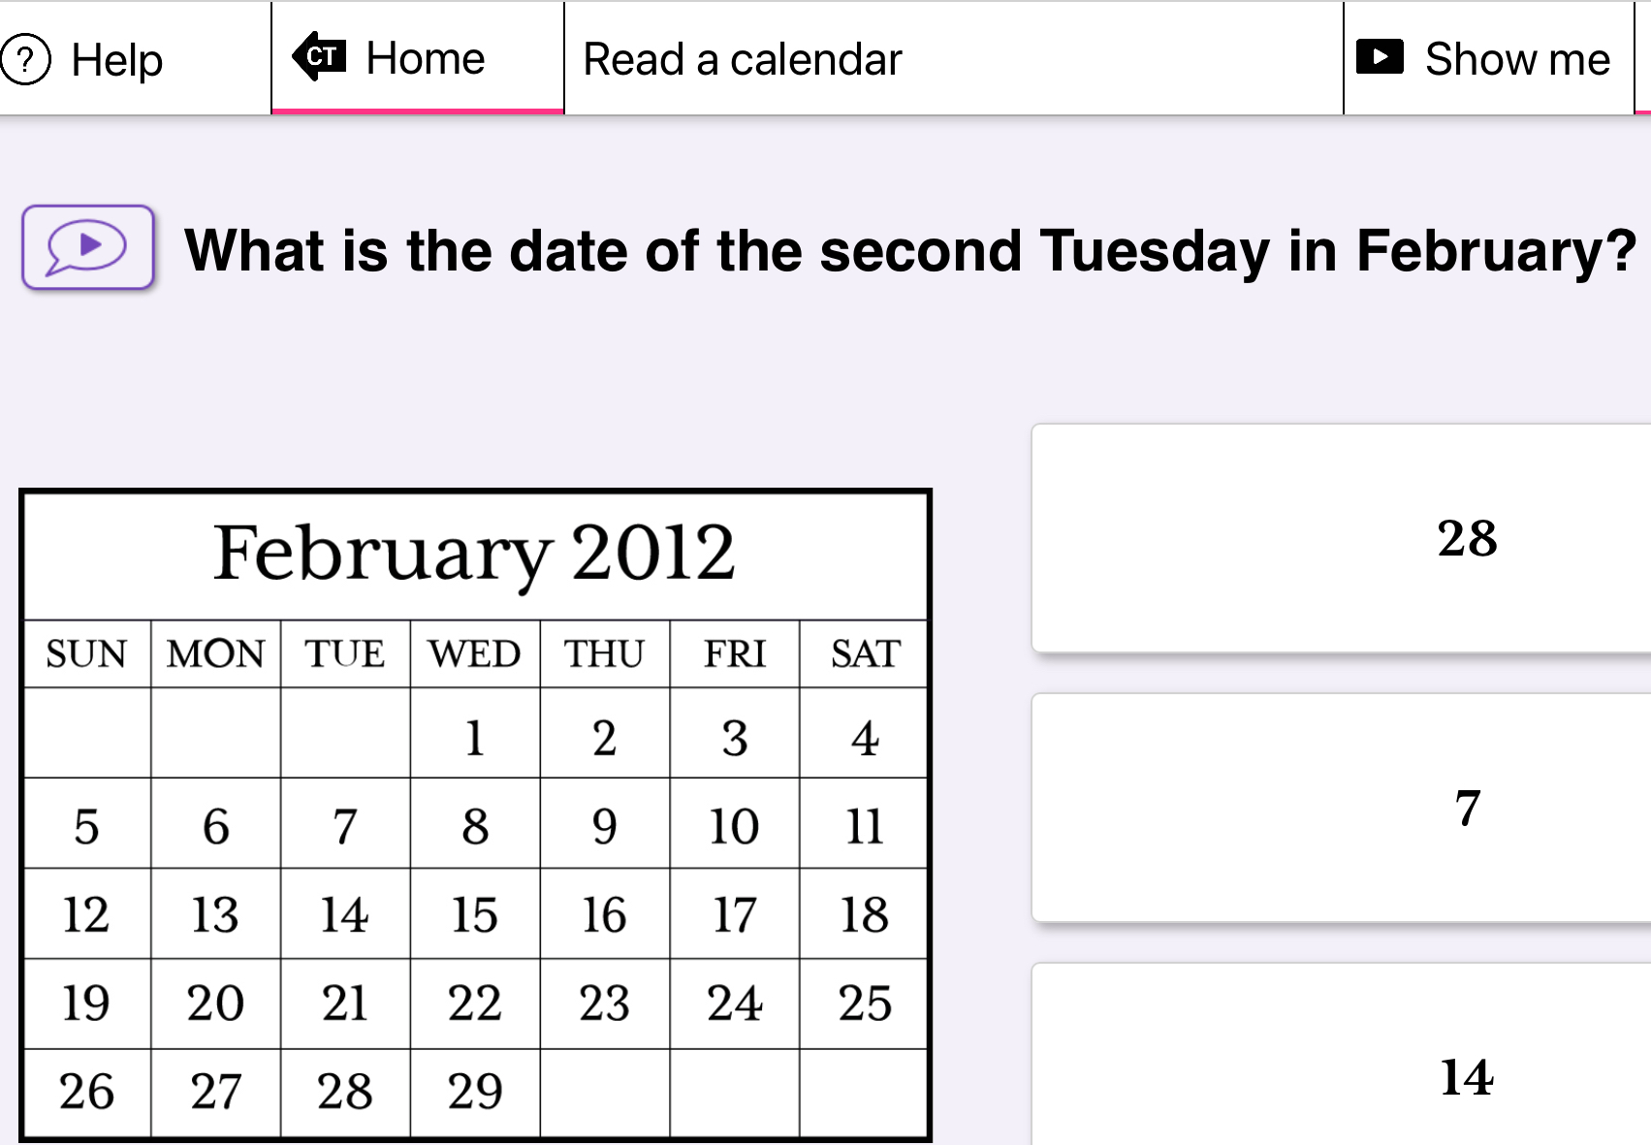
CONSTANT THERAPY
Reading a Map
Reading a Calendar

Slide 11
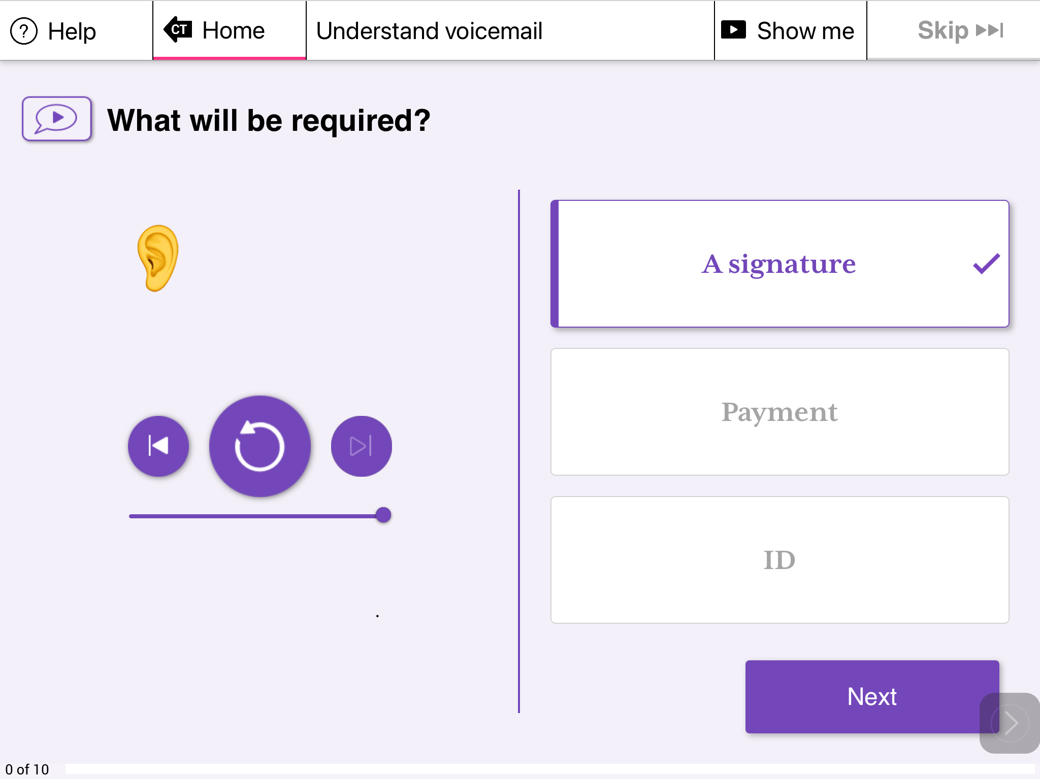
CONSTANT THERAPY
Listening to a VOICEMAIL

Slide 12
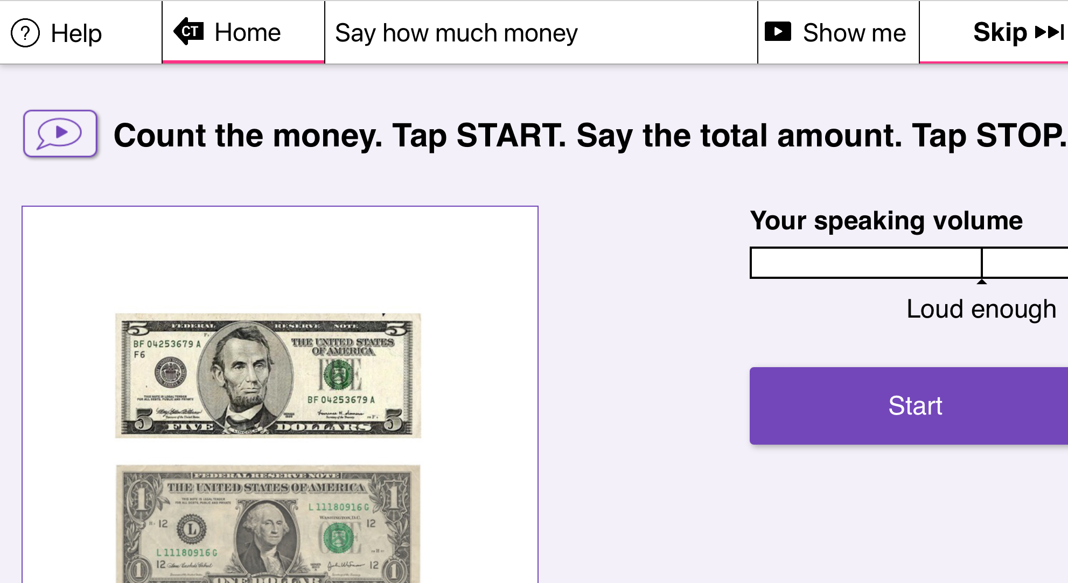
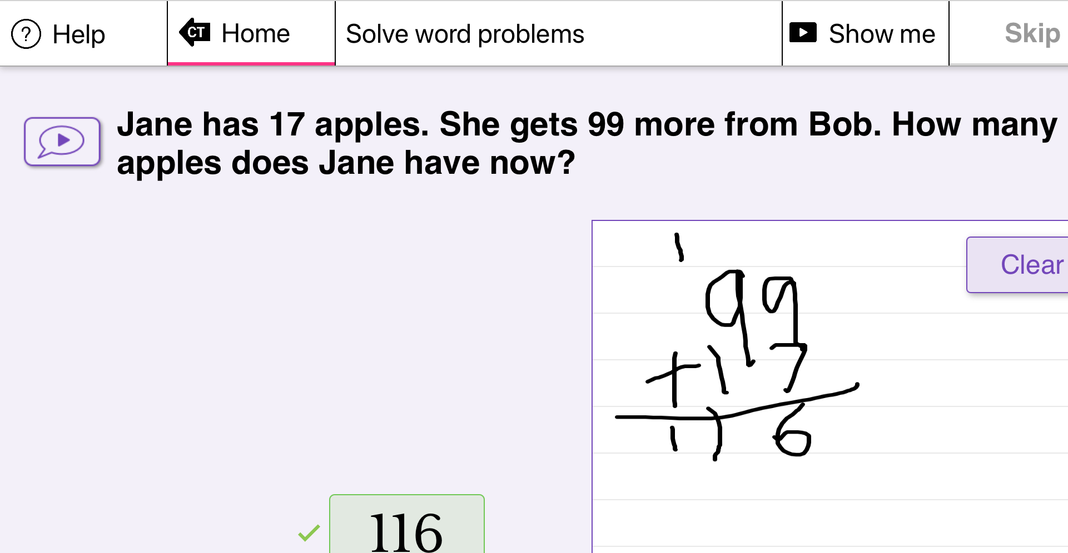
CONSTANT THERAPY
Adding Money
Solving Math Problems

Slide 13
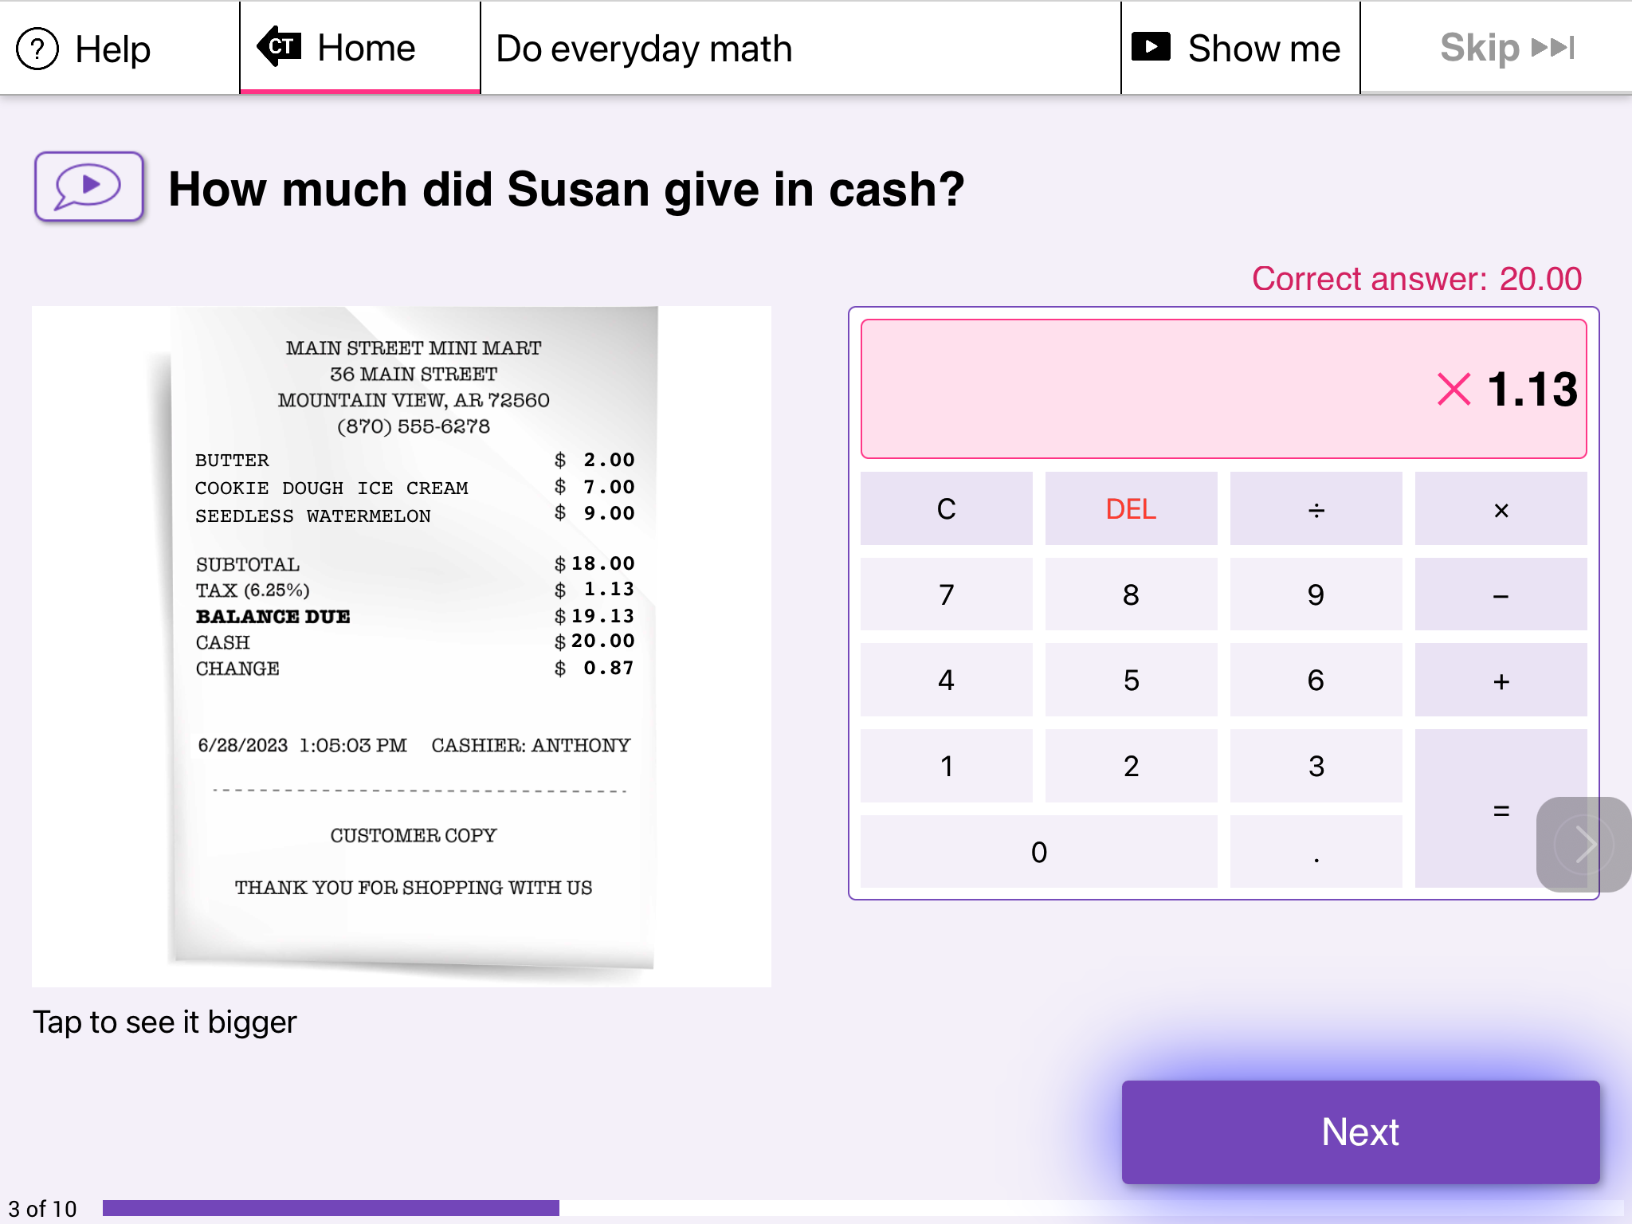
Limitations of Apps
Sometimes the app doesn’t explain WHY an answer is wrong.
Or it repeats the SAME exercises instead of adjusting to what I need THAT DAY.

Slide 14
How AI Could Improve Constant Therapy
AI could help by explaining:
1️⃣ “The total is $19.13.”
2️⃣ “Susan got $0.87 back.”
3️⃣ “Add them together: $19.13 + $0.87 = $20.00.”
🗣️ “She gave twenty dollars in cash.”
Bonus AI features:
Read each number aloud
Highlight steps visually
Explain why $1.13 was wrong (“That’s the tax, not the cash paid”)

Slide 15
The Opportunity with AI
AI could give instant feedback — for example, if I said the word wrong, it could show how to fix it.
AI can make personalized examples — using my interests, like sports or recipes.
AI can turn mistakes into learning — explaining what part of speech or sound was hard.

Slide 16
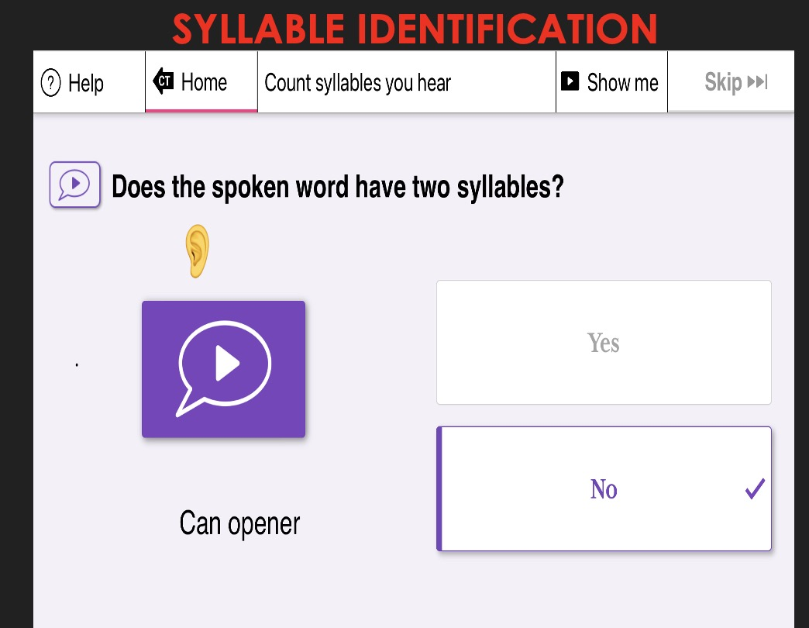
CONSTANT THERAPY + AI
Speech Feedback
🗣️ AI listens as you say the word and gives visual feedback.
📈 Shows which syllable or sound needs more clarity.
💬 Example: “You said can open. Try again: can-op-en-er.”
✅ Helps with pronunciation and apraxia.

Slide 17
CONSTANT THERAPY + AI
Speech Feedback
🗣️ AI listens as you say the word and gives visual feedback.
📈 Shows which syllable or sound needs more clarity.
💬 Example: “You said can open. Try again: can-op-en.”
✅ Helps with pronunciation and apraxia.

Slide 18
CONSTANT THERAPY + AI
Daily Life Practice
Listening to a VOICEMAIL
🏪 AI could make real-world scenarios: reading menus, shopping lists, directions.
📱 Example: 'You got a voicemail from the pharmacy — what do you do next?'
✅ Connects therapy with daily communication.

Slide 19
CONSTANT THERAPY + AI
Custom Practice
✏️ AI creates practice examples about your favorite topics.
🧠 Reading: 'How many cups of flour in this recipe?'
🏀 Math: 'Add the baseball scores from yesterday’s game.'
✅ Keeps it fun and matches your real-life vocabulary
CONSTANT THERAPY + AI
Custom Practice

Slide 20
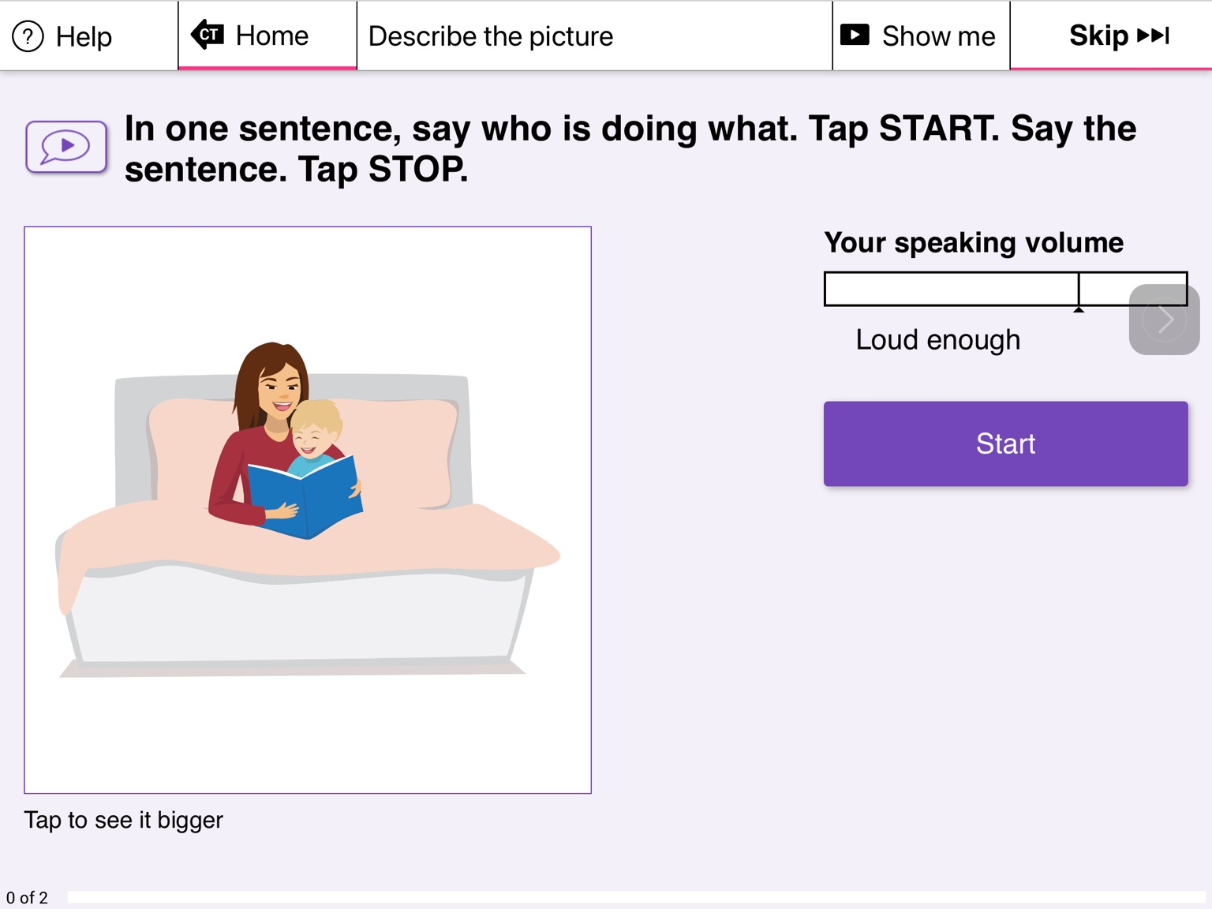
Constant Therapy + AI
Customizing Pracice
Describe the Picture Example
In Constant Therapy, a task says: “In one sentence, say who is doing what.”
The picture shows a mom reading a book with her child.
With AI, you could:
**Say the sentence out loud (“A mom is reading a book with her child.”)
**Give feedback if you miss a word or need help pronouncing a word or the sentence
**Suggest improved or more advanced versions (“The mother is reading to her son in bed.”)

Slide 21

NEXT MEETING
See you next time!
Next Group: Wednesday, December 3rd @4:00pm EST

