Slide 1
Technology and Supports for Aphasia
Brooke Lang, M.A., CCC-SLP and Bryn Lander (formerly Bowles)

Slide 2
New Day and Time
Technology and Support for Aphasia Group will be held the FIRST WEDNESDAY of each month at 4:00pm EST.
Next session → Wednesday, November 5
Future Sessions:
  Wed, Dec 3rd @4:00pm EST
  Wed, Jan 7th @4:00pm EST

Slide 3
Questions for YOU!
How can we help you?
What do you want to learn more about? –relating to Technology and Supports
Is there anything you want to see again?
  AAC, Apps, AI, Reading and writing supports, etc.

Slide 4
Today’s Topics
Using AI to help with READING ALOUD
Using AI to help with READING COMPREHENSION
A new app for practicing - Omilia

Slide 5
What Is ARTIFICIAL INTELLIGENCE (AI)?
AI is technology that can understand, respond, or generate human-like language
Examples: ChatGPT, speech-to-text, text-to-speech tools, captioning apps

Slide 6
Using AI to Assist with READING ALOUD
Echo Reading with AI
Syllable Support Practice
Sentence Completion Out Loud
Role Play Reading

Slide 7
Using AI to Assist with READING ALOUD
Tools & Strategies:
Text-to-speech support: AI reads a sentence, person repeats it
Echo reading practice: AI reads, user imitates
Syllable chunking: Ask AI to break words into syllables
Customizable voice pacing: Adjust speed/intonation for apraxia
Example Activity:
AI reads: “I went to the grocery store.”
User repeats
AI provides gentle correction or encouragement

Slide 8
Echo Reading with AI
What is it?
A strategy where a person listens to a sentence read by AI, then repeats it aloud to practice fluency, pacing, and confidence.
Tool: ChatGPT or a text-to-speech app (i.e. Speechify, Natural Reader, Voice Dream)
How it works:
1. AI reads a sentence aloud slowly.
2. Person listens and repeats it aloud.
3. AI gives feedback (e.g. “Nice job!” or “Want to try again?”)
Example:
AI: “The butterfly flew over the flowers.”
User: Repeats aloud
AI: “Great! Let’s try another one.”

Slide 9
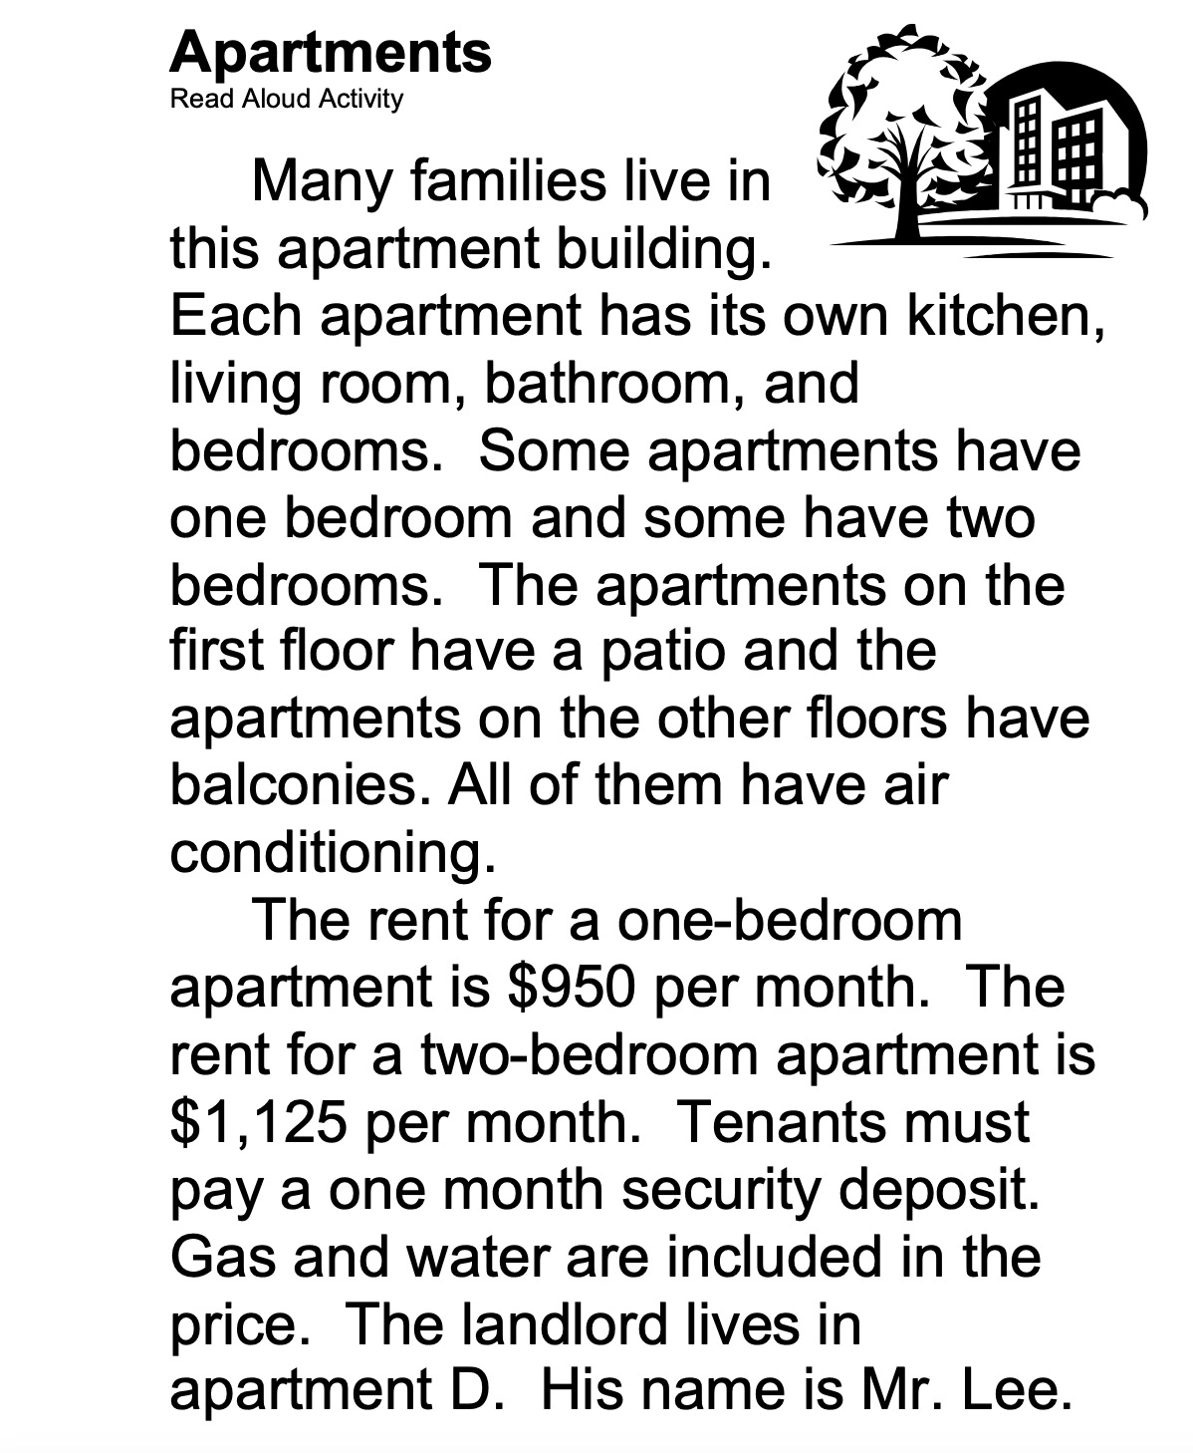
Echo Reading with AI
🗣 Echo Reading: Apartments
Instructions:
1. Listen to the sentence (I’ll read it aloud here).
2. Repeat the sentence out loud after me.
3. Take your time. You can go line by line or one paragraph at a time.
Part 1: Intro
👂 Listen:
“Many families live in this apartment building.”
🗣 Your Turn:
Repeat: “Many families live in this apartment building.”

Slide 10




ChatGPT or a text-to-speech app (i.e. Speechify, Natural Reader, Voice Dream)

Slide 11
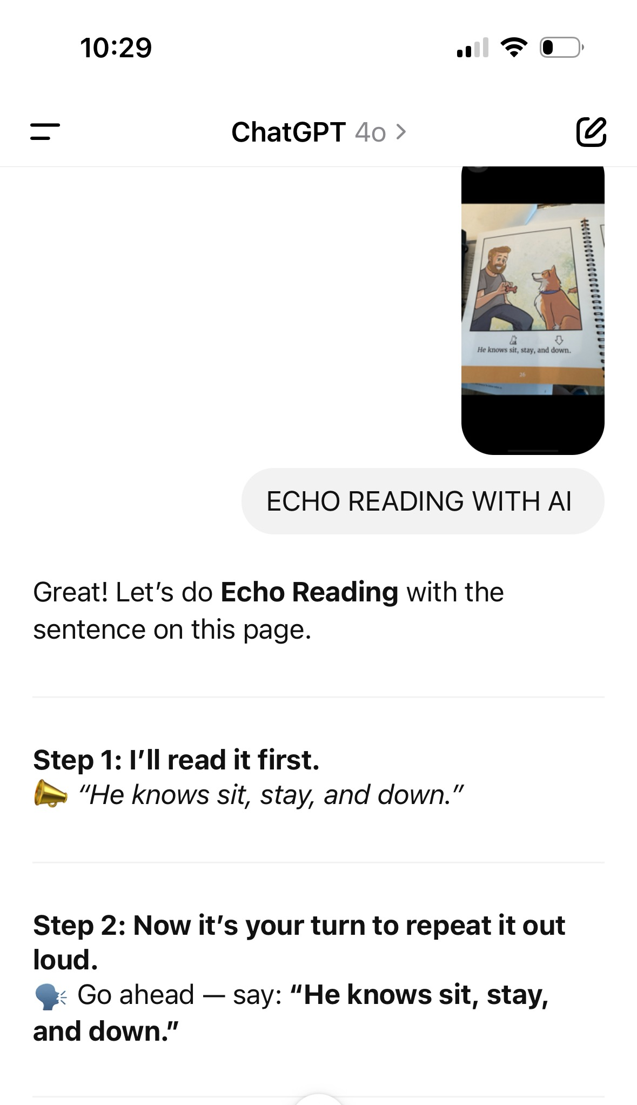
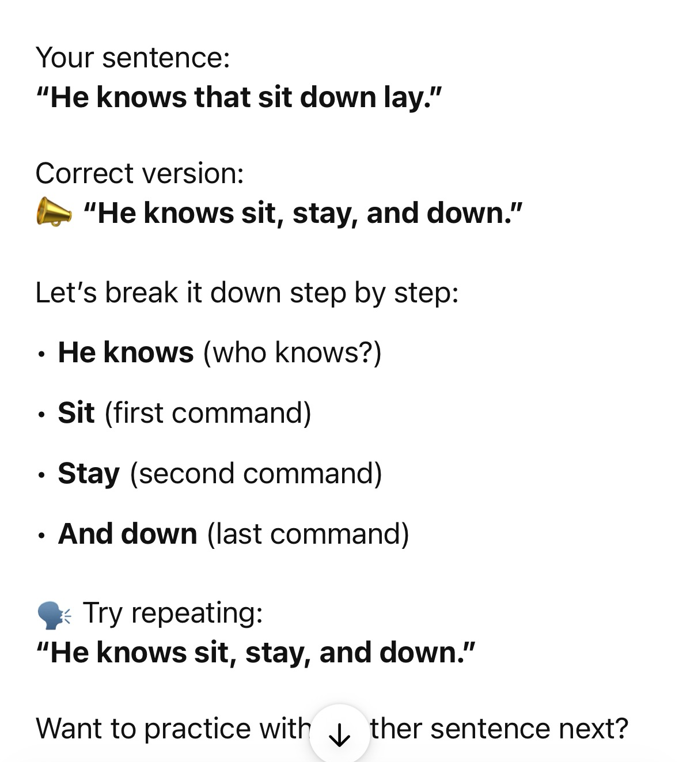

Slide 12
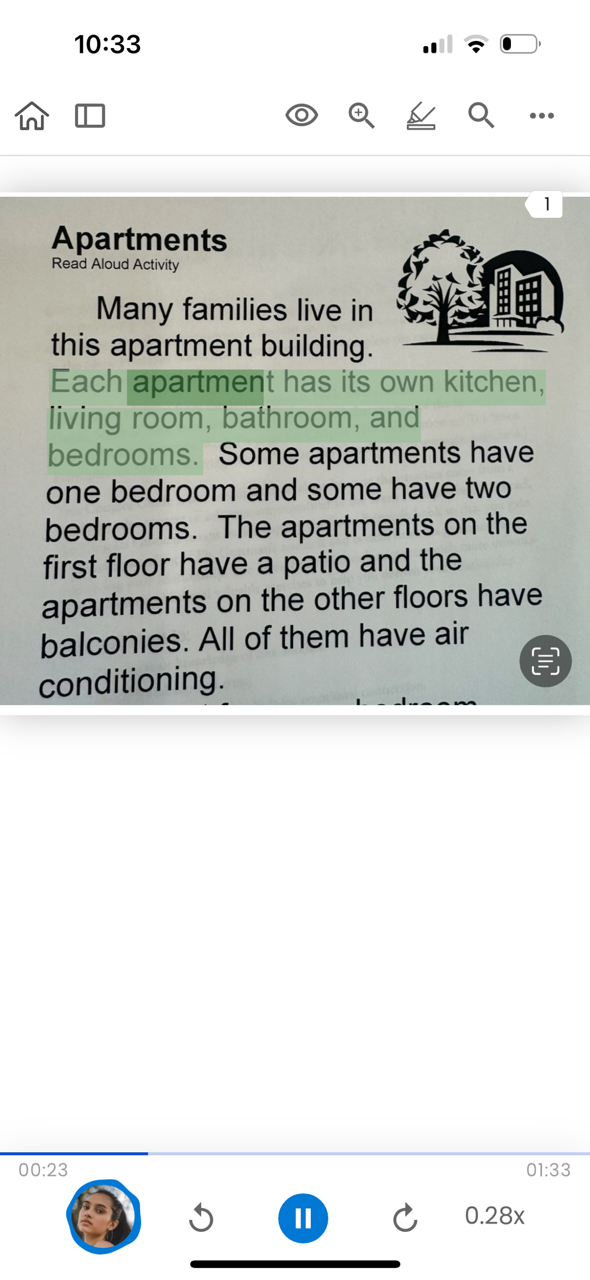

Natural Reader
(text-to-speech app)

Slide 13
Syllable Support Practice
Tool: ChatGPT prompt: “Break this sentence into syllables for me.”
How it works: AI helps chunk a sentence into syllables to make it easier to say aloud.
Example:
Sentence: “Celebrate your progress today.”
Output: Cel-e-brate / your / prog-ress / to-day
User reads aloud slowly with pauses between syllables.

Slide 14
Sentence Completion Out Loud
Tool: ChatGPT with prompt: “Give me sentences with the last word missing.”
How it works: Person reads the sentence aloud and guesses or says the missing word.
Example:
AI: “I like to drink hot ______.”
User: “coffee” (or another guess)

Slide 15
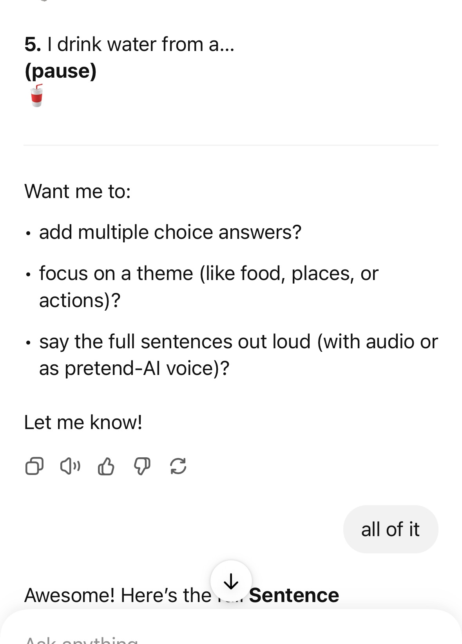
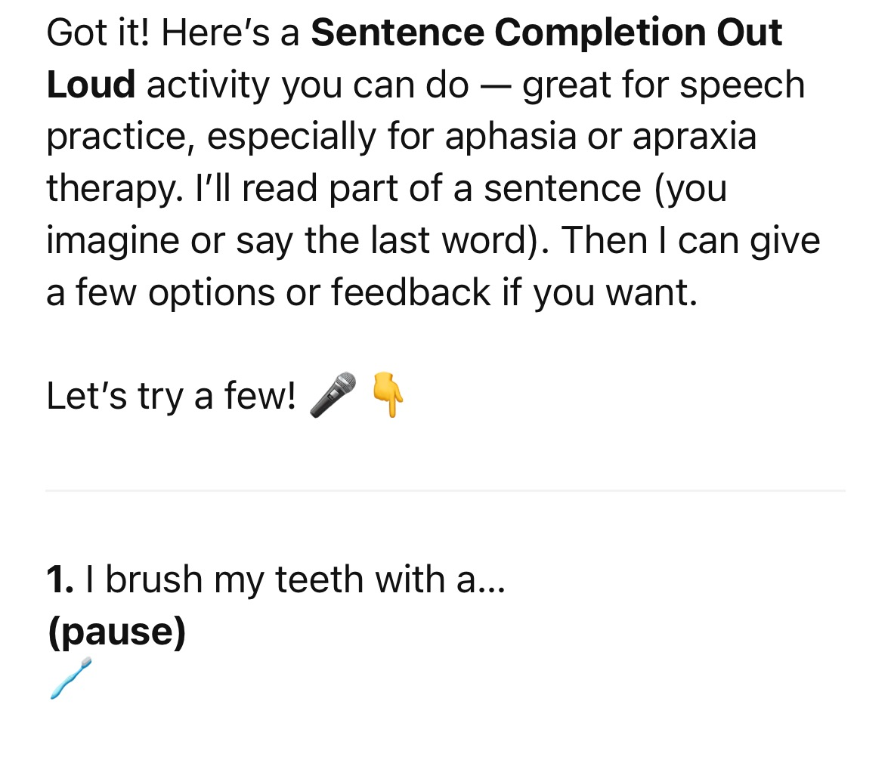

Slide 16
Role Play Reading
Tool: ChatGPT prompt: “Let’s read a short conversation together. I’ll be Person A, you be Person B.”
How it works:
AI presents a dialogue. User reads one role aloud.
Example:
Person A (AI): “Hi! What’s your name?”
Person B (User): “My name is Sam.”

Slide 17
Using AI to Assist with READING COMPREHENSION
Tools & Strategies:
Summarizing text (simplifying articles or stories)
“Explain like I’m five” mode for complex ideas
Interactive quizzes or fill-in-the-blank questions
Multiple-choice Q&A about short passages

Slide 18
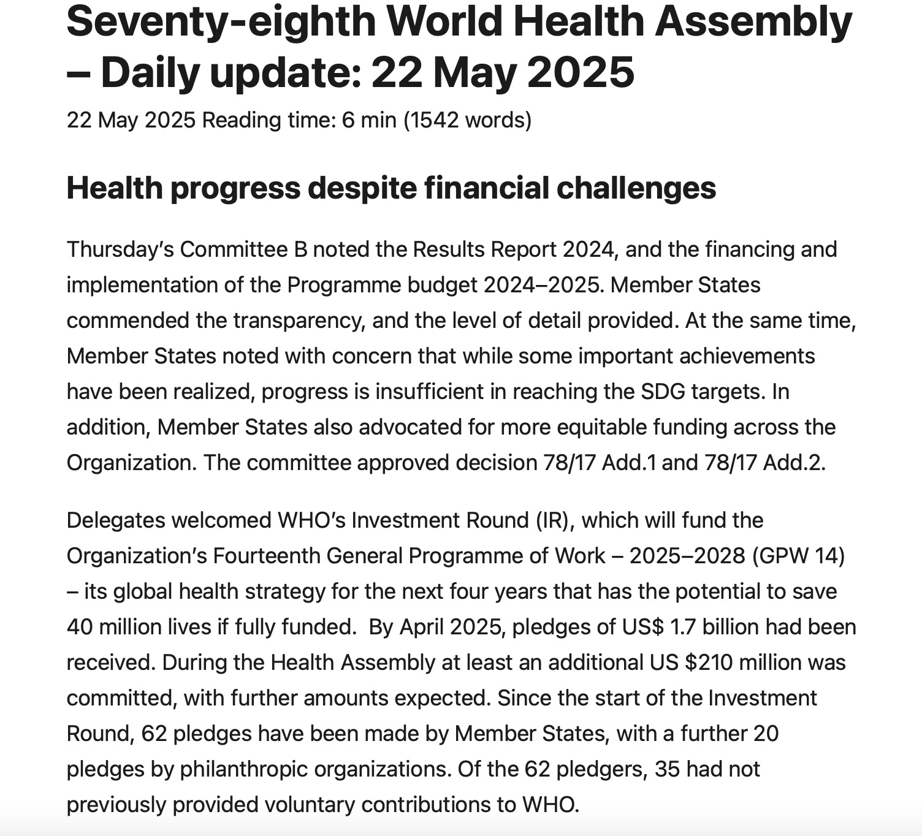
“Can you summarize this?”
AI simplifies or rewrites at different levels

Slide 19
🌍 WHO’s Global Health Efforts
• Funding & Goals: Countries praised WHO’s transparency but emphasized the need for more progress on health goals. Over $1.9 billion has been pledged for WHO’s 2025–2028 plan.
• Health Emergencies: WHO responded to 51 crises, assisting 72 million people, with many emergencies linked to climate change.
• Preparedness & Regulations: WHO reviewed country readiness and updated the International Health Regulations (IHR). Amendments take effect September 2025.
• Public Health Measures: More research is needed on interventions like hygiene and distancing to combat outbreaks.
• Ukraine: WHO supported 4.7 million people and delivered $37 million in aid. Attacks on healthcare continue.
• Gaza & West Bank: WHO reported a severe health crisis. A resolution was passed calling for a ceasefire, aid access, and protection of health services.

Slide 20
Multiple-choice Q&A about short passages
🏢 Comprehension Questions
1. What does each apartment include?
A. Only a bedroom and kitchen
B. A kitchen, living room, bathroom, and bedrooms
C. Just a living room and bathroom
D. A garage and laundry room
✅ Correct Answer: B

Slide 21
“Explain like I’m five” mode for complex ideas: News WHO Meeting
WHO Meeting – 22 May 2025
• Countries praised progress but said more help is needed.
• WHO helped 72 million people in emergencies.
• Climate change caused many health problems.
• New health rules start in September 2025.
• WHO is helping in Ukraine and Gaza.
• They asked for peace and more aid.
“Explain like I’m five”
Here’s your WHO meeting summary like you’re five:
• The world had a big meeting to talk about helping people stay healthy.
• They said, “Good job so far, but we still need to do more.”
• WHO helped lots of people—like 72 million!—when there were big problems like floods or wars.
• The Earth getting hotter is making people sick.
• New health rules are coming soon, like in September.
• WHO is also helping people in hard places like Ukraine and Gaza.
• They said, “Let’s all try to be kind, stop fighting, and help more people.”

Slide 22
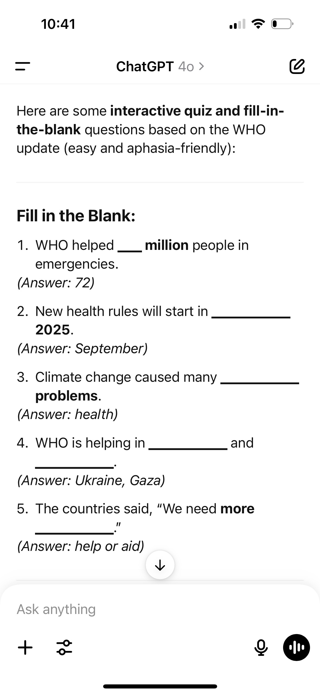
Interactive quizzes or fill-in-the-blank questions

