Slide 1
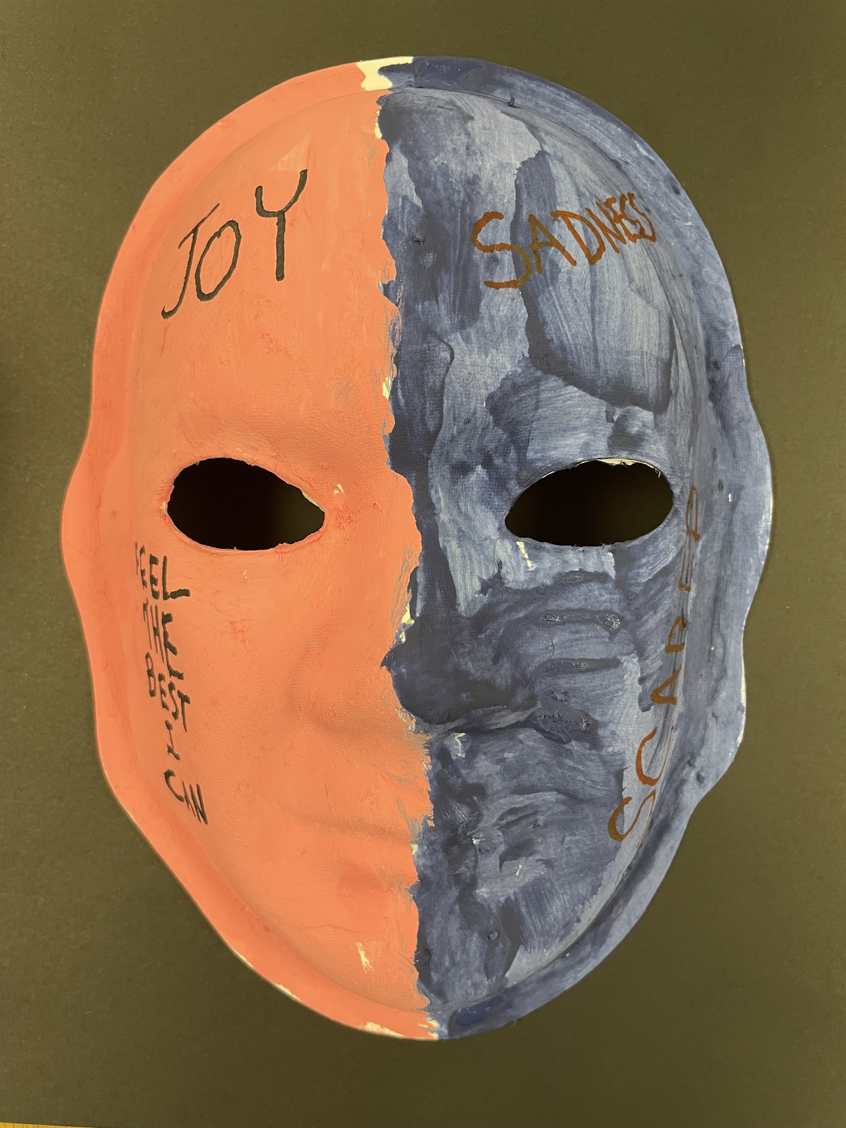
Unmasking Brain Injury

Slide 2


Acquired Brain Injury
CDC’s Definition:
Any damage to the brain that occurs after birth, resulting in a change to the brain's function
Non-traumatic Brain Injury
Traumatic Brain Injury (TBI)
What is a Brain Injury?
Damage to the brain from an internal event or medical condition.
Stroke, Anoxia, Infections, Tumors, Toxins
Damage caused by an external physical force, leading to a change in the brain's function.
Examples: Falls, motor vehicle crashes, severe shaking, physical assaults, blast injuries or sports injuries.

Slide 3
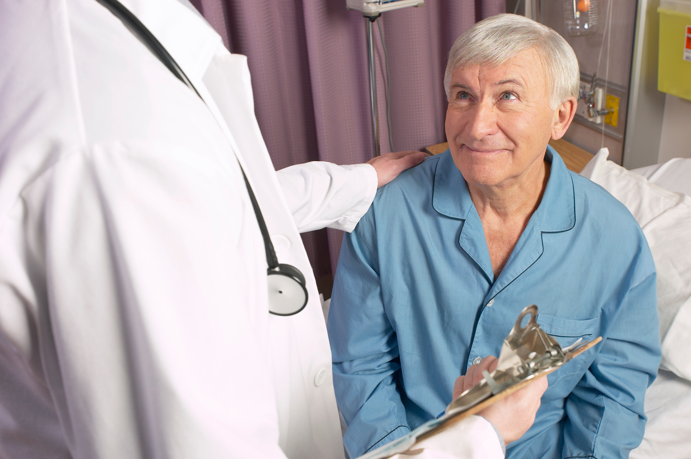
Changes after Brain Injury
PHYSICAL & SENSORY
THINKING & PROCESSING
TALKING & SOCIALIZING
EMOTIONS & BEHAVIOR
Seizures, headaches, & pain
Remembering details & recall
Word-finding & creating sentences
Initiation & motivation
Weakness, paralysis, balance, muscle, & coordination
Mental flexibility, attention, sequencing, & learning
Communicating (understanding & producing)
Psych conditions, unrelated laughter or crying
Sleep disruption & fatigue
Safety awareness & impulsivity
Processing information
Regulating emotion & actions
Sensory changes
Problem solving
Social skills
Personality changes

Slide 4
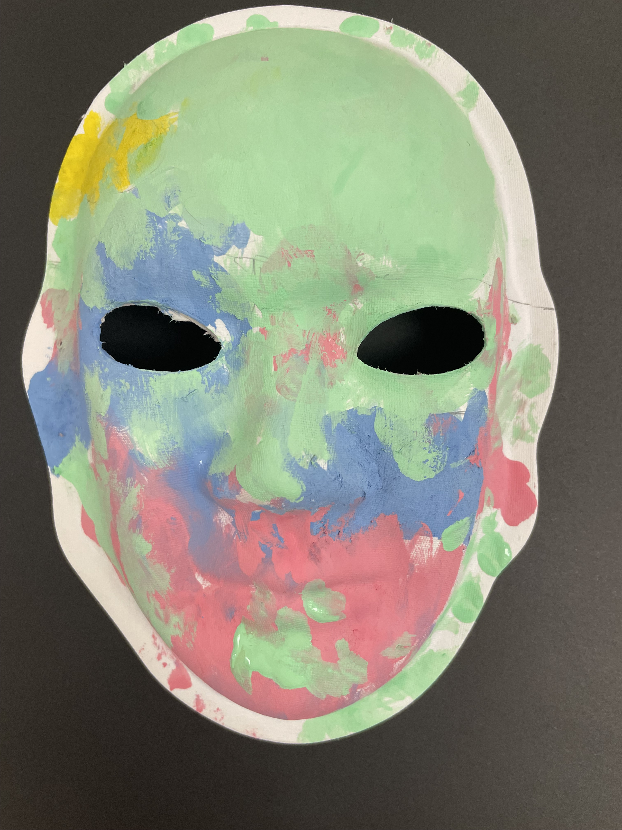
What is Unmasking Brain Injury?
The mission of Unmasking Brain Injury is to promote awareness of the prevalence of brain injury; to give survivors a voice and the means to educate others of what it’s like to live with a brain injury; to show others that persons living with a disability due to their brain injury are like anyone else, deserving of dignity, respect, compassion and the opportunity to prove their value as citizens in their respective communities.

Slide 5
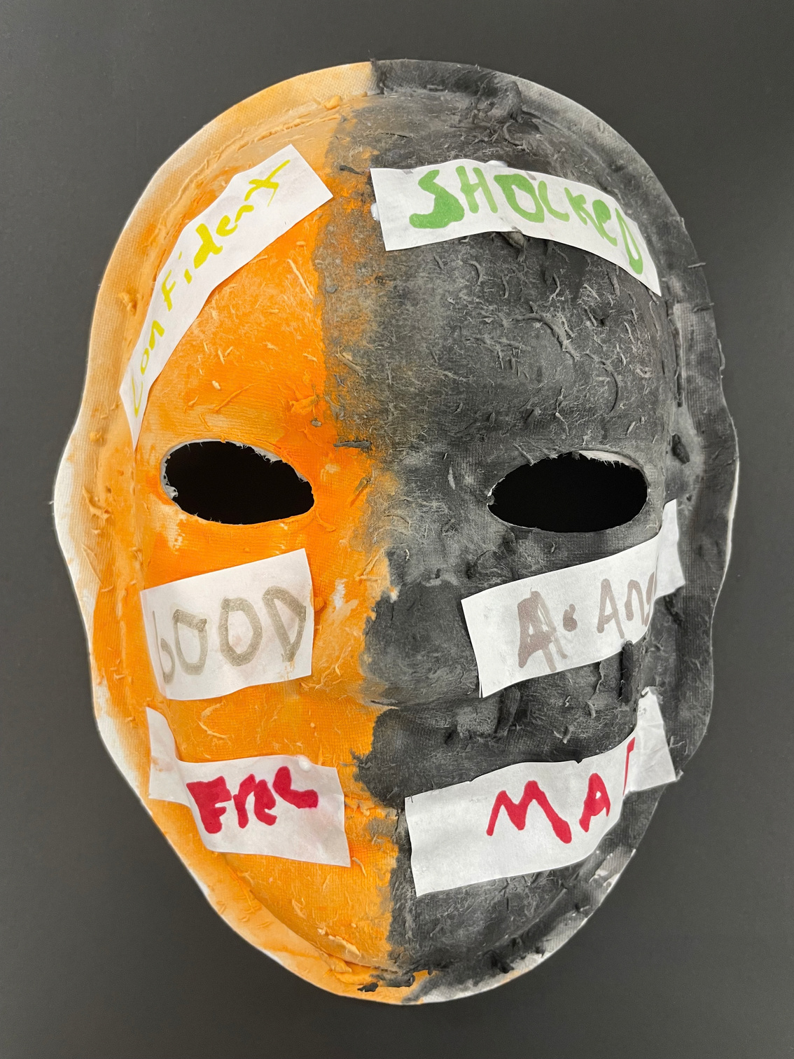
Unmasking Facts
30 US States and 4 countries have participated so far
Over 1,500 masks have been created and submitted
Started in North Carolina at Hinds Feet Farm

Slide 6
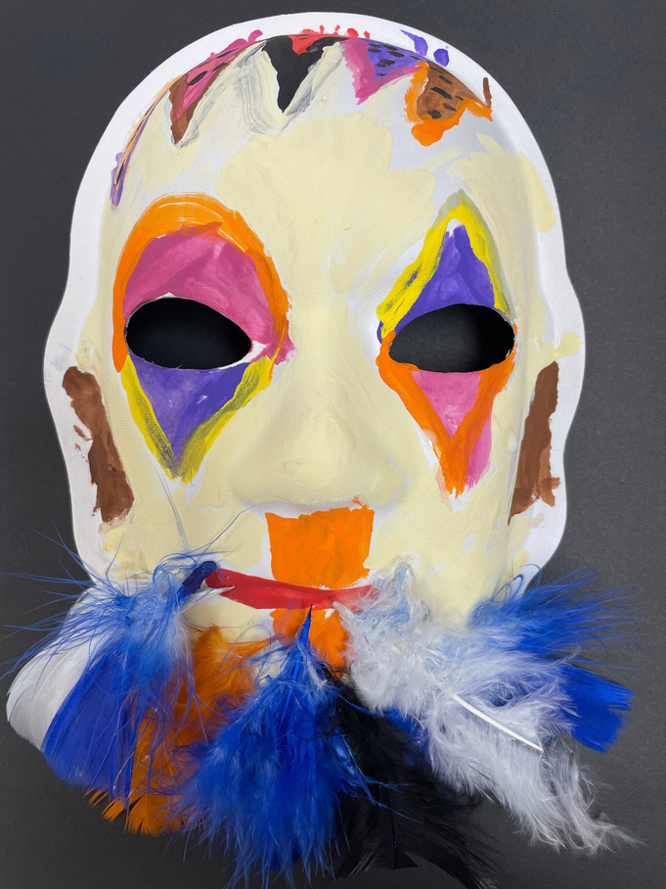
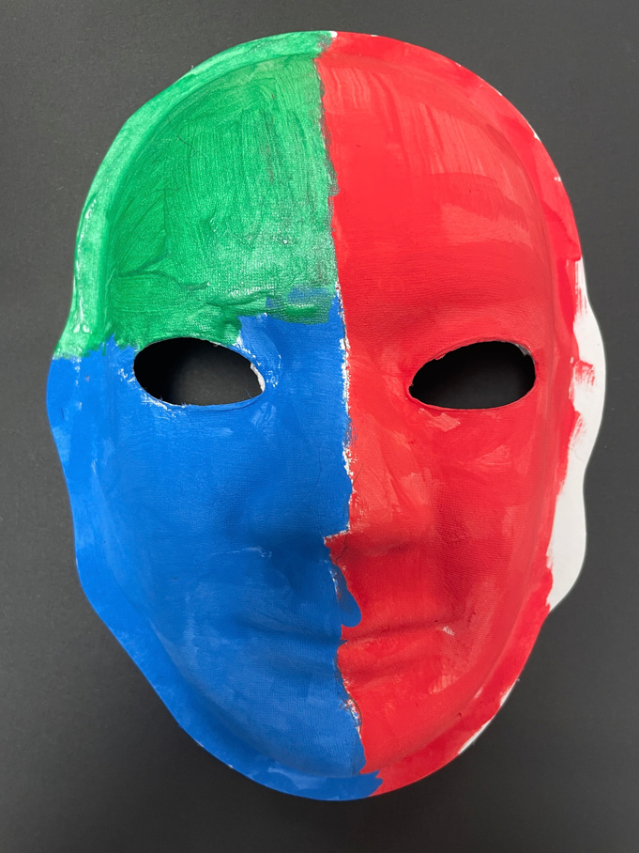
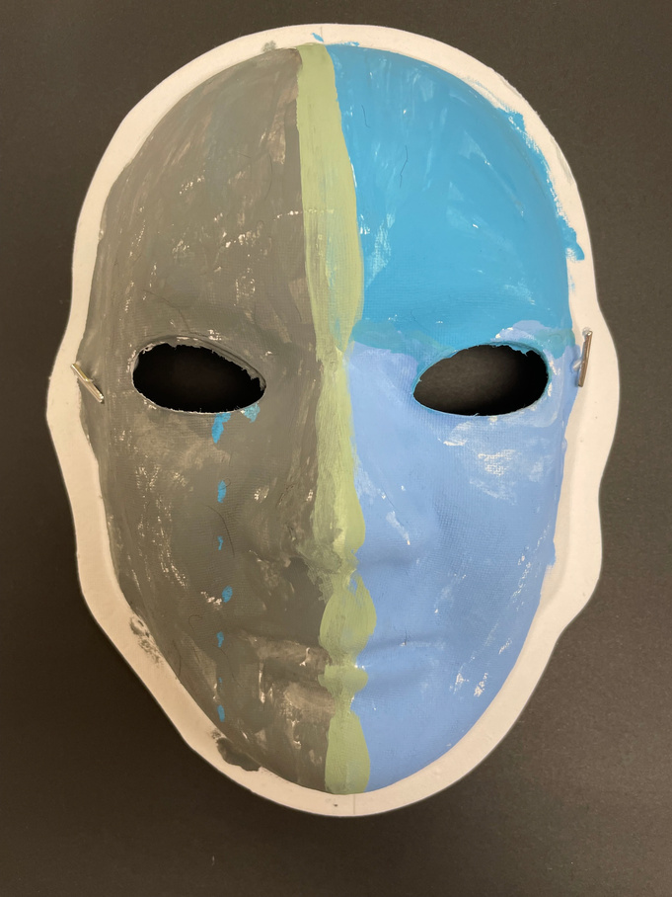
Why Participate?
The Unmasking Brain Injury project gives those with brain injuries (and subsequent diagnoses, such as aphasia) a voice to express themselves through art.
There is no right or wrong way to complete a mask. The project is meant to be personal and meaningful.
This project may bring up many emotions, but may also serve as a healing activity.

Slide 7


Slide 8
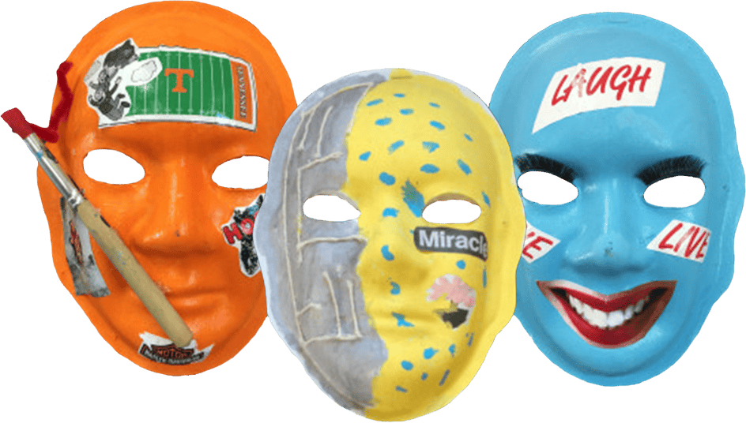
How to Get Involved
Visit the Unmasking Website:
Visit unmaskingbraininjury.org
Click the “Make a Mask” tab on the home page
Fill out the form
Contact Your Local BIA Affiliate:
Visit biausa.org
Click the “Find Your BIA” tab on the home page
Click on your state to find the information for your local BIA affiliate

Slide 9


Created By:
Brain Injury Association of North Carolina

